Slide 1
Year 1 Pure Mathematics
Measure of Location and Spread
– Variance and Standard Deviation
Chapter 2
(Part 4 of 5)

Slide 2
1, 3, 6, 6, 7, 12, 14
Standard Deviation
The mean of each data list is 7
but how does the data differ?
6, 6, 6, 7, 8, 8, 8
7, 7, 7, 7, 7, 7, 7

Slide 3
Standard Deviation
 | Mean | Standard Deviation
1, 3, 6, 6, 7, 12, 14 | 7 | 4.28
6, 6, 6, 7, 8, 8, 8 | 7 | 0.93
7, 7, 7, 7, 7, 7, 7 | 7 | 0
What could Standard Deviation
be a measure of?

Slide 4
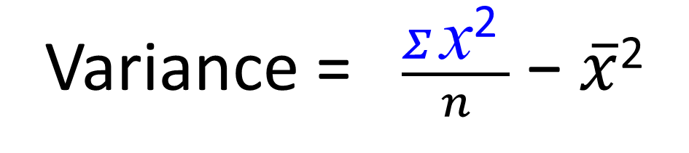
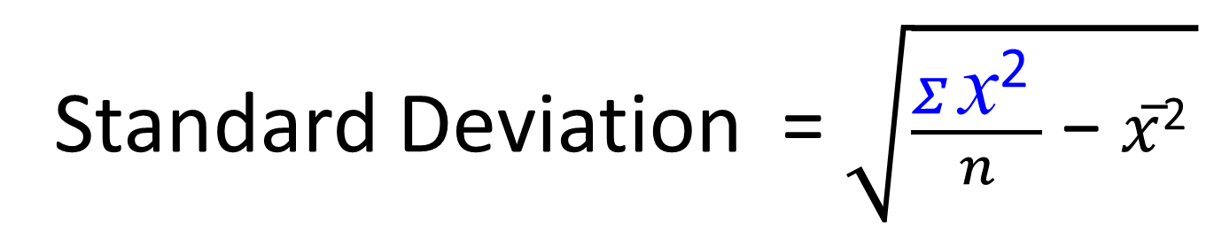
Standard Deviation and Variance
Standard Deviation and Variance
is a measure of spread
and can ‘roughly’ be thought of
as the average distance from the mean.
Standard Deviation = $\sqrt{\frac{Σ \text{x}\text{2 }}{n}\text{ − }\overline{x}\text{2} }$
Variance = $\frac{Σ \text{x}\text{2 }}{n}\text{ − }\overline{x}\text{2 }$

Slide 5
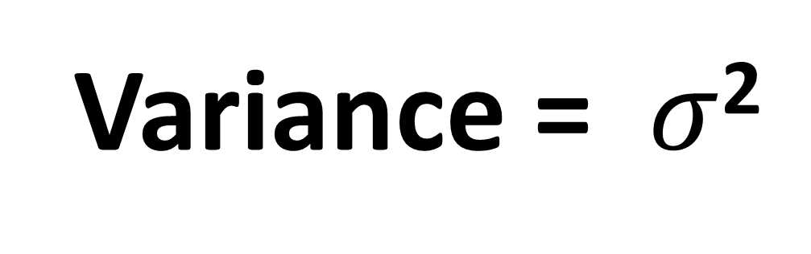
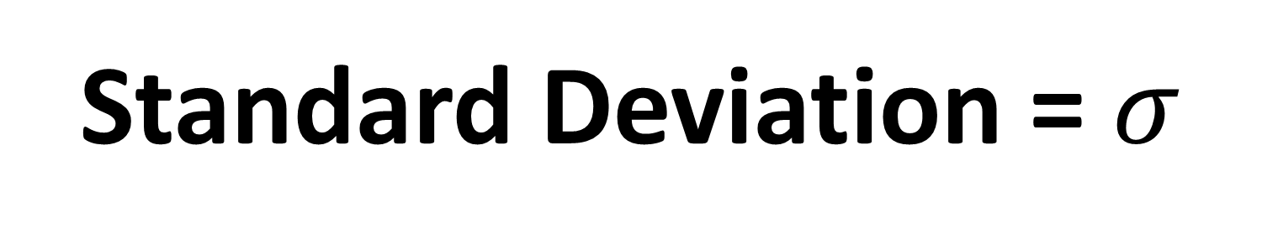
Standard Deviation and Variance - Notation
Standard Deviation = $σ$
Variance = $σ$²

Slide 6
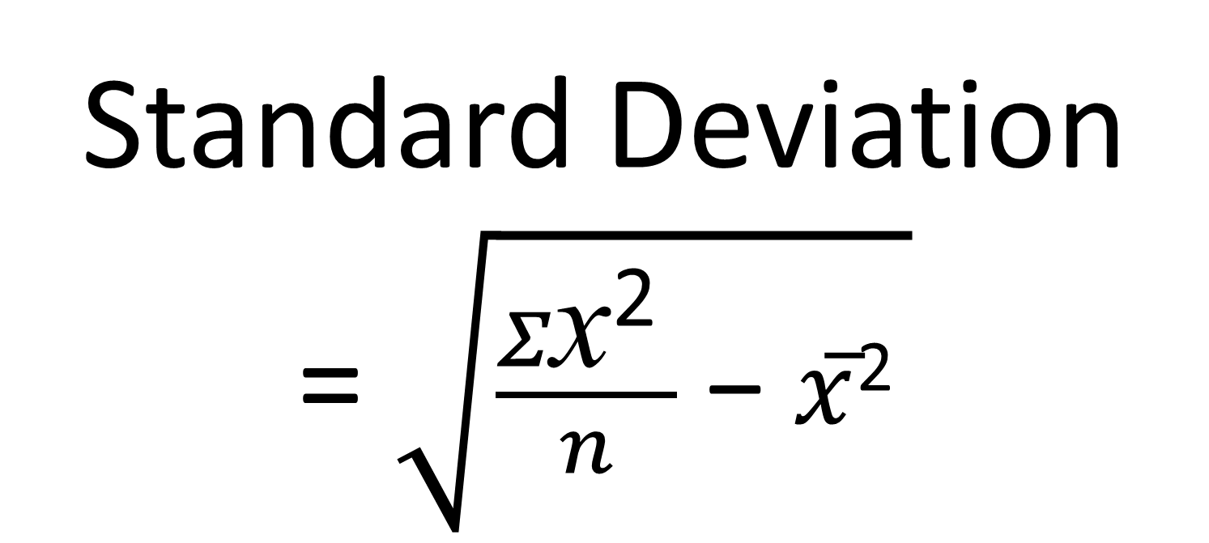
Standard Deviation – Formula
Standard Deviation
= $\sqrt{\frac{Σ\text{x}\text{2 }}{n}\text{ − }\overline{x}\text{2} }$
This formula is given in the formula booklet.

Slide 7
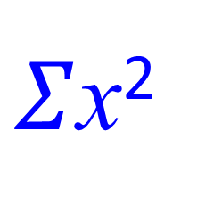
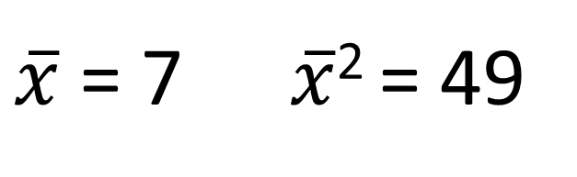
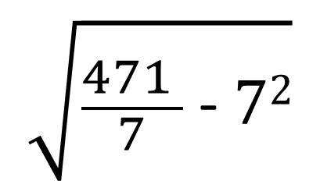
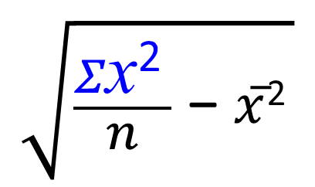
1, 3, 6, 6, 7, 12, 14
Standard Deviation – Listed Data
$\overline{x}$ = 7 $\overline{x}$² = 49
$Σ$x²
1+9+36+36+49+144+196 = 471
$$\sqrt{\frac{Σ\text{x}\text{2 }}{n}\text{ − }\overline{x}\text{2} }$$
$$\sqrt{\frac{471 }{7}\text{ − }72}$$
=
=
4.28

Slide 8
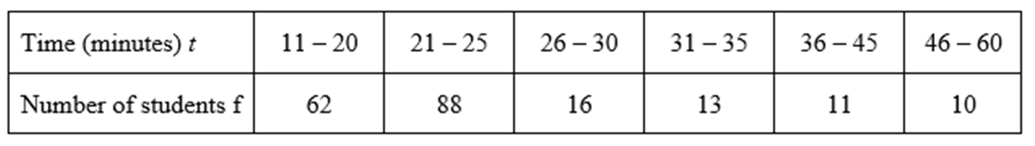
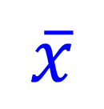
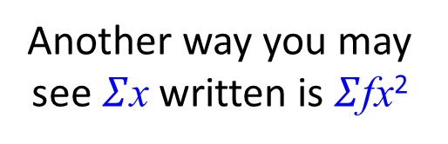
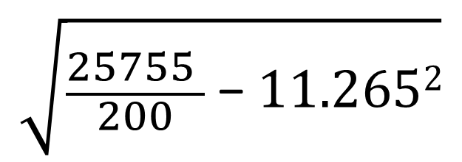
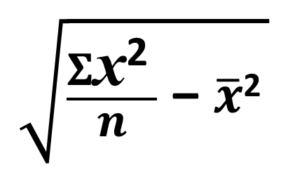
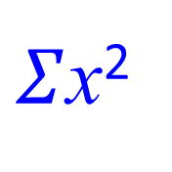
Standard Deviation - Frequency Table
Calculate the standard deviation of the data.
10
11
12
13
14
15
200
$Σ$x²
(10² x 62) + (11² x 88) + (12² x 16) + (13² x 13) +
(14² x 11) + (15² x 10) = 25,755
$$\overline{x}$$
= 11.265
Another way you may see $Σ$x written is $Σ$fx²
$$\sqrt{\frac{Σ\text{x}\text{2 }}{n}\text{ − }\overline{x}\text{2} }$$
$$\sqrt{\frac{25755 }{200}\text{ − }11.2652}$$
=
=
1.37

Slide 9
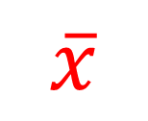
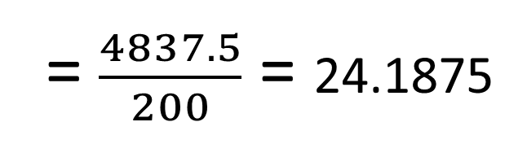
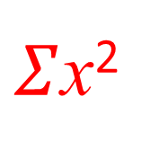
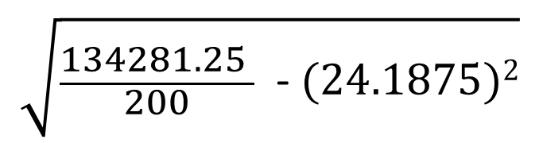
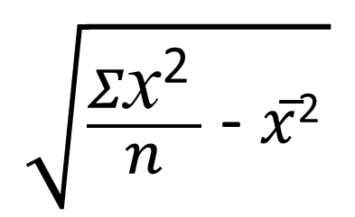
Standard Deviation - Grouped Frequency Table
Estimate the standard deviation of the data.
200
$Σ$x²
(15.5² x 62) + (23² x 88) + (28² x 16) + (33² x 13) + (40.5² x 11) + (53² x 10) = 134281.25
$$\overline{x}$$
= $\frac{4837.5}{200}$ = 24.1875
$$\sqrt{\frac{Σ\text{x}\text{2 }}{n}\text{ − }\overline{x}\text{2} }$$
$$\sqrt{\frac{134281.25 }{200} \text{−} (24.1875)2}$$
=
=
9.28

Slide 10
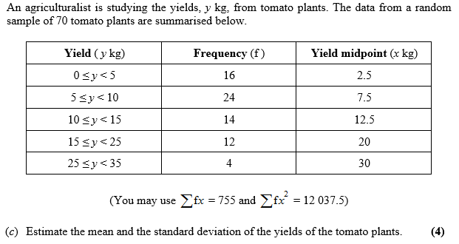
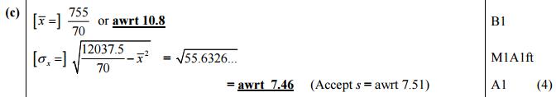
Standard Deviation – Exam Question

Slide 11
Exercise 2E
Pearson Statistics & Mechanics Year 1/AS
Pages 32-33
Complete before the lesson Q1-3
In Class:
Green Q4-5
Amber Q6-8

