Slide 1
Year 2 Applied Mathematics
Further Kinematics
- Variable Acceleration
Chapter 8
(Part 3 of 4)

Slide 2

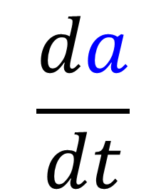

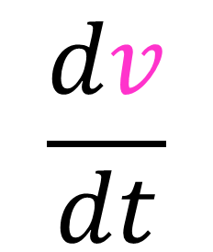

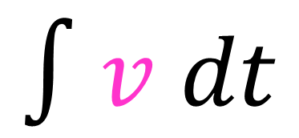
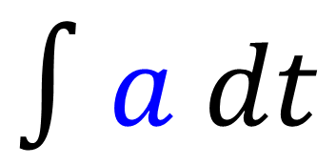
Variable Acceleration
$$s$$
$$\frac{dv}{dt}$$
$$∫v dt$$
$$v$$
$$\frac{da}{dt}$$
$$∫a dt$$
$$a$$

Slide 3
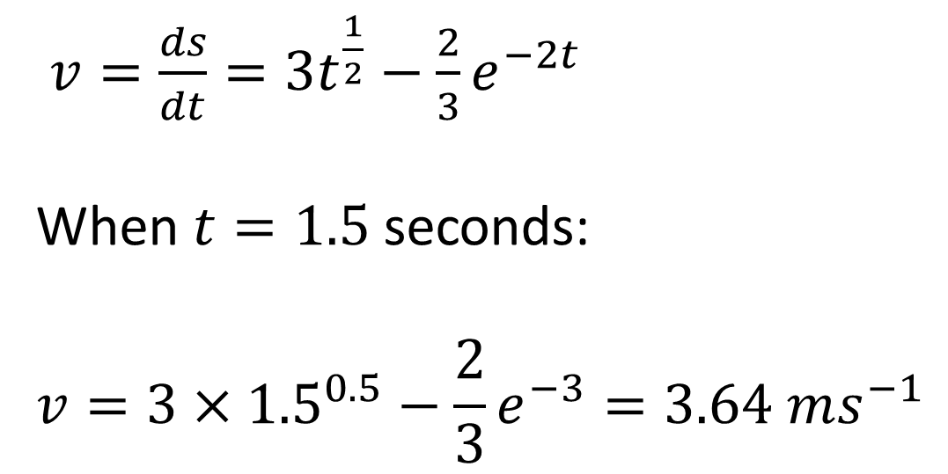
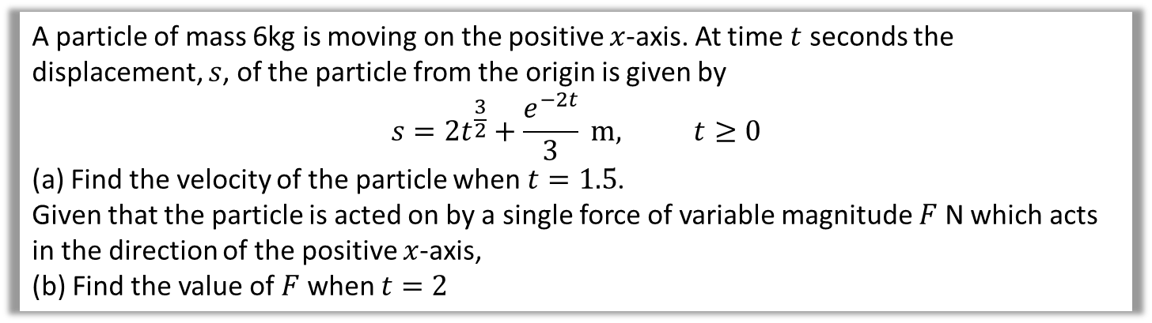
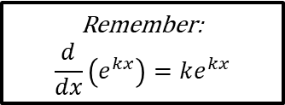
Variable Acceleration – Differentiation Example B
A particle of mass 6kg is moving on the positive $x$-axis. At time $t$ seconds the displacement, $s$, of the particle from the origin is given by
$$s=2t^{\frac{3}{2}}+\frac{e^{−2t}}{3} m, t≥0$$
(a) Find the velocity of the particle when $t=1.5$.
Given that the particle is acted on by a single force of variable magnitude $F$ N which acts in the direction of the positive $x$-axis,
(b) Find the value of $F$ when $t=2$
$v=\frac{ds}{dt}=3t^{\frac{1}{2}}−\frac{2}{3}e^{−2t}$
When $t=1.5$ seconds:
$$v=3×{1.5}^{0.5}−\frac{2}{3}e^{−3}=3.64 ms^{−1}$$
a
Remember:
$$\frac{d}{dx}\left(e^{kx}\right)=ke^{kx}$$

Slide 4
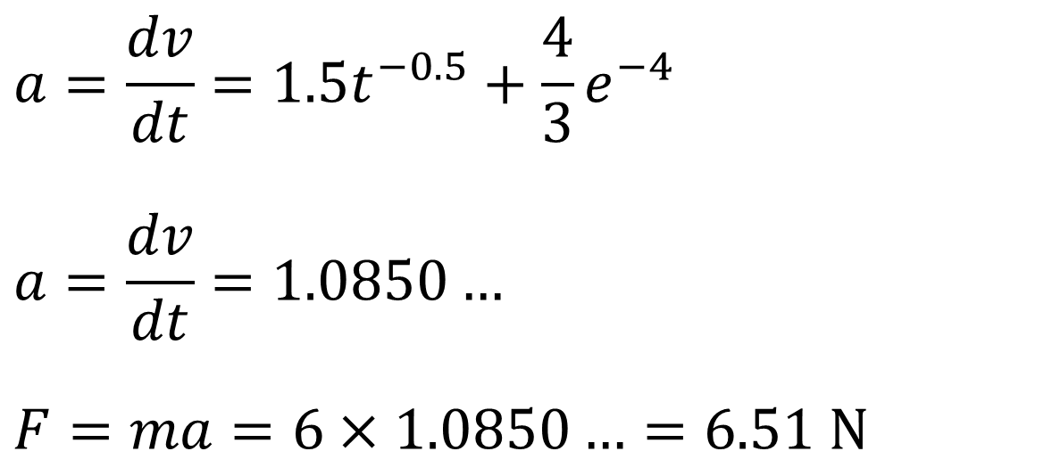
Variable Acceleration – Differentiation Example B
A particle of mass 6kg is moving on the positive $x$-axis. At time $t$ seconds the displacement, $s$, of the particle from the origin is given by
$$s=2t^{\frac{3}{2}}+\frac{e^{−2t}}{3} m, t≥0$$
(a) Find the velocity of the particle when $t=1.5$.
Given that the particle is acted on by a single force of variable magnitude $F$ N which acts in the direction of the positive $x$-axis,
(b) Find the value of $F$ when $t=2$
$$a=\frac{dv}{dt}=1.5t^{−0.5}+\frac{4}{3}e^{−4}$$
$$a=\frac{dv}{dt}=1.0850…$$
$$F=ma=6×1.0850…=6.51 N$$
b

Slide 5
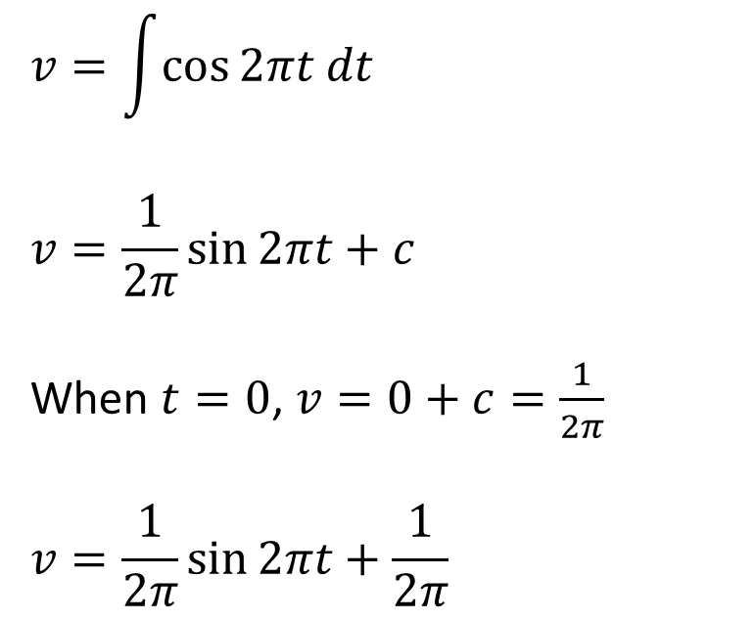
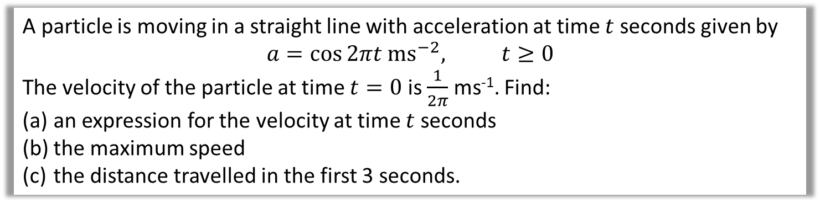
Variable Acceleration – Integration Example A
A particle is moving in a straight line with acceleration at time $t$ seconds given by
$$a=\cos{2πt ms^{−2}, t≥0}$$
The velocity of the particle at time $t=0$ is $\frac{1}{2π}$ ms⁻¹. Find:
an expression for the velocity at time $t$ seconds
the maximum speed
the distance travelled in the first 3 seconds.
$$v=\int{\cos{2πt dt}}$$
$$v=\frac{1}{2π}\sin{2πt}+c$$
When $t=0$, $v=0+c=\frac{1}{2π}$
$$v=\frac{1}{2π}\sin{2πt}+\frac{1}{2π}$$
a
Remember with ‘reverse chain rule’,
you divide by constant in front of variable.

Slide 6
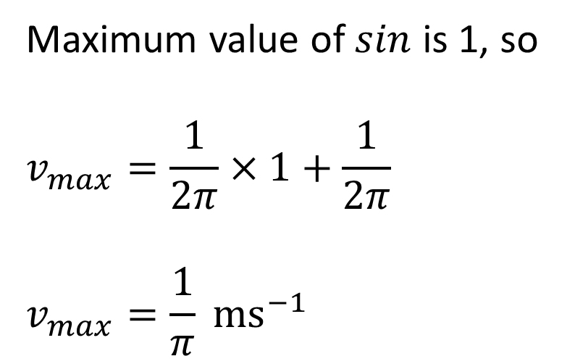
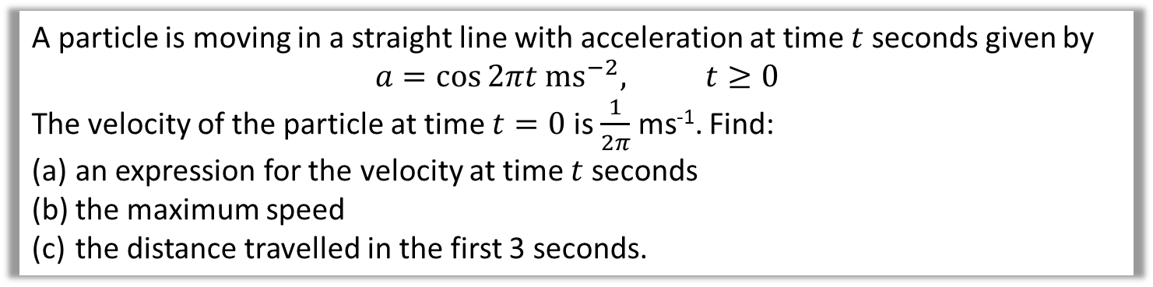
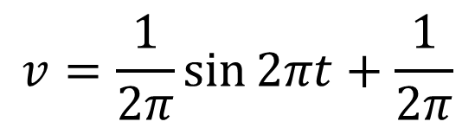
Variable Acceleration – Integration Example A
A particle is moving in a straight line with acceleration at time $t$ seconds given by
$$a=\cos{2πt ms^{−2}, t≥0}$$
The velocity of the particle at time $t=0$ is $\frac{1}{2π}$ ms⁻¹. Find:
an expression for the velocity at time $t$ seconds
the maximum speed
the distance travelled in the first 3 seconds.
$$v=\frac{1}{2π}\sin{2πt}+\frac{1}{2π}$$
b
Maximum value of $sin$ is 1, so
$$v_{max}=\frac{1}{2π}×1+\frac{1}{2π}$$
$$v_{max}=\frac{1}{π} ms^{−1}$$

Slide 7
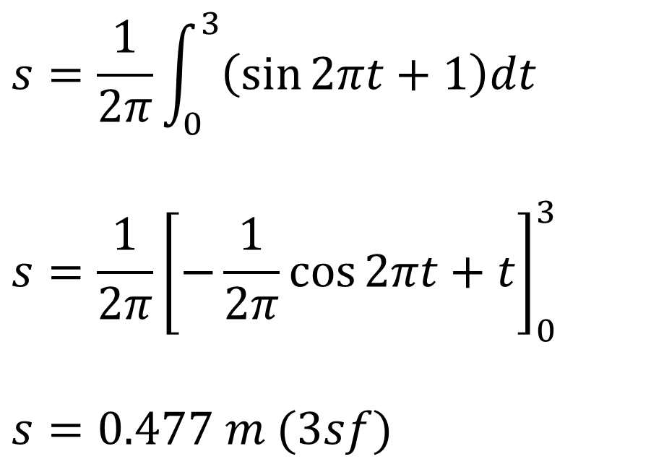
Variable Acceleration – Integration Example A
A particle is moving in a straight line with acceleration at time $t$ seconds given by
$$a=\cos{2πt ms^{−2}, t≥0}$$
The velocity of the particle at time $t=0$ is $\frac{1}{2π}$ ms⁻¹. Find:
an expression for the velocity at time $t$ seconds
the maximum speed
the distance travelled in the first 3 seconds.
$$s=\frac{1}{2π}\int_{0}^{3}{\left(\sin{2πt}+1\right)dt}$$
$$s=\frac{1}{2π}{\left[−\frac{1}{2π}\cos{2πt}+t\right]}_{0}^{3}$$
$$s=0.477 m (3sf)$$
c
Finding area under velocity-time graph.

Slide 8
Exercise 8C
Pearson Stats/Mechanics Year 2
Pages 168-170
Complete before the lesson Q1-2
In Class:
Green Q4
Amber Q3&5-7
Red Q8-10

