Slide 1
Year 1 Applied Mathematics
Variable Acceleration
Understanding an Equation
Chapter 11
(Part 1 of 4)

Slide 2
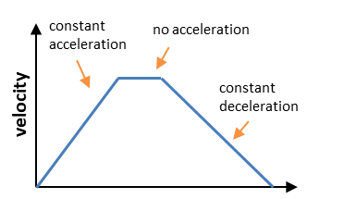
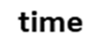
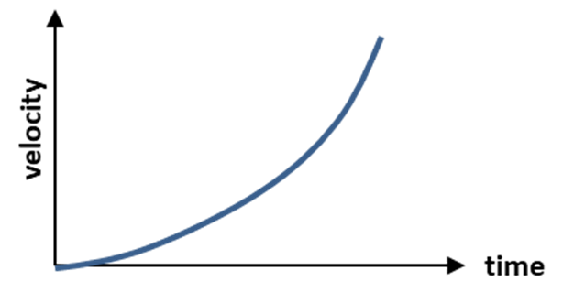
Variable Acceleration
Constant Acceleration
Variable Acceleration

Slide 3
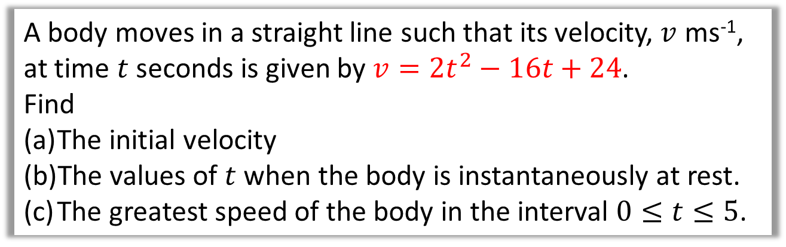
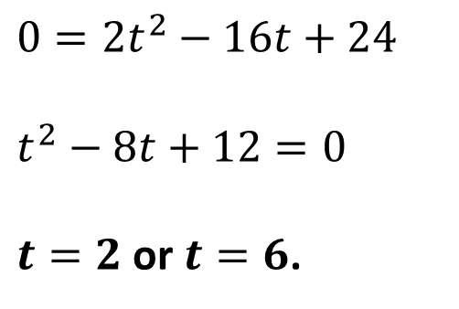

Variable Acceleration
A body moves in a straight line such that its velocity, $v$ ms⁻¹,
at time $t$ seconds is given by $v=2t^{2}−16t+24$.
Find
The initial velocity
The values of $t$ when the body is instantaneously at rest.
The greatest speed of the body in the interval $0≤t≤5$.
a
When $t=0, v=24$ ms⁻¹
b
$$0=2t^{2}−16t+24$$
$$t^{2}−8t+12=0$$
$t=2$ or $t=6$.
It stops on two occasions.
When it comes to rest it could mean the body is changing direction.

Slide 4
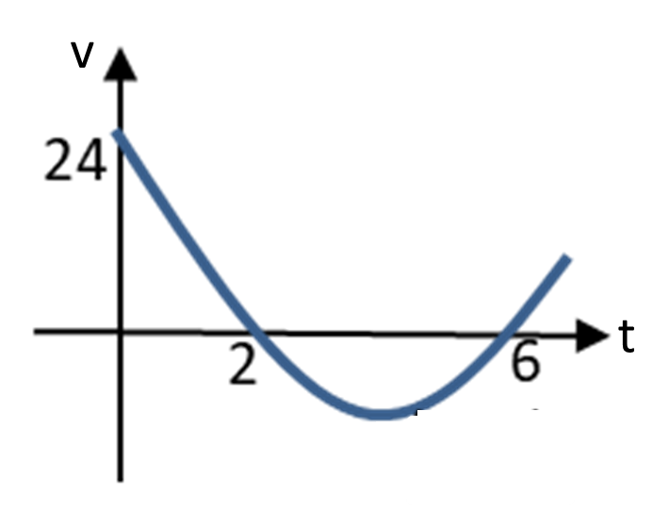
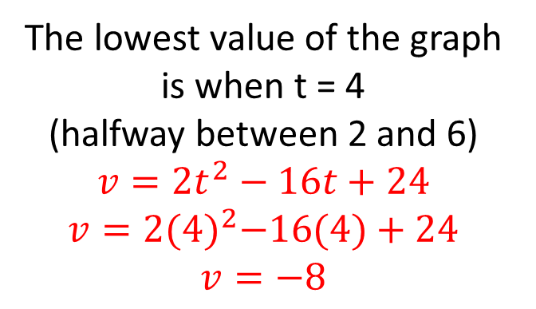
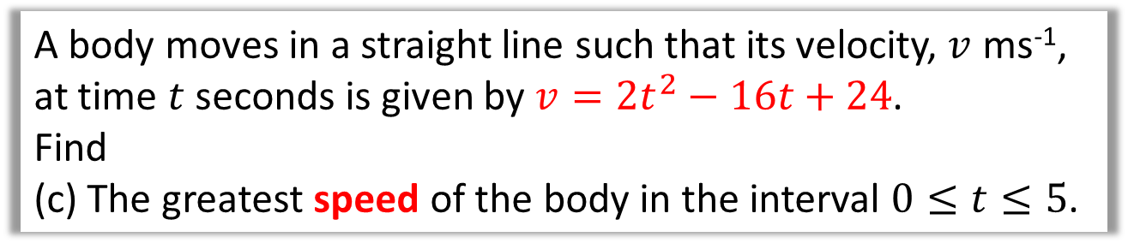

Variable Acceleration
A body moves in a straight line such that its velocity, $v$ ms⁻¹,
at time $t$ seconds is given by $v=2t^{2}−16t+24$.
Find
(c) The greatest speed of the body in the interval $0≤t≤5$.
Note: Speed is a magnitude. Therefore the greatest speed could be a negative velocity.
The lowest value of the graph is when t = 4
(halfway between 2 and 6)
$$v=2t^{2}−16t+24$$
$$v=2{(4)}^{2}−16(4)+24$$
$$v=−8$$
(4,-8)
By inspection, greatest velocity is 24 ms⁻¹ within the range $0≤t≤5$.
Velocity is -8
Speed is 8

Slide 5
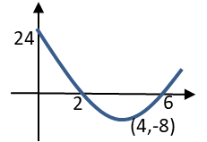
Variable Acceleration
Between 0 and 2 seconds
t = 0
t = 2
Between 2 and 6 seconds
t = 6
From 6 seconds and beyond
t = 6

Slide 6
Exercise 11A
Pearson Stats/Mechanics Year 1
Page 184
Complete before the lesson Q1-2
In Class:
Green Q3-5
Red Q6-8

