Slide 1

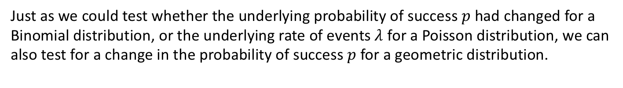


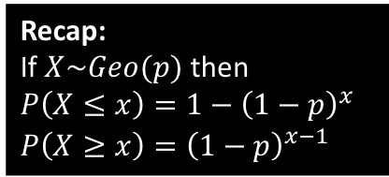
Test on $p$ for geometric distribution
Just as we could test whether the underlying probability of success $p$ had changed for a Binomial distribution, or the underlying rate of events $λ$ for a Poisson distribution, we can also test for a change in the probability of success $p$ for a geometric distribution.
You, Christopher Walken, are captured by the Vietcong and forced to play ‘Russian Roulette’. The Vietcong claim that the probability you will die on each shot is 0.3. You survive a number of shots before dying on the 6th shot. Test, to the 10% level, whether the Vietcong have overstated the probability of dying on each shot.
A scene from one of Dr Frost’s favourite films, The Deer Hunter.
?
We are claiming the probability of dying on each shot is actually lower.
$H_{0}:p=0.3, H_{1}:p<0.3$
Let $X$ be number of shots before dying.
Assuming $H_{0}$, $X\sim Geo(0.3)$
$$P\left(X≥6\right)={\left(1−0.3\right)}^{6−1}=0.16807$$
$0.16807>0.1$ do not reject $H_{0}$.
Insufficient evidence to suggest that the Vietcong have overstated the probability of dying on each shot.
Recap:
If $X\sim Geo(p)$ then
$P\left(X≤x\right)=1−{\left(1−p\right)}^{x}$
$P\left(X≥x\right)={\left(1−p\right)}^{x−1}$
As $p$ decreases, the expected number of shots increases, so “6 or more extreme” is “6 or more”. In general for Geometric tests, the inequality is the opposite direction to $H_{1}$.
* History disclaimer: There is no documented cases of Russian Roulette occurring during the Vietnam War.

Slide 2
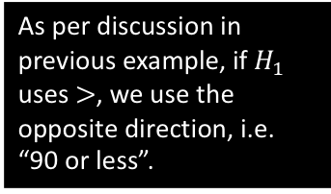


Test Your Understanding
[Textbook] An electronics company makes small components for use in computers. It claims that the percentage of defective components coming off the production line is 0.05%. The electronics company sells the components to a retailer. The retailer suspects that the percentage defective stated by the electronics company should be higher. From a very large consignment recently purchased, the retailer tests the components until he finds a defective component. He finds a defective component on the 90th component that he tests. Is there any evidence to suggest that the retailer’s suspicions are correct? Test at the 5% level of significance.
?
Let the random variable $X$ = number of components tested until finding a defective one.
$H_{0}:p=0.0005, H_{1}:p>0.0005$
Assuming $H_{0}, X\sim Geo(0.0005)$
$P\left(X≤90\right)=1−{\left(1−0.0005\right)}^{30}$
$=0.0440 (4dp)$
$0.0440<0.05$ therefore reject $H_{0}$. Sufficient evidence to conclude that the retailer’s suspicions are correct, i.e. the percentage defective is greater than 0.05%.
As per discussion in previous example, if $H_{1}$ uses $>$, we use the opposite direction, i.e. “90 or less”.
Recap:
If $X\sim Geo(p)$ then
$P\left(X≤x\right)=1−{\left(1−p\right)}^{x}$
$P\left(X≥x\right)={\left(1−p\right)}^{x−1}$

Slide 3
Exercise 4C
Pearson Further Statistics 1
Pages 68-69
Complete before the lesson Q1-3
In Class:
Green Q4-7
Red Q8-12

