Slide 1
Year 2 Pure Mathematics
Radians
– Sector Area
Chapter 5
(Part 3 of 5)

Slide 2


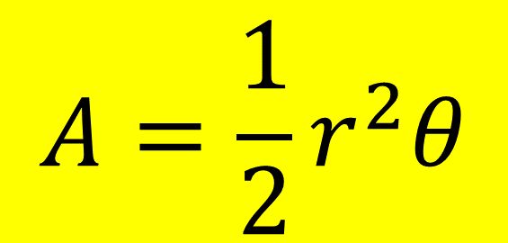
Radians – Area of a Sector
$$r$$
$$θ$$
Calculating Area of a Sector using radians
$$A=\frac{1}{2}r^{2}θ$$

Slide 3

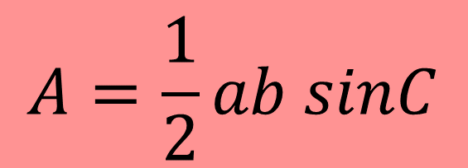



Radians – Area of a Triangle
$$r$$
$$θ$$
$$r$$
Calculating Area of a Triangle
$$A=\frac{1}{2}ab sinC$$
$$A=\frac{1}{2}r2 sinθ$$

Slide 4
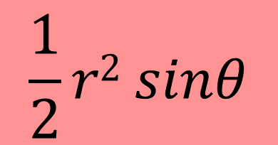
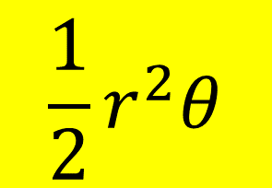
Radians - Segment Area
A segment is the region bound between a chord and the circumference.
$$r$$
$$θ$$
$$r$$
Calculating Area of a Segment using radians
$$\frac{1}{2}r^{2}θ$$
-
$$\frac{1}{2}r2 sinθ$$
=
Area of Segment

Slide 5
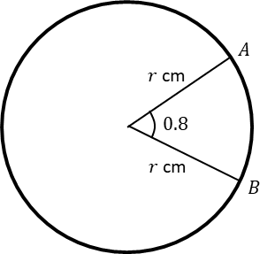
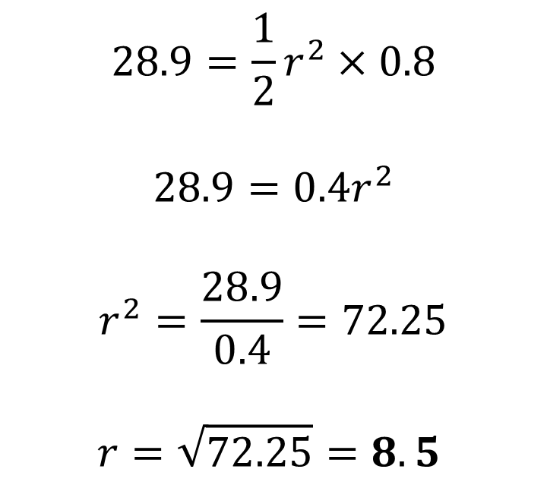
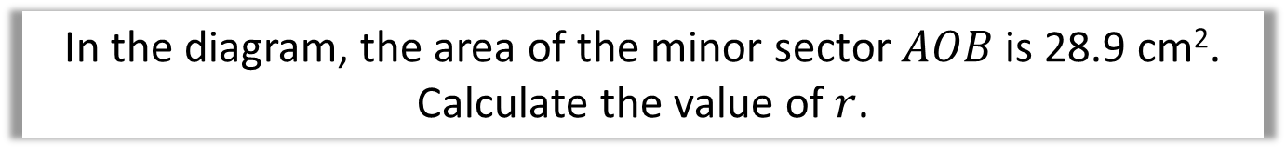
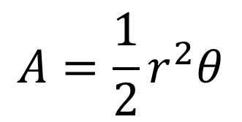
Radians - Examples
In the diagram, the area of the minor sector $AOB$ is 28.9 cm².
Calculate the value of $r$.
$$A=\frac{1}{2}r^{2}θ$$
$$28.9=\frac{1}{2}r^{2}×0.8$$
$$28.9=0.4r^{2}$$
$$r^{2}=\frac{28.9}{0.4}=72.25$$
$$r=\sqrt{72.25}=8.5$$

Slide 6
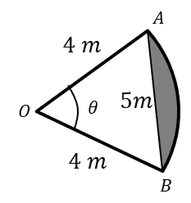
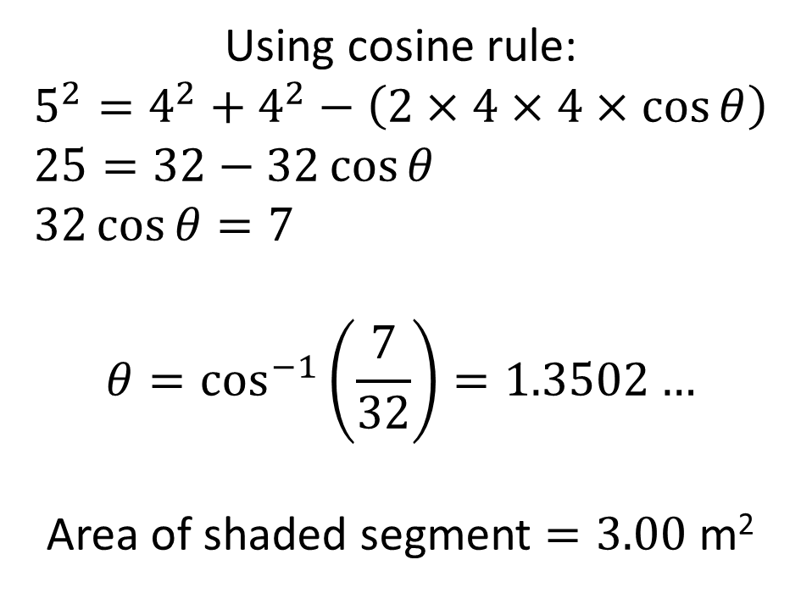
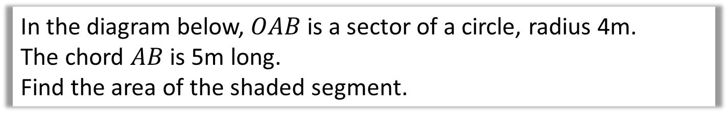
Radian – Exam Question
In the diagram below, $OAB$ is a sector of a circle, radius 4m.
The chord $AB$ is 5m long.
Find the area of the shaded segment.
Using cosine rule:
$$5^{2}=4^{2}+4^{2}−\left(2×4×4×\cos{θ}\right) \\ 25=32−32\cos{θ} \\ 32\cos{θ}=7$$
$$θ=\cos^{−1}\left(\frac{7}{32}\right)=1.3502…$$
Area of shaded segment $=3.00$ m²

Slide 7
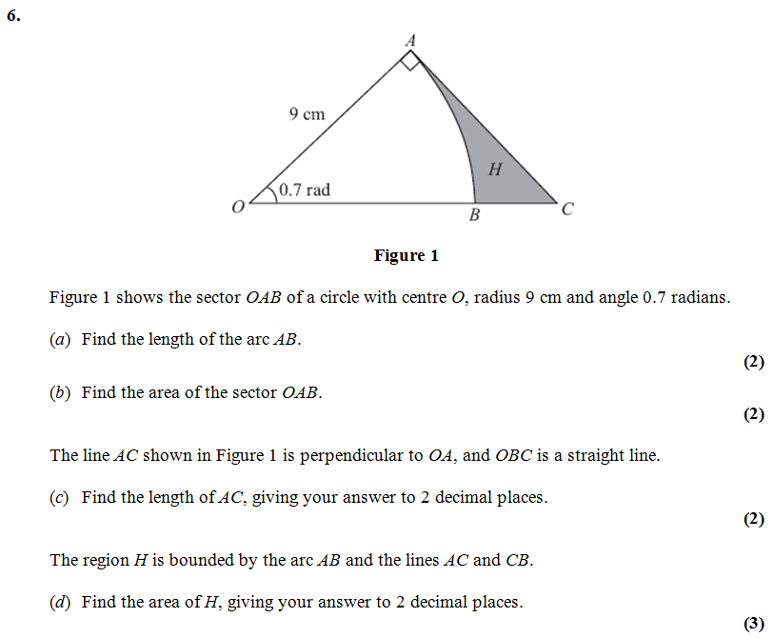


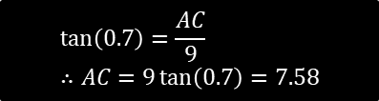
Test Your Understanding
Edexcel C2
?
$$\frac{1}{2}×9^{2}×0.7=28.35$$
?
$$\tan\left(0.7\right)=\frac{AC}{9} \\ ∴AC=9\tan\left(0.7\right)=7.58$$
?
$$Area OAC=\frac{1}{2}×9×7.58=34.11 \\ H=34.11−28.35=5.76$$

Slide 8
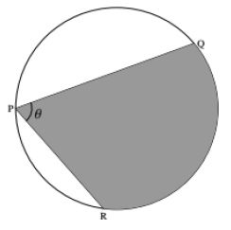


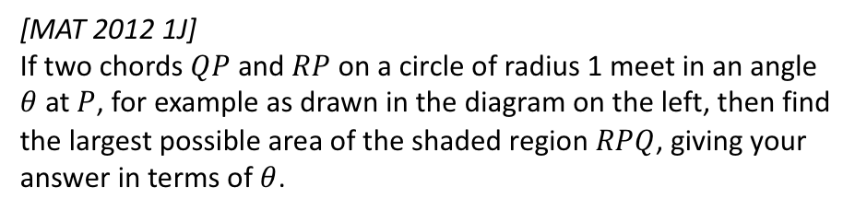







Exercises 5D
Pearson Pure Mathematics Year 2/AS
Pages 125-128
Complete before the lesson Q1-3
In Class:
Green Q4-12
Amber Q13-15
Red Q16-17 & Challenge
Extension
[MAT 2012 1J]
If two chords $QP$ and $RP$ on a circle of radius 1 meet in an angle $θ$ at $P$, for example as drawn in the diagram on the left, then find the largest possible area of the shaded region $RPQ$, giving your answer in terms of $θ$.
?
For a fixed $θ$ the largest area is obtained when the angle bisector of $PQ$ and $PR$ is the diameter of the circle. This can be broken up into two isosceles triangles and a sector as shown.
$∠BOC=2θ$ as angle at centre is twice angle at circumference.
$$∠AOB=π−\frac{θ}{2}−\frac{θ}{2}=π−θ$$
Area of $AOB=\frac{1}{2}×1^{2}×\sin\left(π−θ\right)=\frac{1}{2}\sin\left(θ\right)$
Area of sector $BOC=\frac{1}{2}×1^{2}×2θ=θ$.
Total shaded area $=2×\frac{1}{2}\sin{θ}+θ=θ+\sin{θ}$.
$$B$$
$$\frac{θ}{2}$$
$$π−θ$$
$$1$$
$$A$$
$$1$$
$$2θ$$
$$\frac{θ}{2}$$
$$O$$
$$1$$
$$C$$

