Slide 1
Year 2 Pure Mathematics
Trigonometry and Modelling
- a sin x + b cos x
Chapter 7 (Part 4)

Slide 2
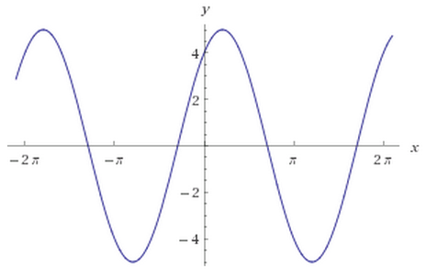

$$a\sin{θ}+b\cos{θ}$$
$$y=3\sin{x}+4\cos{x}$$
It’s a sin graph that has been translated.

Slide 3


$$a\sin{θ}+b\cos{θ}$$
$$y=3\sin{x}+4\cos{x}$$
$y=R sin(x+α)$

Slide 4
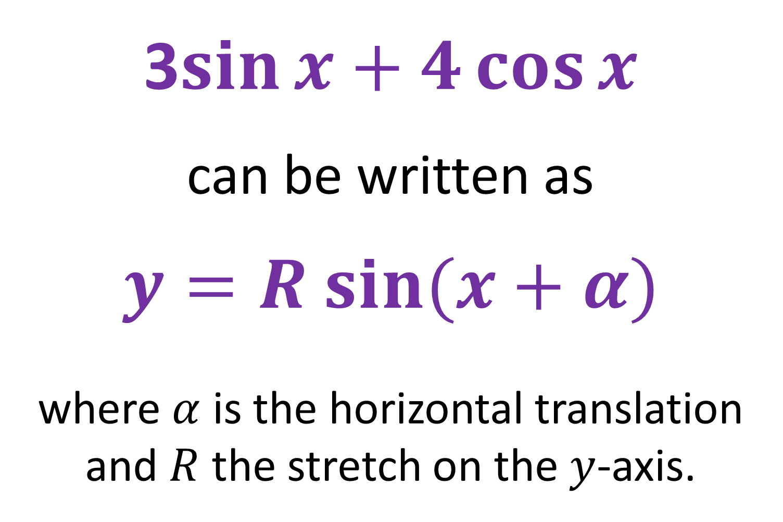
$$a\sin{θ}+b\cos{θ}\text{− }\text{Express}$$
3$\sin{x}+4\cos{x}$
can be written as
$y=R sin⁡(x+α)$
where $α$ is the horizontal translation
and $R$ the stretch on the $y$-axis.

Slide 5
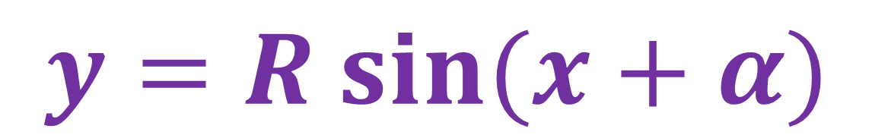
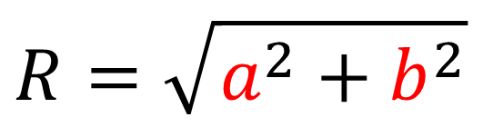
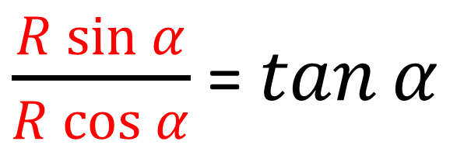

$a\sin{θ}+b\cos{θ}$ - Express
$$a sin{x}+b\cos{x}$$
$y=R sin⁡(x+α)$
$\frac{R\sin{α}}{R\cos{α}}$ = $\tan{α}$
$$R=\sqrt{a^{2}+b^{2}}$$

Slide 6
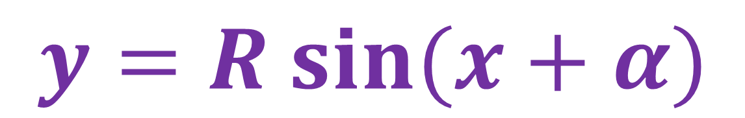
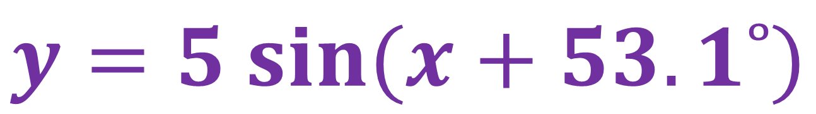
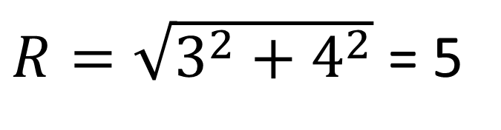
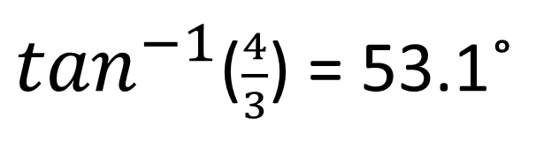
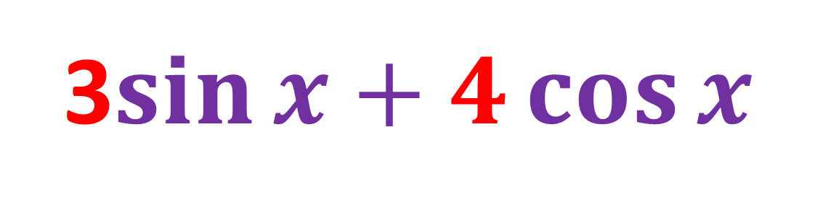
$a\sin{θ}+b\cos{θ }$- Express
3$\sin{x}+4\cos{x}$
$y=R sin⁡(x+α)$
$R=\sqrt{3^{2}+4^{2}}$ = 5
$\tan^{−1}$($\frac{4}{3}$) = 53.1˚
$y=5 sin⁡(x+53.1˚)$

Slide 7

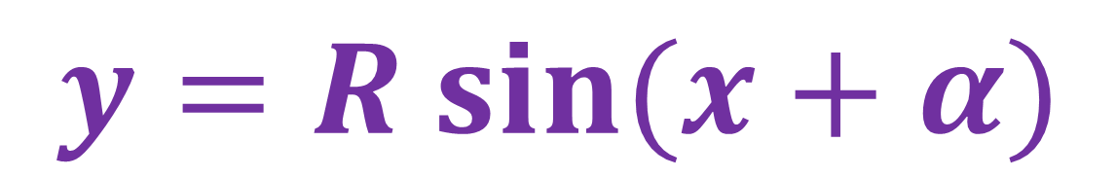
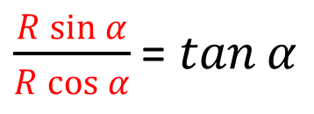
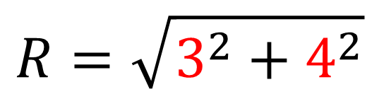

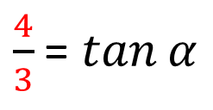
$$a\sin{θ}+b\cos{θ}$$
3$\sin{x}+4\cos{x}$
$y=R sin⁡(x+α)$
Addition Formula
$$R\sin\left(x+α\right)=R\cos{α}sin{x}+R\sin{α}cos{x}$$
$$R=\sqrt{3^{2}+4^{2}}$$
3$\sin{x}+4\cos{x}$
$\frac{R\sin{α}}{R\cos{α}}$ = $\tan{α}$
$\frac{4}{3}$ = $\tan{α}$

Slide 8
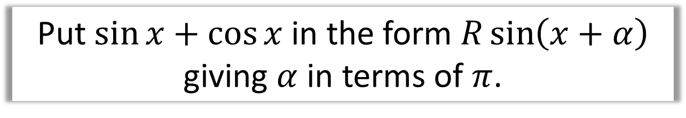
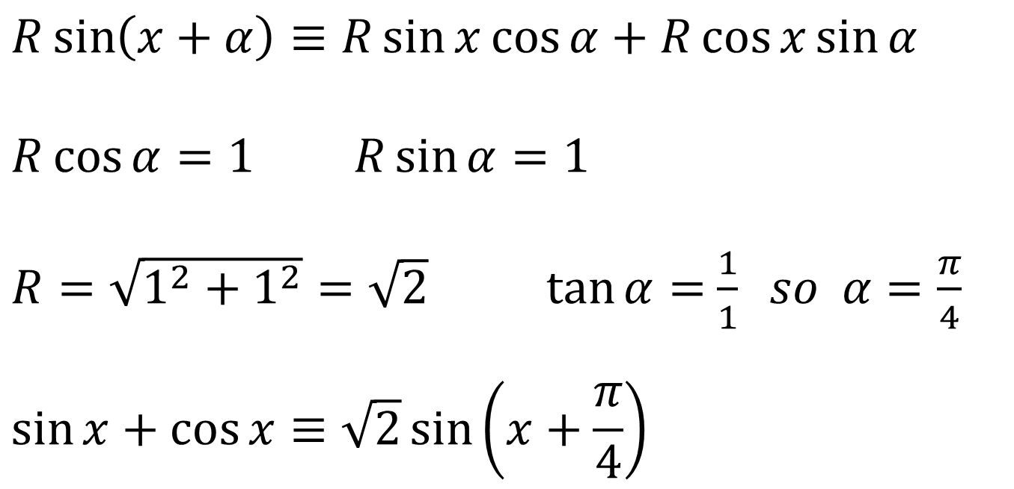
$a\sin{θ}+b\cos{θ}$ - Express
Put $\sin{x}+\cos{x}$ in the form $R\sin\left(x+α\right)$ giving $α$ in terms of $π$.
$$R\sin\left(x+α\right)≡R\sin{x}\cos{α}+R\cos{x}\sin{α}$$
$$R\cos{α}=1 R\sin{α}=1$$
$R=\sqrt{1^{2}+1^{2}}=\sqrt{2} \tan{α}=$ $\frac{1}{1} so α=\frac{π}{4}$
$$\sin{x}+\cos{x}≡\sqrt{2}\sin\left(x+\frac{π}{4}\right)$$

Slide 9
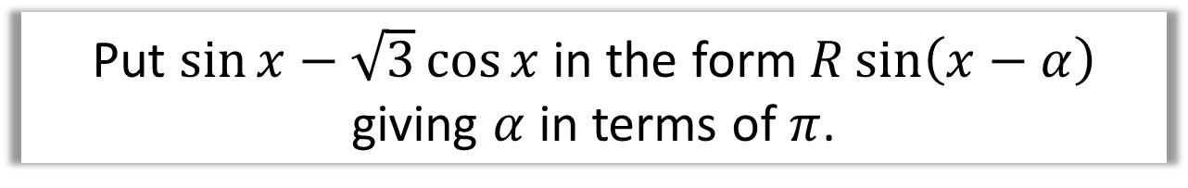
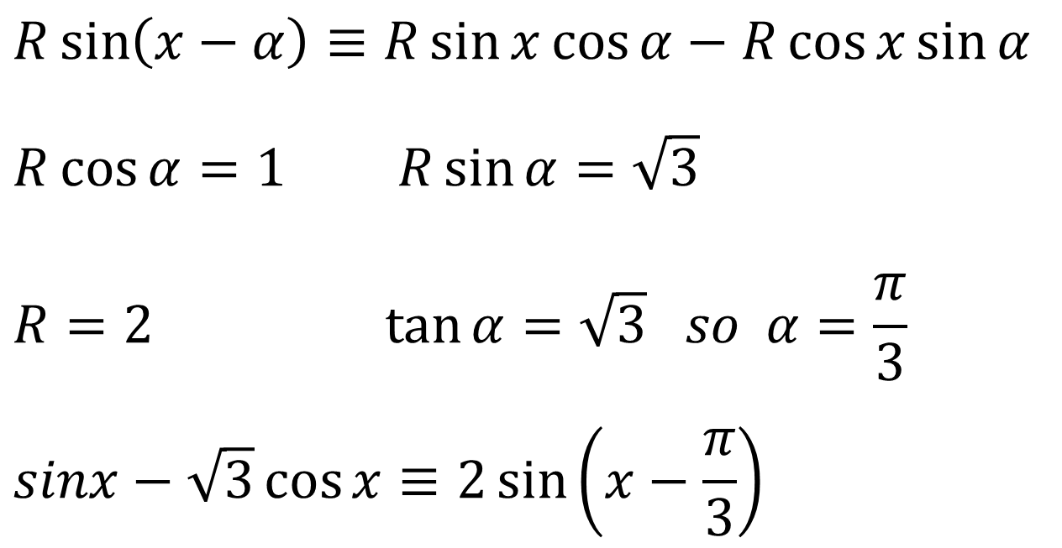
$a\sin{θ}+b\cos{θ}$ - Express
Put $\sin{x}−\sqrt{3}\cos{x}$ in the form $R\sin\left(x−α\right)$ giving $α$ in terms of $π$.
$$R\sin\left(x−α\right)≡R\sin{x}\cos{α}−R\cos{x}\sin{α}$$
$$R\cos{α}=1 R\sin{α}=\sqrt{3}$$
$$R=2\tan{α}=\sqrt{3} so α=\frac{π}{3}$$
$$sinx−\sqrt{3}\cos{x}≡2\sin\left(x−\frac{π}{3}\right)$$

Slide 10
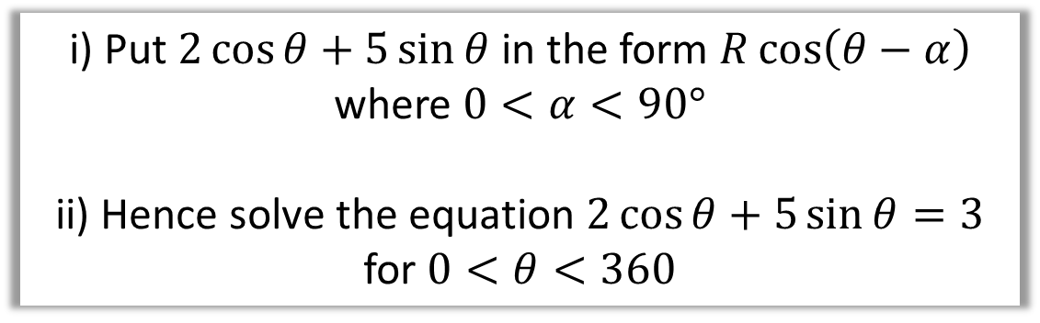
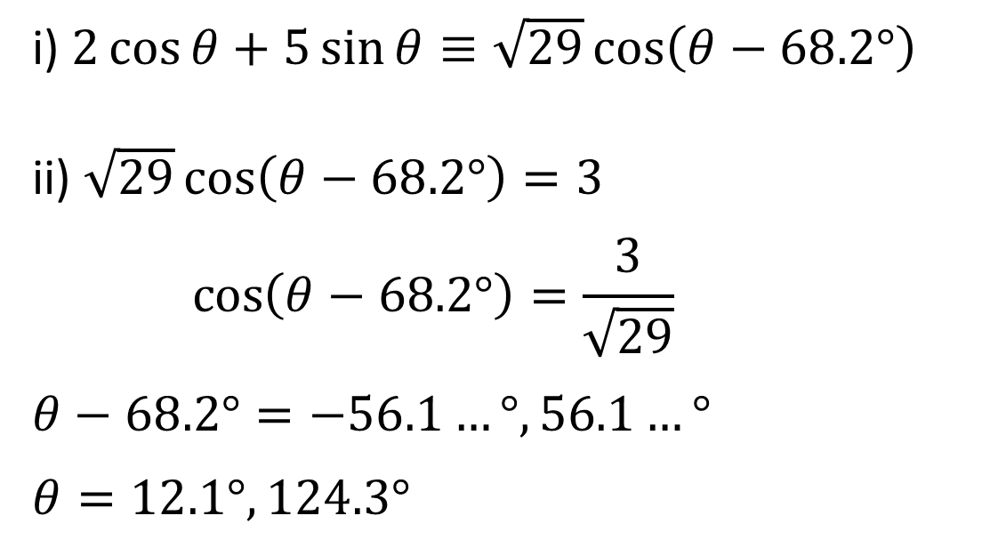
$a\sin{θ}+b\cos{θ}$ - Express and Solve
i) Put $2\cos{θ}+5\sin{θ}$ in the form $R\cos\left(θ−α\right)$
where $0<α<90°$
ii) Hence solve the equation $2\cos{θ}+5\sin{θ}=3$
for $0<θ<360$
i) $2\cos{θ}+5\sin{θ}≡\sqrt{29}\cos\left(θ−68.2°\right)$
ii) $\sqrt{29}\cos\left(θ−68.2°\right)=3$
1
$$\cos\left(θ−68.2°\right)=\frac{3}{\sqrt{29}}$$
1
$$θ−68.2°=−56.1…°, 56.1…°$$
1
$$θ=12.1°, 124.3°$$

Slide 11

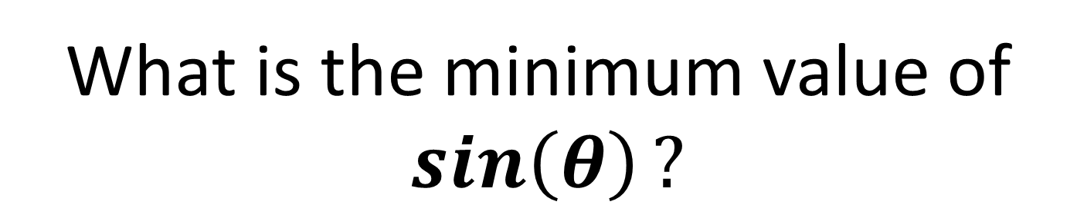
$a\sin{θ}+b\cos{θ}$ - Max and Min
What is the maximum value of
$$\sin\left(θ\right)?$$
1
What is the minimum value of
$$\sin\left(θ\right)?$$
-1

Slide 12
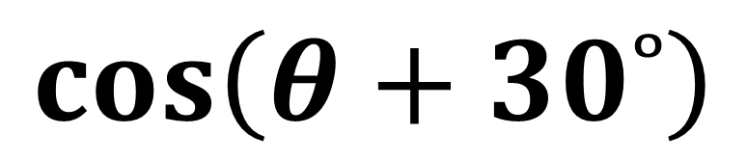

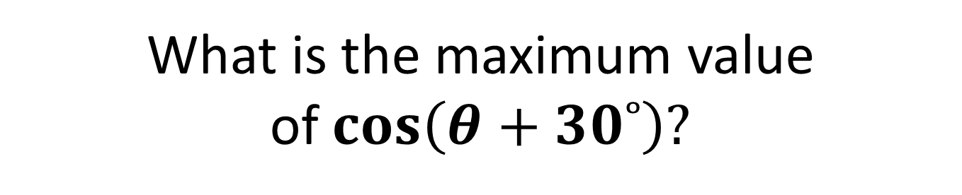
$a\sin{θ}+b\cos{θ}$ - Max and Min
$$\cos\left(θ+30˚\right)$$
What is the maximum value of$\cos\left(θ+30˚\right)?$
1
What is the minimum value of$\cos\left(θ+30˚\right)?$
-1

Slide 13
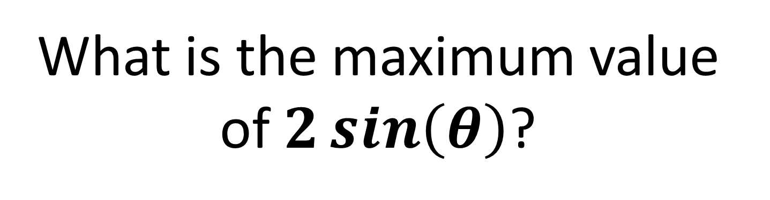
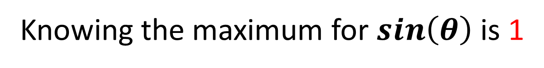
$a\sin{θ}+b\cos{θ}$ - Max and Min
What is the maximum value of$2\sin\left(θ\right)$?
Knowing the maximum for $\sin\left(θ\right)$ is 1
2 (1) = 2

Slide 14
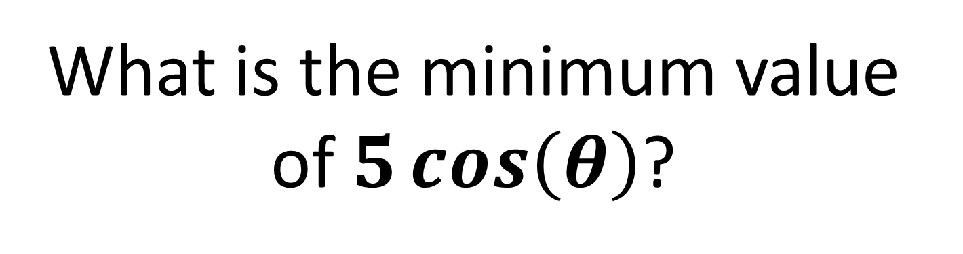
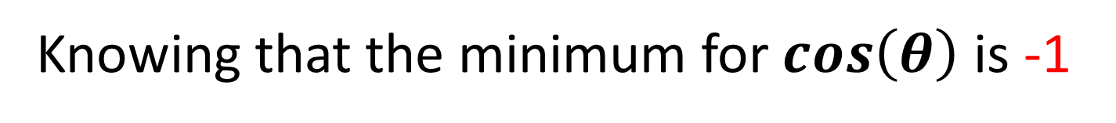
$a\sin{θ}+b\cos{θ}$ - Max and Min
What is the minimum value of$5\cos\left(θ\right)$?
Knowing that the minimum for $\cos\left(θ\right)$ is -1
5 (-1) = -5

Slide 15
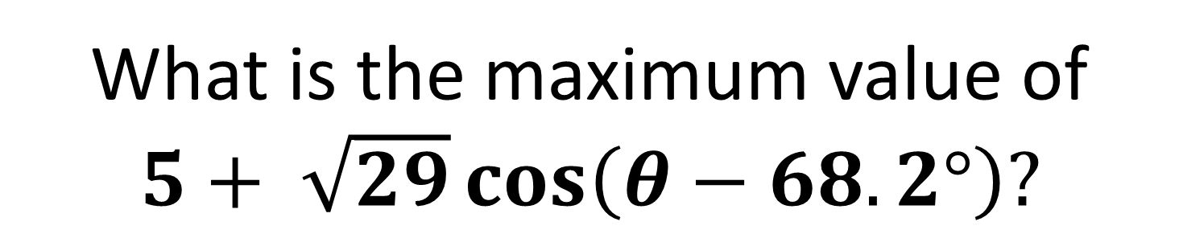
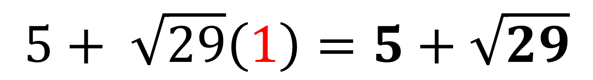

$$a\sin{θ}+b\cos{θ}$$
What is the maximum value of
$5+ \sqrt{29}\cos\left(θ−68.2°\right)?$
Maximum value of $\cos\left(θ−68.2°\right)=1$
$$5+ \sqrt{29}\left(1\right)=5+\sqrt{29}$$

Slide 16
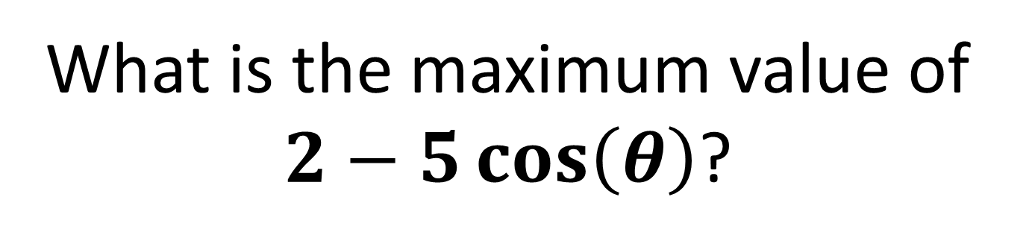


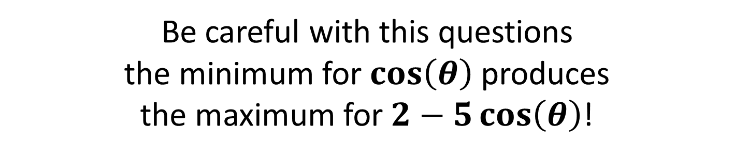
$a\sin{θ}+b\cos{θ}$ - Max and Min
What is the maximum value of
$2−5\cos\left(θ\right)$?
Be careful with this questions
the minimum for $\cos\left(θ\right)$ produces
the maximum for $2−5\cos\left(θ\right)$!
$$2−5\left(1\right)=−3$$
$$2−5\left(−1\right)=8$$

Slide 17

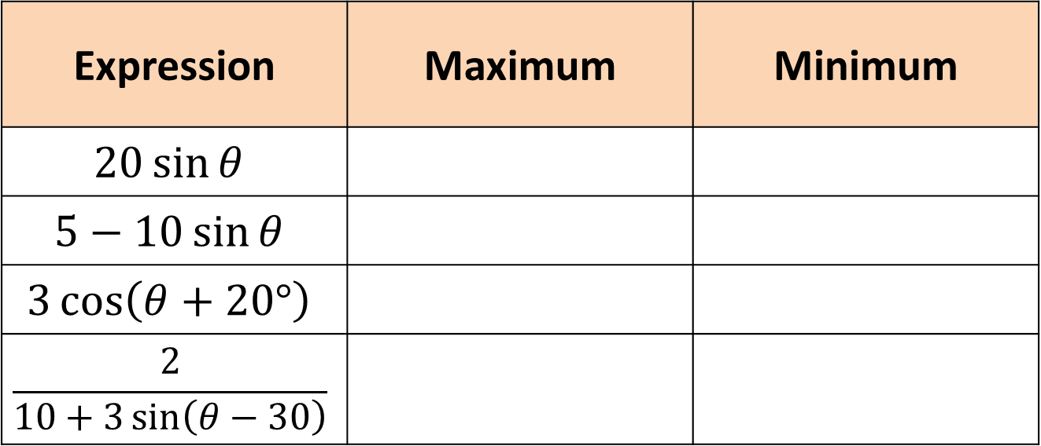







$a\sin{θ}+b\cos{θ}$ - Max and Min
Expression | Maximum | Minimum
$$20\sin{θ}$$
$$5−10\sin{θ}$$
$$3\cos\left(θ+20°\right)$$
$$\frac{2}{10+3\sin\left(θ−30\right)}$$
$$20$$
$$−20$$
$$15$$
$$−5$$
$$3$$
$$−3$$
$$\frac{2}{7}$$
$$\frac{2}{13}$$

Slide 18
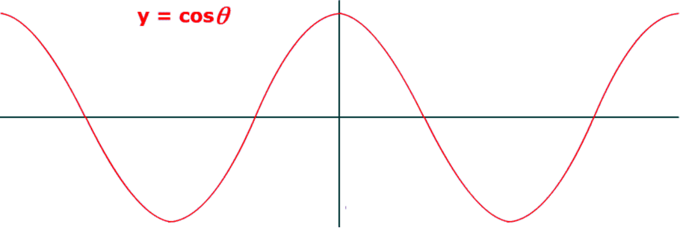
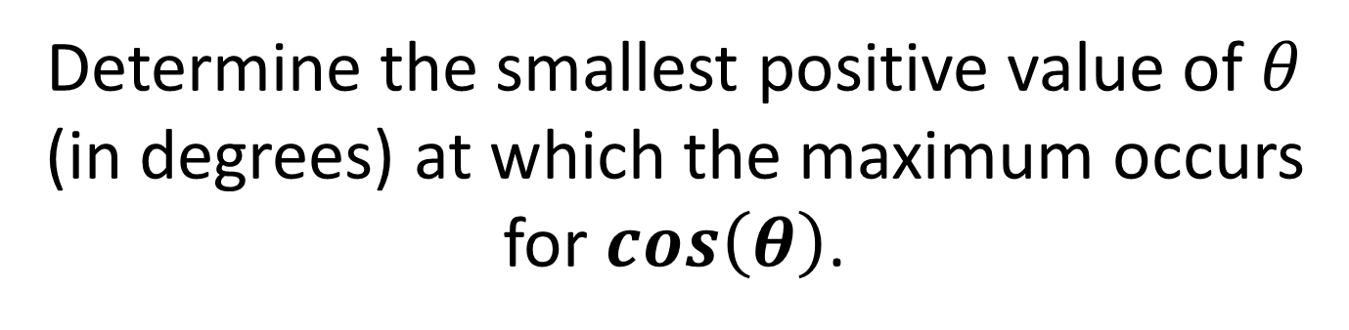
$a\sin{θ}+b\cos{θ}$ - When does it occure
Determine the smallest positive value of $θ$
(in degrees) at which the maximum occurs
for $\cos\left(θ\right)$.
360˚
360˚

Slide 19
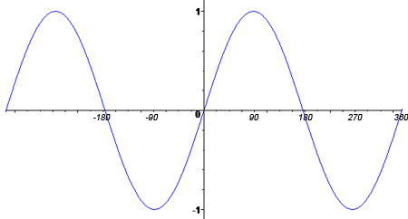
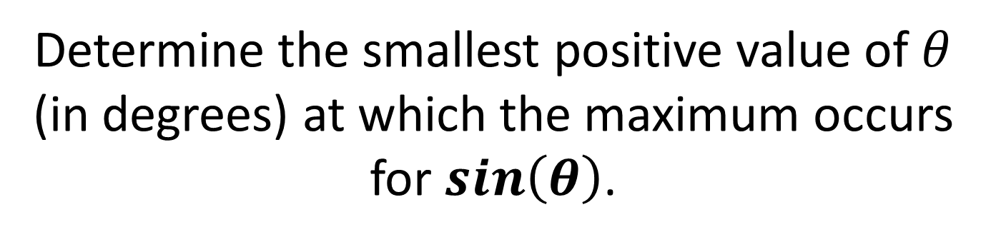
$a\sin{θ}+b\cos{θ}$ - When does it occure
Determine the smallest positive value of $θ$
(in degrees) at which the maximum occurs
for $\sin\left(θ\right)$.
90˚
90˚

Slide 20
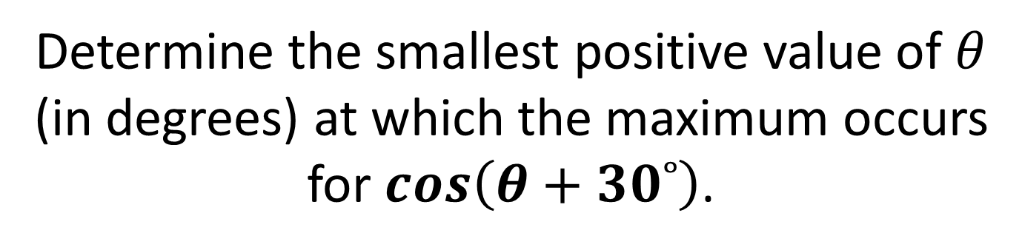
$a\sin{θ}+b\cos{θ}$ - When does it occure
Determine the smallest positive value of $θ$
(in degrees) at which the maximum occurs
for $\cos\left(θ+30˚\right)$.
360˚- 30˚ = 330˚

Slide 21
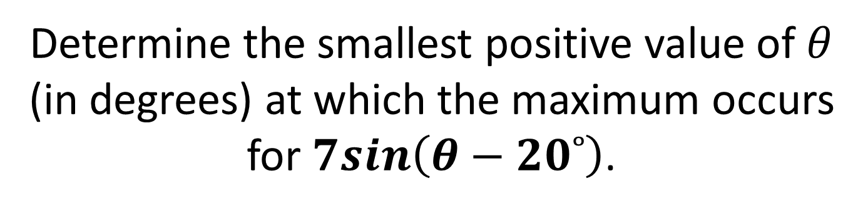
$a\sin{θ}+b\cos{θ}$ - When does it occure
Determine the smallest positive value of $θ$
(in degrees) at which the maximum occurs
for $7sin\left(θ−20˚\right)$.
90˚+ 20˚ = 110˚

Slide 22

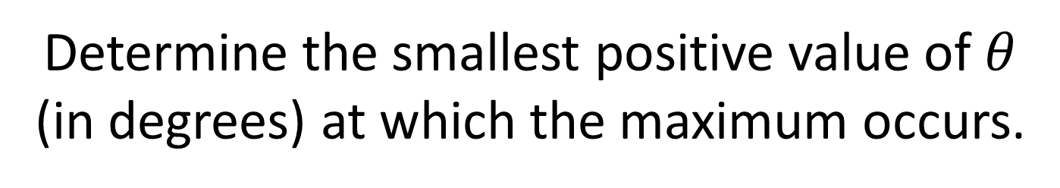



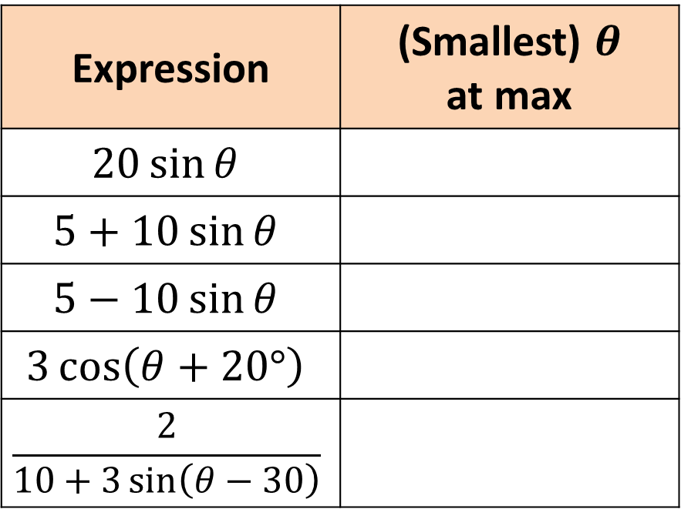

$a\sin{θ}+b\cos{θ}$ - When does it occure
Determine the smallest positive value of $θ$
(in degrees) at which the maximum occurs.
Expression | (Smallest) $θ$ at max
$$20\sin{θ}$$
$$5+10\sin{θ}$$
$$5−10\sin{θ}$$
$$3\cos\left(θ+20°\right)$$
$$\frac{2}{10+3\sin\left(θ−30\right)}$$
$$90°$$
$$90°$$
$$270°$$
$$340°$$
$$300°$$

Slide 23
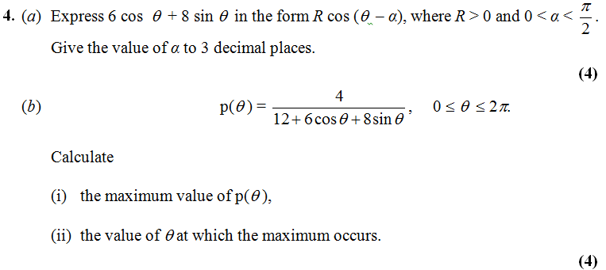
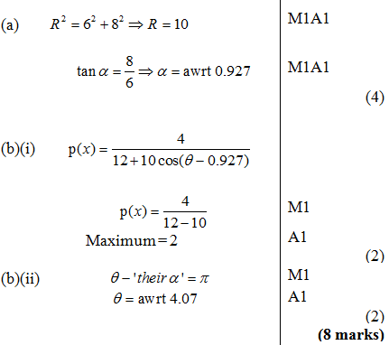
Further Test Your Understanding
Edexcel C3 Jan 2013 Q4
?

Slide 24
Exercise 7E
Pearson Pure Mathematics Year 2/AS
Pages 184-186
Complete before the lesson Q1-4
In Class:
Green Q5-9
Amber Q10-12
Red Q13-15

