Slide 1
Year 2 Applied Mathematics
Regression Correlation
and Hypothesis Testing
- Hypothesis Testing
for Correlation
Chapter 1
(Part 3 of 3)

Slide 2
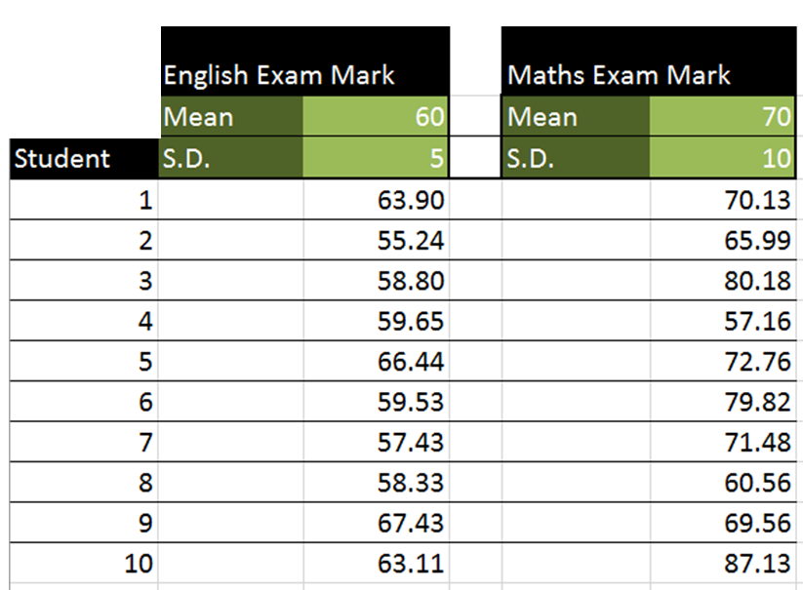
Hypothesis Testing for Correlation
English and Maths results are
independently randomly generated.
PMCC
for this data set is 0.219
What PMCC did you except to get for this data set?
PMCC = 0 because the data was randomly generated.

Slide 3

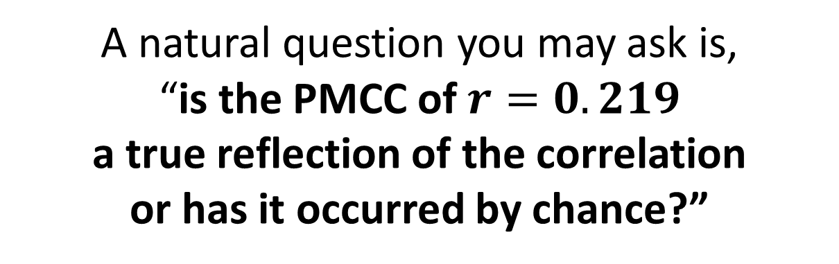
Hypothesis Testing for Correlation
So despite that you know that $r=0$
the observed PMCC suggested some correlation.
A natural question you may ask is,
“is the PMCC of $r=0.219$
a true reflection of the correlation
or has it occurred by chance?”
This sounds like a Hypothesis Test!

Slide 4
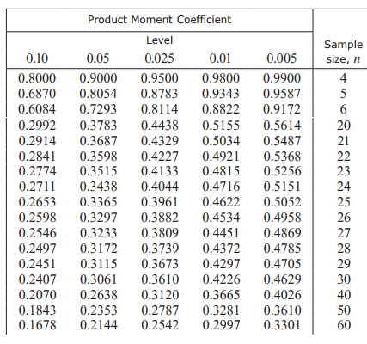
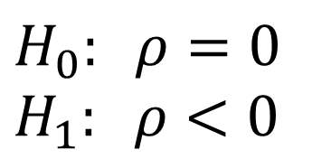
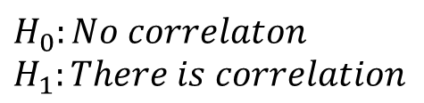
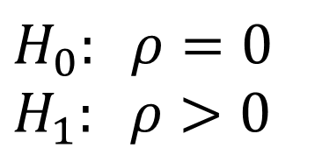
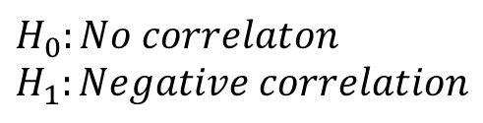
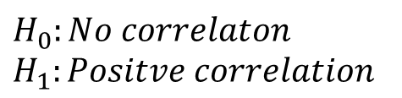
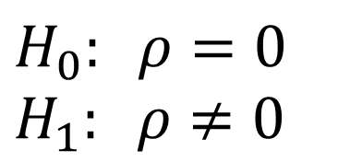
Hypothesis Testing for Correlation
Step 1) Write a hypothesis:
$$H_{0}: ρ=0 \\ H_{1}: ρ>0$$
$$H_{0}: ρ=0 \\ H_{1}: ρ<0$$
$$H_{0}: ρ=0 \\ H_{1}: ρ≠0$$
$$H_{0}:No correlaton \\ H_{1}:Positve correlation$$
$$H_{0}:No correlaton \\ H_{1}:Negative correlation$$
$$H_{0}:No correlaton \\ H_{1}:There is correlation$$
Step 2) Use a PMCC table to identify the minimum value needed to make the correlation statistically signification:
Information needed:
PMCC of sample
Significant Level
Sample Size

Slide 5
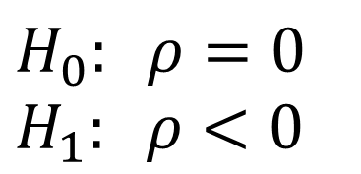
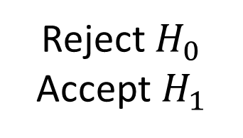
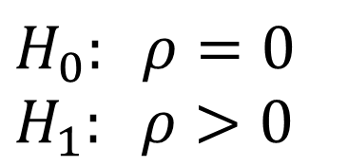
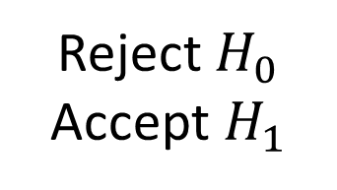
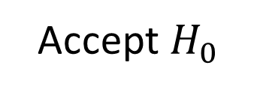
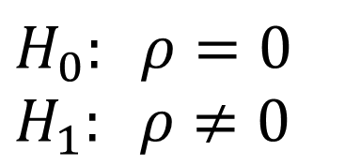
Hypothesis Testing for Correlation
Step 4) Accept or reject your hypothesis:
$$H_{0}: ρ=0 \\ H_{1}: ρ>0$$
Table PMCC: 0.35
Sample PMCC: 0.25
Accept $H_{0}$
$$H_{0}: ρ=0 \\ H_{1}: ρ<0$$
Table PMCC: -0.5
Sample PMCC: -0.7
Reject $H_{0}$
Accept $H_{1}$
$$H_{0}: ρ=0 \\ H_{1}: ρ≠0$$
Table PMCC: 0.4
Sample PMCC: 0.5
Reject $H_{0}$
Accept $H_{1}$

Slide 6
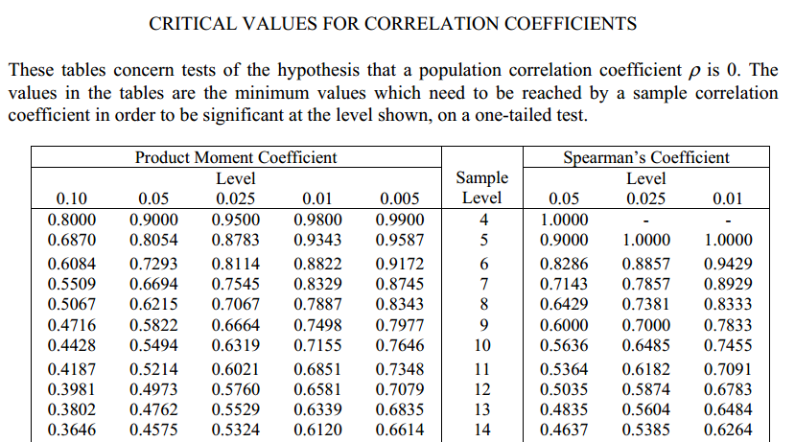
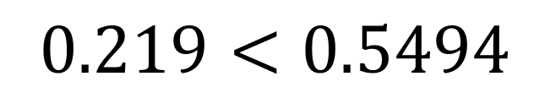
How to carry out the hypothesis test
Sample size is 10
Significance level is 5%
Sample PMCC is 0.219
Is the data is correlated?
$0.219<0.5494$
Insufficient evidence to suggest that
the data is correlated.

Slide 7
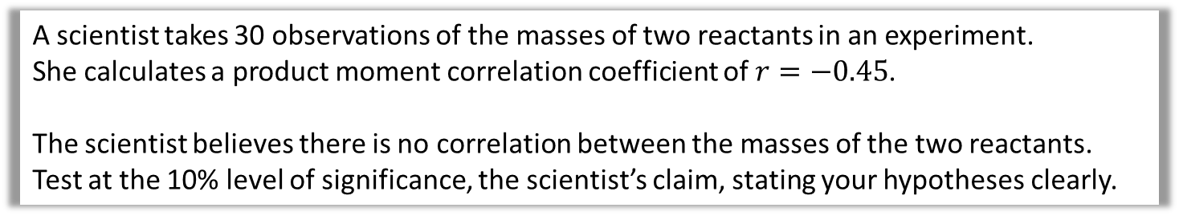
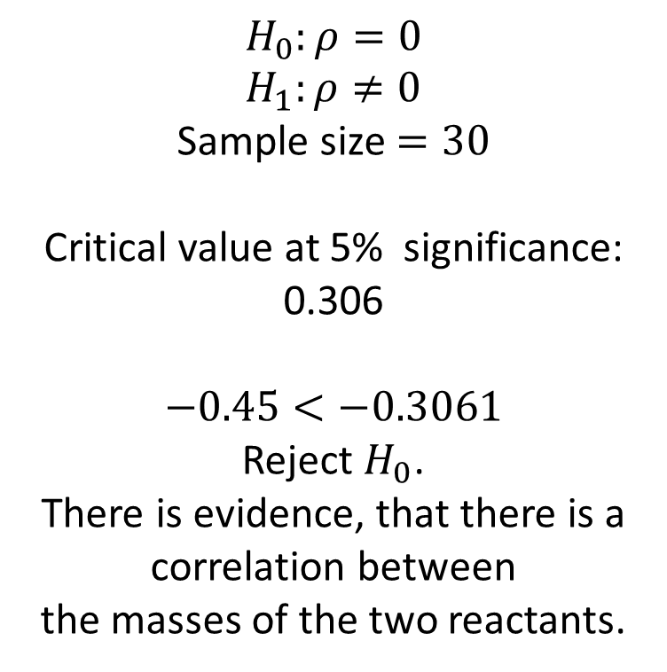
Hypothesis Testing for correlation - Two-tailed test
A scientist takes 30 observations of the masses of two reactants in an experiment.
She calculates a product moment correlation coefficient of $r=−0.45$.
The scientist believes there is no correlation between the masses of the two reactants.
Test at the 10% level of significance, the scientist’s claim, stating your hypotheses clearly.
$$H_{0}:ρ=0 \\ H_{1}:ρ≠0$$
Sample size $=30$
Critical value at 5% significance:
0.306
$−0.45<−0.3061$
Reject $H_{0}$.
There is evidence, that there is a correlation between
the masses of the two reactants.
Two-tailed, so 5% at each tail.

Slide 8
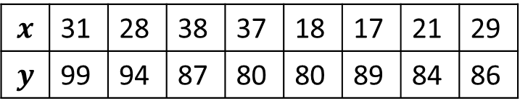
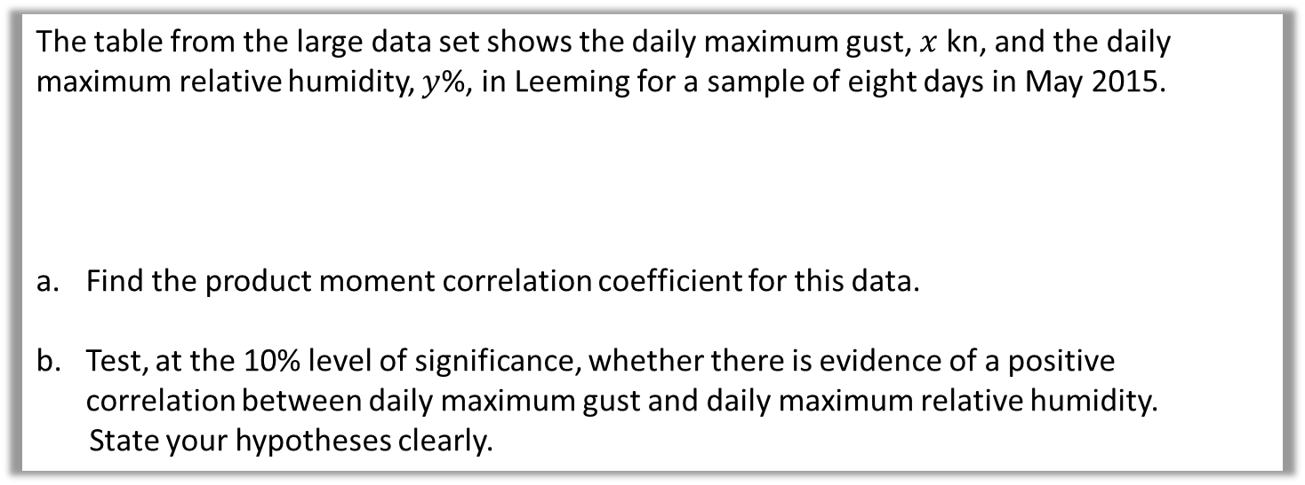
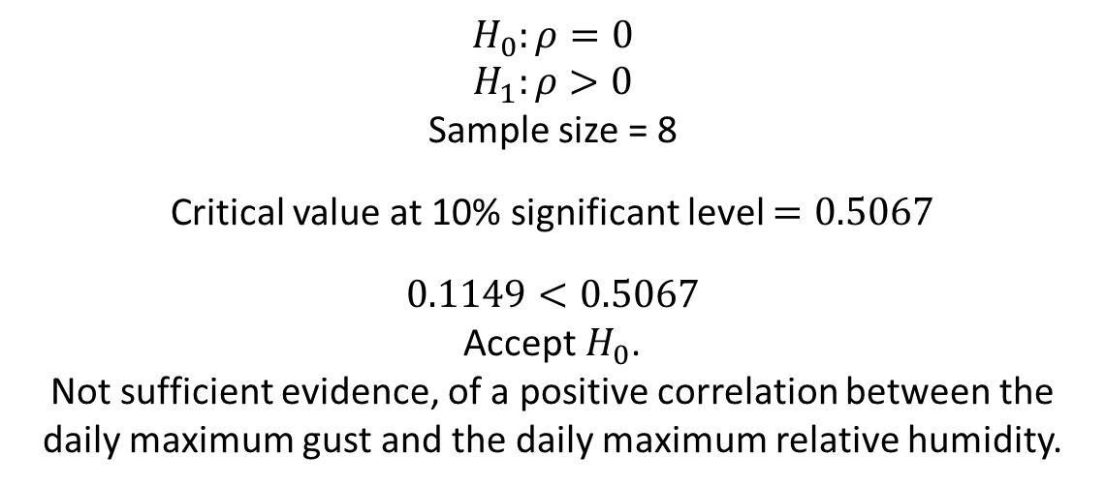

Hypothesis Testing for correlation - Example
The table from the large data set shows the daily maximum gust, $x$ kn, and the daily maximum relative humidity, $y$%, in Leeming for a sample of eight days in May 2015.
Find the product moment correlation coefficient for this data.
Test, at the 10% level of significance, whether there is evidence of a positive correlation between daily maximum gust and daily maximum relative humidity.
State your hypotheses clearly.
$$x$$ | 31 | 28 | 38 | 37 | 18 | 17 | 21 | 29
$$y$$ | 99 | 94 | 87 | 80 | 80 | 89 | 84 | 86
a
$$r=0.1149$$
$$H_{0}:ρ=0$$
$$H_{1}:ρ>0$$
Sample size = 8
Critical value at 10% significant level $=0.5067$
$0.1149<0.5067$
Accept $H_{0}$.
Not sufficient evidence, of a positive correlation between the daily maximum gust and the daily maximum relative humidity.
b

Slide 9
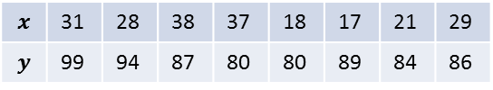
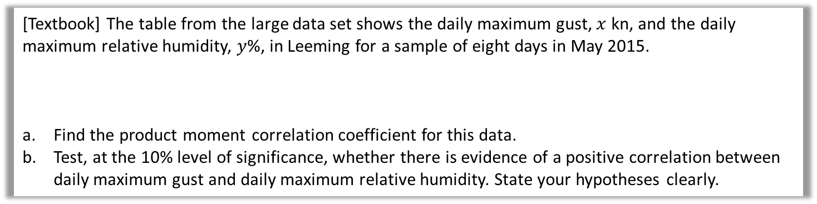

Test Your Understanding
[Textbook] The table from the large data set shows the daily maximum gust, $x$ kn, and the daily maximum relative humidity, $y$%, in Leeming for a sample of eight days in May 2015.
Find the product moment correlation coefficient for this data.
Test, at the 10% level of significance, whether there is evidence of a positive correlation between daily maximum gust and daily maximum relative humidity. State your hypotheses clearly.
$$x$$ | 31 | 28 | 38 | 37 | 18 | 17 | 21 | 29
$$y$$ | 99 | 94 | 87 | 80 | 80 | 89 | 84 | 86
a
$$r=0.1149$$
$$H_{0}:ρ=0, H_{1}:ρ>0$$
Sample size = 8
Critical value at 10% significant level $=0.5067$
$0.1149<0.5067$ therefore insufficient evidence to reject $H_{0}$.
Not sufficient evidence, at 10% significance level, of a positive correlation between the daily maximum gust and the daily maximum relative humidity.
?
b
?

Slide 10
Exercise 1C
Pearson Pure Mathematics Year 1/AS
Pages 10-12
Complete before the lesson Q1-2
In Class:
Green Q3-4
Amber Q5-6
Red Q7-10

