Slide 1


Roots of Polynomials
You need to recognize some patterns involving the roots of quartic equations
The roots of a quartic equation ${ax}^{4}+{bx}^{3}+{cx}^{2}+dx+e=0$ can be represented by $α$, $β$, $γ$ and $δ$.
If the quartic equation ${ax}^{4}+{bx}^{3}+{cx}^{2}+dx+e=0$ has the roots $α$, $β$, $γ$ and $δ$, then the following relationship can be written…
$${ax}^{4}+{bx}^{3}+{cx}^{2}+dx+e=a\left(x−α\right)\left(x−β\right)\left(x−γ\right)\left(x−δ\right)$$
Expand brackets
Group like terms
$${ax}^{4}+{bx}^{3}+{cx}^{2}+dx+e=a\left(\begin{aligned}x^{4}−αx^{3}−βx^{3}−γx^{3}−δx^{3}+{αβx}^{2}+{βγx}^{2}+{γαx}^{2}+{γδx}^{2}+ \\ {αδx}^{2}+{βδx}^{2}−αβγx−αβδx−αγδx−βγδx+αβγδ\end{aligned}\right)$$
$${ax}^{4}+{bx}^{3}+{cx}^{2}+dx+e=a\left(x^{4}−(α+β+γ+δ)x^{3}+({αβ+βγ+γα+γδ+αδ+βδ)x}^{2}−\left(αβγ+αβδ+αγδ+βγδ\right)x+αβγδ\right)$$
$$x^{4}+{\frac{b}{a}x}^{3}+{\frac{c}{a}x}^{2}+\frac{d}{a}x+\frac{e}{a}=x^{4}−(α+β+γ+δ)x^{3}+({αβ+βγ+γα+γδ+αδ+βδ)x}^{2}−\left(αβγ+αβδ+αγδ+βγδ\right)x+αβγδ$$
Divide by $a$
4C

Slide 2













Roots of Polynomials
You need to recognize some patterns involving the roots of quartic equations
The roots of a quartic equation ${ax}^{4}+{bx}^{3}+{cx}^{2}+dx+e=0$ can be represented by $α$, $β$, $γ$ and $δ$.
$$x^{4}+{\frac{b}{a}x}^{3}+{\frac{c}{a}x}^{2}+\frac{d}{a}x+\frac{e}{a}=x^{4}−(α+β+γ+δ)x^{3}+({αβ+βγ+γα+γδ+αδ+βδ)x}^{2}−\left(αβγ+αβδ+αγδ+βγδ\right)x+αβγδ$$
Compare coefficients of $x^{3}$
Compare coefficients of $x^{2}$
Compare coefficients of $x$
Compare constants
$$\frac{b}{a}=−\left(α+β+γ+δ\right)$$
$$\frac{c}{a}=αβ+βγ+γα+γδ+αδ+βδ$$
$$\frac{d}{a}=−\left(αβγ+αβδ+αγδ+βγδ\right)$$
$$\frac{e}{a}=αβγδ$$
$$−\frac{b}{a}=α+β+γ+δ$$
$$−\frac{d}{a}=αβγ+αβδ+αγδ+βγδ$$
→ The sum of the ‘single roots’ is $−\frac{b}{a}$
→ The sum of the ‘double roots’ is $\frac{c}{a}$
→ The sum of the ‘triple roots’ is $−\frac{d}{a}$
→ The sum of the ‘quadruple roots’ is $\frac{e}{a}$
4C

Slide 3















Roots of Polynomials
$$αβ+βγ+γα+γδ+αδ+βδ=\frac{c}{a}$$
$$αβγ+αβδ+αγδ+βγδ=−\frac{d}{a}$$
$$α+β+γ+δ=−\frac{b}{a}$$
$$αβγδ=\frac{e}{a}$$
You need to recognize some patterns involving the roots of cubic equations
Comparing the patterns between quadratics, cubics and quartics
$${ax}^{2}+bx+c=0$$
$${ax}^{3}+bx^{2}+cx+d=0$$
$${ax}^{4}+bx^{3}+cx^{2}+dx+e=0$$
$$α+β=−\frac{b}{a}$$
$$α+β+γ=−\frac{b}{a}$$
Sum of ‘singles’
$$α+β+γ+δ=−\frac{b}{a}$$
$$αβ=\frac{c}{a}$$
Sum of ‘doubles’
$$αβ+βγ+γα=\frac{c}{a}$$
$$αβ+βγ+γα+γδ+αδ+βδ=\frac{c}{a}$$
$$αβγ=−\frac{d}{a}$$
Sum of ‘triples’
$$αβγ+αβδ+αγδ+βγδ=−\frac{d}{a}$$
Sum of ‘quadruples’
$$αβγδ=\frac{e}{a}$$
4C

Slide 4




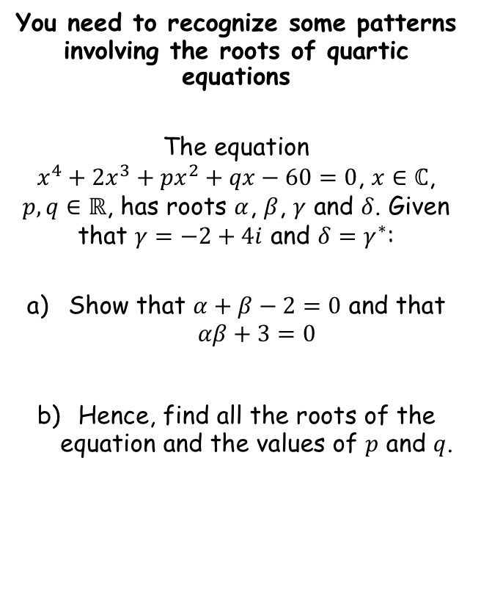





Roots of Polynomials
$$αβ+βγ+γα+γδ+αδ+βδ=\frac{c}{a}$$
$$αβγ+αβδ+αγδ+βγδ=−\frac{d}{a}$$
$$α+β+γ+δ=−\frac{b}{a}$$
$$αβγδ=\frac{e}{a}$$
You need to recognize some patterns involving the roots of quartic equations
The equation
$x^{4}+2x^{3}+px^{2}+qx−60=0$, $x∈ℂ$, $p,q∈ℝ$, has roots $α$, $β$, $γ$ and $δ$. Given that $γ=−2+4i$ and $δ=γ^{∗}$:
Show that $α+β−2=0$ and that $αβ+3=0$
Hence, find all the roots of the equation and the values of $p$ and $q$.
$$α+β+γ+δ=−\frac{b}{a}$$
Sub in values that we know
$$α+β+(−2+4i)+(−2−4i)=−\frac{2}{1}$$
Calculate / simplify
$$α+β−4=−2$$
Add 2
$$α+β−2=0$$
$$αβγδ=\frac{e}{a}$$
Sub in values that we know
$$αβ(−2+4i)(−2−4i)=\frac{−60}{1}$$
Calculate parts / simplify
$$αβ(20)=−60$$
Divide by 20
$$αβ=−3$$
Add 3
$$αβ+3=0$$
4C

Slide 5










Roots of Polynomials
$$αβ+βγ+γα+γδ+αδ+βδ=\frac{c}{a}$$
$$αβγ+αβδ+αγδ+βγδ=−\frac{d}{a}$$
$$α+β+γ+δ=−\frac{b}{a}$$
$$αβγδ=\frac{e}{a}$$
You need to recognize some patterns involving the roots of quartic equations
The equation
$x^{4}+2x^{3}+px^{2}+qx−60=0$, $x∈ℂ$, $p,q∈ℝ$, has roots $α$, $β$, $γ$ and $δ$. Given that $γ=−2+4i$ and $δ=γ^{∗}$:
Show that $α+β−2=0$ and that $αβ+3=0$
Hence, find all the roots of the equation and the values of $p$ and $q$.
$$α+β−2=0$$
$$αβ+3=0$$
Rearrange
$$α=2−β$$
$$αβ+3=0$$
Sub in
$$β(2−β)+3=0$$
Multiply out
$$2β−β^{2}+3=0$$
Multiply by -1
$$β^{2}−2β+3=0$$
Factorise
$$(β−3)(β+1)=0$$
Notice that we actually only have 2 roots here!
$β=3$ or $β=−1$
$α=−1$ or $α=3$
4C

Slide 6


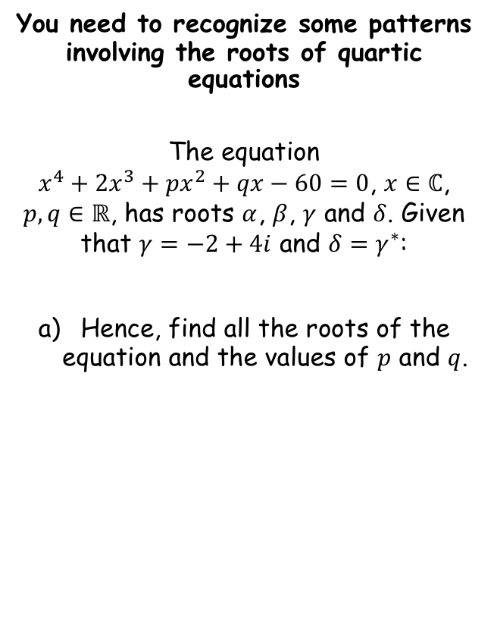

Roots of Polynomials
$$αβ+βγ+γα+γδ+αδ+βδ=\frac{c}{a}$$
$$αβγ+αβδ+αγδ+βγδ=−\frac{d}{a}$$
$$α+β+γ+δ=−\frac{b}{a}$$
$$αβγδ=\frac{e}{a}$$
You need to recognize some patterns involving the roots of quartic equations
The equation
$x^{4}+2x^{3}+px^{2}+qx−60=0$, $x∈ℂ$, $p,q∈ℝ$, has roots $α$, $β$, $γ$ and $δ$. Given that $γ=−2+4i$ and $δ=γ^{∗}$:
Hence, find all the roots of the equation and the values of $p$ and $q$.
Roots are: $−2+4i$, $−2−4i$, $3$ and $−1$
$$αβ+βγ+γα+γδ+αδ+βδ=\frac{c}{a}$$
Sub in values
$$(−2+4i)(−2−4i)+(−2+4i)(3)+(−2+4i)(−1)+(−2−4i)(3)+(−2−4i)(−1)+(3)(−1)=\frac{p}{1}$$
To cut a long story short…
$$9=p$$
4C

Slide 7




Roots of Polynomials
$$αβ+βγ+γα+γδ+αδ+βδ=\frac{c}{a}$$
$$αβγ+αβδ+αγδ+βγδ=−\frac{d}{a}$$
$$α+β+γ+δ=−\frac{b}{a}$$
$$αβγδ=\frac{e}{a}$$
You need to recognize some patterns involving the roots of quartic equations
The equation
$x^{4}+2x^{3}+px^{2}+qx−60=0$, $x∈ℂ$, $p,q∈ℝ$, has roots $α$, $β$, $γ$ and $δ$. Given that $γ=−2+4i$ and $δ=γ^{∗}$:
Hence, find all the roots of the equation and the values of $p$ and $q$.
$$p=9$$
$$q=−52$$
Roots are: $−2+4i$, $−2−4i$, $3$ and $−1$
$$αβγ+αβδ+αγδ+βγδ=−\frac{d}{a}$$
Sub in values
$$\left(−2+4i\right)\left(−2−4i\right)\left(3\right)+\left(−2+4i\right)\left(−2−4i\right)\left(−1\right)+\left(−2+4i\right)\left(−1\right)\left(3\right)+\left(−2−4i\right)\left(−1\right)\left(3\right)=−\frac{q}{1}$$
To cut another long story short…
$$−52=q$$
4C

Slide 8
Exercise 4C
Pearson Further Core Mathematics Year 1/AS
Complete before the lesson Q1-2
In Class:
Green Q3-7
Amber Q7810
Red Q11-13

