Slide 1
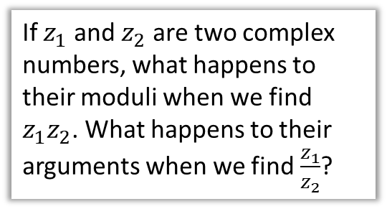
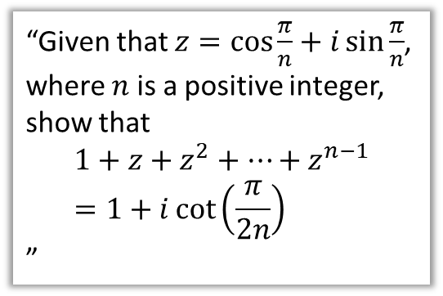
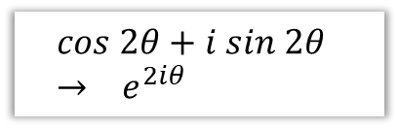

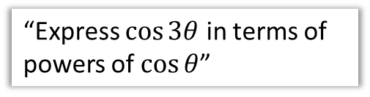
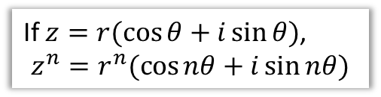
OVERVIEW
1 :: Exponential form of a complex number
2 :: Multiplying and dividing complex numbers
3 :: De Moivre’s Theorem
If $z=r(\cos{θ+i\sin{θ})}$,
$$z^{n}=r^{n}(\cos{nθ}+i\sin{nθ})$$
$$cos 2θ+i sin 2θ \\ → e^{2iθ}$$
If $z_{1}$ and $z_{2}$ are two complex numbers, what happens to their moduli when we find $z_{1}z_{2}$. What happens to their arguments when we find $\frac{z_{1}}{z_{2}}$?
4 :: De Moivre’s for Trigonometric Identities
6 :: Sums of series
“Given that $z=\cos{\frac{π}{n}}+i\sin{\frac{π}{n}}$, where $n$ is a positive integer, show that
$$1+z+z^{2}+…+z^{n−1}=1+i\cot\left(\frac{π}{2n}\right)$$
”
“Express $\cos{3θ}$ in terms of powers of $\cos{θ}$”
Note for teachers: Most of this content is the old FP2, but sums of series is new.
5 :: Roots
“Solve $z^{4}=3+2i$”

Slide 2
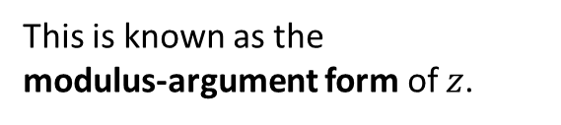
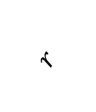




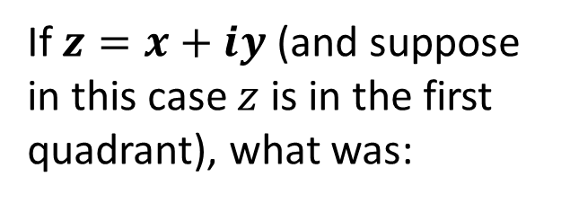
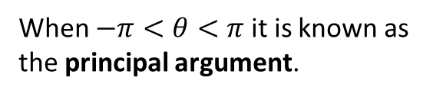
RECAP :: Modulus-Argument Form
Im[z]
$$(x,y)$$
If $z=x+iy$ (and suppose in this case $z$ is in the first quadrant), what was:
$$r$$
$$θ$$
?
$$r=\left|z\right|=\sqrt{x^{2}+y^{2}} \\ θ=arg\left(z\right)=\tan^{−1}\left(\frac{y}{x}\right)$$
Re[z]
?
modulus
?
argument
?
When $−π<θ<π$ it is known as the principal argument.
?
Then in terms of $r$ and $θ$:
$$x=r\cos{θ} \\ y=r\sin{θ} \\ z=x+iy \\ =r cos θ+i rsin θ \\ =r\left(\cos{θ+i\sin{θ}}\right)$$
?
?
This is known as the
modulus-argument form of $z$.
?
?

Slide 3
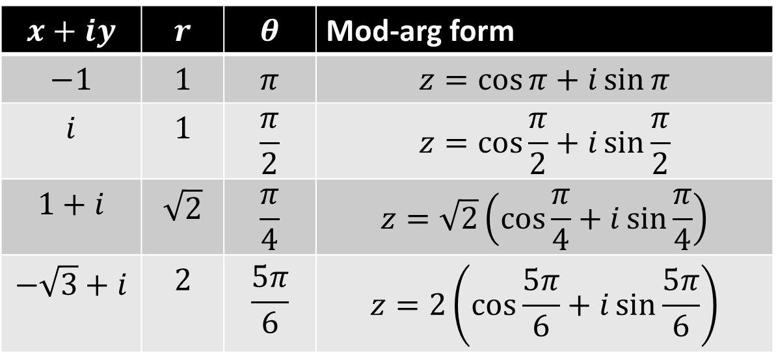
RECAP :: Modulus-Argument Form
$$x+iy$$ | $$r$$ | $$θ$$ | Mod-arg form
$$−1$$ | $$1$$ | $$π$$ | $$z=\cos{π}+i\sin{π}$$
$$i$$ | $$1$$ | $$\frac{π}{2}$$ | $$z=\cos{\frac{π}{2}}+i\sin{\frac{π}{2}}$$
$$1+i$$ | $$\sqrt{2}$$ | $$\frac{π}{4}$$ | $$z=\sqrt{2}\left(\cos{\frac{π}{4}}+i\sin{\frac{π}{4}}\right)$$
$$−\sqrt{3}+i$$ | $$2$$ | $$\frac{5π}{6}$$ | $$z=2\left(\cos{\frac{5π}{6}}+i\sin{\frac{5π}{6}}\right)$$
?
?
?
?
?
?
?
?
?
?
?
?

Slide 4
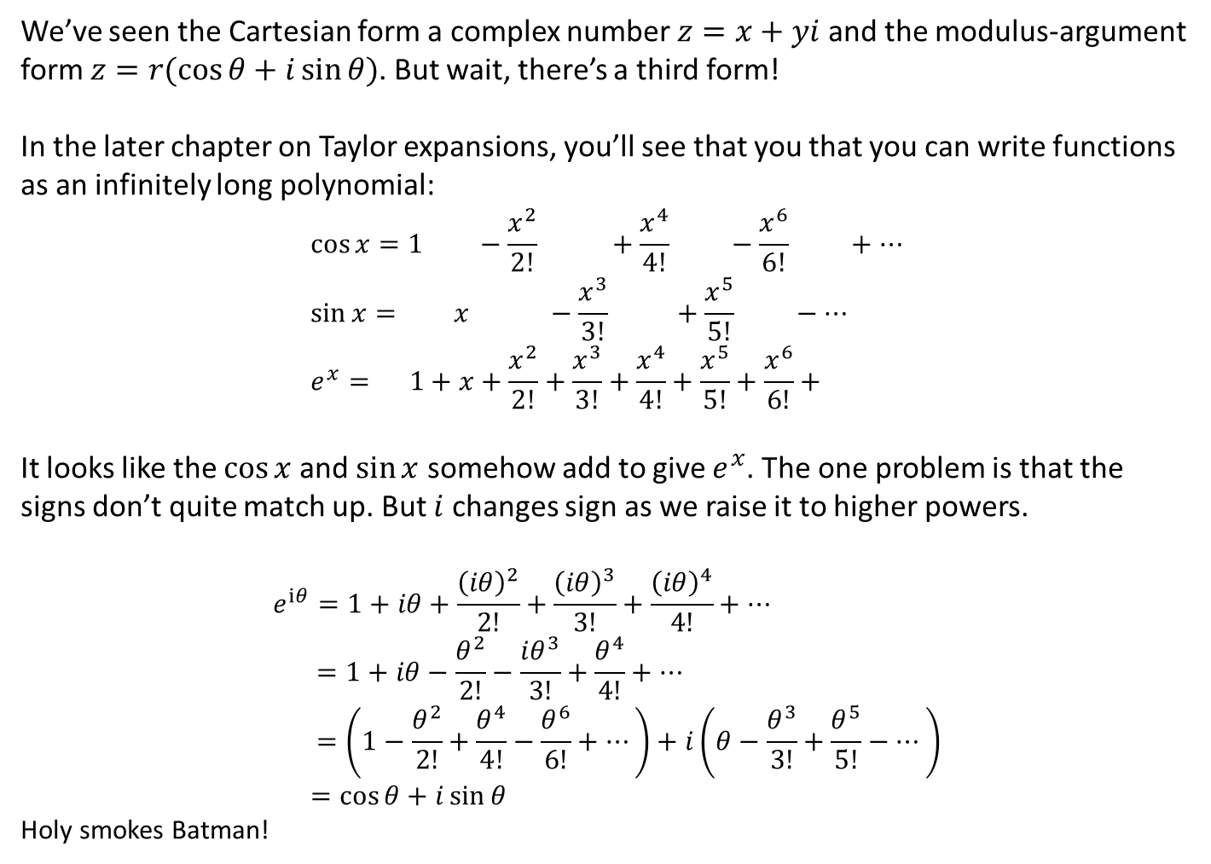
Exponential Form
We’ve seen the Cartesian form a complex number $z=x+yi$ and the modulus-argument form $z=r(\cos{θ+i\sin{θ})}$. But wait, there’s a third form!
In the later chapter on Taylor expansions, you’ll see that you that you can write functions as an infinitely long polynomial:
$$\cos{x}=1 −\frac{x^{2}}{2!} +\frac{x^{4}}{4!} −\frac{x^{6}}{6!} +… \\ \sin{x}= x −\frac{x^{3}}{3!} +\frac{x^{5}}{5!} −… \\ e^{x}= 1+x+\frac{x^{2}}{2!}+\frac{x^{3}}{3!}+\frac{x^{4}}{4!}+\frac{x^{5}}{5!}+\frac{x^{6}}{6!}+$$
It looks like the $\cos{x}$ and $\sin{x}$ somehow add to give $e^{x}$. The one problem is that the signs don’t quite match up. But $i$ changes sign as we raise it to higher powers.
$$e^{iθ}=1+iθ+\frac{{\left(iθ\right)}^{2}}{2!}+\frac{{\left(iθ\right)}^{3}}{3!}+\frac{{\left(iθ\right)}^{4}}{4!}+… \\ =1+iθ−\frac{θ^{2}}{2!}−\frac{iθ^{3}}{3!}+\frac{θ^{4}}{4!}+… \\ =\left(1−\frac{θ^{2}}{2!}+\frac{θ^{4}}{4!}−\frac{θ^{6}}{6!}+…\right)+i\left(θ−\frac{θ^{3}}{3!}+\frac{θ^{5}}{5!}−…\right) \\ =\cos{θ+i\sin{θ}}$$
Holy smokes Batman!
?
?
?
?

Slide 5
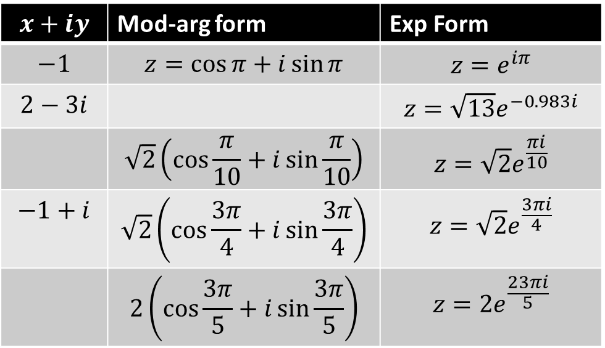

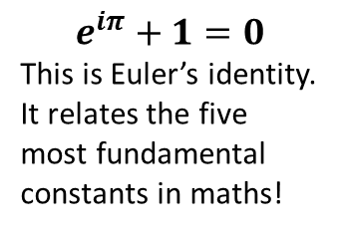
Exponential Form
! Exponential form
$$z=re^{iθ}$$
You need to be able to convert to and from exponential form.
$$x+iy$$ | Mod-arg form | Exp Form
$$−1$$ | $$z=\cos{π}+i\sin{π}$$ | $$z=e^{iπ}$$
$$2−3i$$ |  | $$z=\sqrt{13}e^{−0.983i}$$
 | $$\sqrt{2}\left(\cos{\frac{π}{10}}+i\sin{\frac{π}{10}}\right)$$ | $$z=\sqrt{2}e^{\frac{πi}{10}}$$
$$−1+i$$ | $$\sqrt{2}\left(\cos{\frac{3π}{4}}+i\sin{\frac{3π}{4}}\right)$$ | $$z=\sqrt{2}e^{\frac{3πi}{4}}$$
 | $$2\left(\cos{\frac{3π}{5}}+i\sin{\frac{3π}{5}}\right)$$ | $$z=2e^{\frac{23πi}{5}}$$
?
?
$$e^{iπ}+1=0$$
This is Euler’s identity. It relates the five most fundamental constants in maths!
?
?
To get Cartesian form, put in modulus-argument form first.
?
?
?
Notice this is not a principal argument.

Slide 6
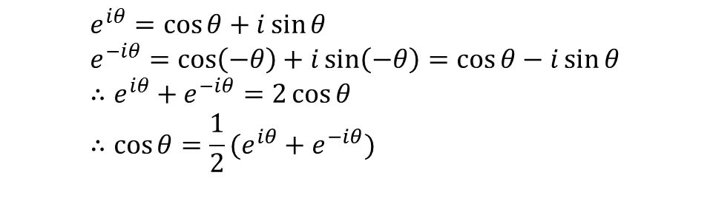
A Final Example
Use $e^{iθ}=\cos{θ}+i\sin{θ}$ to show that $\cos{θ}=\frac{1}{2}(e^{iθ}+e^{−iθ})$
?
$$e^{iθ}=\cos{θ}+i\sin{θ} \\ e^{−iθ}=\cos\left(−θ\right)+i\sin\left(−θ\right)=\cos{θ}−i\sin{θ} \\ ∴e^{iθ}+e^{−iθ}=2\cos{θ} \\ ∴\cos{θ}=\frac{1}{2}(e^{iθ}+e^{−iθ})$$

Slide 7
Exercise 1A
Pearson Core Pure Year 2
Page 5
In Class:
Green Q1-3
Amber Q4

Slide 8
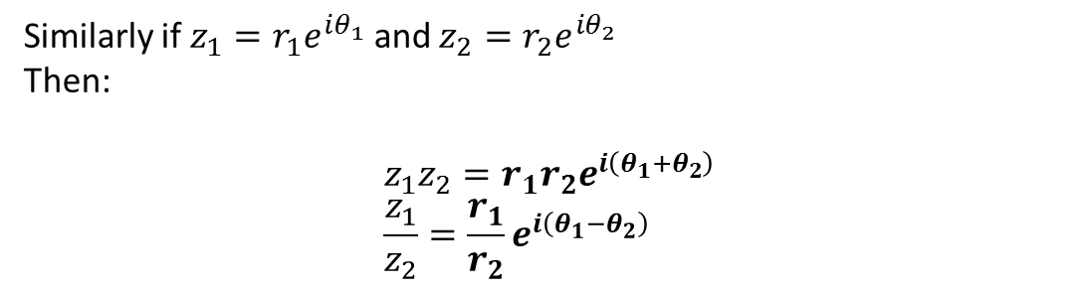
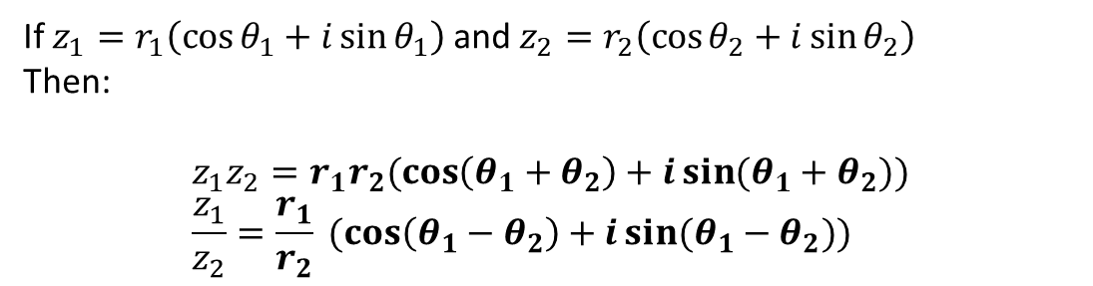
Multiplying and Dividing Complex Numbers
If $z_{1}=r_{1}\left(\cos{θ_{1}}+i\sin{θ_{1}}\right)$ and $z_{2}=r_{2}\left(\cos{θ_{2}}+i\sin{θ_{2}}\right)$
Then:
$$z_{1}z_{2}=r_{1}r_{2}(\cos\left(θ_{1}+θ_{2}\right)+i\sin{(θ_{1}+θ_{2}})) \\ \frac{z_{1}}{z_{2}}=\frac{r_{1}}{r_{2}} (\cos\left(θ_{1}−θ_{2}\right)+i\sin{(θ_{1}−θ_{2}}))$$
?
?
i.e. If you multiply two complex numbers, you multiply the moduli and add the arguments, and if you divide them, you divide the moduli and subtract the arguments.
Similarly if $z_{1}=r_{1}e^{iθ_{1}}$ and $z_{2}=r_{2}e^{iθ_{2}}$
Then:
$$z_{1}z_{2}=r_{1}r_{2}e^{i\left(θ_{1}+θ_{2}\right)} \\ \frac{z_{1}}{z_{2}}=\frac{r_{1}}{r_{2}}e^{i\left(θ_{1}−θ_{2}\right)}$$
?
?

Slide 9
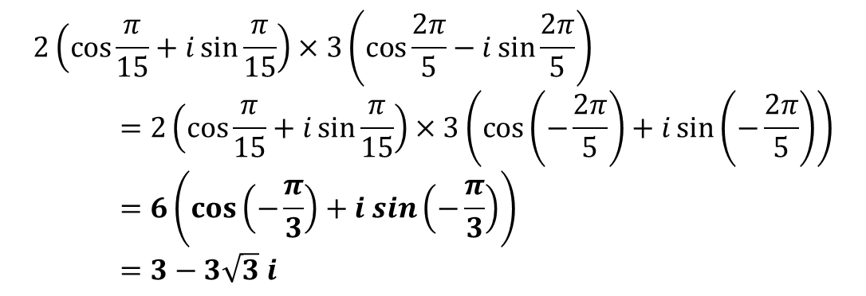
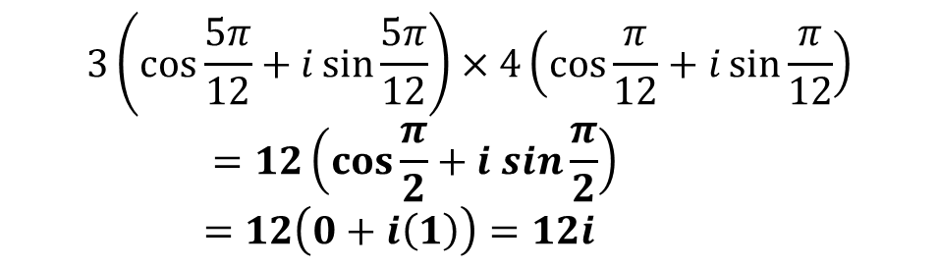


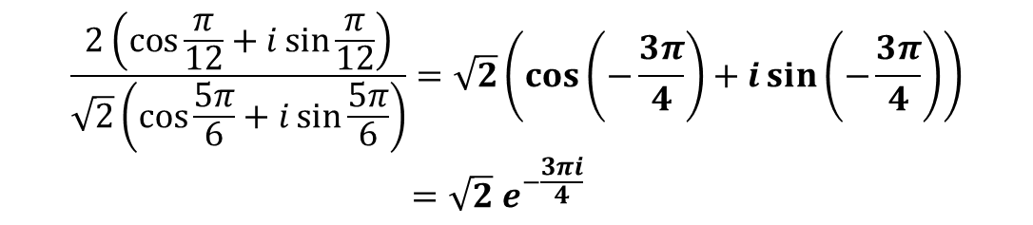
Examples
$$3\left(\cos{\frac{5π}{12}}+i\sin{\frac{5π}{12}}\right)×4\left(\cos{\frac{π}{12}}+i\sin{\frac{π}{12}}\right) \\ =12\left(\cos{\frac{π}{2}}+i sin\frac{π}{2}\right) \\ =12\left(0+i\left(1\right)\right)=12i$$
1
?
$$2\left(\cos{\frac{π}{15}}+i\sin{\frac{π}{15}}\right)×3\left(\cos{\frac{2π}{5}}−i\sin{\frac{2π}{5}}\right) \\ =2\left(\cos{\frac{π}{15}}+i\sin{\frac{π}{15}}\right)×3\left(\cos\left(−\frac{2π}{5}\right)+i\sin\left(−\frac{2π}{5}\right)\right) \\ =6\left(\cos\left(−\frac{π}{3}\right)+i sin\left(−\frac{π}{3}\right)\right) \\ =3−3\sqrt{3} i$$
$\cos{θ}−i\sin{θ}$ can be written as $\cos\left(−θ\right)+i\sin{(−θ})$
2
?
3
Write in the form $re^{iθ}$:
$$\frac{2\left(\cos{\frac{π}{12}}+i\sin{\frac{π}{12}}\right)}{\sqrt{2}\left(\cos{\frac{5π}{6}}+i\sin{\frac{5π}{6}}\right)}=\sqrt{2}\left(\cos\left(−\frac{3π}{4}\right)+i\sin\left(−\frac{3π}{4}\right)\right) \\ =\sqrt{2}{ e}^{−\frac{3πi}{4}}$$
?

Slide 10
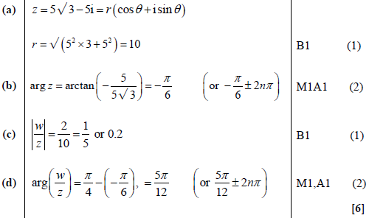
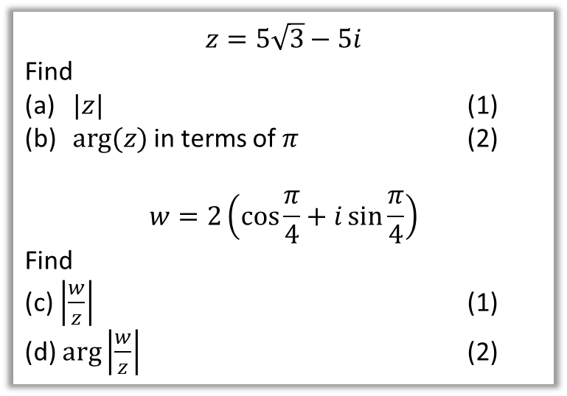
Test Your Understanding
Edexcel FP2(Old) June 2013 Q2
$$z=5\sqrt{3}−5i$$
Find
$|z|$ (1)
$arg⁡(z)$ in terms of $π$ (2)
$$w=2\left(\cos{\frac{π}{4}}+i\sin{\frac{π}{4}}\right)$$
Find
(c) $\left|\frac{w}{z}\right|$ (1)
(d) $\arg\left|\frac{w}{z}\right|$ (2)
?
?
?
?

Slide 11
Exercise 1B
Pearson Core Pure Year 2
Pages 7-8
Complete before the lesson Q1&3
In Class:
Green Q2&4
Amber Q5
Red Q6-9 & Challenge

Slide 12
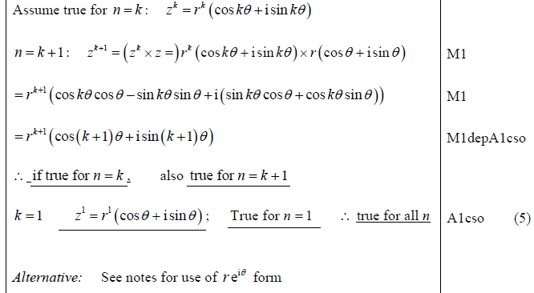
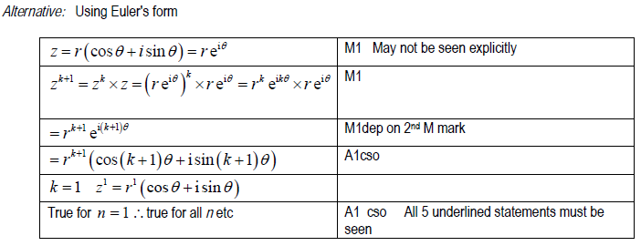
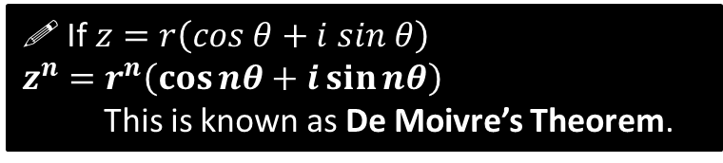
De Moivre’s Theorem
$$z_{1}z_{2}=r_{1}r_{2}(\cos\left(θ_{1}+θ_{2}\right)+i\sin{(θ_{1}+θ_{2}}))$$
We saw that:
Can you think therefore what $z^{n}$ is going to be?
! If $z=r\left(cos θ+i sin θ\right)$
$z^{n}=r^{n}\left(\cos{nθ}+i\sin{nθ}\right)$
This is known as De Moivre’s Theorem.
?
Edexcel FP2(Old) June 2013 Q4
Prove by induction that $z^{n}=r^{n}\left(\cos{nθ}+i\sin{nθ}\right)$
They so went there...
?
Secret Alternative Way
?

Slide 13
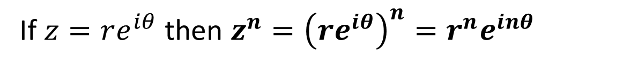
De Moivre’s Theorem for Exponential Form
?
If $z=re^{iθ}$ then $z^{n}={\left(re^{iθ}\right)}^{n}=r^{n}e^{inθ}$

Slide 14

Examples
Simplify $\frac{{\left(\cos{\frac{9π}{17}}+i\sin{\frac{9π}{17}}\right)}^{5}}{{\left(\cos{\frac{2π}{17}} − i\sin{\frac{2π}{17}}\right)}^{3}}$
$$=\frac{{\left(\cos{\frac{9π}{17}}+i\sin{\frac{9π}{17}}\right)}^{5}}{{\left(\cos\left(−\frac{2π}{17}\right)+ i\sin\left(−\frac{2π}{17}\right)\right)}^{3}}=\frac{\cos{\frac{45π}{17}}+i\sin{\frac{45π}{17}}}{\cos\left(−\frac{6π}{17}\right)+ i\sin\left(−\frac{6π}{17}\right)} \\ =\cos{3π}+i\sin{3π} \\ =\cos{π}+i\sin{π}=−1$$
Express ${\left(1+\sqrt{3} i\right)}^{7}$ in the form $x+iy$ where $x,y∈ℝ$.
$$1+\sqrt{3} i=2(\cos{\frac{π}{3}}+i\sin{\frac{π}{3}})$$
Therefore ${\left(1+\sqrt{3} i\right)}^{7}=2^{7}\left(\cos{\frac{7π}{3}}+i\sin{\frac{7π}{3}}\right)$
$$=128\left(\cos{\frac{π}{3}}+i\sin{\frac{π}{3}}\right)=64+64\sqrt{3} i$$
?
?

Slide 15
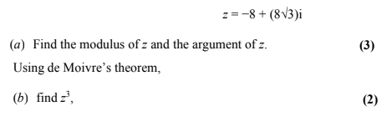
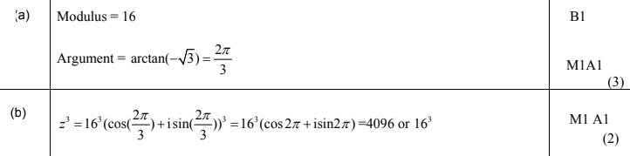
Test Your Understanding
Edexcel FP2(Old) June 2010 Q4
?
?

Slide 16
Exercise 1C
Pearson Core Pure Year 2
Pages 10-11
Complete before the lesson Q1
In Class:
Green Q2-3
Amber Q4
Red Q5-9 & Challenge

Slide 17


Applications of de Moivre #1: Trig identities
Express $\cos{3θ}$ in terms of powers of $\cos{θ}$
Is there someway we could use de Moivre’s theorem to get a $\cos{3θ}$ term?
$${\left(\cos{θ}+i\sin{θ}\right)}^{3}=\cos{3θ}+i\sin{3θ}$$
Could we use the LHS to get another expression?
Use a Binomial expansion!
$${\left(\cos{θ}+i\sin{θ}\right)}^{3}=1\cos^{3}{θ}+3\cos^{2}{θ}\left(i\sin{θ}\right)+3\cos{θ}{\left(i\sin{θ}\right)}^{2}+{\left(i\sin{θ}\right)}^{3} \\ =\cos^{3}{θ}+3i\cos^{2}{θ}\sin{θ}−3\cos{θ}\sin^{2}{θ}−i\sin^{3}{θ}$$
How could we then compare the two expressions?
Equating real parts:
$$\cos{3θ}=\cos^{3}{θ}−3\cos{θ}\sin^{2}{θ} \\ =… \\ =4\cos^{3}{θ}−3\cos{θ}$$
?
?
?

Slide 18
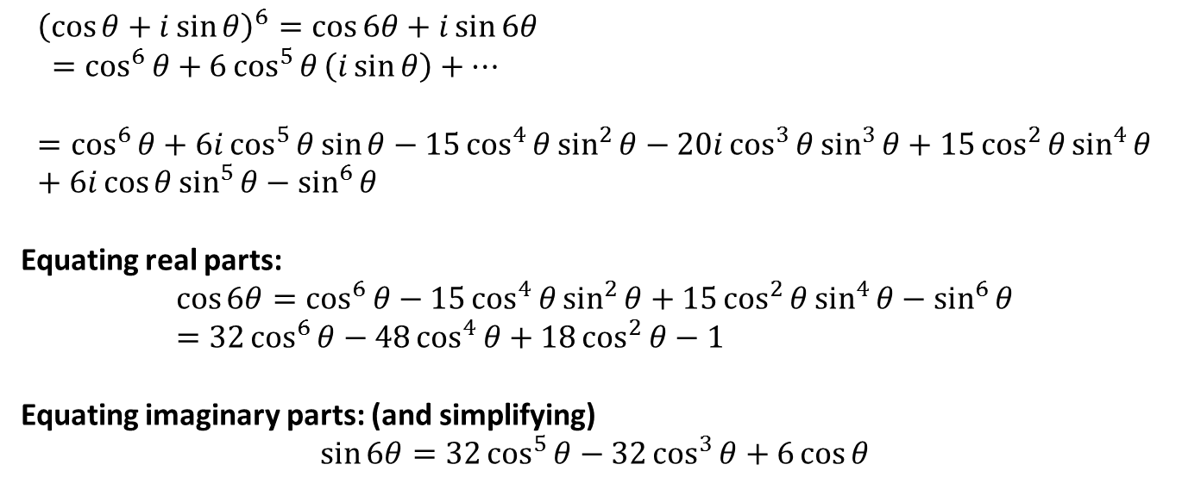
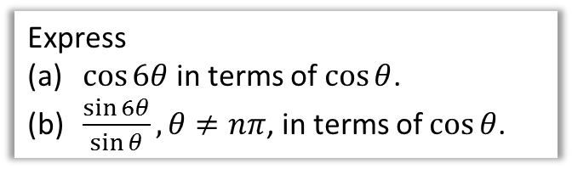
Applications of de Moivre #1: Trig identities
Express
$\cos{6θ}$ in terms of $\cos{θ}$.
$\frac{\sin{6θ}}{\sin{θ}}, θ≠nπ$, in terms of $\cos{θ}$.
$${\left(\cos{θ}+i\sin{θ}\right)}^{6}=\cos{6θ}+i\sin{6θ} \\ =\cos^{6}{θ}+6\cos^{5}{θ}\left(i\sin{θ}\right)+… \\ =\cos^{6}{θ}+6i\cos^{5}{θ}\sin{θ}−15\cos^{4}{θ}\sin^{2}{θ}−20i\cos^{3}{θ}\sin^{3}{θ}+15\cos^{2}{θ}\sin^{4}{θ}+6i\cos{θ\sin^{5}{θ}−\sin^{6}{θ}}$$
Equating real parts:
$$\cos{6θ}=\cos^{6}{θ}−15\cos^{4}{θ}\sin^{2}{θ}+15\cos^{2}{θ}\sin^{4}{θ}−\sin^{6}{θ} \\ =32\cos^{6}{θ}−48\cos^{4}{θ}+18\cos^{2}{θ}−1$$
Equating imaginary parts: (and simplifying)
$$\sin{6θ}=32\cos^{5}{θ}−32\cos^{3}{θ}+6\cos{θ}$$

Slide 19
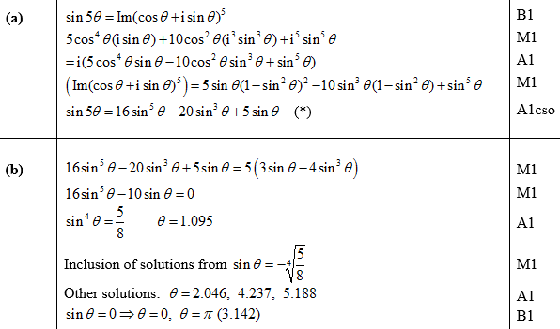
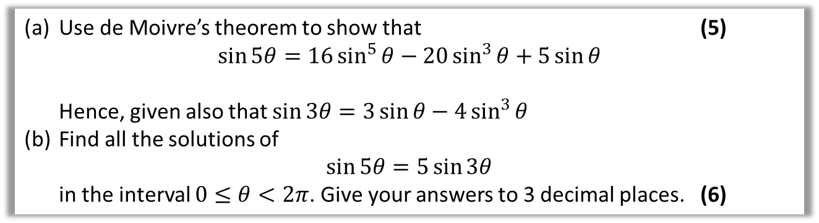
Test Your Understanding
Edexcel FP2(Old) June 2011 Q7
Use de Moivre’s theorem to show that (5)
$\sin{5θ}=16\sin^{5}{θ}−20\sin^{3}{θ}+5\sin{θ}$
Hence, given also that $\sin{3θ}=3\sin{θ}−4\sin^{3}{θ}$
Find all the solutions of
$\sin{5θ}=5\sin{3θ}$
in the interval $0≤θ<2π$. Give your answers to 3 decimal places. (6)
?
?

Slide 20
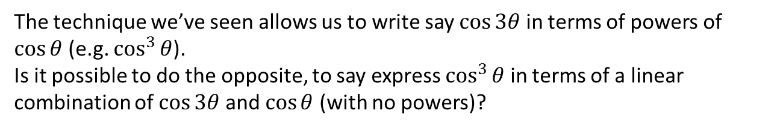
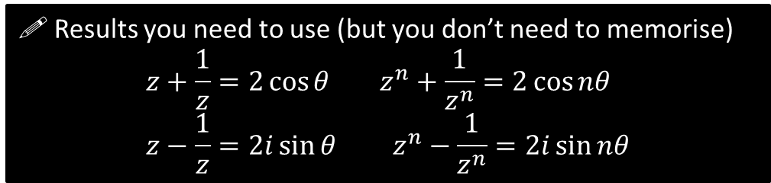

Finding identities for $\sin^{n}{θ}$ and $\cos^{n}{θ}$
The technique we’ve seen allows us to write say $\cos{3θ}$ in terms of powers of $\cos{θ}$ (e.g. $\cos^{3}{θ}$).
Is it possible to do the opposite, to say express $\cos^{3}{θ}$ in terms of a linear combination of $\cos{3θ}$ and $\cos{θ}$ (with no powers)?
If $z=\cos{θ}+i\sin{θ}$, what is $z+\frac{1}{z}$ and $z−\frac{1}{z}$?
$$\frac{1}{z}=z^{−1}={\left(\cos{θ+i\sin{θ}}\right)}^{−1}=\cos\left(−θ\right)+i\sin\left(−θ\right)=\cos{θ}−i\sin{θ}$$
$∴z+\frac{1}{z}=…=2\cos{θ}$ $z−\frac{1}{z}=2i\sin{θ}$
And what is $z^{n}+\frac{1}{z^{n}}$?
Just using de Moivre’s theorem again:
$$z^{n}+\frac{1}{z^{n}}=2\cos{nθ}$$
?
?
! Results you need to use (but you don’t need to memorise)
$$z+\frac{1}{z}=2\cos{θ} z^{n}+\frac{1}{z^{n}}=2\cos{nθ} \\ z−\frac{1}{z}=2i\sin{θ} z^{n}−\frac{1}{z^{n}}=2i\sin{nθ}$$

Slide 21


Finding identities for $\sin^{n}{θ}$ and $\cos^{n}{θ}$
Express $\cos^{5}{θ}$ in the form $a\cos{5θ}+b\cos{3θ}+c\cos{θ}$
Starting point?
$${\left(2\cos{θ}\right)}^{5}={\left(z+\frac{1}{z}\right)}^{5} \\ 32\cos^{5}{θ}=z^{5}+5z^{3}+10z+\frac{10}{z}+\frac{5}{z^{3}}+\frac{1}{z^{5}} \\ 32\cos^{5}{θ}=\left(z^{5}+\frac{1}{z^{5}}\right)+5\left(z^{3}+\frac{1}{z^{3}}\right)+10\left(z+\frac{1}{z}\right) \\ =2\cos{5θ}+5(2\cos{3θ})+10(2\cos{θ})$$
Therefore $\cos^{5}{θ=\frac{1}{16}\cos{5θ}+\frac{5}{16}\cos{3θ}+\frac{5}{8}\cos{θ}}$
?
Notice how the powers descend by 2 each time.
?
Using identities below.
?
?
$$z+\frac{1}{z}=2\cos{θ} z^{n}+\frac{1}{z^{n}}=2\cos{nθ} \\ z−\frac{1}{z}=2i\sin{θ} z^{n}−\frac{1}{z^{n}}=2i\sin{nθ}$$

Slide 22

Finding identities for $\sin^{n}{θ}$ and $\cos^{n}{θ}$
Prove that $\sin^{3}{θ}=−\frac{1}{4}\sin{3θ}+\frac{3}{4}\sin{θ}$
Starting point?
$${{\left(2i\sin{θ}\right)}^{3}=\left(z−\frac{1}{z}\right)}^{3} \\ −8i\sin^{3}{θ}=z^{3}−3z+\frac{3}{z}−\frac{1}{z^{3}} \\ =\left(z^{3}−\frac{1}{z^{3}}\right)−3\left(z−\frac{1}{z}\right) \\ =2i\sin{3θ}−3(2i\sin{θ})$$
Therefore dividing by $−8i$:
$$\sin^{3}{θ=}−\frac{1}{4}\sin{3θ}+\frac{3}{4}\sin{θ}$$
Fro Speed Tip: Remember that terms in such an expansion oscillate between positive and negative.
?
?
?
Again using identities.
?
$$z+\frac{1}{z}=2\cos{θ} z^{n}+\frac{1}{z^{n}}=2\cos{nθ} \\ z−\frac{1}{z}=2i\sin{θ} z^{n}−\frac{1}{z^{n}}=2i\sin{nθ}$$

Slide 23

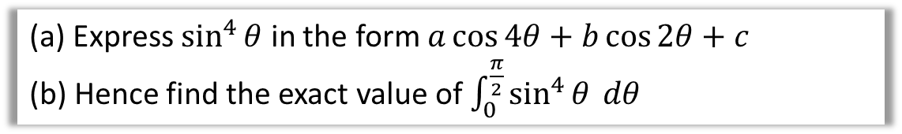
Test Your Understanding
(a) Express $\sin^{4}{θ}$ in the form $a\cos{4θ}+b\cos{2θ}+c$
(b) Hence find the exact value of $\int_{0}^{\frac{π}{2}}{\sin^{4}{θ} dθ}$
$${\left(2i\sin{θ}\right)}^{4}={\left(z−\frac{1}{z}\right)}^{4} \\ 16\sin^{4}{θ}=z^{4}−4z^{2}+6−\frac{4}{z^{2}}+\frac{1}{z^{4}} \\ =\left(z^{4}+\frac{1}{z^{4}}\right)−4\left(z^{2}+\frac{1}{z^{2}}\right)+6 \\ =2\cos{4θ}−4\left(2\cos{2θ}\right)+6 \\ ∴\sin^{4}{θ}=\frac{1}{8}\cos{4θ}−\frac{1}{2}\cos{2θ}+\frac{3}{8}$$
$$\int_{0}^{\frac{π}{2}}{\sin^{4}{θ} dθ}={\left[\frac{1}{32}\sin{4θ}−\frac{1}{4}\sin{2θ}+\frac{3}{8}θ\right]}_{0}^{\frac{π}{2} }=\frac{3π}{16}$$
Starting point?
?
?
?
?
?
$$z+\frac{1}{z}=2\cos{θ} z^{n}+\frac{1}{z^{n}}=2\cos{nθ} \\ z−\frac{1}{z}=2i\sin{θ} z^{n}−\frac{1}{z^{n}}=2i\sin{nθ}$$

Slide 24
Exercise 1D
Pearson Core Pure Year 2
Pages 14-15
Complete before the lesson Q1
In Class:
Amber Q2-5
Red Q6-7

Slide 25
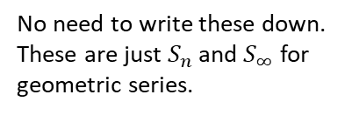
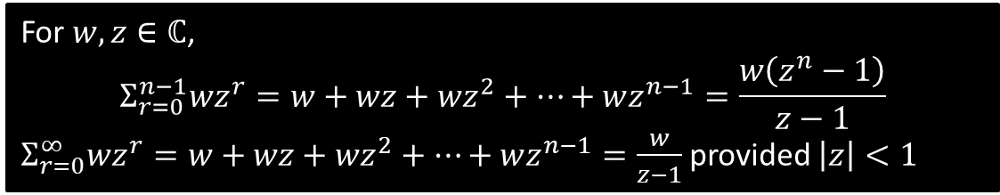
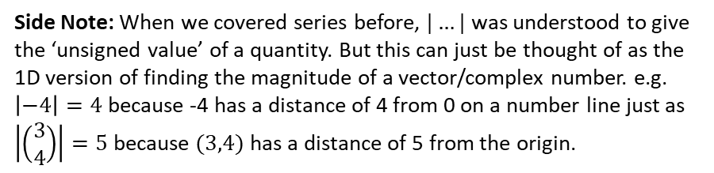
Sums of Series
The formula for the sum of a geometric series also applies to complex numbers:
For $w,z∈ℂ$,
$$Σ_{r=0}^{n−1}wz^{r}=w+wz+wz^{2}+…+wz^{n−1}=\frac{w\left(z^{n}−1\right)}{z−1}$$
$Σ_{r=0}^{∞}wz^{r}=w+wz+wz^{2}+…+wz^{n−1}=\frac{w}{z−1}$ provided $\left|z\right|<1$
No need to write these down. These are just $S_{n}$ and $S_{∞}$ for geometric series.
Side Note: When we covered series before, $|…|$ was understood to give the ‘unsigned value’ of a quantity. But this can just be thought of as the 1D version of finding the magnitude of a vector/complex number. e.g. $\left|−4\right|=4$ because -4 has a distance of 4 from 0 on a number line just as $\left|\left(\begin{matrix}3 \\ 4\end{matrix}\right)\right|=5$ because $(3,4)$ has a distance of 5 from the origin.

Slide 26
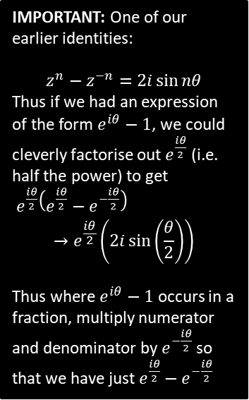


Example
[Textbook] Given that $z=\cos{\frac{π}{n}}+i\sin{\frac{π}{n}}$, where $n$ is a positive integer, show that
$$1+z+z^{2}+…+z^{n−1}=1+i\cot\left(\frac{π}{2n}\right)$$
$$1+z+z^{2}+…+z^{n−1}=\frac{z^{n}−1}{z−1} \\ =\frac{{\left(e^{\frac{πi}{n}}\right)}^{n}−1}{e^{\frac{πi}{n}}−1}=\frac{e^{πi}−1}{e^{\frac{πi}{n}}−1} \\ =\frac{−2}{e^{\frac{πi}{n}}−1}=−\frac{−2e^{−\frac{πi}{2n}}}{\left(e^{\frac{πi}{2n}}−e^{−\frac{πi}{2n}}\right)}=−\frac{−2e^{−\frac{πi}{2n}}}{2i\sin{\frac{π}{2n}}} \\ =\frac{−2ie^{−\frac{πi}{2n}}}{2i^{2}\sin{\frac{π}{2n}}}=\frac{ie^{−\frac{πi}{2n}}}{\sin{\frac{π}{2n}}}=\frac{i\left(\cos\left(−\frac{π}{2n}\right)+i\sin\left(−\frac{π}{2n}\right)\right)}{\sin{\frac{π}{2n}}} \\ =\frac{i\left(\cos\left(\frac{π}{2n}\right)−i\sin\left(\frac{π}{2n}\right)\right)}{\sin{\frac{π}{2n}}}=\frac{\sin\left(\frac{π}{2n}\right)+i\cos\left(2\frac{π}{n}\right)}{\sin{\frac{π}{2n}}} \\ =1+i\cot\left(\frac{π}{2n}\right)$$
IMPORTANT: One of our earlier identities:
$$z^{n}−z^{−n}=2i\sin{nθ}$$
Thus if we had an expression of the form $e^{iθ}−1$, we could cleverly factorise out $e^{\frac{iθ}{2}}$ (i.e. half the power) to get
$e^{\frac{iθ}{2}}\left(e^{\frac{iθ}{2}}−e^{−\frac{iθ}{2}}\right)$
$$→e^{\frac{iθ}{2}}\left(2i\sin\left(\frac{θ}{2}\right)\right)$$
Thus where $e^{iθ}−1$ occurs in a fraction, multiply numerator and denominator by $e^{−\frac{iθ}{2}}$ so that we have just $e^{\frac{iθ}{2}}−e^{−\frac{iθ}{2}}$
?

Slide 27
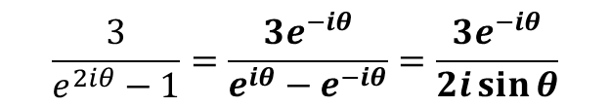
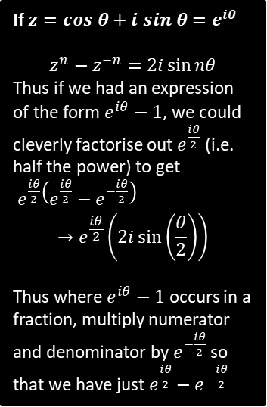

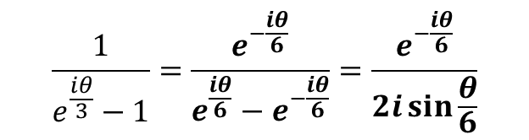

Let’s practise that hard bit…
If $z=cos θ+i sin θ=e^{iθ}$
$$z^{n}−z^{−n}=2i\sin{nθ}$$
Thus if we had an expression of the form $e^{iθ}−1$, we could cleverly factorise out $e^{\frac{iθ}{2}}$ (i.e. half the power) to get
$e^{\frac{iθ}{2}}\left(e^{\frac{iθ}{2}}−e^{−\frac{iθ}{2}}\right)$
$$→e^{\frac{iθ}{2}}\left(2i\sin\left(\frac{θ}{2}\right)\right)$$
Thus where $e^{iθ}−1$ occurs in a fraction, multiply numerator and denominator by $e^{−\frac{iθ}{2}}$ so that we have just $e^{\frac{iθ}{2}}−e^{−\frac{iθ}{2}}$
?
$$\frac{3}{e^{2iθ}−1}=\frac{3e^{−iθ}}{e^{iθ}−e^{−iθ}}=\frac{3e^{−iθ}}{2i\sin{θ}}$$
The $n$ is 2 because if
$z=e^{iθ}$ then $z^{2}=e^{2iθ}$
?
$$\frac{4e^{iθ}}{e^{4iθ}−1}=\frac{4e^{−iθ}}{e^{2iθ}−e^{−2iθ}}=\frac{4e^{−iθ}}{2i\sin{2θ}}$$
?
$$\frac{1}{e^{\frac{iθ}{3}}−1}=\frac{e^{−\frac{iθ}{6}}}{e^{\frac{iθ}{6}}−e^{−\frac{iθ}{6}}}=\frac{e^{−\frac{iθ}{6}}}{2i\sin{\frac{θ}{6}}}$$

Slide 28

Using mod-arg form to split summation
$e^{iθ}+e^{2iθ}+e^{3iθ}+…+e^{niθ}$ is a geometric series,
$$∴e^{iθ}+e^{2iθ}+e^{3iθ}+…+e^{niθ}=\frac{e^{iθ}\left(e^{niθ}−1\right)}{e^{iθ}−1}$$
Converting each exponential term to modulus-argument form would allow us to consider the real and imaginary parts of the series separately:
$$e^{iθ}+e^{2iθ}+e^{3iθ}+…+e^{niθ} \\ =\left(\cos{θ+i\sin{θ}}\right)+\left(\cos{2θ+i\sin{2θ}}\right)+… \\ =\left(\cos{θ}+\cos{2θ}+…\right)+i\left(\sin{θ}+\sin{2θ}+…\right)$$
Thus $\cos{θ}+\cos{2θ}+…$ is the real part of $\frac{e^{iθ}\left(e^{niθ}−1\right)}{e^{iθ}−1}$ and $\sin{θ}+\sin{2θ}+…$ the imaginary part.

Slide 29




Example
[Textbook] $S=e^{iθ}+e^{2iθ}+e^{3iθ}+…+e^{8iθ}$, for $θ≠2nπ$, where $n$ is an integer.
Show that $S=\frac{e^{\frac{9iθ}{2}}\sin{4θ}}{\sin{\frac{θ}{2}}}$
Let $P=\cos{θ}+\cos{2θ}+\cos{3θ}+…+\cos{8θ}$ and $Q=\sin{θ}+\sin{2θ}+…+\sin{8θ}$
(b) Use your answer to part a to show that $P=\cos{\frac{9θ}{2}}\sin{4θ} cosec\frac{θ}{2}$ and find similar expressions for $Q$ and $\frac{Q}{P}$
$$e^{iθ}+e^{2iθ}+e^{3iθ}+…+e^{8iθ}=\frac{e^{iθ}\left({\left(e^{iθ}\right)}^{8}−1\right)}{e^{iθ}−1} \\ =\frac{e^{iθ}\left({\left(e^{iθ}\right)}^{8}−1\right)}{e^{iθ}−1}=\frac{e^{iθ}\left(e^{8iθ}−1\right)}{e^{iθ}−1} \\ =\frac{e^{\frac{iθ}{2}}\left(e^{8iθ}−1\right)}{e^{\frac{iθ}{2}}−e^{−\frac{iθ}{2}}} \\ =\frac{e^{\frac{iθ}{2}}\left(e^{8iθ}−1\right)}{2i\sin{\frac{θ}{2}}}=\frac{ie^{\frac{iθ}{2}}\left(e^{8iθ}−1\right)}{2i^{2}\sin{\frac{θ}{2}}}=\frac{e^{\frac{9iθ}{2}}\sin{4θ}}{\sin{\frac{θ}{2}}}$$
a
?
We can again use the trick of multiplying $e^{iθ}−1$ by $e^{−\frac{iθ}{2}}$
$$z^{n}−z^{−n}=2i\sin{nθ}$$

Slide 30

Example
[Textbook] $S=e^{iθ}+e^{2iθ}+e^{3iθ}+…+e^{8iθ}$, for $θ≠2nπ$, where $n$ is an integer.
Show that $S=\frac{e^{\frac{9iθ}{2}}\sin{4θ}}{\sin{\frac{θ}{2}}}$
Let $P=\cos{θ}+\cos{2θ}+\cos{3θ}+…+\cos{8θ}$ and $Q=\sin{θ}+\sin{2θ}+…+\sin{8θ}$
(b) Use your answer to part a to show that $P=\cos{\frac{9θ}{2}}\sin{4θ} cosec\frac{θ}{2}$ and find similar expressions for $Q$ and $\frac{Q}{P}$
b
First note that $S=\frac{e^{\frac{9iθ}{2}}\sin{4θ}}{\sin{\frac{θ}{2}}}=e^{\frac{9iθ}{2}}\sin{4θ}cosec\frac{θ}{2}$
But also, by expressing each term within $S=e^{iθ}+e^{2θ}…$ in modulus-argument form, we have $S=P+iQ$
$$∴P=Re\left(S\right)=Re\left(e^{\frac{9iθ}{2}}\sin{4θ}cosec\frac{θ}{2}\right) \\ =\cos{\frac{9θ}{2}}\sin{4θ} cosec\frac{θ}{2}$$
Similarly:
$$Q=Im\left(S\right)=\sin{\frac{9θ}{2}}\sin{4θ} cosec\frac{θ}{2}$$
$$\frac{Q}{P}=\frac{\sin{\frac{9θ}{2}}\sin{4θ}cosec\frac{θ}{2}}{\cos{\frac{9θ}{2}}\sin{4θ} cosec\frac{θ}{2}}=\tan{\frac{9θ}{2}}$$
?

Slide 31
Exercise 1E
Pearson Core Pure Year 2
Pages 18-19
Complete before the lesson Q1
In Class:
Green Q2-3
Amber Q4-5
Red Q6-7

Slide 32











Applications of de Moivre #2: Roots
$$z^{n}=r^{n}\left(\cos{nθ}+i\sin{nθ}\right)$$
We have so far used de Moivre’s theorem when $n$ was an integer.
It also works however when $n$ is a rational number! (proof not required)
Solve $z^{3}=1$
Plot these roots on an Argand diagram.
?
The modulus-argument form of $1$ is $1(\cos{0}+i\sin{0})$ thus:
$$z^{3}=1\left(\cos{0}+i\sin{0}\right) \\ =1(\cos\left(0+2kπ\right)+i\sin\left(0+2kπ\right) \\ z ={\left(\cos{2kπ}+i\sin{2kπ}\right)}^{\frac{1}{3}} \\ =\cos{\frac{2kπ}{3}}+i\sin{\frac{2kπ}{3}}$$
$k=0$, $z_{1}=\cos{0}+i\sin{0}=1$
$k=1$, $z_{2}=\cos{\frac{2π}{3}}+i\sin{\frac{2π}{3}}=−\frac{1}{2}+i\frac{\sqrt{3}}{2}$
$k=2$, $z_{3}=\cos{\frac{4π}{3}}+i\sin{\frac{4π}{3}}=−\frac{1}{2}−i\frac{\sqrt{3}}{2}$
These are known as the ‘cube roots of unity’ (more on this in a bit).
In Pure Year 1 I mentioned in a side note that by the Fundamental Law of Arithmetic, a polynomial of order $n$ has $n$ solutions (some potentially repeated and some potentially not real). So this equation has 3 solutions.
?
$$z_{2}$$
$$\frac{2π}{3}$$
$$\frac{2π}{3}$$
$$z_{1}$$
$$\frac{2π}{3}$$
$$z_{3}$$
1 is always a root – the rest are spread out equally distributed. We’ll see why we get this pattern on the next slide.

Slide 33












More on Roots of Unity
The solutions to $z^{n}=1$ are known as the “roots of unity” (1 is a “unit”). Why are they nicely spread out?
1 is clearly a root as $1^{n}=1$.
$$z_{2}$$
In the method on the previous slide, we ended up adding $\frac{2kπ}{n}$ to the argument, but left the modulus untouched. If $n=3$ then this rotates the line $\frac{2π}{3}=120°$ each time. When $k=n$ then we would have rotated
$\frac{2nπ}{n}=2π$ so end up where we started.
$$z^{3}=1$$
$$\frac{2π}{3}$$
$$\frac{2π}{3}$$
$$z_{1}$$
$$\frac{2π}{3}$$
Then by De Moivre’s, then $ω^{2}$ would be:
$$ω^{2}={\left(\cos{\frac{2π}{3}}+i\sin{\frac{2π}{3}}\right)}^{2} \\ =\cos{\frac{4π}{3}}+i\sin{\frac{4π}{3}}$$
i.e. the next root! Therefore, the roots can be represented as $1, ω, ω^{2}$. Since the resultant ‘vector’ is 0, then $1+ω+ω^{2}=0$.
Formal Proof: Geometric series where $a=1$ and $r=ω$ and $n=n$.
$$S_{n}=\frac{a\left(r^{n}−1\right)}{r−1}=\frac{ω^{n}−1}{ω−1}=\frac{1−1}{ω−1}=0$$
$$z_{3}$$
Suppose this root is $ω$ (Greek letter “omega”)…
$$ω=\cos{\frac{2π}{3}}+i\sin{\frac{2π}{3}}$$
! If $z^{n}=1$ and $ω=e^{\frac{2πi}{n}}$ then $1,ω,ω^{2},…,ω^{n−1}$ are the roots and $1+ω+ω^{2}+…+ω^{n−1}=0$

Slide 34



Example
[Textbook] Solve $z^{4}=2+2\sqrt{3} i$
?
$$z^{4}=4\left(\cos{\frac{π}{3}}+i\sin{\frac{π}{3}}\right) \\ =4\left(\cos\left(\frac{π}{3}+2kπ\right)+i\sin{(\frac{π}{3}+2kπ})\right) \\ z =\sqrt{2} \left(\cos\left(\frac{π}{12}+\frac{2kπ}{4}\right)+i\sin\left(\frac{π}{12}+\frac{2kπ}{4}\right)\right)$$
$k=0$, $z=\sqrt{2}\left(\cos{\frac{π}{12}}+i\sin{\frac{π}{12}}\right)$
$k=1$, $z=\sqrt{2}\left(\cos{\frac{7π}{12}}+i\sin{\frac{7π}{12}}\right)$
$k=2$, $z=\sqrt{2}\left(\cos{\frac{13π}{12}}+i\sin{\frac{13π}{12}}\right)$
$$=\sqrt{2}\left(\cos\left(−\frac{11π}{12}\right)+i\sin\left(−\frac{11π}{12}\right)\right)$$
$k=3$, $z=…$
We need principal roots. Alternative is to use $k=0, 1, −1, −2$ instead of 0, 1, 2, 3, which will give your principal roots directly.

Slide 35



Test Your Understanding
Edexcel FP2(Old) June 2012 Q3
Express the complex number $−2+\left(2\sqrt{3}\right)i$ in the form $r\left(\cos{θ+i\sin{θ}}\right)$, $−π<θ≤π$. (3)
Solve the equation
$z^{4}=−2+\left(2\sqrt{3}\right)i$
giving the roots in the form $r\left(\cos{θ}+i\sin{θ}\right)$, $−π<θ≤π$. (5)
?
?
You can avoid the previous large amount of working by just dividing your angle by the power (4), and adding/subtracting increments of $2π$ again divided by the power.

Slide 36
Exercise 1F
Pearson Core Pure Year 2
Pages 24-25
Complete before the lesson Q1
In Class:
Green Q2-3
Amber Q4-5
Red Q6-9 & Challenge

Slide 37





Solving Geometric Problems
We already saw in the previous exercise that the roots of an equation such as that on the left give evenly spaced points in the Argand diagram, because the modulus remained the same but we kept adding $\frac{2π}{n}$ to the argument.
These points formed a regular hexagon, and in general for $z^{n}=s$, form a regular $n$-agon.
Recall that $ω$ is the first root of unity: $\cos\left(\frac{2π}{n}\right)+i\sin\left(\frac{2π}{n}\right)$.
This has modulus 1 and argument $\frac{2π}{n}$.
$$z^{6}=7+24i$$
Suppose $z_{1}$ was the first root of $z^{6}=7+24i$. Then consider the product $z_{1}ω$. What happens?
Multiplying these multiplies the moduli. But $\left|ω\right|=1$ therefore the modulus of $z_{1}$ is unaffected. But we also add the arguments. $\arg\left(ω\right)=\frac{2π}{n}$ so multiplying by $ω$ rotates $z_{1}$ by this. We can see therefore that it gives us the next root, i.e. $z_{2}=z_{1}ω$.
! If $z_{1}$ is one root of the equation $z_{n}=s$, and $1,ω,ω^{2},…,ω^{n−1}$ are the $n$th roots of unity, then the roots of $z^{n}=s$ are given by $z_{1},z_{1}ω,z_{1}ω^{2},…,z_{1}ω^{n−1}$.
?

Slide 38







Example
[Textbook] The point $P\left(\sqrt{3},1\right)$ lies at one vertex of an equilateral triangle. The centre of the triangle is at the origin.
Find the coordinates of the other vertices of the triangle.
Find the area of the triangle.
a
Convert $\sqrt{3}+i$ to either exponential of modulus-argument form. We can then rotate the point $120°$ around origin (and again) by multiplying by $ω$.
$\sqrt{3}+i=2e^{\frac{π}{6}i}$ and $ω=e^{\frac{2π}{3}i}$
Next vertex:
$2e^{\frac{π}{6}i}×e^{\frac{2π}{3}i}=2e^{\frac{5π}{6}i}=−\sqrt{3}+i → \left(−\sqrt{3},1\right)$
Next vertex:
$2e^{\frac{5π}{6}i}×e^{\frac{2π}{3}i}=2e^{\frac{3π}{2}i}=2e^{−\frac{π}{2}i}=−2i → (0,−2)$
Area $=\frac{1}{2}×base×height$
$=\frac{1}{2}×2\sqrt{3}×3$
$=3\sqrt{3}$
?
? Diagram
$$y$$
$$(−\sqrt{3},1)$$
$$(\sqrt{3},1)$$
$$x$$
b
?
$$(0,−2)$$

Slide 39
Exercise 1G
Pearson Core Pure Year 2
Pages 26-27
Complete before the lesson Q1
In Class:
Amber Q2
Red Q3-6

