Slide 1
Year 2 Pure Mathematics
Differentiation
- Chain Rule
Chapter 9
(Part 3 of 10)

Slide 2
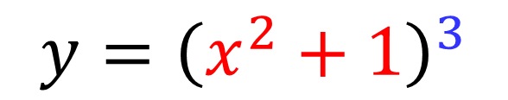
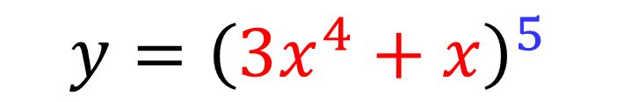
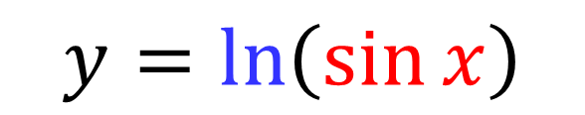
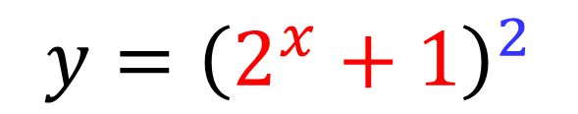
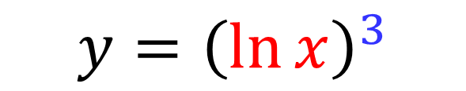
The Chain Rule
The chain rule allows you to differentiate
a function within a function.
$$y={\left(3x^{4}+x\right)}^{5}$$
$$y={\left(2^{x}+1\right)}^{2}$$
$$y={\left(x^{2}+1\right)}^{3}$$
$$y=\ln\left(\sin{x}\right)$$
$$y={\left(\ln{x}\right)}^{3}$$

Slide 3
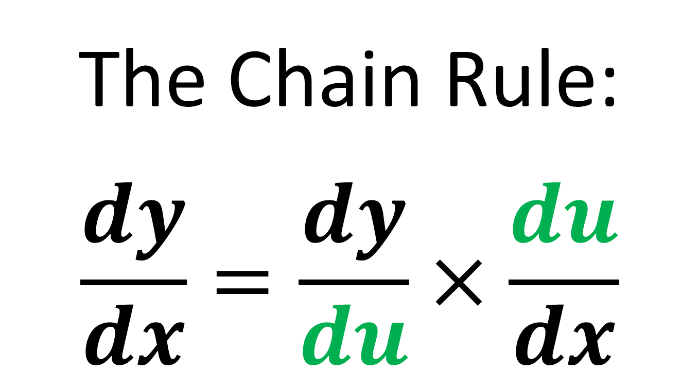
The Chain Rule
The Chain Rule:
$$\frac{dy}{dx}=\frac{dy}{du}×\frac{du}{dx}$$

Slide 4
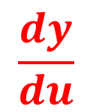
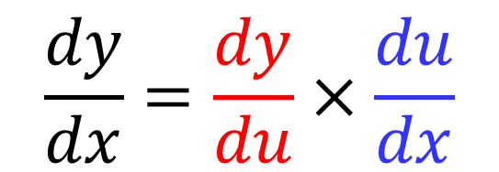
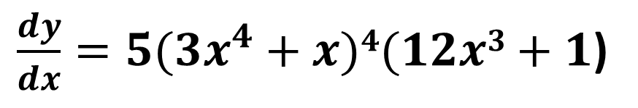
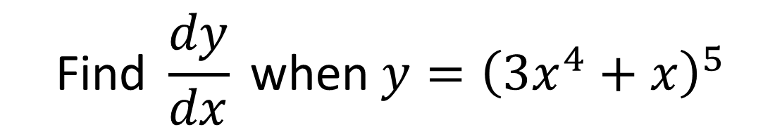
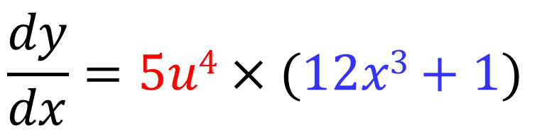
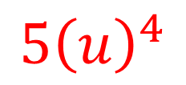
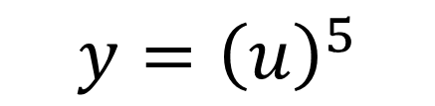
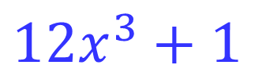
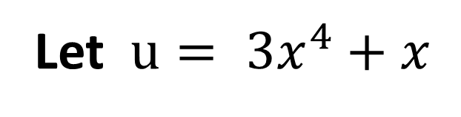
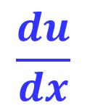
The Chain Rule – Formal Method
$$\text{Find} \frac{dy}{dx} \text{when} y={\left(3x^{4}+x\right)}^{5}$$
Let $u= 3x^{4}+x$
$$\frac{dy}{dx}=\frac{dy}{du}×\frac{du}{dx}$$
$$y={\left(u\right)}^{5}$$
$$\frac{dy}{dx}=5u4×(12x3+1)$$
$$\frac{dy}{du}$$
=
$${5\left(u\right)}^{4}$$
$\frac{dy}{dx}=5(3x^{4}+x)4(12x3+1$)
$$\frac{du}{dx}$$
=
$12x^{3}+1$

Slide 5
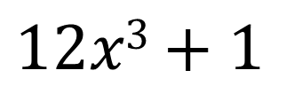
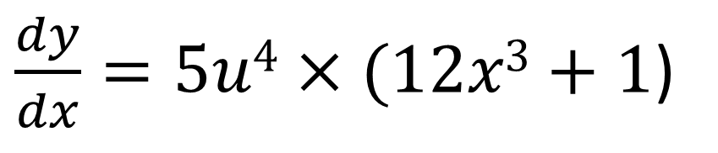
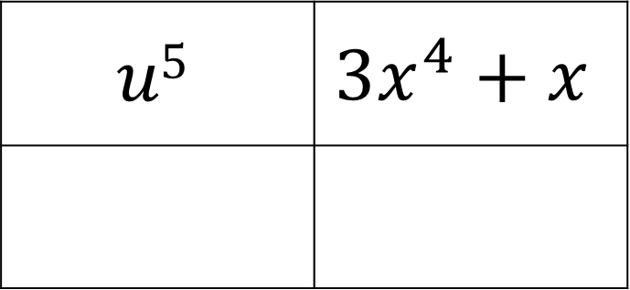

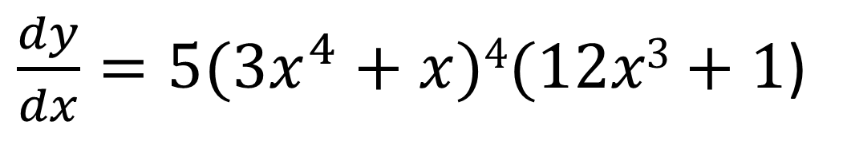

The Chain Rule – Informal Method
$$\text{Find} \frac{dy}{dx} \text{when} y={\left(3x^{4}+x\right)}^{5}$$
$$u5$$ | $$3x^{4}+x$$
$$5u4$$ | $$12x3+1$$
$$5u4$$
$$12x3+1$$
multiply the bottom row
$\frac{dy}{dx}=5u4×(12x3+1$)
substitute
$u$
$\frac{dy}{dx}=5(3x^{4}+x)4(12x3+1$)

Slide 6
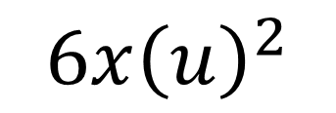
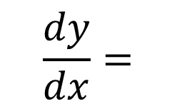
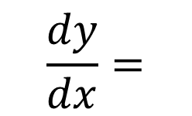
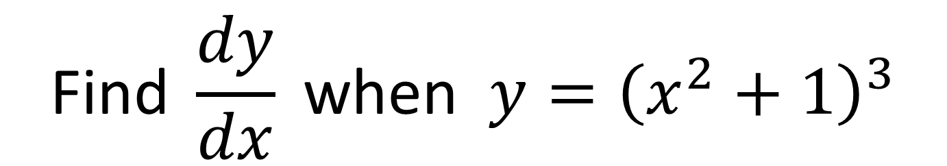


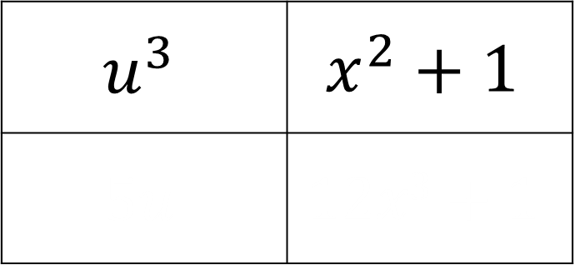
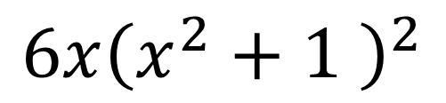
The Chain Rule - Practice
$$\text{Find} \frac{dy}{dx} \text{when} y={\left(x^{2}+1\right)}^{3}$$
$$u^{3}$$ | $$x^{2}+1$$
$$5u$$ | $$12x3+1$$
$$3u^{2}$$
$$2x$$
$$\frac{dy}{dx}=$$
$$6x{\left(u\right)}^{2}$$
$$\frac{dy}{dx}=$$
$$6x{\left(x^{2}+1 \right)}^{2}$$

Slide 7
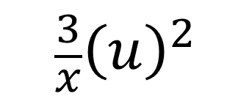
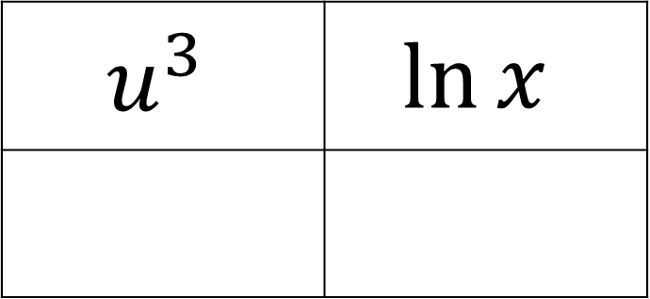
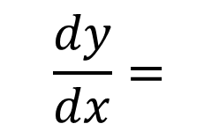
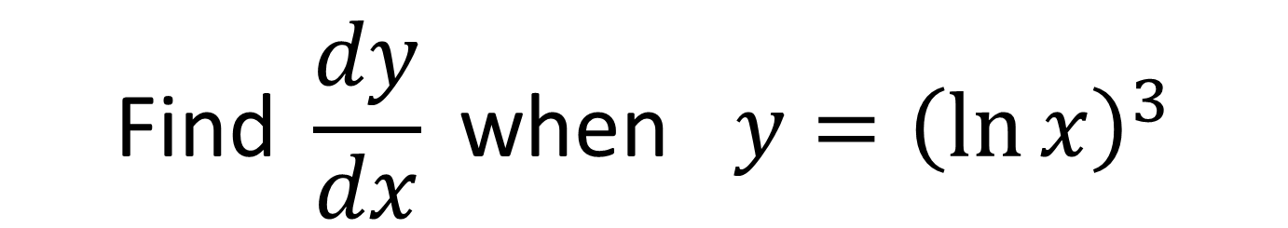
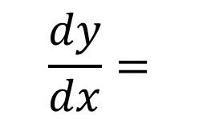


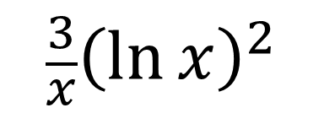
The Chain Rule - Practice
$$\text{Find} \frac{dy}{dx} \text{when} y={\left(\ln{x}\right)}^{3}$$
$$u^{3}$$ | $$\ln{x}$$
$$5u$$ | $$12x3+1$$
$$3u^{2}$$
$$\frac{1}{x}$$
$$\frac{dy}{dx}=$$
$$\frac{3}{x}{\left(u\right)}^{2}$$
$$\frac{dy}{dx}=$$
$$\frac{3}{x}{\left(\ln{x}\right)}^{2}$$

Slide 8
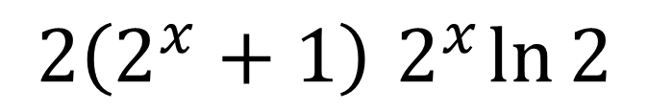

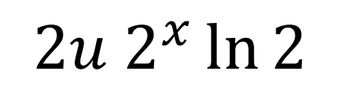
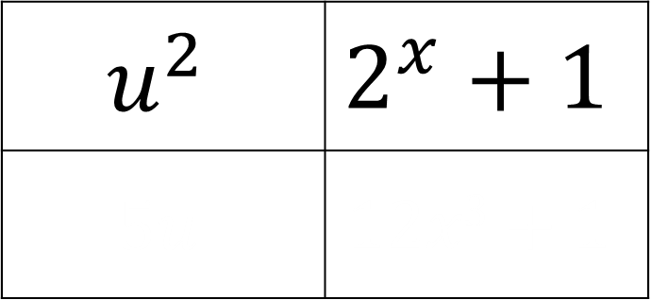

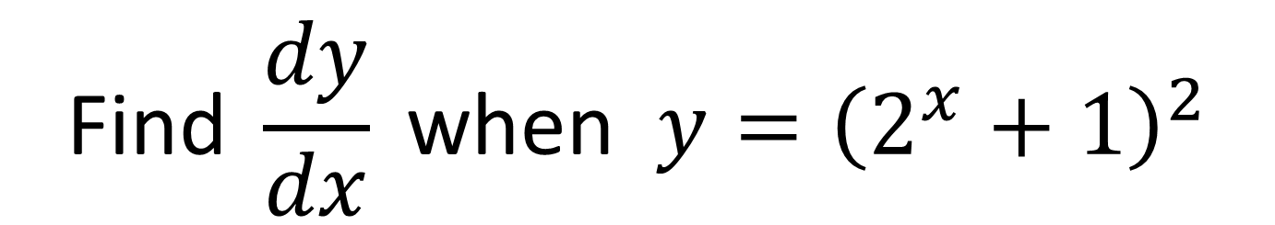
The Chain Rule - Practice
$$\text{Find} \frac{dy}{dx} \text{when} y={\left(2^{x}+1\right)}^{2}$$
$$u^{2}$$ | $$2^{x}+1$$
$$5u$$ | $$12x3+1$$
$$2u$$
$$2^{x}\ln{2}$$
$$\frac{dy}{dx}=$$
$$2u 2^{x}\ln{2}$$
$$\frac{dy}{dx}=$$
$$2\left(2^{x}+1\right){ 2}^{x}\ln{2}$$

Slide 9
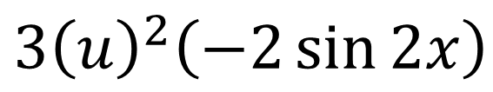
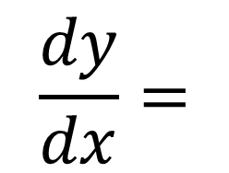
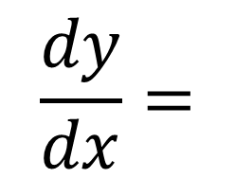

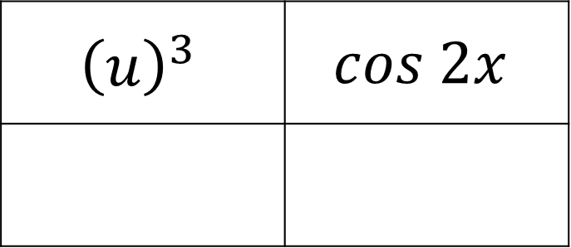
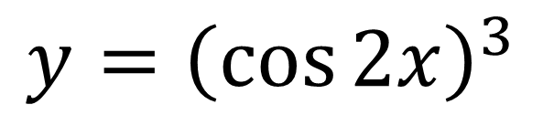
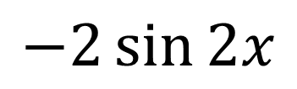
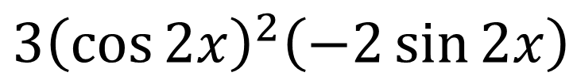

Chain Rule
$$\text{Find} \frac{dy}{dx} \text{when} y=\cos^{3}{2x}$$
$$y={\left(\cos{2x}\right)}^{3}$$
$${\left(u\right)}^{3}$$ | $$cos 2x$$
$${3\left(u\right)}^{2}$$ | $$−2\sin{2x}$$
$${3u}^{2}$$
$$−2\sin{2x}$$
$$\frac{dy}{dx}=$$
$$3{\left(u\right)}^{2}\left(−2\sin{2x}\right)$$
$$\frac{dy}{dx}=$$
$$3{\left(\cos{2x}\right)}^{2}\left(−2\sin{2x}\right)$$

Slide 10






The Chain Rule
$$ln(u)$$ | $$x^{2}+3x+5$$
$${3\left(u\right)}^{2}$$ | $$−2\sin{2x}$$
$$\frac{1}{u}$$
$$2x+3$$
$$\frac{dy}{dx}=\frac{1}{u}×\left(2x+3\right)$$
$$\frac{dy}{dx}=\frac{2x+3}{x^{2}+3x+5}$$

Slide 11







The Chain Rule
Given that $y=\sqrt{5x^{2}+1}$, find $\frac{dy}{dx}$ at $\left(4,9\right)$
$${\left(u\right)}^{1/2}$$ | $$5x^{2}+1$$
$${\frac{1}{2}\left(u\right)}^{−1/2}$$
$$\frac{dy}{dx}=5x{\left(5x^{2}+1\right)}^{−\frac{1}{2}}$$
$${\frac{1}{2}u}^{−1/2}$$
$$10x$$
$$\frac{dy}{dx}=20{\left(5\left(4^{2}\right)+1\right)}^{−\frac{1}{2}}$$
$$\frac{dy}{dx}=\frac{20}{9}$$
When $x=4$,

Slide 12





The Chain Rule - $dx/dy$
What do you do if you are asked
to find $\frac{dx}{dy}$ (instead $\frac{dy}{dx}$ of)
Find $\frac{dx}{dy} when y={−2x}^{−4}$
$$\frac{dy}{dx}={8x}^{−5} =\frac{8}{x^{5}}$$
$$\frac{dy}{dx}=\frac{1}{\left(\frac{dx}{dy}\right)}$$
$$\frac{dx}{dy}=\frac{x^{5}}{8}$$

Slide 13


The Chain Rule - $dx/dy$
Find $\frac{dy}{dx}$ when $x=2y^{2}+y$
$$\frac{dx}{dy}=4y+1$$
$$\frac{dy}{dx}=\frac{1}{4y+1}$$

Slide 14

Exercise 9C
Pearson Pure Mathematics Year 2/AS
Pages 239-240
Complete before the lesson Q1-3
In Class:
Green Q4-5
Amber Q6-9
Red Q10-13 & Challenge & Ext
Extension:
[STEP I 2014 Q4] An accurate clock has an hour hand of length $a$ and a minute hand of length $b$ (where $b>a$), both measured from the pivot at the centre of the clock face. Let $x$ be the distance between the ends of the hands when the angle between the hands is $θ$, where $0≤θ<π$.
Show that the rate of increase of $x$ is greatest when $x={\left(b^{2}−a^{2}\right)}^{\frac{1}{2}}$.
In the case when $b=2a$ and the clock starts at mid-day (with both hands pointing vertically upwards), show that this occurs for the first time a little less than 11 minutes later.

