Slide 1
Year 1 Pure Mathematics
Quadratics
- Functions
Chapter 2
(Part 2 of 4)

Slide 2
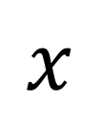
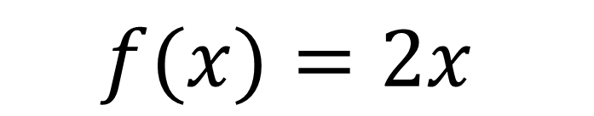
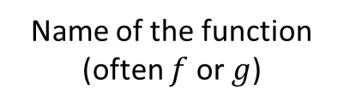
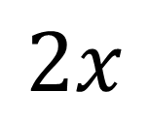
Functions
A function is something which provides
a rule on how to
map inputs to outputs.
Informal
(number machine)
Input
Output
$$x$$
x 2
$$2x$$
Name of the function (often $f$ or $g$)
Input
Output
Formal
(function)
$$f(x)=2x$$

Slide 3

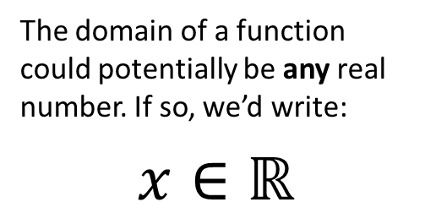
Functions
Inputs
(Domain)
Outputs
(Range)
-1
1
The domain of a function could potentially be any real number. If so, we’d write:
$$x∈ℝ$$
0
0
1.7
2.89
2
3.1
The input $x$…
the set of real numbers
9.61
is a member of…

Slide 4
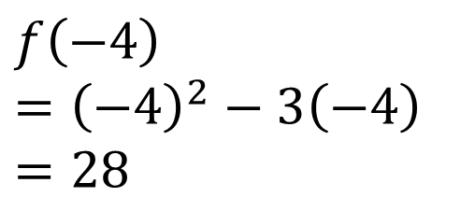
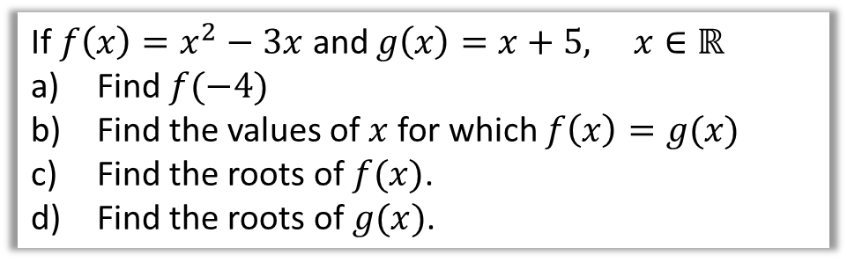
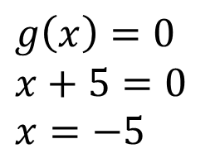
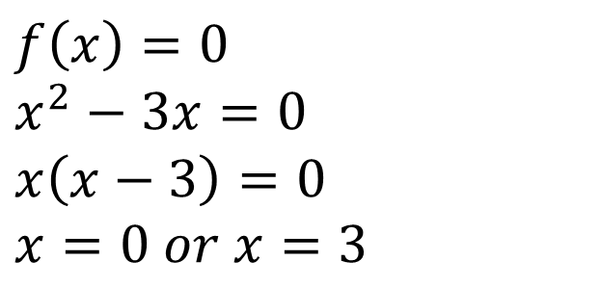
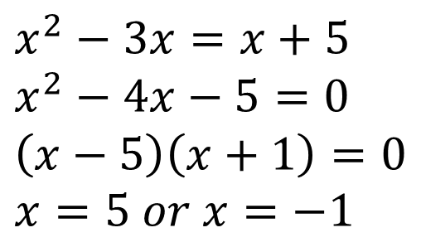
Functions
If $f\left(x\right)=x^{2}−3x$ and $g\left(x\right)=x+5, x∈ℝ$
Find $f(−4)$
Find the values of $x$ for which $f\left(x\right)=g(x)$
Find the roots of $f(x)$.
Find the roots of $g(x)$.
Note: The domain is usually stated for you.
a
$$f\left(−4\right)={\left(−4\right)}^{2}−3\left(−4\right) \\ =28$$
c
$$f\left(x\right)=0$$
$$x^{2}−3x=0 \\ x\left(x−3\right)=0 \\ x=0 or x=3$$
b
$$x^{2}−3x=x+5 \\ x^{2}−4x−5=0 \\ \left(x−5\right)\left(x+1\right)=0 \\ x=5 or x=−1$$
d
$$g\left(x\right)=0$$
$$x+5=0 \\ x=−5$$

Slide 5
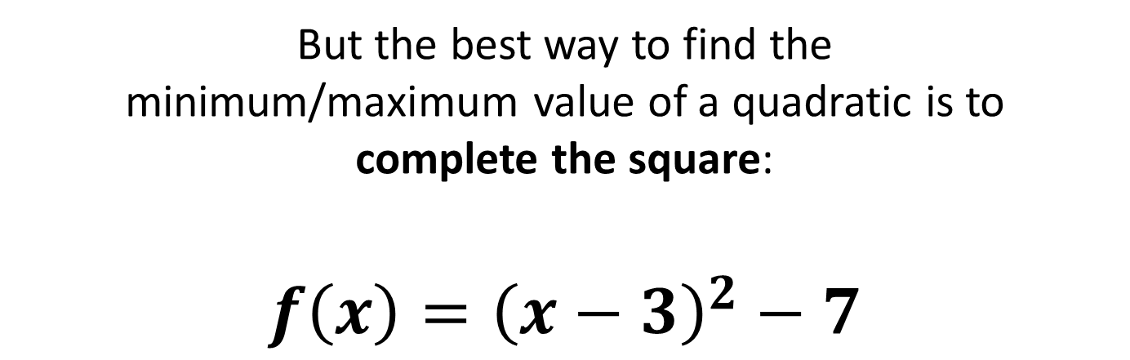
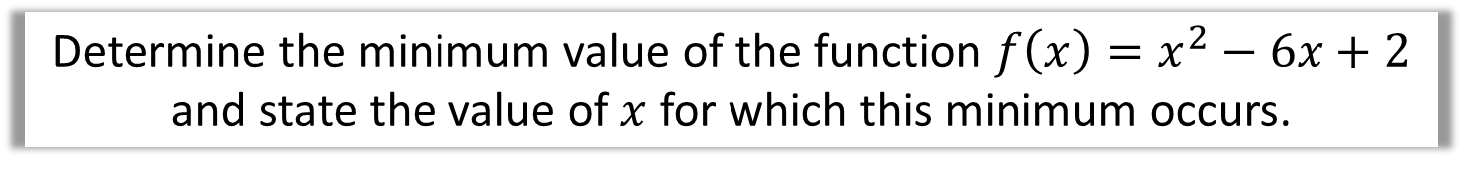
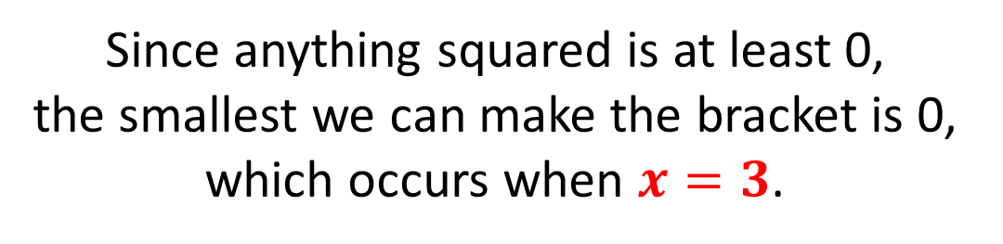
Functions
Determine the minimum value of the function $f\left(x\right)=x^{2}−6x+2$
and state the value of $x$ for which this minimum occurs.
But the best way to find the
minimum/maximum value of a quadratic is to
complete the square:
$$f\left(x\right)={\left(x−3\right)}^{2}−7$$
Since anything squared is at least 0,
the smallest we can make the bracket is 0,
which occurs when $x=3$.

Slide 6





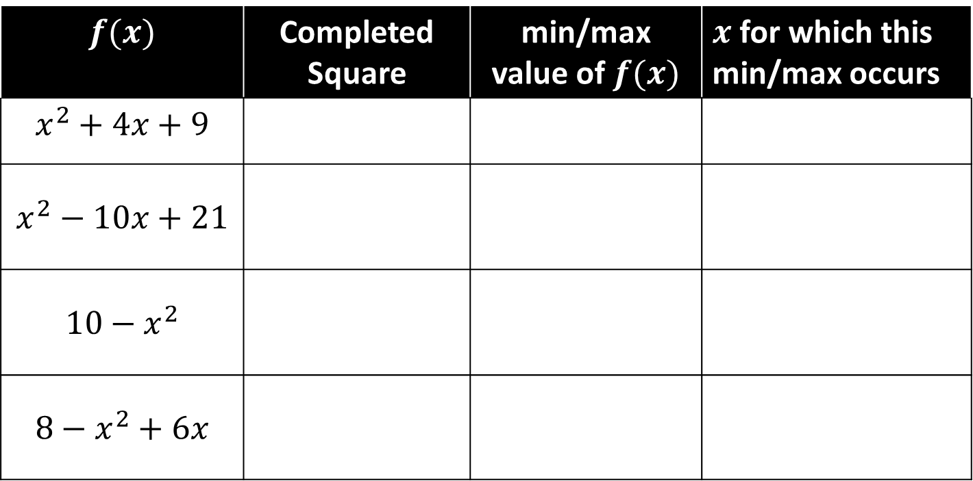






Functions
$$f(x)$$ | Completed Square | min/max value of $f(x)$ | $x$ for which this min/max occurs
$$x^{2}+4x+9$$
$$x^{2}−10x+21$$
$$10−x^{2}$$
$$8−x^{2}+6x$$
$${\left(x+2\right)}^{2}+5$$
$$5$$
$$−2$$
$${\left(x−5\right)}^{2}−4$$
$$−4$$
$$5$$
Already completed
$$10$$
$$0$$
$$17−{\left(x−3\right)}^{2}$$
$$17$$
$$3$$

Slide 7
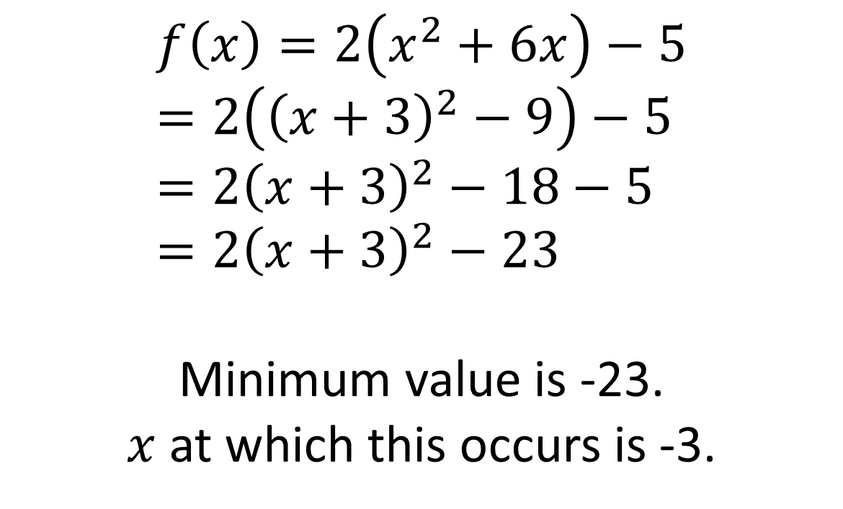
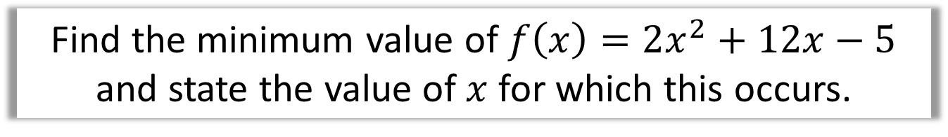
Functions
Find the minimum value of $f\left(x\right)=2x^{2}+12x−5$ and state the value of $x$ for which this occurs.
$$f\left(x\right)=2\left(x^{2}+6x\right)−5 \\ =2\left({\left(x+3\right)}^{2}−9\right)−5 \\ =2{\left(x+3\right)}^{2}−18−5 \\ =2{\left(x+3\right)}^{2}−23$$
Minimum value is -23.
$x$ at which this occurs is -3.

Slide 8
Exercise 2E
Pearson Pure Mathematics Year 1/AS
Page 26-27
Complete before the lesson Q1-3
In Class:
Green Q4-5
Amber Q6-7
Red Q8

