Slide 1

Stats Yr2 Chapter 3 :: Normal Distribution
jfrost@tiffin.kingston.sch.uk
www.drfrostmaths.com
@DrFrostMaths
Last modified: 11th February 2018

Slide 2

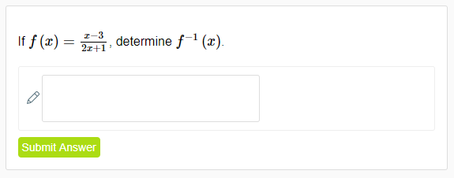
Use of DrFrostMaths for practice
Register for free at:
www.drfrostmaths.com/homework
Practise questions by chapter, including past paper Edexcel questions and extension questions (e.g. MAT).
Teachers: you can create student accounts (or students can register themselves).

Slide 3
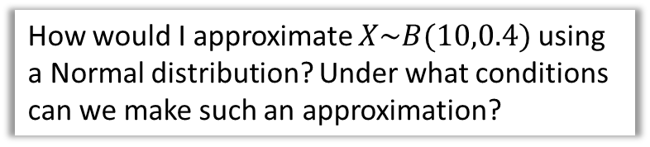
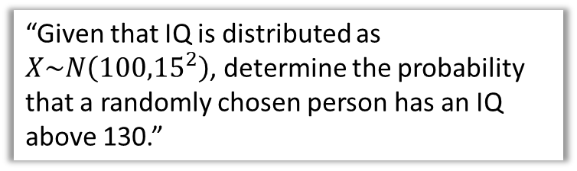

Chapter Overview
1:: Characteristics of the Normal Distribution
2:: Finding probabilities on a standard normal curve.
What shape is it? What parameters does it have?
“Given that IQ is distributed as $X\sim N\left({100,15}^{2}\right)$, determine the probability that a randomly chosen person has an IQ above 130.”
3:: Finding unknown means/standard deviations.
In Wales, 30% of people have a height above 1.6m. Given the mean height is 1.4m and heights are normally distributed, determine the standard deviation of heights.
4:: Binomial $→$ Normal Approximations
How would I approximate $X\sim B(10,0.4)$ using a Normal distribution? Under what conditions can we make such an approximation?
5:: Hypothesis Testing
Teacher Notes: This is a combination of all the old S1 content combined with aspects of S2 (Normal approximations) and S3! (hypothesis testing on the mean of a normal distribution)

Slide 4



What does it look like?
The following shows what the probability distribution might look like for a random variable $X,$ if $X$ is the height of a randomly chosen person.
We expect this ‘bell-curve’ shape, where we’re most likely to pick someone with a height around the mean of 180cm, with the probability diminishing symmetrically either side of the mean.
$$f\left(x\right)$$
180cm
Height in cm ($x$)
A variable with this kind of distribution is said to have a normal distribution.
For normal distributions we tend to draw the $y$ axis at the mean for symmetry.

Slide 5
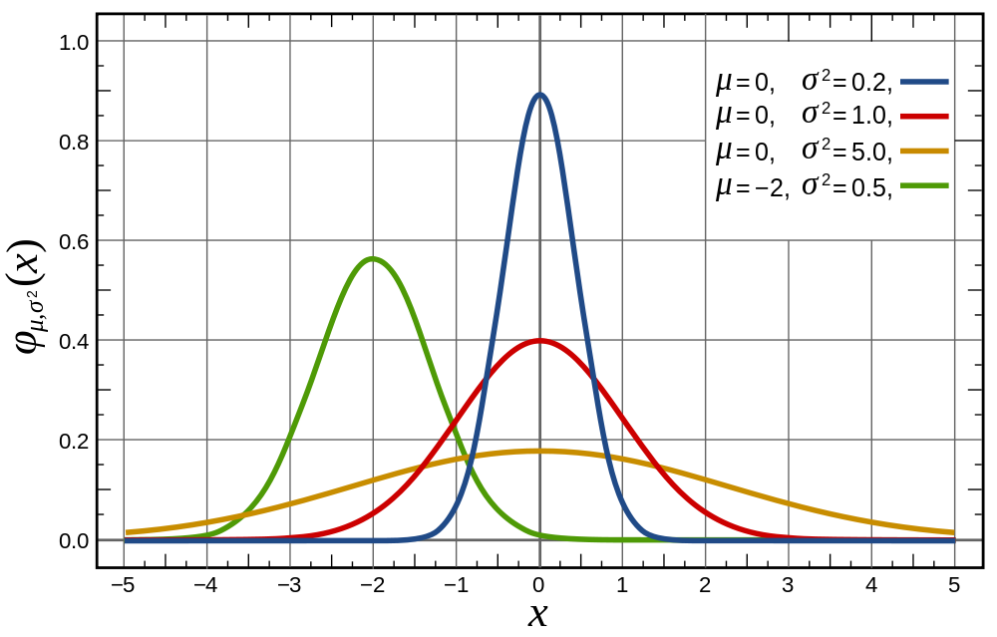


What does it look like?
$$f(x)$$
Compare for example the blue and red curve. If the standard deviation is greater, the data is more spread out, and therefore a randomly chosen thing is less likely to have a value near the mean (hence it being less peaky).
We can set the mean $μ$ and the standard deviation $σ$ of the Normal Distribution. If a random variable $X$ is normally distributed, then we write
$$X\sim N\left(μ,σ^{2}\right)$$

Slide 6



Normal Distribution Q & A
Q1
For a Normal Distribution to be used, the variable has to be:
continuous
With a discrete variable, all the probabilities had to add up to 1.
For a continuous variable, similarly:
the area under the probability graph has
to be 1.
To find $P\left(170<X<190\right)$, we could:
find the area between these values.
Would we ever want to find $P\left(X=200\right)$ say?
Since height is continuous, the probability someone is ‘exactly’ 200cm is infinitesimally small. So not a ‘probability’ in the normal sense.
?
Q2
$$f\left(x\right)$$
?
Q3
?
Q4
?
170cm
180cm
190cm
Height in cm ($x$)
Side Notes: You might therefore wonder what the $y$-axis actually is. It is probability density, i.e. “the probability per unit cm”. This is analogous to frequency density with histograms, where the $y$-value is frequency density area under the graph gives frequency. We use $f(x)$ rather than $p(x)$, to indicate probability density.

Slide 7
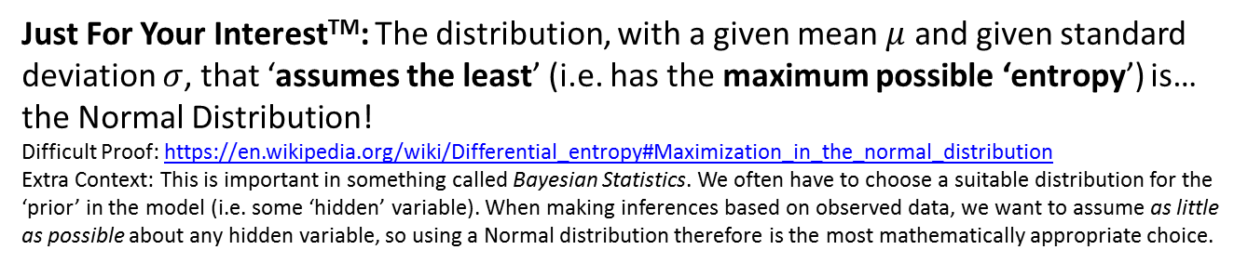


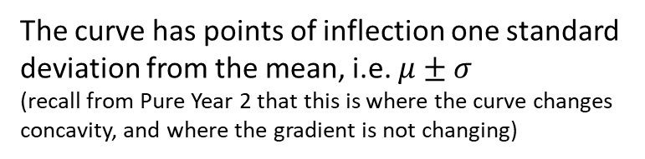


Further Facts
$$f\left(x\right)$$
The curve has points of inflection one standard deviation from the mean, i.e. $μ±σ$
(recall from Pure Year 2 that this is where the curve changes concavity, and where the gradient is not changing)
The Normal Distribution is symmetrical, i.e. mean = mode = median
$$μ−σ$$
$$μ+σ$$
Height in cm ($x$)
Just For Your InterestTM: The distribution, with a given mean $μ$ and given standard deviation $σ$, that ‘assumes the least’ (i.e. has the maximum possible ‘entropy’) is… the Normal Distribution!
Difficult Proof: https://en.wikipedia.org/wiki/Differential_entropy#Maximization_in_the_normal_distribution
Extra Context: This is important in something called Bayesian Statistics. We often have to choose a suitable distribution for the ‘prior’ in the model (i.e. some ‘hidden’ variable). When making inferences based on observed data, we want to assume as little as possible about any hidden variable, so using a Normal distribution therefore is the most mathematically appropriate choice.

Slide 8
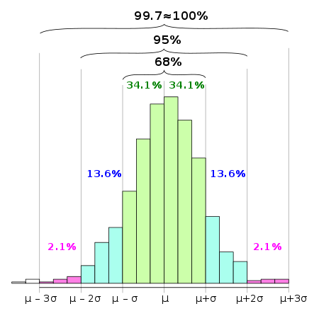
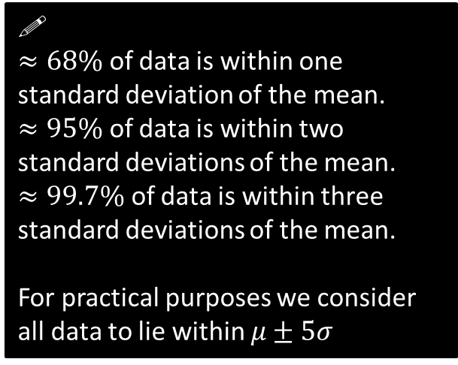
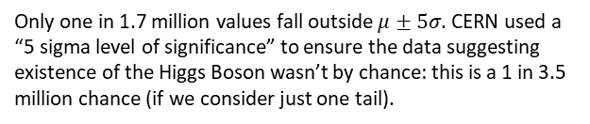
The 68-95-99.7 rule
The 68-95-99.7 rule is a shorthand used to remember the percentage of data that is within 1, 2 and 3 standard deviations from the mean respectively.
You need to memorise this!
!
$≈68\%$ of data is within one standard deviation of the mean.
$≈95\%$ of data is within two standard deviations of the mean.
$≈99.7\%$ of data is within three standard deviations of the mean.
For practical purposes we consider all data to lie within $μ±5σ$
The histogram above is for a quantity which is approximately normally distributed.
Source: Wikipedia
Only one in 1.7 million values fall outside $μ±5σ$. CERN used a “5 sigma level of significance” to ensure the data suggesting existence of the Higgs Boson wasn’t by chance: this is a 1 in 3.5 million chance (if we consider just one tail).

Slide 9

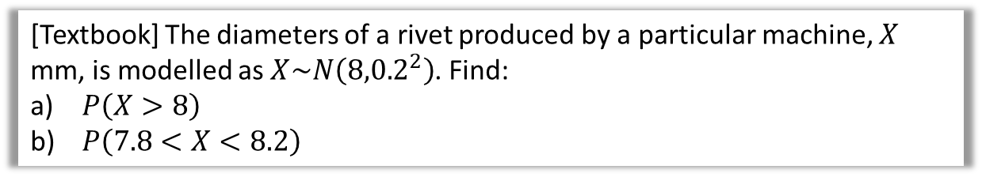
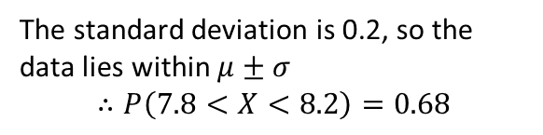
Examples
[Textbook] The diameters of a rivet produced by a particular machine, $X$ mm, is modelled as $X\sim N\left({8,0.2}^{2}\right)$. Find:
$P\left(X>8\right)$
$P\left(7.8<X<8.2\right)$
Fro Tip: Draw a diagram!
?
b
?
a
8
7.8
8
8.2
8 is the mean, so by the symmetry of the normal distribution, 50% of the area lies above the mean.
$$∴P\left(X>8\right)=0.5$$
The standard deviation is 0.2, so the data lies within $μ±σ$
$$∴P\left(7.8<X<8.2\right)=0.68$$

Slide 10

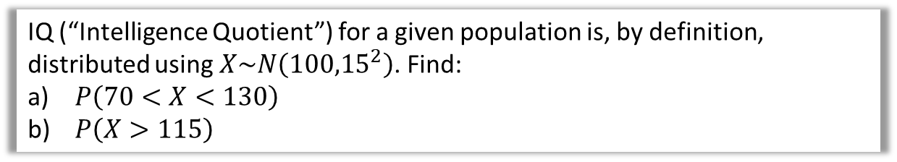
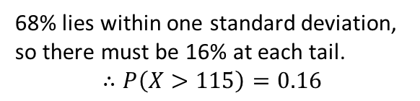
Test Your Understanding
IQ (“Intelligence Quotient”) for a given population is, by definition, distributed using $X\sim N\left({100,15}^{2}\right)$. Find:
$P\left(70<X<130\right)$
$P\left(X>115\right)$
Fro Tip: Draw a diagram!
?
?
a
b
68%
16%
70
100
130
100
115
We know that 95% of data lies within 2 standard deviations of the mean.
$$∴P\left(70<X<130\right)=0.95$$
68% lies within one standard deviation, so there must be 16% at each tail.
$$∴P\left(X>115\right)=0.16$$

Slide 11
Exercise 3A
Pearson Stats/Mechanics Year 2
Pages 40-41
Complete before the lesson Q1-5
In Class:
Green Q6
Amber Q7
Red Q8&9

Slide 12
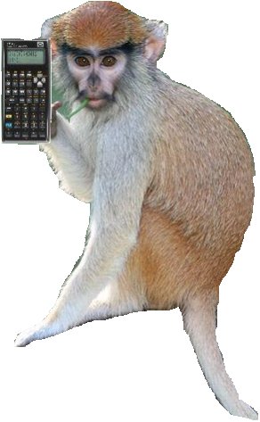
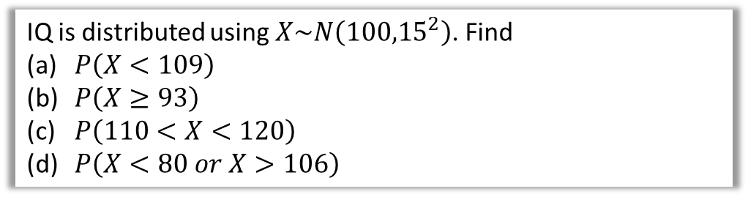
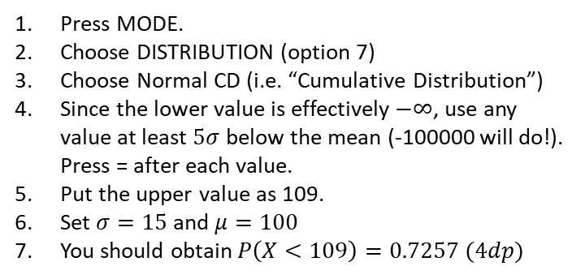
Getting normal values from your calculator
“Use of Technology” Monkey says:
If for some reason you haven’t got a Classwiz by this point, for Kong’s sake, buy one now. [Surreptitiously pockets banana handed to me by Casio]. The instructions below assume you have a Classwiz.
Just like a cumulative frequency graph gives the running total of the frequency up to a given value, a cumulative distribution gives the running total of the probability up to a given value.
IQ is distributed using $X\sim N\left({100,15}^{2}\right)$. Find
$P\left(X<109\right)$
$P\left(X≥93\right)$
$P\left(110<X<120\right)$
$P\left(X<80 or X>106\right)$
Press MODE.
Choose DISTRIBUTION (option 7)
Choose Normal CD (i.e. “Cumulative Distribution”)
Since the lower value is effectively $−∞$, use any value at least $5σ$ below the mean (-100000 will do!). Press = after each value.
Put the upper value as 109.
Set $σ=15$ and $μ=100$
You should obtain $P\left(X<109\right)=0.7257 (4dp)$
A diagram, while not essential, is useful to get a sense of whether our answer is correct. We know the probability must be above 0.5, so 0.7257 sounds about right.
a
100
109
No lower bound, so use -100000

Slide 13
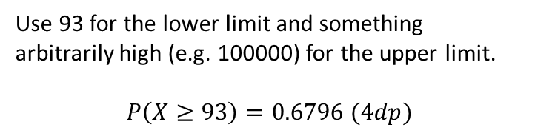

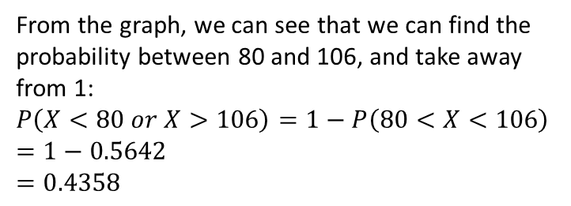

Getting normal values from your calculator
IQ is distributed using $X\sim N\left({100,15}^{2}\right)$. Find
$P\left(X<109\right)$
$P\left(X≥93\right)$
$P\left(110<X<120\right)$
$P\left(X<80 or X>106\right)$
b
?
Fro Note: $≥$ vs $>$ makes no difference as the distribution is continuous.
Use 93 for the lower limit and something arbitrarily high (e.g. 100000) for the upper limit.
$$P\left(X≥93\right)=0.6796 (4dp)$$
93
100
c
?
$$P\left(110<X<120\right)=0.1613 (4dp)$$
d
?
From the graph, we can see that we can find the probability between 80 and 106, and take away from 1:
$$P\left(X<80 or X>106\right)=1−P\left(80<X<106\right) \\ =1−0.5642 \\ =0.4358$$
80
100
106
Froculator Tip: You will need to switch back to normal calculation mode to do the $1−…$.
Note however that the ANS key will store the last result from the Distribution Mode!

Slide 14

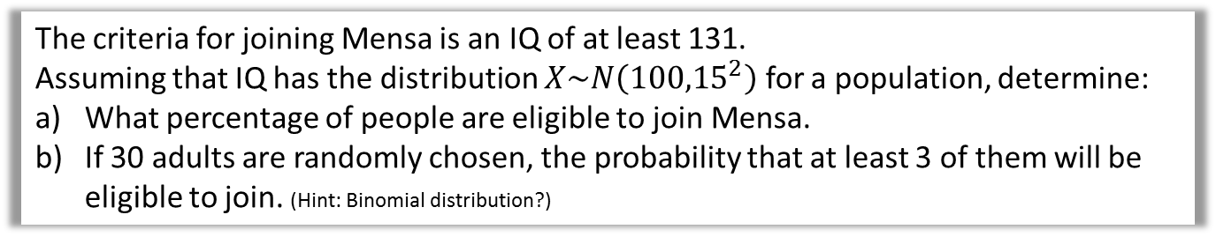
Test Your Understanding
The criteria for joining Mensa is an IQ of at least 131.
Assuming that IQ has the distribution $X\sim N\left({100,15}^{2}\right)$ for a population, determine:
What percentage of people are eligible to join Mensa.
If 30 adults are randomly chosen, the probability that at least 3 of them will be eligible to join. (Hint: Binomial distribution?)
$$P\left(X≥131\right)=0.01938 \left(4sf\right)$$
Let $Y$ be the number of adults among 30 who are eligible to join.
$$Y\sim B(30, 0.0193827)$$
$$P\left(Y≥3\right)=1−P\left(Y≤2\right) \\ =1−0.979986 \\ =0.02001 (4sf)$$
a
?
b
?
Froculator Note: You absolutely can’t use tables in a formula booklet here. You’ll need to use a calculator.

Slide 15
Exercise 3B
Pearson Stats/Mechanics Year 2
Pages 40-41
Complete before the lesson Q1&5
In Class:
Green Q6-7
Amber Q8-9
Red Q10-12

Slide 16

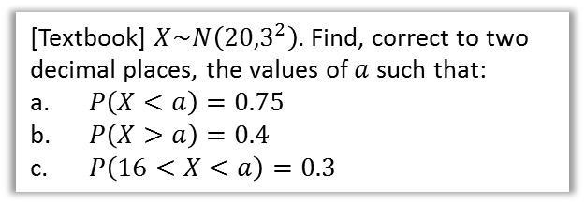

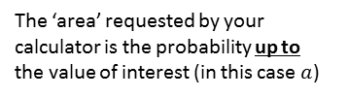


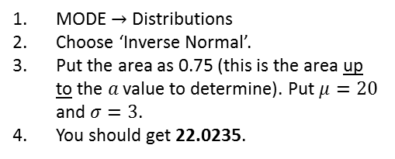

Inverse Normal Distribution
We now know how to use a calculator to value of the variable to obtain a probability. But we might want to do the reverse: given a probability of being in a region, how do we find the value of the boundary?
$$P\left(X>a\right)=0.4 \\ ∴P\left(X<a\right)=0.6$$
(i.e. if 40% is above $a$, then 60% must be below)
$$a=20.76$$
[Textbook] $X\sim N\left({20,3}^{2}\right)$. Find, correct to two decimal places, the values of $a$ such that:
$P\left(X<a\right)=0.75$
$P\left(X>a\right)=0.4$
$P\left(16<X<a\right)=0.3$
b
?
0.6
$$a$$
20
a
MODE $→$ Distributions
Choose ‘Inverse Normal’.
Put the area as 0.75 (this is the area up to the $a$ value to determine). Put $μ=20$ and $σ=3$.
You should get 22.0235.
c
?
We need to find the area up to $a$. From the sketch we can therefore see we first find the area up to 16 and add on the 0.3:
$$P\left(X<16\right)=0.09121 \\ ∴P\left(X<a\right)=0.3+0.09121=0.39121$$
$$∴a=19.17$$
0.3
$$16$$
$$a$$
20
The ‘area’ requested by your calculator is the probability up to the value of interest (in this case $a$)
REALLY, DRAW A SKETCH!
0.75
20
$$a$$
DRAW A SKETCH!

Slide 17






Further Example
If the IQ of a population is distributed using $X\sim N\left({100,15}^{2}\right)$.
Determine the IQ corresponding to the top 30% of the population.
Determine the interquartile range of IQs.
a
?
b
?
$$P\left(X<Q_{1}\right)=0.25 \\ ∴Q_{1}=89.88$$
$$P\left(X<Q_{3}\right)=0.75 \\ ∴Q_{3}=110.12$$
$$IQR=110.12−89.88=20.24$$
0.70
0.50
0.25
100
$$a$$
$$Q_{1}$$
100
$$Q_{3}$$
$$P\left(X>k\right)=0.3 \\ ∴P\left(X<k\right)=0.7 \\ k=107.87 (2dp)$$
In general the quartiles of a normal distribution are approximately $μ±\frac{2}{3}σ$

Slide 18




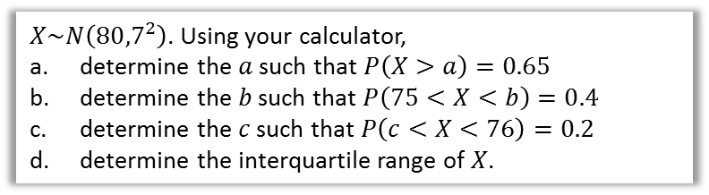


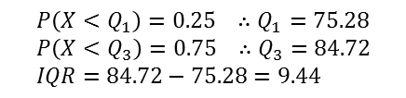


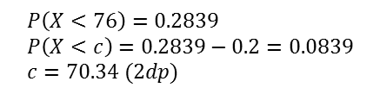
Test Your Understanding
$X\sim N\left({80,7}^{2}\right)$. Using your calculator,
determine the $a$ such that $P\left(X>a\right)=0.65$
determine the $b$ such that $P\left(75<X<b\right)=0.4$
determine the $c$ such that $P\left(c<X<76\right)=0.2$
determine the interquartile range of $X$.
a
?
c
?
$$P\left(X>a\right)=0.65 \\ ∴P\left(X<a\right)=0.35 \\ a=77.303 (3dp)$$
0.2839
$$P\left(X<76\right)=0.2839 \\ P\left(X<c\right)=0.2839−0.2=0.0839 \\ c=70.34 (2dp)$$
0.75
0.2
$$76$$
80
80
$$a$$
$$c$$
b
?
d
?
$$P\left(X<75\right)=0.2375 \\ ∴P\left(X<b\right)=0.2375+0.4=0.6375$$
$$b=82.463$$
$$P\left(X<Q_{1}\right)=0.25 ∴Q_{1}=75.28 \\ P\left(X<Q_{3}\right)=0.75 ∴Q_{3}=84.72 \\ IQR=84.72−75.28=9.44$$
0.4
0.50
0.2375
0.25
$$75$$
80
$$b$$
$$Q_{1}$$
80
$$Q_{3}$$

Slide 19
Exercise 3C
Pearson Stats/Mechanics Year 2
Pages 46-47
Complete before the lesson Q1-3
In Class:
Green Q4-5
Amber Q6-7
Red Q8-9

Slide 20
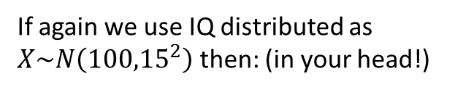
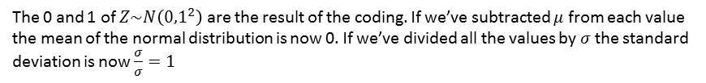
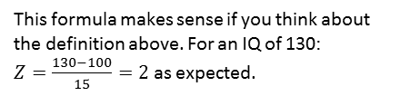
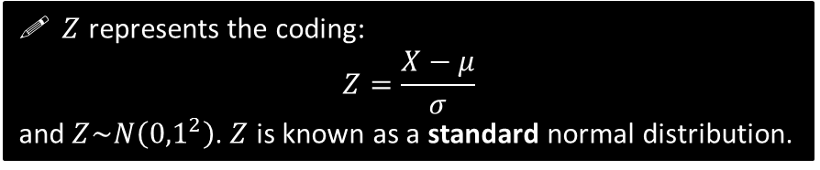
Standard Normal Distribution
! $Z$ is the number of standard deviations above the mean.
If again we use IQ distributed as $X\sim N\left({100,15}^{2}\right)$ then: (in your head!)
This formula makes sense if you think about the definition above. For an IQ of 130:
$Z=\frac{130−100}{15}=2$ as expected.
IQ | Z
100 | 0
130 | 2
85 | -1
165 | 4.333
62.5 | -2.5
?
$Z$ represents the coding:
$$Z=\frac{X−μ}{σ}$$
and $Z\sim N\left({0,1}^{2}\right)$. $Z$ is known as a standard normal distribution.
?
?
?
?
The 0 and 1 of $Z\sim N\left({0,1}^{2}\right)$ are the result of the coding. If we’ve subtracted $μ$ from each value the mean of the normal distribution is now 0. If we’ve divided all the values by $σ$ the standard deviation is now $\frac{σ}{σ}=1$

Slide 21
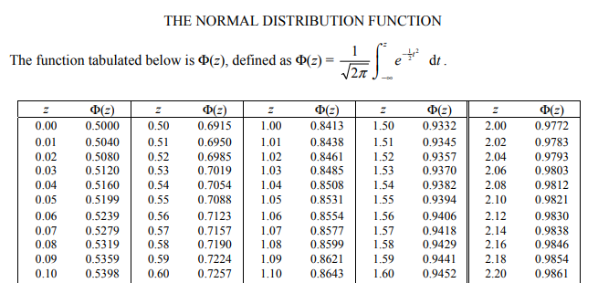
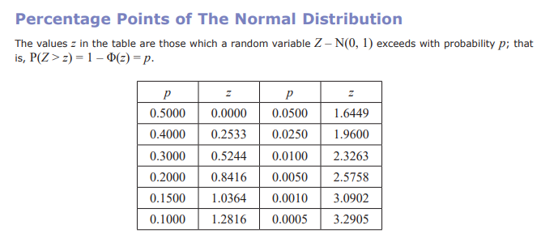

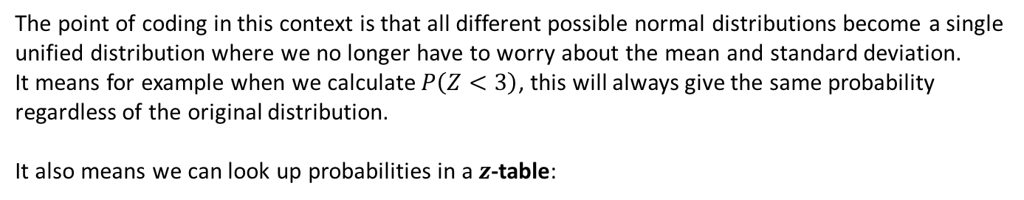
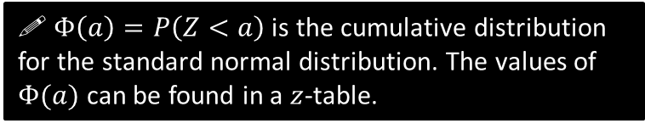
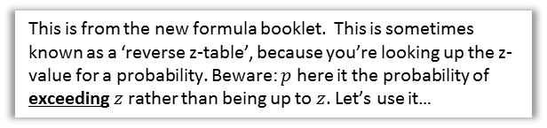
Standard Normal Distribution
The point of coding in this context is that all different possible normal distributions become a single unified distribution where we no longer have to worry about the mean and standard deviation.
It means for example when we calculate $P\left(Z<3\right)$, this will always give the same probability regardless of the original distribution.
It also means we can look up probabilities in a $z$-table:
$$φ\left(a\right)=P\left(Z<a\right)$$
! $Φ\left(a\right)=P\left(Z<a\right)$ is the cumulative distribution for the standard normal distribution. The values of $Φ(a)$ can be found in a $z$-table.
This is a traditional z-table in the old A Level syllabus (but also found elsewhere). You no longer get given this and are expected to use your calculator.
This is from the new formula booklet. This is sometimes known as a ‘reverse z-table’, because you’re looking up the z-value for a probability. Beware: $p$ here it the probability of exceeding $z$ rather than being up to $z$. Let’s use it…
$$a$$
0

Slide 22
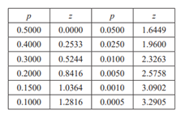


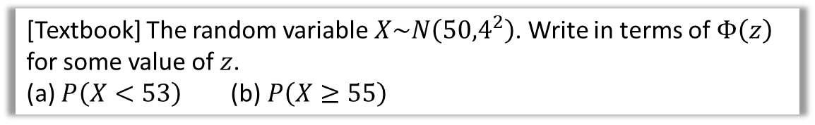






Examples
[Textbook] The random variable $X\sim N\left({50,4}^{2}\right)$. Write in terms of $Φ\left(z\right)$ for some value of $z$.
(a) $P\left(X<53\right)$ (b) $P\left(X≥55\right)$
$$P\left(X<53\right) \\ =P\left(Z<\frac{53−50}{4}\right)=P\left(Z<0.75\right) \\ =Φ\left(0.75\right)$$
b
$$P\left(X≥55\right) \\ =P\left(Z≥\frac{55−50}{4}\right)=P\left(Z≥1.25\right) \\ =1−P\left(Z<1.25\right) \\ =1−Φ\left(1.25\right)$$
a
?
?
‘Standardise’ to turn $X$ into $Z$.
[Textbook] The systolic blood pressure of an adult population, $S$ mmHg, is modelled as a normal distribution with mean 127 and standard deviation 16. A medical research wants to study adults with blood pressures higher than the 95th percentile. Find the minimum blood pressure for an adult included in her study.
?
A sketch will help you visualise whether you expect a positive or negative value of $z$.
$$S\sim N\left({127,16}^{2}\right)$$
Looking at the table, we see that the top 5% corresponds to a $z$-value of 1.6449.
$$\frac{s−127}{16}=1.6449 \\ s=153 (3sf)$$
Use $Z=\frac{X−μ}{σ}$ formula as soon as you determine $z$.
5%
$$z$$
0

Slide 23














Further Examples
Determine $P(Z>−1.3)$
Determine $P\left(−2<Z<1\right)$
Determine the $a$ such that $P\left(Z>a\right)=0.7$
Determine the $a$ such that $P\left(−a<Z<a\right)=0.6$
a
?
Fro Tip: Either changing < to/from > or changing the sign (+ to/from -) has the effect of “$1−$”. However, if you change both, the “$1−$”s cancel out!
$$P\left(Z>−1.3\right)=P\left(Z<1.3\right) \\ =0.9032$$
$$P\left(−2<Z<1\right)=P\left(Z<1\right)−P\left(Z<−2\right) \\ =P\left(Z<1\right)−\left(1−P\left(Z<2\right)\right) \\ =0.8413−\left(1−0.9772\right) \\ =0.8185 (4dp)$$
$$−1.3$$
$$1.3$$
b
?
0
$$P\left(a<Z<b\right)=P\left(Z<b\right)−P\left(Z<a\right)$$
c
?
From the second sketch we can see that our $z$ value is in the bottom half, so it is negative. However, our table only gives positive values of $z$.
From the graphs on the left, we can see by symmetry that the $z$ value for the top 30% must be the negation of the $z$-value for the bottom 30% (i.e. top 70%).
0.7
By symmetry, if 0.6 at the centre, must be 0.2 at each tail.
$$P\left(Z>a\right)=0.2 \\ a=0.8416$$
d
?
$$0.5244$$
0
0.6
0.7
$$P\left(Z>a\right)=0.7 \\ a=−0.5244$$
0.2
0.2
$$−a$$
$$a$$
0
$$−0.5244$$
0

Slide 24






Test Your Understanding
1
IQ is distributed with mean 100 and standard deviation 15. Using an appropriate table, determine the IQ corresponding to the
top 10% of people.
bottom 20% of people.
$$X\sim N\left({100,15}^{2}\right) \\ 1.2816=\frac{x−100}{15} \\ x=119.24$$
$$−0.8416=\frac{x−100}{15} \\ x=87.376$$
a
?
2
If $X\sim N\left({100,15}^{2}\right)$, determine, in terms of $Φ$:
$P(X>115)$
$P\left(77.5<X<112\right)$
a
$$P\left(X>115\right)=P\left(Z>\frac{115−100}{15}\right)=P\left(Z>1\right)=1−P\left(Z<1\right)=1−Φ\left(1\right)$$
$$P\left(77.5<X<112\right)=P\left(X<112\right)−P\left(X<77.5\right) \\ =P\left(Z<0.8\right)−P\left(Z<−1.5\right) \\ =Φ\left(0.8\right)−\left(1−Φ\left(1.5\right)\right) \\ =Φ\left(0.8\right)+Φ\left(1.5\right)−1$$
b
?
?
b
?
3
Find the $a$ such that:
$P\left(−a<Z<a\right)=0.2$
$P\left(0<Z<a\right)=0.35$
Using appropriate sketch:
$$P\left(Z>a\right)=0.4 \\ a=0.2533$$
$$P\left(Z>a\right)=0.15 \\ a=1.0364$$
a
?
b
?

Slide 25
Exercise 3D
Pearson Stats/Mechanics Year 2
Page 49
Complete before the lesson Q1-2
In Class:
Green Q3
Amber Q4
Red Q5-7

Slide 26











Missing $μ$ and $σ$
In the last section, you may have thought, “what’s the point of standardising to $Z$ when I can just use the DISTRIBUTION mode on my calculator?”
Fair point, but both forward and reverse normal lookups on the calculator required you to specify $μ$ and $σ$.
[Textbook] $X\sim N\left(μ,3^{2}\right)$. Given that $P\left(X>20\right)=0.2$, find the value of $μ$.
?
$$P\left(X>20\right)=0.2 \\ 0.8416=\frac{20−μ}{3} \\ μ=17.5 (3sf)$$
0.2
$$μ$$
$$20$$
The method here is exactly the same as before:
1. Using a sketch, determine whether you’re expecting a positive or negative $z$ value.
2. Look up $z$ value, using tables if you can (otherwise your calculator). Make negative if in bottom half.
3. Use $Z=\frac{X−μ}{σ}$
[Textbook] A machine makes metal sheets with width, $X$ cm, modelled as a normal distribution such that $X\sim N\left(50,σ^{2}\right)$.
Given that $P\left(X<46\right)=0.2119$, find the value of $σ$.
Find the 90th percentile of the widths.
?
$$P\left(X<46\right)=0.2119 \\ −0.80=\frac{46−50}{σ} \\ σ=5$$
$$X\sim N\left({50,5}^{2}\right) \\ P\left(X<a\right)=0.9 \\ a=56.4 cm (1dp)$$
0.2
0.2
To use inverse normal distribution on calculator, note that $Z\sim N\left({0,1}^{2}\right)$, so use $μ=0$ and $σ=1$.
$$46$$
$$50$$

Slide 27



When both are missing
If both $μ$ and $σ$ are missing, we end up with simultaneous equations which we must solve.
Edexcel S1 Jan 2011
?
“Use of Technology” Monkey says:
Your Classwiz solves simultaneous equations. Look under the EQUATIONS mode.

Slide 28




Test Your Understanding
Edexcel S1 May 2013 (R)
?
Edexcel S1 Jan 2002
?
?
?
?

Slide 29
Exercise 3E
Pearson Stats/Mechanics Year 2
Pages 51-53
Complete before the lesson Q1&4
In Class:
Green Q5-6
Amber Q7-10
Red Q11-14 & Challenge

Slide 30




Approximating a Binomial Distribution
$$p\left(x\right)$$
$x$ (#successes)
The graph shows the probability function for different Binomial Distributions. Which one resembles another distribution and what distribution does it resemble?
When $p$ is close to 0.5, and $n$ is fairly large, it resembles a normal distribution.
The $p=0.5$ results in the distribution being symmetrical. e.g. For a fair coin toss with 10 throws, we’re just as likely to get 1 Head out fo 10 as we are 1 Tail.
?

Slide 31




Approximating a Binomial Distribution
If we’re going to use a normal distribution to approximate a Binomial distribution, it makes sense that we set the mean and standard deviation of the normal distribution to match that of the original binomial distribution:
?
$$μ=np \\ σ=\sqrt{np\left(1−p\right)}$$
?
! If $n$ is large and $p$ close to 0.5, then the binomial distribution $X\sim B\left(n,p\right)$ can be approximated by the normal distribution $N\left(μ,σ^{2}\right)$ where
$$μ=np \\ σ=\sqrt{np\left(1−p\right)}$$
Quickfire Questions:
We tend to use the letter $Y$ to represent the normal distribution approximation of the distribution $X$.
?
$$X\sim B\left(10,0.2\right) → Y\sim N(2, 1.6)$$
?
$$X\sim B\left(20,0.5\right) → Y\sim N(10, 5)$$
Why use a normal approximation?
Tables for the binomial distribution only goes up to $n=50$ and your calculator will reject large values of $n$.
The formula for $P\left(X=x\right)$ makes use a factorials. Factorials of large numbers cannot be computed efficiently. Type in 65! for example; your calculator will hesitate! Now imagine how many factorials would be required if you wanted to find $P\left(X≤65\right)$. 😐
$$X\sim B\left(6, 0.3\right) → Y\sim N(1.8, 1.26)$$
?

Slide 32



Continuity Corrections
One problem is that the outcomes of a binomial distribution (i.e. number of successes) are discrete whereas the Normal distribution is continuous.
We apply something called a continuity correction to approximate a discrete distribution using a continuous one.
The random variable $X$ represents the time to finish a race in hours. We’re interested in knowing the probability Alice took 6 hours to the nearest hour.
How would you represent this time on a number line given hours is discrete? And what about if hours was now considered to be continuous (as $Y$)?
Discrete:
$$X=6$$
$$5.5<Y<6.5$$
Continuous:
?
3 4 5 6 7 8 9 10
We can’t just find $P\left(Y=6\right)$ when $Y$ is continuous, because the probability is effectively 0. But $P\left(5.5<Y<6.5\right)$ would seem a sensible interval to use because any time between 5.5 and 6.5 would have rounded to 6 hours were it discrete.

Slide 33





Continuity Corrections
If $X$ is a discrete variable, and $Y$ is its continuous equivalent, how would you represent $P\left(X≥5\right)$ for $Y$?
Discrete:
$$X≥5$$
?
Continuous:
$$Y≥4.5$$
Notice the range has been enlarged by an extra 0.5.
3 4 5 6 7 8 9 10
How would represent $P\left(X<9\right)$ for $Y$?
Discrete:
$$X<9→X≤8$$
?
Continuous:
$$Y≤8.5$$
3 4 5 6 7 8 9 10
! A continuity correction is approximating a discrete range using a continuous one.
1. If > or <, convert to $≥,≤$ first.
2. Enlarge the range by 0.5.

Slide 34



Examples
Discrete
Continuous
$$P\left(X≤7\right) \\ P\left(X<10\right) \\ P\left(X>9\right) \\ P\left(1≤X≤10\right) \\ P\left(3<X<6\right) \\ P\left(3≤X<6\right)$$
$$P\left(3<X≤6\right)$$
$$P(X=3)$$
?
$$≈P\left(Y≤7.5\right) \\ =P\left(X≤9\right)≈P\left(Y≤9.5\right) \\ =P\left(X≥10\right)≈P\left(Y≥9.5\right) \\ ≈P\left(0.5≤Y≤10.5\right) \\ =P\left(4≤X≤5\right)≈P\left(3.5≤Y≤5.5\right) \\ ≈P\left(2.5≤Y≤5.5\right)$$
$$≈P\left(3.5≤X≤6.5\right)$$
$$≈P\left(2.5≤X≤3.5\right)$$
?
?
?
?
?
?
?
! A continuity correction is approximating a discrete range using a continuous one.
1. If > or <, convert to $≥,≤$ first.
2. Enlarge the range (at each end) by 0.5.

Slide 35

Full Example
[Textbook - Edited] For a particular type of flower bulbs, 55% will produce yellow flowers. A random sample of 80 bulbs is planted.
Calculate the actual probability that there are exactly 50 flowers.
Use a normal approximation to find a estimate that there are exactly 50 flowers.
Hence determine the percentage error of the normal approximation for 50 flowers.
a
$$X\sim B\left(80, 0.55\right) \\ P\left(X=50\right)=\left(\begin{matrix}80 \\ 50 \end{matrix}\right)×{0.55}^{50}×{0.45}^{30}=0.0365$$
$$Y\sim N\left(44, 19.8\right) \\ P\left(X=50\right)≈P\left(49.5<Y<50.5\right) \\ =0.9280−0.8918=0.0362 (4dp)$$
Percentage error:
$$\frac{0.0365−0.0362}{0.0365}×100=0.82\%$$
?
b
?
c
?

Slide 36



Test Your Understanding
Edexcel S2 Jan 2004 Q3
?
?
?
$$\sim$$

Slide 37
Exercise 3F
Pearson Stats/Mechanics Year 2
Page 55
Complete before the lesson Q1-3
In Class:
Green Q4-6
Amber Q7-8
Red Q9

Slide 38







Hypothesis Testing on the Sample Mean
0
1
2
3
4
5
6
7
8
9
Imagine we have 10 children, one of each age between 0 and 9.
This is our population. There is a known population mean of $μ=4.5$
$$\overline{x}$$
Suppose we took a sample of 4 children.
Sample 1:
1
3
7
8
4.75
Sample 2:
6
2
0
9
4.25
Sample mean $\overline{x}$ | Tally
4.00
4.25
4.50
4.75
5.00
…
The mean of this sample is $\overline{x}=4.75$. This sample mean $\overline{x}$ is close the true population mean $μ$, but is naturally going to vary as we consider different samples.
$$\overline{X}$$
For a different sample of 4, we might obtain a different sample mean. What would happen if we took lots of different samples of 4, and found the mean $\overline{x}$ of each? How would these means be distributed?
I took 1000 random samples.
In this histogram, 5 actually means $4.5≤\overline{x}<5$

Slide 39



Hypothesis Testing on the Sample Mean
$\overline{X}$ is our distribution across different sample means as we consider different samples.
1000 samples.
Size of each sample: 4 children.
Question 1: What type of distribution is $\overline{X}$?
From the left it seems like it is approximately normally distributed!
Question 2: On average, what sample mean do we see? (i.e. the mean of the means!)
$μ$. The sample means $\overline{x}$ vary around the population mean $μ$, but on average is $μ$.
Question 3: Is the variance of $\overline{X}$ (i.e. how spread out the sample means are) the same as that of the variance of the population of children?
No! On the left, we can see that how spread out the sample means are depends on the sample size. If the sample size is small, the sample means are likely to vary quite a bit. But with a larger sample size, we expect the different $\overline{x}$ to be closer to the population mean $μ$.
?
?
1000 samples.
Size of each sample: 10 children.
?
! For a random sample of size $n$ taken from a random variable $X$, the sample mean $\overline{X}$ is normally distributed with $\overline{X}\sim N\left(μ,\frac{σ^{2}}{n}\right)$

Slide 40





Examples
[Textbook] A certain company sells fruit juice in cartons. The amount of juice in a carton has a normal distribution with a standard deviation of 3ml.
The company claims that the mean amount of juice per carton, $μ$, is 60ml. A trading inspector has received complaints that the company is overstating the mean amount of juice per carton and wishes to investigate this complaint. The trading inspector takes a random sample of 16 cartons and finds that the mean amount of juice per carton is 59.1ml.
Using a 5% level of significance, and stating your hypotheses clearly, test whether or not there is evidence to uphold this complaint.
?
As always, state the distribution $X$ and its distribution under $H_{0}$.
Fro Note: Don’t confuse $X$ and $\overline{X}$. The $X$ is the distribution over amounts of drink in each individual carton.
$\overline{X}$ is the distribution over sample means, i.e. the possible sample means we see as we take samples of 16 cartons. $X$ might not be normally distributed, but $\overline{X}$ will be.
$$H_{0}:μ=60 \\ H_{1}:μ<60$$
Let $X$ be the amount of juice per carton.
Assuming $H_{0}$, $X\sim N\left({60,3}^{2}\right)$
$$∴\overline{X}\sim N\left(60,\frac{3^{2}}{16}\right) → \overline{X}\sim N\left({60,0.75}^{2}\right)$$
$$P\left(\overline{X}<59.1\right)=0.1151$$
$0.1151>0.05$ so there is insufficient evidence to reject $H_{0}$ and conclude that the mean amount of juice in the whole population is less than 60 ml.
?
?
?
Use $X$ to work out the distribution of the sample means, $\overline{X}$.
?
?

Slide 41




Finding the critical region
[Textbook] A machine products bolts of diameter $D$ where $D$ has a normal distribution with mean 0.580 cm and standard deviation 0.015 cm. The machine is serviced and after the service a random sample of 50 bolts from the next production run is taken to see if the mean diameter of the bolts has changed from 0.580 cm. The distribution of the diameters of bolts after the service is still normal with a standard deviation of 0.015 cm.
Find, at the 1% level, the critical region for this test, stating your hypotheses clearly.
The mean diameter of the sample of 50 bolts is calculated to be 0.587 cm.
(b) Comment on this observation in light of the critical region.
$$H_{0}:μ=0.580, H_{1}:μ≠0.580$$
Assuming $H_{0}$, $D\sim N\left(0.580, {0.015}^{2}\right)$
$$\overline{D}\sim N\left(0.580,\frac{{0.015}^{2}}{50}\right) → \overline{D}\sim N\left(0.580, {\left(\frac{0.015}{\sqrt{50}}\right)}^{2}\right)$$
$$z=±2.5758$$
$$−2.5758=\frac{\overline{d}−0.580}{\frac{0.015}{\sqrt{50}}} → \overline{d}=0.5745$$
$$2.5758=\frac{\overline{d}−0.580}{\frac{0.015}{\sqrt{50}}} → \overline{d}=0.5854$$
Critical region is $\overline{D}≤0.575$ or $\overline{D}≥0.585 (3sf)$
Observed value falls within critical region so sufficient evidence at 1% level that mean diameter has changed from 0.580cm.
a
?
This is a two-tailed test so want the $z$ value corresponding to the top 0.5% and bottom 0.5% respectively. Use table below or your calculator.
?
?
?
?
Use the usual formula $Z=\frac{X−μ}{σ}$, except this time we use the standard deviation of $\overline{X}$: $\sqrt{\frac{σ^{2}}{n}}=\frac{σ}{\sqrt{n}}$
b
?

Slide 42


Test Your Understanding
Edexcel S3 June 2011 Q7a
?

Slide 43
Exercise 3G
Pearson Stats/Mechanics Year 2
Pages 58-60
Complete before the lesson Q1-2
In Class:
Green Q3-5
Amber Q6-7
Red Q7-8

Slide 44






Conditional Probabilities
This is not in the textbook. But given the recent Chapter 2 on Conditional Probabilities and the fact that the type of question below occurred frequently in S1 papers, it seems worthwhile to cover!
Edexcel S1 May 2014(R) Q4
?
$$P\left(X>μ+15 | X>μ−15\right) \\ =\frac{P\left(X>μ+15\right)}{P\left(X>μ−15\right)} \\ =\frac{0.35}{0.65}=\frac{7}{13}$$
The intersection of “above $μ+15$” and “above $μ−15$” is just “above $μ+15$” because the stronger statements takes precedent. If I said “my age is above 20, and above 30”, this is equivalent to saying just “my age is above 30”.
0.35
$$μ−15$$
$$μ$$
$$μ+15$$

Slide 45


Test Your Understanding
Edexcel S1 Jan 2013 Q4a,c
?
?

Slide 46



One Last Toughie…
IQ is distributed as $X\sim N\left({100,15}^{2}\right)$.
A person is considered to be ‘pretty smart’ if their IQ is at least 130.
Determine the median IQ of ‘pretty smart’ people.
?
Let $a$ be the median IQ of ‘pretty smart’ people.
$$P\left(X>a | X>130\right)=0.5 \\ \frac{P\left(X>a\right)}{P\left(X>130\right)}=0.5$$
$$P\left(X>a\right)=0.5×P\left(X>130\right)=0.5×P\left(Z>2\right)=0.5×0.0228 \\ =0.0114$$
$$2.277=\frac{a−100}{15} \\ a=134.155$$
We could have obtained $a$ directly at this point using the calculator’s inverse normal distribution functionality.

