Slide 1
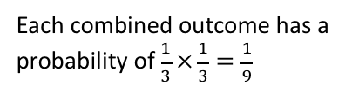
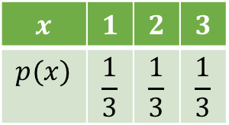


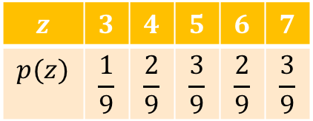
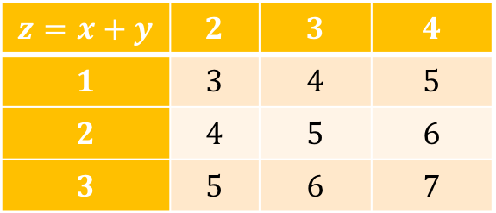
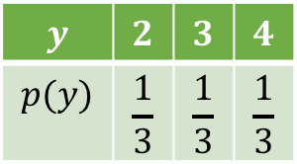
Adding Random Variables
Suppose that we had two fair three-sided spinners, each which could be represented using random variables $X$ and $Y$ respectively:
1
2
2
3
3
4
$$x$$ | $$1$$ | $$2$$ | $$3$$
$$p(x)$$ | $$\frac{1}{3}$$ | $$\frac{1}{3}$$ | $$\frac{1}{3}$$
$$y$$ | $$2$$ | $$3$$ | $$4$$
$$p(y)$$ | $$\frac{1}{3}$$ | $$\frac{1}{3}$$ | $$\frac{1}{3}$$
Then $Z=X+Y$ would represent the distribution of adding each possible outcome from $X$ with each possible outcome from $Y:$
$$z=x+y$$ | $$2$$ | $$3$$ | $$4$$
$$1$$ | $$3$$ | $$4$$ | $$5$$
$$2$$ | $$4$$ | $$5$$ | $$6$$
$$3$$ | $$5$$ | $$6$$ | $$7$$
$$z$$ | $$3$$ | $$4$$ | $$5$$ | $$6$$ | $$7$$
$$p(z)$$ | $$\frac{1}{9}$$ | $$\frac{2}{9}$$ | $$\frac{3}{9}$$ | $$\frac{2}{9}$$ | $$\frac{3}{9}$$
Each combined outcome has a probability of $\frac{1}{3}×\frac{1}{3}=\frac{1}{9}$

Slide 2
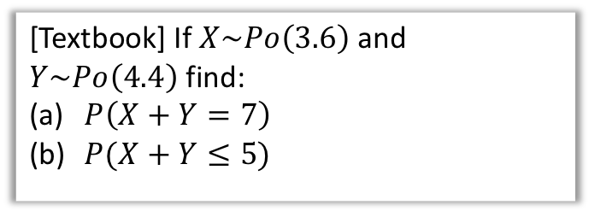
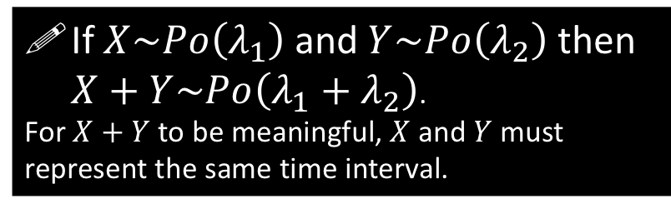
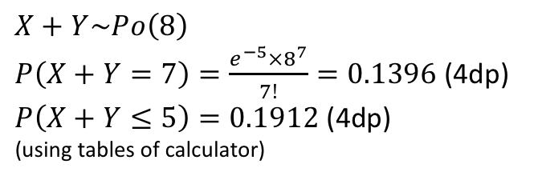
Adding Poisson Distributions
If 5 cars pass per hour in road A and 8 cars pass per hour in road B, how many cars pass per hour in roads A and B combined?
Obviously 13 per hour! This suggests that if we have two Poisson distributions and want to represent the total number of events across the same time interval, we can form a new Poisson distribution in which we simply add the rates.
?
If $X\sim Po\left(λ_{1}\right)$ and $Y\sim Po\left(λ_{2}\right)$ then $X+Y\sim Po\left(λ_{1}+λ_{2}\right)$.
For $X+Y$ to be meaningful, $X$ and $Y$ must represent the same time interval.
[Textbook] If $X\sim Po\left(3.6\right)$ and $Y\sim Po\left(4.4\right)$ find:
$P\left(X+Y=7\right)$
$P(X+Y≤5)$
a
$$X+Y\sim Po\left(8\right)$$
$P\left(X+Y=7\right)=\frac{e^{−5}×8^{7}}{7!}=0.1396$ (4dp)
$P\left(X+Y≤5\right)=0.1912$ (4dp)
(using tables of calculator)
?
b
?

Slide 3
Exercise 2D
Pearson Further Statistics 1
Pages 28-29
Complete before the lesson Q1-3
In Class:
Green Q4-5
Amber Q6-8
Red Q9-10 & Challenge

