Slide 1

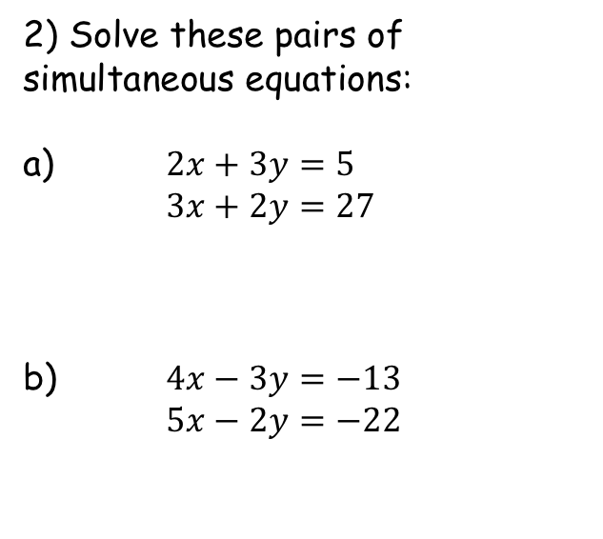

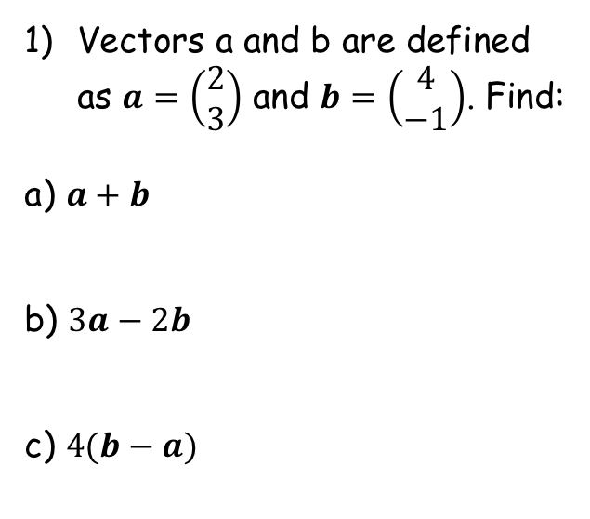


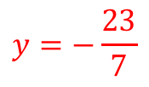

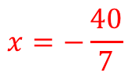
Prior Knowledge Check
Vectors a and b are defined as $a=\left(\begin{matrix}2 \\ 3\end{matrix}\right)$ and $b=\left(\begin{matrix}4 \\ −1\end{matrix}\right)$. Find:
a) $a+b$
b) $3a−2b$
c) $4(b−a)$
2) Solve these pairs of simultaneous equations:
a) $2x+3y=5$
$3x+2y=27$
b) $4x−3y=−13$
$5x−2y=−22$
$$x=7$$
$$\left(\begin{matrix}6 \\ 2\end{matrix}\right)$$
$$y=3$$
$$\left(\begin{matrix}−2 \\ 11\end{matrix}\right)$$
$$x=−\frac{40}{7}$$
$$\left(\begin{matrix}8 \\ −16\end{matrix}\right)$$
$$y=−\frac{23}{7}$$

Slide 2


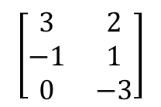

Matrices
You need to know how to find the dimensions of a matrix, and add and subtract matrices of the same dimensions
A matrix is a array of numbers set out in a table of varying shapes and sizes.
These sizes are described as the ‘dimensions’ of the matrix. This is given by two numbers n and m and written in the form n x m.
The letter n represents the number of rows in the matrix, and m represents the number of columns.
Matrices are usually denoted in bold print with a capital letter, for example, ‘The matrix M’
Write the dimensions of the following matrices
a)
$$\left[\begin{matrix}2 & −1 \\ 1 & 3\end{matrix}\right]$$
b)
$$\left[\begin{matrix}1 & 0 & 2\end{matrix}\right]$$
→ 2 rows
→ 1 row
→ 2 columns
→ 3 columns
→ The matrix is 2 x 2
→ The matrix is 1 x 3
c)
$$\left[\begin{matrix}4 \\ −1\end{matrix}\right]$$
d)
$$\left[\begin{matrix}3 & 2 \\ −1 & 1 \\ 0 & −3\end{matrix}\right]$$
→ 2 rows
→ 3 rows
→ 1 column
→ 2 columns
→ The matrix is 2 x 1
→ The matrix is 3 x 2
6A

Slide 3













Matrices
You need to know how to find the dimensions of a matrix, and add and subtract matrices of the same dimensions
You can add and subtract matrices of the same dimensions. To do so, you just add/subtract corresponding elements in each matrix.
(ie – add the same positions together!)
Find the value of:
$$1$$
$$=\left[\begin{matrix} & \\ & \end{matrix}\right]$$
a)
$$\left[\begin{matrix}2 & −1 \\ 0 & 3\end{matrix}\right]+\left[\begin{matrix}−1 & 4 \\ 5 & 3\end{matrix}\right]$$
$$3$$
$$5$$
$$6$$
$$1$$
$$−5$$
b)
$$\left[\begin{matrix}1 & −3 \\ 4 & 2 \\ 1 & 1\end{matrix}\right]−\left[\begin{matrix}0 & 2 \\ 1 & −5 \\ −3 & 2\end{matrix}\right]$$
$$= \left[\begin{matrix} & \\ & \\ & \end{matrix}\right]$$
$$3$$
$$7$$
$$4$$
$$−1$$
6A

Slide 4












Matrices
You need to know how to find the dimensions of a matrix, and add and subtract matrices of the same dimensions
You can use simple algebra when adding or subtracting matrices..
$$A=\left[\begin{matrix}2 & 3 \\ 1 & a\end{matrix}\right]$$
$$B=\left[\begin{matrix}b & −1 \\ 2 & 4\end{matrix}\right]$$
$$C=\left[\begin{matrix}3 & y \\ x & 3\end{matrix}\right]$$
Given that A + B = C, find the values of a, b, x and y
$$\left[\begin{matrix}2 & 3 \\ 1 & a\end{matrix}\right]+\left[\begin{matrix}b & −1 \\ 2 & 4\end{matrix}\right]=\left[\begin{matrix}3 & y \\ x & 3\end{matrix}\right]$$
$$2+b=3$$
$$3−1=y$$
$$b=1$$
$$y=2$$
$$1+2=x$$
$$a+4=3$$
$$x=3$$
$$a=−1$$
6A

Slide 5



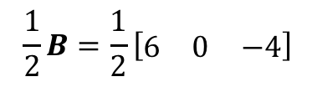


Matrices
You need to know how to multiply a matrix by a scalar value
A scalar value is just a number.
To multiply a matrix by a scalar, you simply multiply each element of the matrix by that number.
$$A=\left[\begin{matrix}1 & 2 \\ −1 & 0\end{matrix}\right]$$
$$B=\left[\begin{matrix}6 & 0 & −4\end{matrix}\right]$$
Find the value of 2A:
$$2A=2\left[\begin{matrix}1 & 2 \\ −1 & 0\end{matrix}\right]$$
Multiply each element by 2
$$=\left[\begin{matrix}2 & 4 \\ −2 & 0\end{matrix}\right]$$
Find the value of ¹/₂B:
$$\frac{1}{2}B=\frac{1}{2}\left[\begin{matrix}6 & 0 & −4\end{matrix}\right]$$
Halve each element (you can use fractions in matrices if the division isn’t exact!)
$$=\left[\begin{matrix}3 & 0 & −2\end{matrix}\right]$$
6A

Slide 6









Matrices
You need to know how to multiply a matrix by a scalar value
A scalar value is just a number.
To multiply a matrix by a scalar, you simply multiply each element of the matrix by that number.
$$A=\left[\begin{matrix}a & 0 \\ 1 & 2\end{matrix}\right]$$
$$B=\left[\begin{matrix}1 & b \\ 0 & 3\end{matrix}\right]$$
$$C=\left[\begin{matrix}6 & 6 \\ 1 & c\end{matrix}\right]$$
Given that A + 2B = C, find the values of a, b and c
$$a+2=6$$
$$a=4$$
$$0+2b=6$$
$$b=3$$
$$2+6=c$$
$$c=8$$
6A

Slide 7
Exercise 6A
Pearson Further Core Mathematics Year 1/AS
Complete before the lesson Q1-5
In Class:
Green Q6-9
Amber Q10-15
Red Q16-18

