Slide 1
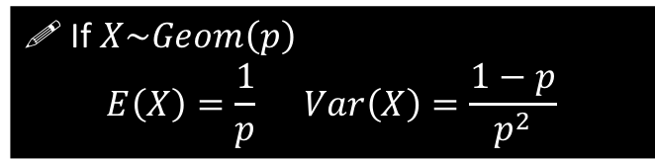
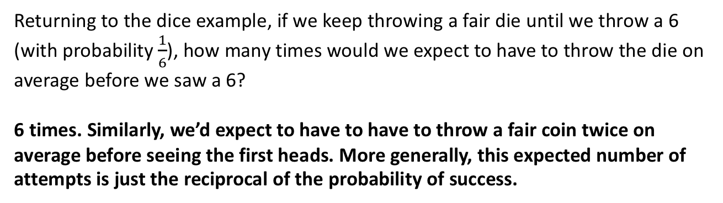
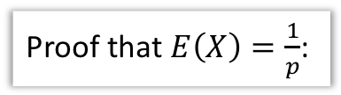

Mean and Variance
Returning to the dice example, if we keep throwing a fair die until we throw a 6 (with probability $\frac{1}{6}$), how many times would we expect to have to throw the die on average before we saw a 6?
6 times. Similarly, we’d expect to have to have to throw a fair coin twice on average before seeing the first heads. More generally, this expected number of attempts is just the reciprocal of the probability of success.
! If $X\sim Geom\left(p\right)$
$$E\left(X\right)=\frac{1}{p} Var\left(X\right)=\frac{1−p}{p^{2}}$$
Proof that $E\left(X\right)=\frac{1}{p}$:
?
$$E\left(X\right)=Σ_{x=1}^{∞}x p\left(x\right) \\ E\left(X\right) =1 p + 2\left(1−p\right)p+3{\left(1−p\right)}^{2}p+… \\ \left(1−p\right)E\left(X\right)= 1\left(1−p\right)p+2{\left(1−p\right)}^{2}p+…$$
Subtracting:
$$E\left(X\right)\left[1−\left(1−p\right)\right]=p+p\left(1−p\right)+p{\left(1−p\right)}^{2}+…$$
This is an infinite geometric series with $a=p, r=1−p$
$$S_{∞}=\frac{a}{1−r}=\frac{p}{1−\left(1−p\right)}=1 \\ ∴pE\left(X\right)=1 → E\left(X\right)=\frac{1}{p}$$
This strategy is similar to that of proving the sum of a geometric series. We find something suitable to multiply by; this effectively shifts the terms along so that subtracting the two sequences yields a simpler sequence that is easily simplified.

Slide 2
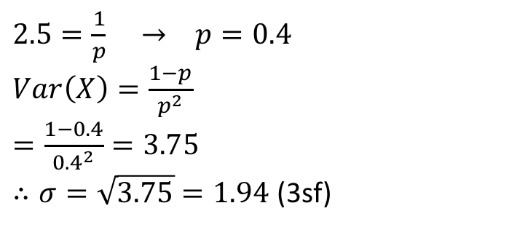
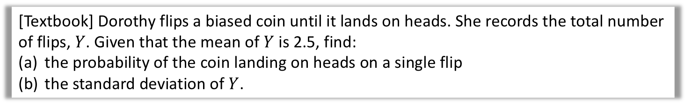
Examples
[Textbook] Dorothy flips a biased coin until it lands on heads. She records the total number of flips, $Y$. Given that the mean of $Y$ is 2.5, find:
the probability of the coin landing on heads on a single flip
the standard deviation of $Y$.
$2.5=\frac{1}{p} → p=0.4$
$Var\left(X\right)=\frac{1−p}{p^{2}}$
$=\frac{1−0.4}{{0.4}^{2}}=3.75$
$∴σ=\sqrt{3.75}=1.94$ (3sf)
a
?
b
?

Slide 3

Exercise 3B
Complete before the lesson Q1-2
Green Q3-4
Amber Q5-6
Red Q7-10
Pearson Further Statistics 1
Pages 47-49
N
One way in which we can use a biased coin, with probability of heads of $p$, to model a fair coin, is to use the following process:
Flip the unfair coin twice.
If the first flip is Heads and the second Tails, declare “Heads”.
If the second flip is Tails and the second Heads, declare “Tails”.
Otherwise, go back to step 1 until a declaration is made.
Determine the average number of flips required of the biased coin, before we can declare “Heads” or “Tails”.
The probability of declaring is $p\left(1−p\right)+p\left(1−p\right)=2p(1−p)$
So number of times we do this process: $X\sim Geo\left(2p\left(1−p\right)\right).$
$E\left(X\right)=\frac{1}{2p\left(1−p\right)}$, but each application of the process involves 2 flips of the coin, so $\frac{2}{2p\left(1−p\right)}=\frac{1}{p\left(1−p\right)}$ flips required on average.
?

