Slide 1
Year 2 Pure Mathematics
Probability
- Mutually Exclusive and Independent
Chapter 6 (Part 3)

Slide 2

Mutually Exclusive Events
If two events are mutually exclusive when
they can’t happen at the same time.
Roll a 4 and odd number with a roll of a dice.
Mutually Exclusive

Slide 3
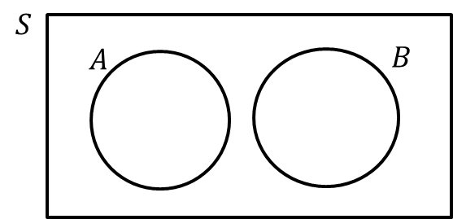
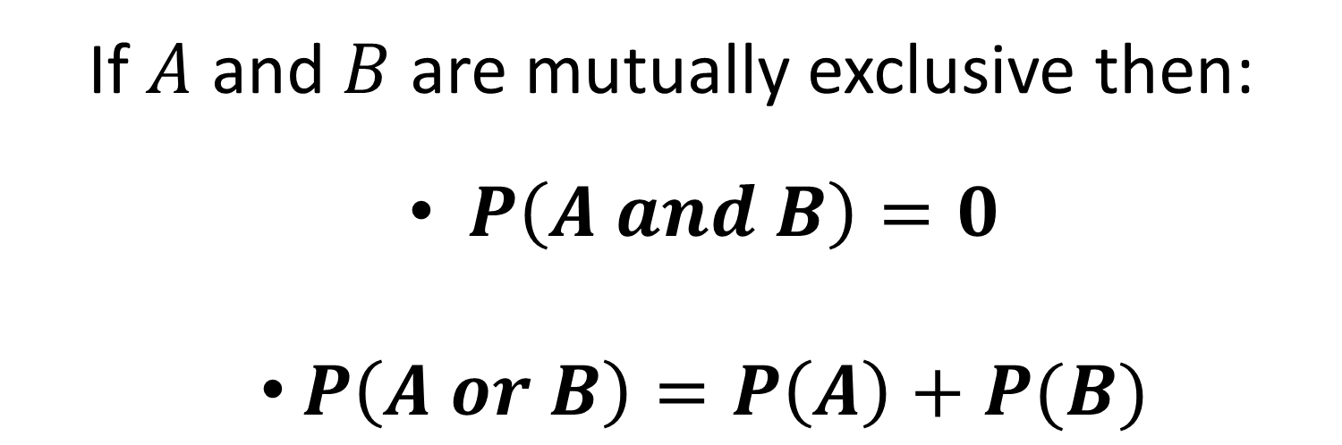
Mutually Exclusive Events
If $A$ and $B$ are mutually exclusive then:
  $P\left(A and B\right)=0$
  $P\left(A or B\right)=P\left(A\right)+P(B)$
Mutually Exclusive
(No Overlap)

Slide 4
Independent Events
If two events are independent then one event
does not affect the probability of the other event.
Rolling a 4 on you first roll does not effect
the probability of rolling a 4 on your second roll.

Slide 5
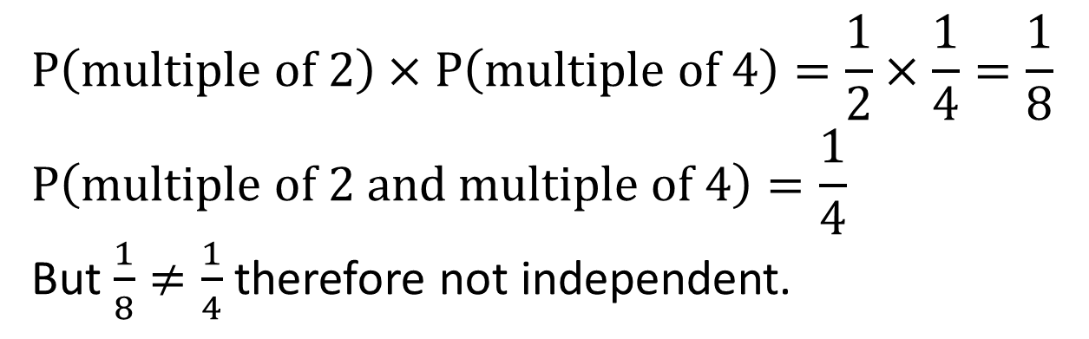
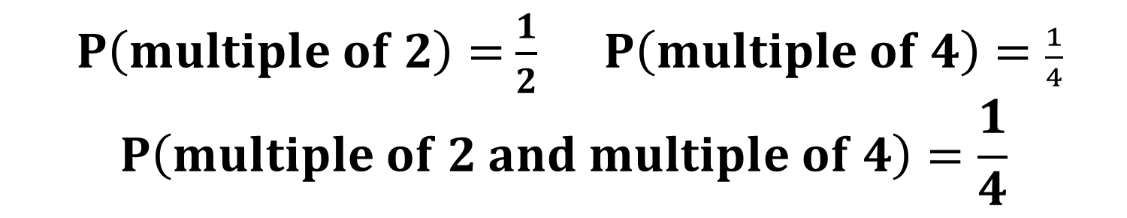
Independent Events
1 2 3 4
$P\left(multiple of 2\right)=$ $\frac{1}{2} P\left(multiple of 4\right)=\frac{1}{4}$
$$P\left(multiple of 2 and multiple of 4\right)=\frac{1}{4}$$
Show that the events are not independent.
$$P\left(multiple of 2\right)×P\left(multiple of 4\right)=\frac{1}{2}×\frac{1}{4}=\frac{1}{8} \\ P\left(multiple of 2 and multiple of 4\right)=\frac{1}{4}$$
But $\frac{1}{8}≠\frac{1}{4}$ therefore not independent.

Slide 6

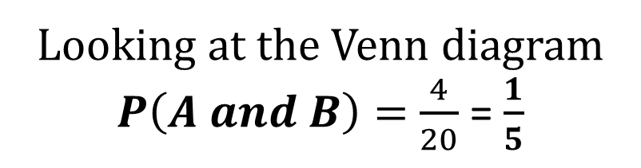



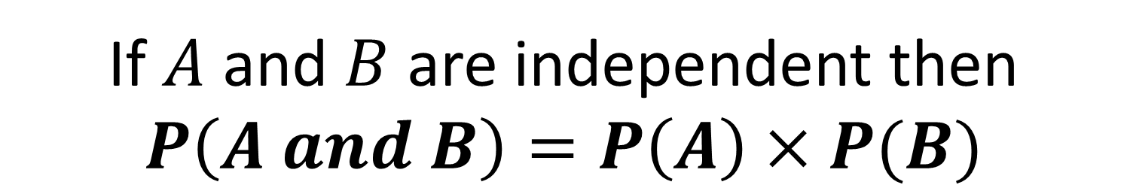



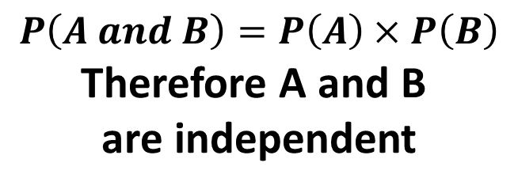



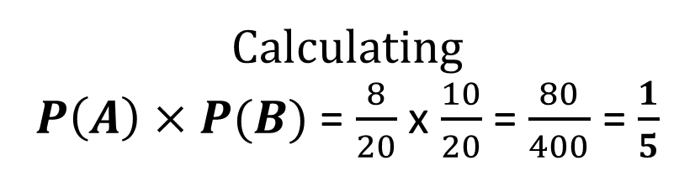
Independent Events
If $A$ and $B$ are independent then
$$P\left(A and B\right)=P\left(A\right)×P(B)$$
$$S$$
$$B$$
$$A$$
$$C$$
$$4$$
$$4$$
$$5$$
$$1$$
$$5$$
$$1$$
Looking at the Venn diagram
$P\left(A and B\right)=$ $\frac{4}{20}$ = $\frac{1}{5}$
$$P\left(A and B\right)=P\left(A\right)×P\left(B\right)$$
Therefore A and B
are independent
Calculating
$P\left(A\right)×P(B)$ = $\frac{8}{20}$ x $\frac{10}{20}$ = $\frac{80}{400}$ = $\frac{1}{5}$

Slide 7
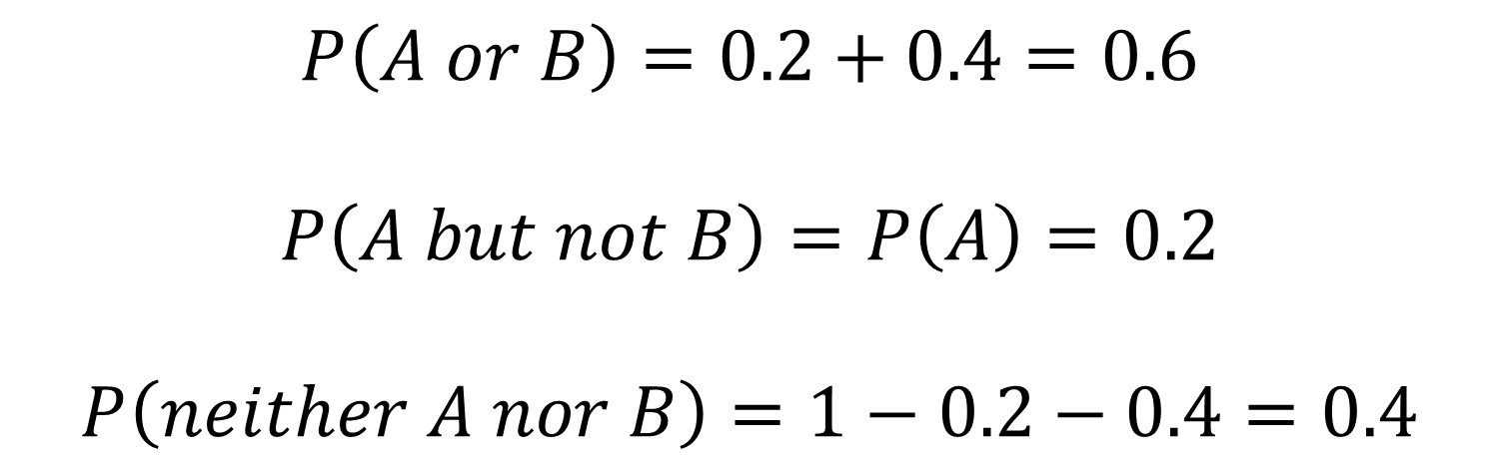
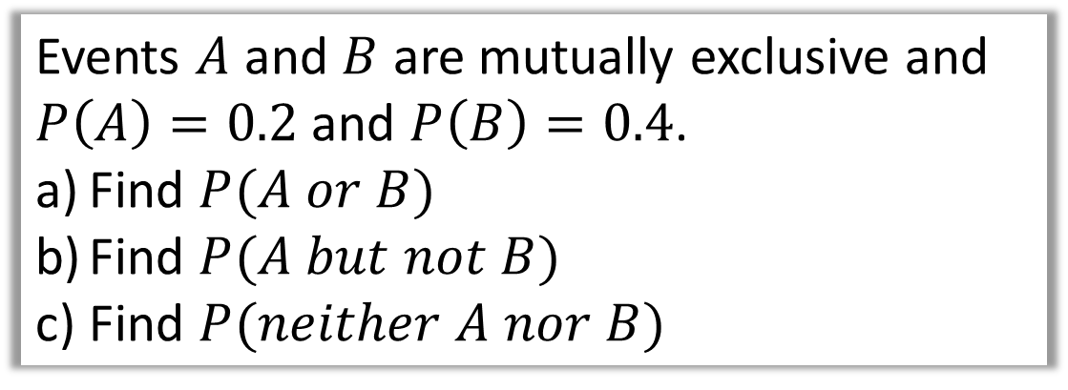
Test Your Understanding
Events $A$ and $B$ are mutually exclusive and
$P\left(A\right)=0.2$ and $P\left(B\right)=0.4$.
Find $P(A or B)$
Find $P(A but not B)$
Find $P(neither A nor B)$
$$P\left(A or B\right)=0.2+0.4=0.6$$
$$P\left(A but not B\right)=P\left(A\right)=0.2$$
$$P\left(neither A nor B\right)=1−0.2−0.4=0.4$$

Slide 8

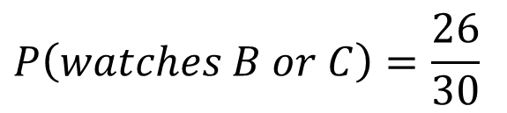



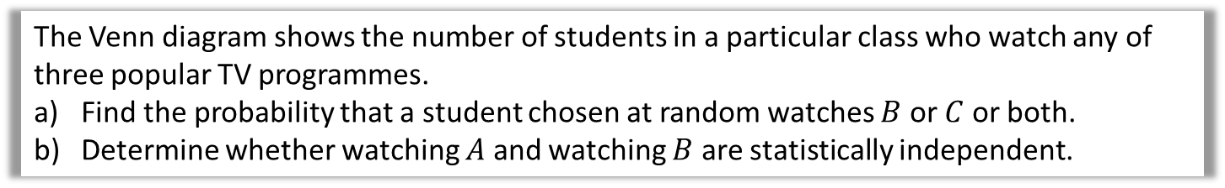






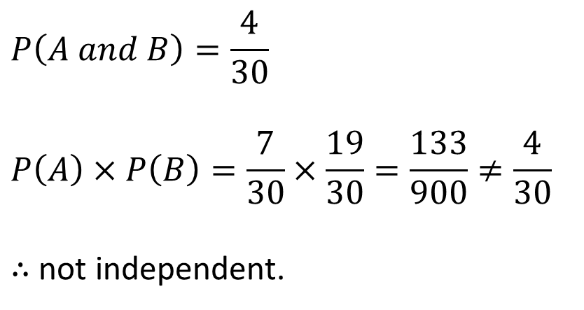
Test Your Understanding
The Venn diagram shows the number of students in a particular class who watch any of three popular TV programmes.
Find the probability that a student chosen at random watches $B$ or $C$ or both.
Determine whether watching $A$ and watching $B$ are statistically independent.
$$S$$
$$B$$
$$A$$
$$C$$
$$3$$
$$4$$
$$5$$
$$10$$
$$7$$
$$1$$
$$P\left(watches B or C\right)=\frac{26}{30}$$
$$P\left(A and B\right)=\frac{4}{30}$$
$$P\left(A\right)×P\left(B\right)=\frac{7}{30}×\frac{19}{30}=\frac{133}{900}≠\frac{4}{30}$$
$∴$ not independent.

Slide 9
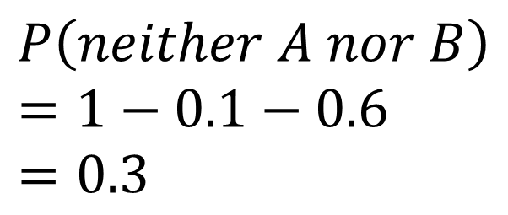

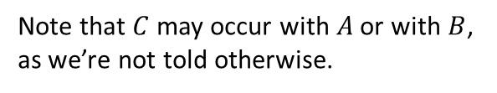

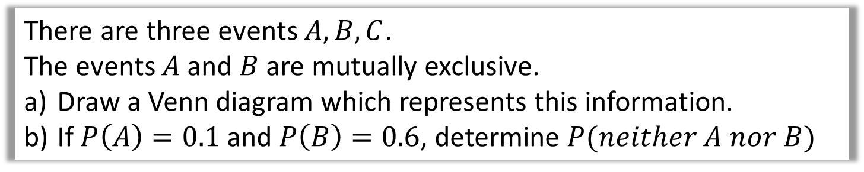


Test Your Understanding
There are three events $A,B,C$.
The events $A$ and $B$ are mutually exclusive.
Draw a Venn diagram which represents this information.
If $P\left(A\right)=0.1$ and $P\left(B\right)=0.6$, determine $P(neither A nor B)$
$$S$$
$$C$$
$$P\left(neither A nor B\right) \\ =1−0.1−0.6=0.3$$
$$A$$
$$B$$
Note that $C$ may occur with $A$ or with $B$, as we’re not told otherwise.

Slide 10
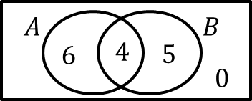
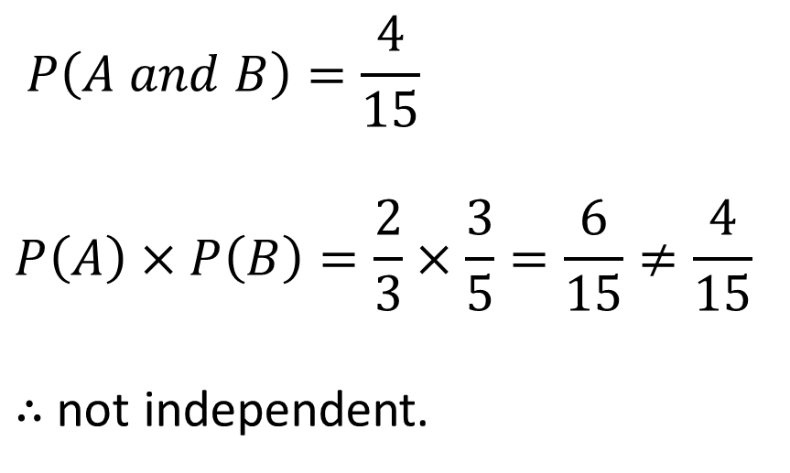
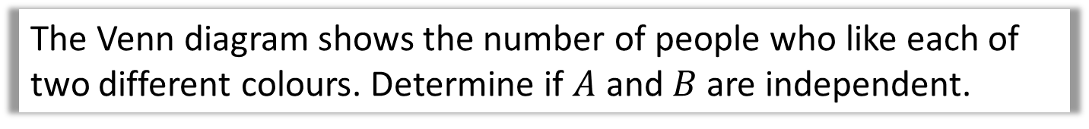
Test Your Understanding
The Venn diagram shows the number of people who like each of two different colours. Determine if $A$ and $B$ are independent.
$$P\left(A and B\right)=\frac{4}{15}$$
$$P\left(A\right)×P\left(B\right)=\frac{2}{3}×\frac{3}{5}=\frac{6}{15}≠\frac{4}{15}$$
$∴$ not independent.

Slide 11
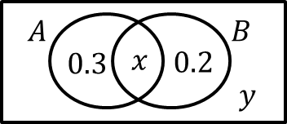
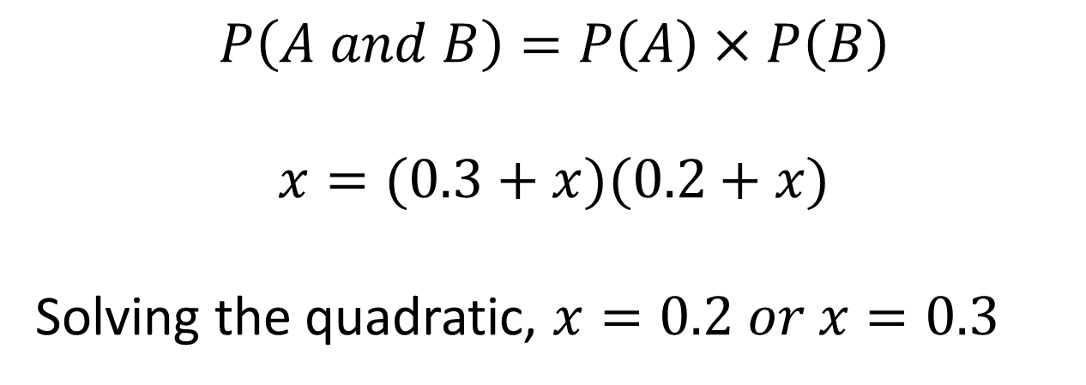
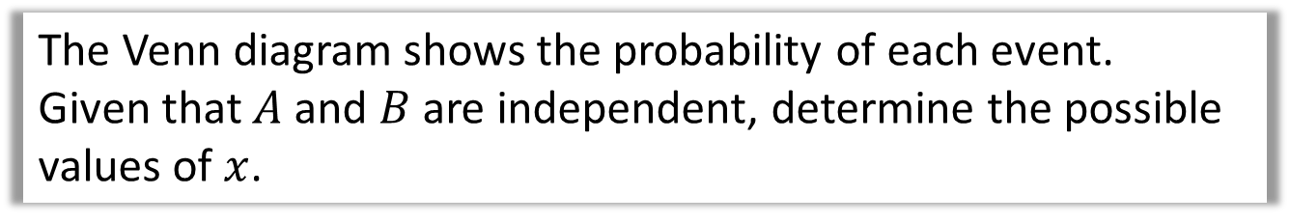
Test Your Understanding
The Venn diagram shows the probability of each event.
Given that $A$ and $B$ are independent, determine the possible values of $x$.
$$P\left(A and B\right)=P\left(A\right)×P\left(B\right)$$
$$x=(0.3+x)(0.2+x)$$
Solving the quadratic, $x=0.2 or x=0.3$

Slide 12
Exercise 5C
Pearson Pure Mathematics Year 1/AS
Pages 77-78
Complete before the lesson Q1-4
In Class:
Green Q5-6
Amber Q7
Red Q8-10 & Challenge

