Slide 1
Methods in
Differential Equations
Twitter: @Owen134866
www.mathsfreeresourcelibrary.com

Slide 2
Teachings for
Exercise 7D

Slide 3
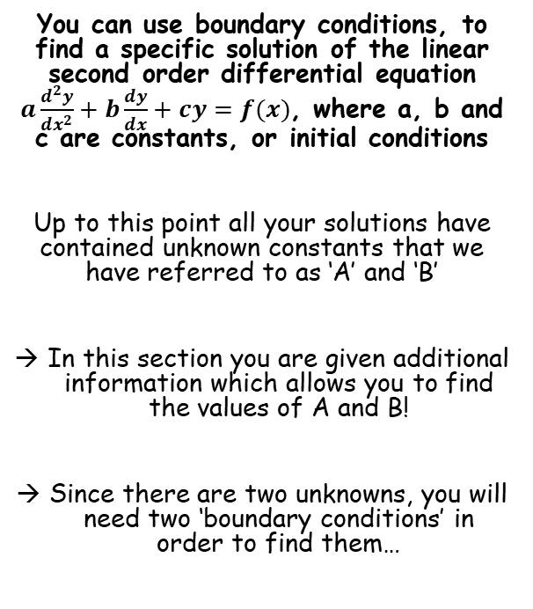
Methods in Differential Equations
You can use boundary conditions, to find a specific solution of the linear second order differential equation $a\frac{d^{2}y}{{dx}^{2}}+b\frac{dy}{dx}+cy=f(x)$, where a, b and c are constants, or initial conditions
Up to this point all your solutions have contained unknown constants that we have referred to as ‘A’ and ‘B’
In this section you are given additional information which allows you to find the values of A and B!
Since there are two unknowns, you will need two ‘boundary conditions’ in order to find them…
7D

Slide 4





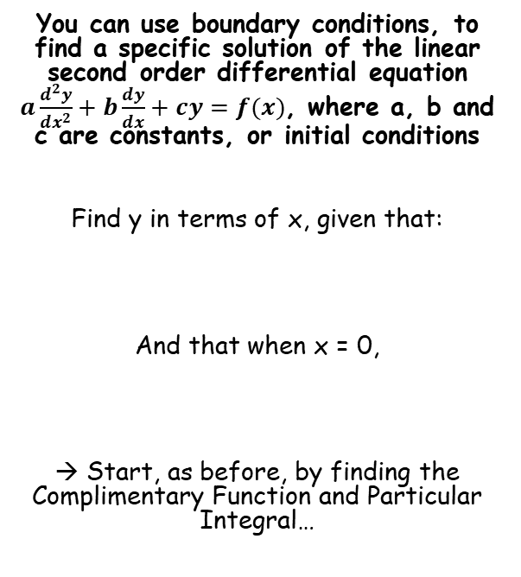







Methods in Differential Equations
$$(A+Bx)e^{mx}$$
$$Ae^{m_{1}x}+Be^{m_{2}x}$$
$$e^{px}\left(Acosqx+Bsinqx\right)$$
Complimentary Function
You can use boundary conditions, to find a specific solution of the linear second order differential equation $a\frac{d^{2}y}{{dx}^{2}}+b\frac{dy}{dx}+cy=f(x)$, where a, b and c are constants, or initial conditions
Find y in terms of x, given that:
And that when x = 0,
→ Start, as before, by finding the Complimentary Function and Particular Integral…
$$\frac{d^{2}y}{{dx}^{2}}−y=0$$
Form the auxiliary equation
$$m^{2}−1=0$$
Add 1
$$m^{2}=1$$
Square root
$$m=1 or −1$$
$$\frac{d^{2}y}{{dx}^{2}}−y=2e^{x}$$
Sub the two answers into the ‘real roots’ form above
$$Ae^{m_{1}x}+Be^{m_{2}x}$$
$$y=0 and \frac{dy}{dx}=0$$
m₁ = 1 and m₂ = -1
$$Ae^{x}+Be^{−x}$$
$$CF=Ae^{x}+Be^{−x}$$
7D

Slide 5



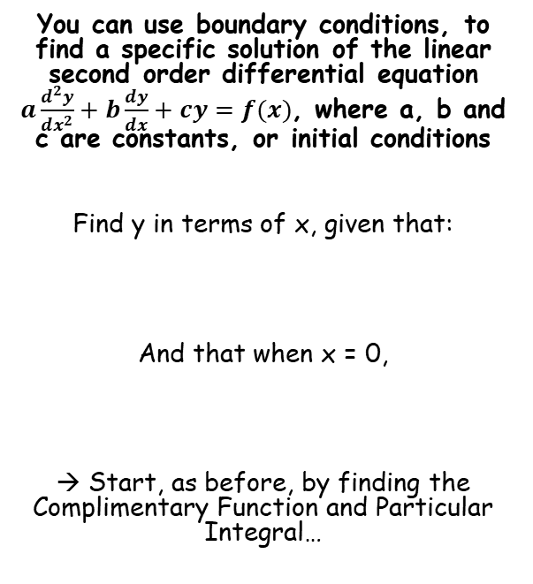















Methods in Differential Equations
$$(A+Bx)e^{mx}$$
$$Ae^{m_{1}x}+Be^{m_{2}x}$$
$$e^{px}\left(Acosqx+Bsinqx\right)$$
We cannot use λe^{x} as this is a part of the complimentary function
Particular Integral
You can use boundary conditions, to find a specific solution of the linear second order differential equation $a\frac{d^{2}y}{{dx}^{2}}+b\frac{dy}{dx}+cy=f(x)$, where a, b and c are constants, or initial conditions
Find y in terms of x, given that:
And that when x = 0,
→ Start, as before, by finding the Complimentary Function and Particular Integral…
$$f\left(x\right)=2e^{x}$$
$$Let y=λ{xe}^{x}$$
→ Include x in the expression for y
Now differentiate this expression for y (we will need the product rule!)
$$y=λ{xe}^{x}$$
$$\frac{d^{2}y}{{dx}^{2}}−y=2e^{x}$$
Differentiate, using the product rule
$$\frac{dy}{dx}=$$
$$λ{xe}^{x}$$
$$+ λe^{x}$$
Differentiate again (the first part needs the product rule, but is identical to the first one we already did!)
$$\frac{d^{2}y}{{dx}^{2}}=$$
$$y=0 and \frac{dy}{dx}=0$$
$$λ{xe}^{x}+λe^{x}$$
$$+ λe^{x}$$
$$\frac{d^{2}y}{{dx}^{2}}=λ{xe}^{x}+2λe^{x}$$
Simplify
$$\frac{d^{2}y}{{dx}^{2}}−y=2e^{x}$$
$$CF=Ae^{x}+Be^{−x}$$
Product rule for λxe^{x}
$$u=λx$$
$$v=e^{x}$$
Replace differentials
$$PI=xe^{x}$$
$$λ{xe}^{x}+2λe^{x}−λ{xe}^{x}=2e^{x}$$
$$\frac{du}{dx}=λ$$
$$\frac{dv}{dx}=e^{x}$$
$$y=Ae^{x}+Be^{−x}+xe^{x}$$
λ = 1 as the other terms will cancel out…
7D

Slide 6



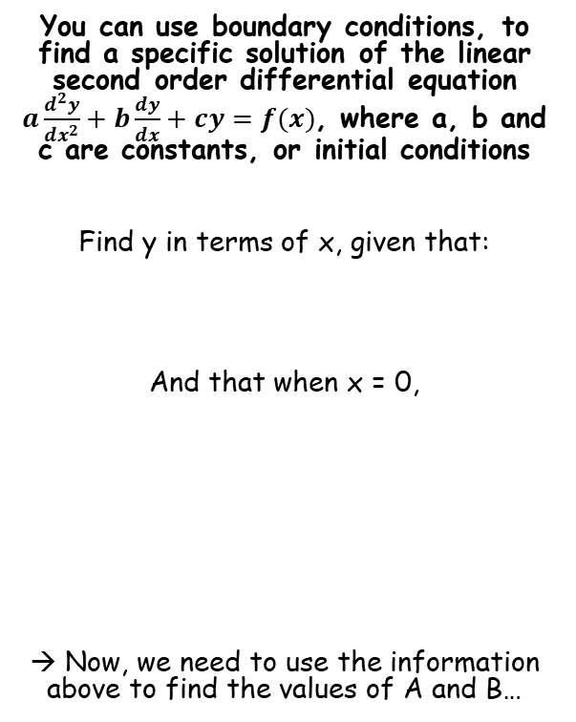




Methods in Differential Equations
$$(A+Bx)e^{mx}$$
$$Ae^{m_{1}x}+Be^{m_{2}x}$$
$$e^{px}\left(Acosqx+Bsinqx\right)$$
You can use boundary conditions, to find a specific solution of the linear second order differential equation $a\frac{d^{2}y}{{dx}^{2}}+b\frac{dy}{dx}+cy=f(x)$, where a, b and c are constants, or initial conditions
Find y in terms of x, given that:
And that when x = 0,
→ Now, we need to use the information above to find the values of A and B…
$$y=Ae^{x}+Be^{−x}+xe^{x}$$
When x = 0, y = 0
$$(0)=Ae^{\left(0\right)}+Be^{−\left(0\right)}+(0)e^{(0)}$$
Calculate
$$0=A+B$$
$$y=Ae^{x}+Be^{−x}+xe^{x}$$
$$\frac{d^{2}y}{{dx}^{2}}−y=2e^{x}$$
Differentiate (using the product rule for xe^{x})
$$\frac{dy}{dx}=Ae^{x}−Be^{−x}+xe^{x}+e^{x}$$
When x = 0, ^{dy}/_{dx} = 0
$$y=0 and \frac{dy}{dx}=0$$
$$(0)=Ae^{\left(0\right)}−Be^{−\left(0\right)}+x(0)e^{(0)}+e^{(0)}$$
Calculate
$$0=A−B+1$$
$$y=Ae^{x}+Be^{−x}+xe^{x}$$
Rearrange
$$−1=A−B$$
7D

Slide 7





Methods in Differential Equations
$$(A+Bx)e^{mx}$$
$$Ae^{m_{1}x}+Be^{m_{2}x}$$
$$e^{px}\left(Acosqx+Bsinqx\right)$$
You can use boundary conditions, to find a specific solution of the linear second order differential equation $a\frac{d^{2}y}{{dx}^{2}}+b\frac{dy}{dx}+cy=f(x)$, where a, b and c are constants, or initial conditions
Find y in terms of x, given that:
And that when x = 0,
→ Now, we need to use the information above to find the values of A and B…
$$0=A+B$$
$$−1=A−B$$
Add together
$$−1=2A$$
$$−\frac{1}{2}=A$$
Solve
$$\frac{d^{2}y}{{dx}^{2}}−y=2e^{x}$$
Use this to find B
$$\frac{1}{2}=B$$
$$y=0 and \frac{dy}{dx}=0$$
Now we have A and B, we finally have the solution of the differential equation, given the conditions we were told!
$$y=Ae^{x}+Be^{−x}+xe^{x}$$
$$y=−\frac{1}{2}e^{x}+\frac{1}{2}e^{−x}+xe^{x}$$
7D

Slide 8




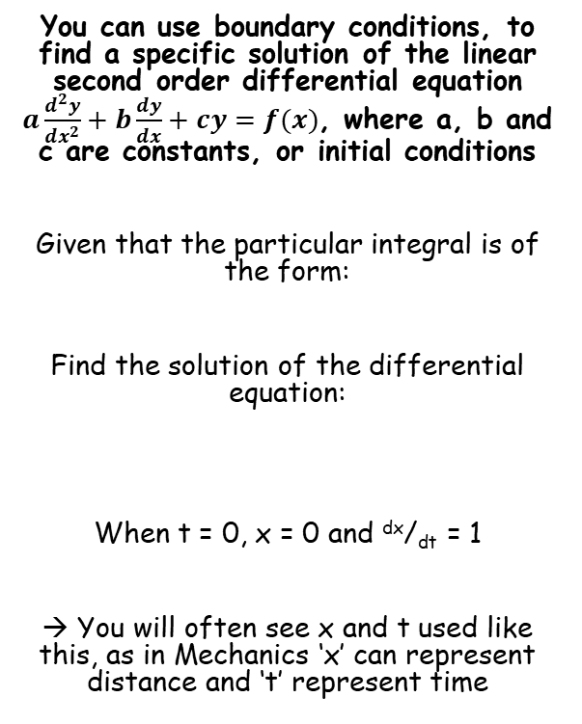





Methods in Differential Equations
$$(A+Bx)e^{mx}$$
$$Ae^{m_{1}x}+Be^{m_{2}x}$$
$$e^{px}\left(Acosqx+Bsinqx\right)$$
Complimentary Function
You can use boundary conditions, to find a specific solution of the linear second order differential equation $a\frac{d^{2}y}{{dx}^{2}}+b\frac{dy}{dx}+cy=f(x)$, where a, b and c are constants, or initial conditions
Given that the particular integral is of the form:
Find the solution of the differential equation:
When t = 0, x = 0 and ^{dx}/_{dt} = 1
→ You will often see x and t used like this, as in Mechanics ‘x’ can represent distance and ‘t’ represent time
$$\frac{d^{2}x}{{dt}^{2}}+x=0$$
Form the auxiliary equation
$$m^{2}+1=0$$
Subtract 1
$$m^{2}=−1$$
Square root
$$m=±i$$
$$λsin2t$$
Sub the two answers into the ‘imaginary roots’ form above
(remember as there is no real part, we can ignore the part outside the bracket…)
$$\frac{d^{2}x}{{dt}^{2}}+x=3sin2t$$
$$Acosqt+Bsinqt$$
q = 1 (as it is ±1i)
→ Also, remember that for this example we are using t, not x here!
$$Acost+Bsint$$
$$CF=Acost+Bsint$$
7D

Slide 9










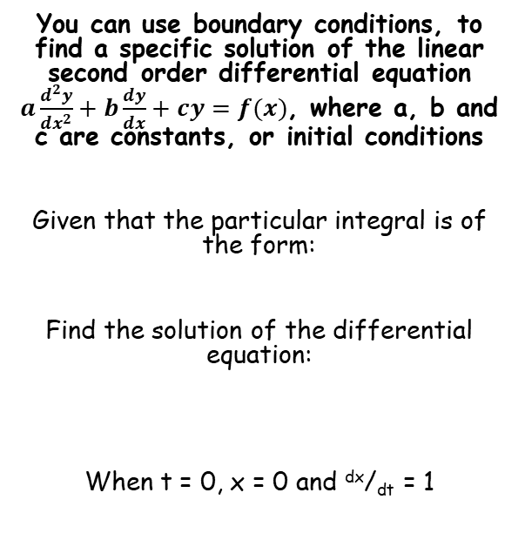


Methods in Differential Equations
$$(A+Bx)e^{mx}$$
$$Ae^{m_{1}x}+Be^{m_{2}x}$$
$$e^{px}\left(Acosqx+Bsinqx\right)$$
Use the form you’re given!
Particular Integral
You can use boundary conditions, to find a specific solution of the linear second order differential equation $a\frac{d^{2}y}{{dx}^{2}}+b\frac{dy}{dx}+cy=f(x)$, where a, b and c are constants, or initial conditions
Given that the particular integral is of the form:
Find the solution of the differential equation:
When t = 0, x = 0 and ^{dx}/_{dt} = 1
$$f\left(t\right)=3sin2t$$
$$Let x=λsin2t$$
Remember to use x in place of y, and t in place of x
$$x=λsin2t$$
$$\frac{dx}{dt}=2λcos2t$$
Differentiate
Differentiate again
$$λsin2t$$
$$\frac{d^{2}x}{{dt}^{2}}=−4λsin2t$$
$$\frac{d^{2}x}{{dt}^{2}}+x=3sin2t$$
$$\frac{d^{2}x}{{dt}^{2}}+x=3sin2t$$
Replace the differentials
$$−4λsin2t+λsin2t=3sin2t$$
Simplify
$$CF=Acost+Bsint$$
$$−3λsin2t=3sin2t$$
Calculate λ
$$PI=−sin2t$$
$$λ=−1$$
$$x=Acost+Bsint−sin2t$$
7D

Slide 10



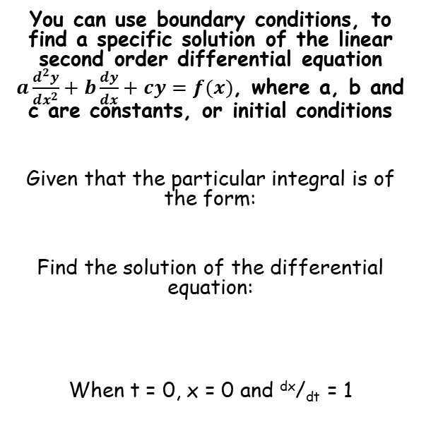






Methods in Differential Equations
$$(A+Bx)e^{mx}$$
$$Ae^{m_{1}x}+Be^{m_{2}x}$$
$$e^{px}\left(Acosqx+Bsinqx\right)$$
$$x=Acost+Bsint−sin2t$$
You can use boundary conditions, to find a specific solution of the linear second order differential equation $a\frac{d^{2}y}{{dx}^{2}}+b\frac{dy}{dx}+cy=f(x)$, where a, b and c are constants, or initial conditions
Given that the particular integral is of the form:
Find the solution of the differential equation:
When t = 0, x = 0 and ^{dx}/_{dt} = 1
When t = 0, x = 0
$$(0)=Acos(0)+Bsin(0)−sin2(0)$$
Calculate
$$0=A$$
As we found the value of A straight away, we can update the equation for x…
(This is an important step as it can make the next step, differentiation, much easier)
$$λsin2t$$
$$x=Bsint−sin2t$$
$$\frac{dx}{dt}=Bcost−2cos2t$$
Differentiate
$$\frac{d^{2}x}{{dt}^{2}}+x=3sin2t$$
When t = 0, ^{dx}/_{dt} = 1
$$\left(1\right)=Bcos(0)−2cos2(0)$$
Calculate
$$1=B−2$$
$$x=Acost+Bsint−sin2t$$
Add 2
Update, with A = 0 and B = 3
$$3=B$$
$$x=3sint−sin2t$$
Check that it makes the differential equation work!
7D

Slide 11
Exercise 7D
Pearson Core Pure Year 2
Pages 164-165
Complete before the lesson Q1
In Class:
Green Q2-5
Amber Q6-9
Red Q10-13

