Slide 1
Year 2 Applied Mathematics
Normal Distribution
– Approximating Binomial Distribution
Chapter 3 (Part 6)

Slide 2
Approximating a Binomial Distribution
Watch the first 4 min and 35 secs
to get an appreciation of using
a normal distribution to
approximate a binomial distribution.
https://youtu.be/z2HoOWn914o

Slide 3
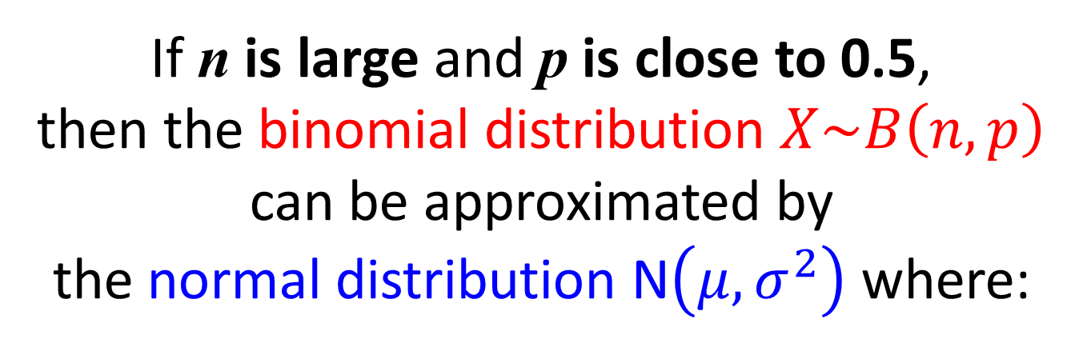
Approximating a Binomial Distribution
If n is large and p is close to 0.5,
then the binomial distribution $X\sim B\left(n,p\right)$
can be approximated by
the normal distribution N$\left(μ, σ^{2}\right)$ where:
Probability
27
28
29
30
31
32
33
Outcomes

Slide 4
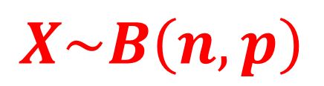
Approximating a Binomial Distribution
Binomial Distribution
(Discrete Random Variable)
$$X\sim B\left(n,p\right)$$
Probability
x
27
28
29
30
31
32
33

Slide 5
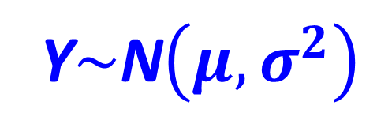
Approximating a Binomial Distribution
Normal Distribution
(Continuous Random Variable)
Y$\sim$N$\left(μ, σ^{2}\right)$
Probability
Y
27
28
29
30
31
32
33

Slide 6
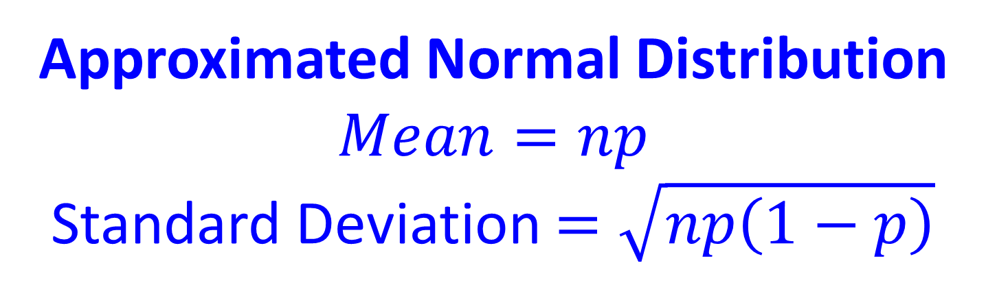
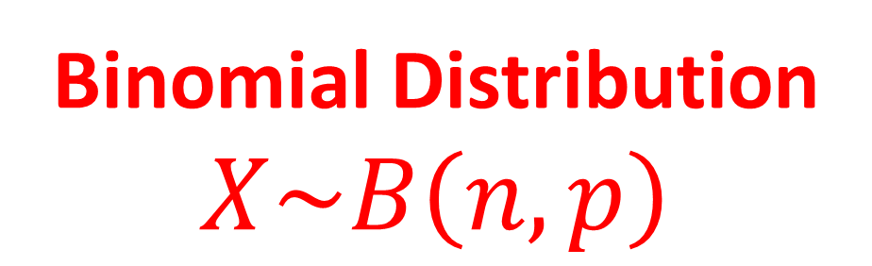
Approximating a Binomial Distribution
Binomial Distribution
$$X\sim B\left(n,p\right)$$
Approximated Normal Distribution
$$Mean=np$$
Standard Deviation $=\sqrt{np\left(1−p\right)}$

Slide 7

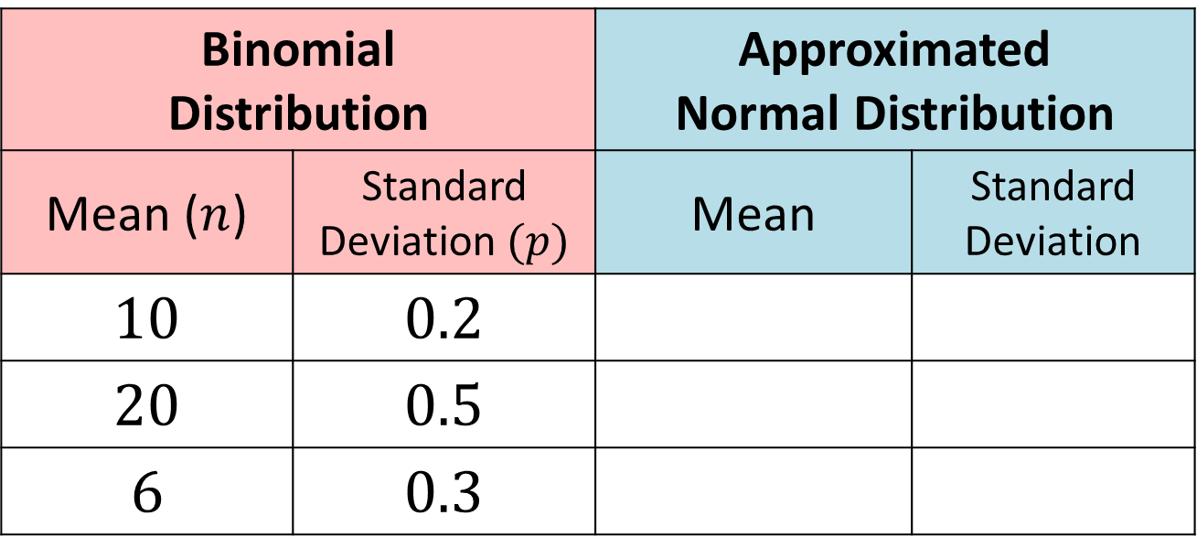

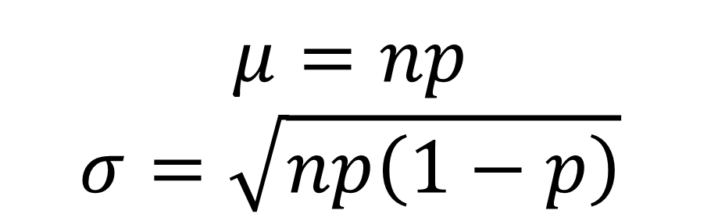




Approximating a Binomial Distribution
$$μ=np$$
$$σ=\sqrt{np\left(1−p\right)}$$
Binomial Distribution |  | Approximated Normal Distribution
Mean ($n$) | Standard Deviation $(p)$ | Mean | Standard Deviation
$$10$$ | $$0.2$$
$$20$$ | $$0.5$$
$$6$$ | $$0.3$$
$$2$$
$$1.6$$
$$10$$
$$5$$
$$1.8$$
$$1.26$$

Slide 8
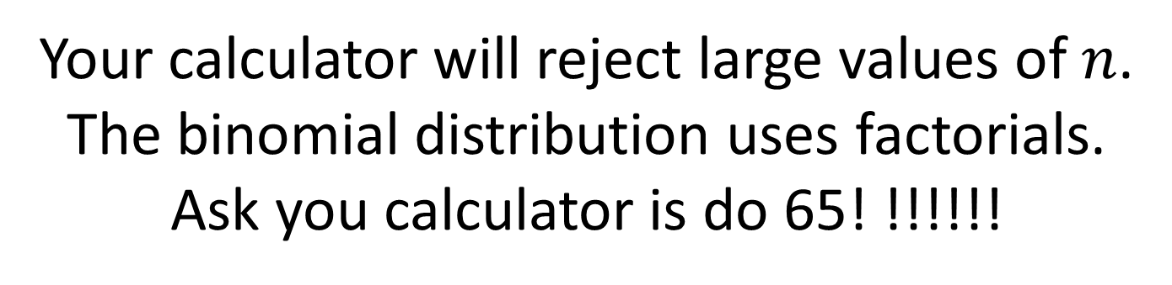
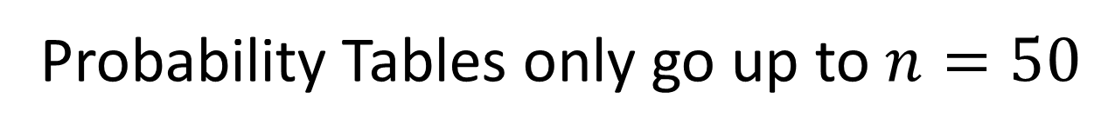
Approximating a Binomial Distribution
Why use a normal approximation?
Probability Tables only go up to $n=50$
Your calculator will reject large values of $n$.
The binomial distribution uses factorials.
Ask you calculator is do 65! !!!!!!

Slide 9
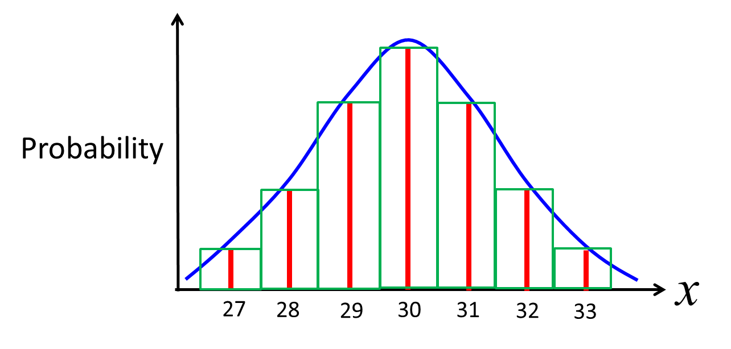
Continuity Correction
Binomial Distribution =
Discrete Data (i.e. number of successes)
Normal Distribution =
Continuous Data (i.e cumulative probability)
Therefore you have to apply something called a
continuity correction.

Slide 10
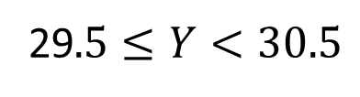

Continuity Correction
Probability
x
27
28
29
30
31
32
33
Discrete:
$$X=30$$
Continuous:
29$.5≤Y<30.5$
27 28 29 30 31 32 33

Slide 11


Continuity Correction
Probability
x
27
28
29
30
31
32
33
Discrete:
$$P(X<32)$$
Continuous:
$$P(X<31.5)$$
27 28 29 30 31 32 33

Slide 12


Continuity Correction
Probability
x
27
28
29
30
31
32
33
Discrete:
$$P(X≤29)$$
Continuous:
$$P(X<29.5)$$
27 28 29 30 31 32 33

Slide 13


Approximating a Binomial Distribution – Continuity Correction
Probability
x
27
28
29
30
31
32
33
Discrete:
$$P(X>28)$$
Continuous:
$$P(X≥28.5)$$
27 28 29 30 31 32 33

Slide 14


Approximating a Binomial Distribution
Probability
x
27
28
29
30
31
32
33
Discrete:
$$P(X≥31)$$
Continuous:
$$P(X≥30.5)$$
27 28 29 30 31 32 33

Slide 15


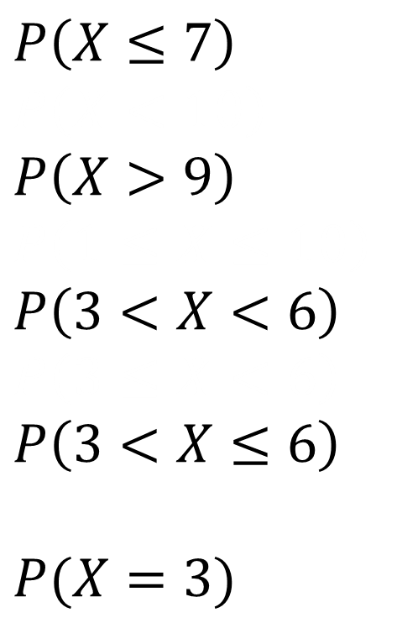



Approximating a Binomial Distribution – Continuity Correction
Discrete
Continuous
$$P\left(X≤7\right) \\ P\left(X<10\right) \\ P\left(X>9\right) \\ P\left(1≤X≤10\right) \\ P\left(3<X<6\right) \\ P\left(3≤X<6\right)$$
$$P\left(3<X≤6\right)$$
$$P(X=3)$$
$$≈P\left(Y<7.5\right)$$
$$≈P\left(Y≥9.5\right)$$
$$≈P\left(3.5≤Y<5.5\right)$$
$$≈P\left(3.5≤X<5.5\right)$$
$$≈P\left(2.5≤X<3.5\right)$$

Slide 16
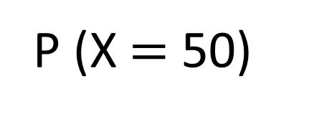

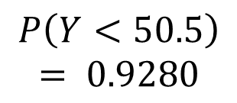

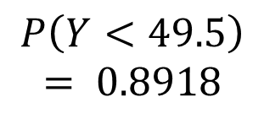
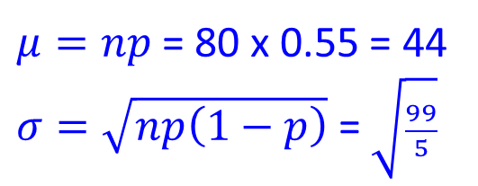
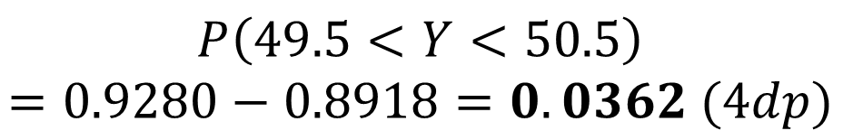
Exam Question
For a particular type of flower bulbs, 55% will produce yellow flowers. A random sample of 80 bulbs is planted.
Calculate the actual probability that there are exactly 50 flowers.
Use a normal approximation to find a estimate that there are exactly 50 flowers.
a
b
$$P\left(X=50\right)≈P\left(49.5<Y<50.5\right)$$
$$X\sim B\left(80, 0.55\right)$$
$μ=np$ = 80 x 0.55 = 44
$σ=\sqrt{np\left(1−p\right)}$ = $\sqrt{\frac{99}{5}}$
P (X $=$ 50)
Binomial PD
X = 50
N = 80
P = 0.55
Normal CD
Lower = 0
Upper = 49.5
Normal CD
Lower = 0
Upper = 50.5
$$P\left(Y<49.5\right)= 0.8918$$
$$P\left(Y<50.5\right)= 0.9280$$
$$=0.0365$$
$$P\left(49.5<Y<50.5\right)=0.9280−0.8918=0.0362 (4dp)$$

Slide 17
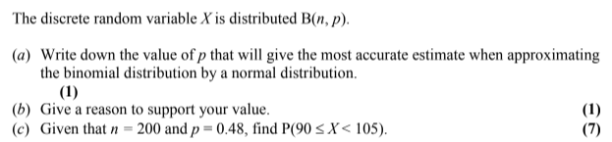
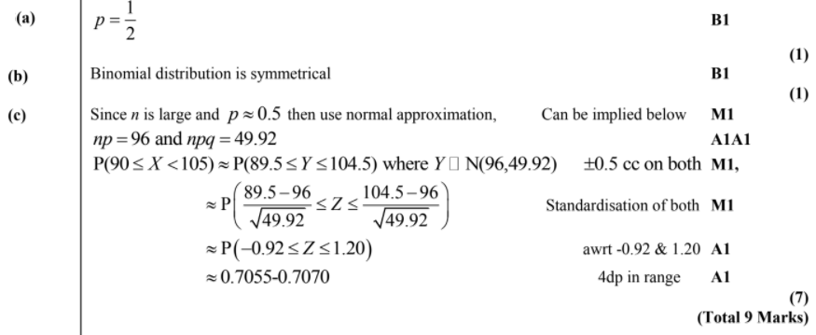

Test Your Understanding
Edexcel S2 Jan 2004 Q3
?
?
?
$$\sim$$

Slide 18
Exercise 3F
Pearson Stats/Mechanics Year 2
Page 55
Complete before the lesson Q1-3
In Class:
Green Q4-6
Amber Q7-8
Red Q9

