Slide 1
Roots of Polynomials
You need to recognize some patterns involving the roots of cubic equations
We can follow a similar process as the one we did for quadratics…
If the cubic equation ${ax}^{3}+{bx}^{2}+cx+d=0$ has the roots $α$, $β$ and $γ$, then the following relationship can be written…
$${ax}^{3}+{bx}^{2}+cx+d=a\left(x−α\right)\left(x−β\right)\left(x−γ\right)$$
Expand the triple bracket
$${ax}^{3}+{bx}^{2}+cx+d=a\left(x^{3}−αx^{2}−βx^{2}−γx^{2}+αβx+βγx+γαx−αβγ\right)$$
Group like terms and factorise
$${ax}^{3}+{bx}^{2}+cx+d=a\left(x^{3}−(α+β+γ)x^{2}+\left(αβ+βγ+γα\right)x−αβγ\right)$$
$$x^{3}+{\frac{b}{a}x}^{2}+\frac{c}{a}x+\frac{d}{a}=x^{3}−(α+β+γ)x^{2}+\left(αβ+βγ+γα\right)x−αβγ$$
Divide all by a
4B

Slide 2









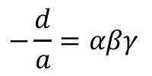
Roots of Polynomials
You need to recognize some patterns involving the roots of cubic equations
We can follow a similar process as the one we did for quadratics…
$$x^{3}+{\frac{b}{a}x}^{2}+\frac{c}{a}x+\frac{d}{a}=x^{3}−(α+β+γ)x^{2}+\left(αβ+βγ+γα\right)x−αβγ$$
Compare coefficients of $x$
Compare constants
Compare coefficients of $x^{2}$
$$\frac{b}{a}=−\left(α+β+γ\right)$$
$$\frac{c}{a}=αβ+βγ+γα$$
$$\frac{d}{a}=−αβγ$$
$$−\frac{b}{a}=α+β+γ$$
$$−\frac{d}{a}=αβγ$$
→ The sum of the ‘single roots’ is $−\frac{b}{a}$
→ The sum of the ‘double roots’ is $\frac{c}{a}$
→ The sum of the ‘triple roots’ is $−\frac{d}{a}$
4B

Slide 3










Roots of Polynomials
$$α+β+γ=−\frac{b}{a}$$
$$αβ+βγ+γα=\frac{c}{a}$$
$$αβγ=−\frac{d}{a}$$
You need to recognize some patterns involving the roots of cubic equations
Comparing the patterns with quadratics and cubics
$${ax}^{2}+bx+c=0$$
$${ax}^{3}+bx^{2}+cx+d=0$$
$$α+β=−\frac{b}{a}$$
$$α+β+γ=−\frac{b}{a}$$
Sum of ‘singles’
$$αβ=\frac{c}{a}$$
Sum of ‘doubles’
$$αβ+βγ+γα=\frac{c}{a}$$
$$αβγ=−\frac{d}{a}$$
Sum of ‘triples’
4B

Slide 4




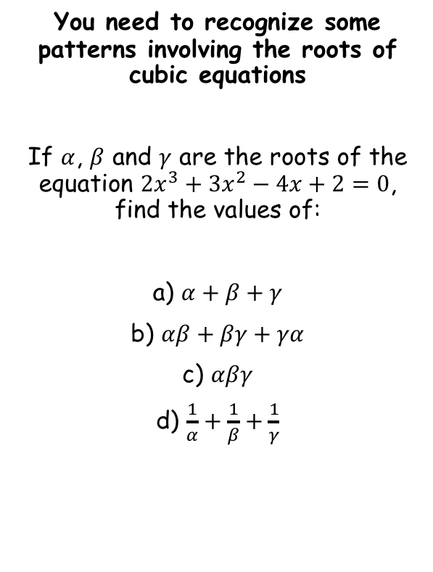





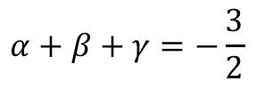
Roots of Polynomials
$$α+β+γ=−\frac{b}{a}$$
$$αβ+βγ+γα=\frac{c}{a}$$
$$αβγ=−\frac{d}{a}$$
You need to recognize some patterns involving the roots of cubic equations
If $α$, $β$ and $γ$ are the roots of the equation ${2x}^{3}+{3x}^{2}−4x+2=0$, find the values of:
a) $α+β+γ$
b) $αβ+βγ+γα$
c) $αβγ$
d) $\frac{1}{α}+\frac{1}{β}+\frac{1}{γ}$
$${2x}^{3}+3x^{2}−4x+2=0$$
$$a=2$$
$$b=3$$
Summarise $a$, $b$, $c$ and $d$ first!
$$c=−4$$
$$d=2$$
Then, write out the relationship that you will use
$$α+β+γ=−\frac{b}{a}$$
$$−\frac{3}{2}$$
Sub in $b$ and $a$
$$α+β+γ=−\frac{3}{2}$$
4B

Slide 5





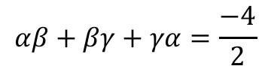
Roots of Polynomials
$$α+β+γ=−\frac{b}{a}$$
$$αβ+βγ+γα=\frac{c}{a}$$
$$αβγ=−\frac{d}{a}$$
You need to recognize some patterns involving the roots of cubic equations
If $α$, $β$ and $γ$ are the roots of the equation ${2x}^{3}+{3x}^{2}−4x+2=0$, find the values of:
a) $α+β+γ$
b) $αβ+βγ+γα$
c) $αβγ$
d) $\frac{1}{α}+\frac{1}{β}+\frac{1}{γ}$
$${2x}^{3}+3x^{2}−4x+2=0$$
$$a=2$$
$$b=3$$
Summarise $a$, $b$, $c$ and $d$ first!
$$c=−4$$
$$d=2$$
Then, write out the relationship that you will use
$$αβ+βγ+γα=\frac{c}{a}$$
$$−\frac{3}{2}$$
Sub in $c$ and $a$
$$−2$$
$$αβ+βγ+γα=\frac{−4}{2}$$
$$=−2$$
4B

Slide 6





Roots of Polynomials
$$α+β+γ=−\frac{b}{a}$$
$$αβ+βγ+γα=\frac{c}{a}$$
$$αβγ=−\frac{d}{a}$$
You need to recognize some patterns involving the roots of cubic equations
If $α$, $β$ and $γ$ are the roots of the equation ${2x}^{3}+{3x}^{2}−4x+2=0$, find the values of:
a) $α+β+γ$
b) $αβ+βγ+γα$
c) $αβγ$
d) $\frac{1}{α}+\frac{1}{β}+\frac{1}{γ}$
$${2x}^{3}+3x^{2}−4x+2=0$$
$$a=2$$
$$b=3$$
Summarise $a$, $b$, $c$ and $d$ first!
$$c=−4$$
$$d=2$$
Then, write out the relationship that you will use
$$αβγ=−\frac{d}{a}$$
$$−\frac{3}{2}$$
Sub in $d$ and $a$
$$−2$$
$$αβγ=−\frac{4}{2}$$
$$−1$$
$$=−1$$
4B

Slide 7
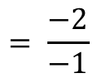
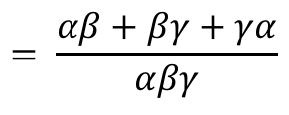
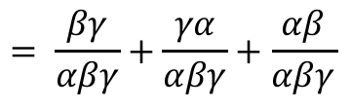
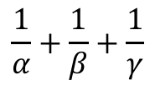


Roots of Polynomials
$$α+β+γ=−\frac{b}{a}$$
$$αβ+βγ+αγ=\frac{c}{a}$$
$$αβγ=−\frac{d}{a}$$
You need to recognize some patterns involving the roots of cubic equations
If $α$, $β$ and $γ$ are the roots of the equation ${2x}^{3}+{3x}^{2}−4x+2=0$, find the values of:
a) $α+β+γ$
b) $αβ+βγ+γα$
c) $αβγ$
d) $\frac{1}{α}+\frac{1}{β}+\frac{1}{γ}$
$${2x}^{3}+3x^{2}−4x+2=0$$
$$a=2$$
$$b=3$$
Summarise $a$, $b$, $c$ and $d$ first!
$$c=−4$$
$$d=2$$
You might have to manipulate the expression!
$$\frac{1}{α}+\frac{1}{β}+\frac{1}{γ}$$
Rewrite with common denominators
$$−\frac{3}{2}$$
$$= \frac{βγ}{αβγ}+\frac{γα}{αβγ}+\frac{αβ}{αβγ}$$
$$−2$$
$$−1$$
Group up
$$= \frac{αβ+βγ+γα}{αβγ}$$
Replace using b) and c)
$$= \frac{−2}{−1}$$
Simplify
$$=2$$
4B

Slide 8




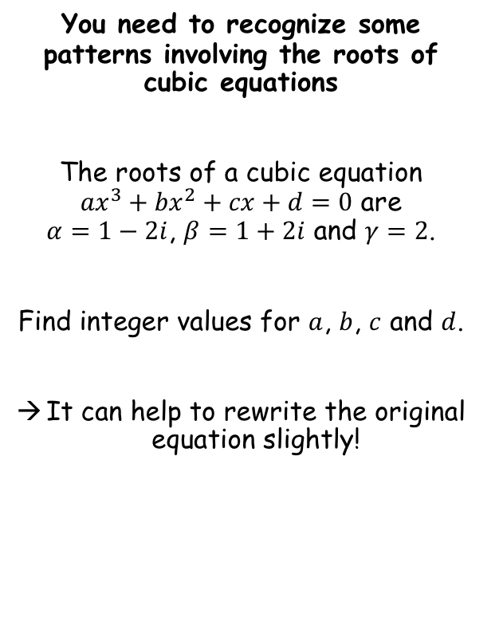




Roots of Polynomials
$$α+β+γ=−\frac{b}{a}$$
$$αβ+βγ+γα=\frac{c}{a}$$
$$αβγ=−\frac{d}{a}$$
You need to recognize some patterns involving the roots of cubic equations
The roots of a cubic equation ${ax}^{3}+{bx}^{2}+cx+d=0$ are $α=1−2i$, $β=1+2i$ and $γ=2$.
Find integer values for $a$, $b$, $c$ and $d$.
It can help to rewrite the original equation slightly!
$$\frac{b}{a}=−4$$
In this question you have to use the relationships ‘backwards’…
$$α+β+γ=−\frac{b}{a}$$
Sub in the roots
$$\left(1−2i\right)+\left(1+2i\right)+2=−\frac{b}{a}$$
Simplify
$$4=−\frac{b}{a}$$
$${ax}^{3}+{bx}^{2}+cx+d=0$$
Multiply by -1
$$−4=\frac{b}{a}$$
Divide by $a$
$$x^{3}+{\frac{b}{a}x}^{2}+\frac{c}{a}x+\frac{d}{a}=0$$
4B

Slide 9





Roots of Polynomials
$$α+β+γ=−\frac{b}{a}$$
$$αβ+βγ+γα=\frac{c}{a}$$
$$αβγ=−\frac{d}{a}$$
You need to recognize some patterns involving the roots of cubic equations
The roots of a cubic equation ${ax}^{3}+{bx}^{2}+cx+d=0$ are $α=1−2i$, $β=1+2i$ and $γ=2$.
Find integer values for $a$, $b$, $c$ and $d$.
It can help to rewrite the original equation slightly!
$$\frac{b}{a}=−4$$
$$\frac{c}{a}=9$$
In this question you have to use the relationships ‘backwards’…
$$αβ+βγ+αγ=\frac{c}{a}$$
Sub in the roots
$$\left(1−2i\right)\left(1+2i\right)+2\left(1+2i\right)+2(1−2i)=\frac{c}{a}$$
Expand brackets
$$5+2+4i+2−4i=\frac{c}{a}$$
Simplify
$${ax}^{3}+{bx}^{2}+cx+d=0$$
$$9=\frac{c}{a}$$
Divide by $a$
$$x^{3}+{\frac{b}{a}x}^{2}+\frac{c}{a}x+\frac{d}{a}=0$$
4B

Slide 10






Roots of Polynomials
$$α+β+γ=−\frac{b}{a}$$
$$αβ+βγ+γα=\frac{c}{a}$$
$$αβγ=−\frac{d}{a}$$
You need to recognize some patterns involving the roots of cubic equations
The roots of a cubic equation ${ax}^{3}+{bx}^{2}+cx+d=0$ are $α=1−2i$, $β=1+2i$ and $γ=2$.
Find integer values for $a$, $b$, $c$ and $d$.
It can help to rewrite the original equation slightly!
$$\frac{b}{a}=−4$$
$$\frac{c}{a}=9$$
$$\frac{d}{a}=−10$$
In this question you have to use the relationships ‘backwards’…
$$αβγ=−\frac{d}{a}$$
Sub in the roots
$$\left(1−2i\right)\left(1+2i\right)(2)=−\frac{d}{a}$$
Expand brackets
$$\left(5\right)(2)=−\frac{d}{a}$$
$${ax}^{3}+{bx}^{2}+cx+d=0$$
Simplify
$$10=−\frac{d}{a}$$
Divide by $a$
$$−10=\frac{d}{a}$$
Multiply by -1
$$x^{3}+{\frac{b}{a}x}^{2}+\frac{c}{a}x+\frac{d}{a}=0$$
4B

Slide 11



Roots of Polynomials
$$α+β+γ=−\frac{b}{a}$$
$$αβ+βγ+γα=\frac{c}{a}$$
$$αβγ=−\frac{d}{a}$$
You need to recognize some patterns involving the roots of cubic equations
The roots of a cubic equation ${ax}^{3}+{bx}^{2}+cx+d=0$ are $α=1−2i$, $β=1+2i$ and $γ=2$.
Find integer values for $a$, $b$, $c$ and $d$.
It can help to rewrite the original equation slightly!
$$\frac{b}{a}=−4$$
$$\frac{c}{a}=9$$
$$\frac{d}{a}=−10$$
Now we can substitute these into the relationship from before
$$x^{3}+{\frac{b}{a}x}^{2}+\frac{c}{a}x+\frac{d}{a}=0$$
Sub in the values above…
$$x^{3}−4x^{2}+9x−10=0$$
$${ax}^{3}+{bx}^{2}+cx+d=0$$
$a=1$, $b=−4$, $c=9$, $d=−10$
Divide by $a$
$$x^{3}+{\frac{b}{a}x}^{2}+\frac{c}{a}x+\frac{d}{a}=0$$
4B

Slide 12
Exercise 4B
Pearson Further Core Mathematics Year 1/AS
Complete before the lesson Q2-4
In Class:
Green Q5-7
Amber Q8-10
Red Q11-13 & challenge

