Slide 1
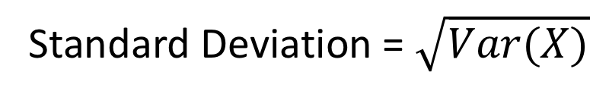
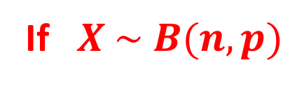
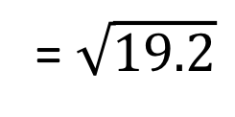
MEAN AND VARIANCE OF THE BINOMIAL DISTRIBUTION
If $X \sim B(n, p)$
E(X) = np
Var(X) = np(1 – p)
If X ~ B(10, 0.2) find the mean and variance of X
E(X) = np
= 10 x 0.2
= 2
Var(X) = np(1 – p)
= 10 x 0.2 x 0.8
= 1.6
If X ~ B(80, 0.4) find the mean and standard deviation of X
E(X) = np
= 80 x 0.4
= 32
Var(X) = np(1 – p)
= 80 x 0.4 x 0.6
= 19.2
Standard Deviation = $\sqrt{Var(X)}$
= $\sqrt{19.2}$
= 4.38

Slide 2
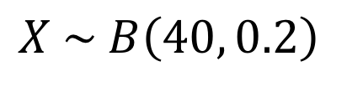
X is a binomial distribution with mean 8 and variance 6.4.
Find P(X ≤ 3).
np = 8
np(1 – p) = 6.4
8(1 – p) = 6.4
1 – p = 0.8
p = 0.2
n = 40
$X \sim B\left(40, 0.2\right)$
P(X ≤ 3)
= 0.0285

Slide 3
For the following random variables state whether they can
be modelled by a binomial distribution. If they can, give the
model, if they cannot then explain why.
A dice is thrown repeatedly until a 1 is seen.
X = number of throws.
A dice is thrown 10 times. X = number of 1’s seen
A bag has 25 red and 25 blue balls in it. Five balls are
taken out without replacement.
X = number of red balls taken
X = number of boys in a family of five children
A pair of dice is thrown 25 times.
X = number of times a double is thrown
A pair of dice is thrown 25 times.
X = average score of the sum of the
numbers showing.

Slide 4
A dice is thrown repeatedly until a 1 is seen.
X = number of throws.
NOT binomial
No fixed number of trials
There is a fixed number of trials
Each trial has the same two possible outcomes
The outcomes of the trials are independent of one another
The probability of ‘success’ remains constant

Slide 5
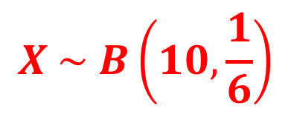
A dice is thrown 10 times. X = number of 1’s seen
Binomial
$$X \sim B\left(10,\frac{1}{6}\right)$$
There is a fixed number of trials
Each trial has the same two possible outcomes
The outcomes of the trials are independent of one another
The probability of ‘success’ remains constant

Slide 6
(c) A bag has 25 red and 25 blue balls in it. Five balls are
taken out without replacement.
X = number of red balls taken
NOT binomial
P(success) NOT constant
Outcomes of trials NOT independent
There is a fixed number of trials
Each trial has the same two possible outcomes
The outcomes of the trials are independent of one another
The probability of ‘success’ remains constant

Slide 7
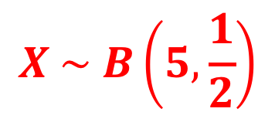
X = number of boys in a family of five children
Binomial
$$X \sim B\left(5,\frac{1}{2}\right)$$
There is a fixed number of trials
Each trial has the same two possible outcomes
The outcomes of the trials are independent of one another
The probability of ‘success’ remains constant

Slide 8
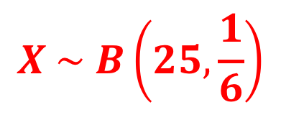
(e) A pair of dice is thrown 25 times.
X = number of times a double is thrown
Binomial
$$X \sim B\left(25,\frac{1}{6}\right)$$
There is a fixed number of trials
Each trial has the same two possible outcomes
The outcomes of the trials are independent of one another
The probability of ‘success’ remains constant

Slide 9
A pair of dice is thrown 25 times.
X = average score of the sum of the numbers showing.
NOT binomial
Different outcomes – not counting how many
times something happens.
There is a fixed number of trials
Each trial has the same two possible outcomes
The outcomes of the trials are independent of one another
The probability of ‘success’ remains constant

Slide 10
A vet thinks that the number of male puppies in litters of a
Given size will follow a binomial distribution with p = 0.5.
In litters of six puppies, what would be the mean and
variance of the number of males if the distribution is
binomial?
The vet records the number of males in 82 litters of six
Puppies and the results are summarised in the table:
Calculate the mean and variance of the number of
males in litters of six puppies.
Do you think the binomial distribution is a good model
for the number of males in a litter of
puppies?
Males | 0 | 1 | 2 | 3 | 4 | 5 | 6
Frequency | 8 | 10 | 16 | 15 | 14 | 12 | 7

Slide 11
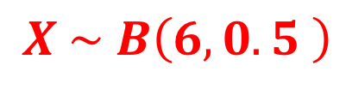
A vet thinks that the number of male puppies in litters of a
Given size will follow a binomial distribution with p = 0.5.
In litters of six puppies, what would be the mean and
variance of the number of males if the distribution is
binomial?
$$X \sim B\left(6,0.5 \right)$$
E(X) = np
= 6 x 0.5
= 3
Var(X) = np(1 – p)
= 6 x 0.5 x 0.5
= 1.5

Slide 12
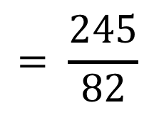

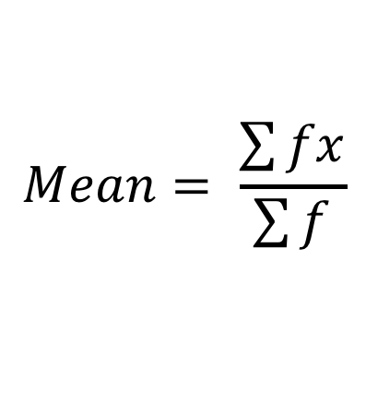
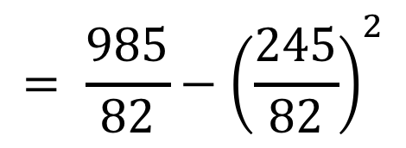
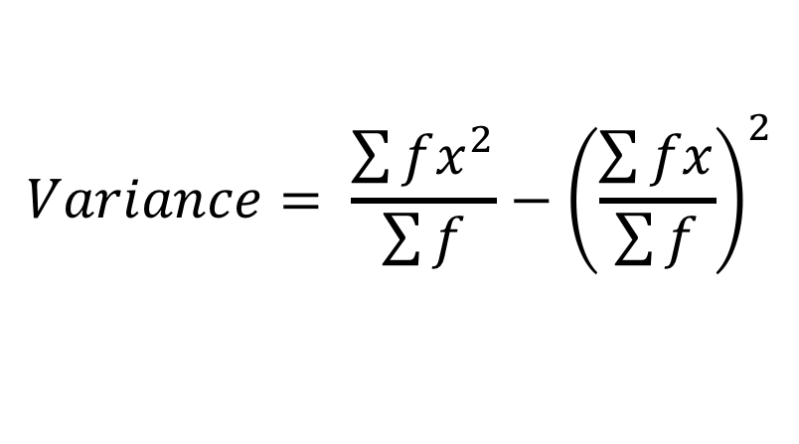

The vet records the number of males in 82 litters of six
Puppies and the results are summarised in the table:
Calculate the mean and variance of the number of
males in litters of six puppies.
Males | 0 | 1 | 2 | 3 | 4 | 5 | 6
Frequency | 8 | 10 | 16 | 15 | 14 | 12 | 7
$$Mean= \frac{\sum{fx}}{\sum{f}}$$
$$= \frac{245}{82}$$
$$=2.99$$
$$Variance= \frac{\sum{fx^{2}}}{\sum{f}}−{\left(\frac{\sum{fx}}{\sum{f}}\right)}^{2}$$
$$= \frac{985}{82}−{\left(\frac{245}{82}\right)}^{2}$$
$$=3.09$$

Slide 13
(c) Do you think the binomial distribution is a good model
for the number of males in a litter of puppies?
Model
Actual
Mean
3
2.99
Variance
1.5
3.09
NO – Mean is a good match but variance is
significantly bigger than model predicts.

Slide 14
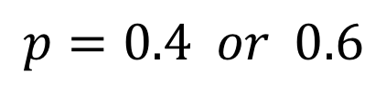
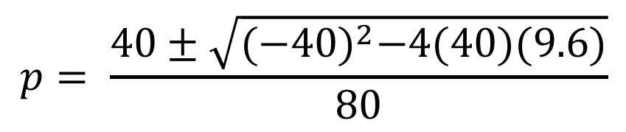
If X ~ B(40, p) and Var(X) = 9.6
Find the two possible values of p
For each of the values of p find P(X < μ – σ)
(a) 40p(1 – p) = 9.6
40p – 40p² = 9.6
40p² – 40p + 9.6 = 0
$$p= \frac{40±\sqrt{{(−40)}^{2}−4(40)(9.6)}}{80}$$
$$p=0.4 or 0.6$$

Slide 15









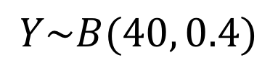
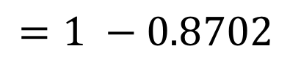

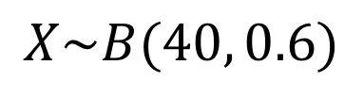

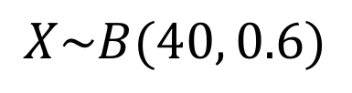

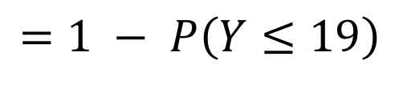
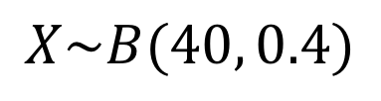


If X ~ B(40, p) and Var(X) = 9.6
Find the two possible values of p
For each of the values of p find P(X < μ – σ)
(b) Var(X) = 9.6
σ = 3.098
$$p=0.4$$
$$X\sim B(40, 0.4)$$
$$μ=40×0.4=16$$
$$P\left(X<16−3.098\right)$$
$$=P\left(X<12.902\right)$$
$$=P\left(X≤12\right)$$
$$=0.1285$$
$$p=0.6$$
$$X\sim B(40, 0.6)$$
$$μ=40×0.6=24$$
$$P\left(X<24−3.098\right)$$
$$=P\left(X<20.902\right)$$
$$=P\left(X≤20\right)$$
$$X\sim B(40, 0.6)$$
$$Y\sim B(40, 0.4)$$
$$P\left(X≤20\right)$$
$$P\left(Y≥20\right)$$
$$=1 − P\left(Y≤19\right)$$
$$=1 −0.8702$$
$$=0.1298$$

Slide 16
Exercise 2F
Pearson Further Statistics 1
Pages 33-34
Complete before the lesson Q1-5
In Class:
Green Q6-7
Amber Q8
Red Q9-10 & Challenge

