Slide 1
Year 2 Pure Mathematics
Vectors
- Geometric Problems
Chapter 12
(Part 5 of 6)

Slide 2
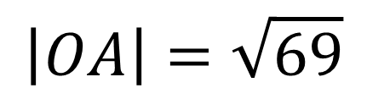
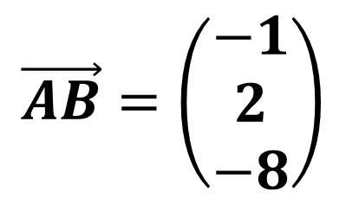
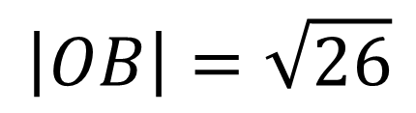
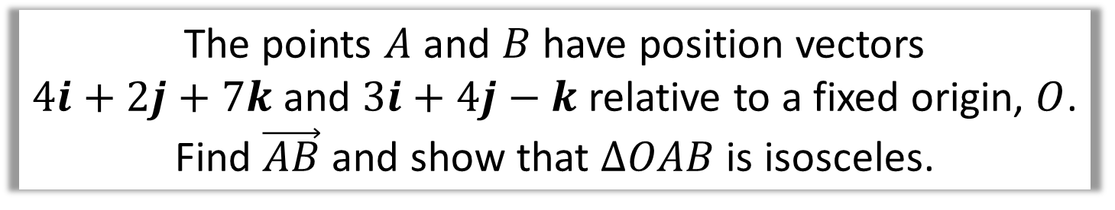
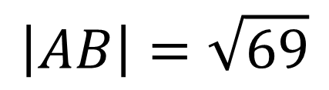
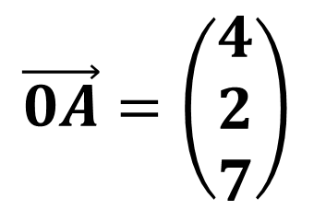
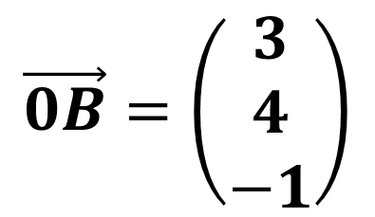
Vectors – Geometric Problems
The points $A$ and $B$ have position vectors
$4i+2j+7k$ and $3i+4j−k$ relative to a fixed origin, $O$.
Find $\vec{AB}$ and show that $ΔOAB$ is isosceles.
$$\vec{AB}=\left(\begin{matrix}−1 \\ 2 \\ −8\end{matrix}\right)$$
$$\vec{0B}=\left(\begin{aligned}3 \\ 4 \\ −1\end{aligned}\right)$$
$$\vec{0A}=\left(\begin{aligned}4 \\ 2 \\ 7\end{aligned}\right)$$
$$\left|AB\right|=\sqrt{69}$$
$$\left|OB\right|=\sqrt{26}$$
$$\left|OA\right|=\sqrt{69}$$
Side AB and OA are the same length
so therefore it is an isosceles triangle.

Slide 3
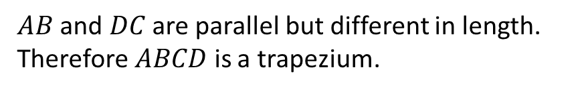
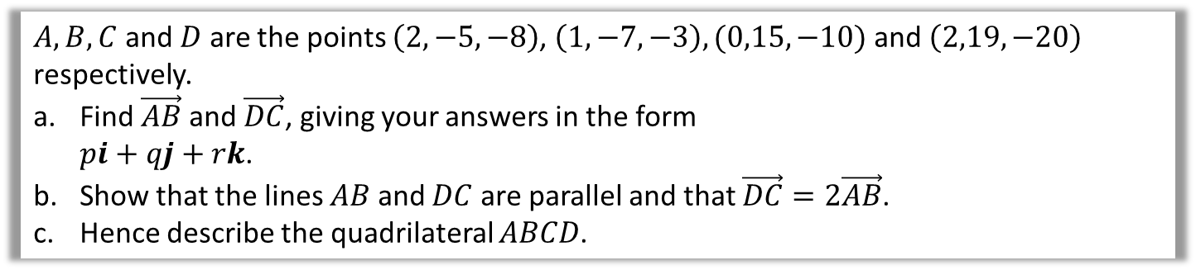
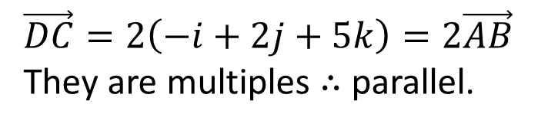
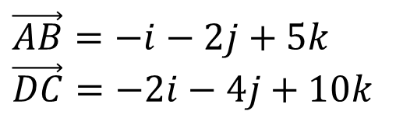
Vectors - Geometric Problems
$A, B, C$ and $D$ are the points $\left(2,−5,−8\right)$, $\left(1,−7,−3\right), (0,15,−10)$ and $\left(2,19,−20\right)$ respectively.
Find $\vec{AB}$ and $\vec{DC}$, giving your answers in the form
$pi+qj+rk$.
Show that the lines $AB$ and $DC$ are parallel and that $\vec{DC}=2\vec{AB}$.
Hence describe the quadrilateral $ABCD$.
a
$$\vec{AB}=−i−2j+5k \\ \vec{DC}=−2i−4j+10k$$
b
$$\vec{DC}=2\left(−i+2j+5k\right)=2\vec{AB}$$
They are multiples $∴$ parallel.
c
$AB$ and $DC$ are parallel but different in length. Therefore $ABCD$ is a trapezium.

Slide 4
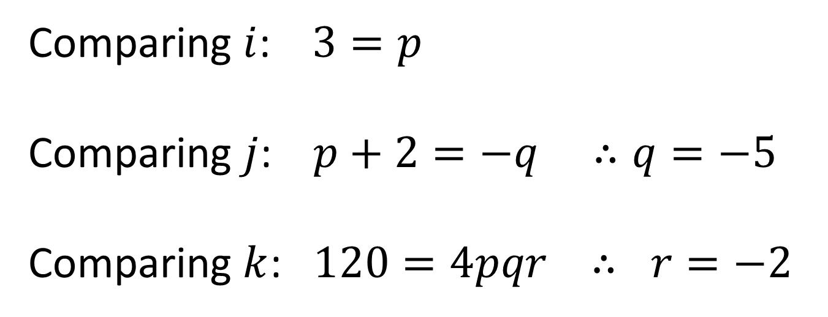
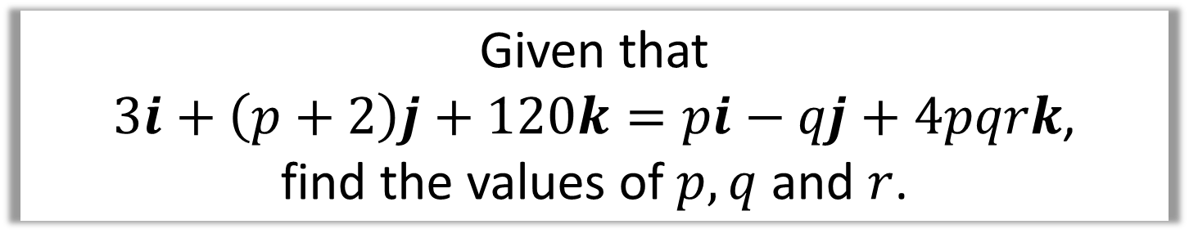
Vectors - Comparing Coefficients
Given that
$3i+\left(p+2\right)j+120k=pi−qj+4pqrk$,
find the values of $p, q$ and $r$.
Comparing $i$: $3=p$
Comparing $j$: $p+2=−q ∴q=−5$
Comparing $k$: $120=4pqr ∴ r=−2$

Slide 5



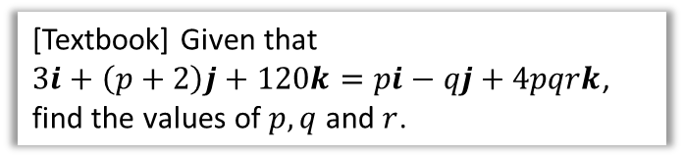



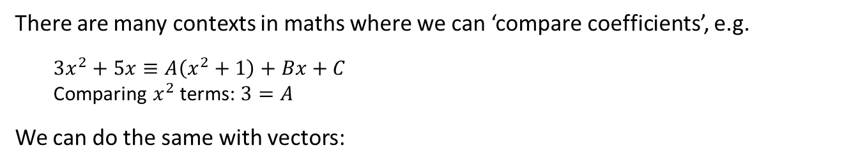






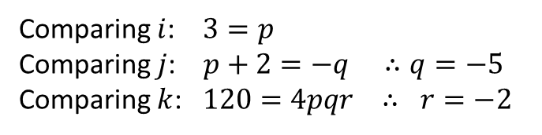


Comparing Coefficients
There are many contexts in maths where we can ‘compare coefficients’, e.g.
$3x^{2}+5x≡A\left(x^{2}+1\right)+Bx+C$
Comparing $x^{2}$ terms: $3=A$
We can do the same with vectors:
[Textbook] The diagram shows a cuboid whose vertices are $O,A,B,C,D,E,F$ and $G$. Vectors $a, b$ and $c$ are the position vectors of the vertices $A, B$ and $C$ respectively. Prove that the diagonals $OE$ and $BG$ bisect each other.
[Textbook] Given that
$3i+\left(p+2\right)j+120k=pi−qj+4pqrk$, find the values of $p, q$ and $r$.
$$F$$
$$E$$
$$C$$
$$G$$
The strategy behind this type of question is to find the point of intersection in 2 ways, and compare coefficients.
$$c$$
$$H$$
$$B$$
$$D$$
?
$$b$$
$$a$$
$$A$$
Comparing $i$: $3=p$
Comparing $j$: $p+2=−q ∴q=−5$
Comparing $k$: $120=4pqr ∴ r=−2$
$$O$$
?
Suppose there is a point of intersection $H$ of $OE$ and $BG$.
We can get to $H$ in two ways:
$\vec{OH}=r \vec{OE}$ for some scalar $r$.
$\vec{OH}=\vec{OB}+\vec{BH}=\vec{OB}+s \vec{BG}$ for some scalar $s$.
$$\vec{OH}=r\left(a+b+c\right)=b+s\left(a−b+c\right) \\ ra+rb+rc=sa+\left(1−s\right)b+sc$$
Comparing coefficients, $r=s$ and $r=1−s$
Adding: $2r=1 ∴r=s=\frac{1}{2}$
Therefore lines bisect each other.

Slide 6
Exercise 12C
Pearson Pure Mathematics Year 2/AS
Pages 346-347
Complete before the lesson Q1-3
In Class:
Green Q4
Amber Q5-6
Red Q7-8 & Challenge

