Slide 1

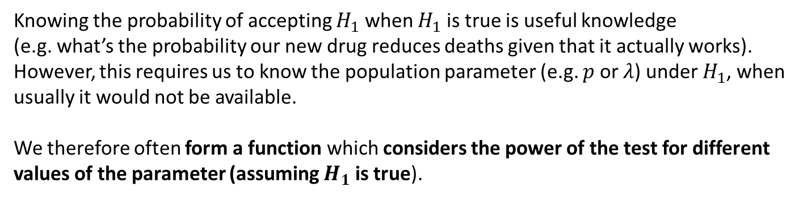
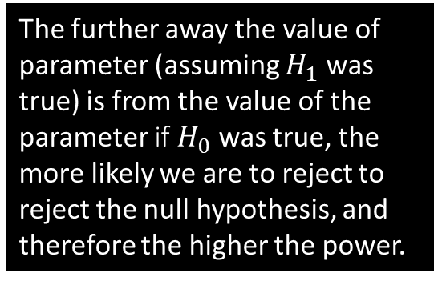
Power Function
Knowing the probability of accepting $H_{1}$ when $H_{1}$ is true is useful knowledge
(e.g. what’s the probability our new drug reduces deaths given that it actually works).
However, this requires us to know the population parameter (e.g. $p$ or $λ$) under $H_{1}$, when usually it would not be available.
We therefore often form a function which considers the power of the test for different values of the parameter (assuming $H_{1}$ is true).
Power
1.0
0.8
0.6
0.4
0.2
The further away the value of parameter (assuming $H_{1}$ was true) is from the value of the parameter if $H_{0}$ was true, the more likely we are to reject to reject the null hypothesis, and therefore the higher the power.
$$λ$$
3 4 5 6 7 8 9

Slide 2
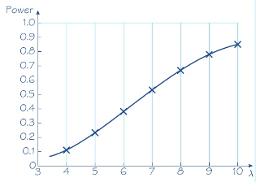

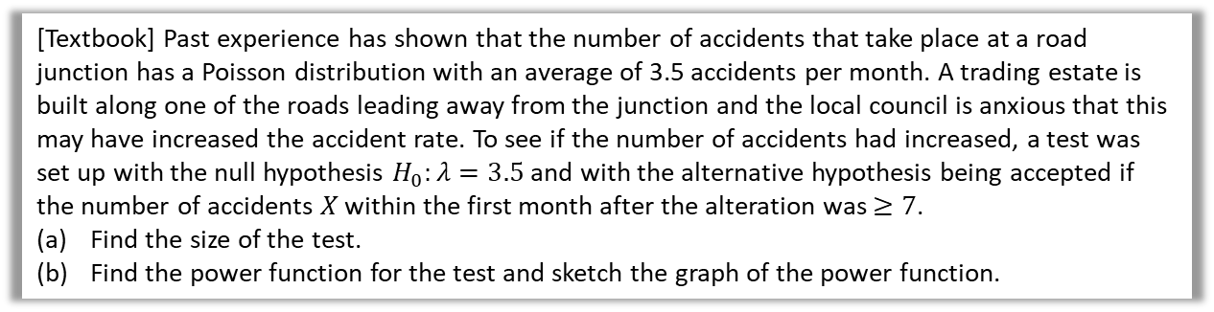

Example
[Textbook] Past experience has shown that the number of accidents that take place at a road junction has a Poisson distribution with an average of 3.5 accidents per month. A trading estate is built along one of the roads leading away from the junction and the local council is anxious that this may have increased the accident rate. To see if the number of accidents had increased, a test was set up with the null hypothesis $H_{0}:λ=3.5$ and with the alternative hypothesis being accepted if the number of accidents $X$ within the first month after the alteration was $≥7$.
Find the size of the test.
Find the power function for the test and sketch the graph of the power function.
a
?
$P\left(X≥7 \right| λ=3.5)=1−0.9347=0.0653$
Power function
$$=P\left(X≥7\right)=1−P\left(X≤6\right) \\ =1−e^{−λ}\left(1+λ+\frac{λ^{2}}{2}+\frac{λ^{3}}{6}+\frac{λ^{4}}{24}+\frac{λ^{5}}{120}+\frac{λ^{6}}{720}\right)$$
Then using your calculator for different values of $λ$:
$$λ=4 → Power=0.1107 \\ λ=5 →0.2378 \\ λ=6 →0.3937 \\ …$$
b
?
A function of the parameter $λ$.
In an exam question they might give you a partially completed table.

Slide 3
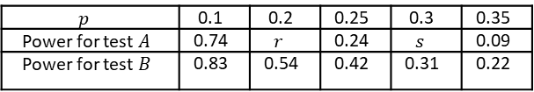
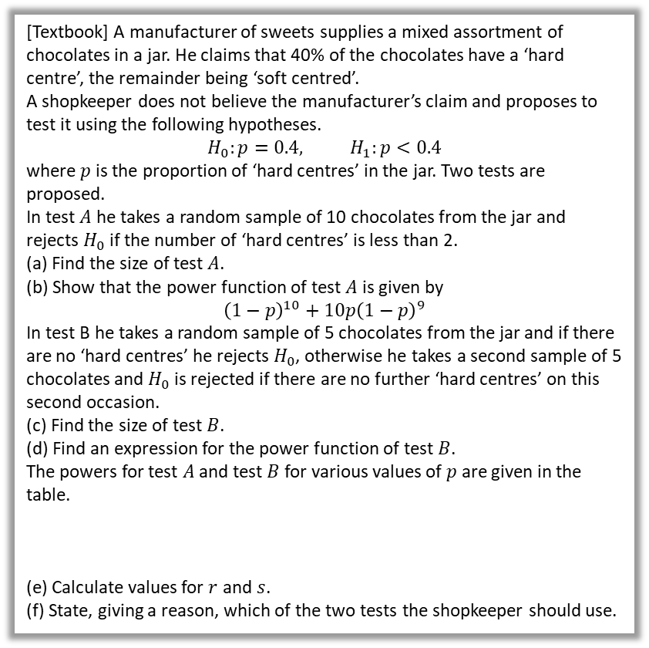

Comparing Tests
We can construct different tests for example by varying the critical region and/or the sample size.
When comparing two tests (of comparable size), you should recommend the test with the higher power within the likely range of the parameter, as being more confident in the claim we’re making (e.g. new drugs reduces death rate) is clearly desirable.
a
$P\left(X<2 | p=0.4\right)=0.0464$
$P\left(X<2\right)=P\left(X=0\right)+P\left(X=1\right)$
$={\left(1−p\right)}^{10}+10p{\left(1−p\right)}^{9}$
Size of test $B=P($accept $H_{1}$ | $p=0.4)$
$$=P\left(X=0\right)+(1−P\left(X=0\right))P(X=0) \\ ={0.6}^{5}+\left(1−{0.6}^{5}\right)×{0.6}^{5} \\ =0.1495$$
Power of test B = $P($0 hard centres in first 5) + P(0 hard centres in second 5 and >0 hard centres in first 5)
$$=P\left(X=0\right)+\left(1−P\left(X=0\right)\right)P\left(X=0\right) \\ ={\left(1−p\right)}^{5}+\left(1−{\left(1−p\right)}^{5}\right){\left(1−p\right)}^{5} \\ =2{\left(1−p\right)}^{5}−{\left(1−p\right)}^{10}$$
Using (d), $p=0.2 →r=0.38$
$$p=0.3 → s=0.15$$
Power for test $B>$ Power for test $A$ for all given values of $p$, so he should use test $B$.
[Textbook] A manufacturer of sweets supplies a mixed assortment of chocolates in a jar. He claims that 40% of the chocolates have a ‘hard centre’, the remainder being ‘soft centred’.
A shopkeeper does not believe the manufacturer’s claim and proposes to test it using the following hypotheses.
$$H_{0}:p=0.4, H_{1}:p<0.4$$
where $p$ is the proportion of ‘hard centres’ in the jar. Two tests are proposed.
In test $A$ he takes a random sample of 10 chocolates from the jar and rejects $H_{0}$ if the number of ‘hard centres’ is less than 2.
(a) Find the size of test $A$.
(b) Show that the power function of test $A$ is given by
$${\left(1−p\right)}^{10}+10p{\left(1−p\right)}^{9}$$
In test B he takes a random sample of 5 chocolates from the jar and if there are no ‘hard centres’ he rejects $H_{0}$, otherwise he takes a second sample of 5 chocolates and $H_{0}$ is rejected if there are no further ‘hard centres’ on this second occasion.
(c) Find the size of test $B$.
(d) Find an expression for the power function of test $B$.
The powers for test $A$ and test $B$ for various values of $p$ are given in the table.
(e) Calculate values for $r$ and $s$.
(f) State, giving a reason, which of the two tests the shopkeeper should use.
?
b
?
c
?
Note: Textbook gets wrong value, 0.1495 here is correct.
d
?
$$p$$ | 0.1 | 0.2 | 0.25 | 0.3 | 0.35
Power for test $A$ | 0.74 | $$r$$ | 0.24 | $$s$$ | 0.09
Power for test $B$ | 0.83 | 0.54 | 0.42 | 0.31 | 0.22
e
?
f
?

Slide 4
Exercise 8D
Pearson Further Statistics 1
Pages 165-167
Complete before the lesson Q1
In Class:
Green Q2-3
Amber Q4-5
Red Q6

