Slide 1
Year 1 Pure Mathematics
Equations and Inequalities
- Inequalities
Chapter 3
(Part 2 of 3)

Slide 2
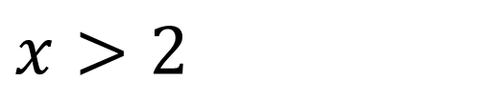
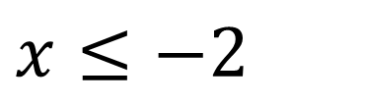
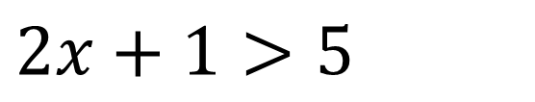
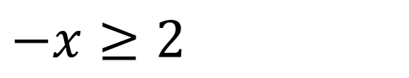
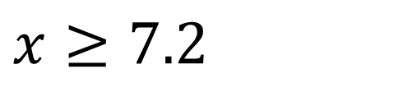
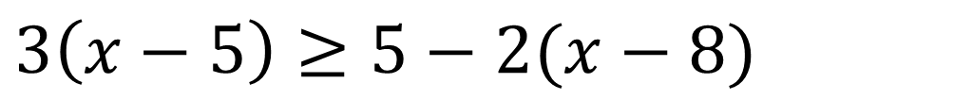
Linear inequalities
Inequality
Solution Set
$$2x+1>5$$
$$x>2$$
$$3\left(x−5\right)≥5−2(x−8)$$
$$x≥7.2$$
$$−x≥2$$
$$x≤−2$$
Note:
Multiply or divide both sides of an inequality
by a negative number
reverses the direction of the inequality.

Slide 3
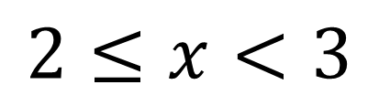

Linear inequalities
Combining Inequalities
If $x<3$ and $2≤x<4$
what is the combined solution set?
2
3
4
$$2≤x<3$$

Slide 4



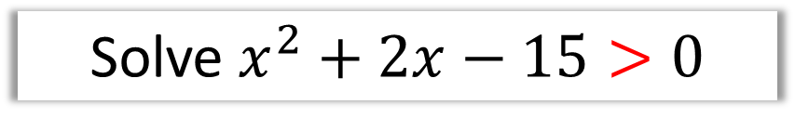

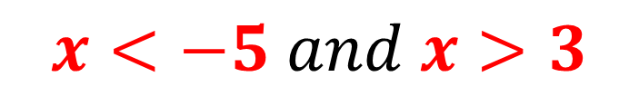




Solving Quadratic Inequalities
Solve $x^{2}+2x−15>0$
$$\left(x+5\right)\left(x−3\right)>0$$
Sketch and Reason
$$y$$
$$y=(x+5)(x−3)$$
This is where the graph is y > 0
$$x$$
$$−5$$
$$3$$
$$x<−5$$
$$x>3$$
$$x<−5 and x>3$$

Slide 5


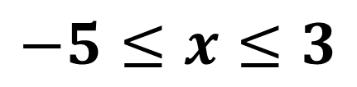
Solving Quadratic Inequalities
Solve $x^{2}+2x−15≤0$
$$\left(x+5\right)\left(x−3\right)≤0$$
Sketch and Reason
$$y$$
$$y=(x+5)(x−3)$$
This is where the graph is y ≤ 0
$$x$$
$$−5$$
$$3$$
$$−5≤x≤3$$

Slide 6
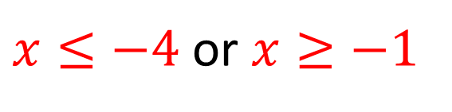




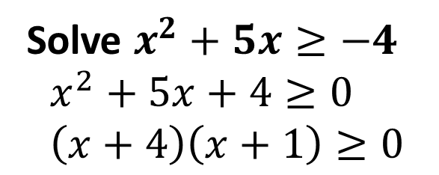
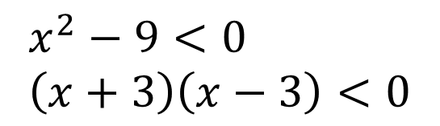








Solving Quadratic Inequalities
Solve $x^{2}+5x≥−4$
$$x^{2}+5x+4≥0 \\ \left(x+4\right)\left(x+1\right)≥0$$
Solve $x^{2}<9$
$$x^{2}−9<0 \\ \left(x+3\right)\left(x−3\right)<0$$
$$y$$
$$y$$
$$y=(x+4)(x+1)$$
$$y=(x+3)(x−3)$$
$$x$$
$$3$$
$$x$$
$$−4$$
$$−1$$
$$−3$$
$x≤−4$ or $x≥−1$
$$−3<x<3$$

Slide 7
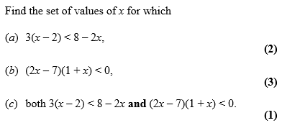
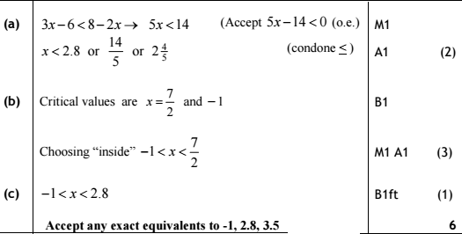
Solving Quadratic Inequalities

Slide 8
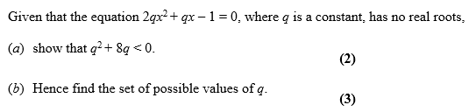
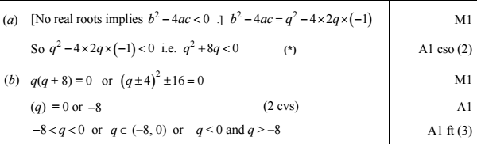
Solving Quadratic Inequalities

Slide 9
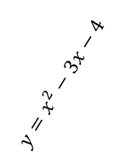

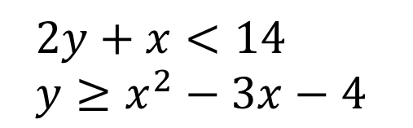


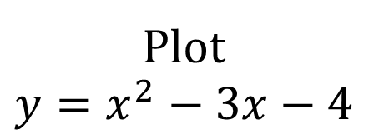

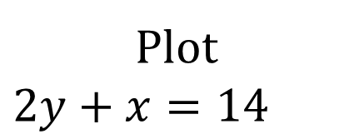
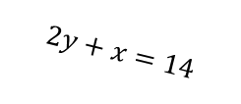
Inequality Regions
Shade the region that satisfies the inequalities:
$$2y+x<14 \\ y≥x^{2}−3x−4$$
Plot
$$y=x^{2}−3x−4$$
$$y$$
Plot
$$2y+x=14$$
$$y=x^{2}−3x−4$$
$$2y+x=14$$
then shade
Shade below the line
$$x$$
$$−1$$
$$4$$
$$2y+x<14 \\ y≥x^{2}−3x−4$$
Shade above the line

Slide 10
Exercise 3D/3E
Pearson Pure Mathematics Year 1/AS
Page 47-48, 50-51
Complete before the lesson Ex3D Q1-2 & Ex3E Q1-3 a-d only
Green Ex3D Q3 & Challenge
Amber Ex3E Q4-6
Red Ex3E Q7-9

Slide 11
Exercise 3F/3G
Pearson Pure Mathematics Year 1/AS
Page 53, 55
Complete before the lesson Ex3F Q1 & Ex3G Q1-4
Green Ex3F Q2-3 & Challenge
Amber Ex3G Q5-6
Red Ex3G Q7-8

