Slide 1
Year 2 Pure Mathematics
Differentiation
- Implicit
Chapter 9
(Part 8 or 10)

Slide 2
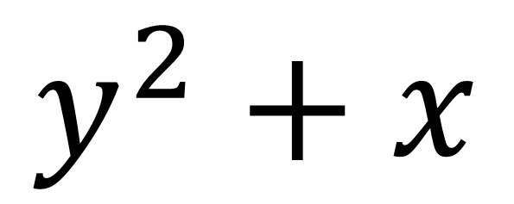
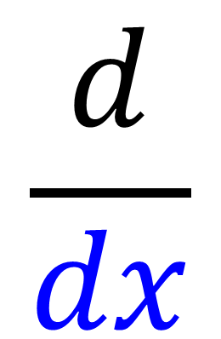
Implicit Differentiation
$$\frac{d}{dx}$$
$$y^{2}+x$$
What is the problem with this differentiation?
You are differentiation with respect to x
but there is a y term as well as an x term

Slide 3
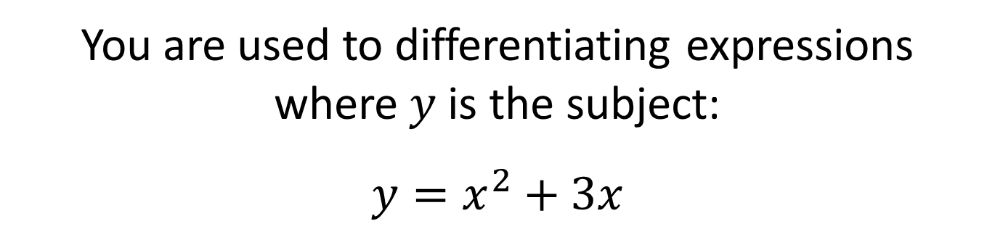
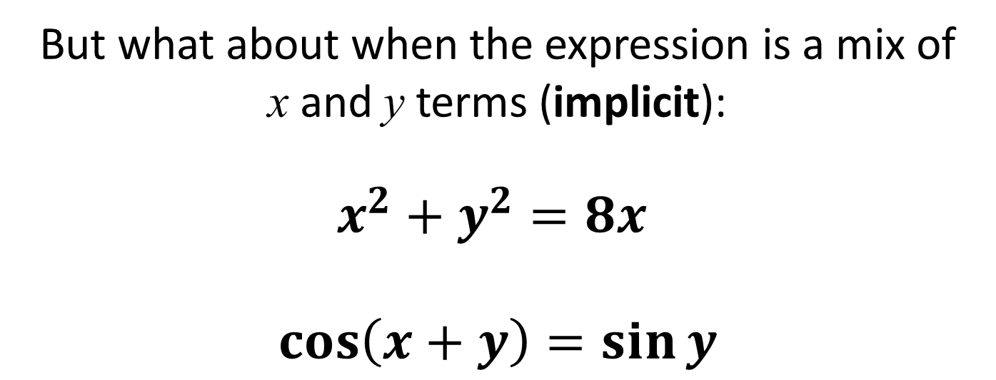
Implicit Differentiation
You are used to differentiating expressions
where $y$ is the subject:
$$y=x^{2}+3x$$
But what about when the expression is a mix of
x and y terms (implicit):
$$x^{2}+y^{2}=8x$$
$$\cos\left(x+y\right)=\sin{y}$$

Slide 4
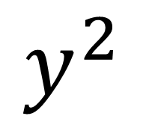
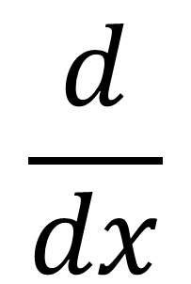
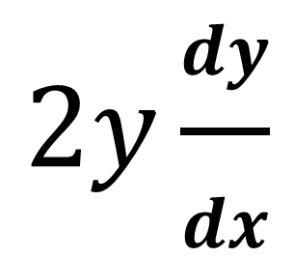
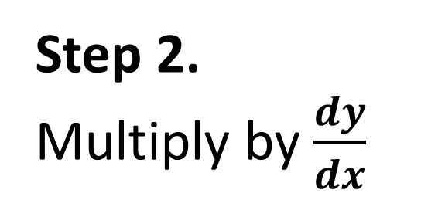
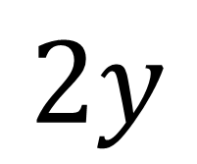
Implicit Differentiation
$$\frac{d}{dx}$$
$$y^{2}$$
Step 1.
Differentiate with respect to y
$$2y$$
Step 2.
Multiply by $\frac{dy}{dx}$
$$2y\frac{dy}{dx}$$

Slide 5
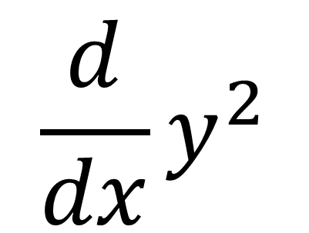
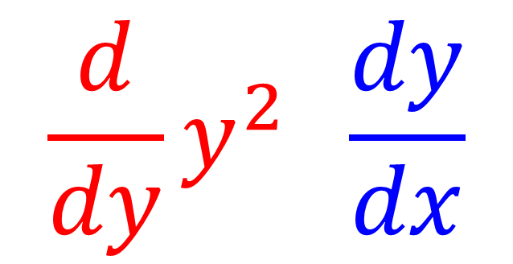
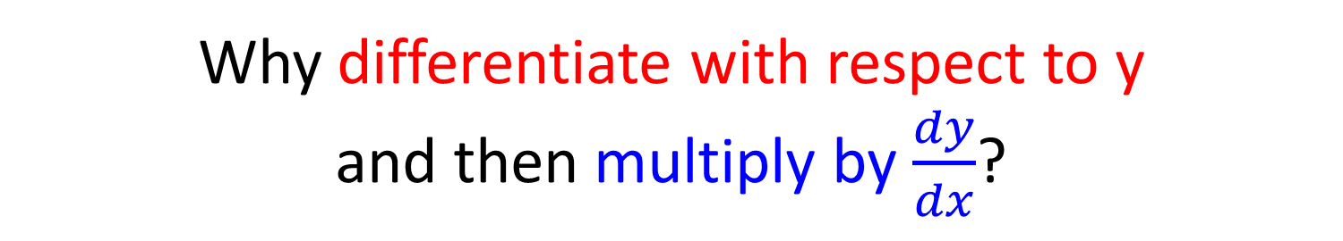
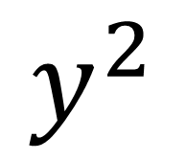
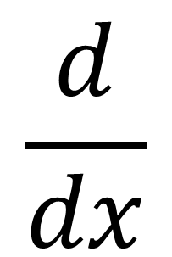
Implicit Differentiation
$$\frac{d}{dx}$$
$$y^{2}$$
Why differentiate with respect to y
and then multiply by $\frac{dy}{dx}$?
$$\frac{d}{dy}y^{2} \frac{dy}{dx}$$
$$\frac{d}{dx}y^{2}$$
=

Slide 6
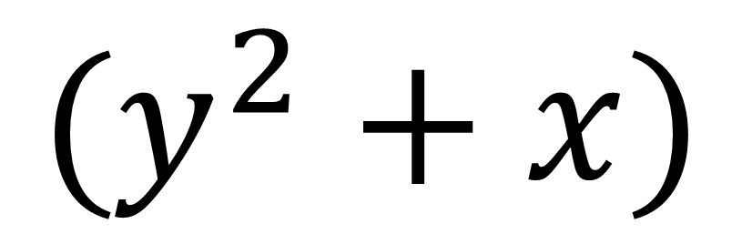
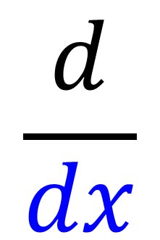
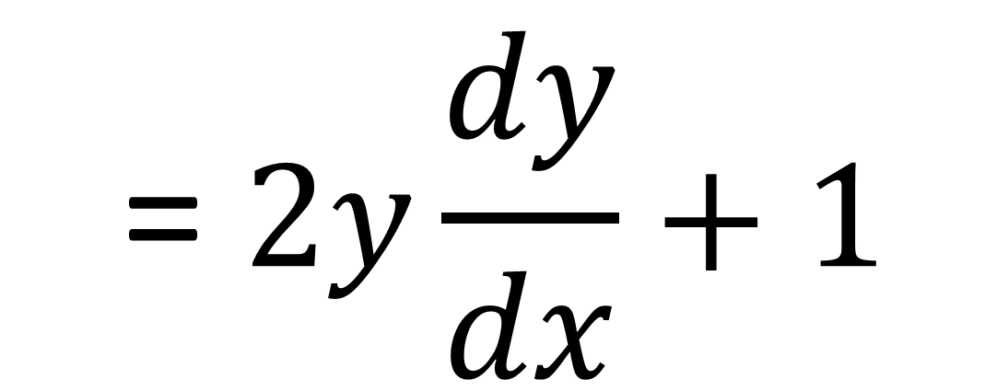
Implicit Differentiation
$$\frac{d}{dx}$$
$$(y^{2}+x)$$
$$\text{=} 2y\frac{dy}{dx}+1$$

Slide 7
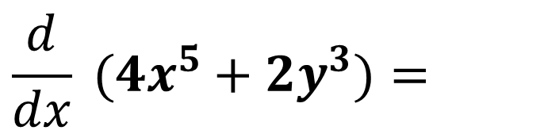
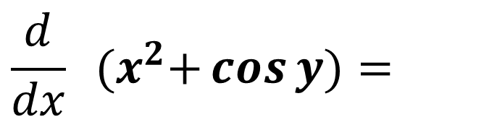
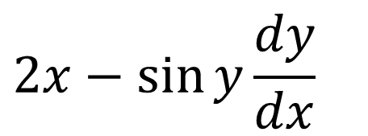
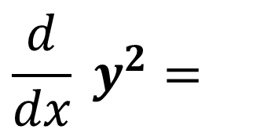
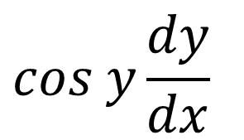
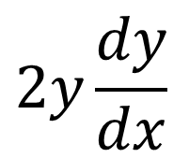
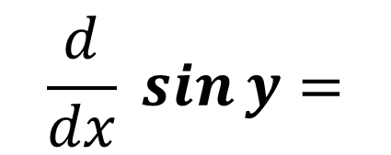
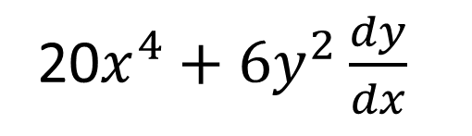
Implicit Differentiation
$$\frac{d}{dx} y^{2}=$$
$$2y\frac{dy}{dx}$$
$$\frac{d}{dx} \sin{y}=$$
$$cos y\frac{dy}{dx}$$
$$\frac{d}{dx} (4x^{5}+2y^{3})=$$
20$x^{4}+{6y}^{2}\frac{dy}{dx}$
$$\frac{d}{dx} {(x}^{2}+\cos{y)}=$$
$$2x−\sin{y}\frac{dy}{dx}$$

Slide 8
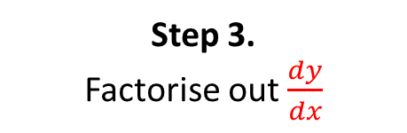
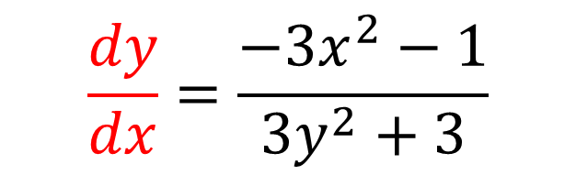
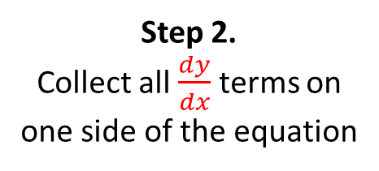
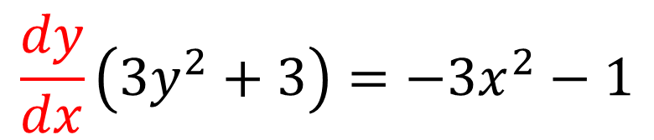
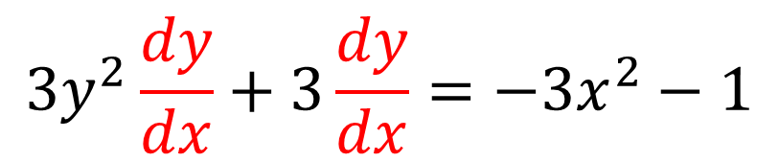
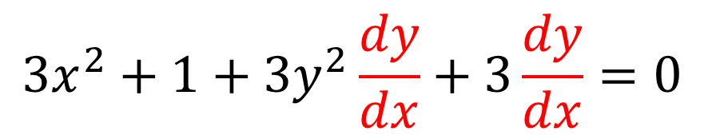
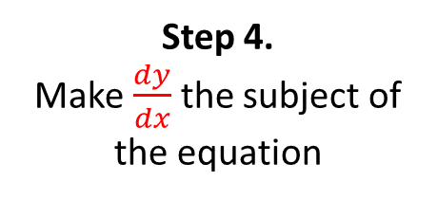
Implicit Differentiation
Find $\frac{dy}{dx}$ in terms of $x$ and $y$ where $x^{3}+x+y^{3}+3y=6$
$$3x^{2}+1+3y^{2}\frac{dy}{dx}+3\frac{dy}{dx}=0$$
Step 1.
Differentiate each term
Step 2.
Collect all $\frac{dy}{dx}$ terms on
one side of the equation
$$3y^{2}\frac{dy}{dx}+3\frac{dy}{dx}=−3x^{2}−1$$
Step 3.
Factorise out $\frac{dy}{dx}$
$$\frac{dy}{dx}\left(3y^{2}+3\right)=−3x^{2}−1$$
Step 4.
Make $\frac{dy}{dx}$ the subject of the equation
$$\frac{dy}{dx}=\frac{−3x^{2}−1}{3y^{2}+3}$$

Slide 9
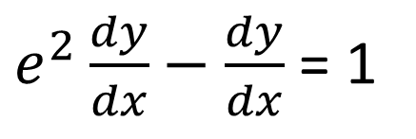
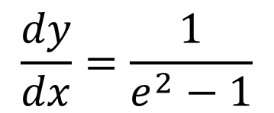
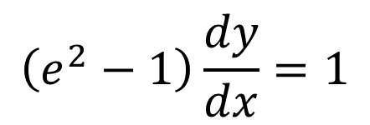
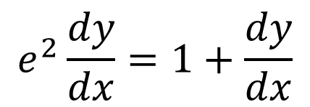
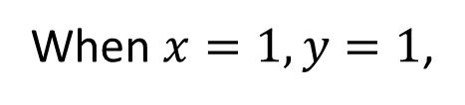
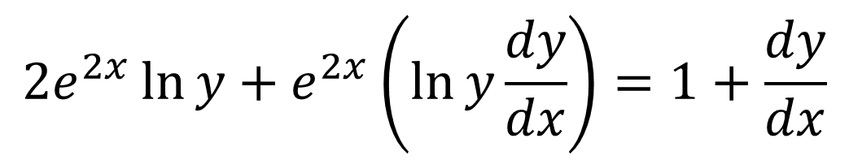
Implicit Differentiation
Find the value of $\frac{dy}{dx}$ at the point $(1,1)$, where $e^{2x}\ln{y}=x+y−2$
$$2e^{2x}\ln{y}+e^{2x}\left(\ln{y}\frac{dy}{dx}\right)=1+\frac{dy}{dx}$$
When $x=1, y=1$,
$$\left(e^{2}−1\right)\frac{dy}{dx}=1$$
$$e^{2}\frac{dy}{dx}=1+\frac{dy}{dx}$$
$$\frac{dy}{dx}=\frac{1}{e^{2}−1}$$
$e^{2}\frac{dy}{dx}−\frac{dy}{dx}$ = 1

Slide 10
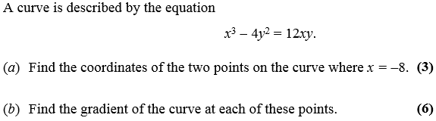
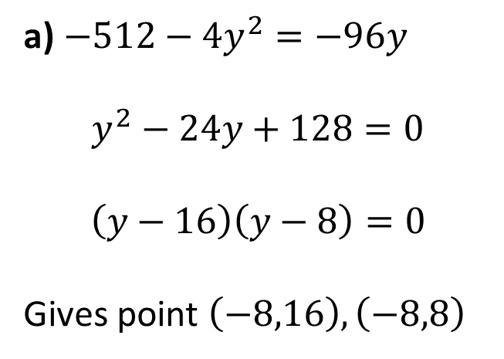
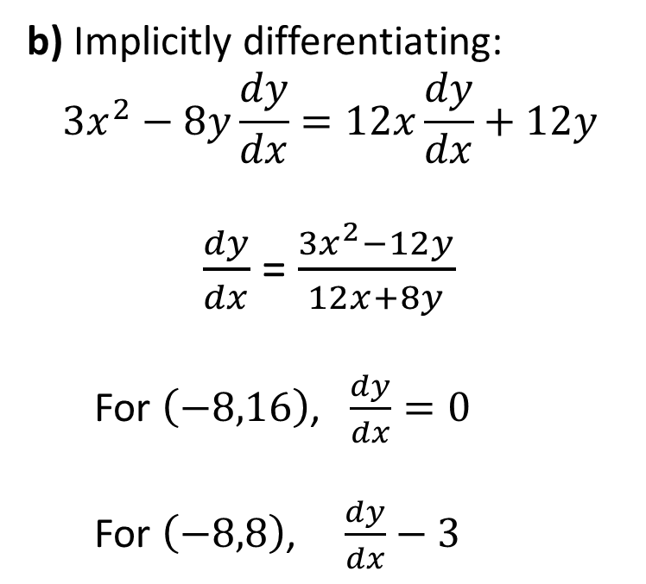
Implicit Differentiation
a) $−512−4y^{2}=−96y$
$$y^{2}−24y+128=0$$
$$\left(y−16\right)\left(y−8\right)=0$$
Gives point $\left(−8,16\right), \left(−8,8\right)$
b) Implicitly differentiating:
$$3x^{2}−8y\frac{dy}{dx}=12x\frac{dy}{dx}+12y$$
$\frac{dy}{dx}$ =$\frac{3x^{2}−12y}{12x+8y}$
For $\left(−8,16\right)$, $\frac{dy}{dx}=0$
For $\left(−8,8\right)$, $\frac{dy}{dx}−3$

Slide 11
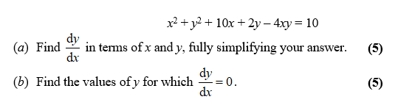
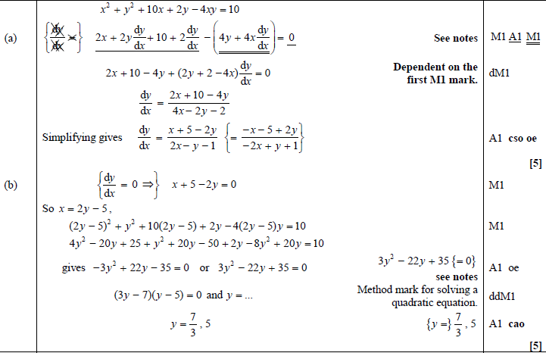

Test Your Understanding
C4 Jan 2008 Q5
Hint for (b): Solve simultaneously with original equation.
C4 June 2014(R) Q3
$−512−4y^{2}=−96y$
$y^{2}−24y+128=0$
$\left(y−16\right)\left(y−8\right)=0$
Gives point $\left(−8,16\right), \left(−8,8\right)$
Implicitly differentiating:
$3x^{2}−8y\frac{dy}{dx}=12x\frac{dy}{dx}+12y$
$\frac{dy}{dx}$ not needed, but it’s $\frac{3x^{2}−12y}{12x+8y}$
If $x=−8, y=16,\frac{dy}{dx}=−3$
If $x=−8, y=8,\frac{dy}{dx}=0$
?
?
?
?
Exam Note: This type of question was quite common.

Slide 12
Exercise 9H
Pearson Pure Mathematics Year 2/AS
Pages 255-256
Complete before the lesson Q3-5
In Class:
Green Q6-8
Amber Q9-10
Red Q11 & Challenge

