Slide 1
Year 1 Pure Mathematics
Integration
- Introduction
Chapter 13
(Part 1 of 2)

Slide 2


Integration
Integration is the opposite of differentiation.
differentiation
multiply by power
reduce power by 1
$$15x^{2}$$
$$5x^{3}$$
divide by new power
increase power by 1
Integration

Slide 3
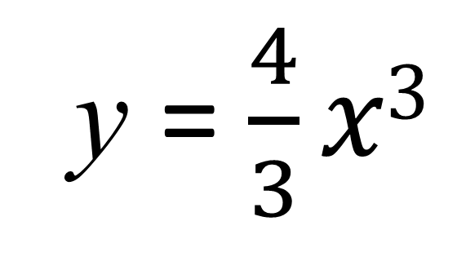
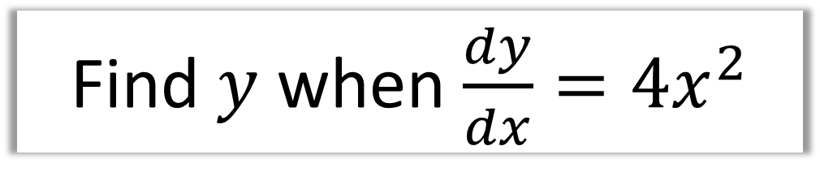
Integration
Find $y$ when $\frac{dy}{dx}=4x^{2}$
y = $\frac{4}{3}x3$

Slide 4
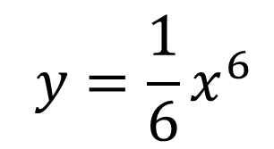
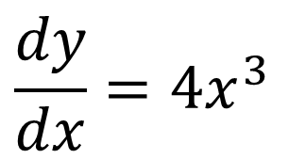


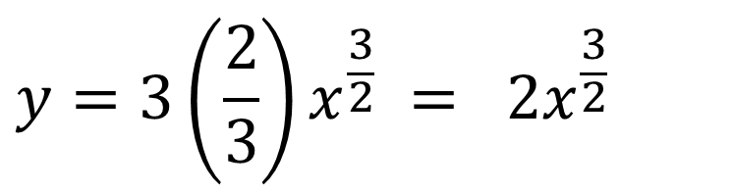
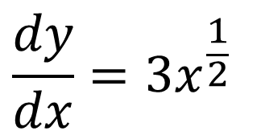
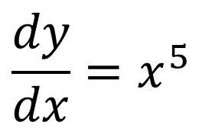
Integration
Find $y$ when:
$$\frac{dy}{dx}=4x^{3}$$
$$y=x^{4}$$
$$\frac{dy}{dx}=x^{5}$$
$$y=\frac{1}{6}x^{6}$$
$$\frac{dy}{dx}=3x^{\frac{1}{2}}$$
$$y=3\left(\frac{2}{3}\right)x^{\frac{3}{2}} = 2x^{\frac{3}{2}}$$

Slide 5

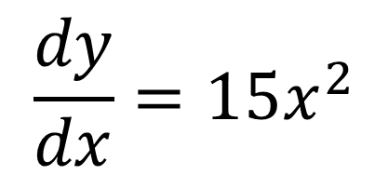

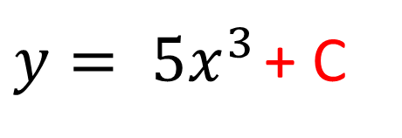


Integration
However, there is a complication!
$$5x^{3}+3$$
Differentiate
$$15x^{2}$$
$$15x^{2}$$
Integrate
$$5x^{3}$$
The constant disappeared!
$$\frac{dy}{dx}=15x^{2}$$
$y= 5x^{3}$ + C

Slide 6


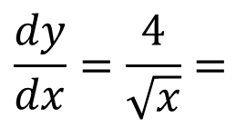
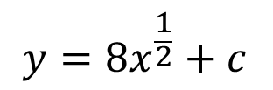
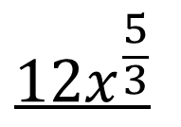


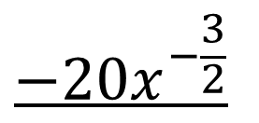
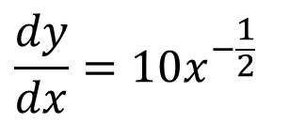

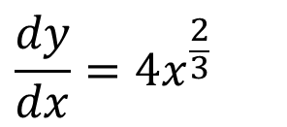

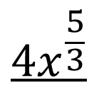
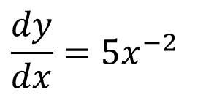
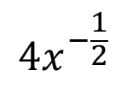
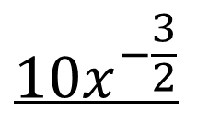
Integration
Find $y$ when:
$$\frac{dy}{dx}=\frac{4}{\sqrt{x}}=$$
$$4x^{−\frac{1}{2}}$$
$$y=8x^{\frac{1}{2}}+c$$
$$\frac{dy}{dx}=5x^{−2}$$
$$y=−5x^{−1}+c$$
$$4x^{\frac{5}{3}}$$
$$12x^{\frac{5}{3}}$$
$$\frac{dy}{dx}=4x^{\frac{2}{3}}$$
+ 𝑐
=
+ 𝑐
𝑦 =
$$\frac{5}{3}$$
$$5$$
$$10x^{−\frac{3}{2}}$$
$$−20x^{−\frac{3}{2}}$$
$$\frac{dy}{dx}=10x^{−\frac{1}{2}}$$
𝑦 =
+ 𝑐
=
+ 𝑐
$$−\frac{3}{2}$$
$$3$$

Slide 7

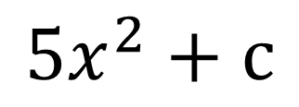
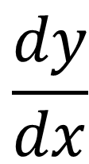
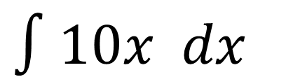
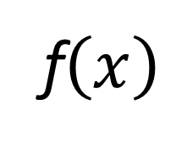
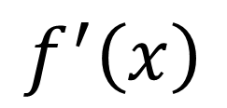
Integration
Possible notation:
Gradient
Equation
$$\frac{dy}{dx}$$
$$y$$
$$f^{′}\left(x\right)$$
f$\left(x\right)$
$∫10x dx$
$${5x}^{2}+c$$

Slide 8
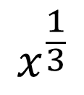
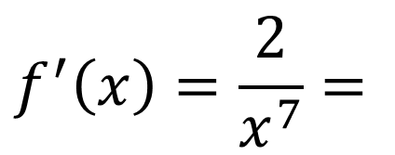


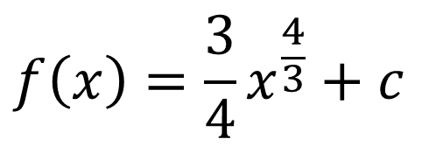
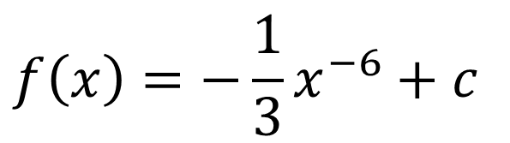

Integration
Find $f(x)$ when:
$$f^{′}\left(x\right)=\frac{2}{x^{7}}=$$
$$f\left(x\right)=−\frac{1}{3}x^{−6}+c$$
$$2x^{−7}$$
$$x^{\frac{1}{3}}$$
$$f\left(x\right)=\frac{3}{4}x^{\frac{4}{3}}+c$$
$$f^{′}\left(x\right)=\sqrt[3]{x}=$$

Slide 9
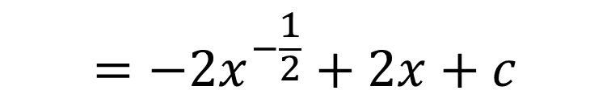
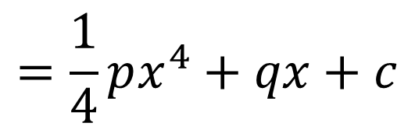
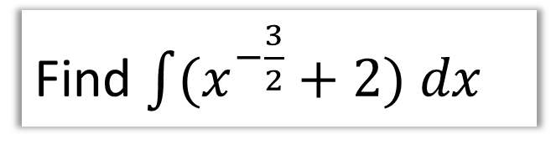

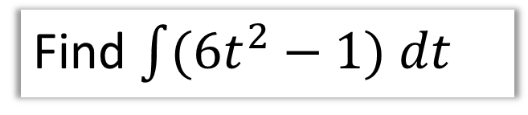
Integration
Find $\int{(x^{−\frac{3}{2}}+2) dx}$
$$=−2x^{−\frac{1}{2}}+2x+c$$
Find $\int{(6t^{2}−1) dt}$
$$=2t^{3}−t+c$$
Find $\int{(px^{3}+q) dx}$ where $p$ and $q$ are constants.
$$=\frac{1}{4}px^{4}+qx+c$$

Slide 10

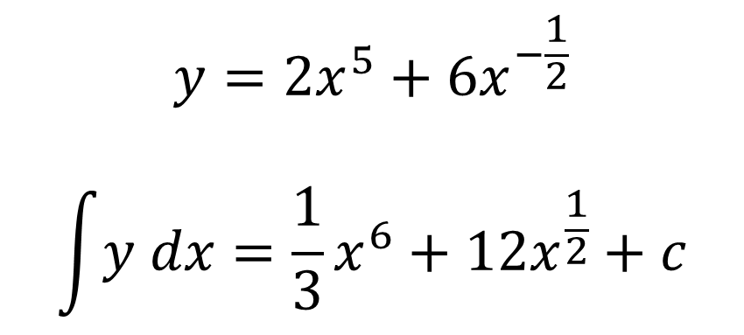
Integration – Exam Question
$$y=2x^{5}+6x^{−\frac{1}{2}}$$
$$\int{y dx}=\frac{1}{3}x^{6}+12x^{\frac{1}{2}}+c$$

Slide 11
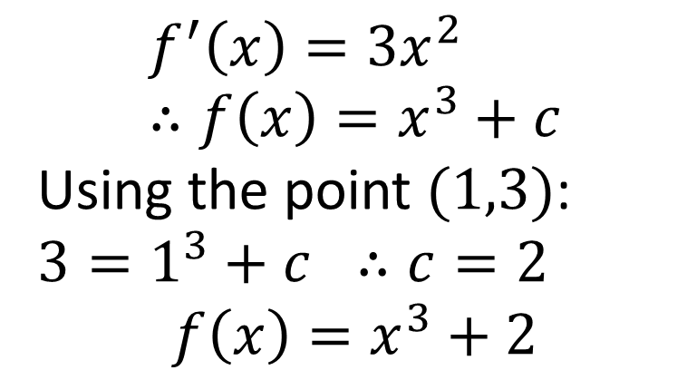
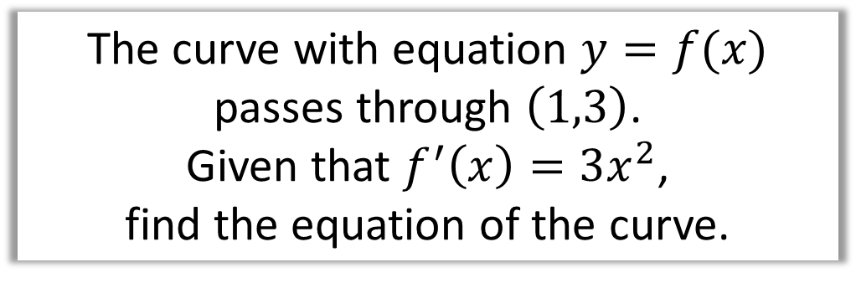
Integration - Finding the constant
To the constant C you need to be given a co-ordinate.
The curve with equation $y=f(x)$
passes through $\left(1,3\right)$.
Given that $f^{′}\left(x\right)=3x^{2}$,
find the equation of the curve.
$$f^{′}\left(x\right)=3x^{2} \\ ∴f\left(x\right)=x^{3}+c$$
Using the point $(1,3)$: $3=1^{3}+c ∴c=2$
$$f\left(x\right)=x^{3}+2$$

Slide 12
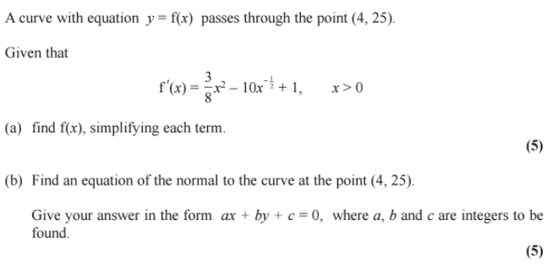
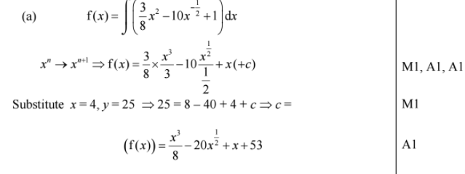
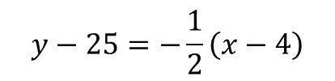
Integration- Exam Question
$$y−25=−\frac{1}{2}\left(x−4\right)$$
(b)

Slide 13
Exercise 13A
Pearson Pure Mathematics Year 1/AS
Pages 289-290
Complete before the lesson Ex3B Q2-4
Green Complete Ex3B
Amber Ex3C Q1-6
Red Ex3C Q7-9

Slide 14
Exercise 13B
Pearson Pure Mathematics Year 1/AS
Pages 291-293
Complete before the lesson Ex3B Q2-4
Green Complete Ex3B
Amber Ex3C Q1-6
Red Ex3C Q7-9

Slide 15
Exercise 13C
Pearson Pure Mathematics Year 1/AS
Pages 294-295
Complete before the lesson Ex3B Q2-4
Green Complete Ex3B
Amber Ex3C Q1-6
Red Ex3C Q7-9

