Slide 1
Year 2 Applied Mathematics
Probability
– Probability Trees
Chapter 2
(Part 4 of 4)

Slide 2
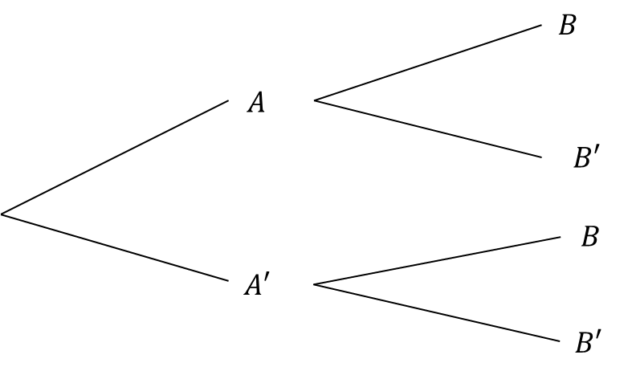










Probability Trees
$$P\left(B | A\right)$$
$$P\left(A∩B\right)$$
$$P\left(A\right)$$
$$P\left(B′ | A\right)$$
$$P\left(A∩B′\right)$$
$$P\left(B | A′\right)$$
$$P\left(A′∩B\right)$$
$$P\left(A′\right)$$
$$P\left(B′ | A′\right)$$
$$P\left(A′∩B′\right)$$

Slide 3
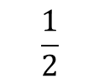
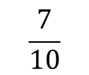


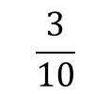


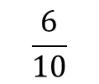

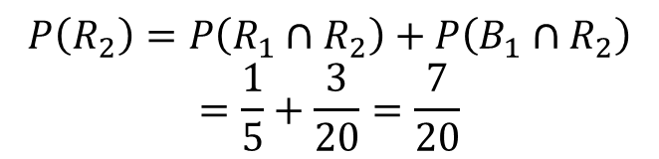
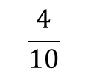

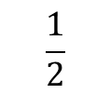
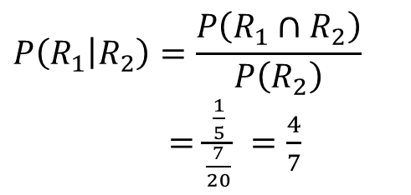
Probability Trees - Examples
Example:
You have two bags, the first with 5 red balls and 5 blue balls, and the second with 3 red balls and 6 blue balls.
You first pick a ball from the first bag, and place it in the second.
You then pick a ball from the second bag.
a) You pick a red ball on your second pick.
$$\frac{4}{10}$$
$$P\left(R_{2}\right)=P\left(R_{1}∩R_{2}\right)+P\left(B_{1}{∩R}_{2}\right)$$
$$=\frac{1}{5}+\frac{3}{20}=\frac{7}{20}$$
$$R_{2}$$
$$\frac{1}{2}$$
$$R_{1}$$
$$\frac{6}{10}$$
$$B_{2}$$
$$\frac{3}{10}$$
b) Given that your second pick was red,
the first pick was also red.
$$R_{2}$$
$$\frac{1}{2}$$
$$B_{1}$$
$$P\left(R_{1} | R_{2}\right)=\frac{P\left(R_{1}∩R_{2}\right)}{P\left(R_{2}\right)}$$
$=\frac{\frac{1}{5}}{\frac{7}{20}} =\frac{4}{7}$
$$\frac{7}{10}$$
$$B_{2}$$

Slide 4
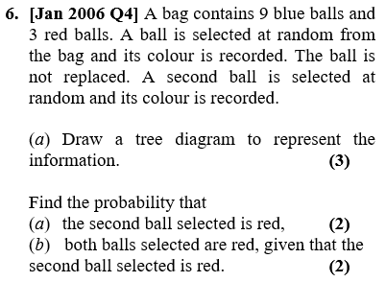
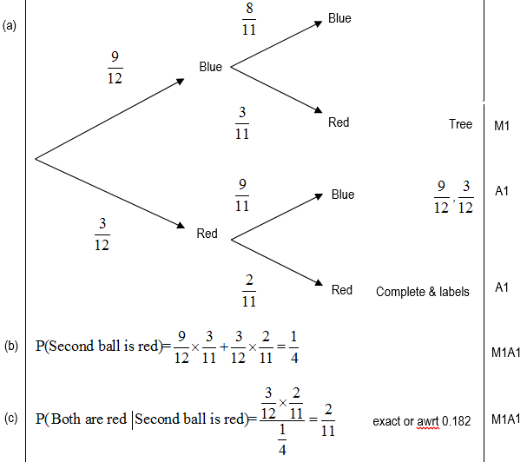
Probability Trees – Exam Question

Slide 5
Testing Your Understanding
Edexcel S1
?
?
?

Slide 6
Exercise 2E
Pearson Stats/Mechanics Year 2
Pages 31-34
Complete before the lesson Q1-3
In Class:
Green Q4-6
Amber Q7-8
Red Q9-11

