Slide 1

Further Stats 1 Chapter 2 ::
Poisson Distribution
jfrost@tiffin.kingston.sch.uk
www.drfrostmaths.com
@DrFrostMaths
Last modified: 19th July 2018

Slide 2



Register at: www.drfrostmaths.com
Everything is completely free.
Practise questions by chapter, including past paper questions and extension questions (e.g. MAT).
Teachers: you can create student accounts (or students can register themselves).

Slide 3
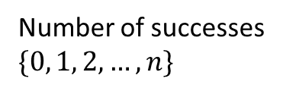

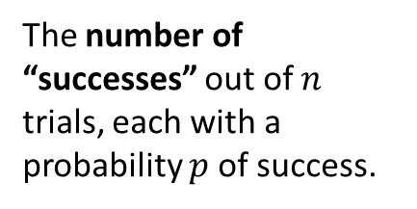

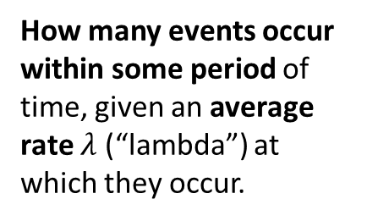

What is the Poisson Distribution?
Name
Description
Outcomes
?
?
Binomial
$$B(n,p)$$
The number of “successes” out of $n$ trials, each with a probability $p$ of success.
Number of successes
$$\{0, 1, 2, …, n\}$$
How many events occur within some period of time, given an average rate $λ$ (“lambda”) at which they occur.
Number of events
$$ℕ=\{0, 1, 2, …\}$$
(since technically any non-negative number of events could occur)
Poisson
$$Po(λ)$$
?
?

Slide 4
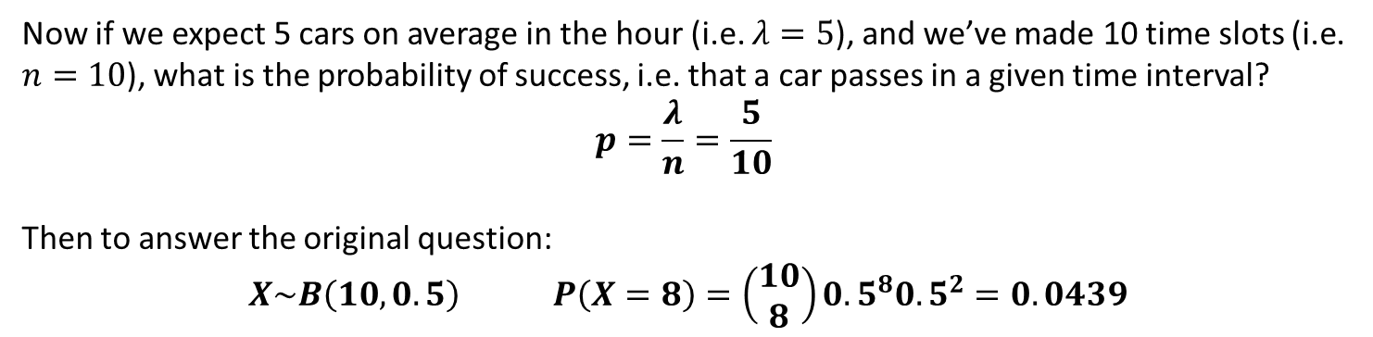
How does it arise?
(You don’t need to write any of this down)
We said that the Poisson Distribution allows us to calculate the count of a number of events happening within some period, given an average rate.
Q
Calculate the probability of 8 cars passing in the next hour, given that on average 5 pass an hour.
Suppose we wanted to see how we could do this with a Binomial Distribution…
2pm
3pm
Suppose we divided the hour up into 10 equal time intervals. Each time slot is a trial, where “success” is a car passing in that period.
✓
✓
✓
✓
✓
Now if we expect 5 cars on average in the hour (i.e. $λ=5$), and we’ve made 10 time slots (i.e. $n=10$), what is the probability of success, i.e. that a car passes in a given time interval?
$$p=\frac{λ}{n}=\frac{5}{10}$$
Then to answer the original question:
$X\sim B\left(10, 0.5\right) P\left(X=8\right)=\left(\begin{matrix}10 \\ 8\end{matrix}\right){0.5}^{8}{0.5}^{2}=0.0439$
?
?

Slide 5

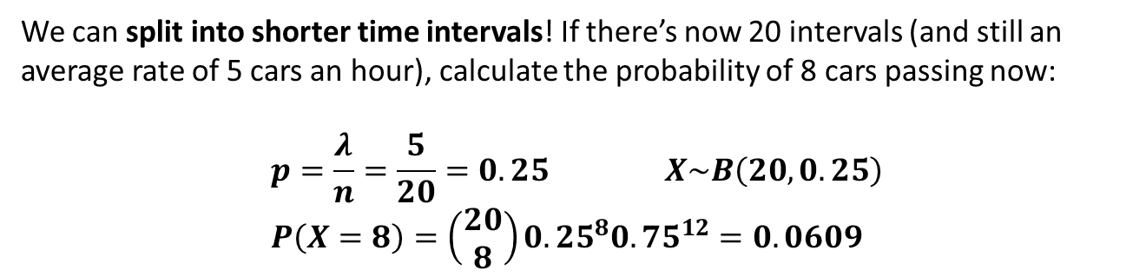
How does it arise?
2pm
3pm
✓
✓
✓
✓
✓
$$P\left(X=8\right)=0.0439$$
A problem with how we’ve modelled this is that more the one car could pass in any given time interval, and thus the count of successes won’t necessarily be the count of cars.
How could we lessen this problem?
2pm
3pm
✓
✓
✓
✓
✓
✓
We can split into shorter time intervals! If there’s now 20 intervals (and still an average rate of 5 cars an hour), calculate the probability of 8 cars passing now:
$$p=\frac{λ}{n}=\frac{5}{20}=0.25 X\sim B\left(20, 0.25\right) \\ P\left(X=8\right)=\left(\begin{matrix}20 \\ 8\end{matrix}\right){0.25}^{8}{0.75}^{12}=0.0609$$
?

Slide 6
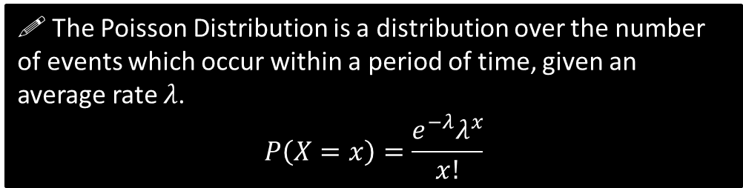
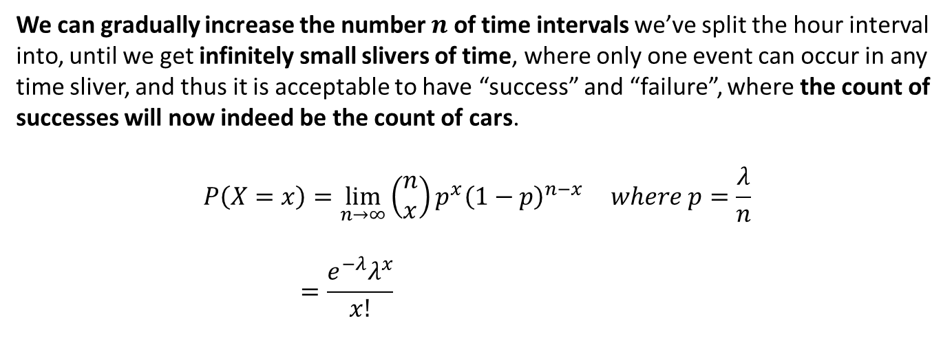
How does it arise?
We can gradually increase the number $n$ of time intervals we’ve split the hour interval into, until we get infinitely small slivers of time, where only one event can occur in any time sliver, and thus it is acceptable to have “success” and “failure”, where the count of successes will now indeed be the count of cars.
$$P\left(X=x\right)=\lim_{n→∞}\left(\begin{matrix}n \\ x\end{matrix}\right)p^{x}{\left(1−p\right)}^{n−x} where p=\frac{λ}{n} \\ =\frac{e^{−λ}λ^{x}}{x!}$$
?
The proof for this can be found at the end of these slides.
! The Poisson Distribution is a distribution over the number of events which occur within a period of time, given an average rate $λ$.
$$P\left(X=x\right)=\frac{e^{−λ}λ^{x}}{x!}$$

Slide 7

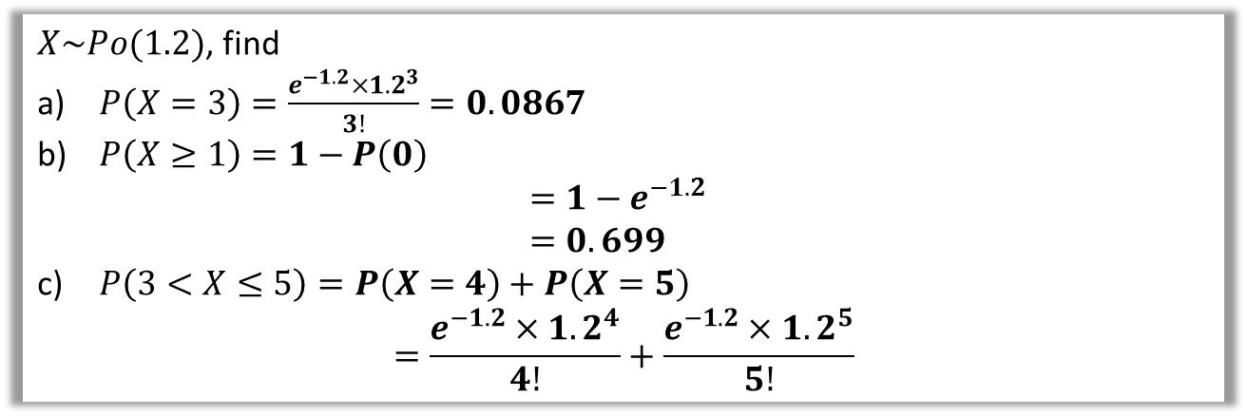
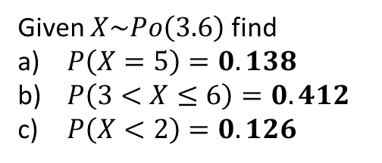
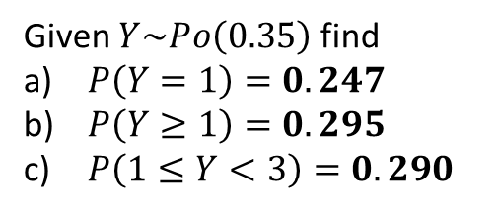
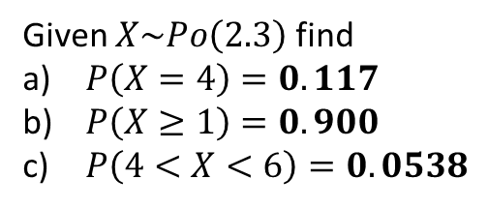
Examples
Q
$X\sim Po(1.2)$, find
$P\left(X=3\right)=\frac{e^{−1.2}{×1.2}^{3}}{3!}=0.0867$
$P\left(X≥1\right)=1−P\left(0\right)$
$=1−e^{−1.2}$
$=0.699$
$P\left(3<X≤5\right)=P\left(X=4\right)+P\left(X=5\right)$
$=\frac{e^{−1.2}{×1.2}^{4}}{4!}+\frac{e^{−1.2}{×1.2}^{5}}{5!}$
?
Froculator Tip: You can get these values on a ClassWiz by going to Distributions and selecting “Poisson PD”.
?
?
Q
Given that www.drfrostmaths.com receives 25 hits a second on average, determine the probability it receives 20 hits in the second.
$$X\sim Po\left(25\right) \\ P\left(X=20\right)=\frac{e^{−25}{×25}^{20}}{20!}=0.0519$$
?
Test Your Understanding:
1
Given $X\sim Po\left(2.3\right)$ find
$P\left(X=4\right)=0.117$
$P\left(X≥1\right)=0.900$
$P\left(4<X<6\right)=0.0538$
Given $Y\sim Po\left(0.35\right)$ find
$P\left(Y=1\right)=0.247$
$P\left(Y≥1\right)=0.295$
$P\left(1≤Y<3\right)=0.290$
Given $X\sim Po\left(3.6\right)$ find
$P\left(X=5\right)=0.138$
$P\left(3<X≤6\right)=0.412$
$P\left(X<2\right)=0.126$
2
3
?
?
?
?
?
?
?
?
?

Slide 8
Exercise 2A
Pearson Further Statistics 1
Page 21
Complete before the lesson Q1-2
In Class:
Green Q3-4
Amber Q5-6

Slide 9
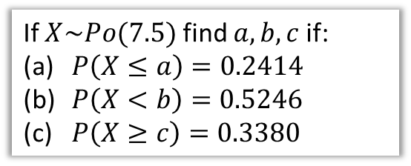
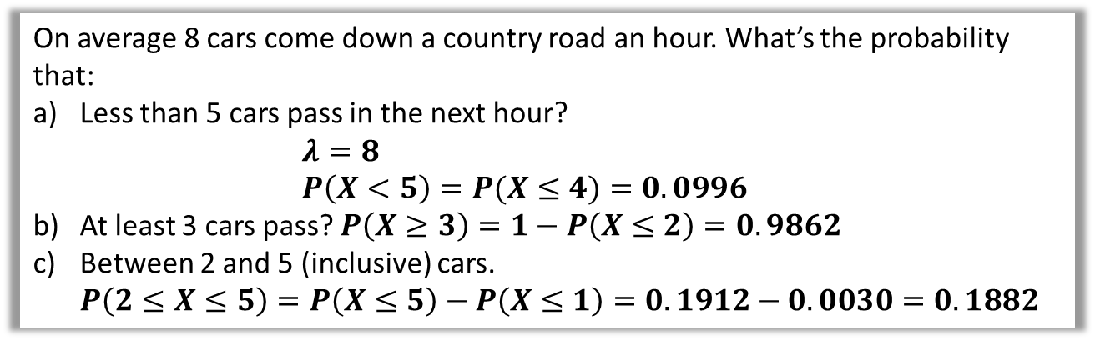

Using Tables
As with the Binomial distribution, we can use tables for the Cumulative Distribution Function of a Poisson distribution, i.e. the running total of the probability up to a particular value. You can also use your Classwiz (or other suitable calculator); choose Poisson CF.
On average 8 cars come down a country road an hour. What’s the probability that:
Less than 5 cars pass in the next hour?
$λ=8$
$P\left(X<5\right)=P(X≤4)=0.0996$
At least 3 cars pass? $P\left(X≥3\right)=1−P\left(X≤2\right)=0.9862$
Between 2 and 5 (inclusive) cars.
$P\left(2≤X≤5\right)=P\left(X≤5\right)−P\left(X≤1\right)=0.1912−0.0030=0.1882$
?
?
?
Using tables backwards: (calculators can’t unfortunately do discrete distributions backwards)
? a
If $X\sim Po(7.5)$ find $a, b, c$ if:
$P\left(X≤a\right)=0.2414$
$P\left(X<b\right)=0.5246$
$P\left(X≥c\right)=0.3380$
$a=5$ (directly from tables)
$$P\left(X≤b−1\right)=0.5246 \\ b−1=7 \\ b=8$$
$$1−P\left(X≤c−1\right)=0.3380 \\ P\left(X≤c−1\right)=0.6620 \\ c−1=8 \\ c=9$$
? b
? c

Slide 10
Exercise 2B
Pearson Further Statistics 1
Page 22
Complete before the lesson Q1-2
In Class:
Green Q3-4
Amber Q5-6

Slide 11
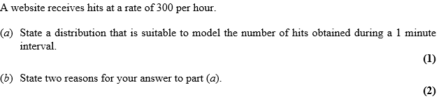

Properties of Poisson Distribution
We saw with in order to model something with a Binomial Distribution, we had to make some assumptions, e.g. each event was independent, and had two outcomes.
We have similar restrictions on events for a Poisson Distribution:
This means we can’t have multiple events occurring at once. We treat events as instantaneous.
! Events must occur:
Singly in time.
Independently of each other.
At a constant rate in the sense that the mean number of occurrences in the interval is proportional to the length of the interval.
If an event occurred just a moment ago, another one is no less likely to occur now than it a while later..
You can usually tell in an exam if a Poisson Distribution is intended if the word ‘rate’ is used.
Jan 2012 Q4
Poisson (or $Po\left(5\right)$ )
?
(From mark scheme) Hits occur singly in time
Hits are independent or hits occurs randomly
Hits occur at a constant rate
?

Slide 12
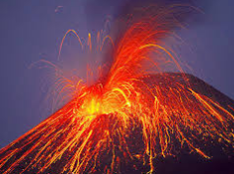
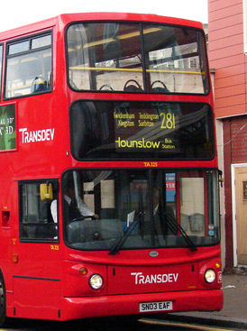

Poisson or not Poisson?
Given these restrictions, which of the following could we model using a Poisson Distribution (where any reasonable simplifying assumptions are justifiable)
A volcano erupts every 1000 years, and we’re interested in the probability of at least one eruption next year.
If a volcano erupted today and then finished erupting, it’s less likely to erupt next year. So events are not independent.
?
On average the 281 bus comes 10 times an hour. We’re interested in the probability of (at least one) bus coming in the next hour.
Definitely not. Buses aren’t equally likely to come at any moment – the probability is going to spike each 6 minutes since buses intend to come at regular intervals, not randomly.
?
A call centre receives on average 80 calls an hour, and wish to work out the probability they have over 100 calls at some hour in the day.
Yes, justified, provided that the average rate is constant. We’re making some simplifying assumptions, such as that we don’t have repeat calls from the same customer.
?

Slide 13
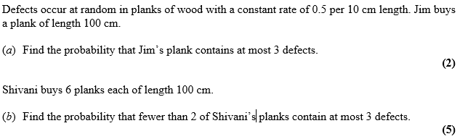

General Questions
Fro Tip: Think carefully about whether we wish to use Binomial or Poisson.
May 2011 Q5
Fro Tip: Sometimes we need to scale the rate to a different time period/length.
a
If 0.5 defects occur per 10cm, 5 defects occur per 100cm
$$X\sim Po\left(5\right) \\ P\left(X≤3\right)=0.2650$$
From (a), the probability that any given blank has at most 3 defects is 0.2650. We have 6 planks, and a Binomial Distribution over the count of how many are defective out of 6.
Let $Y$ be the number of defective planks.$Y\sim B\left(6, 0.2650\right)$
$$P\left(Y<2\right)=P\left(Y=0\right)+P\left(Y=1\right) \\ ={0.735}^{6}+6×0.265×{0.735}^{5}=0.4987…$$
?
b
?
Bro Tip: You should be clear about what your random variables are and how they’re distributed.

Slide 14

Test Your Understanding
A shop sells radios at a rate of 2.5 per week.
Find the probability that in a two-week period the shop sells at least 7 radios.
Deliveries of these radios come every 4 weeks. Find the probability of selling fewer than 12 radios in a four-week period.
The manager wishes to make sure that the probability of the shop running out of radios during a four-week period is less than 0.01. Find the smallest number of radios the manager should have in stock immediately after the delivery.
$X=$the number of radios sold in a two-week period
$$X\sim Po\left(5\right) \\ P\left(X≥7\right)=1−P\left(X≤6\right) \\ =0.2378$$
$Y=$ the number of radios sold in a four-week period
$$Y\sim Po\left(10\right) \\ P\left(Y<12\right)=P\left(Y≤11\right)$$
$=0.6968$
Let $s=$ the number the manager should have in stock
$P\left(Y>s\right)<0.01$ $→ P\left(Y≤s\right)>0.99$
Using the table, we find $s=18$.
a
?
Fro Tip: The method/principle her is exactly the same as with Binomial questions.
b
?
c
?

Slide 15


Exercise 2C
Complete before the lesson Q1-2
Green Q3-6
Amber Q7-9
Red Q10-15
Pearson Further Statistics 1
Pages 24-27
N
(Knowledge of Stats Year 2 conditional probability required)
In a football game of France versus Croatia, France score goals at a rate of $λ$ per 10 minutes. Given that in a (90 minute) game France score 5 goals, determine the probability that 2 of those goals were scored within the first 10 minutes.
$$P\left(2 goals in first 10 mins | 5 goals in 90 mins\right)=\frac{P\left(2 goals in first 10 mins and 5 goals in 90 mins\right)}{P\left(5 goals in 90 mins\right)} \\ =\frac{P\left(2 goals in first 10 mins 3 goals in next 80 mins\right)}{P\left(5 goals in 90 mins\right)} \\ =\frac{\frac{e^{−λ}λ^{2}}{2!}×\frac{e^{−8λ}{\left(8λ\right)}^{3}}{3!}}{\frac{e^{−9λ}{\left(9λ\right)}^{5}}{5!}}=…=\frac{5120}{59049}$$
?
Note: I realise they actually scored 4 goals in the 2018 World Cup.

Slide 16
Exercise 2C
Pearson Further Statistics 1
Pages 24-27
Complete before the lesson Q1-2
In Class:
Green Q
Amber Q
Red Q

Slide 17
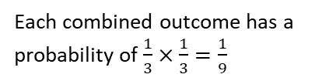
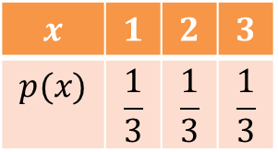


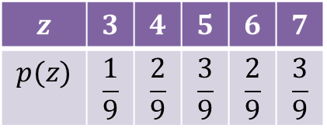
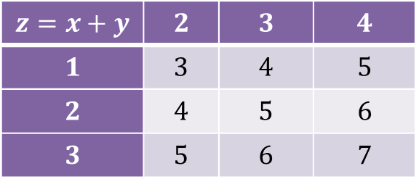
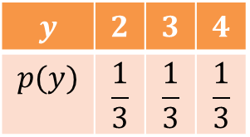
Adding Random Variables
Suppose that we had two fair three-sided spinners, each which could be represented using random variables $X$ and $Y$ respectively:
1
2
2
3
3
4
$$x$$ | $$1$$ | $$2$$ | $$3$$
$$p(x)$$ | $$\frac{1}{3}$$ | $$\frac{1}{3}$$ | $$\frac{1}{3}$$
$$y$$ | $$2$$ | $$3$$ | $$4$$
$$p(y)$$ | $$\frac{1}{3}$$ | $$\frac{1}{3}$$ | $$\frac{1}{3}$$
Then $Z=X+Y$ would represent the distribution of adding each possible outcome from $X$ with each possible outcome from $Y:$
$$z=x+y$$ | $$2$$ | $$3$$ | $$4$$
$$1$$ | $$3$$ | $$4$$ | $$5$$
$$2$$ | $$4$$ | $$5$$ | $$6$$
$$3$$ | $$5$$ | $$6$$ | $$7$$
$$z$$ | $$3$$ | $$4$$ | $$5$$ | $$6$$ | $$7$$
$$p(z)$$ | $$\frac{1}{9}$$ | $$\frac{2}{9}$$ | $$\frac{3}{9}$$ | $$\frac{2}{9}$$ | $$\frac{3}{9}$$
Each combined outcome has a probability of $\frac{1}{3}×\frac{1}{3}=\frac{1}{9}$

Slide 18
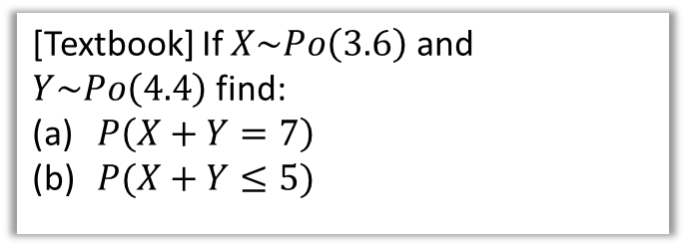
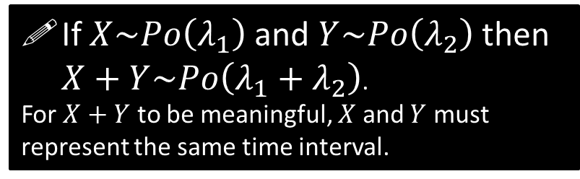
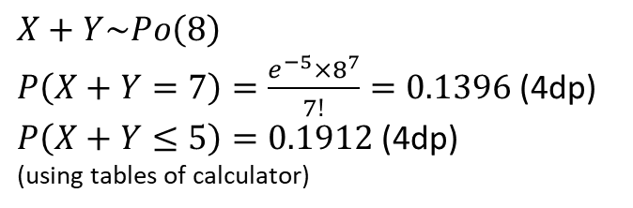
Adding Poisson Distributions
If 5 cars pass per hour in road A and 8 cars pass per hour in road B, how many cars pass per hour in roads A and B combined?
Obviously 13 per hour! This suggests that if we have two Poisson distributions and want to represent the total number of events across the same time interval, we can form a new Poisson distribution in which we simply add the rates.
?
If $X\sim Po\left(λ_{1}\right)$ and $Y\sim Po\left(λ_{2}\right)$ then $X+Y\sim Po\left(λ_{1}+λ_{2}\right)$.
For $X+Y$ to be meaningful, $X$ and $Y$ must represent the same time interval.
[Textbook] If $X\sim Po\left(3.6\right)$ and $Y\sim Po\left(4.4\right)$ find:
$P\left(X+Y=7\right)$
$P(X+Y≤5)$
a
$$X+Y\sim Po\left(8\right)$$
$P\left(X+Y=7\right)=\frac{e^{−5}×8^{7}}{7!}=0.1396$ (4dp)
$P\left(X+Y≤5\right)=0.1912$ (4dp)
(using tables of calculator)
?
b
?

Slide 19
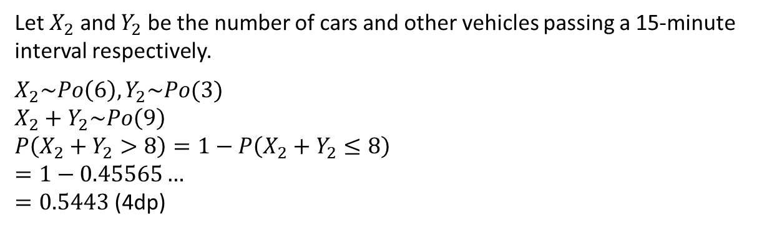
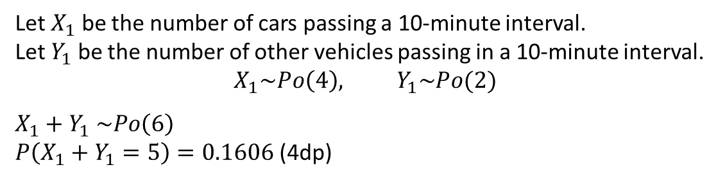
Adding Poisson Distributions
[Textbook] The number of cars passing an observation point in a 5-minute interval is modelled by a Poisson distribution with mean 2. The number of other vehicles passing the observation point in a 15-minute interval is modelled by a Poisson distribution with mean 3. Find the probability that:
exactly 5 vehicles, of any type, pass the observation point in a 10-minute interval
more than 8 vehicles, of any type, pass the observation point in a 15-minute interval
Let $X_{1}$ be the number of cars passing a 10-minute interval.
Let $Y_{1}$ be the number of other vehicles passing in a 10-minute interval.
$$X_{1}\sim Po\left(4\right), Y_{1}\sim Po(2)$$
$X_{1}+Y_{1} \sim Po\left(6\right)$
$P\left(X_{1}+Y_{1}=5\right)=0.1606$ (4dp)
a
?
b
Let $X_{2}$ and $Y_{2}$ be the number of cars and other vehicles passing a 15-minute interval respectively.
$X_{2}\sim Po\left(6\right), Y_{2}\sim Po(3)$
$X_{2}+Y_{2}\sim Po\left(9\right)$
$P\left(X_{2}+Y_{2}>8\right)=1−P\left(X_{2}+Y_{2}≤8\right)$
$=1−0.45565…$
$=0.5443$ (4dp)
?

Slide 20
Exercise 2D
Pearson Further Statistics 1
Pages 28-29
Complete before the lesson Q1-3
In Class:
Green Q4-5
Amber Q6-8
Red Q9-10 & Challenge

Slide 21
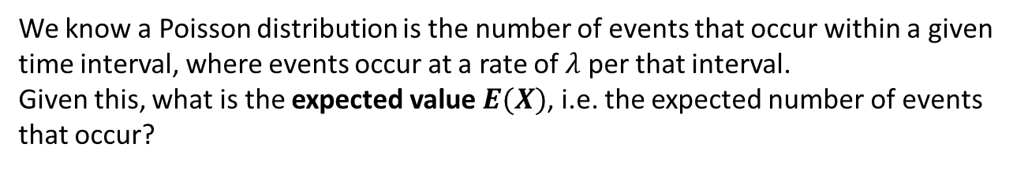

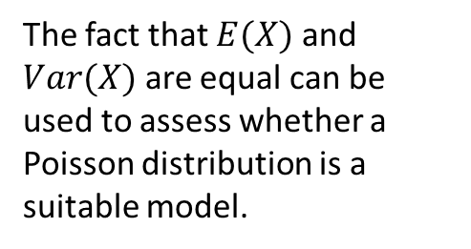


Mean and variance of Poisson distribution
We know a Poisson distribution is the number of events that occur within a given time interval, where events occur at a rate of $λ$ per that interval.
Given this, what is the expected value $E(X)$, i.e. the expected number of events that occur?
!
$$E\left(X\right)=λ \\ Var\left(X\right)=λ$$
Proof (harder than you think):
$$E\left(X\right)=Σ_{x=0}^{∞} x p\left(x\right)=Σ_{x=0}^{∞}\frac{xe^{−λ}λ^{x}}{x!}=Σ_{x=1}^{∞}\frac{xe^{−λ}λ^{x}}{x!} \\ =e^{−λ}Σ_{x=1}^{∞}\frac{xλ^{x}}{x!}=λe^{−λ}Σ_{x=1}^{∞}\frac{λ^{x−1}}{\left(x−1\right)!} \\ =λe^{−λ}Σ_{x=0}^{∞}\frac{λ^{x}}{x!}$$
In Core Pure Year 2 you will learn that:
$$e^{λ}=1+\frac{λ}{1!}+\frac{λ^{2}}{2!}+\frac{λ^{3}}{3!}+…=Σ_{x=0}^{∞}\frac{λ^{x}}{x!}$$
Therefore $E\left(X\right)=λe^{−λ}e^{λ}=λ$
The proof is considerably easier when using a probability generating function. You will learn about these later in FS1.
?
$x=0$ term will be 0.
The fact that $E(X)$ and $Var(X)$ are equal can be used to assess whether a Poisson distribution is a suitable model.
Note change of limit.

Slide 22

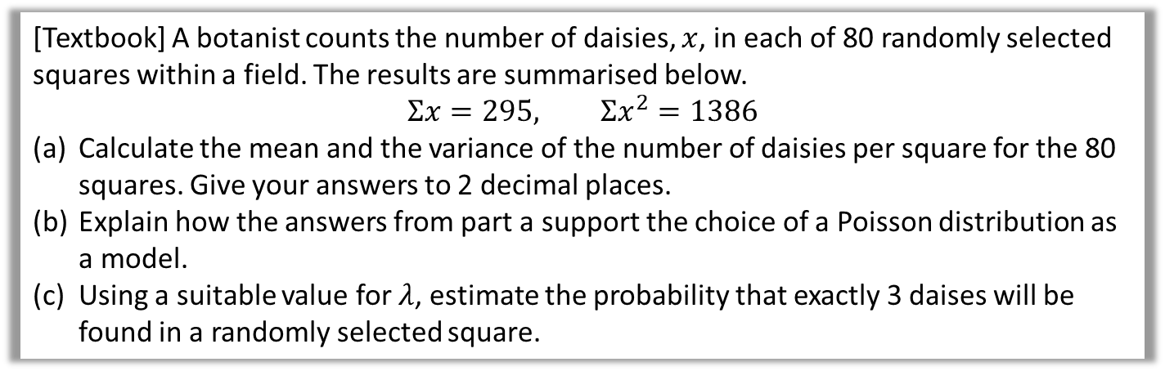
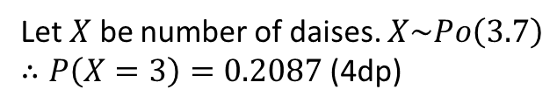
Mean and variance of Poisson distribution
[Textbook] A botanist counts the number of daisies, $x$, in each of 80 randomly selected squares within a field. The results are summarised below.
$$Σx=295, Σx^{2}=1386$$
Calculate the mean and the variance of the number of daisies per square for the 80 squares. Give your answers to 2 decimal places.
Explain how the answers from part a support the choice of a Poisson distribution as a model.
Using a suitable value for $λ$, estimate the probability that exactly 3 daises will be found in a randomly selected square.
Mean $=\overline{x}=\frac{Σx}{80}=\frac{295}{80}=3.69$ (2dp)
Variance $=σ^{2}=\frac{Σx^{2}}{80}−{\overline{x}}^{2}$
$$=\frac{1386}{80}−{\left(\frac{295}{80}\right)}^{2}$$
$=3.73$ (2dp)
Both mean and variance are 3.7 to 1dp; their proximity in value supports Poisson distribution.
c
Let $X$ be number of daises. $X\sim Po\left(3.7\right)$
$∴P\left(X=3\right)=0.2087$ (4dp)
a
?
?
b
?

Slide 23
Exercise 2E
Pearson Further Statistics 1
Page 31
Complete before the lesson Q1
In Class:
Green Q2
Amber Q3
Red Challenge

Slide 24
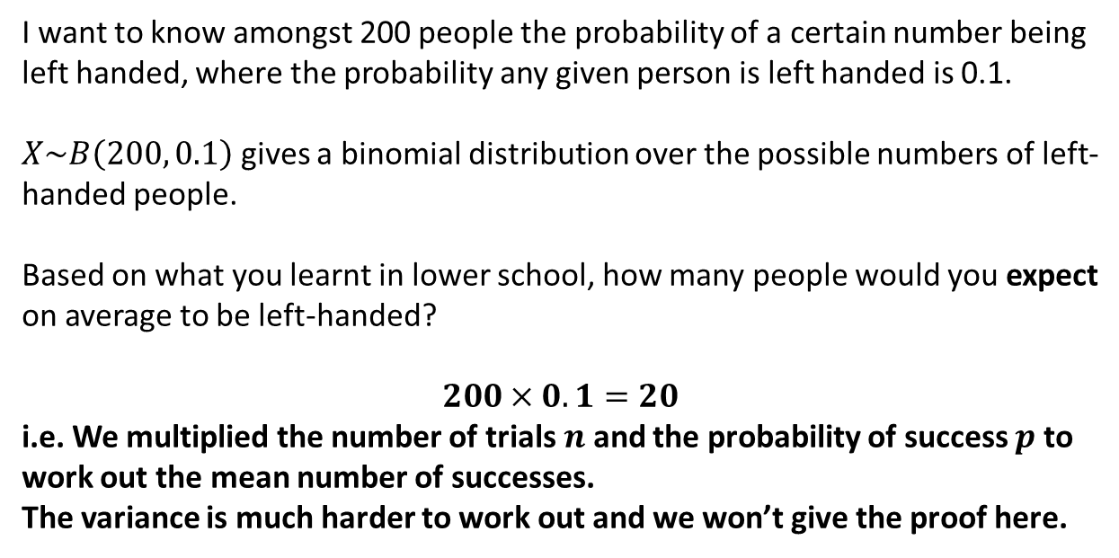
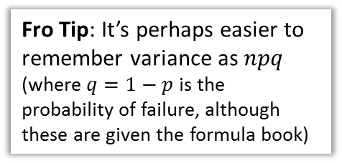
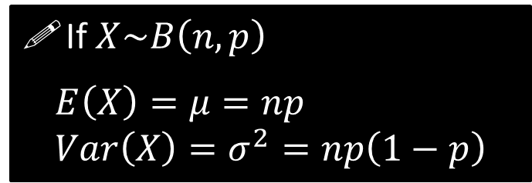
Mean and Variance of Binomial Distribution
I want to know amongst 200 people the probability of a certain number being left handed, where the probability any given person is left handed is 0.1.
$X\sim B\left(200, 0.1\right)$ gives a binomial distribution over the possible numbers of left-handed people.
Based on what you learnt in lower school, how many people would you expect on average to be left-handed?
$$200×0.1=20$$
i.e. We multiplied the number of trials $n$ and the probability of success $p$ to work out the mean number of successes.
The variance is much harder to work out and we won’t give the proof here.
?
If $X\sim B\left(n,p\right)$
$$E\left(X\right)=μ=np \\ Var\left(X\right)=σ^{2}=np\left(1−p\right)$$
Fro Tip: It’s perhaps easier to remember variance as $npq$ (where $q=1−p$ is the probability of failure, although these are given the formula book)

Slide 25

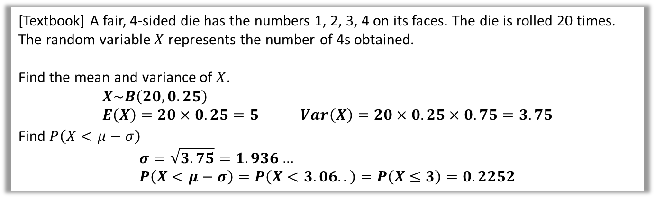
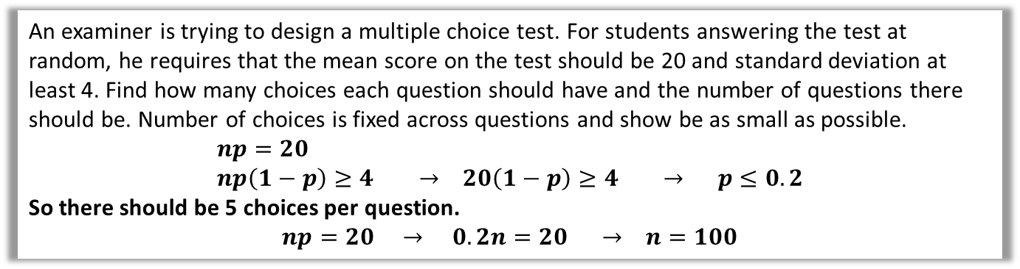
Examples
Q
[Textbook] A fair, 4-sided die has the numbers 1, 2, 3, 4 on its faces. The die is rolled 20 times. The random variable $X$ represents the number of 4s obtained.
Find the mean and variance of $X$.
$$X\sim B\left(20,0.25\right) \\ E\left(X\right)=20×0.25=5 Var\left(X\right)=20×0.25×0.75=3.75$$
Find $P\left(X<μ−σ\right)$
$$σ=\sqrt{3.75}=1.936… \\ P\left(X<μ−σ\right)=P\left(X<3.06..\right)=P\left(X≤3\right)=0.2252$$
?
?
Q
David believes that 35% of people in a certain town will vote for him in the next election and he commissions a survey. Find the minimum number of people the survey should ask to have a mean number of more than 100 voting for David.
$$0.35n=100 n=285.7$$
So $286$ people should be asked.
?
Q
An examiner is trying to design a multiple choice test. For students answering the test at random, he requires that the mean score on the test should be 20 and standard deviation at least 4. Find how many choices each question should have and the number of questions there should be. Number of choices is fixed across questions and show be as small as possible.
$$np=20 \\ np\left(1−p\right)≥4 → 20\left(1−p\right)≥4 → p≤0.2$$
So there should be 5 choices per question.
$$np=20 → 0.2n=20 → n=100$$
?

Slide 26
Exercise 2F
Pearson Further Statistics 1
Pages 33-34
Complete before the lesson Q1-5
In Class:
Green Q6-7
Amber Q8
Red Q9-10 & Challenge

Slide 27


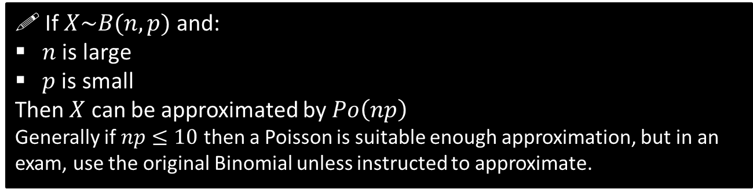
Approximating a Binomial using a Poisson
Earlier we saw how we could solve problems involving rates using a Binomial Distribution, where we’d split up the time period into intervals where in each the event either happened or it didn’t, where $p=\frac{λ}{n}$.
2pm
3pm
✓
✓
✓
✓
✓
We saw that the Poisson Distribution is obtained when we divided time into more and more chunks (i.e. where $n$ became infinitely large). Note also that $p$ is small because in a very short time interval, the probability of the event occurring is low. This naturally leads us to:
! If $X\sim B(n, p)$ and:
$n$ is large
$p$ is small
Then $X$ can be approximated by $Po\left(np\right)$
Generally if $np≤10$ then a Poisson is suitable enough approximation, but in an exam, use the original Binomial unless instructed to approximate.

Slide 28
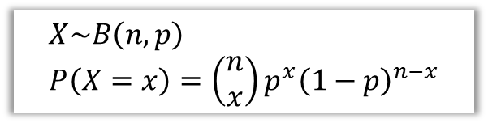
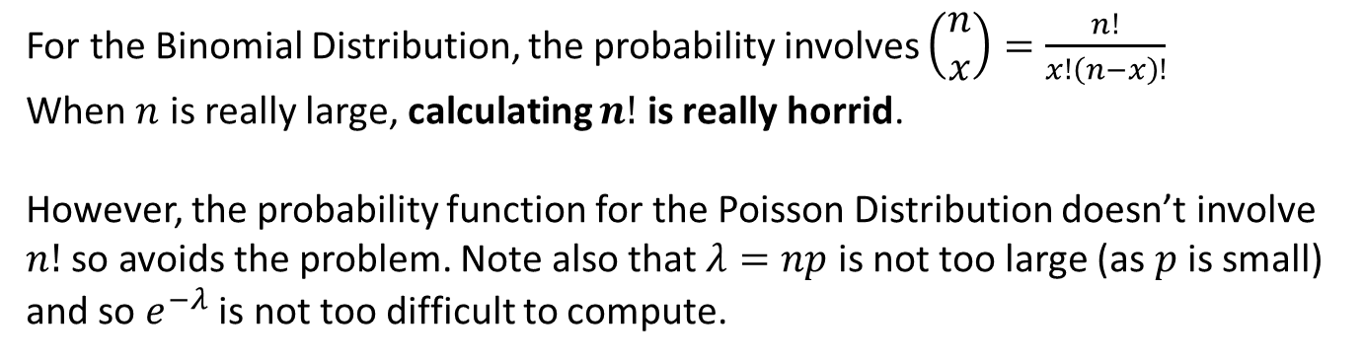
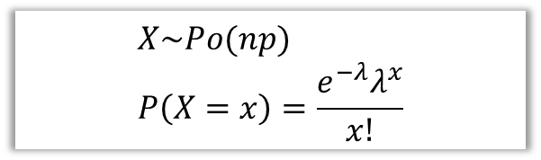
Why would we want to approximate?
$$X\sim B\left(n,p\right) \\ P\left(X=x\right)=\left(\begin{matrix}n \\ x\end{matrix}\right)p^{x}{\left(1−p\right)}^{n−x}$$
$$X\sim Po(np) \\ P\left(X=x\right)=\frac{e^{−λ}λ^{x}}{x!}$$
For the Binomial Distribution, the probability involves $\left(\begin{matrix}n \\ x\end{matrix}\right)=\frac{n!}{x!\left(n−x\right)!}$
When $n$ is really large, calculating $n!$ is really horrid.
However, the probability function for the Poisson Distribution doesn’t involve $n!$ so avoids the problem. Note also that $λ=np$ is not too large (as $p$ is small) and so $e^{−λ}$ is not too difficult to compute.

Slide 29








Quickfire
State whether you would use a Poisson Approximation for each Binomial (recall: $np≤10$), and state the distribution used as the approximation.
$$X\sim B(100, 0.1)$$
?
$$X\sim Po\left(10\right)$$
?
$$X\sim B(50, 0.5)$$
Poisson approximation not appropriate as $np=25$.
?
$$X\sim B(40, 0.02)$$
$$X\sim Po\left(8\right)$$
Poisson approximation not appropriate as $np=60$.
$$X\sim B(300, 0.2)$$
?

Slide 30
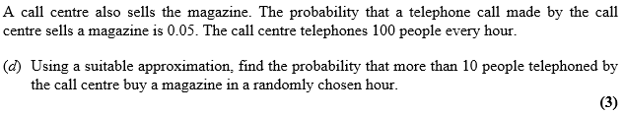





Example Exam Questions
May 2013 Q7d
$np=5≤10$ so use $X\sim Po(5)$
$$P\left(X>10\right)=1−P\left(X≤10\right)=0.0137$$
?
Jan 2013 Q1b
$$X\sim Po\left(10\right) \\ P\left(X≥4\right)=1−P\left(X≤3\right) =0.9897$$
?
June 2009 Q1
$X\sim B\left(30, 0.15\right)$
$P\left(X≤6\right)=0.8474$
$Y\sim B\left(60, 0.15\right)$
$≈Po\left(9\right)$
$P\left(Y≤12\right)=0.8758$
?

Slide 31
Exercise 2G
Pearson Further Statistics 1
Pages 36-38
Complete before the lesson Q1-3
In Class:
Green Q4-7
Amber Q8-10
Red Q11-15

Slide 32

APPENDIX: Proof of Poisson Probability Function
Prove that $\lim_{n→∞}\left(\begin{matrix}n \\ x\end{matrix}\right)p^{x}{\left(1−p\right)}^{n−x} =\frac{e^{−λ}λ^{x}}{x!}$ (where $where p=\frac{λ}{n}$)
$$\lim_{n→∞}\left(\begin{matrix}n \\ x\end{matrix}\right){\left(\frac{λ}{n}\right)}^{x}{\left(1−\frac{λ}{n}\right)}^{n−x} \\ =\lim_{n→∞}\frac{n\left(n−1\right)\left(n−2\right)…\left(n−x+1\right)}{x!} \frac{λ^{x}}{n^{x}} {\left(1−\frac{λ}{n}\right)}^{n−x}{ } \\ =\lim_{n→∞}\frac{1\left(1−\frac{1}{n}\right)\left(1−\frac{2}{n}\right)…\left(1−\frac{x−1}{n}\right)}{x!} λ^{x} {\left(1−\frac{λ}{n}\right)}^{n−x}{ }$$
But given $n→∞$, $1−\frac{1}{n}→1, 1−\frac{2}{n}→1$ and so on.
The numerator therefore simplifies to 1.
Also, as $n→∞$, $n−x→n$ (i.e. infinity minus a finite number is still infinity!)
So:
$$\lim_{n→∞}{{\left(1−\frac{λ}{n}\right)}^{n−x}}=\lim_{n→∞}{{\left(1−\frac{λ}{n}\right)}^{n}=e^{−k}}$$
(this is a standard result which we won’t prove here)

