Slide 1
Year 1 Applied Mathematics
Statistical Distributions
-The Binomial Distribution
Chapter 6 (Part 2)

Slide 2
The Binomial Distribution
2 Flips of the coin
0 Head exactly
How many successful
outcomes?
2 Flips of the coin
1 Head exactly
How many successful
outcomes?
2 Flips of the coin
2 Head exactly
How many successful
outcomes?
1
2
1
T T
H T
H H
T H

Slide 3
The Binomial Distribution
3 Flips of the coin
0 Head exactly
How many successful
outcomes?
3 Flips of the coin
1 Head exactly
How many successful
outcomes?
3 Flips of the coin
2 Head exactly
How many successful
outcomes?
3 Flips of the coin
3 Head exactly
How many successful
outcomes?
1
3
3
1
T T T
H T T
H H T
H H H
T H T
H T H
T T H
T H H

Slide 4
The Binomial Distribution
4 Flips of the coin
0 Head exactly
How many successful
outcomes?
4 Flips of the coin
1 Head exactly
How many successful
outcomes?
4 Flips of the coin
2 Head exactly
How many successful
outcomes?
4 Flips of the coin
3 Head exactly
How many successful
outcomes?
4 Flips of the coin
4 Head exactly
How many successful
outcomes?
1
4
6
4
1
T T T T
H T T T
H H T T
H H H T
H H H H
T H T T
T H H T
H H T H
T T H T
T T H H
H T H H
T T T H
H T T H
T H H H
H T H T
T H T H

Slide 5
The Binomial Distribution
20 Flips of the coin
4 Head exactly
How many successful outcomes?
A lot!
4845

Slide 6
The Binomial Distribution – Using the Calculator
nCr
n = number of trials
r = required number of success
Total Trials | Successful Outcomes Required | Combinations
2 | 1
3 | 2
4 | 2
²C₁ = 2
³C₂ = 3
⁴C₂ = 6

Slide 7
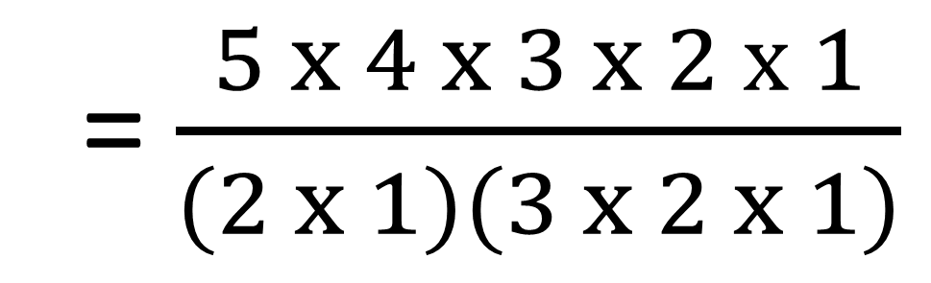
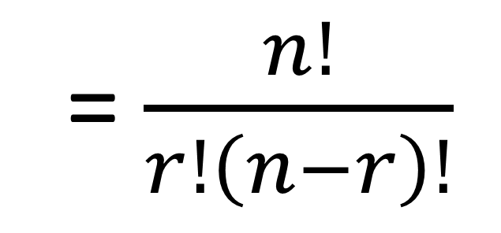
The Binomial Distribution
nCr
= $\frac{n!}{r!\left(n−r\right)!}$
5C2
= $\frac{5 x 4 x 3 x 2 x 1}{(2 x 1)(3 x 2 x 1)}$

Slide 8
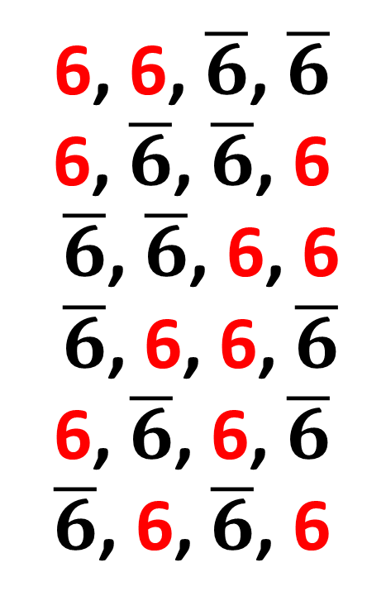
The Binomial Distribution
A dice is rolled 4 times.
How many outcomes for getting a 6 exactly 2 times?
6, 6, $\overline{6}$, $\overline{6}$
6, $\overline{6}$, $\overline{6}$, 6
$\overline{6}$, $\overline{6}$, 6, 6
$\overline{6}$, 6, 6, $\overline{6}$
6, $\overline{6}$, 6, $\overline{6}$
$\overline{6}$, 6, $\overline{6}$, 6
There are 6 possible outcomes.

Slide 9
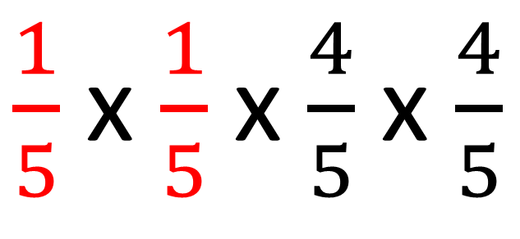
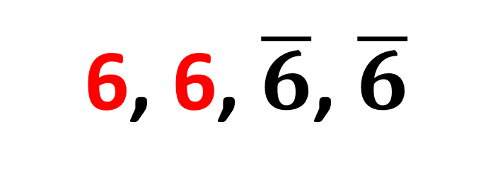

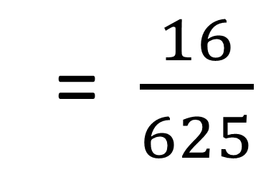
The Binomial Distribution
The dice has a probability of $\frac{1}{5}$ for rolling a 6.
What is the probability of getting the following outcomes?
6, 6, $\overline{6}$, $\overline{6}$
$\frac{1}{5}$ x $\frac{1}{5}$ x $\frac{4}{5}$ x $\frac{4}{5}$
= $\frac{16}{625}$

Slide 10
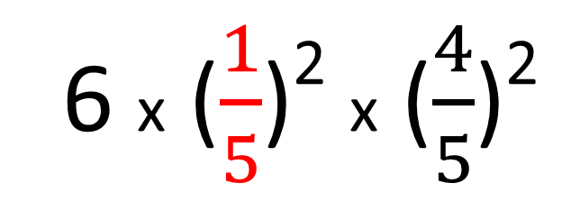
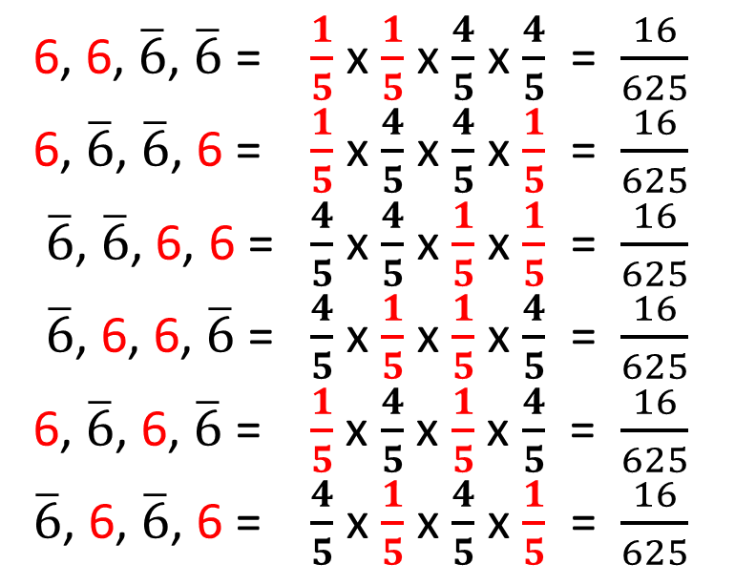
The Binomial Distribution
What is the probability the dice will
show 6 exactly 2 times?
6, 6, $\overline{6}$, $\overline{6}$ = $\frac{1}{5}$ x $\frac{1}{5}$ x $\frac{4}{5}$ x $\frac{4}{5}$ = $\frac{16}{625}$
6, $\overline{6}$, $\overline{6}$, 6 = $\frac{1}{5}$ x $\frac{4}{5}$ x $\frac{4}{5}$ x $\frac{1}{5}$ = $\frac{16}{625}$
$\overline{6}$, $\overline{6}$, 6, 6 = $\frac{4}{5}$ x $\frac{4}{5}$ x $\frac{1}{5}$ x $\frac{1}{5}$ = $\frac{16}{625}$
$\overline{6}$, 6, 6, $\overline{6}$ = $\frac{4}{5}$ x $\frac{1}{5}$ x $\frac{1}{5}$ x $\frac{4}{5}$ = $\frac{16}{625}$
6, $\overline{6}$, 6, $\overline{6}$ = $\frac{1}{5}$ x $\frac{4}{5}$ x $\frac{1}{5}$ x $\frac{4}{5}$ = $\frac{16}{625}$
$\overline{6}$, 6, $\overline{6}$, 6 = $\frac{4}{5}$ x $\frac{1}{5}$ x $\frac{4}{5}$ x $\frac{1}{5}$ = $\frac{16}{625}$
6 x ($\frac{1}{5}$)² x ($\frac{4}{5}$)²
= 0.1536

Slide 11
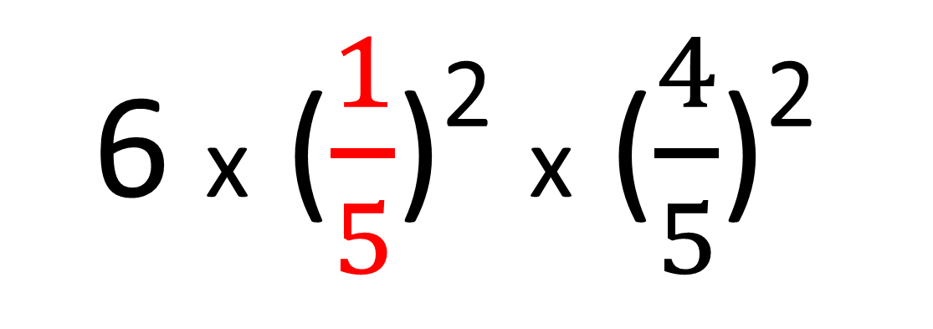
The Binomial Distribution
Number of failures
Number of success
6 x ($\frac{1}{5}$)² x ($\frac{4}{5}$)²
Possible Outcomes
Probability of success
Probability of failure

Slide 12
The Binomial Distribution – Formula
P(X = x) = ^{n}C_{x} (p)^{x}(q)^{n-x}
n = number of trials
p = probability of success
q = probability of failure
x = number of success needed

Slide 13
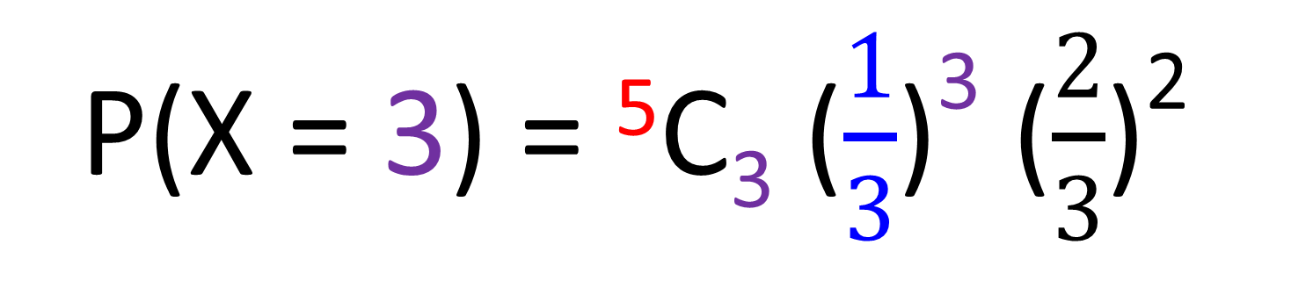
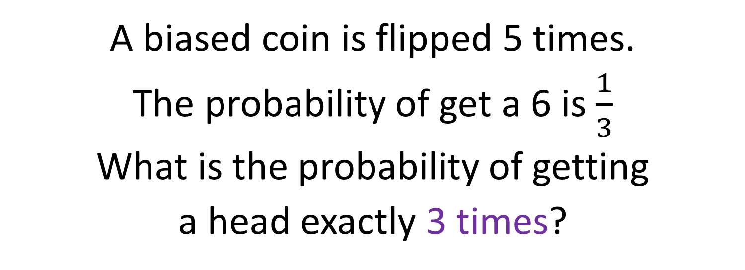
The Binomial Distribution
A biased coin is flipped 5 times.
The probability of get a 6 is $\frac{1}{3}$
What is the probability of getting
a head exactly 3 times?
P(X = 3) = ⁵C₃ ($\frac{1}{3}$)³ ($\frac{2}{3}$)²
= 0.1646

Slide 14
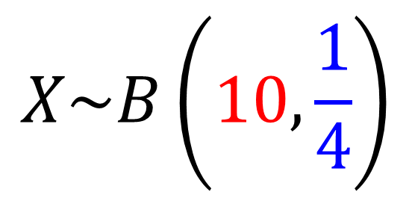
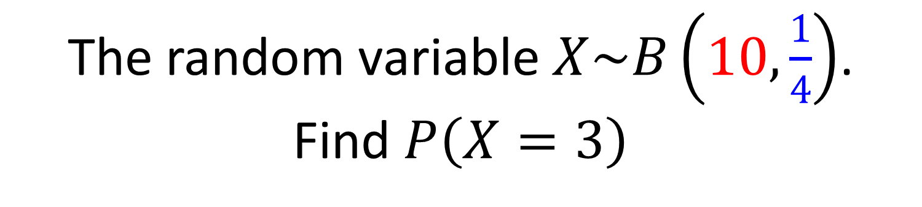
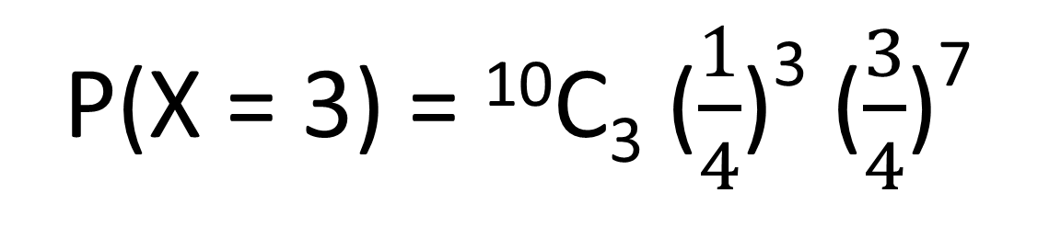
The Binomial Distribution
The random variable $X\sim B\left(10,\frac{1}{4}\right)$.
Find $P\left(X=3\right)$
Binomial
Distribution
$$X\sim B\left(10,\frac{1}{4}\right)$$
Number of Trials
Probability of success
P(X = 3) = ¹⁰C₃ ($\frac{1}{4}$)³ ($\frac{3}{4}$)⁷
= 0.250

Slide 15
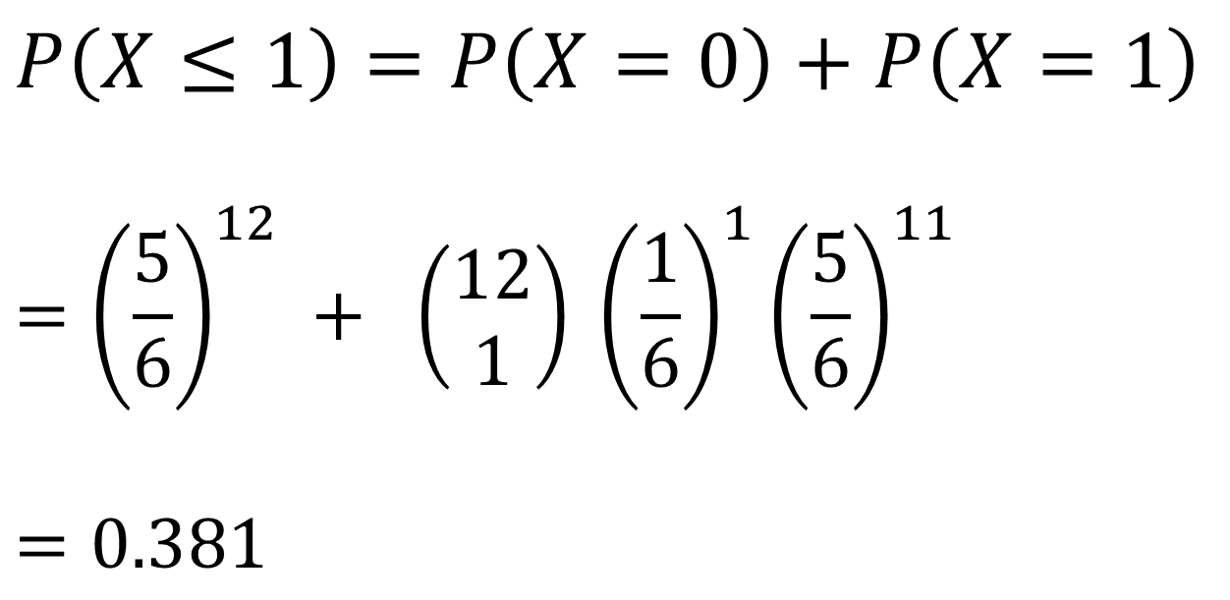
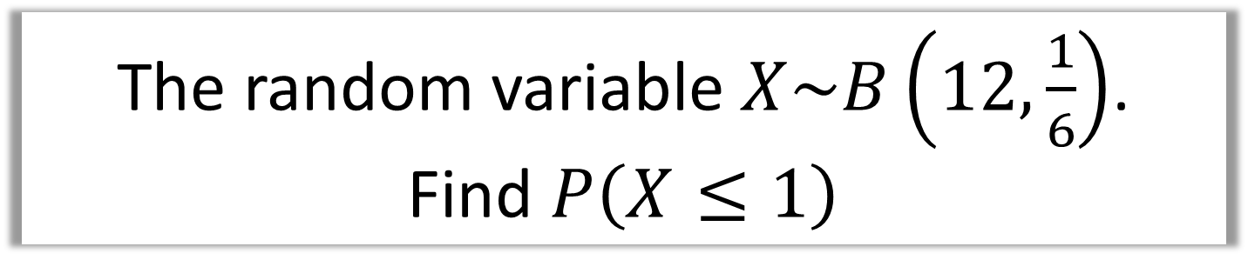
The Binomial Distribution
The random variable $X\sim B\left(12,\frac{1}{6}\right)$.
Find $P\left(X≤1\right)$
$$P\left(X≤1\right)=P\left(X=0\right)+P\left(X=1\right)$$
$$={\left(\frac{5}{6}\right)}^{12} + \left(\begin{matrix}12 \\ 1\end{matrix}\right) {\left(\frac{1}{6}\right)}^{1}{\left(\frac{5}{6}\right)}^{11}$$
$$=0.381$$

Slide 16

The Binomial Distribution
A company claims that a quarter of the bolts sent to them are faulty. To test this claim the number of faulty bolts in a random sample of 50 is recorded.
Give two reasons why a binomial distribution may be a suitable model for the number of faulty bolts in the sample. (2)

Slide 17
Exercise 6B
Pearson Pure Mathematics Year 1/AS
Pages 90-91
Complete before the lesson Q1-2
In Class:
Green Q3-4
Amber Q5
Red Q6-8

