Slide 1
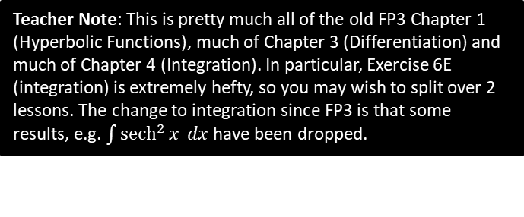

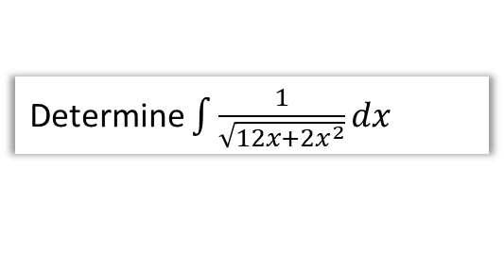
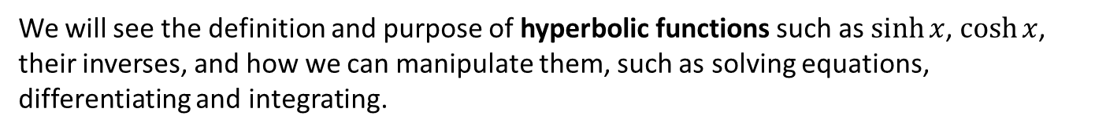
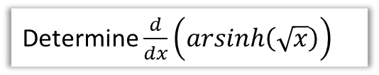
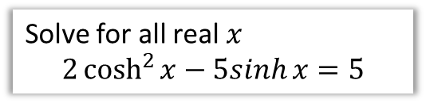
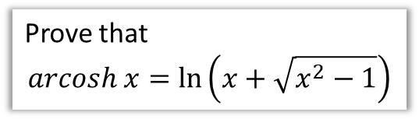
Overview
We will see the definition and purpose of hyperbolic functions such as $\sinh{x}$, $\cosh{x}$, their inverses, and how we can manipulate them, such as solving equations, differentiating and integrating.
1 :: Definition of hyperbolic functions and their sketches.
2 :: Inverse hyperbolic functions.
“Find the exact value of:$tanh \left(ln 4\right)$”
Prove that
$$arcosh x=\ln\left(x+\sqrt{x^{2}−1}\right)$$
3 :: Hyperbolic Identities and Solving Equations
4 :: Differentiation
Determine $\frac{d}{dx}\left(arsinh\left(\sqrt{x}\right)\right)$
Solve for all real $x$
$$2\cosh^{2}{x}−5sinh{x}=5$$
5 :: Integration
Teacher Note: This is pretty much all of the old FP3 Chapter 1 (Hyperbolic Functions), much of Chapter 3 (Differentiation) and much of Chapter 4 (Integration). In particular, Exercise 6E (integration) is extremely hefty, so you may wish to split over 2 lessons. The change to integration since FP3 is that some results, e.g. $\int{{sech}^{2}{x} dx}$ have been dropped.
Determine $\int{\frac{1}{\sqrt{12x+2x^{2}}}dx}$

Slide 2
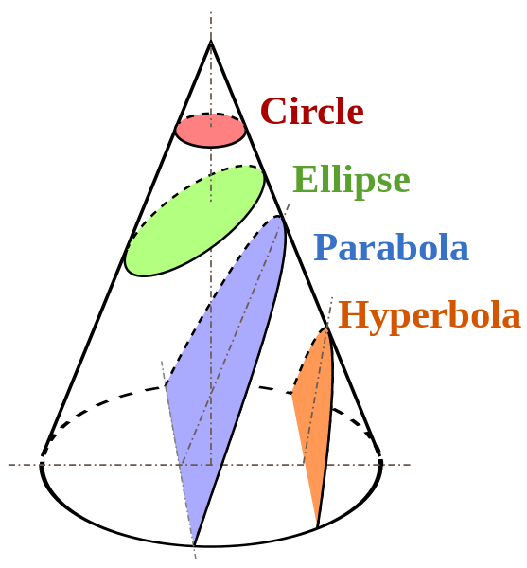
Conic Sections
The axis of the parabola is parallel to the side of the cone.
In mathematics there are a number of different families of curves. These doing FP1 as their Further Maths option will encounter ellipses, parabolas and hyperbolas in Chapters 2 and Chapter 3 (“Conic Sections I and II”).
Each of these have different properties and their equations have different forms.
It is possible to obtain these different types of curves by slicing a cone, hence “conic sections”.

Slide 3
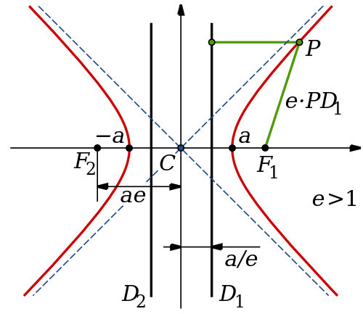
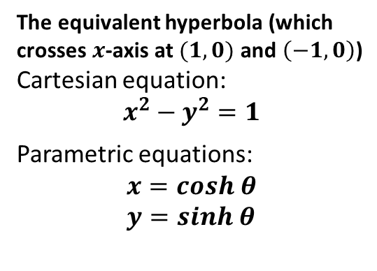



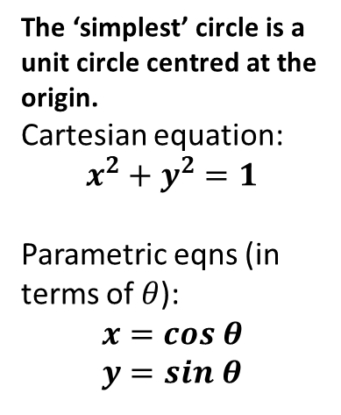
!
Comparing circles and hyperbolas
(Don’t make notes on this slide) You will cover Hyperbolas in FP1, but this will give some context for the eponymously named ‘hyperbolic functions’ that we will explore in this chapter.
Circles
Hyperbolas
Source: Wikipedia
$$1$$
$$\left(x,y\right)$$
$$θ$$
$$1$$
The ‘simplest’ circle is a unit circle centred at the origin.
Cartesian equation:
$$x^{2}+y^{2}=1$$
Parametric eqns (in terms of $θ$):
$$x=cos θ \\ y=sin θ$$
The equivalent hyperbola (which crosses $x$-axis at $(1,0)$ and $\left(−1,0\right)$)
Cartesian equation:
$$x^{2}−y^{2}=1$$
Parametric equations:
$$x=cosh θ \\ y=sinh θ$$
?
similar
?
?
?
similar

Slide 4
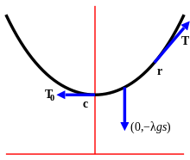
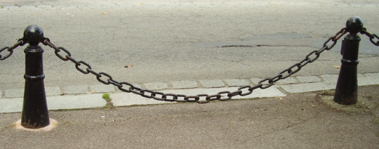
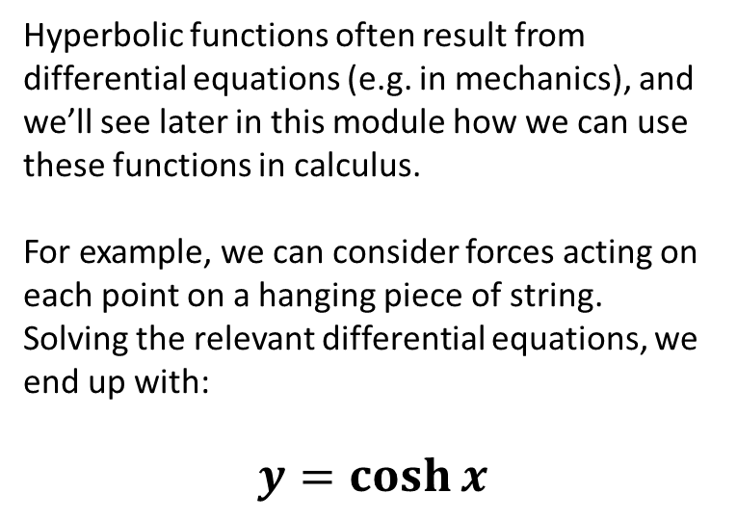
What’s the point of hyperbolic functions?
Hyperbolic functions often result from differential equations (e.g. in mechanics), and we’ll see later in this module how we can use these functions in calculus.
For example, we can consider forces acting on each point on a hanging piece of string.
Solving the relevant differential equations, we end up with:
$$y=\cosh{x}$$
?
OMG modelling!

Slide 5

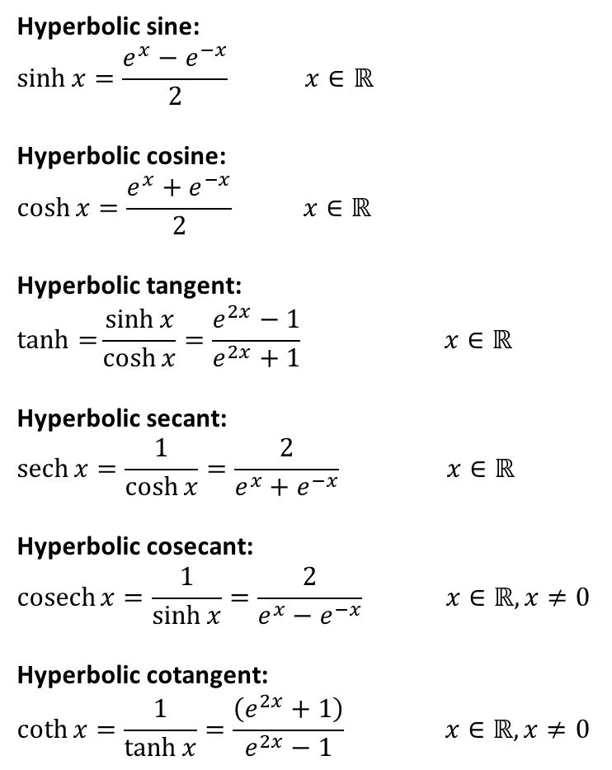
Equations for hyperbolic functions
Hyperbolic sine:
$$\sinh{x}=\frac{e^{x}−e^{−x}}{2} x∈ℝ$$
Hyperbolic cosine:
$$\cosh{x}=\frac{e^{x}+e^{−x}}{2} x∈ℝ$$
Hyperbolic tangent:
$$\tanh{=}\frac{\sinh{x}}{\cosh{x}}=\frac{e^{2x}−1}{e^{2x}+1} x∈ℝ$$
Hyperbolic secant:
$$\operatorname{sech}{x}=\frac{1}{\cosh{x}}=\frac{2}{e^{x}+e^{−x}} x∈ℝ$$
Hyperbolic cosecant:
$$\operatorname{cosech}{x}=\frac{1}{\sinh{x}}=\frac{2}{e^{x}−e^{−x}} x∈ℝ, x≠0$$
Hyperbolic cotangent:
$$\coth{x}=\frac{1}{\tanh{x}}=\frac{\left(e^{2x}+1\right)}{e^{2x}−1} x∈ℝ, x≠0$$
?
Say as “shine” of $x$
?
Say as “cosh”
?
?
Say as “tanch”
?
?
Say as “setch”
?
?
Say as “cosetch”
?
?
Say as “coth”

Slide 6

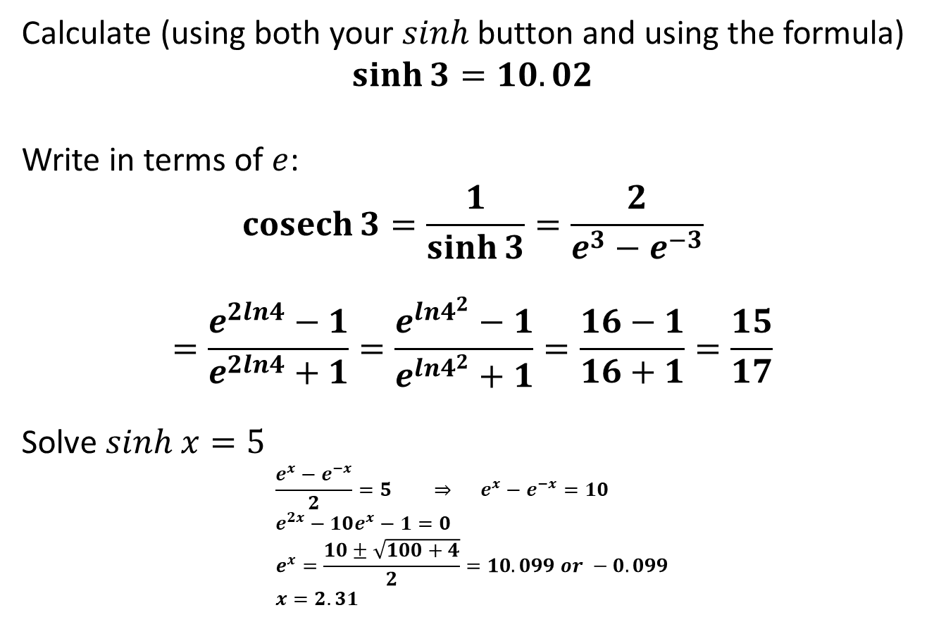
Equations for hyperbolic functions
Q
Calculate (using both your $sinh$ button and using the formula)
$$\sinh{3}=10.02$$
Write in terms of $e$:
$$\operatorname{cosech}{3}=\frac{1}{\sinh{3}}=\frac{2}{e^{3}−e^{−3}}$$
$$=\frac{e^{2ln4}−1}{e^{2ln4}+1}=\frac{e^{ln4^{2}}−1}{e^{ln4^{2}}+1}=\frac{16−1}{16+1}=\frac{15}{17}$$
Solve $sinh x=5$
$$\frac{e^{x}−e^{−x}}{2}=5 ⇒ e^{x}−e^{−x}=10 \\ e^{2x}−10e^{x}−1=0 \\ e^{x}=\frac{10±\sqrt{100+4}}{2}=10.099 or −0.099 \\ x=2.31$$
?
Froculator Tip: Press the ‘hyp’ button.
Q
?
Q
?
Find the exact value of:
$$tanh \left(ln 4\right)$$
Q
?

Slide 7
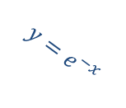
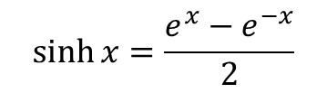


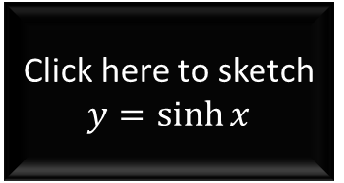
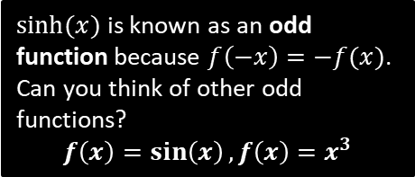




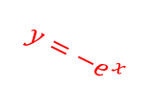
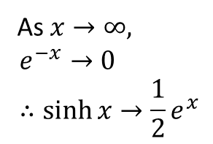


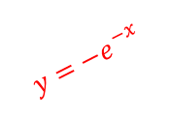

Sketching hyperbolic functions
$$y$$
$$y$$
$$y=e^{−x}$$
$$y=e^{x}$$
$$x$$
$$x$$
$$y=−e^{x}$$
$$y=−e^{−x}$$
$sinh⁡(x)$ is known as an odd function because $f\left(−x\right)=−f(x)$. Can you think of other odd functions?
$$f\left(x\right)=\sin\left(x\right), f\left(x\right)=x^{3}$$
$$y$$
?
We can see we have the average of $e^{x}$ and $−e^{−x}$
$$y=\sinh{x}$$
Click here to sketch $y=\sinh{x}$
$$x$$
As $x→∞,$
$$e^{−x}→0 \\ ∴\sinh{x}→\frac{1}{2}e^{x}$$
?
?
$$\sinh{x}=\frac{e^{x}−e^{−x}}{2}$$

Slide 8
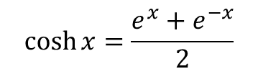

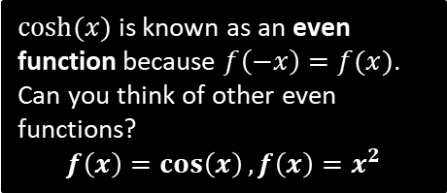

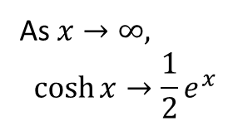
Sketching hyperbolic functions
$$y$$
$$y$$
$$y=e^{−x}$$
$$y=e^{x}$$
$$x$$
$$x$$
$$y=−e^{x}$$
$$y=−e^{−x}$$
$cosh⁡(x)$ is known as an even function because $f\left(−x\right)=f(x)$. Can you think of other even functions?
$$f\left(x\right)=\cos\left(x\right), f\left(x\right)=x^{2}$$
$$y$$
?
$$y=\cosh{x}$$
Click here to sketch $y=\cosh{x}$
$$x$$
As $x→∞,$
$$\cosh{x}→\frac{1}{2}e^{x}$$
?
$$\cosh{x}=\frac{e^{x}+e^{−x}}{2}$$

Slide 9

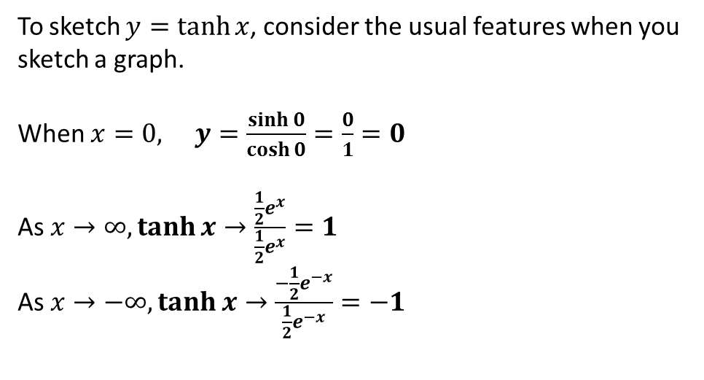
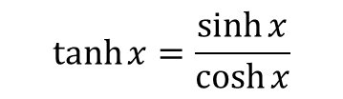
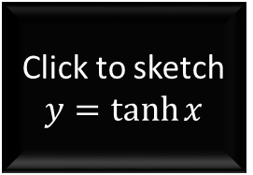

Sketching hyperbolic functions
To sketch $y=tanh{x}$, consider the usual features when you sketch a graph.
When $x=0, y=\frac{\sinh{0}}{\cosh{0}}=\frac{0}{1}=0$
As $x→∞, \tanh{x}→\frac{\frac{1}{2}e^{x}}{\frac{1}{2}e^{x}}=1$
As $x→−∞, \tanh{x}→\frac{−\frac{1}{2}e^{−x}}{\frac{1}{2}e^{−x}}=−1$
$$\tanh{x}=\frac{\sinh{x}}{\cosh{x}}$$
?
?
?
$$y$$
$$y=1$$
Click to sketch $y=\tanh{x}$
$$x$$
$$y=−1$$

Slide 10
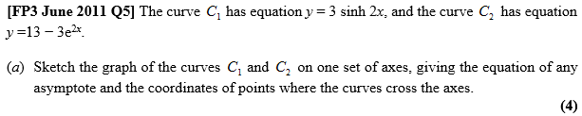
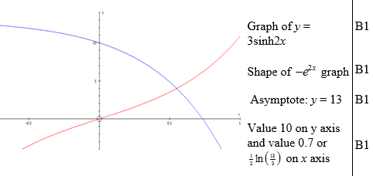






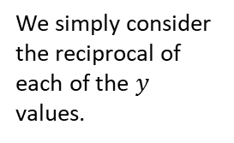


Test Your Understanding
Sketch the graph of $y=\operatorname{sech}{x}$
$$y=\cosh{x}$$
$$1$$
?
$$x$$
$$y$$
?
We simply consider the reciprocal of each of the $y$ values.
$$1$$
$$y=\operatorname{sech}{x}$$
$$x$$

Slide 11
Exercise 6A
Pearson Core Pure Year 2
Pages 122-123
Complete before the lesson Q1-2
In Class:
Green Q3-6
Amber Q7-9
Red Challenge

Slide 12


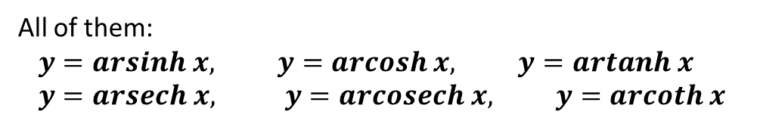
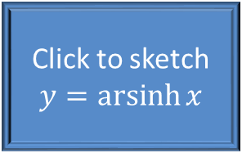
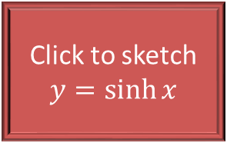
Inverse Hyperbolic Functions
As you might expect, each hyperbolic function has an inverse.
Note that lack of ‘c’ (e.g. arsinh not arcsinh).
$$y$$
Click to sketch $y=\sinh{x}$
$$x$$
Click to sketch $y=\operatorname{arsinh}{x}$
All of them:
$$y=arsinh x, y=arcosh x, y=artanh x \\ y=arsech x, y=arcosech x, y=arcoth x$$

Slide 13
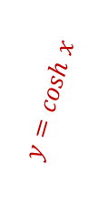

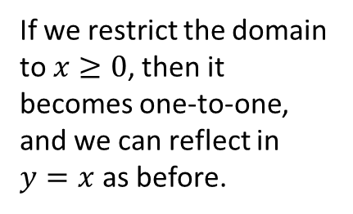
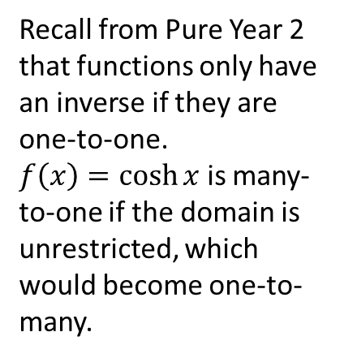
Inverse Hyperbolic Functions
Why is there a problem when finding the inverse of $f\left(x\right)=\cosh{x}$?
$$y$$
x
Recall from Pure Year 2 that functions only have an inverse if they are one-to-one.
$f\left(x\right)=\cosh{x}$ is many-to-one if the domain is unrestricted, which would become one-to-many.
$$y=cosh x$$
$$y=arcosh x$$
$$x$$
If we restrict the domain to $x≥0$, then it becomes one-to-one, and we can reflect in $y=x$ as before.

Slide 14

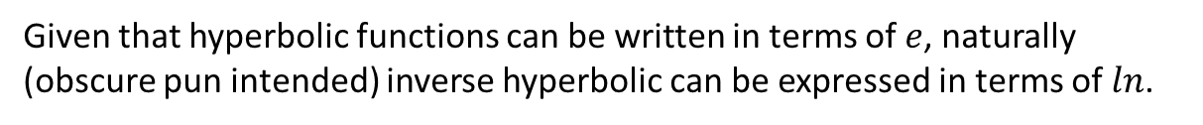

Inverse Hyperbolic Functions
Given that hyperbolic functions can be written in terms of $e$, naturally (obscure pun intended) inverse hyperbolic can be expressed in terms of $ln$.
Prove that $arsinh x=\ln\left(x+\sqrt{x^{2}+1}\right)$
?
$$y=arsinh x \\ x=\sinh{y} \\ x=\frac{e^{y}−e^{−y}}{2} \\ e^{y}−e^{−y}=2x \\ e^{2y}−2xe^{y}−1=0 \\ a=−1, b=−2x, c=−1 \\ e^{y}=\frac{2x±\sqrt{4x^{2}+4}}{2}=x±\sqrt{x^{2}+1}$$
However since $\sqrt{x^{2}+1}>x$, can only use positive case as $e^{y}$ is positive.
$$y=\ln\left(x+\sqrt{x^{2}+1}\right) \\ arsinh x=\ln\left(x+\sqrt{x^{2}+1}\right)$$
?
?

Slide 15



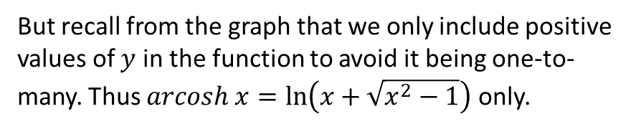

Test Your Understanding
Prove that $arcosh x=\ln\left(x+\sqrt{x^{2}−1}\right), x≥1$
Proof that $ln⁡(x−\sqrt{x^{2}−1}$) is negative: $\left(x−\sqrt{x^{2}−1}\right)\left(x+\sqrt{x^{2}−1}\right)=1$
$$x−\sqrt{x^{2}−1}=\frac{1}{x+\sqrt{x^{2}−1}}$$
Taking logs of both sides:
$$\ln\left(x−\sqrt{x^{2}−1}\right)=−\ln\left(x+\sqrt{x^{2}−1}\right)$$
Since $x≥1$, $x+\sqrt{x^{2}−1}≥1$, thus RHS is negative.
?
$$y=arcosh x \\ x=\cosh{y} \\ x=\frac{e^{y}+e^{−y}}{2} \\ e^{y}+e^{−y}=2x \\ e^{2y}−2xe^{y}+1=0 \\ a=−1, b=−2x, c=+1 \\ e^{y}=\frac{2x±\sqrt{4x^{2}−4}}{2}=x±\sqrt{x^{2}−1}$$
However this time, both $+$ and $−$ cases are possible.
We can prove that $ln⁡(x−\sqrt{x^{2}−1}$) gives a negative value.
Show >
$$y=arcosh x$$
But recall from the graph that we only include positive values of $y$ in the function to avoid it being one-to-many. Thus $arcosh x=\ln\left(x+\sqrt{x^{2}−1}\right)$ only.

Slide 16
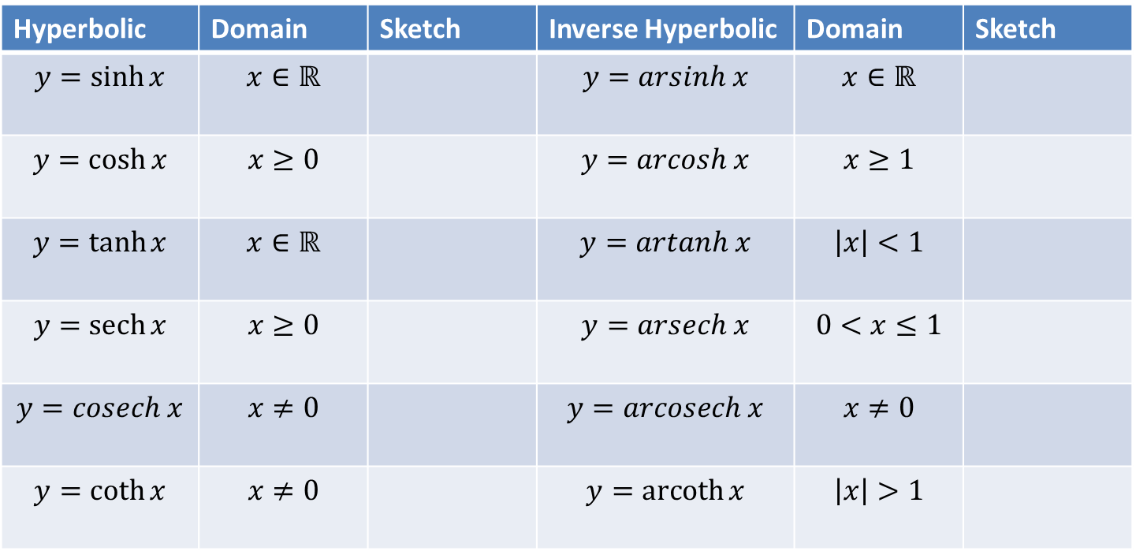
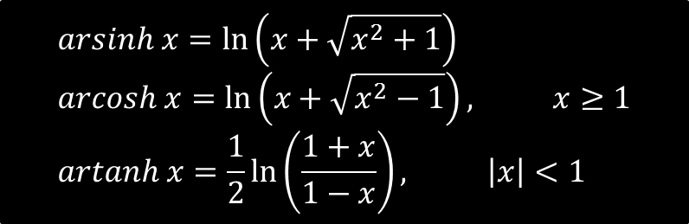
Summary so Far
$$arsinh x=\ln\left(x+\sqrt{x^{2}+1}\right) \\ arcosh x=\ln\left(x+\sqrt{x^{2}−1}\right), x≥1 \\ artanh x=\frac{1}{2}\ln\left(\frac{1+x}{1−x}\right), \left|x\right|<1$$
Hyperbolic | Domain | Sketch | Inverse Hyperbolic | Domain | Sketch
$$y=\sinh{x}$$ | $$x∈ℝ$$ |  | $$y=arsinh x$$ | $$x∈ℝ$$
$$y=\cosh{x}$$ | $$x≥0$$ |  | $$y=arcosh x$$ | $$x≥1$$
$$y=\tanh{x}$$ | $$x∈ℝ$$ |  | $$y=artanh x$$ | $$\left|x\right|<1$$
$$y=\operatorname{sech}{x}$$ | $$x≥0$$ |  | $$y=arsech x$$ | $$0<x≤1$$
$$y=cosech x$$ | $$x≠0$$ |  | $$y=arcosech x$$ | $$x≠0$$
$$y=\coth{x}$$ | $$x≠0$$ |  | $$y=\operatorname{arcoth}{x}$$ | $$\left|x\right|>1$$
?
?
?
1
?
1
?
1
?
-1
?
1
?
?
?
?
1
?
-1

Slide 17
Exercise 6B
Pearson Core Pure Year 2
Pages 124-125
Complete before the lesson Q1
In Class:
Green Q2
Amber Q3-6
Red Q7

Slide 18

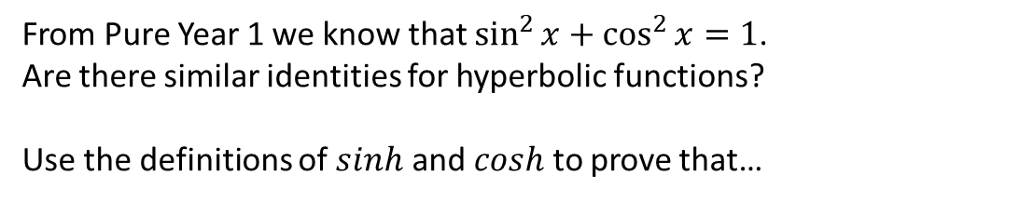

Hyperbolic Identities
From Pure Year 1 we know that $\sin^{2}{x}+\cos^{2}{x}=1$.
Are there similar identities for hyperbolic functions?
Use the definitions of $sinh$ and $cosh$ to prove that…
?
$$\cosh^{2}{x}−\sinh^{2}{x}=1$$
?
$$sech^{2}x=1−tanh^{2}x$$
?
$$cosech^{2}x=coth^{2}x−1$$

Slide 19
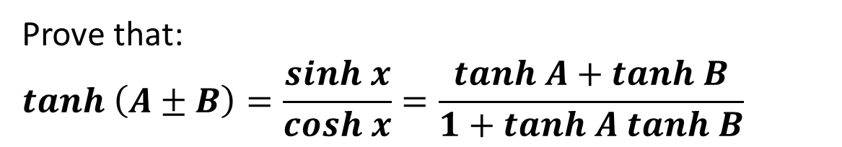


Hyperbolic Identities
We can similar prove that:
Similar to $sin⁡(A+B)$ identity.
$$sinh \left(A±B\right)=sinh A cosh B±cosh A sinh B$$
$$cosh \left(A±B\right)=cosh A cosh B±sinh A sinh B$$
However this is $±$ not $∓$, unlike in $cos⁡(A+B)$
Prove that:
$$tanh \left(A±B\right)=\frac{sinh x}{cosh x}=\frac{tanh A+tanh B}{1+tanh A tanh B}$$
Notice this is + rather than - .

Slide 20
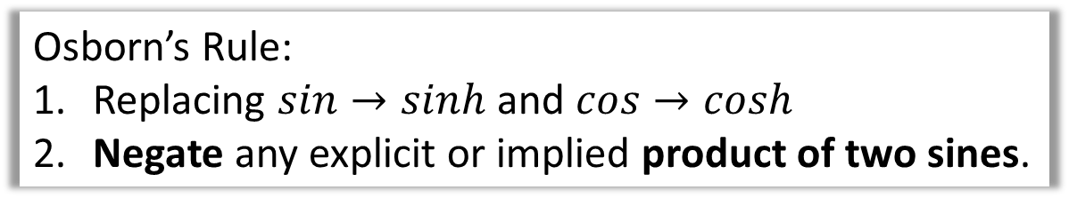
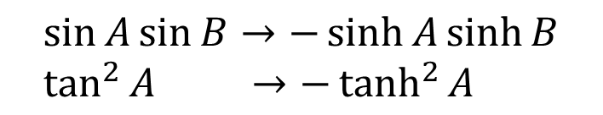
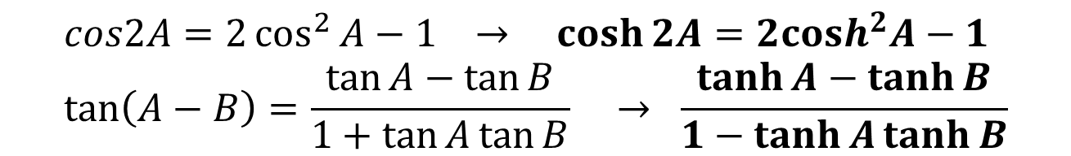

Osborn’s Rule
We can get these identities from the normal sin/cos ones by:
Osborn’s Rule:
Replacing $sin→sinh$ and $cos→cosh$
Negate any explicit or implied product of two sines.
?
$$\sin{A}\sin{B}→−\sinh{A}\sinh{B} \\ \tan^{2}{A} →−\tanh^{2}{A}$$
?
Since $\tan^{2}{A}=\frac{\sin^{2}{A}}{\cos^{2}{A}}$
?
$$cos2A=2\cos^{2}{A}−1 → \cosh{2A}=2cosh^{2}A−1 \\ \tan\left(A−B\right)=\frac{\tan{A}−\tan{B}}{1+\tan{A}\tan{B}} → \frac{\tanh{A}−\tanh{B}}{1−\tanh{A}\tanh{B}}$$
?

Slide 21




Solving Equations
Either use hyperbolic identities or basic definitions of hyperbolic functions.
Solve for all real $x$
$$6\sinh{x}−2\cosh{x}=7$$
Solve for all real $x$
$$2\cosh^{2}{x}−5sinh{x}=5$$
?
?
Using $\cosh^{2}{x}−sinh^{2}x=1$
$$2\left(1+\sinh^{2}{x}\right)−5\sinh{x}=5 \\ \left(2\sinh{x}+1\right)\left(\sinh{x}−3\right)=0 \\ \sinh{x}=−\frac{1}{2},\sinh{x}=3 \\ x=arsinh\left(−\frac{1}{2}\right), x=arsinh 3 \\ x=\ln\left(−\frac{1}{2}+\frac{\sqrt{5}}{2}\right), x=\ln\left(3+\sqrt{10}\right)$$
$$6\left(\frac{e^{x}−e^{−x}}{2}\right)−2\left(\frac{e^{x}+e^{−x}}{2}\right)=7 \\ … \\ \left(2e^{x}+1\right)\left(e^{x}−4\right)=0 \\ x=\ln{4}$$

Slide 22




Further Examples
Pure Year 1 one: If $\cos{x}=\frac{3}{5}$, find $\sin{x}$.
?
$$\sin^{2}{x}+\cos^{2}{x}=1 \\ \sin{x}=\sqrt{1−\frac{9}{25}}=\frac{4}{5}$$
?
If $\sinh{x}=\frac{3}{4}$, find the exact value of:
$\cosh{x}$
$\tanh{x}$
$\sinh{2x}$
$$\cosh^{2}{x}−\sinh^{2}{x}=1 \\ \cosh{x}=\sqrt{{\left(\frac{3}{4}\right)}^{2}+1}=\frac{5}{4} \\ \tanh{x}=\frac{\sinh{x}}{\cosh{x}}=\frac{3}{5} \\ \sinh{2x}=2\sinh{x}\cosh{x} \\ =\frac{15}{8}$$
?
?

Slide 23




Test Your Understanding
?
?

Slide 24


Exercise 6C
Complete before the lesson Q1
In Class:
Green Q2-5
Amber Q6-7
Red Q8-9
Pearson Core Pure Year 2
Pages 128-129
?

Slide 25


Differentiating hyperbolic functions
$$\frac{d}{dx}\left(\sinh{x}\right)=\cosh{x} \\ \frac{d}{dx}\left(\cosh{x}\right)=\sinh{x} \\ \frac{d}{dx}\left(\tanh{x}\right)={sech}^{2}{x} \\ \frac{d}{dx}\left(\coth{x}\right)=−cosech^{2}x$$
Important Memorisation Tip: They’re all the same as non-hyperbolic results, other than that $cosh$ is not negated and $\operatorname{sech}{x}$ becomes $−\operatorname{sech}{x}\tanh{x}$ (i.e. is negated).
Prove that $\frac{d}{dx}\left(\sinh{x}\right)=\cosh{x}$
?
$$\sinh{x}=\frac{e^{x}−e^{−x}}{2} \\ \frac{d}{dx}\left(\sinh{x}\right)=\frac{e^{x}+e^{−x}}{2}=\cosh{x}$$

Slide 26


Test Your Understanding
Hint: Did someone say chain rule?
?

Slide 27
Inverse Hyperbolic Functions
$$\frac{d}{dx}\left(\operatorname{arsinh}{x}\right)=\frac{1}{\sqrt{x^{2}+1}} \\ \frac{d}{dx}\left(\operatorname{arcosh}{x}\right)=\frac{1}{\sqrt{x^{2}−1}} \\ \frac{d}{dx}\left(\operatorname{artanh}{x}\right)=\frac{1}{1−x^{2}}$$
Proof
$$y=arsinh x \\ \sinh{y}=x \\ \frac{dx}{dy}=\cosh{y} \\ \frac{dx}{dy}=\sqrt{\sinh^{2}{y}+1} \\ =\sqrt{x^{2}+1} \\ \frac{dy}{dx}=\frac{1}{\sqrt{x^{2}+1}}$$
?
?
?
?
Examples
Given that $y={\left(arcosh x\right)}^{2}$ prove that $\left(x^{2}−1\right){\left(\frac{dy}{dx}\right)}^{2}=4y$
Find $\frac{d}{dx}\left(artanh 3x\right)$
By chain rule:
$$\frac{d}{dx}\left(artanh 3x\right)=\frac{1}{1−{\left(3x\right)}^{2}}×3 \\ =\frac{3}{1−9x^{2}}$$
$$\frac{dy}{dx}=2\left(arcosh x\right)\frac{1}{\sqrt{x^{2}−1}} \\ \sqrt{x^{2}−1}\frac{dy}{dx}=2 arcosh x \\ \left(x^{2}−1\right){\left(\frac{dy}{dx}\right)}^{2}=4 {\left(arcosh x\right)}^{2} \\ \left(x^{2}−1\right){\left(\frac{dy}{dx}\right)}^{2}=4y$$
?
?

Slide 28





Test Yarrr Understanding
?
?
?

Slide 29



Using Maclaurin expansions for approximations
[Textbook] (a) Show that $\frac{d}{dx}\left(arsinh x\right)=\frac{1}{\sqrt{1+x^{2}}}$ [We did this earlier]
(b) Find the first two non-zero terms of the series expansion of $arsinh x$.
The general form for the series expansion of $arsinh x$ is given by
$$arsinh x=\sum_{r=0}^{∞}{\left(\frac{{\left(−1\right)}^{n}\left(2n\right)!}{2^{2n}{\left(n!\right)}^{2}}\right)\frac{x^{2n+1}}{2n+1}}$$
(c) Find, in simplest terms, the coefficient of $x^{5}$.
(d) Use your approximation up to and including the term in $x^{5}$ to find an approximate value for $arsinh 0.5$.
(e) Calculate the percentage error in using this approximation.
b
Need to use a Maclaurin expansion.
$$f\left(x\right)=arsinh x ⇒ f\left(0\right)=0 \\ f^{′}\left(x\right)={\left(1+x^{2}\right)}^{−\frac{1}{2}} ⇒ f^{′}\left(0\right)=1 \\ f^{′′}\left(x\right)=−x{\left(1+x^{2}\right)}^{−\frac{3}{2}} ⇒ f^{′′}\left(0\right)=0 \\ f^{′′′}\left(x\right)=\frac{2x^{2}−1}{{\left(1+x^{2}\right)}^{\frac{5}{2}}} ⇒ f^{′′′}\left(0\right)=−1$$
Maclaurin expansion: $f\left(x\right)=f\left(0\right)+\frac{f^{′}\left(0\right)}{1!}x+\frac{f^{′′}\left(0\right)}{2!}x^{2}+\frac{f^{′′′}\left(0\right)}{3!}x^{3}+…$
$$∴arsinh x≈x−\frac{x^{3}}{3!}=x−\frac{1}{6}x^{3}$$
$x^{5}$ term will occur when $n=2 ⇒ \left(\frac{{\left(−1\right)}^{2}4!}{2^{4}{\left(2!\right)}^{2}}\right)\frac{x^{5}}{5}=\frac{3}{40}x^{5}$
Coefficient is $\frac{3}{40}$
?
d
$$arsinh 0.5≈0.5−\frac{1}{6}{\left(0.5\right)}^{3}+\frac{3}{40}{\left(0.5\right)}^{5} \\ =0.48151$$
% error $=\frac{0.48151−arsinh 0.5}{arsinh 0.5}×100$
$$=0.062\% (3dp)$$
?
Need to keep going until we have two non-zero terms for the Maclaurin expansion.
e
?
c
?

Slide 30
Exercise 6D
Pearson Core Pure Year 2
Pages 133-134
Complete before the lesson Q1
In Class:
Green Q2-5
Amber Q6-9
Red Q10-17 & Challenge

Slide 31

Standard Integrals
Same as non-hyperbolic version?
?
$$\int{\sinh{x} dx}=\cosh{x}+C \\ \int{\cosh{x} dx}=\sinh{x}+C \\ \int{{sech}^{2}{x} dx}=\tanh{x}+C \\ \int{{cosech}^{2}{x} dx}=−coth{x}+C \\ \int{\operatorname{sech}{x}\tanh{x} dx}=−{\operatorname{sech}{x}}+C \\ \int{\operatorname{cosech}{x}\coth{x}dx}=−cosech{x}+C \\ \int{\frac{1}{\sqrt{1−x^{2}}} dx}=\arcsin{x}+C, \left|x\right|<1 \\ \int{\frac{1}{1+x^{2}} dx}=\arctan{x}+C \\ \int{\frac{1}{\sqrt{1+x^{2}}} dx}=\operatorname{arcsinh}{x}+C \\ \int{\frac{1}{\sqrt{x^{2}−1}} dx}=\operatorname{arccosh}{x}+C, x>1$$
✗
✓
?
?
✓
Not in this chapter but worth briefly mentioning.
?
✓
?
Not in formula booklet.
✗
✓
?
?
Was covered in Chapter 3.
?
?
?

Slide 32



Quickfire Examples – Do From Memory!
Recall that:
$$\int{f^{′}\left(ax+b\right) dx}=\frac{1}{a}f\left(ax+b\right)+C$$
e.g. $\int{e^{3x+2}dx}=\frac{1}{3}e^{3x+2}$
?
$$\int{\cosh\left(4x−1\right)dx}=\frac{1}{4}\sinh\left(4x−1\right)+C \\ \int{sinh \left(\frac{2}{3}x\right)} dx=\frac{3}{2}\cosh\left(\frac{2}{3}x\right)+C \\ \int{\frac{3}{\sqrt{1+x^{2}}}dx}=3 arsinh x \\ \int{\frac{4}{\sqrt{x^{2}−1}}dx}=4 arcosh x \\ \int{sinh \left(3x\right)} dx=\frac{1}{3}\cosh\left(3x\right)+C \\ \int{\frac{10}{\sqrt{x^{2}−1}}dx}=10 arcosh x \\ \int{\frac{2}{\sqrt{1+x^{2}}}dx}=2 arsinh x$$
?
?
?
?
$$\int{\sinh{x} dx}=\cosh{x}+C \\ \int{\cosh{x} dx}=\sinh{x}+C \\ \int{\frac{1}{\sqrt{1−x^{2}}} dx}=\arcsin{x}+C, \left|x\right|<1 \\ \int{\frac{1}{1+x^{2}} dx}=\arctan{x}+C \\ \int{\frac{1}{\sqrt{1+x^{2}}} dx}=\operatorname{arcsinh}{x}+C \\ \int{\frac{1}{\sqrt{x^{2}−1}} dx}=\operatorname{arccosh}{x}+C, x>1$$
?
Click only if you’ve forgotten them.
?
?

Slide 33



Further Example
[Textbook] $\int{\frac{2+5x}{\sqrt{x^{2}+1}} dx}$
?
$$\int{\frac{2+5x}{\sqrt{x^{2}+1}} dx}=\int{\frac{2}{\sqrt{x^{2}+1}} dx}+\int{\frac{5x}{\sqrt{x^{2}+1}} dx} \\ =2\int{\frac{1}{\sqrt{x^{2}+1}} dx}+\int{5x{\left(x^{2}+1\right)}^{\frac{1}{2}} dx} \\ =2 arsinh x+5\sqrt{1+x^{2}}+c$$
Integration Strategy Recap:
If multiple terms in numerator, split fraction.
$$\int{\sinh{x} dx}=\cosh{x}+C \\ \int{\cosh{x} dx}=\sinh{x}+C \\ \int{\frac{1}{\sqrt{1+x^{2}}} dx}=\operatorname{arcsinh}{x}+C \\ \int{\frac{1}{\sqrt{x^{2}−1}} dx}=\operatorname{arccosh}{x}+C, x>1$$

Slide 34







Integrating when not quite so standard
$$\int{\cosh^{5}{2x}\sinh{2x} dx}$$
In the past we’ve integrated expressions of the form $\int{\sin^{n}{x}\cos{x} dx}$ and $\int{\cos^{n}{x}\sin{x} dx}$ by the “consider and scale” method.
?
(Using Method 1)
Try $y=\cosh^{6}{2x}$
$$\frac{dy}{dx}=6\cosh^{5}{2x}×2sinh 2x \\ =12\cosh^{5}{2x} sinh 2x$$
$$∴\int{\cosh^{5}{2x}\sinh{2x} dx}=\frac{1}{12}\cosh^{6}{2x}+C$$
$$\int{\tanh{x} dx}$$
?
$$=\int{\frac{\sinh{x}}{\cosh{x}} dx}=\ln\left|\cosh{x}\right|+C$$
Use the same method for integrating $\tan{x}$, i.e. expressing first as a division.
Note that because $cosh$ differentiates to positive $sinh$, unlike the non-hyperbolic version, we don’t have the minus.

Slide 35





Using Identities
$$\int{\cosh^{2}{3x} dx}$$
?
$$=\int{\frac{1}{2}+\frac{1}{2}\cosh{6x} dx} \\ =\frac{1}{2}x+\frac{1}{12}\sinh{6x}+C$$
Use double angle formulae for $\cos{2A}$
$$\int{\sinh^{3}{x} dx}$$
?
$$=\int{\sinh^{2}{x}\sinh{x} dx} \\ =\int{\left(\cosh^{2}{x}−1\right)\sinh{x}} dx \\ =\int{\cosh^{2}{x}\sinh{x}}−\sinh{x} dx \\ =\frac{1}{3}\cosh^{3}{x}−\cosh{x}+C$$
Use this approach in general for small odd powers of sinh and cosh.

Slide 36




When that doesn’t work…
Sometimes there are techniques which work on non-hyperbolic trig functions but doesn’t work on hyperbolic ones. Just first replace any hyperbolic functions with their definition.
Find $\int{e^{2x}\sinh{x} dx}$
Find $\int{\operatorname{sech}{x} dx}$
?
?
$$\int{e^{2x}\sinh{x} dx}=\int{e^{2x}}\left(\frac{e^{x}−e^{−x}}{2}\right) \\ =\frac{1}{2} \int{e^{3x}−e^{x}}dx \\ =\frac{1}{6}\left(e^{3x}−3e^{x}\right)+C$$
$$=\int{\frac{2}{e^{x}+e^{−x}}dx} \\ =\int{\frac{2e^{x}}{e^{2x}+1}}dx$$
Use the substitution $u=e^{x}$
$$\frac{du}{dx}=e^{x} ∴du=e^{x}dx$$
$$\int{\frac{2e^{x}}{e^{2x}+1}}dx=\int{\frac{2}{u^{2}+1}du} \\ =2\arctan{u}+C \\ =2\arctan\left(e^{x}\right)+C$$
(Integration by parts DOES also work, but requires a significantly greater amount of working!)
(Fro Exam Note: This very question appeared FP3(Old) June 2014, except involving definite integration)

Slide 37







Dealing with $1/\sqrt{a^{2}+x^{2}}$, $1/\sqrt{x^{2}−a^{2}}$, ….
$$\sin^{2}{θ}+\cos^{2}{θ}=1 \\ 1+\tan^{2}{θ}=\sec^{2}{θ} \\ 1+\sinh^{2}{u}=\cosh^{2}{u}$$
Sensible substitution and why?
$$\int{\frac{1}{\sqrt{a^{2}+x^{2}}}dx}$$
$$x=a\sinh{u}$$
tan wouldn’t work as well this time because the denominator would simplify to $a\sec{u},$ but we’d be multiplying by $a\sec^{2}{θ}$, meaning not all the secs would cancel. With $\sinh{u}$ the two $\cosh{u}$’s obtained would fully cancel.
?
$$\int{\frac{1}{\sqrt{x^{2}−a^{2}}}dx}$$
?
$$x=a\cosh{u}$$
Show that $\int{\frac{1}{\sqrt{x^{2}−a^{2}}}dx}=arcosh \left(\frac{x}{a}\right)+c$
!
$$\int{\frac{1}{\sqrt{a^{2}+x^{2}}}dx}=arsinh \left(\frac{x}{a}\right)+c$$
$$\int{\frac{1}{\sqrt{x^{2}−a^{2}}}dx}=arcosh \left(\frac{x}{a}\right)+c, x>a$$
Let $x=a\cosh{u}$ $⇒\frac{dx}{du}=a\sinh{u}$
$$\int{\frac{1}{\sqrt{x^{2}−a^{2}}}dx}=\int{\frac{1}{\sqrt{a^{2}\cosh^{2}{u}−a^{2}}} a\sinh{u}du} \\ =\frac{1}{a}\int{\frac{a \sinh{u}}{\sqrt{\cosh^{2}{u}−1}} du=\int{\frac{\sinh{u}}{\sinh{u}} du}} \\ =u+c=arcosh \left(\frac{x}{a}\right)+c$$
?

Slide 38



Dealing with $1/\sqrt{a^{2}+x^{2}}$, $1/\sqrt{x^{2}−a^{2}}$, ….
$$\int{\frac{1}{\sqrt{a^{2}+x^{2}}}dx}=arsinh \left(\frac{x}{a}\right)+c$$
$$\int{\frac{1}{\sqrt{x^{2}−a^{2}}}dx}=arcosh \left(\frac{x}{a}\right)+c, x>a$$
$$arsinh x=\ln\left(x+\sqrt{x^{2}+1}\right) \\ arcosh x=\ln\left(x+\sqrt{x^{2}−1}\right), x≥1$$
[Textbook] Show that $\int_{5}^{8}{\frac{1}{\sqrt{x^{2}−16}}dx}=\ln\left(\frac{2+\sqrt{3}}{2}\right)$
?
$$={\left[arcosh\left(\frac{x}{4}\right)\right]}_{5}^{8} \\ =arcosh 2−arcosh \left(\frac{5}{4}\right) \\ =\ln\left(2+\sqrt{3}\right)−\ln\left(\frac{5}{4}+\sqrt{\frac{9}{16}}\right) \\ =\ln\left(2+\sqrt{3}\right)−\ln{2} \\ =\ln\left(\frac{2+\sqrt{3}}{2}\right)$$

Slide 39




Harder Example
$$\sin^{2}{θ}+\cos^{2}{θ}=1 \\ 1+\tan^{2}{θ}=\sec^{2}{θ} \\ 1+\sinh^{2}{u}=\cosh^{2}{u}$$
Show that $\int{\sqrt{1+x^{2}} dx}=\frac{1}{2}arsinh x+\frac{1}{2}x\sqrt{1+x^{2}}+C$.
(Hint: Use a sensible substitution)
Trying $x=tan⁡θ$:
$$\frac{dx}{dθ}=\sec^{2}{θ} → dx=\sec^{2}{θ} dθ$$
$$\int{\sqrt{1+x^{2}} dx}=\int{secθ\sec^{2}{θ} dθ}$$
Using integration by parts:
$$u=secθ \frac{dv}{dx}=\sec^{2}{θ} \\ \frac{du}{dx}=secθ\tan{θ} v=tanθ \\ \int{\sec^{3}{θ} dθ}=\sec{θ}\tan{θ}−\int{\sec{θ}\tan^{2}{θ}}dθ+C \\ \int{\sec^{3}{θ} dθ}=\sec{θ}\tan{θ}−\int{\sec{θ}(\sec^{2}{θ−1) dθ}}+C \\ \int{\sec^{3}{θ} dθ}=\sec{θ}\tan{θ}−\int{\sec^{3}{θ}}+\int{secθ}+C \\ 2\int{\sec^{3}{θ}dθ}=secθ\tan{θ}+\ln\left|\sec{θ}+\tan{θ}\right|+C \\ \int{\sec^{3}{θ}dθ}=\frac{1}{2}secθ\tan{θ}+\frac{1}{2}\ln\left|\sec{θ}+\tan{θ}\right|+C′ \\ =\frac{1}{2}x\sqrt{1+x^{2}}+\frac{1}{2}\ln\left|\sqrt{1+x^{2}}+x\right|+C′ \\ =\frac{1}{2}x\sqrt{1+x^{2}}+\frac{1}{2}arsinh x+C′$$
? Using a seemingly-sensible-but-turns-out-rather-nasty substitution
? Using the other-possible-substitution-that-turns-out-much-more-pretty-yay
Trying $x=\sinh{u}$:
$$\frac{dx}{du}=\cosh{u} → dx=\cosh{u} du$$
$$\int{\sqrt{1+x^{2}} dx}=\int{\cosh{u}×\cosh{u} du} \\ =\int{\cosh^{2}{u} du} \\ =\frac{1}{2}\int{1+\cosh{2u} du} \\ =\frac{1}{2}\left(u+\frac{1}{2}\sinh{2u}\right)+C \\ =\frac{1}{2}arsinh x+\frac{1}{2}x\sqrt{1+x^{2}}+C$$

Slide 40





Test Your Understanding So Far
Hint: You may want to factorise out $\frac{1}{\sqrt{4}}$ first, as we did in Chapter 3.
?
Using a hyperbolic substitution, evaluate $\int_{0}^{6}{\frac{x^{3}}{\sqrt{x^{2}+9}} dx}$
?
?
Using $x=3\sinh{u}$ yields $18\left(\sqrt{5}+1\right)$

Slide 41



Integrating by Completing the Square
Determine $\int{\frac{1}{x^{2}−8x+8}dx}$
By completing the square, we can then use one of the standard results.
?
$$=\int{\frac{1}{x^{2}−8x+8}dx}=\int{\frac{1}{{\left(x−4\right)}^{2}−8 }dx}$$
Let $u=x−4 → du=dx$
$$=\int{\frac{1}{u^{2}−8} du} \\ =\frac{1}{2\sqrt{8}}\ln\left|\frac{u−\sqrt{8}}{u+\sqrt{8}}\right|+C \\ =\frac{\sqrt{2}}{8}\ln\left|\frac{x−4−2\sqrt{2}}{x−4+2\sqrt{2}}\right|+C$$
This is not in the standard form yet, but a simple substitution would make it so.
Standard results: (in formula booklet)
$$\int{\frac{1}{\sqrt{a^{2}−x^{2}}} dx}=\arcsin\left(\frac{x}{a}\right)+C, \left|x\right|<a \\ \int{\frac{1}{a^{2}+x^{2}} dx}=\frac{1}{a}\arctan\left(\frac{x}{a}\right)+C \\ \int{\frac{1}{\sqrt{a^{2}+x^{2}}} dx}=\operatorname{arcsinh}\left(\frac{x}{a}\right)+C \\ \int{\frac{1}{\sqrt{x^{2}−a^{2}}} dx}=\operatorname{arccosh}\left(\frac{x}{a}\right)+C, x>a \\ \int{\frac{1}{a^{2}−x^{2}}dx}=\frac{1}{2a}\ln\left|\frac{a+x}{a−x}\right|+C \\ \int{\frac{1}{x^{2}−a^{2}}dx}=\frac{1}{2a}\ln\left|\frac{x−a}{x+a}\right|+C$$

Slide 42


Further Example
Determine $\int{\frac{1}{\sqrt{12x+2x^{2}}}dx}$
?
$$2x^{2}+12x=2\left(x^{2}+6x\right) \\ =2\left({\left(x+3\right)}^{2}−9\right)$$
$$\int{\frac{1}{\sqrt{12x+2x^{2}}}dx}=\int{\frac{1}{\sqrt{2\left({\left(x+3\right)}^{2}−9\right)}}dx} \\ =\frac{1}{\sqrt{2}}\int{\frac{1}{\sqrt{{\left(x+3\right)}^{2}−9}}}dx$$
Let $u=x+3 → du=dx$
$$=\frac{1}{\sqrt{2}}\int{\frac{1}{\sqrt{u^{2}−9}}du} \\ =\frac{1}{\sqrt{2}}arcosh \left(\frac{u}{3}\right)+C \\ =\frac{1}{\sqrt{2}}arcosh \left(\frac{x+3}{3}\right)+C$$
Standard results: (in formula booklet)
$$\int{\frac{1}{\sqrt{a^{2}−x^{2}}} dx}=\arcsin\left(\frac{x}{a}\right)+C, \left|x\right|<a \\ \int{\frac{1}{a^{2}+x^{2}} dx}=\frac{1}{a}\arctan\left(\frac{x}{a}\right)+C \\ \int{\frac{1}{\sqrt{a^{2}+x^{2}}} dx}=\operatorname{arcsinh}\left(\frac{x}{a}\right)+C \\ \int{\frac{1}{\sqrt{x^{2}−a^{2}}} dx}=\operatorname{arccosh}\left(\frac{x}{a}\right)+C, x>a \\ \int{\frac{1}{a^{2}−x^{2}}dx}=\frac{1}{2a}\ln\left|\frac{a+x}{a−x}\right|+C \\ \int{\frac{1}{x^{2}−a^{2}}dx}=\frac{1}{2a}\ln\left|\frac{x−a}{x+a}\right|+C$$

Slide 43


Test Your Understanding
? a
? b
? c

Slide 44
Exercise 6E
Pearson Core Pure Year 2
Pages 140-142
(If I was to pick one chapter where it was worth doing the Mixed Exercises [6F], it would be this one!)
Complete before the lesson Q1-3
In Class:
Green Q4-9
Amber Q10-15
Red Q16-27 & Challenge

