Slide 1
Year 2 Pure Mathematics
Trigonometry and Modelling
- Double Angle Formulae
Chapter 7
(Part 2 of 5)

Slide 2
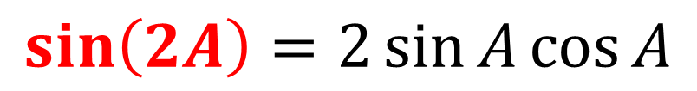
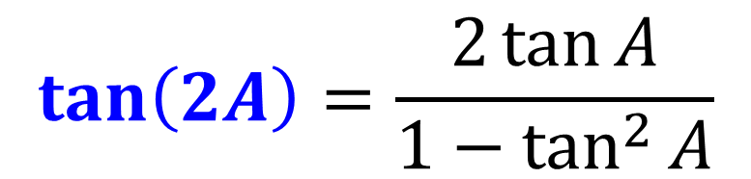
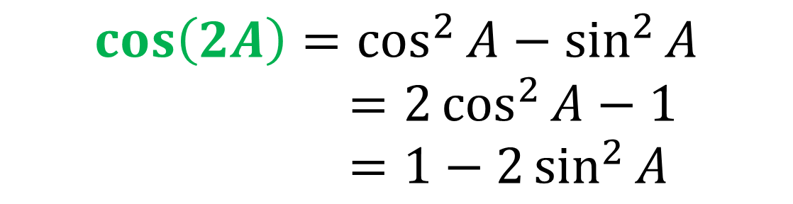
Double Angle Formulae
Double-angle formula allows you to
halve the angle within a trig function.
$$\sin\left(2A\right)=2\sin{A}\cos{A}$$
$$\cos\left(2A\right)=\cos^{2}{A}−\sin^{2}{A}$$
$=2\cos^{2}{A}−1$
$=1−2\sin^{2}{A}$
$$\tan\left(2A\right)=\frac{2\tan{A}}{1−\tan^{2}{A}}$$

Slide 3
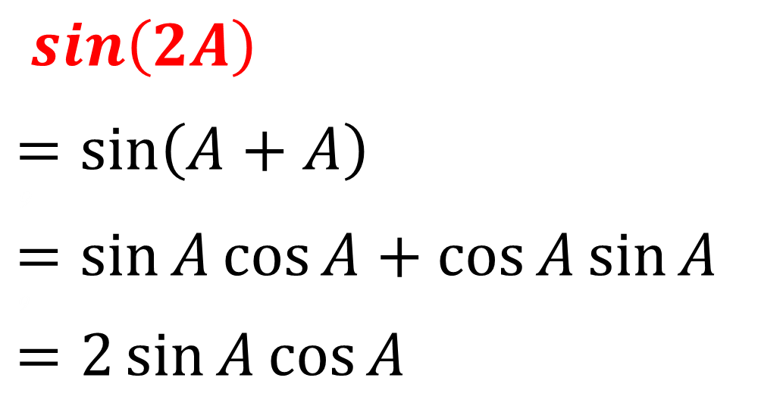
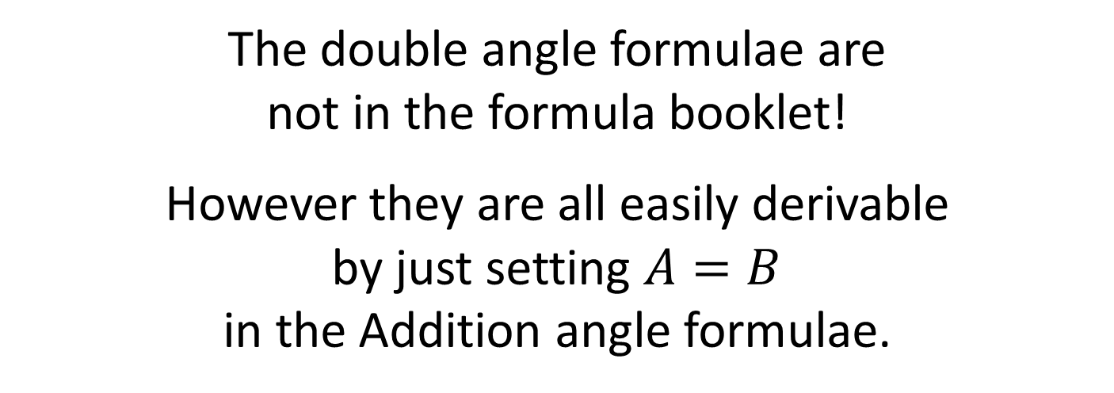
Double Angle Formulae
The double angle formulae are
not in the formula booklet!
However they are all easily derivable
by just setting $A=B$
in the Addition angle formulae.
$\sin\left(2A\right)$
$$=\sin\left(A+A\right)$$
9
$$=\sin{A}\cos{A}+\cos{A}\sin{A}$$
9
$$=2\sin{A}\cos{A}$$
Additional Formula

Slide 4
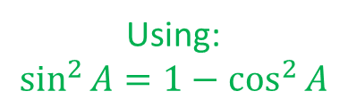
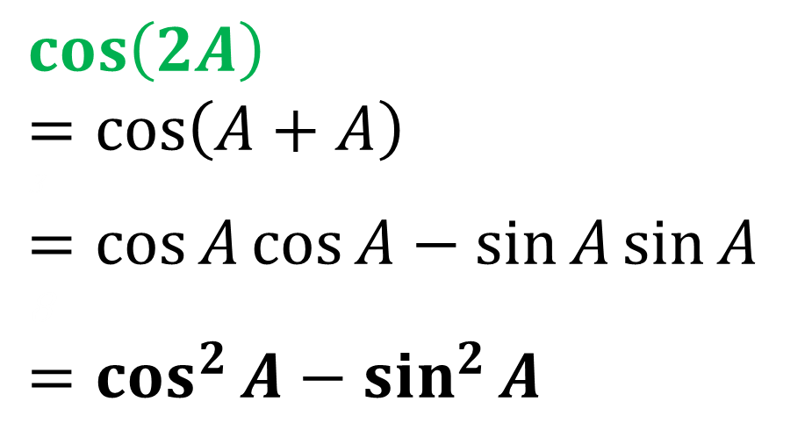
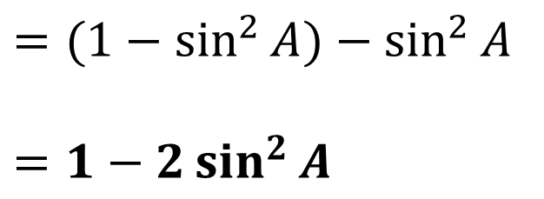
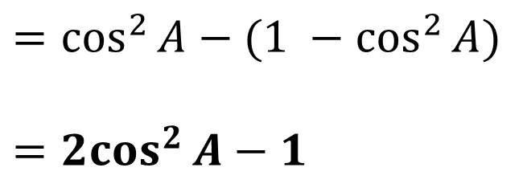
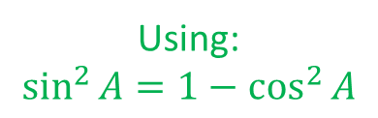
Double Angle Formulae
$$\cos\left(2A\right)$$
$$=\cos\left(A+A\right)$$
3
$$=\cos{A}\cos{A}−\sin{A}\sin{A}$$
8
$$=\cos^{2}{A}−\sin^{2}{A}$$
Additional Formula
Using:
$$\sin^{2}{A}=1−\cos^{2}{A}$$
Using:
$$\sin^{2}{A}=1−\cos^{2}{A}$$
$$=(1−\sin^{2}{A)}−\sin^{2}{A}$$
$$=1−2\sin^{2}{A}$$
$$=\cos^{2}{A}−{(1 −cos}^{2}{A})$$
$$={2cos}^{2}{A}−1$$

Slide 5
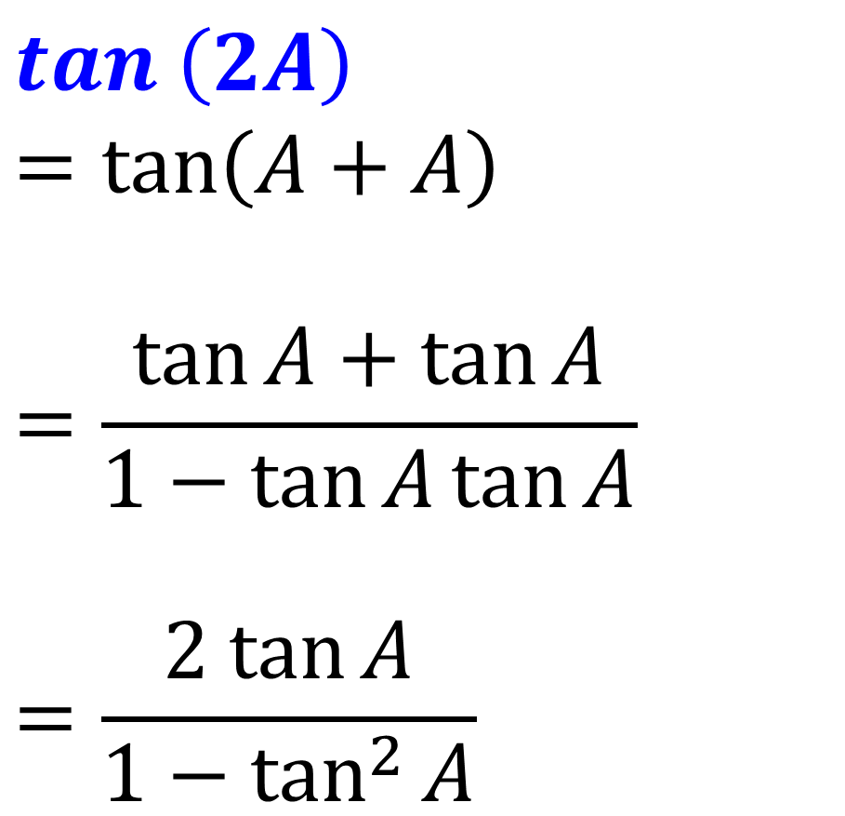
Double Angle Formulae
$$\tan\left(2A\right)$$
$$=\tan\left(A+A\right)$$
$$=\frac{\tan{A}+\tan{A}}{1−\tan{A}\tan{A}}$$
$$=\frac{2 tan{A}}{1−\tan^{2}{A}}$$
Additional Formula

Slide 6
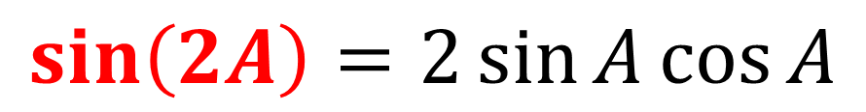
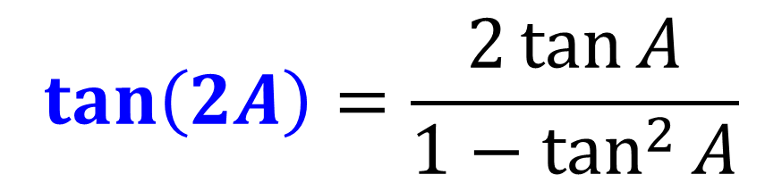
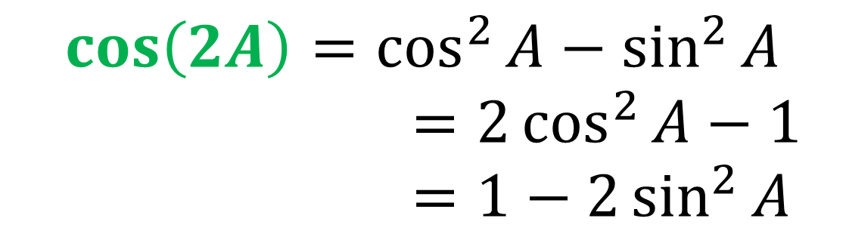
Double Angle Formulae
Double-angle formula summary:
$$\sin\left(2A\right)=2\sin{A}\cos{A}$$
$$\cos\left(2A\right)=\cos^{2}{A}−\sin^{2}{A}$$
$=2\cos^{2}{A}−1$
$=1−2\sin^{2}{A}$
$$\tan\left(2A\right)=\frac{2\tan{A}}{1−\tan^{2}{A}}$$

Slide 7
Double Angle Formulae
Show that (sin A + cos A)² = 1 + sin 2A
(sin A + cos A)(sin A + cos A)
= sin² A + sin A cos A + cos A sin A + cos² A
= sin² A + 2 sin A cos A + cos² A
= sin² A + cos² A + 2 sin A cos A
= 1 + sin 2A

Slide 8
Double Angle Formulae
5 cos 2x + 3 sin x = 4
Rewrite as quadratic that you could solve.
5 cos 2x + 3 sin x = 4
5 (1 – 2 sin² x) + 3 sin x = 4
5 – 10 sin² x + 3 sin x = 4
10 sin² x – 3 sin x – 1 = 0

Slide 9

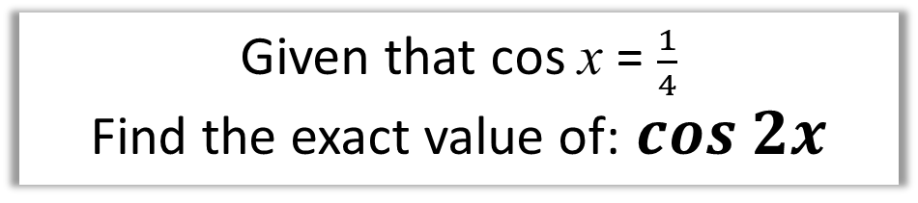
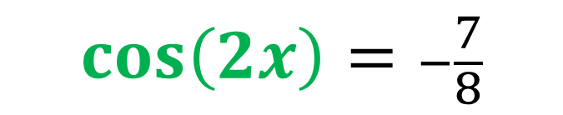
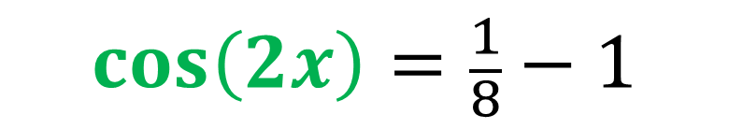
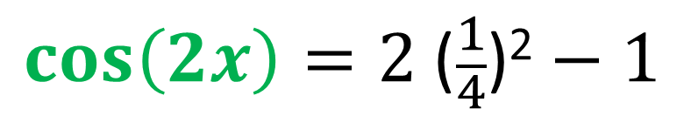
Double Angle Formulae
Given that cos x = $\frac{1}{4}$
Find the exact value of:$cos 2x$
$$\cos\left(2x\right)=2\cos^{2}{x}−1$$
$$\cos\left(2x\right)=2 \text{(}\frac{1}{4}\text{)}\text{2}−1$$
$$\cos\left(2x\right)=\frac{1}{8}−1$$
$$\cos\left(2x\right)=−\frac{7}{8}$$

Slide 10

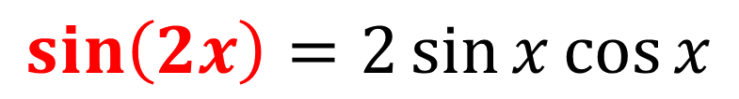

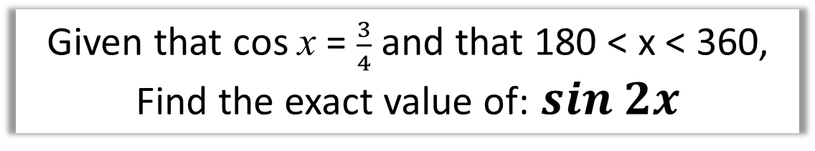
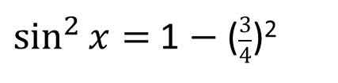
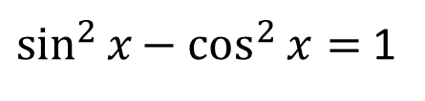

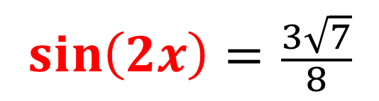
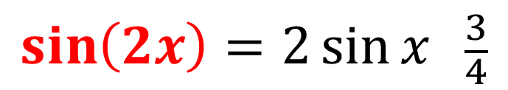
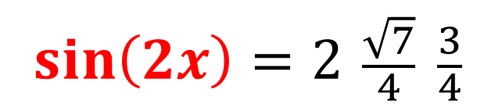
Double Angle Formulae
Given that cos x = $\frac{3}{4}$ and that 180 < x < 360,
Find the exact value of:$sin 2x$
$$\sin\left(2x\right)=2\sin{x}\cos{x}$$
$$\sin\left(2x\right)=2\sin{x } \frac{3}{4}$$
$$\sin\left(2x\right)=2 \frac{\sqrt{7}}{4} \frac{3}{4}$$
$\sin^{2}{x}{− cos}^{2}{x}=$ 1
$$\sin^{2}{x}={1− cos}^{2}{x}$$
$$\sin\left(2x\right)= \frac{3\sqrt{7}}{8}$$
$\sin^{2}{x}=$ 1 $−$ ($\frac{3}{4}$)²
$$\sin^{2}{x}= \frac{7}{16}$$
$$\sin{x}= \frac{\sqrt{7}}{4}$$

Slide 11
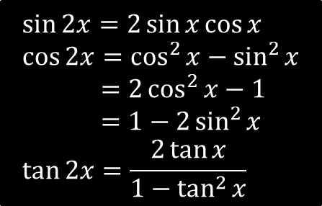
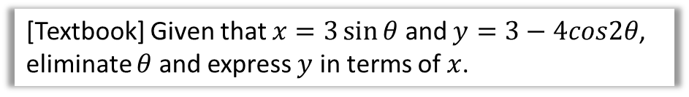

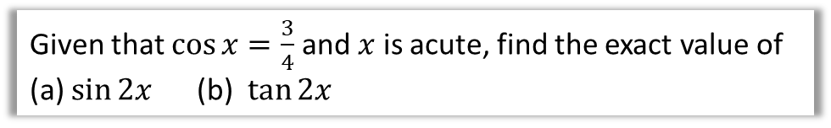

Examples
[Textbook] Given that $x=3\sin{θ}$ and $y=3−4cos2θ$, eliminate $θ$ and express $y$ in terms of $x$.
$$\sin{2x}=2\sin{x}\cos{x} \\ \cos{2x}=\cos^{2}{x}−\sin^{2}{x} \\ =2\cos^{2}{x}−1 \\ =1−2\sin^{2}{x} \\ \tan{2x}=\frac{2\tan{x}}{1−\tan^{2}{x}}$$
?
$$y=3−4\left(1−2\sin^{2}{θ}\right)$$
$$=8\sin^{2}{θ}−1$$
$$\sin{θ}=\frac{x}{3}$$
$$∴y=8{\left(\frac{x}{3}\right)}^{2}−1$$
Fro Note: This question is an example of turning a set of parametric equations into a single Cartesian one. You will cover this in the next chapter.
Given that $\cos{x}=\frac{3}{4}$ and $x$ is acute, find the exact value of
(a) $\sin{2x}$ (b) $\tan{2x}$
?
Since $sin^{2}x+cos^{2}x=1$, $sin x=±\sqrt{1−cos^{2}x}$
$sin x=\sqrt{1−{\left(\frac{3}{4}\right)}^{2}}=\frac{\sqrt{7}}{4}$ (and is positive given $0<x<90°$)
$$∴sin 2x=2sin x cos x=2×\frac{\sqrt{7}}{4}×\frac{3}{4}=\frac{3\sqrt{7}}{8}$$
$$tan x=\frac{sin x}{cos}=\frac{3\sqrt{7}/8}{3/4}=\frac{\sqrt{7}}{3} ∴tan2x=\frac{2×\frac{\sqrt{7}}{3}}{1−{\left(\frac{\sqrt{7}}{3}\right)}^{2}}=3\sqrt{7}$$

Slide 12
Exercise 7C
Pearson Pure Mathematics Year 2/AS
Pages 175-177
Complete before the lesson Q1-3
In Class:
Green Q4-7
Amber Q8-13
Red Q14-19

