Slide 1
Year 2 Applied Mathematics
Probability
– Conditional Probability
Chapter 2
(Part 2 of 4)

Slide 2


Conditional Probability
Probability of an event can change dependent on the outcome
of a previous event.
For example, the chance of winning a
2nd football match is dependent on
how you get on in your 1st match.

Slide 3


Conditional Probability
$$P\left(B | A\right)$$
Probability of B given that
A has already occurred.
$$P\left(A | B\right)$$
Probability of A given that
B has already occurred.

Slide 4
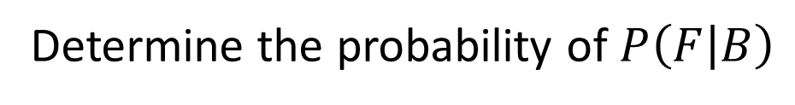
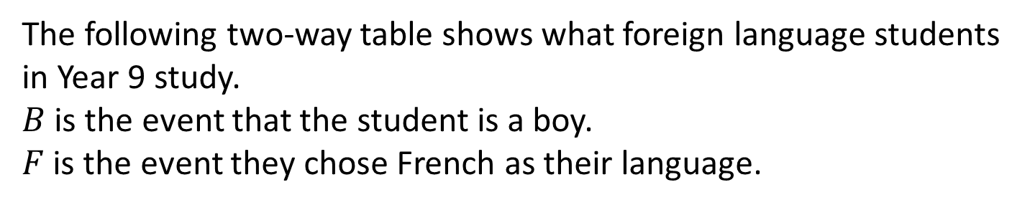
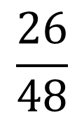
Conditional Probability
The following two-way table shows what foreign language students in Year 9 study.
$B$ is the event that the student is a boy.
$F$ is the event they chose French as their language.
 | French | Spanish | Total
Girls | 14 | 38 | 52
Boys | 26 | 22 | 48
Total | 40 | 60 | 100
$$\frac{26}{48}$$
Determine the probability of$P\left(F | B\right)$
A boy has already been chosen so
what is the probability they have chosen French.

Slide 5
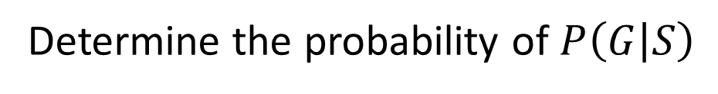
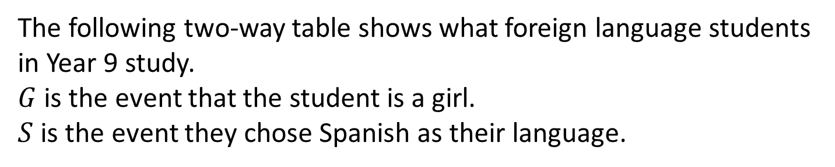
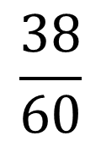
Conditional Probability
The following two-way table shows what foreign language students in Year 9 study.
$G$ is the event that the student is a girl.
$S$ is the event they chose Spanish as their language.
 | French | Spanish | Total
Girls | 14 | 38 | 52
Boys | 26 | 22 | 48
Total | 40 | 60 | 100
$$\frac{38}{60}$$
Determine the probability of$P\left(G | S\right)$
Spanish has already been chosen so
what is the probability they are girls.

Slide 6
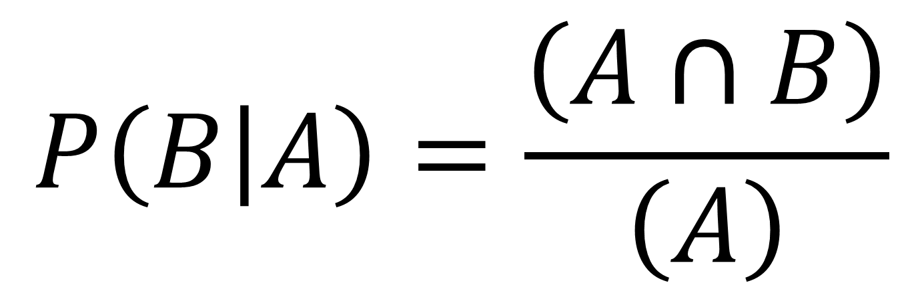
Conditional Probability
$$P\left(B | A\right)=\frac{\left(A∩B\right)}{\left(A\right)}$$
The ‘|’ symbol reads:
“B occurred given that A occurred”

Slide 7


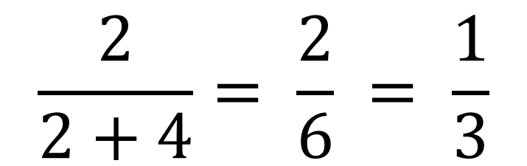

Conditional Probability – Venn Diagram
$$A$$
$$B$$
2
3
6
4
$$\frac{2}{2+4}= \frac{2}{6} = \frac{1}{3}$$
$$P\left(A | B\right)=$$

Slide 8
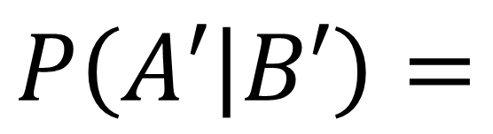
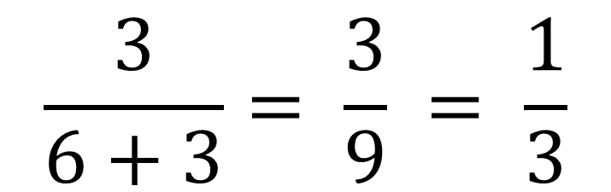
Conditional Probability – Venn Diagram
$$A$$
$$B$$
2
3
2
6
4
$$\frac{3}{6+3}= \frac{3}{9} = \frac{1}{3}$$
$$P\left(A′ | B′\right)=$$

Slide 9

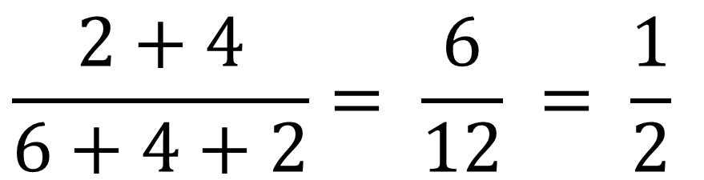
Conditional Probability – Venn Diagram
$$A$$
$$B$$
2
3
6
4
$$\frac{2+4}{6+4+2}= \frac{6}{12} = \frac{1}{2}$$
$$P\left(B | A∪B\right)=$$

Slide 10

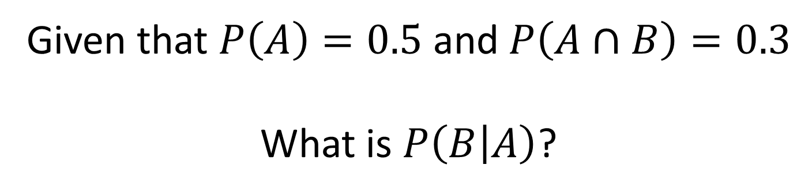
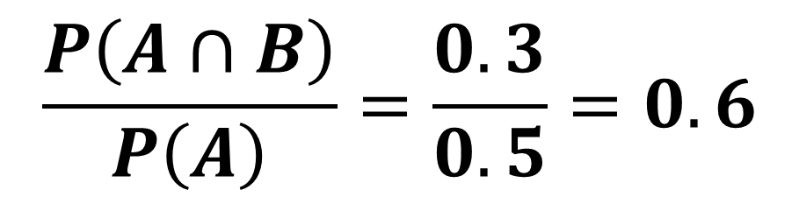
Conditional Probability
Given that $P\left(A\right)=0.5$ and $P\left(A∩B\right)=0.3$
What is $P\left(B | A\right)$?
$$\frac{P\left(A∩B\right)}{P\left(A\right)}=\frac{0.3}{0.5}=0.6$$
$$P\left(B | A\right)=$$

Slide 11
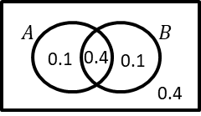
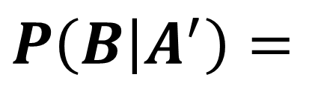
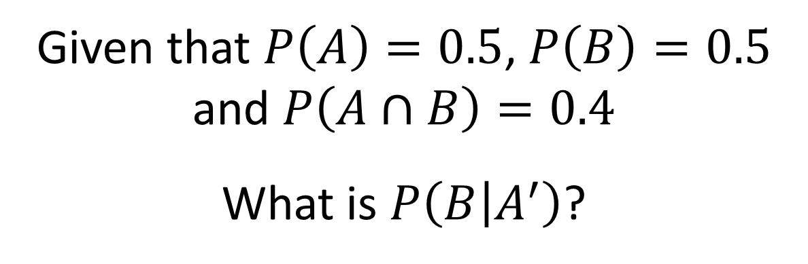
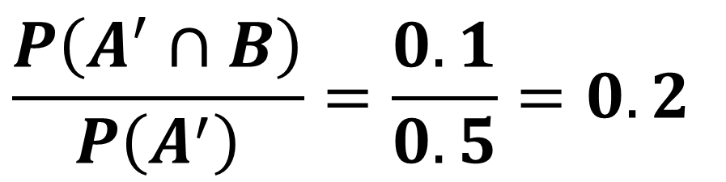
Conditional Probability
Given that $P\left(A\right)=0.5$, $P\left(B\right)=0.5$
and $P\left(A∩B\right)=0.4$
What is $P\left(B | A^{′}\right)$?
$$\frac{P\left(A^{′}∩B\right)}{P\left(A^{′}\right)}=\frac{0.1}{0.5}=0.2$$
$$P\left(B | A^{′}\right)=$$

Slide 12
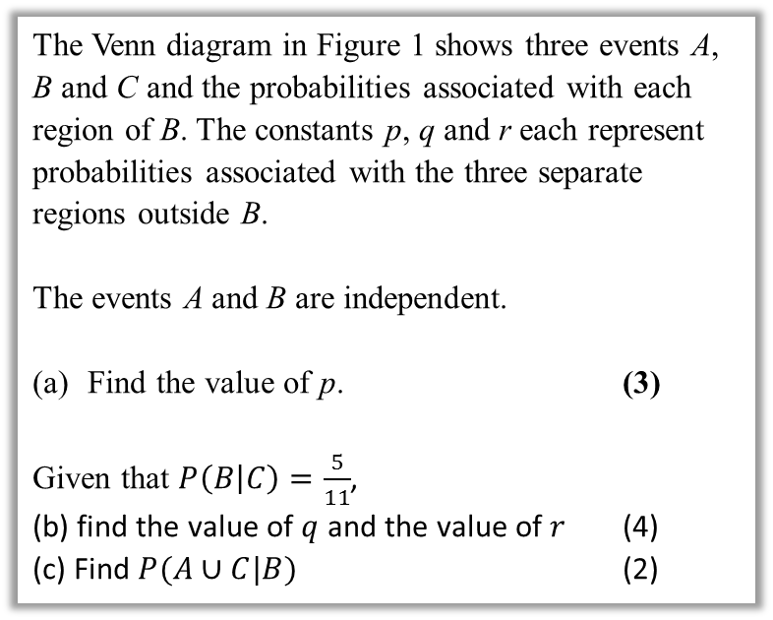

Further Test Your Understanding
May 2013 (R) Q6
(From earlier)
$0.1=\left(p+0.1\right)×0.4$
$p+0.1=0.25$
$p=0.15$
$P\left(B | C\right)=\frac{P\left(B∩C\right)}{P\left(C\right)}$
$\frac{5}{11}=\frac{0.2}{0.2+q}$
$q=0.24$
$r=1−0.15−0.1−0.1−0.2−0.24$
$=0.21$
$P\left(A∪C | B\right)=\frac{P\left(\left(A∪C\right)∩B\right)}{P\left(B\right)}$
$=\frac{0.1+0.2}{0.4}=0.75$
?
The Venn diagram in Figure 1 shows three events A, B and C and the probabilities associated with each region of B. The constants p, q and r each represent probabilities associated with the three separate regions outside B.
The events A and B are independent.
Find the value of p. (3)
Given that $P\left(B | C\right)=\frac{5}{11}$,
(b) find the value of $q$ and the value of $r$ (4)
(c) Find $P(A∪C|B)$ (2)
?

Slide 13

Exercise 2C
Pearson Stats/Mechanics Year 2
Pages 25-27
Note: I have skipped Exercise 2B.
Extension:
[Classic puzzle] I have 2 children. One of them is a boy. What’s the probability the other is a boy?
If (at least) one is a boy, restricted sample space is BB, BG, GB. Of these, only in one case is the other a boy. $∴\frac{1}{3}$
1
?
Before the lesson Q1-2 & From Ex2B Q9&10
In Class Ex2C:
Green Q3-5
Amber Q6-8
Red Q9-12 & Ext

