Slide 1
Methods in Calculus
Twitter: @Owen134866
www.mathsfreeresourcelibrary.com

Slide 2
Teachings for
Exercise 3E

Slide 3





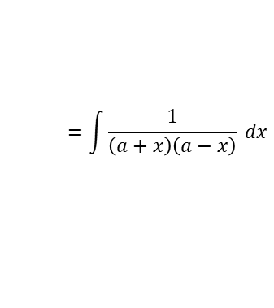


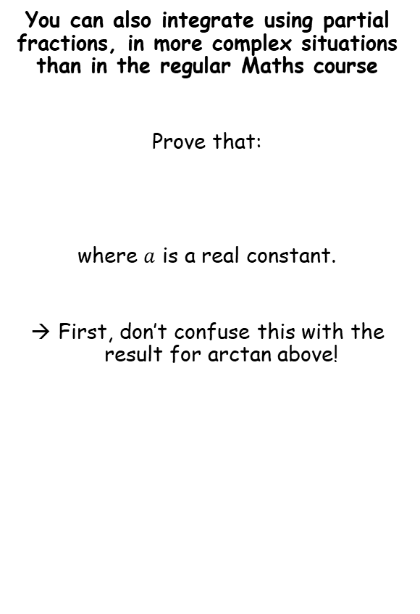


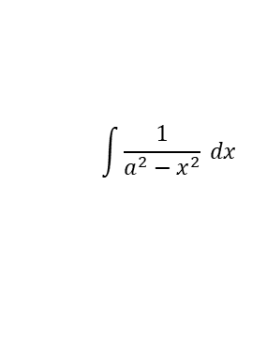

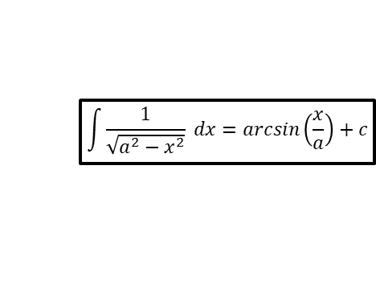






Methods in Calculus
$$\int{\frac{1}{\sqrt{a^{2}−x^{2}}} dx}=arcsin\left(\frac{x}{a}\right)+c$$
$$\int{\frac{1}{a^{2}+x^{2}} dx}=\frac{1}{a}arctan\left(\frac{x}{a}\right)+c$$
You can also integrate using partial fractions, in more complex situations than in the regular Maths course
Prove that:
where $a$ is a real constant.
First, don’t confuse this with the result for arctan above!
$$\int{\frac{1}{a^{2}−x^{2}} dx}$$
Factorise the denominator
$$=\int{\frac{1}{\left(a+x\right)\left(a−x\right)} dx}$$
We need to write this using partial fractions…
$$\int{\frac{1}{a^{2}−x^{2}} dx=\frac{1}{2a}ln\left|\frac{a+x}{a−x}\right|+c}$$
$$\frac{1}{\left(a+x\right)\left(a−x\right)}$$
$$=\frac{A}{\left(a+x\right)}+\frac{B}{\left(a−x\right)}$$
Multiply all by $\left(a+x\right)\left(a−x\right)$
$$1=A\left(a−x\right)+B\left(a+x\right)$$
Let $x=a$
Let $x=−a$
$$1=2aB$$
Divide by $2a$
$$1=2aA$$
Divide by $2a$
$$\frac{1}{2a}=B$$
$$\frac{1}{2a}=A$$
So in partial fractions, it will be the following:
$$\frac{1}{\left(a+x\right)\left(a−x\right)}$$
$$=\frac{\frac{1}{2a}}{\left(a+x\right)}+\frac{\frac{1}{2a}}{\left(a−x\right)}$$
3E

Slide 4






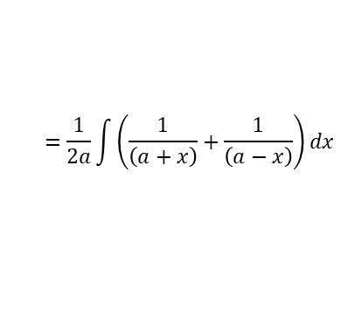
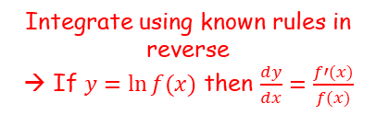
Methods in Calculus
$$\int{\frac{1}{\sqrt{a^{2}−x^{2}}} dx}=arcsin\left(\frac{x}{a}\right)+c$$
$$\int{\frac{1}{a^{2}+x^{2}} dx}=\frac{1}{a}arctan\left(\frac{x}{a}\right)+c$$
You can also integrate using partial fractions, in more complex situations than in the regular Maths course
Prove that:
where $a$ is a real constant.
$$\int{\frac{1}{a^{2}−x^{2}} dx}$$
Factorise the denominator
$$=\int{\frac{1}{\left(a+x\right)\left(a−x\right)} dx}$$
Replace using the partial fractions we worked out
$$=\int{\left(\frac{\frac{1}{2a}}{\left(a+x\right)}+\frac{\frac{1}{2a}}{\left(a−x\right)}\right)dx}$$
$$\int{\frac{1}{a^{2}−x^{2}} dx=\frac{1}{2a}ln\left|\frac{a+x}{a−x}\right|+c}$$
Take out $\frac{1}{2a}$ as a factor
$$=\frac{1}{2a}\int{\left(\frac{1}{\left(a+x\right)}+\frac{1}{\left(a−x\right)}\right)dx}$$
Integrate using known rules in reverse
→ If $y=ln⁡f(x)$ then $\frac{dy}{dx}=\frac{f′(x)}{f(x)}$
$$=\frac{1}{2a}\left(ln\left|a+x\right|−ln\left|a−x\right|\right)+c$$
Combine using the division law
$$=\frac{1}{2a}\left(ln\left|\frac{a+x}{a−x}\right|\right)+c$$
Simplify
$$=\frac{1}{2a}ln\left|\frac{a+x}{a−x}\right|+c$$
3E

Slide 5


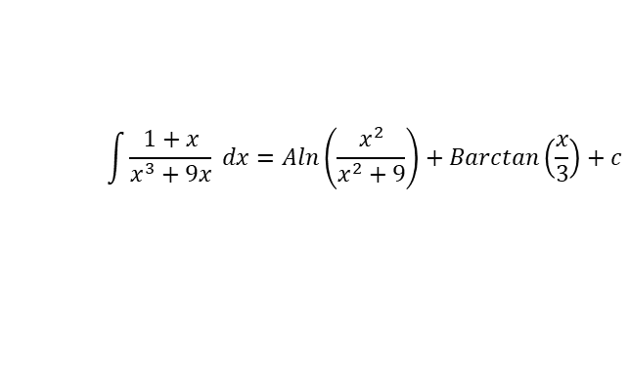

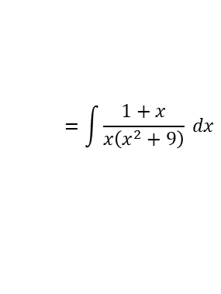




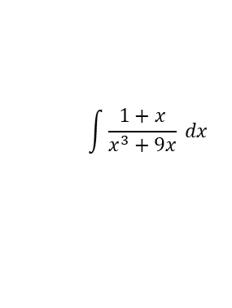



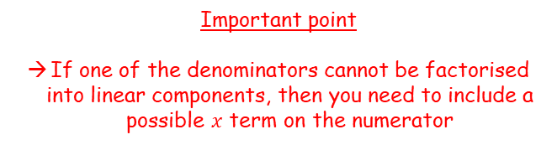




Methods in Calculus
$$\int{\frac{1}{\sqrt{a^{2}−x^{2}}} dx}=arcsin\left(\frac{x}{a}\right)+c$$
$$\int{\frac{1}{a^{2}+x^{2}} dx}=\frac{1}{a}arctan\left(\frac{x}{a}\right)+c$$
You can also integrate using partial fractions, in more complex situations than in the regular Maths course
Show that:
where $A$ and $B$ are constants to be found.
$$\int{\frac{1+x}{x^{3}+9x} dx}$$
Factorise the denominator
$$=\int{\frac{1+x}{x\left(x^{2}+9\right)} dx}$$
We need to write this using partial fractions…
$$\int{\frac{1+x}{x^{3}+9x} dx=Aln\left(\frac{x^{2}}{x^{2}+9}\right)+Barctan\left(\frac{x}{3}\right)+c}$$
$$\frac{1+x}{x\left(x^{2}+9\right)}=$$
$$\frac{A}{x}+\frac{Bx+C}{x^{2}+9}$$
Multiply all by $x\left(x^{2}+9\right)$
$$1+x=A\left(x^{2}+9\right)+\left(Bx+C\right)x$$
Expand brackets
Important point
If one of the denominators cannot be factorised into linear components, then you need to include a possible $x$ term on the numerator
$$1+x=Ax^{2}+9A+Bx^{2}+Cx$$
Separate into $x^{2}$, $x$ and constant parts
$$1+x=\left(A+B\right)x^{2}+Cx+9A$$
Now we can compare the coefficients of each term on both sides
So in partial fractions, it will be the following:
$$\frac{1+x}{x\left(x^{2}+9\right)}=\frac{\frac{1}{9}}{x}+\frac{−\frac{1}{9}x+1}{x^{2}+9}$$
Constant term
$x$ term
$x^{2}$ term
Divide by 9
$$1=9A$$
$$1=C$$
$$0=A+B$$
$$A=\frac{1}{9}$$
$$\frac{1}{9}=A$$
$$−\frac{1}{9}=B$$
3E

Slide 6


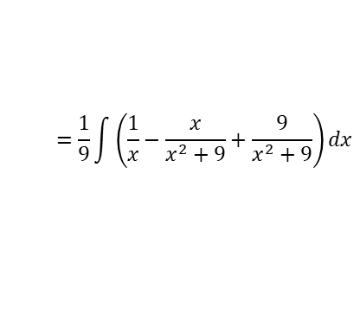
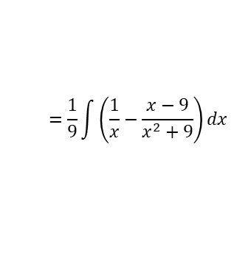
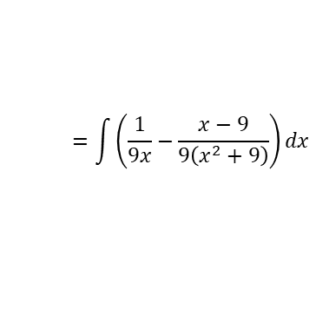

Methods in Calculus
$$\int{\frac{1}{\sqrt{a^{2}−x^{2}}} dx}=arcsin\left(\frac{x}{a}\right)+c$$
$$\int{\frac{1}{a^{2}+x^{2}} dx}=\frac{1}{a}arctan\left(\frac{x}{a}\right)+c$$
You can also integrate using partial fractions, in more complex situations than in the regular Maths course
Show that:
where $A$ and $B$ are constants to be found.
$$\int{\frac{1+x}{x^{3}+9x} dx}$$
Factorise the denominator
$$=\int{\frac{1+x}{x\left(x^{2}+9\right)} dx}$$
Replace using the partial fractions we just worked out
$$=\int{\left(\frac{\frac{1}{9}}{x}+\frac{−\frac{1}{9}x+1}{x^{2}+9}\right)dx}$$
$$\int{\frac{1+x}{x^{3}+9x} dx=Aln\left(\frac{x^{2}}{x^{2}+9}\right)+Barctan\left(\frac{x}{3}\right)+c}$$
Rewrite
$$=\int{\left(\frac{\frac{1}{9}}{x}−\frac{\frac{1}{9}x−1}{x^{2}+9}\right)dx}$$
Multiply all by 9
$$=\int{\left(\frac{1}{9x}−\frac{x−9}{9\left(x^{2}+9\right)}\right)dx}$$
Factorise out $\frac{1}{9}$ from the integral
$$=\frac{1}{9}\int{\left(\frac{1}{x}−\frac{x−9}{x^{2}+9}\right)dx}$$
Write the second fraction as two separate ones
$$=\frac{1}{9}\int{\left(\frac{1}{x}−\frac{x}{x^{2}+9}+\frac{9}{x^{2}+9}\right)dx}$$
We need to integrate each of these terms separately…
3E

Slide 7

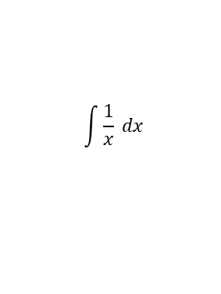
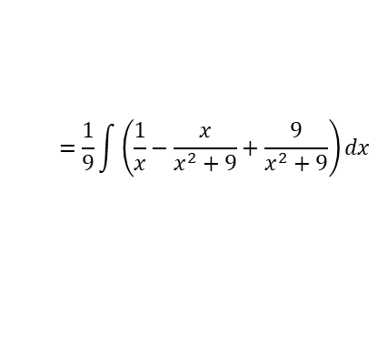
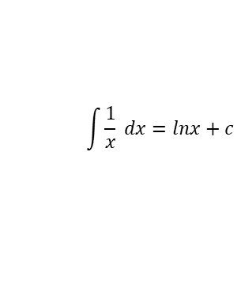
Methods in Calculus
$$\int{\frac{1}{\sqrt{a^{2}−x^{2}}} dx}=arcsin\left(\frac{x}{a}\right)+c$$
$$\int{\frac{1}{a^{2}+x^{2}} dx}=\frac{1}{a}arctan\left(\frac{x}{a}\right)+c$$
You can also integrate using partial fractions, in more complex situations than in the regular Maths course
Show that:
where $A$ and $B$ are constants to be found.
$$=\frac{1}{9}\int{\left(\frac{1}{x}−\frac{x}{x^{2}+9}+\frac{9}{x^{2}+9}\right)dx}$$
$$\int{\frac{1}{x} dx}$$
This is a standard result
$$\int{\frac{1+x}{x^{3}+9x} dx=Aln\left(\frac{x^{2}}{x^{2}+9}\right)+Barctan\left(\frac{x}{3}\right)+c}$$
$$=lnx+c$$
$$\int{\frac{1}{x} dx=lnx+c }$$
3E

Slide 8

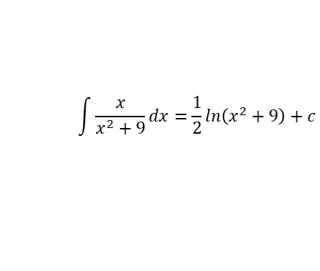
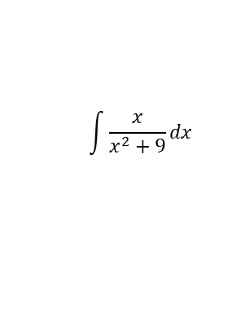


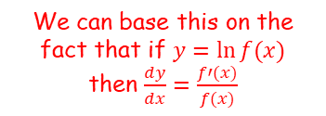
Methods in Calculus
$$\int{\frac{1}{\sqrt{a^{2}−x^{2}}} dx}=arcsin\left(\frac{x}{a}\right)+c$$
$$\int{\frac{1}{a^{2}+x^{2}} dx}=\frac{1}{a}arctan\left(\frac{x}{a}\right)+c$$
You can also integrate using partial fractions, in more complex situations than in the regular Maths course
Show that:
where $A$ and $B$ are constants to be found.
$$=\frac{1}{9}\int{\left(\frac{1}{x}−\frac{x}{x^{2}+9}+\frac{9}{x^{2}+9}\right)dx}$$
$$\int{\frac{x}{x^{2}+9}dx}$$
We can base this on the fact that if $y=ln⁡f(x)$ then $\frac{dy}{dx}=\frac{f′(x)}{f(x)}$
$$\int{\frac{1+x}{x^{3}+9x} dx=Aln\left(\frac{x^{2}}{x^{2}+9}\right)+Barctan\left(\frac{x}{3}\right)+c}$$
$$=\frac{1}{2}ln\left(x^{2}+9\right)+c$$
$$y=ln\left(x^{2}+9\right)$$
Differentiate using the rule mentioned above
$$\int{\frac{1}{x} dx=lnx+c }$$
$$\frac{dy}{dx}=\frac{2x}{x^{2}+9}$$
$$\int{\frac{x}{x^{2}+9}dx}=\frac{1}{2}ln\left(x^{2}+9\right)+c$$
This is double what we want, so the starting value should be halved
3E

Slide 9
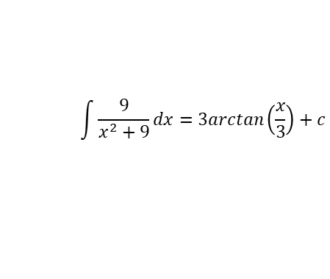


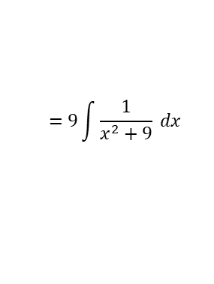
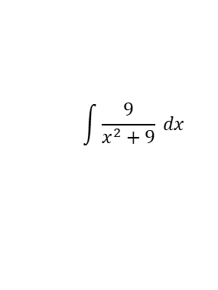

Methods in Calculus
$$\int{\frac{1}{\sqrt{a^{2}−x^{2}}} dx}=arcsin\left(\frac{x}{a}\right)+c$$
$$\int{\frac{1}{a^{2}+x^{2}} dx}=\frac{1}{a}arctan\left(\frac{x}{a}\right)+c$$
You can also integrate using partial fractions, in more complex situations than in the regular Maths course
Show that:
where $A$ and $B$ are constants to be found.
$$=\frac{1}{9}\int{\left(\frac{1}{x}−\frac{x}{x^{2}+9}+\frac{9}{x^{2}+9}\right)dx}$$
$$\int{\frac{9}{x^{2}+9} dx}$$
Take 9 out as a factor from the integral
$$=9\int{\frac{1}{x^{2}+9} dx}$$
$$\int{\frac{1+x}{x^{3}+9x} dx=Aln\left(\frac{x^{2}}{x^{2}+9}\right)+Barctan\left(\frac{x}{3}\right)+c}$$
Integrate using the rule above and $a=3$
$$=9\left(\frac{1}{3}arctan\left(\frac{x}{3}\right)+c\right)$$
Simplify
$$\int{\frac{1}{x} dx=lnx+c }$$
$$=3arctan\left(\frac{x}{3}\right)+c$$
$$\int{\frac{x}{x^{2}+9}dx}=\frac{1}{2}ln\left(x^{2}+9\right)+c$$
$$\int{\frac{9}{x^{2}+9}dx}=3arctan\left(\frac{x}{3}\right)+c$$
3E

Slide 10






Methods in Calculus
$$\int{\frac{1}{\sqrt{a^{2}−x^{2}}} dx}=arcsin\left(\frac{x}{a}\right)+c$$
$$\int{\frac{1}{a^{2}+x^{2}} dx}=\frac{1}{a}arctan\left(\frac{x}{a}\right)+c$$
You can also integrate using partial fractions, in more complex situations than in the regular Maths course
Show that:
where $A$ and $B$ are constants to be found.
$$=\frac{1}{9}\int{\left(\frac{1}{x}−\frac{x}{x^{2}+9}+\frac{9}{x^{2}+9}\right)dx}$$
We now know these integrals
$$=\frac{1}{9}\left(lnx−\frac{1}{2}ln\left(x^{2}+9\right)+3arctan\left(\frac{x}{3}\right)\right)+c$$
Expand the bracket
Look at the target – we need to find a way to group the first 2 terms, so they will need to have the same coefficient
$$=\frac{1}{9}lnx−\frac{1}{18}ln\left(x^{2}+9\right)+\frac{1}{3}arctan\left(\frac{x}{3}\right)+c$$
$$\int{\frac{1+x}{x^{3}+9x} dx=Aln\left(\frac{x^{2}}{x^{2}+9}\right)+Barctan\left(\frac{x}{3}\right)+c}$$
$$=\frac{1}{18}2lnx−\frac{1}{18}ln\left(x^{2}+9\right)+\frac{1}{3}arctan\left(\frac{x}{3}\right)+c$$
Use the power law
$$\int{\frac{1}{x} dx=lnx+c }$$
$$=\frac{1}{18}lnx^{2}−\frac{1}{18}ln\left(x^{2}+9\right)+\frac{1}{3}arctan\left(\frac{x}{3}\right)+c$$
Group the first 2 terms using the division law
$$\int{\frac{x}{x^{2}+9}dx}=\frac{1}{2}ln\left(x^{2}+9\right)+c$$
$$=\frac{1}{18}ln\left(\frac{x^{2}}{x^{2}+9}\right)+\frac{1}{3}arctan\left(\frac{x}{3}\right)+c$$
$$\int{\frac{9}{x^{2}+9}dx}=3arctan\left(\frac{x}{3}\right)+c$$
So $A=\frac{1}{18}$ and $B=\frac{1}{3}$
3E

Slide 11








Methods in Calculus
$$\int{\frac{1}{\sqrt{a^{2}−x^{2}}} dx}=arcsin\left(\frac{x}{a}\right)+c$$
$$\int{\frac{1}{a^{2}+x^{2}} dx}=\frac{1}{a}arctan\left(\frac{x}{a}\right)+c$$
You can also integrate using partial fractions, in more complex situations than in the regular Maths course
a) Express the following as partial fractions
$$\frac{x^{4}+x}{x^{4}+{5x}^{2}+6}$$
Factorise the denominator
$$=\frac{x^{4}+x}{\left(x^{2}+2\right)\left(x^{2}+3\right)}$$
We need to write this using partial fractions…
→ Since the numerator has a higher/equal power than the denominator, this is an improper fraction and a constant can be taken out
$$\frac{x^{4}+x}{x^{4}+{5x}^{2}+6}$$
$$\frac{x^{4}+x}{\left(x^{2}+2\right)\left(x^{2}+3\right)}$$
$$=A+\frac{Bx+C}{x^{2}+2}+\frac{Dx+E}{x^{2}+3}$$
Multiply all by $\left(x^{2}+2\right)\left(x^{2}+3\right)$
$$x^{4}+x=A\left(x^{2}+2\right)\left(x^{2}+3\right)+\left(Bx+C\right)\left(x^{2}+3\right)+\left(Dx+E\right)\left(x^{2}+2\right)$$
Expand
$$x^{4}+x=Ax^{4}+5Ax^{2}+6A+Bx^{3}+3Bx+Cx^{2}+3C+{Dx}^{3}+2Dx+Ex^{2}+2E$$
Group like terms
$$x^{4}+x=Ax^{4}+\left(B+D\right)x^{3}+\left(5A+C+E\right)x^{2}+\left(3B+2D\right)x+6A+3C+2E$$
Comparing $x^{4}$ terms
$$A=1$$
3E

Slide 12


Methods in Calculus
$$\int{\frac{1}{\sqrt{a^{2}−x^{2}}} dx}=arcsin\left(\frac{x}{a}\right)+c$$
$$\int{\frac{1}{a^{2}+x^{2}} dx}=\frac{1}{a}arctan\left(\frac{x}{a}\right)+c$$
You can also integrate using partial fractions, in more complex situations than in the regular Maths course
a) Express the following as partial fractions
$$\frac{x^{4}+x}{x^{4}+{5x}^{2}+6}$$
Factorise the denominator
$$=\frac{x^{4}+x}{\left(x^{2}+2\right)\left(x^{2}+3\right)}$$
We need to write this using partial fractions…
→ Since the numerator has a higher/equal power than the denominator, this is an improper fraction and a constant can be taken out
$$\frac{x^{4}+x}{x^{4}+{5x}^{2}+6}$$
$$\frac{x^{4}+x}{\left(x^{2}+2\right)\left(x^{2}+3\right)}$$
$$=A+\frac{Bx+C}{x^{2}+2}+\frac{Dx+E}{x^{2}+3}$$
Multiply all by $\left(x^{2}+2\right)\left(x^{2}+3\right)$
$$A=1$$
$$x^{4}+x=A\left(x^{2}+2\right)\left(x^{2}+3\right)+\left(Bx+C\right)\left(x^{2}+3\right)+\left(Dx+E\right)\left(x^{2}+2\right)$$
Expand
$$x^{4}+x=Ax^{4}+5Ax^{2}+6A+Bx^{3}+3Bx+Cx^{2}+3C+{Dx}^{3}+2Dx+Ex^{2}+2E$$
Group like terms
$$x^{4}+x=Ax^{4}+\left(B+D\right)x^{3}+\left(5A+C+E\right)x^{2}+\left(3B+2D\right)x+6A+3C+2E$$
Comparing $x^{3}$ terms
$$B+D=0$$
3E

Slide 13





Methods in Calculus
$$\int{\frac{1}{\sqrt{a^{2}−x^{2}}} dx}=arcsin\left(\frac{x}{a}\right)+c$$
$$\int{\frac{1}{a^{2}+x^{2}} dx}=\frac{1}{a}arctan\left(\frac{x}{a}\right)+c$$
You can also integrate using partial fractions, in more complex situations than in the regular Maths course
a) Express the following as partial fractions
$$\frac{x^{4}+x}{x^{4}+{5x}^{2}+6}$$
Factorise the denominator
$$=\frac{x^{4}+x}{\left(x^{2}+2\right)\left(x^{2}+3\right)}$$
We need to write this using partial fractions…
→ Since the numerator has a higher/equal power than the denominator, this is an improper fraction and a constant can be taken out
$$\frac{x^{4}+x}{x^{4}+{5x}^{2}+6}$$
$$\frac{x^{4}+x}{\left(x^{2}+2\right)\left(x^{2}+3\right)}$$
$$=A+\frac{Bx+C}{x^{2}+2}+\frac{Dx+E}{x^{2}+3}$$
Multiply all by $\left(x^{2}+2\right)\left(x^{2}+3\right)$
$$A=1$$
$$B+D=0$$
$$x^{4}+x=A\left(x^{2}+2\right)\left(x^{2}+3\right)+\left(Bx+C\right)\left(x^{2}+3\right)+\left(Dx+E\right)\left(x^{2}+2\right)$$
Expand
$$x^{4}+x=Ax^{4}+5Ax^{2}+6A+Bx^{3}+3Bx+Cx^{2}+3C+{Dx}^{3}+2Dx+Ex^{2}+2E$$
Group like terms
$$x^{4}+x=Ax^{4}+\left(B+D\right)x^{3}+\left(5A+C+E\right)x^{2}+\left(3B+2D\right)x+6A+3C+2E$$
Comparing $x^{2}$ terms
$$5A+C+E=0$$
$$A=1$$
$$C+E=−5$$
3E

Slide 14



Methods in Calculus
$$\int{\frac{1}{\sqrt{a^{2}−x^{2}}} dx}=arcsin\left(\frac{x}{a}\right)+c$$
$$\int{\frac{1}{a^{2}+x^{2}} dx}=\frac{1}{a}arctan\left(\frac{x}{a}\right)+c$$
You can also integrate using partial fractions, in more complex situations than in the regular Maths course
a) Express the following as partial fractions
$$\frac{x^{4}+x}{x^{4}+{5x}^{2}+6}$$
Factorise the denominator
$$=\frac{x^{4}+x}{\left(x^{2}+2\right)\left(x^{2}+3\right)}$$
We need to write this using partial fractions…
→ Since the numerator has a higher/equal power than the denominator, this is an improper fraction and a constant can be taken out
$$\frac{x^{4}+x}{x^{4}+{5x}^{2}+6}$$
$$\frac{x^{4}+x}{\left(x^{2}+2\right)\left(x^{2}+3\right)}$$
$$=A+\frac{Bx+C}{x^{2}+2}+\frac{Dx+E}{x^{2}+3}$$
Multiply all by $\left(x^{2}+2\right)\left(x^{2}+3\right)$
$$A=1$$
$$B+D=0$$
$$x^{4}+x=A\left(x^{2}+2\right)\left(x^{2}+3\right)+\left(Bx+C\right)\left(x^{2}+3\right)+\left(Dx+E\right)\left(x^{2}+2\right)$$
$$C+E=−5$$
Expand
$$x^{4}+x=Ax^{4}+5Ax^{2}+6A+Bx^{3}+3Bx+Cx^{2}+3C+{Dx}^{3}+2Dx+Ex^{2}+2E$$
Group like terms
$$x^{4}+x=Ax^{4}+\left(B+D\right)x^{3}+\left(5A+C+E\right)x^{2}+\left(3B+2D\right)x+6A+3C+2E$$
Comparing $x$ terms
$$3B+2D=1$$
3E

Slide 15




Methods in Calculus
$$\int{\frac{1}{\sqrt{a^{2}−x^{2}}} dx}=arcsin\left(\frac{x}{a}\right)+c$$
$$\int{\frac{1}{a^{2}+x^{2}} dx}=\frac{1}{a}arctan\left(\frac{x}{a}\right)+c$$
You can also integrate using partial fractions, in more complex situations than in the regular Maths course
a) Express the following as partial fractions
$$\frac{x^{4}+x}{x^{4}+{5x}^{2}+6}$$
Factorise the denominator
$$=\frac{x^{4}+x}{\left(x^{2}+2\right)\left(x^{2}+3\right)}$$
We need to write this using partial fractions…
→ Since the numerator has a higher/equal power than the denominator, this is an improper fraction and a constant can be taken out
$$\frac{x^{4}+x}{x^{4}+{5x}^{2}+6}$$
$$\frac{x^{4}+x}{\left(x^{2}+2\right)\left(x^{2}+3\right)}$$
$$=A+\frac{Bx+C}{x^{2}+2}+\frac{Dx+E}{x^{2}+3}$$
Multiply all by $\left(x^{2}+2\right)\left(x^{2}+3\right)$
$$A=1$$
$$B+D=0$$
$$x^{4}+x=A\left(x^{2}+2\right)\left(x^{2}+3\right)+\left(Bx+C\right)\left(x^{2}+3\right)+\left(Dx+E\right)\left(x^{2}+2\right)$$
$$C+E=−5$$
Expand
$$3B+2D=1$$
$$x^{4}+x=Ax^{4}+5Ax^{2}+6A+Bx^{3}+3Bx+Cx^{2}+3C+{Dx}^{3}+2Dx+Ex^{2}+2E$$
Group like terms
$$x^{4}+x=Ax^{4}+\left(B+D\right)x^{3}+\left(5A+C+E\right)x^{2}+\left(3B+2D\right)x+6A+3C+2E$$
Comparing constants
$$6A+3C+2E=0$$
$$A=1$$
$$3C+2E=−6$$
3E

Slide 16









Methods in Calculus
$$\int{\frac{1}{\sqrt{a^{2}−x^{2}}} dx}=arcsin\left(\frac{x}{a}\right)+c$$
$$\int{\frac{1}{a^{2}+x^{2}} dx}=\frac{1}{a}arctan\left(\frac{x}{a}\right)+c$$
You can also integrate using partial fractions, in more complex situations than in the regular Maths course
a) Express the following as partial fractions
$$\frac{x^{4}+x}{x^{4}+{5x}^{2}+6}$$
Factorise the denominator
$$=\frac{x^{4}+x}{\left(x^{2}+2\right)\left(x^{2}+3\right)}$$
We need to write this using partial fractions…
→ Since the numerator has a higher/equal power than the denominator, this is an improper fraction and a constant can be taken out
$$\frac{x^{4}+x}{x^{4}+{5x}^{2}+6}$$
$$=1+\frac{x+4}{x^{2}+2}−\frac{x+9}{x^{2}+3}$$
$$\frac{x^{4}+x}{\left(x^{2}+2\right)\left(x^{2}+3\right)}$$
$$=A+\frac{Bx+C}{x^{2}+2}+\frac{Dx+E}{x^{2}+3}$$
$$A=1$$
Replace A-E with the values we worked out
$$B=1$$
$$=1+\frac{x+4}{x^{2}+2}+\frac{−x−9}{x^{2}+3}$$
$$B+D=0$$
Rewrite the second fraction
$$C=4$$
$B=1$, $D=−1$
$$C+E=−5$$
$$=1+\frac{x+4}{x^{2}+2}−\frac{x+9}{x^{2}+3}$$
$$3B+2D=1$$
$$D=−1$$
$C=4$, $E=−9$
$$3C+2E=−6$$
$$E=−9$$
3E

Slide 17
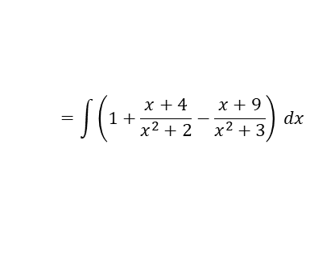
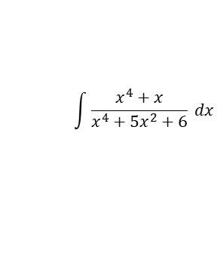

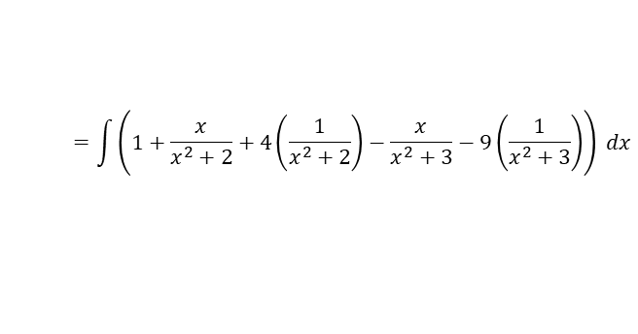
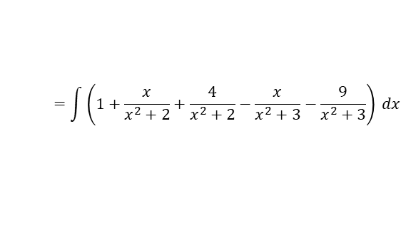

Methods in Calculus
$$\int{\frac{1}{\sqrt{a^{2}−x^{2}}} dx}=arcsin\left(\frac{x}{a}\right)+c$$
$$\int{\frac{1}{a^{2}+x^{2}} dx}=\frac{1}{a}arctan\left(\frac{x}{a}\right)+c$$
You can also integrate using partial fractions, in more complex situations than in the regular Maths course
a) Express the following as partial fractions
b) Hence, find:
$$\int{\frac{x^{4}+x}{x^{4}+{5x}^{2}+6} dx}$$
Replace with the partial fractions we worked out
$$=\int{\left(1+\frac{x+4}{x^{2}+2}−\frac{x+9}{x^{2}+3}\right) dx}$$
Separate the fractions as in the previous example
$$=\int{\left(1+\frac{x}{x^{2}+2}+\frac{4}{x^{2}+2}−\frac{x}{x^{2}+3}−\frac{9}{x^{2}+3}\right) dx}$$
$$\frac{x^{4}+x}{x^{4}+{5x}^{2}+6}$$
Take out the numerator as a factor on ones that will use the above rules
$$=\int{\left(1+\frac{x}{x^{2}+2}+4\left(\frac{1}{x^{2}+2}\right)−\frac{x}{x^{2}+3}−9\left(\frac{1}{x^{2}+3}\right)\right) dx}$$
$$=1+\frac{x+4}{x^{2}+2}−\frac{x+9}{x^{2}+3}$$
Integrate
$$=x+\frac{1}{2}ln\left|x^{2}+2\right|+4\left(\frac{1}{\sqrt{2}}arctan\left(\frac{x}{\sqrt{2}}\right)\right)−\frac{1}{2}ln\left|x^{2}+3\right|−9\left(\frac{1}{\sqrt{3}}arctan\left(\frac{x}{\sqrt{3}}\right)\right)+c$$
Simplify
$$\int{\frac{x^{4}+x}{x^{4}+{5x}^{2}+6} dx}$$
$$=x+\frac{1}{2}ln\left|x^{2}+2\right|+\frac{4}{\sqrt{2}}arctan\left(\frac{x}{\sqrt{2}}\right)−\frac{1}{2}ln\left|x^{2}+3\right|−\frac{9}{\sqrt{3}}arctan\left(\frac{x}{\sqrt{3}}\right)+c$$
Simplify more
$$=x+\frac{1}{2}ln\left|x^{2}+2\right|+2\sqrt{2}arctan\left(\frac{x}{\sqrt{2}}\right)−\frac{1}{2}ln\left|x^{2}+3\right|−3\sqrt{3}arctan\left(\frac{x}{\sqrt{3}}\right)+c$$
Division law
$$=x+\frac{1}{2}ln\left|\frac{x^{2}+2}{x^{2}+3}\right|+2\sqrt{2}arctan\left(\frac{x}{\sqrt{2}}\right)−3\sqrt{3}arctan\left(\frac{x}{\sqrt{3}}\right)+c$$
3E

Slide 18
Exercise 3E
Pearson Core Pure Year 2
Pages 72-73
Complete before the lesson Q1-2
In Class:
Green Q3-5
Amber Q6-7
Red Q8-12 & Challenge

