Slide 1
Year 2 Pure Mathematics
Probability
- Tree Diagrams
Chapter 6 (Part 4)

Slide 2
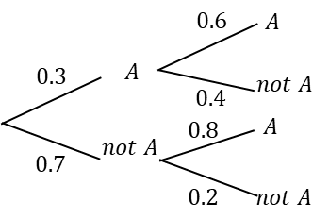

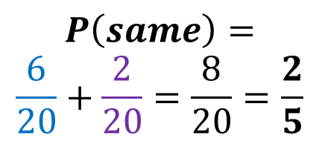


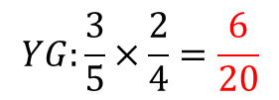

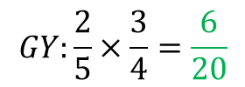

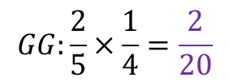

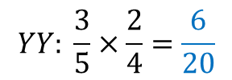
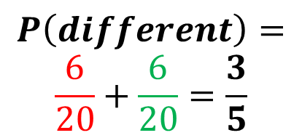
Tree Diagrams
At GCSE we saw that tree diagrams were an effective way of showing the outcome of two events which happen in succession.
There are 3 yellow and 2 green counters in a bag. I take two counters at random. Draw a tree diagram and determine the probability that:
They are of the same colour.
They are of different colours.
$$\frac{2}{4}$$
$$YY: \frac{3}{5}×\frac{2}{4}=\frac{6}{20}$$
Y
$$P\left(same\right)=$$
$$\frac{6}{20}+\frac{2}{20}=\frac{8}{20}=\frac{2}{5}$$
$$\frac{3}{5}$$
Y
$$YG:\frac{3}{5}×\frac{2}{4}=\frac{6}{20}$$
G
$\frac{2}{4 }$
Y
$$GY:\frac{2}{5}×\frac{3}{4}=\frac{6}{20}$$
$\frac{3}{4}$
G
$$P\left(different\right)=$$
$$\frac{6}{20}+\frac{6}{20}=\frac{3}{5}$$
$$\frac{2}{5}$$
$$\frac{1}{4}$$
$$GG:\frac{2}{5}×\frac{1}{4}=\frac{2}{20}$$
G

Slide 3
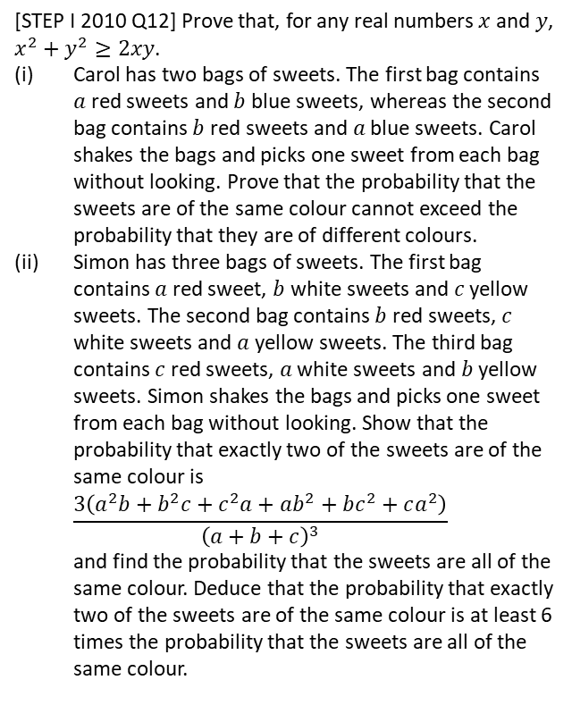

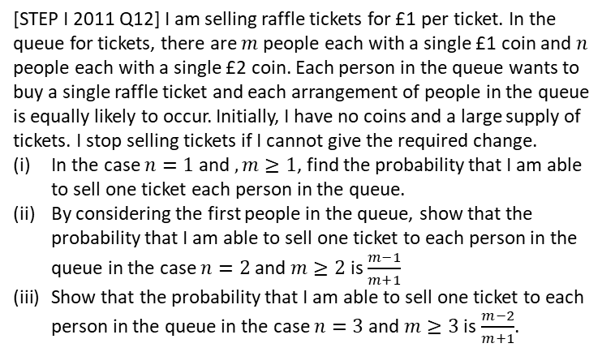
Exercise 5D
Complete before the lesson Q1-2
Green Q3-4
Amber Q5-6
Red Ext
Pearson Pure Mathematics
Pages 79-80
Extension Questions
2
[STEP I 2011 Q12] I am selling raffle tickets for £1 per ticket. In the queue for tickets, there are $m$ people each with a single £1 coin and $n$ people each with a single £2 coin. Each person in the queue wants to buy a single raffle ticket and each arrangement of people in the queue is equally likely to occur. Initially, I have no coins and a large supply of tickets. I stop selling tickets if I cannot give the required change.
In the case $n=1$ and $,m≥1$, find the probability that I am able to sell one ticket each person in the queue.
By considering the first people in the queue, show that the probability that I am able to sell one ticket to each person in the queue in the case $n=2$ and $m≥2$ is $\frac{m−1}{m+1}$
Show that the probability that I am able to sell one ticket to each person in the queue in the case $n=3$ and $m≥3$ is $\frac{m−2}{m+1}$.
1
[STEP I 2010 Q12] Prove that, for any real numbers $x$ and $y$, $x^{2}+y^{2}≥2xy$.
Carol has two bags of sweets. The first bag contains $a$ red sweets and $b$ blue sweets, whereas the second bag contains $b$ red sweets and $a$ blue sweets. Carol shakes the bags and picks one sweet from each bag without looking. Prove that the probability that the sweets are of the same colour cannot exceed the probability that they are of different colours.
Simon has three bags of sweets. The first bag contains $a$ red sweet, $b$ white sweets and $c$ yellow sweets. The second bag contains $b$ red sweets, $c$ white sweets and $a$ yellow sweets. The third bag contains $c$ red sweets, $a$ white sweets and $b$ yellow sweets. Simon shakes the bags and picks one sweet from each bag without looking. Show that the probability that exactly two of the sweets are of the same colour is
$\frac{3\left(a^{2}b+b^{2}c+c^{2}a+ab^{2}+bc^{2}+ca^{2}\right)}{{\left(a+b+c\right)}^{3}}$
and find the probability that the sweets are all of the same colour. Deduce that the probability that exactly two of the sweets are of the same colour is at least 6 times the probability that the sweets are all of the same colour.
3
I have an unfair coin with a fixed probability $p$ of heads. Determine how the unfair coin could be used to simulate a fair coin, i.e. you declare “Heads” or “Tails” each with probability 0.5.
Throw the coin twice. Then the probability of each sequence:
$$P\left(HH\right)=p^{2} P\left(TT\right)={\left(1−p\right)}^{2} \\ P\left(HT\right)=p\left(1−p\right) P\left(TH\right)=p(1−p)$$
Note that two of these have the same probability. So if the first throw is Heads and the second Tails, declare “Heads”, or if Tails then Heads, declare “Tails”. If the two throws are the same, repeat the process until the two throws are different.
?

