Slide 1
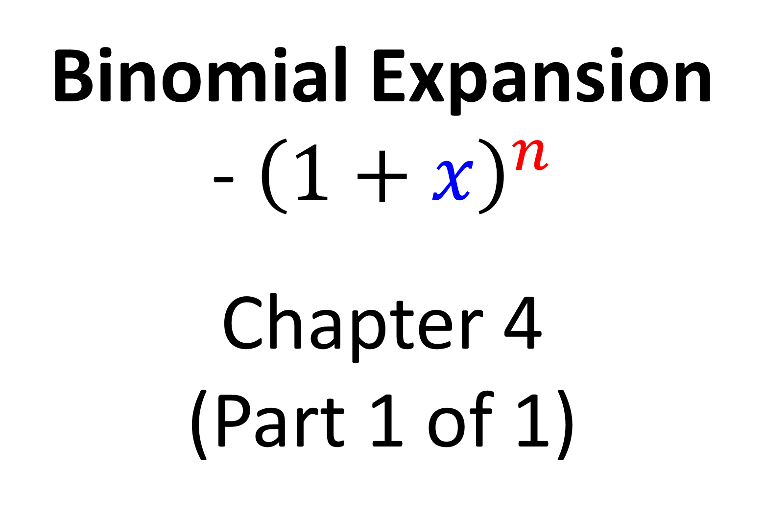
Year 2 Pure Mathematics
Binomial Expansion
- ${\left(1+x\right)}^{n}$
Chapter 4
(Part 1 of 1)

Slide 2
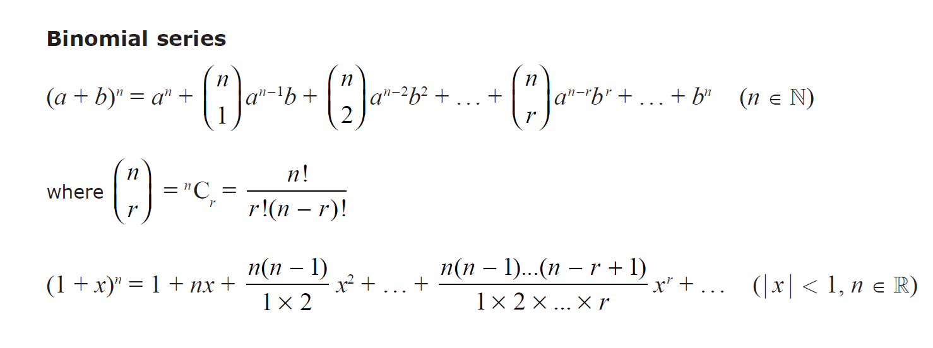
Binomial Expansion – Formulas
Given in the formula booklet:
Natural Numbers:
positive integers
Real Numbers:
all rational and irrational numbers
(positive, negatives and fractions)
Use when the question is:
Use when the question is:
(2 + x)⁵
(1 + x)^{1/2}
(2 + 3x)⁴
(1 + 3x)⁻²
(1 – 2x)⁴
(1 – 2x)^{-1/2}

Slide 3
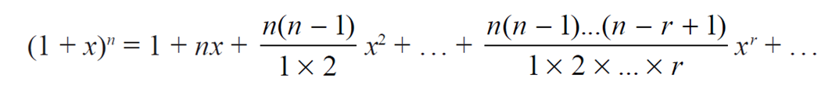
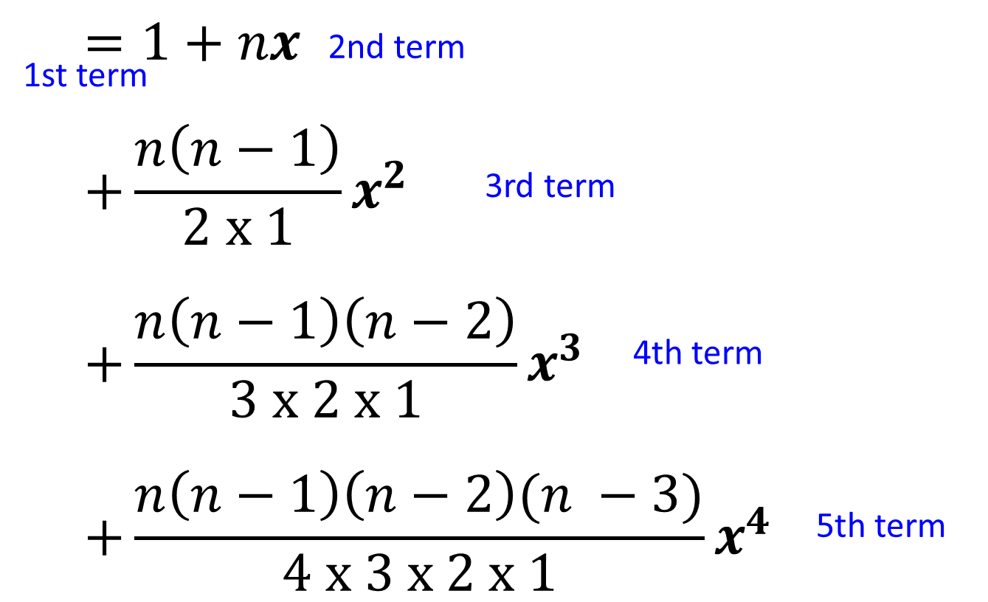
Binomial Expansion - Factorials
1st term
3rd term
2nd term

Slide 4
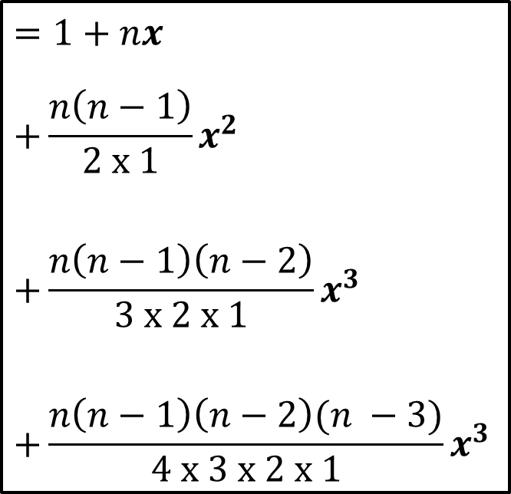
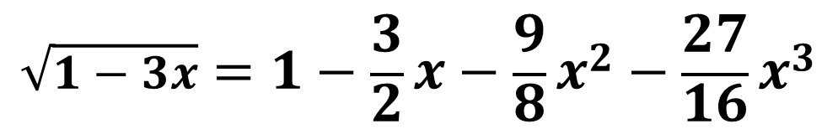
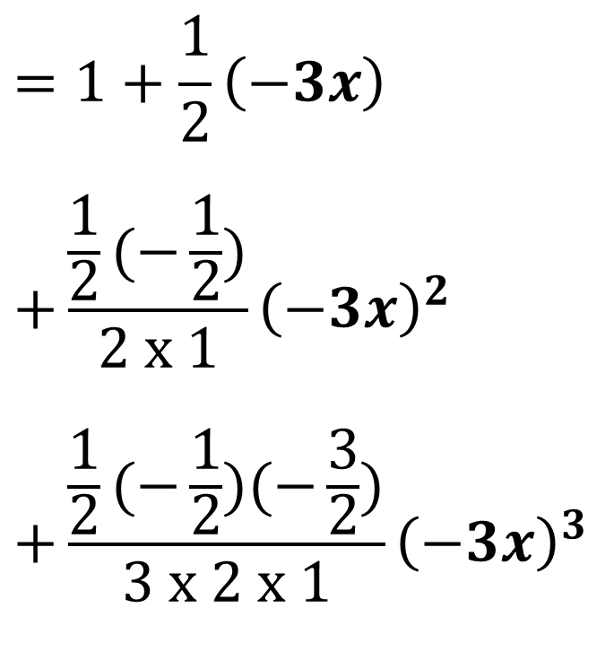

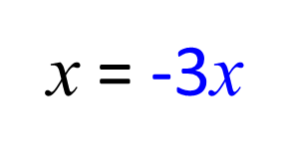
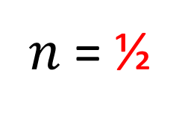
Binomial Expansion - Example
$$={\left(1−3x\right)}^{\frac{1}{2}}$$
Expand and find the first four terms of $\sqrt{1−3x}$
$$=1+\frac{1}{2}\left(−3x\right)$$
$$+\frac{\frac{1}{2}(−\frac{1}{2})}{2 x 1}{\left(−3x\right)}^{2}$$
$$+\frac{\frac{1}{2}(−\frac{1}{2})(−\frac{3}{2})}{3 x 2 x 1}{\left(−3x\right)}^{3}$$
$n$= ½
x = -3x
$$\sqrt{1−3x}=1−\frac{3}{2}x−\frac{9}{8}x^{2}−\frac{27}{16}x^{3}$$

Slide 5
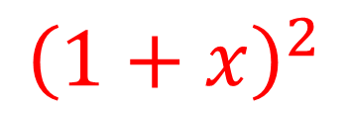
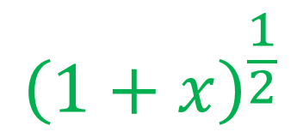
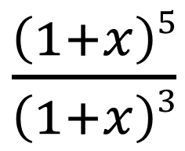
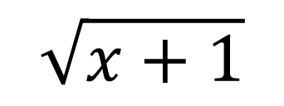
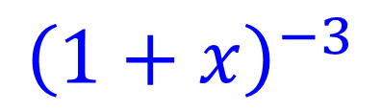
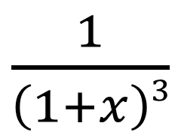
Binomial Expansion – Combining Expansions
Question
Expansion Required
$\frac{\left(1+x\right)5}{\left(1+x\right)3}$
$${\left(1+x\right)}^{2}$$
$\frac{1}{\left(1+x\right)3}$
$${\left(1+x\right)}^{−3}$$
$${\left(1+x\right)}^{\frac{1}{2}}$$
$$\sqrt{x+1}$$

Slide 6
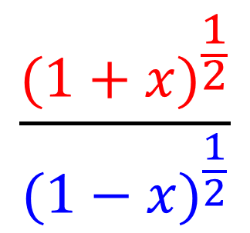
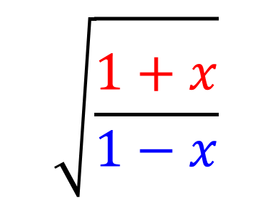
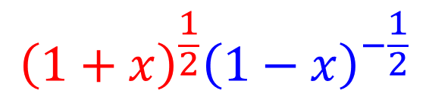
Binomial Expansion – Combining Expansions
Question
Expansion Required
$$\sqrt{\frac{1+x}{1−x}}$$
$$\frac{{(1+x)}^{\frac{1}{2}}}{{(1−x)}^{\frac{1}{2}}}$$
$${\left(1+x\right)}^{\frac{1}{2}}{\left(1−x\right)}^{−\frac{1}{2}}$$

Slide 7
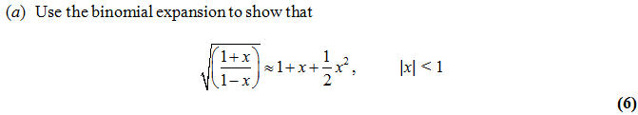
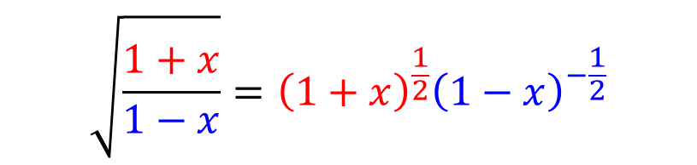
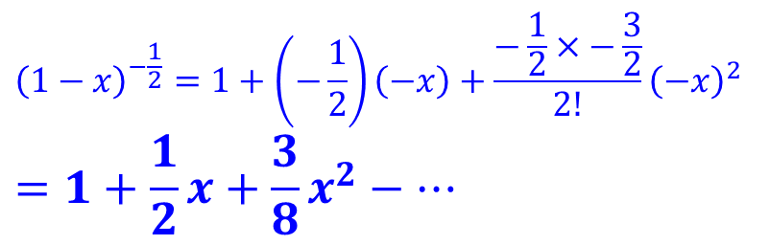
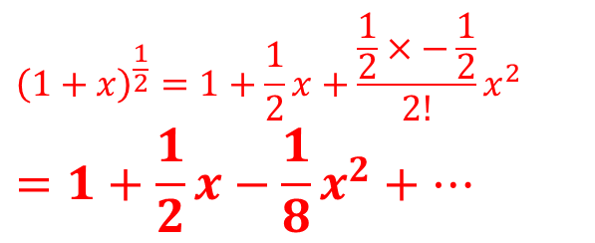
Binomial Expansion – Combining Expansions
$$\sqrt{\frac{1+x}{1−x}}={\left(1+x\right)}^{\frac{1}{2}}{\left(1−x\right)}^{−\frac{1}{2}}$$
$${\left(1+x\right)}^{\frac{1}{2}}=1+\frac{1}{2}x+\frac{\frac{1}{2}×−\frac{1}{2}}{2!}x^{2}$$
$$=1+\frac{1}{2}x−\frac{1}{8}x^{2}+…$$
$${\left(1−x\right)}^{−\frac{1}{2}}=1+\left(−\frac{1}{2}\right)\left(−x\right)+\frac{−\frac{1}{2}×−\frac{3}{2}}{2!}{\left(−x\right)}^{2}$$
$$=1+\frac{1}{2}x+\frac{3}{8}x^{2}−…$$

Slide 8
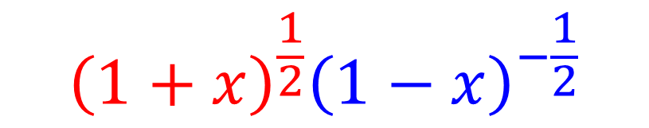
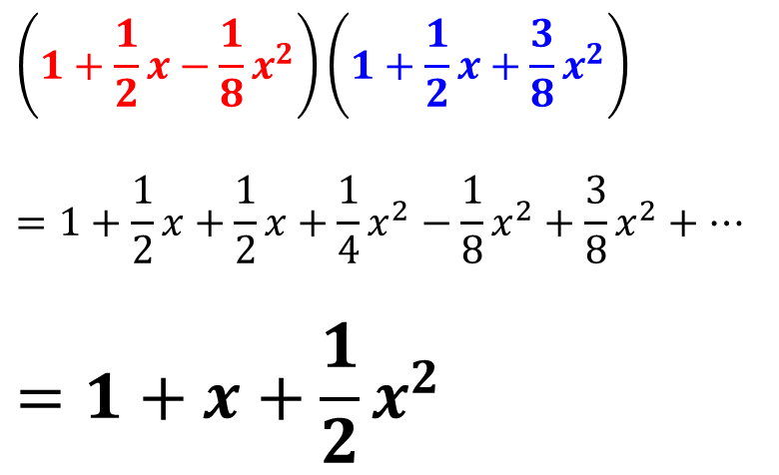
Binomial Expansion – Combining Expansions
$${\left(1+x\right)}^{\frac{1}{2}}{\left(1−x\right)}^{−\frac{1}{2}}$$
$$\left(1+\frac{1}{2}x−\frac{1}{8}x^{2}\right)\left(1+\frac{1}{2}x+\frac{3}{8}x^{2}\right)$$
$$=1+\frac{1}{2}x+\frac{1}{2}x+\frac{1}{4}x^{2}−\frac{1}{8}x^{2}+\frac{3}{8}x^{2}+…$$
$$=1+x+\frac{1}{2}x^{2}$$

