Slide 1
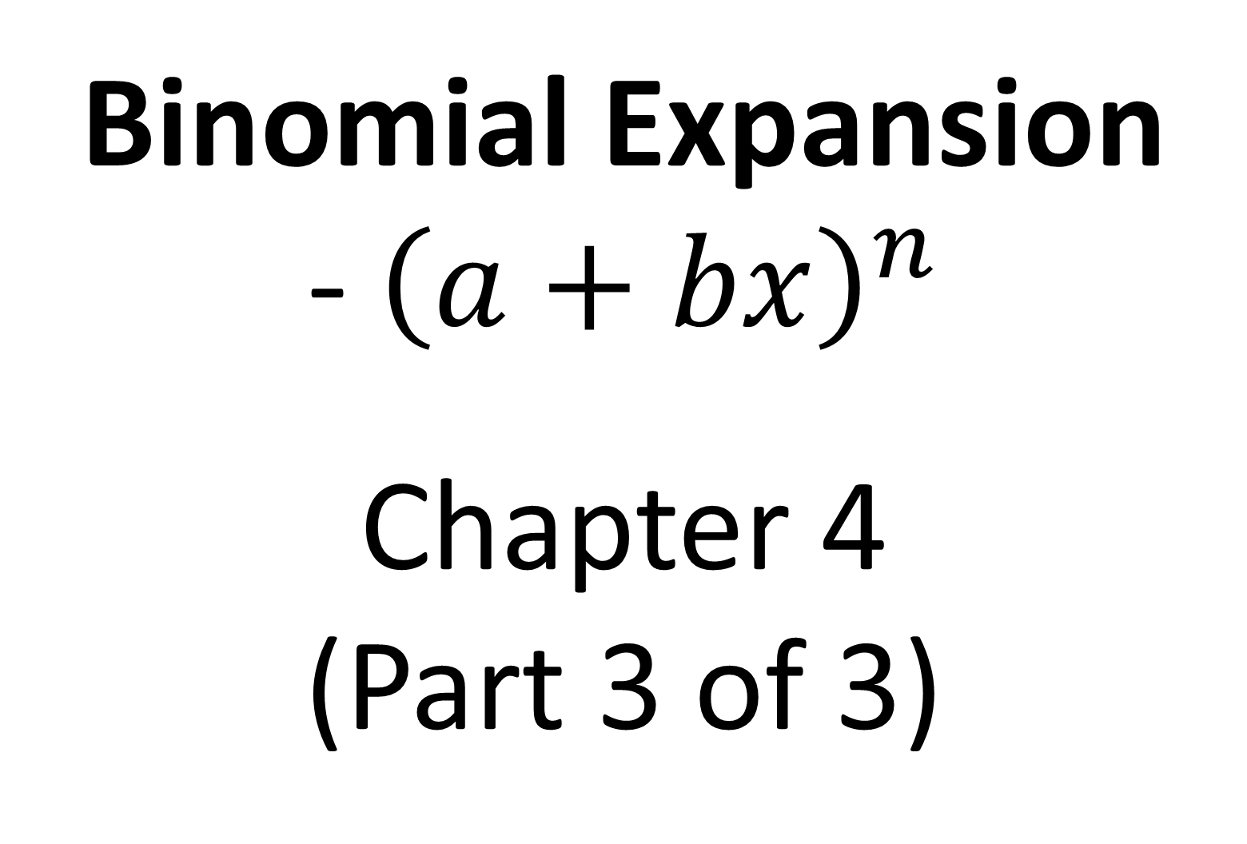
Year 2 Pure Mathematics
Binomial Expansion
-${ \left(a+bx\right)}^{n}$
Chapter 4
(Part 3 of 3)

Slide 2
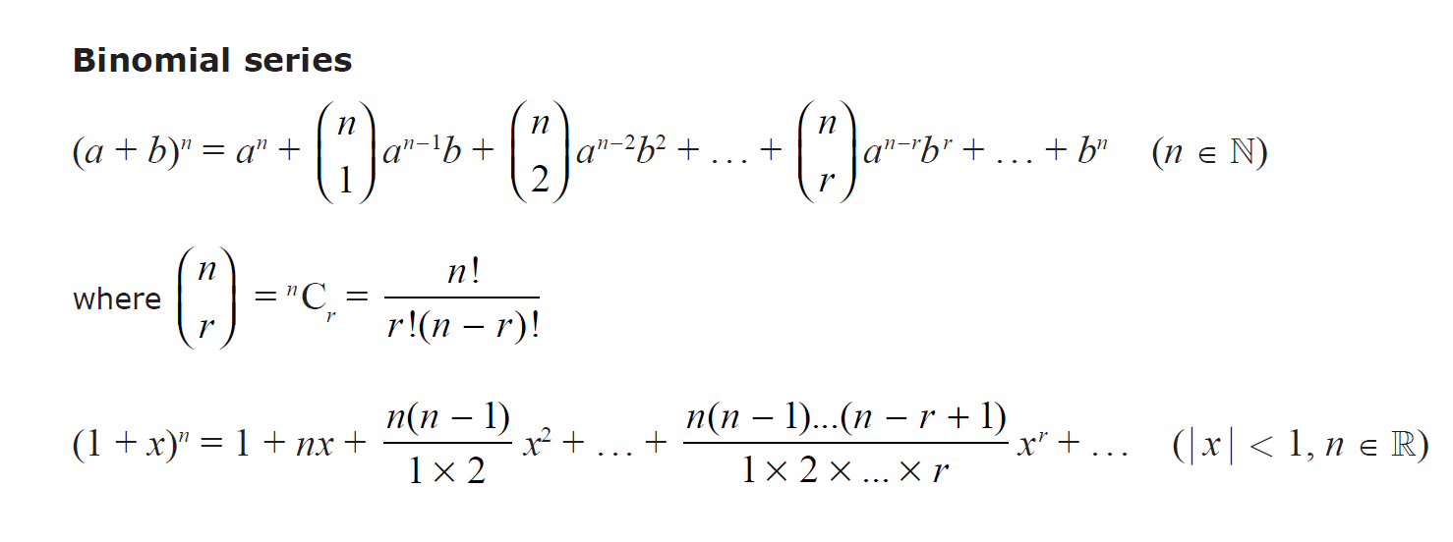

Binomial Expansion - ${\left(a+bx\right)}^{n}$
Find first four terms in the binomial expansion of ${\left(4+x\right)}^{\frac{1}{2}}$
Which formula should you use?
Natural Numbers:
positive integers
Real Numbers:
all rational and irrational numbers
(positive, negatives and fractions)

Slide 3


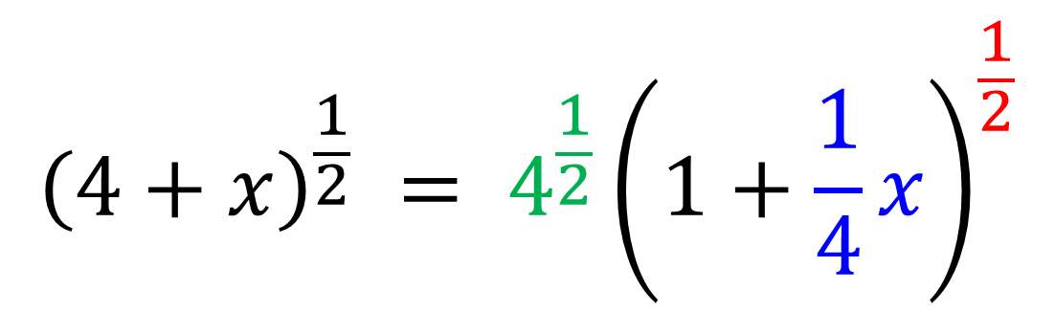
Binomial Expansion - ${\left(a+bx\right)}^{n}$
Find first four terms in the binomial expansion of ${\left(4+x\right)}^{\frac{1}{2}}$
${\left(1+x\right)}^{n}=1+nx+\frac{n\left(n−1\right)}{2!}x^{2}+\frac{n\left(n−1\right)\left(n−2\right)}{3!}x^{3}+…$
You need ${\left(4+x\right)}^{\frac{1}{2}}$ to be in the form ${\left(1+x\right)}^{n}$.
So factorise the 4 out.
$${\left(4+x\right)}^{\frac{1}{2}} = 4^{\frac{1}{2}}{\left(1+\frac{1}{4}x\right)}^{\frac{1}{2}}$$

Slide 4
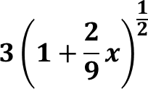
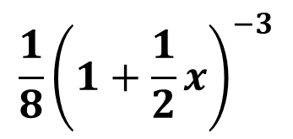
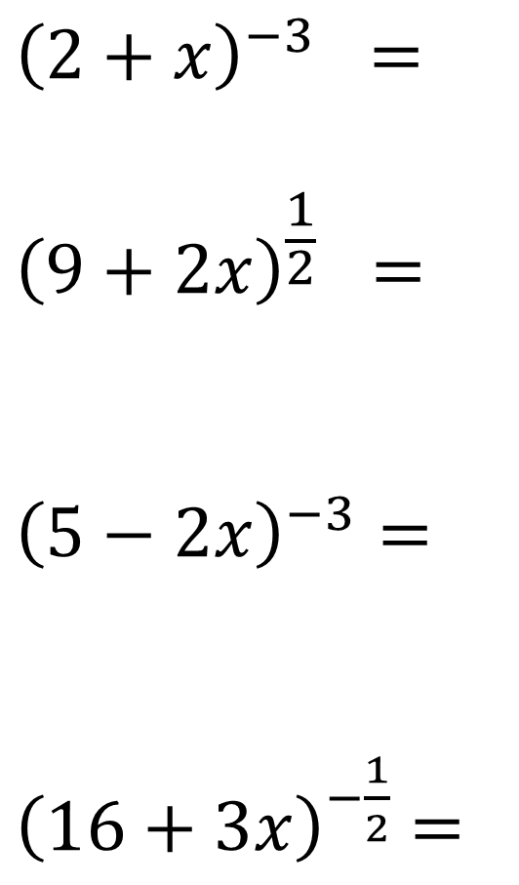
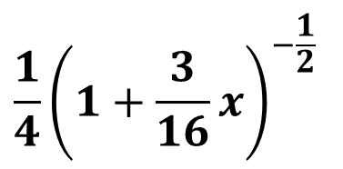
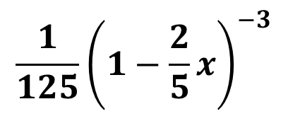
Binomial Expansion – Write in the form (1 + x)^{n}
$$\frac{1}{8}{\left(1+\frac{1}{2}x\right)}^{−3}$$
$${\left(2+x\right)}^{−3} =$$
$${\left(9+2x\right)}^{\frac{1}{2}} =$$
$${\left(5−2x\right)}^{−3}=$$
${\left(16+3x\right)}^{−\frac{1}{2}}$ $=$
$$\frac{1}{125}{\left(1−\frac{2}{5}x\right)}^{−3}$$
$$\frac{1}{4}{\left(1+\frac{3}{16}x\right)}^{−\frac{1}{2}}$$

Slide 5
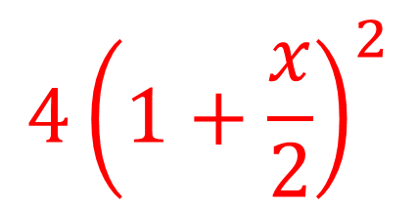
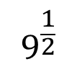
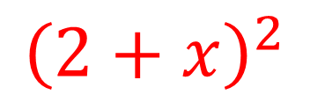
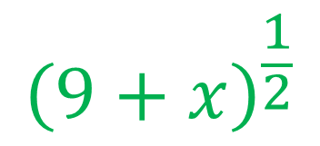

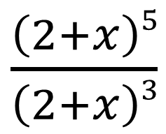
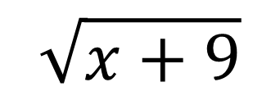

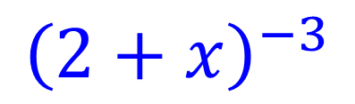
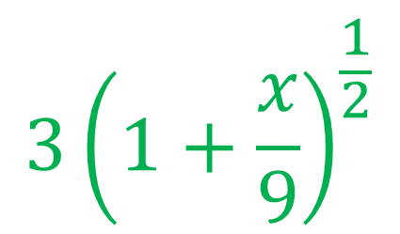
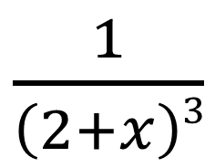
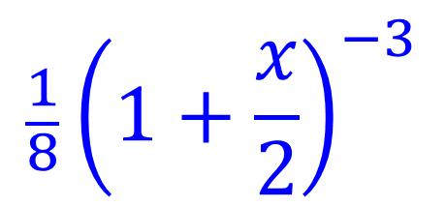
Binomial Expansion – Combining Expansions
Question
Expansion Required
$${4\left(1+\frac{x}{2}\right)}^{2}$$
$\frac{\left(2+x\right)5}{\left(2+x\right)3}$
$${\left(2+x\right)}^{2}$$
$$2^{2}$$
$$\frac{1}{8}{\left(1+\frac{x}{2}\right)}^{−3}$$
$\frac{1}{\left(2+x\right)3}$
$${\left(2+x\right)}^{−3}$$
$$2^{−3}$$
$${3\left(1+\frac{x}{9}\right)}^{\frac{1}{2}}$$
$${\left(9+x\right)}^{\frac{1}{2}}$$
$$\sqrt{x+9}$$
$$9^{\frac{1}{2}}$$

Slide 6

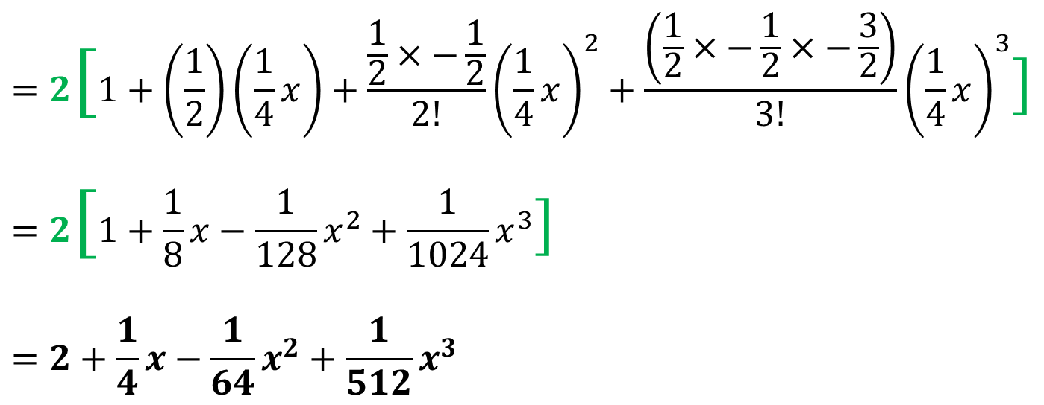
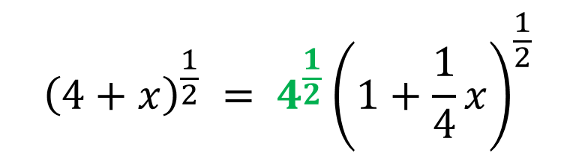
Binomial Expansion - ${\left(a+bx\right)}^{n}$
Find first four terms in the binomial expansion of ${\left(4+x\right)}^{\frac{1}{2}}$
$${\left(4+x\right)}^{\frac{1}{2}} = 4^{\frac{1}{2}}{\left(1+\frac{1}{4}x\right)}^{\frac{1}{2}}$$
$$=2[1+\left(\frac{1}{2}\right)\left(\frac{1}{4}x\right)+\frac{\frac{1}{2}×−\frac{1}{2}}{2!}{\left(\frac{1}{4}x\right)}^{2}+\frac{\left(\frac{1}{2}×−\frac{1}{2}×−\frac{3}{2}\right)}{3!}{\left(\frac{1}{4}x\right)}^{3}]$$
$$=2[1+\frac{1}{8}x−\frac{1}{128}x^{2}+\frac{1}{1024}x^{3}]$$
$$=2+\frac{1}{4}x−\frac{1}{64}x^{2}+\frac{1}{512}x^{3}$$

Slide 7
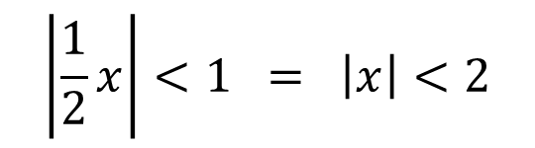
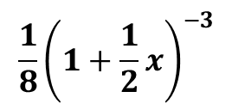
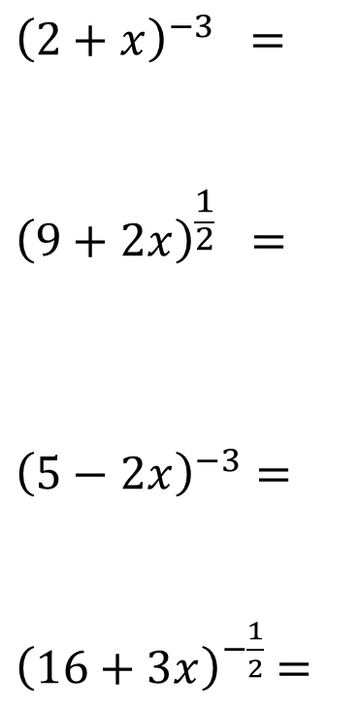
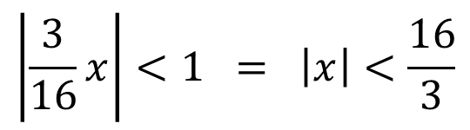
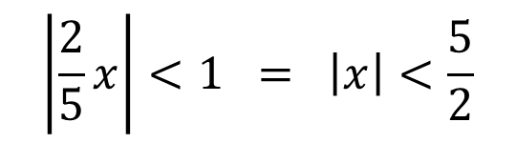
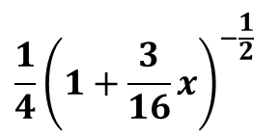
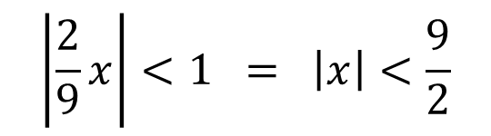
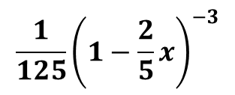
Binomial Expansion – When is it Valid
(1 + x)^{n}
Valid when:
$$\frac{1}{8}{\left(1+\frac{1}{2}x\right)}^{−3}$$
$$\left|\frac{1}{2}x\right|<1 = \left|x\right|<2$$
$${\left(2+x\right)}^{−3} =$$
$${\left(9+2x\right)}^{\frac{1}{2}} =$$
$${\left(5−2x\right)}^{−3}=$$
${\left(16+3x\right)}^{−\frac{1}{2}}$ $=$
$$\left|\frac{2}{9}x\right|<1 = \left|x\right|<\frac{9}{2}$$
$$\frac{1}{125}{\left(1−\frac{2}{5}x\right)}^{−3}$$
$$\left|\frac{2}{5}x\right|<1 = \left|x\right|<\frac{5}{2}$$
$$\frac{1}{4}{\left(1+\frac{3}{16}x\right)}^{−\frac{1}{2}}$$
$$\left|\frac{3}{16}x\right|<1 = \left|x\right|<\frac{16}{3}$$

Slide 8
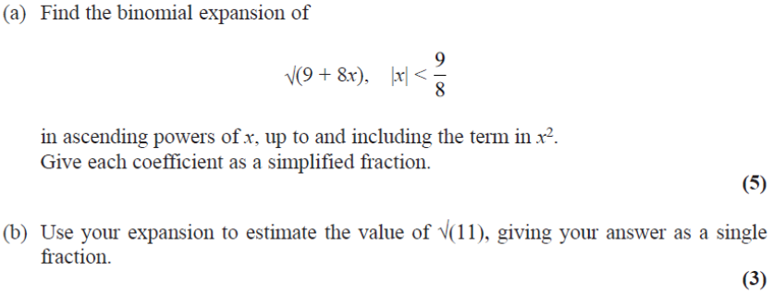
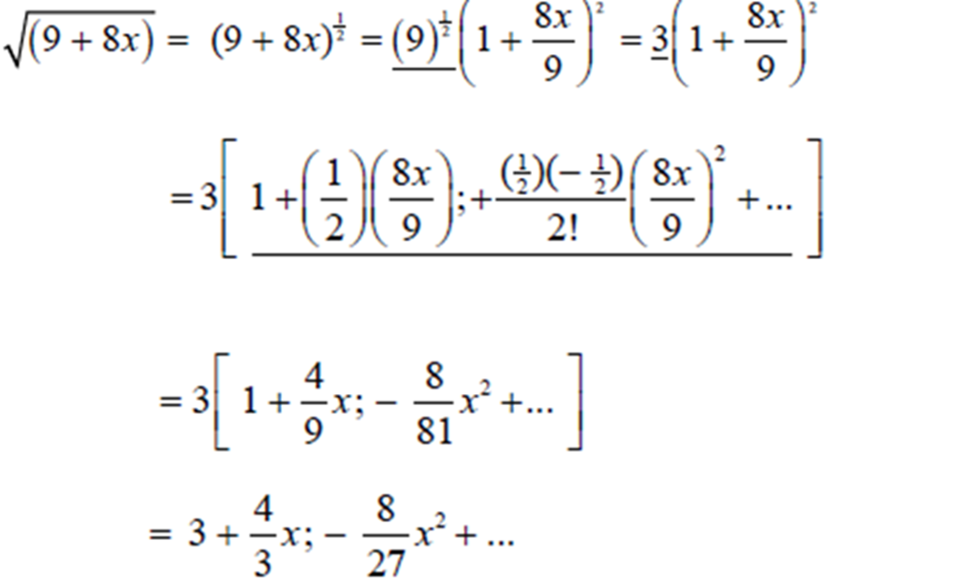
Binomial Expansion – Exam Question

Slide 9
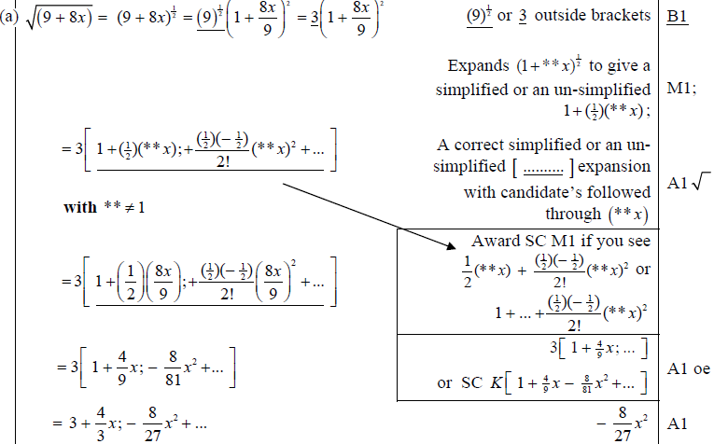
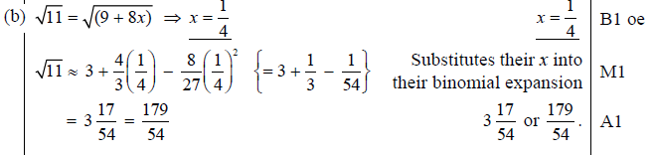
Test Your Understanding
Edexcel C4 June 2013 (Withdrawn) Q1
?
?

Slide 10
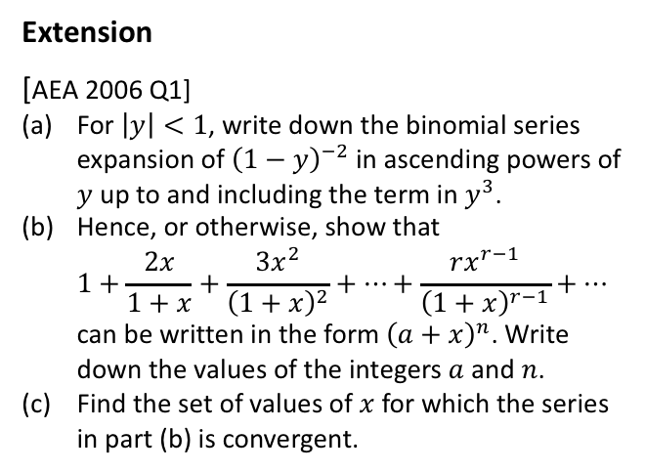
Exercise 4B
Pearson Pure Mathematics Year 2/AS
Pages 99-100
Complete before the lesson Q1 all parts
In Class:
Green Q2-3
Amber Q4-5
Red Q6-8
Extension
[AEA 2006 Q1]
For $\left|y\right|<1$, write down the binomial series expansion of ${\left(1−y\right)}^{−2}$ in ascending powers of $y$ up to and including the term in $y^{3}$.
Hence, or otherwise, show that
$1+\frac{2x}{1+x}+\frac{3x^{2}}{{\left(1+x\right)}^{2}}+…+\frac{rx^{r−1}}{{\left(1+x\right)}^{r−1}}+…$
can be written in the form ${\left(a+x\right)}^{n}$. Write down the values of the integers $a$ and $n$.
Find the set of values of $x$ for which the series in part (b) is convergent.
? a
? b
? c

Slide 11
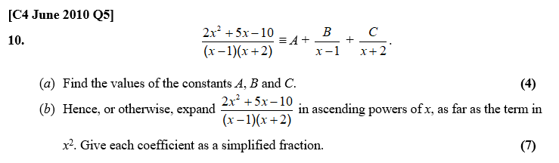
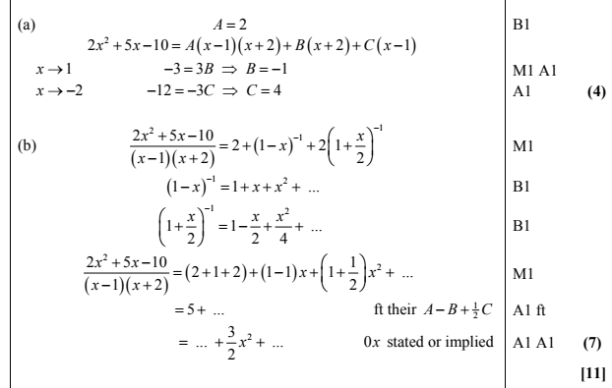
Test Your Understanding
? a
? b

Slide 12
Exercise 4C
Pearson Pure Mathematics Year 2/AS
Pages 102-103
Complete before the lesson Q1
In Class:
Green Q2-3
Amber Q4-5
Red Q6-7

