Slide 1
Volumes of
Revolution
Twitter: @Owen134866
www.mathsfreeresourcelibrary.com

Slide 2










Prior Knowledge Check
Evaluate:
a)
b)
c)
3) The region R is bounded by the curve $y={4x}^{2}+5$, the x-axis and the lines $x=2$ and $x=4$. The region is rotated through $2π$ radians about the x-axis. Find the volume of the object generated.
$$\int_{0}^{3}{x^{2}{\left({3x}^{3}−6\right)}^{2} dx}$$
$$15633$$
$$\int_{\frac{π}{6}}^{\frac{π}{2}}{\cos^{2}x dx}$$
$$\frac{π}{6}−\frac{\sqrt{3}}{8}$$
$$\frac{59566π}{15}$$
$$\int_{0}^{2}{x^{2}e^{−2x} dx}$$
$$\frac{1−13e^{−4}}{4}$$
2) Find the area of the region bounded by the curve $y=\frac{1}{2}\sec^{4}x$, the x-axis, the y-axis and the line $x=1$
$$1.41$$

Slide 3
Teachings for
Exercise 4A

Slide 4

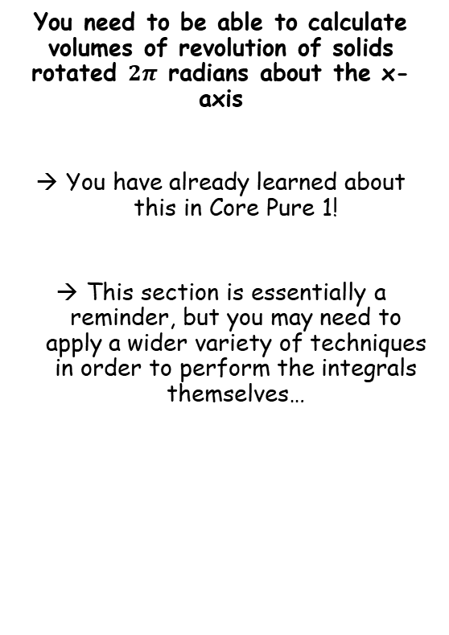
Volumes of Revolution
$$V=π\int_{a}^{b}{y^{2}} dx$$
You need to be able to calculate volumes of revolution of solids rotated $2π$ radians about the x-axis
You have already learned about this in Core Pure 1!
This section is essentially a reminder, but you may need to apply a wider variety of techniques in order to perform the integrals themselves…
4A

Slide 5





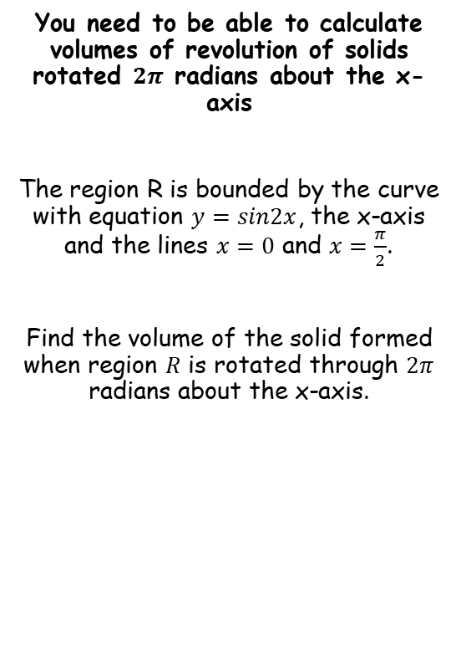









Volumes of Revolution
$$V=π\int_{a}^{b}{y^{2}} dx$$
You need to be able to calculate volumes of revolution of solids rotated $2π$ radians about the x-axis
The region R is bounded by the curve with equation $y=sin2x$, the x-axis and the lines $x=0$ and $x=\frac{π}{2}$.
Find the volume of the solid formed when region $R$ is rotated through $2π$ radians about the x-axis.
$$V=π\int_{a}^{b}{y^{2}} dx$$
Sub in the limits and the function. Remember the whole function needs to be squared!
$$=π\int_{0}^{\frac{π}{2}}{{\left(sin2x\right)}^{2}} dx$$
Square the bracket (there will often be more to do than this!)
$$=π\int_{0}^{\frac{π}{2}}{\sin^{2}2x} dx$$
If it cannot be integrated easily, find a way to change it using rules you know…
$$=π\int_{0}^{\frac{π}{2}}{\frac{1}{2}\left(1−cos4x\right)} dx$$
Take out $\frac{1}{2}$ from the integral
$$=\frac{1}{2}π\int_{0}^{\frac{π}{2}}{\left(1−cos4x\right)}dx$$
Integrate and use a square bracket
$$cos2x=1−2\sin^{2}x$$
$$=\frac{1}{2}π{\left[x−\frac{1}{4}sin4x\right]}_{0}^{\frac{π}{2}}$$
Add $2\sin^{2}x$, subtract $cos2x$
Sub in limits and subtract
$$2\sin^{2}x=1−cos2x$$
Divide by 2
$$=\frac{1}{2}π\left(\left(\left(\frac{π}{2}\right)−\frac{1}{4}sin4\left(\frac{π}{2}\right)\right)−\left(\left(0\right)−\frac{1}{4}sin4\left(0\right)\right)\right)$$
$$\sin^{2}x=\frac{1}{2}\left(1−cos2x\right)$$
Double the angles
Calculate
$$\sin^{2}2x=\frac{1}{2}\left(1−cos4x\right)$$
$$=\frac{π^{2}}{4}$$
4A

Slide 6
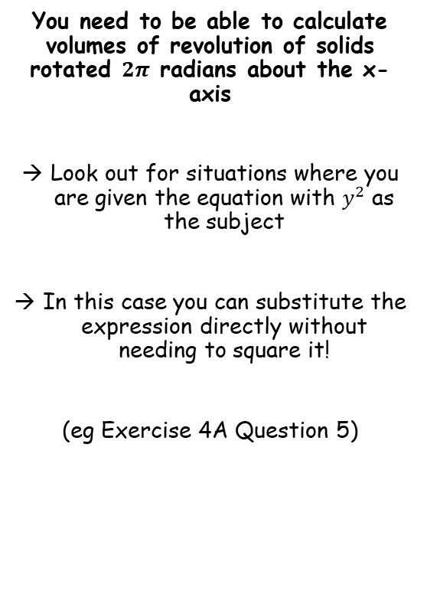
Volumes of Revolution
$$V=π\int_{a}^{b}{y^{2}} dx$$
You need to be able to calculate volumes of revolution of solids rotated $2π$ radians about the x-axis
Look out for situations where you are given the equation with $y^{2}$ as the subject
In this case you can substitute the expression directly without needing to square it!
(eg Exercise 4A Question 5)
4A

Slide 7
Exercise 4A
Pearson Core Pure Year 2
Pages 78-80
Complete before the lesson Q1
In Class:
Green Q2-5
Amber Q6
Red Q7-8 & Challenge

