Slide 1
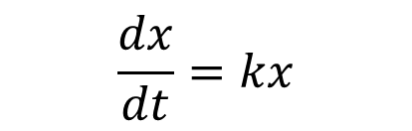
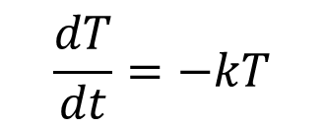
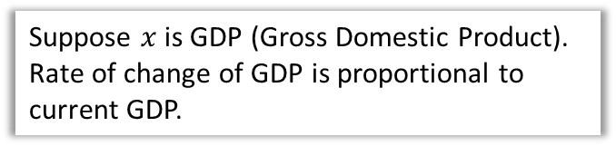
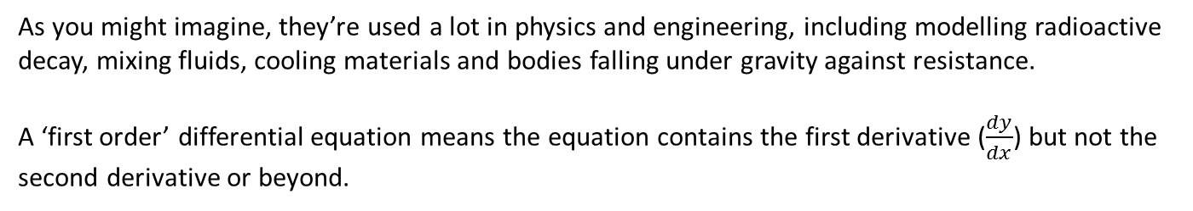
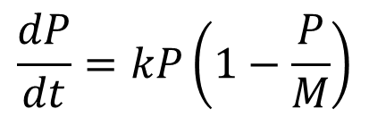
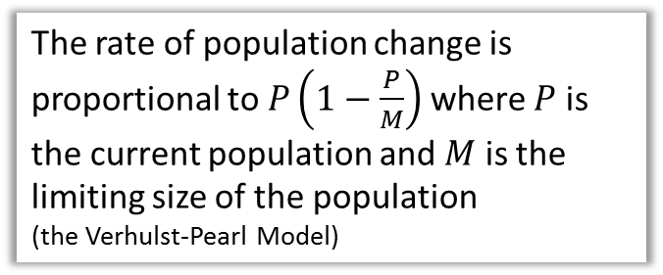
Intro
Differential equations are equations which relate $x$ and $y$ with derivatives. e.g.
The rate of temperature loss is proportional to the current temperature.
$$\frac{dT}{dt}=−kT$$
The rate of population change is proportional to $P\left(1−\frac{P}{M}\right)$ where $P$ is the current population and $M$ is the limiting size of the population
(the Verhulst-Pearl Model)
$$\frac{dP}{dt}=kP\left(1−\frac{P}{M}\right)$$
Suppose $x$ is GDP (Gross Domestic Product).
Rate of change of GDP is proportional to current GDP.
$$\frac{dx}{dt}=kx$$
As you might imagine, they’re used a lot in physics and engineering, including modelling radioactive decay, mixing fluids, cooling materials and bodies falling under gravity against resistance.
A ‘first order’ differential equation means the equation contains the first derivative ($\frac{dy}{dx}$) but not the second derivative or beyond.

Slide 2
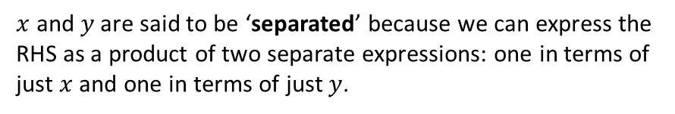
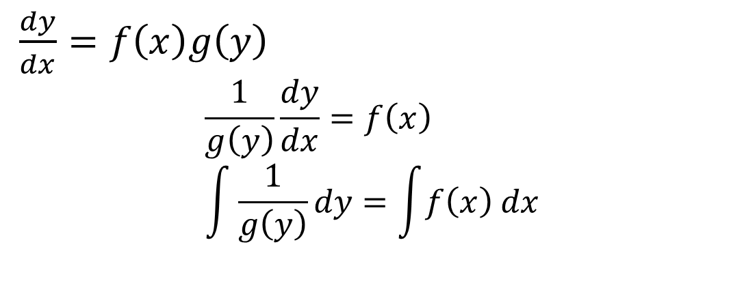
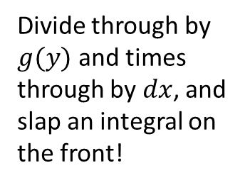
Pure Year 2 Recap
$x$ and $y$ are said to be ‘separated’ because we can express the RHS as a product of two separate expressions: one in terms of just $x$ and one in terms of just $y$.
$\frac{dy}{dx}=f\left(x\right)g\left(y\right)$
$$\frac{1}{g\left(y\right)}\frac{dy}{dx}=f\left(x\right) \\ \int{\frac{1}{g\left(y\right)}dy}=\int{f\left(x\right) dx}$$
Divide through by $g(y)$ and times through by $dx$, and slap an integral on the front!

Slide 3


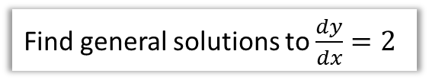


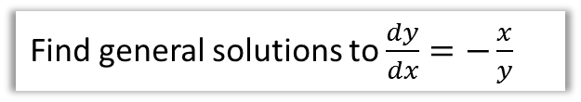
Examples
Find general solutions to $\frac{dy}{dx}=2$
Why is it called the general solution?
We have a ‘family’ of solutions as the constant of integration varies.
?
$$y=2x+C$$
?
Find general solutions to $\frac{dy}{dx}=−\frac{x}{y}$
?
$$y$$
$$\int{y dy}=\int{−x dx} \\ \frac{1}{2}y^{2}=−\frac{1}{2}x^{2}+C \\ x^{2}+y^{2}=2C$$
If we let $r^{2}=2C$, we get
$$x^{2}+y^{2}=r^{2}$$
So the ‘family of circles’ satisfies this differential equation.
$$x$$

Slide 4

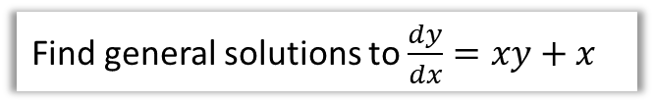

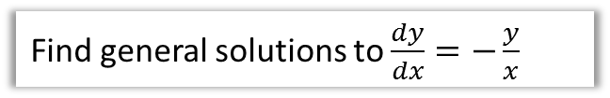
Examples
Find general solutions to $\frac{dy}{dx}=xy+x$
Find general solutions to $\frac{dy}{dx}=−\frac{y}{x}$
?
?
Known as ‘separating the variables’.
$$\frac{dy}{dx}=x\left(y+1\right) \\ \int{\frac{1}{y+1}dy}=\int{x dx} \\ \ln\left|y+1\right|=\frac{1}{2}x^{2}+C \\ y+1=e^{\frac{1}{2}x^{2}+C}=e^{\frac{1}{2}x^{2}}e^{C} \\ =Ae^{\frac{1}{2}x^{2}}$$
where $A=e^{C}$
$$\int{\frac{1}{y}dy}=\int{−\frac{1}{x}dx} \\ \ln{|y|}=−\ln\left|x\right|+C \\ \ln\left|x\right|+\ln{|y|}=C \\ \ln\left|xy\right|=C \\ |xy|=e^{C}=A \\ y=±\frac{A}{x}$$
(a family of “rectangular hyperbolae” [see FP1])

Slide 5
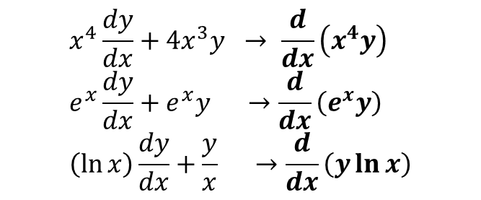
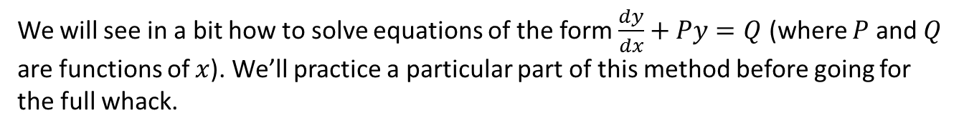
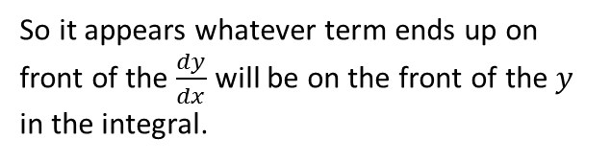
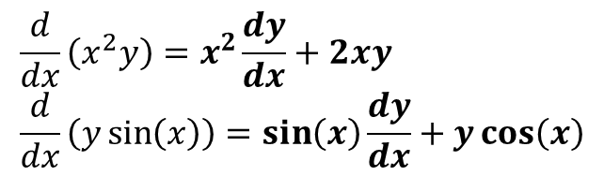
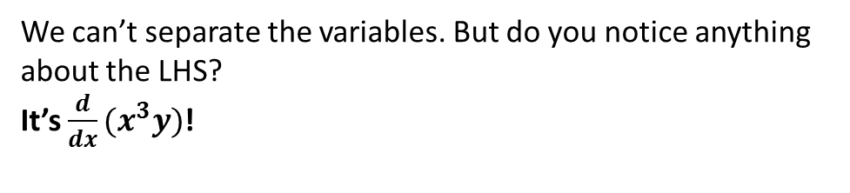
Using reverse product rule
We will see in a bit how to solve equations of the form $\frac{dy}{dx}+Py=Q$ (where $P$ and $Q$ are functions of $x$). We’ll practice a particular part of this method before going for the full whack.
Find general solutions of the equation $x^{3}\frac{dy}{dx}+3x^{2}y=\sin{x}$
We can’t separate the variables. But do you notice anything about the LHS?
It’s $\frac{d}{dx}(x^{3}y)$!
?
Quickfire Questions:
?
$$\frac{d}{dx}\left(x^{2}y\right)=x^{2}\frac{dy}{dx}+2xy \\ \frac{d}{dx}\left(y\sin\left(x\right)\right)=\sin\left(x\right)\frac{dy}{dx}+y\cos\left(x\right)$$
$$x^{4}\frac{dy}{dx}+4x^{3}y → \frac{d}{dx}\left(x^{4}y\right) \\ e^{x}\frac{dy}{dx}+e^{x}y →\frac{d}{dx}\left(e^{x}y\right) \\ \left(\ln{x}\right)\frac{dy}{dx}+\frac{y}{x} →\frac{d}{dx}\left(y\ln{x}\right)$$
?
?
?
?
So it appears whatever term ends up on front of the $\frac{dy}{dx}$ will be on the front of the $y$ in the integral.

Slide 6



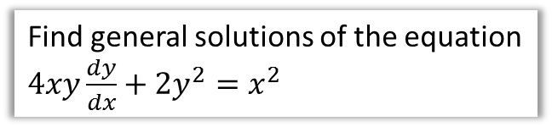
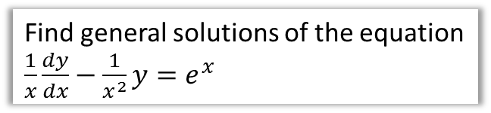
Using reverse product rule
Find general solutions of the equation $x^{3}\frac{dy}{dx}+3x^{2}y=\sin{x}$
?
$$\frac{d}{dx}\left(x^{3}y\right)=\sin{x} \\ x^{3}y=\int{\sin{x}} dx=−\cos{x}+C \\ y=\frac{C−\cos{x}}{x^{3}}$$
Test Your Understanding
Find general solutions of the equation $\frac{1}{x}\frac{dy}{dx}−\frac{1}{x^{2}}y=e^{x}$
Find general solutions of the equation $4xy\frac{dy}{dx}+2y^{2}=x^{2}$
?
?
$$\frac{d}{dx}\left(\frac{y}{x}\right)=e^{x} \\ \frac{y}{x}=e^{x}+C \\ y=x(e^{x}+C)$$
$$\frac{d}{dx}\left(2xy^{2}\right)=x^{2} \\ 2xy^{2}=\frac{1}{3}x^{3}+C \\ …$$

Slide 7

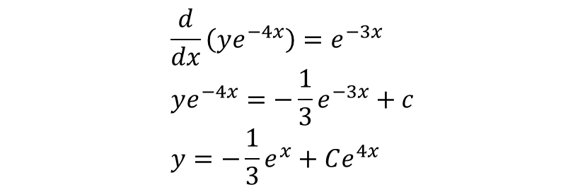


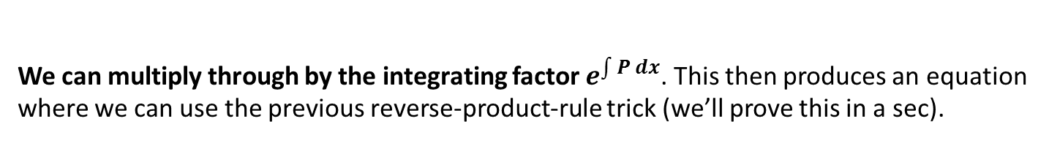
$dy/dx$ $+ Py=Q$
But what if we can’t use the product rule backwards?
Find the general solution of $\frac{dy}{dx}−4y=e^{x}$
We can multiply through by the integrating factor $e^{\int{P} dx}$. This then produces an equation where we can use the previous reverse-product-rule trick (we’ll prove this in a sec).
?
$$I.F.=e^{\int{−4 dx}}=e^{−4x}$$
Then multiplying through by the integrating factor:
?
$$e^{−4x}\frac{dy}{dx}−4e^{−4x}y=e^{−3x}$$
Then we can solve in the usual way:
$$\frac{d}{dx}\left(ye^{−4x}\right)=e^{−3x} \\ ye^{−4x}=−\frac{1}{3}e^{−3x}+c \\ y=−\frac{1}{3}e^{x}+Ce^{4x}$$
?

Slide 8
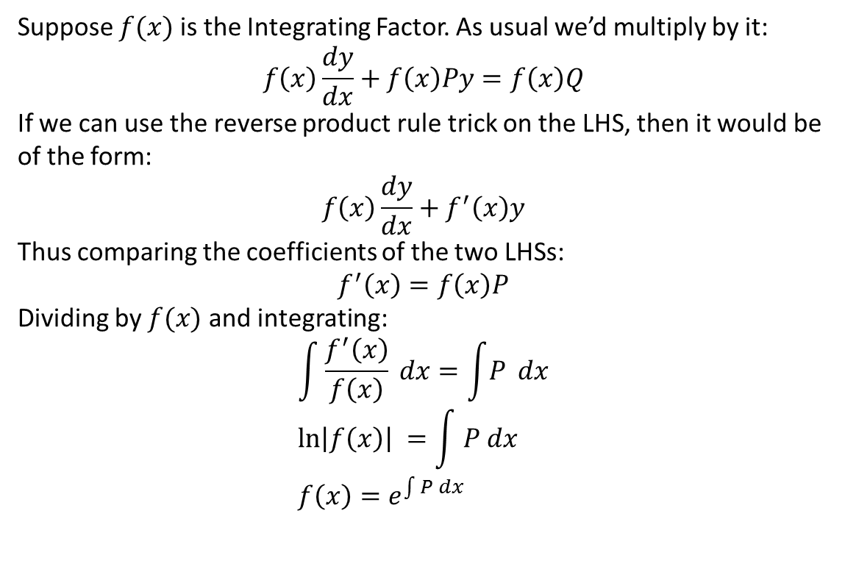
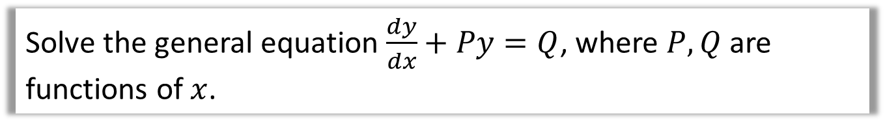
Proof that Integrating Factor works
Solve the general equation $\frac{dy}{dx}+Py=Q$, where $P, Q$ are functions of $x$.
Suppose $f(x)$ is the Integrating Factor. As usual we’d multiply by it:
$$f\left(x\right)\frac{dy}{dx}+f\left(x\right)Py=f\left(x\right)Q$$
If we can use the reverse product rule trick on the LHS, then it would be of the form:
$$f\left(x\right)\frac{dy}{dx}+f^{′}\left(x\right)y$$
Thus comparing the coefficients of the two LHSs:
$$f^{′}\left(x\right)=f\left(x\right)P$$
Dividing by $f(x)$ and integrating:
$$\int{\frac{f^{′}\left(x\right)}{f\left(x\right)} dx}=\int{P} dx \\ \ln\left|f\left(x\right)\right| =\int{ P dx} \\ f\left(x\right)=e^{\int{P} dx}$$
?
?
?

Slide 9


When there’s something on front of the $dy/dx$
Find the general solution of $\cos{x}\frac{dy}{dx}+2y\sin{x}=\cos^{4}{x}$
What shall we do first so that we have an equation like before?
?
$$\frac{dy}{dx}+2y\tan{x}=\cos^{3}{x} \\ IF=e^{\int{2tan{x} dx}}=e^{2\ln{\sec{x}}}=e^{\ln{\sec^{2}{x}}}=\sec^{2}{x} \\ \sec^{2}{x}\frac{dy}{dx}+2y\sec^{2}{x}\tan{x}=\cos{x} \\ \frac{d}{dx}\left(y\sec^{2}{x}\right)=\cos{x} \\ y\sec^{2}{x}=\sin{x}+c \\ y=\cos{x}\left(\sin{x}+c\right)$$
STEP 1: Divide by anything on front of $dy/dx$
?
STEP 2: Determine IF
?
You could skip to here provided you don’t forget to multiply the RHS by the IF.
STEP 3: Multiply through by IF and use product rule backwards.
?
STEP 4: Integrate and simplify.

Slide 10
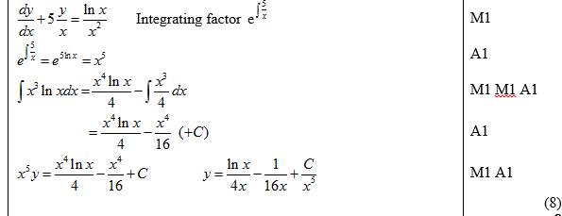
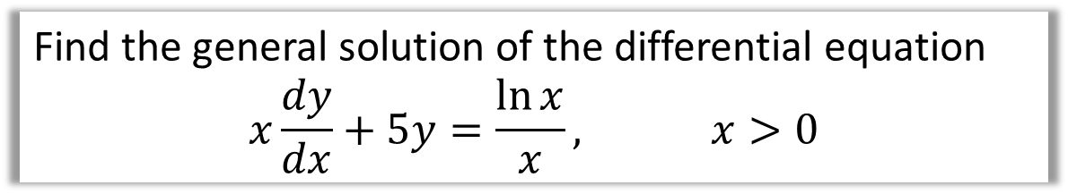
Test Your Understanding
Edexcel FP2(Old) June 2011 Q3
Find the general solution of the differential equation
$$x\frac{dy}{dx}+5y=\frac{\ln{x}}{x}, x>0$$
?

Slide 11
Exercise 7A
Pearson Core Pure Year 2
Pages 151-153
Complete before the lesson Q1
In Class:
Green Q2-7
Amber Q8-12
Red Q13-16

Slide 12
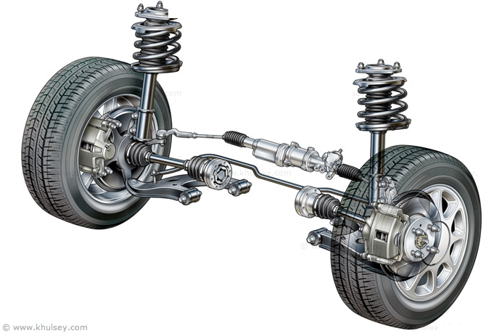
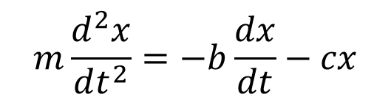
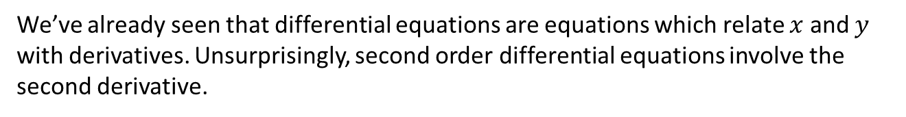

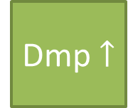

Second Order Differential Equation Intro
We’ve already seen that differential equations are equations which relate $x$ and $y$ with derivatives. Unsurprisingly, second order differential equations involve the second derivative.
Shock absorbers as part of suspension of car subject to force down of car acting under acceleration, and forces up: damping force (proportional to velocity) and restoring force (proportional to extension of spring)
Acc $↓$
Dmp $↑$
Rst $↑$
$$m\frac{d^{2}x}{dt^{2}}=−b\frac{dx}{dt}−cx$$

Slide 13
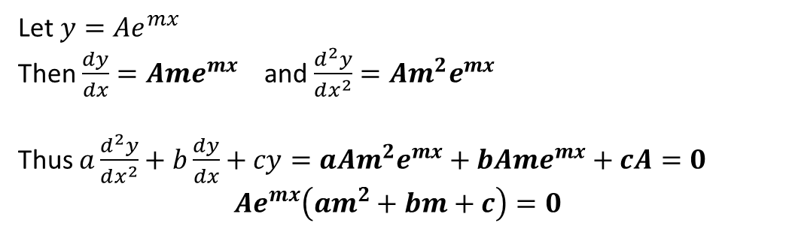
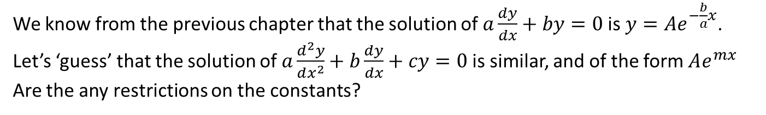
Simple second order differential equations
We know from the previous chapter that the solution of $a\frac{dy}{dx}+by=0$ is $y=Ae^{−\frac{b}{a}x}$.
Let’s ‘guess’ that the solution of $a\frac{d^{2}y}{dx^{2}}+b\frac{dy}{dx}+cy=0$ is similar, and of the form $Ae^{mx}$
Are the any restrictions on the constants?
Let $y=Ae^{mx}$
Then $\frac{dy}{dx}=Ame^{mx}$ and $\frac{d^{2}y}{dx^{2}}=Am^{2}e^{mx}$
Thus $a\frac{d^{2}y}{dx^{2}}+b\frac{dy}{dx}+cy=aAm^{2}e^{mx}+bAme^{mx}+cA=0$
$${Ae}^{mx}\left(am^{2}+bm+c\right)=0$$
?
?
?
?
?
Since $Ae^{mx}>0$ thus $am^{2}+bm+c=0$
This is known as an auxiliary equation.
An auxiliary equation is (by definition) is an equation on which the solutions of a differential equation depend.

Slide 14

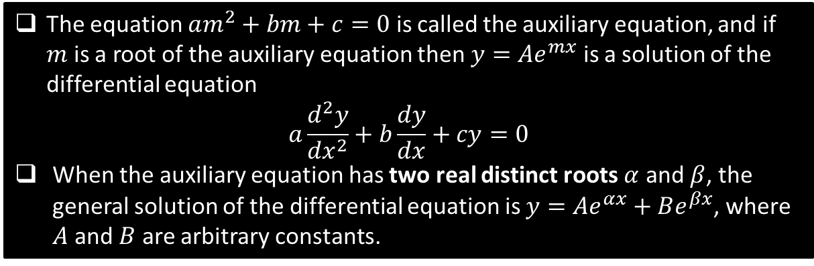
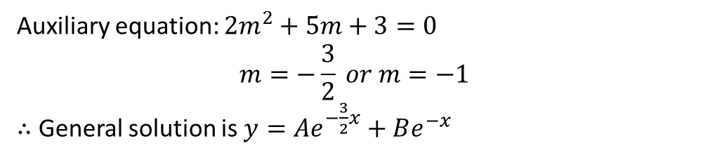
Simple second order differential equations
The equation $am^{2}+bm+c=0$ is called the auxiliary equation, and if $m$ is a root of the auxiliary equation then $y=Ae^{mx}$ is a solution of the differential equation
$$a\frac{d^{2}y}{dx^{2}}+b\frac{dy}{dx}+cy=0$$
When the auxiliary equation has two real distinct roots $α$ and $β$, the general solution of the differential equation is $y=Ae^{αx}+Be^{βx}$, where $A$ and $B$ are arbitrary constants.
Find the general solution of the equation $2\frac{d^{2}y}{dx^{2}}+5\frac{dy}{dx}+3y=0$
?
Auxiliary equation: $2m^{2}+5m+3=0$
$$m=−\frac{3}{2} or m=−1$$
$∴$ General solution is $y=Ae^{−\frac{3}{2}x}+Be^{−x}$
This is known as a homogeneous second-order differential equation because the RHS is 0. We will encountered nonhomogeneous equations later in the chapter.

Slide 15
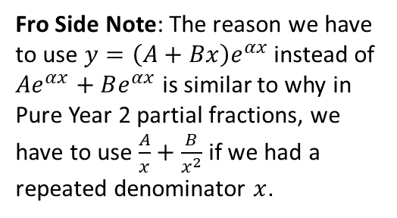
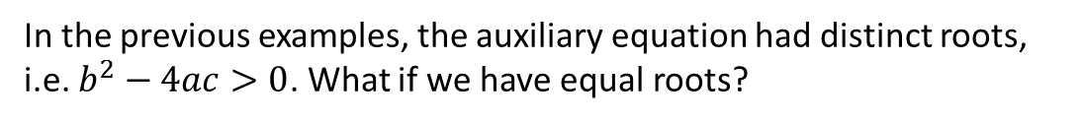

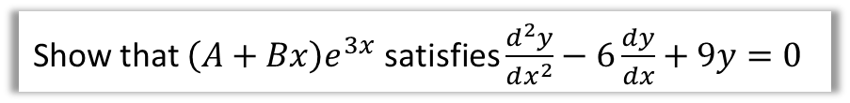
Variants: $b^{2}−4ac=0$
In the previous examples, the auxiliary equation had distinct roots, i.e. $b^{2}−4ac>0$. What if we have equal roots?
When the auxiliary equation has two equal roots $α$, the general solution is
$y=\left(A+Bx\right)e^{αx}$
This is because the root of the auxiliary equation $m^{2}−6m+9=0$ is 3.
Show that $\left(A+Bx\right)e^{3x}$ satisfies $\frac{d^{2}y}{dx^{2}}−6\frac{dy}{dx}+9y=0$
?
$$y=\left(A+Bx\right)e^{3x}=A+Bxe^{3x} \\ \frac{dy}{dx}=3Ae^{3x}+3Bxe^{3x}+Be^{3x} \\ \frac{d^{2}y}{dx^{2}}=9Ae^{3x}+9Bxe^{3x}+6Be^{3x} \\ ∴\frac{d^{2}y}{dx^{2}}−6\frac{dy}{dx}+9y=9Ae^{3x}+…=0$$
Fro Side Note: The reason we have to use $y=\left(A+Bx\right)e^{αx}$ instead of $Ae^{αx}+Be^{αx}$ is similar to why in Pure Year 2 partial fractions, we have to use $\frac{A}{x}+\frac{B}{x^{2}}$ if we had a repeated denominator $x$.

Slide 16
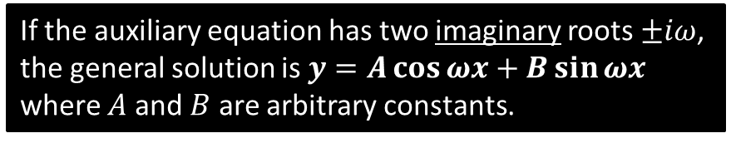

Variants: $b^{2}−4ac<0$
This is actually exactly the same as when we usually have distinct real roots!
Find the general solution of the differential equation $\frac{d^{2}y}{dx^{2}}+16y=0$
?
Auxiliary equation: $m^{2}+16=0$
$$m=±4i$$
$∴$ General solution is $y=Ae^{4ix}+Be^{−4ix}$
This can be rewritten as (using Chapter 1 knowledge):
$$y=A\left(\cos{4x}+i\sin{4x}\right)+B\left(\cos{4x}−i\sin{4x}\right) \\ =P\cos{4x}+Q\sin{4x} (where P=A+B, Q=i\left(A−B\right))$$
?
?
If the auxiliary equation has two imaginary roots $±iω$, the general solution is $y=A\cos{ωx}+B\sin{ωx}$ where $A$ and $B$ are arbitrary constants.

Slide 17
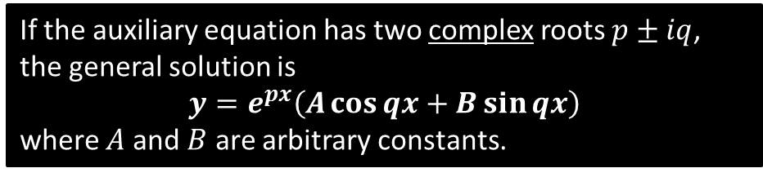
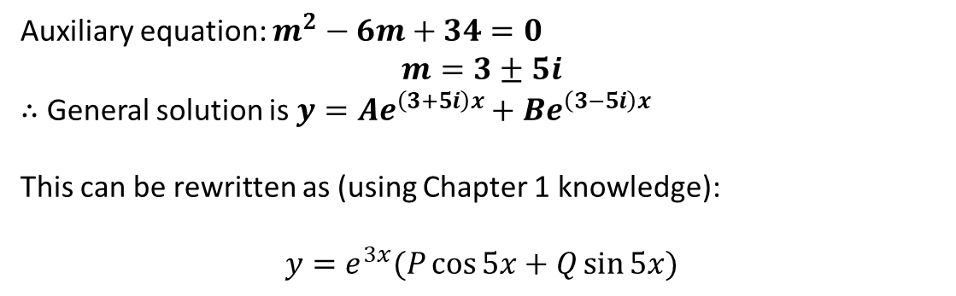
Variants: $b^{2}−4ac<0$
So what about more general complex roots $a±bi$?
Find the general solution of the differential equation $\frac{d^{2}y}{dx^{2}}−6\frac{dy}{dx}+34y=0$
?
Auxiliary equation: $m^{2}−6m+34=0$
$$m=3±5i$$
$∴$ General solution is $y=Ae^{\left(3+5i\right)x}+Be^{\left(3−5i\right)x}$
This can be rewritten as (using Chapter 1 knowledge):
$$y=e^{3x}(P\cos{5x}+Q\sin{5x})$$
?
?
?
If the auxiliary equation has two complex roots $p±iq$, the general solution is
$$y=e^{px}\left(A\cos{qx}+B\sin{qx}\right)$$
where $A$ and $B$ are arbitrary constants.

Slide 18
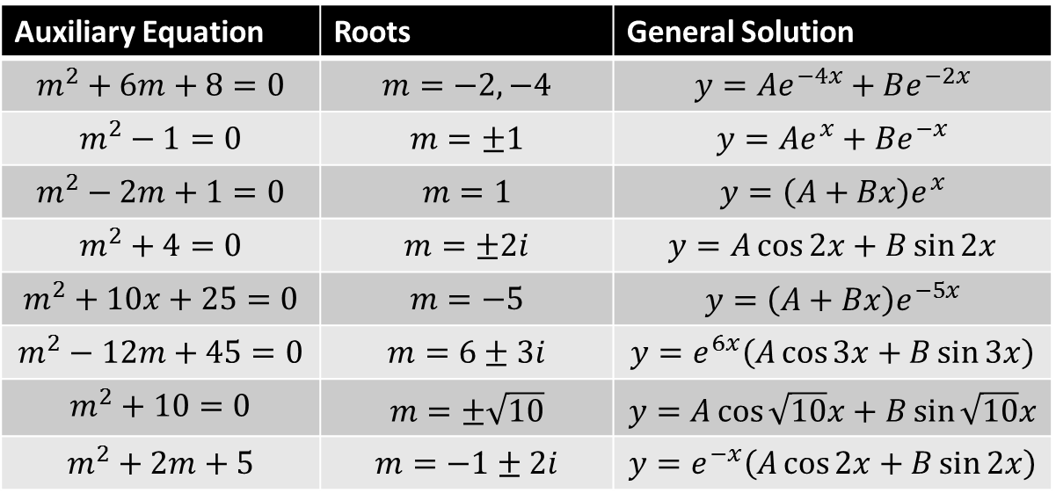

Quickfire Questions!
Find solutions to differential equations of the form $a\frac{d^{2}y}{dx^{2}}+b\frac{dy}{dx}+cy=0$ with the following auxiliary equations (and helpfully provided roots).
Auxiliary Equation | Roots | General Solution
$$m^{2}+6m+8=0$$ | $$m=−2, −4$$ | $$y=Ae^{−4x}+Be^{−2x}$$
$$m^{2}−1=0$$ | $$m=±1$$ | $$y=Ae^{x}+Be^{−x}$$
$$m^{2}−2m+1=0$$ | $$m=1$$ | $$y=\left(A+Bx\right)e^{x}$$
$$m^{2}+4=0$$ | $$m=±2i$$ | $$y=A\cos{2x}+B\sin{2x}$$
$$m^{2}+10x+25=0$$ | $$m=−5$$ | $$y=\left(A+Bx\right)e^{−5x}$$
$$m^{2}−12m+45=0$$ | $$m=6±3i$$ | $$y=e^{6x}\left(A\cos{3x}+B\sin{3x}\right)$$
$$m^{2}+10=0$$ | $$m=±\sqrt{10}$$ | $$y=A\cos{\sqrt{10}x}+B\sin{\sqrt{10}x}$$
$$m^{2}+2m+5$$ | $$m=−1±2i$$ | $$y=e^{−x}\left(A\cos{2x}+B\sin{2x}\right)$$
?
?
?
?
?
?
?
?

Slide 19
Exercise 7B
Pearson Core Pure Year 2
Pages 156-157
Complete before the lesson Q1
In Class:
Green Q2-4
Amber Q5-7
Red Challenge

Slide 20




Particular Integrals
So far we’ve always had 0 in the RHS of the differential equation.
What if we have some function in terms of $x$?
$$a\frac{d^{2}y}{dx^{2}}+b\frac{dy}{dx}+cy=f(x)$$
When the RHS is not 0, we have a non-homogeneous second order differential equation.
Solve $a\frac{d^{2}y}{dx^{2}}+b\frac{dy}{dx}+cy=0$ first to obtain what is known as the complementary function. (C.F.)
Then solve $a\frac{d^{2}y}{dx^{2}}+b\frac{dy}{dx}+cy=f(x)$ which can be found using appropriate substitution and comparing coefficients. Solution known as particular integral. (P.I.)
$$y=C.F. +P.I.$$
This is because $a\frac{d^{2}y}{dx^{2}}+b\frac{dy}{dx}+cy$ for the C.F. is 0 and $f(x)$ for the P.I., which sum to $f(x)$

Slide 21


Examples
Find the particular integral of the differential equation $\frac{d^{2}y}{dx^{2}}−5\frac{dy}{dx}+6y=3$
If $f(x)$ is a constant, let the particular integral be a constant too.
$$y=λ → \frac{dy}{dx}=0, \frac{d^{2}y}{dx^{2}}=0$$
Substituting in to differential equation:
$$0−5\left(0\right)+6λ=3 \\ λ=\frac{1}{2}$$
?
?
?
Hence find the general solution of the differential equation $\frac{d^{2}y}{dx^{2}}−5\frac{dy}{dx}+6y=3$
?
Find complementary function:
$$\frac{d^{2}y}{dx^{2}}−5\frac{dy}{dx}+6y=0$$
Auxiliary equation: $m^{2}−5m+6=0$
Roots of aux eq: $m=2,3$
C.F. $y=Ae^{2x}+Be^{3x}$
General solution: $y=Ae^{2x}+Be^{3x}+\frac{1}{2}$

Slide 22

Examples
Find the general solution of the differential equation $\frac{d^{2}y}{dx^{2}}−5\frac{dy}{dx}+6y=2x$
$f(x)$ is a linear function, so makes sense to try a linear function for the particular integral.
$$y=λx+μ → \frac{dy}{dx}=λ, \frac{d^{2}y}{dx^{2}}=0$$
Substituting in:
$$\left(6μ−5λ\right)+6λx=2x$$
Comparing coefficients:
$$6μ−5λ=0 \\ 6λ=2 \\ λ=\frac{1}{3}, μ=\frac{5}{18}$$
General solution:
$$y=Ae^{2x}+Be^{3x}+\frac{1}{3}x+\frac{5}{18}$$
?
?
?
?
?
?

Slide 23

Examples
Find the general solution of the differential equation $\frac{d^{2}y}{dx^{2}}−5\frac{dy}{dx}+6y=3x^{2}$
$f(x)$ is a quadratic function, so makes sense to try a quadratic function for the particular integral!
$$y=λx^{2}+μx+ν → \frac{dy}{dx}=2λx+μ, \frac{d^{2}y}{dx^{2}}=2λ$$
…
General solution:
$$y=Ae^{2x}+Be^{3x}+\frac{1}{2}x^{2}+\frac{5}{6}x+\frac{19}{36}$$
?
?
?
?

Slide 24


Examples
Find the general solution of the differential equation $\frac{d^{2}y}{dx^{2}}−5\frac{dy}{dx}+6y=e^{x}$
?
?
?
$$y=λe^{x} → \frac{dy}{dx}=λe^{x}, \frac{d^{2}y}{dx^{2}}=λe^{x}$$
…
General solution:
$$y=Ae^{2x}+Be^{3x}+\frac{1}{2}e^{x}$$
?
Find the general solution of the differential equation $\frac{d^{2}y}{dx^{2}}−5\frac{dy}{dx}+6y=13 sin 3x$
?
$$y=λ\sin{3x}+μ\cos{3x} → \frac{dy}{dx}=3λ\cos{3x}−3μ\sin{3x}, \frac{d^{2}y}{dx^{2}}=−9λ\sin{3x}−9μ\cos{3x}$$
…
General solution:
$$y=Ae^{2x}+Be^{3x}−\frac{1}{6} sin 3x+\frac{5}{6} cos 3x$$
?
?
?

Slide 25


Examples
But be warned!!!
Your particular integral can’t be part of your complementary function. This is just like how we weren’t allowed to use $Ae^{αx}+Be^{βx}$ for the complementary function if the two roots of the auxiliary equation were equal.
Find the general solution of the differential equation $\frac{d^{2}y}{dx^{2}}−5\frac{dy}{dx}+6y=e^{2x}$
The difference to when we had $=e^{x}$ is that now the $e^{2x}$ matches the $e^{2x}$ term in the complementary function.
Suppose we did use $y=λe^{2x}$ for the particular integral. What goes wrong?
Then the general solution might appear to be $y=Ae^{2x}+Be^{3x}+λe^{2x}$
$$=\left(A+λ\right)e^{2x}+Be^{2x}$$
But $A+λ$ is still just an arbitrary constant, so we have exactly the same as the complementary function, which we know gives 0 when subbed into $\frac{d^{2}y}{dx^{2}}−5\frac{dy}{dx}+6y$. Thus we end up with $0=e^{2x}$. Oh dear!
So let $y=λxe^{2x}$
This ends up giving $λ=−1$
So general solution: $y=Ae^{2x}+Be^{3x}−xe^{2x}$
?
?
?
?

Slide 26


Examples
But be warned!!!
Your particular integral can’t be part of your complementary function. This is just like how we weren’t allowed to use $Ae^{αx}+Be^{βx}$ for the complementary function if the two roots of the auxiliary equation were equal.
Find the general solution of the differential equation $\frac{d^{2}y}{dx^{2}}−2\frac{dy}{dx}=3$
Auxiliary equation: $m^{2}−2m=0$
$$m=0 or 2$$
Complementary function: $y=Ae^{0x}+Be^{2x}=A+Be^{2x}$
So particular integral? We know we can’t use $y=λ$ as CF contains a constant term.
Instead use $y=λx$
General solution: $y=A+Be^{2x}−\frac{3}{2}x$
?
?
?
?
So it seems we add a “cheeky little $x$” to the front of the Particular Integral in any case where the particular integral is part of the complementary function.

Slide 27

Summary So Far
Form of $f(x)$ | Form of particular integral
$$k$$ | $$λ$$
$$ax+b$$ | $$λ+μx$$
$$ax^{2}+bx+c$$ | $$λ+μx+νx^{2}$$
$$ke^{px}$$ | $$λe^{px}$$
$$m\cos{ωx}$$ | $$λ\cos{ωx}+μ\sin{ωx}$$
$$m\sin{ωx}$$ | $$λ\cos{ωx}+μ\sin{ωx}$$
$$m\cos{ωx}+n\sin{ωx}$$ | $$λ\cos{ωx}+μ\sin{ωx}$$
(But need to modify if term is same as one of the terms in the complementary function. You will probably be given this in an exam if the case)

Slide 28



Test Your Understanding
It’s that cheeky little $x$.
June 2010 Q8
Find the value of $λ$ for which $y=λx\sin{5x}$ is a particular integral of the differential equation (4 marks)
$\frac{d^{2}y}{dx^{2}}+25y=3\cos{5x}$
Using your answer to part (a), find the general solution of the differential equation (3 marks)
$\frac{d^{2}y}{dx^{2}}+25y=3\cos{5x}$
?
?

Slide 29



Test Your Understanding
Be warned: $x$ is being used here as $y$ was previous used.
June 2012 Q4
Find the general solution of the differential equation
$$\frac{d^{2}x}{dt^{2}}+5\frac{dx}{dt}+6x=2\cos{t}−\sin{t}$$
?

Slide 30
Exercise 7C
Pearson Core Pure Year 2
Pages 161-162
Complete before the lesson Q1
In Class:
Green Q2
Amber Q3-4
Red Q5-6 & Challenge

Slide 31

Boundary Conditions
Sometimes you’re given certain conditions, which allows us to find constants (just as we could with first order differential equations).
Find $y$ in terms of $x$, given that $\frac{d^{2}y}{dx^{2}}−y=2e^{x}$, and that $\frac{dy}{dx}=0$ and $y=0$ at $x=0$.
?
General solution: $y=Ae^{x}+Be^{−x}+xe^{x}$
Now substituting in boundary conditions into solution:
$$0=Ae^{0}+Be^{0}+0 → A+B=0$$
We want to use $\frac{dy}{dx}$, so let’s differentiate general solution:
$$\frac{dy}{dx}=Ae^{x}−Be^{−x}+xe^{x}+e^{x}$$
Substituting in again:
$$0=A−B+1 \\ → A−B=−1$$
Solving simultaneously:
$$A=−\frac{1}{2}, B=\frac{1}{2}$$
Therefore solution is $y=−\frac{1}{2}e^{x}+\frac{1}{2}e^{−x}+xe^{x}$
?
?
?
?
?

Slide 32


Test Your Understanding
June 2010 Q8 (revisited!)
$$\frac{d^{2}y}{dx^{2}}+25y=3\cos{5x}$$
(c) Given that at $x=0, y=0$ and $\frac{dy}{dx}=5$, find the particular solution to this differential equation, giving your solution in the form $y=f(x)$ (5)
(d) Sketch the curve with equation $y=f(x)$ for $0≤x≤π$ (2)
You previously found the general solution in (b) as $y=A\cos{5x}+B\sin{5x}+\frac{3}{10}x\sin{5x}$
?
?

Slide 33
Exercise 7D
Pearson Core Pure Year 2
Pages 164-165
Complete before the lesson Q1
In Class:
Green Q2-5
Amber Q6-9
Red Q10-13

