Slide 1
Year 1 Pure Mathematics
Trigonometric Identities
and Equations
- Quadratics
Chapter 10
(Part 4 of 4)

Slide 2
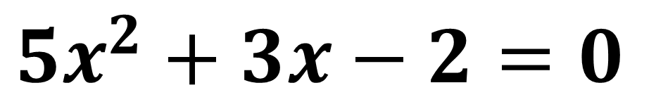
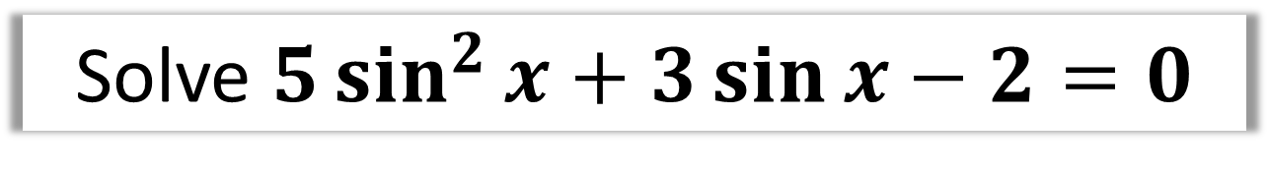
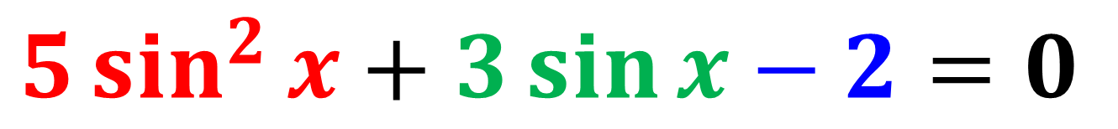
Trigonometric Equations
Solve $5\sin^{2}{x}+3\sin{x}−2=0$
What does the above equation remind you of?
A Quadratic Equation!
$$5\sin^{2}{x}+3\sin{x}−2=0$$
$$5x^{2}+3x−2=0$$

Slide 3
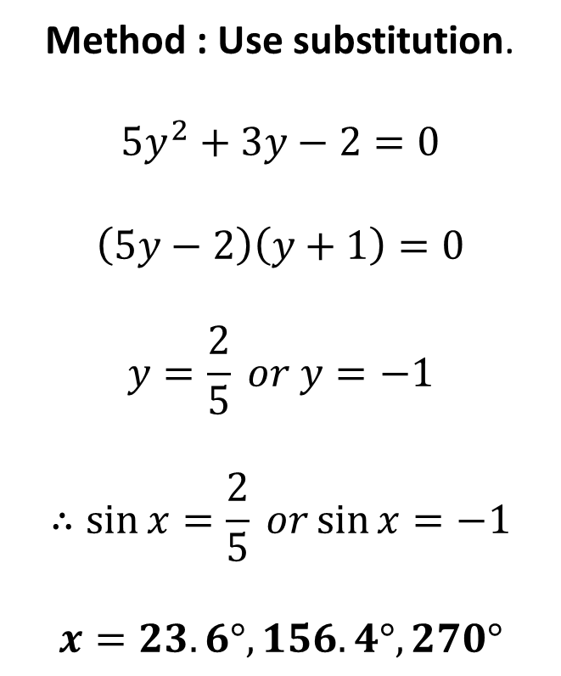
Quadratic Trigonometric Equations
Solve $5\sin^{2}{x}+3\sin{x}−2=0$ in the interval $0≤x≤360°$
Method : Use substitution.
$$5y^{2}+3y−2=0$$
$$\left(5y−2\right)\left(y+1\right)=0$$
$$y=\frac{2}{5} or y=−1$$
$$∴\sin{x}=\frac{2}{5} or\sin{x}=−1$$
$$x=23.6°, 156.4°,270°$$

Slide 4

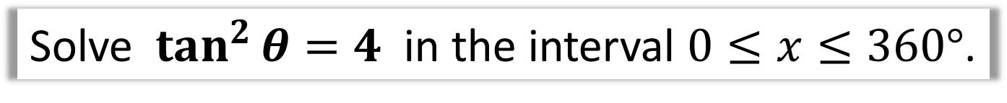

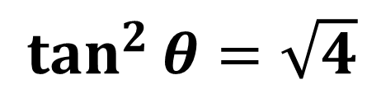
Quadratic Trigonometric Equations
Solve $\tan^{2}{θ}=4$ in the interval $0≤x≤360°$.
$\tan^{2}{θ}=\sqrt{4}$
$$\tan{θ}=2$$
$$\tan{θ}=−2$$
$$θ=63.4°, 243.4°$$
$$θ=−63.4°, 116.6°,296.6°$$
$$θ=63.4°, 116.6°, 243.4°,296.6°$$

Slide 5


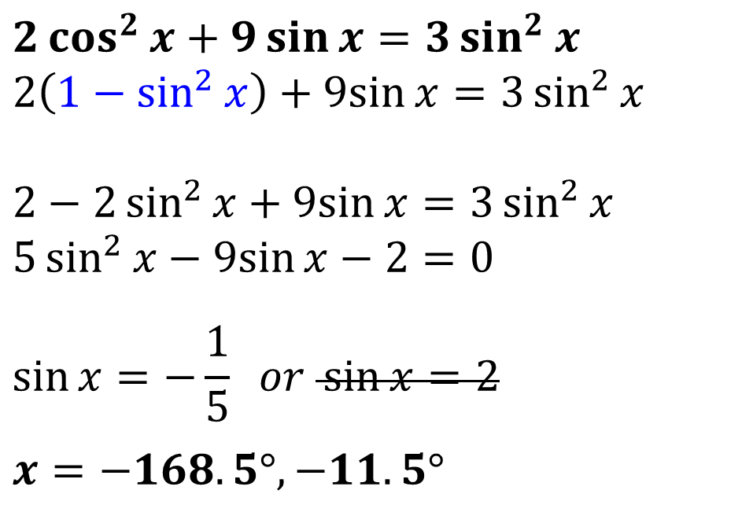
Quadratic Trigonometric Equations
Solve $2\cos^{2}{x}+9\sin{x}=3\sin^{2}{x}$
in the interval $−180°≤x≤180°$.
Tip: Replace $\cos^{2}{x}$
$$2\cos^{2}{x}+9\sin{x}=3\sin^{2}{x}$$
$$2\left(1−\sin^{2}{x}\right)+9sin{x}=3\sin^{2}{x}$$
$$2−2\sin^{2}{x}+9sin{x}=3\sin^{2}{x} \\ 5\sin^{2}{x}−9sin{x}−2=0$$
$$\sin{x}=−\frac{1}{5} or \sin{x}=2$$
$$x=−168.5°, −11.5°$$

Slide 6
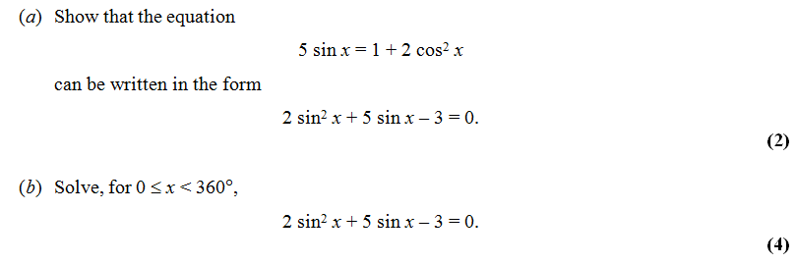
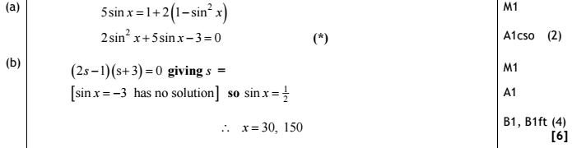
Harder Trigonometric Equations

Slide 7


Exercise 10F
Complete before the lesson Q1
Green Q2-3
Amber Q4-5
Red Q6-9 & Challenge
Pearson Pure Mathematics
Page 221-222
Extension
1
[MAT 2010 1C] In the range $0≤x<360°$, the equation
$$\sin^{2}{x}+3\sin{x}\cos{x}+2\cos^{2}{x}=0$$
Has how many solutions?
There are multiple ways to do this, including factorising LHS to
$(\sin{x}+\cos{x})(\sin{x}+2\cos{x})$, but dividing by $\cos^{2}{x}$ gives:
$$\tan^{2}{x}+3\tan{x}+2=0 \\ \left(\tan{x}+1\right)\left(\tan{x}+2\right)=0 \\ \tan{x}=−1 or\tan{x}=−2$$
tan always gives a pair of solutions per $360°$, so there are 4 solutions.
2
[MAT 2014 1E] As $x$ varies over the real numbers, the largest value taken by the function
${\left(4\sin^{2}{x}+4\cos{x}+1\right)}^{2}$ equals what?
$${\left(4−4\cos^{2}{x}+4\cos{x}+1\right)}^{2} \\ ={\left(−4\cos^{2}{x}+4\cos{x}+5\right)}^{2} \\ ={\left(6−{\left(1−2\cos{x}\right)}^{2}\right)}^{2}$$
We can make $\cos{x}=\frac{1}{2}$, thus giving a maximum value of $6^{2}=36$.
?
?

