Slide 1










Momentum and Impulse
$$Momentum=mv$$
$$m_{1}u_{1}+m_{2}u_{2}=m_{1}v_{1}+m_{2}v_{2}$$
$$Impulse=mv−mu$$
$$Impulse=Ft$$
You can apply the principles you have learnt when the variables are given as vectors (A2 level only)
A particle of mass 0.2kg is moving with velocity $\left(10i−5j\right) ms^{−1}$ when it receives an impulse $\left(3i−2j\right) Ns$. Find the new velocity of the particle.
$$Impulse=mv−mu$$
Sub in values
$$3i−2j=0.2v−0.2\left(10i−5j\right)$$
Expand the bracket
$$3i−2j=0.2v−2i+j$$
Add 2i, subtract j
$$5i−3j=0.2v$$
Multiply by 5
$$25i−15j=v$$
1C

Slide 2






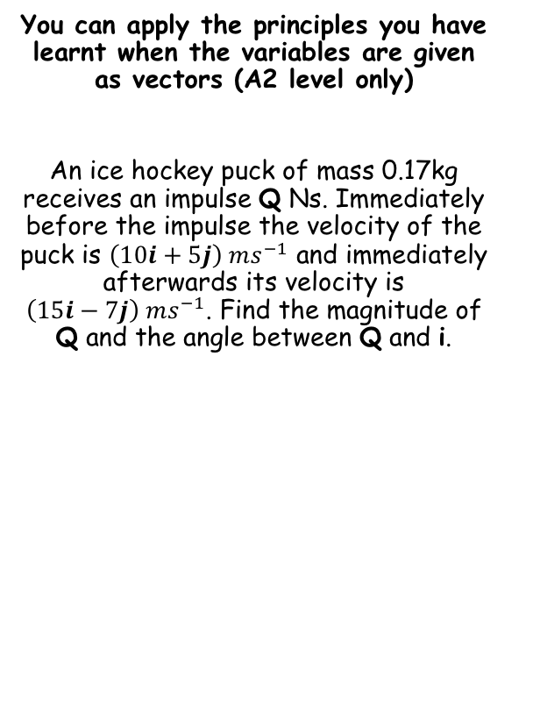





Momentum and Impulse
$$Momentum=mv$$
$$m_{1}u_{1}+m_{2}u_{2}=m_{1}v_{1}+m_{2}v_{2}$$
$$Impulse=mv−mu$$
$$Impulse=Ft$$
You can apply the principles you have learnt when the variables are given as vectors (A2 level only)
An ice hockey puck of mass 0.17kg receives an impulse Q Ns. Immediately before the impulse the velocity of the puck is $\left(10i+5j\right) ms^{−1}$ and immediately afterwards its velocity is $\left(15i−7j\right) ms^{−1}$. Find the magnitude of Q and the angle between Q and i.
$$Impulse=mv−mu$$
Sub in values
$$Impulse=0.17\left(15i−7j\right)−0.17(10i+5j)$$
Expand Brackets
$$Impulse=2.55i−1.19j−1.7i−0.85j$$
Simplify
$$Impulse=0.85i−2.04j$$
Sketch!
$$\left|Q\right|=\sqrt{{\left(0.85\right)}^{2}+{\left(−2.04\right)}^{2}}$$
$$0.85i$$
Calculate
$$θ$$
$$\left|Q\right|=2.21 Ns$$
$$Q$$
$$2.04j$$
$$θ={Tan}^{−1}\left(\frac{2.04}{0.85}\right)$$
Calculate
$$θ=67.4^{°}$$
1C

Slide 3





Momentum and Impulse
$$Momentum=mv$$
$$m_{1}u_{1}+m_{2}u_{2}=m_{1}v_{1}+m_{2}v_{2}$$
$$Impulse=mv−mu$$
$$Impulse=Ft$$
You can apply the principles you have learnt when the variables are given as vectors (A2 level only)
A particle of mass 0.15kg is moving with velocity $\left(20i−10j\right) ms^{−1}$ when it collides with a particle of mass 0.25kg moving with velocity $\left(16i−8j\right) ms^{−1}$. The two particles coalesce and form one particle of mass 0.4kg. Find the velocity of the combined particle.
$$m_{1}u_{1}+m_{2}u_{2}=m_{1}v_{1}+m_{2}v_{2}$$
Sub in values
$$0.15(20i−10j)+0.25(16i−8j)=0.4v$$
Expand and simplify
$$7i−3.5j=0.4v$$
Divide by 0.4
$$17.5i−8.75j=v$$
1C

Slide 4
Exercise 1C – A Level Only
Pearson Pure Mathematics Year 1/AS
Pages 3-5
Complete before the lesson Q1-3
In Class:
Green Q4-6
Amber Q7-10
Red Q11-16 & challenge

