Slide 1

Further Stats 1 Chapter 5 ::
Central Limit Theorem
jfrost@tiffin.kingston.sch.uk
www.drfrostmaths.com
@DrFrostMaths
Last modified: 22nd July 2018

Slide 2



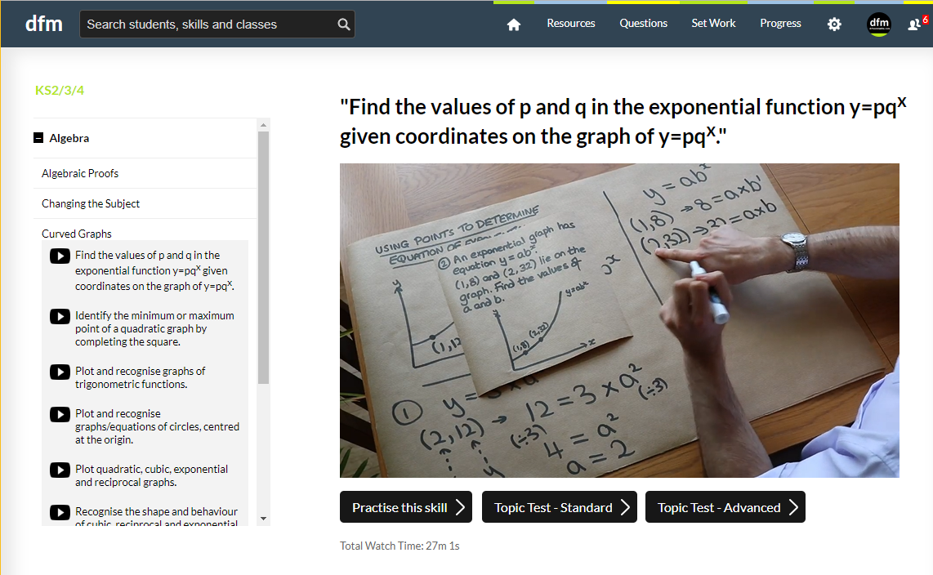
Register at: www.drfrostmaths.com
Everything is completely free.
Practise questions by chapter, including past paper questions and extension questions (e.g. MAT).
Teachers: you can create student accounts (or students can register themselves).
Teaching videos with topic tests to check understanding.

Slide 3
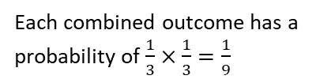
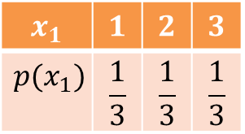
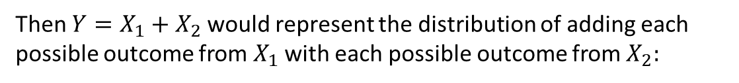
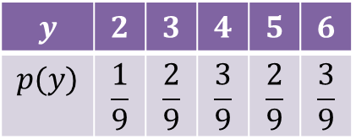

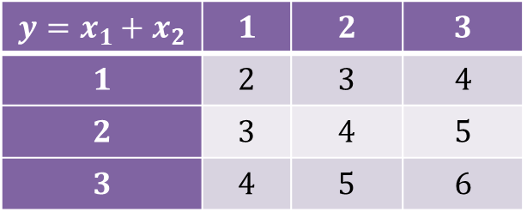



Recap of Adding Random Variables
Suppose that we had a fair three-sided spinner, and span it twice, represented by random variables $X_{1}, X_{2}$, both of which are the same discrete uniform distribution:
1
2
1
2
3
3
$$x_{1}$$ | $$1$$ | $$2$$ | $$3$$
$$p(x_{1})$$ | $$\frac{1}{3}$$ | $$\frac{1}{3}$$ | $$\frac{1}{3}$$
$$x_{2}$$ | $$1$$ | $$2$$ | $$3$$
$$p(x_{2})$$ | $$\frac{1}{3}$$ | $$\frac{1}{3}$$ | $$\frac{1}{3}$$
Then $Y=X_{1}+X_{2}$ would represent the distribution of adding each possible outcome from $X_{1}$ with each possible outcome from $X_{2}:$
$$y=x_{1}+x_{2}$$ | $$1$$ | $$2$$ | $$3$$
$$1$$ | $$2$$ | $$3$$ | $$4$$
$$2$$ | $$3$$ | $$4$$ | $$5$$
$$3$$ | $$4$$ | $$5$$ | $$6$$
$$y$$ | $$2$$ | $$3$$ | $$4$$ | $$5$$ | $$6$$
$$p(y)$$ | $$\frac{1}{9}$$ | $$\frac{2}{9}$$ | $$\frac{3}{9}$$ | $$\frac{2}{9}$$ | $$\frac{3}{9}$$
$$p(y)$$
Already, the shape of the distribution is vaguely resembling a well-known distribution…
Each combined outcome has a probability of $\frac{1}{3}×\frac{1}{3}=\frac{1}{9}$
$$y$$
$$2 3 4 5 6$$

Slide 4



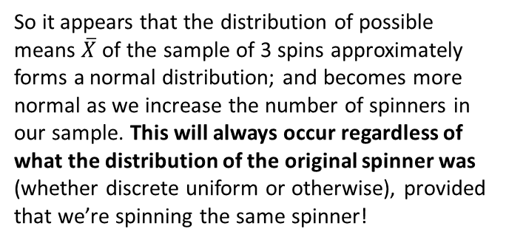

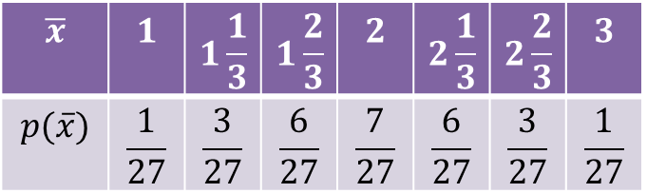
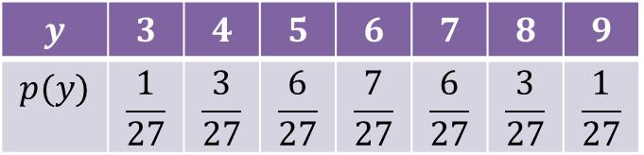


Adding Random Variables
1
1
1
2
2
2
3
3
3
$$X_{1}$$
$$X_{2}$$
$$X_{3}$$
Let’s now get a sample of 3 values, i.e. spin it 3 times: $Y=X_{1}+X_{2}+X_{3}$
$$p(y)$$
$$y$$ | $$3$$ | $$4$$ | $$5$$ | $$6$$ | $$7$$ | $$8$$ | $$9$$
$$p(y)$$ | $$\frac{1}{27}$$ | $$\frac{3}{27}$$ | $$\frac{6}{27}$$ | $$\frac{7}{27}$$ | $$\frac{6}{27}$$ | $$\frac{3}{27}$$ | $$\frac{1}{27}$$
That’s looking pretty damn like a normal distribution now…
$$y$$
$$3 4 5 6 7 8 9$$
If we divide each of these combined outcomes by 3, then we’d have $\frac{X_{1}+X_{2}+X_{3}}{3}=\overline{X}$:
$$\overline{x}$$ | $$1$$ | $$1\frac{1}{3}$$ | $$1\frac{2}{3}$$ | $$2$$ | $$2\frac{1}{3}$$ | $$2\frac{2}{3}$$ | $$3$$
$$p(\overline{x})$$ | $$\frac{1}{27}$$ | $$\frac{3}{27}$$ | $$\frac{6}{27}$$ | $$\frac{7}{27}$$ | $$\frac{6}{27}$$ | $$\frac{3}{27}$$ | $$\frac{1}{27}$$
So it appears that the distribution of possible means $\overline{X}$ of the sample of 3 spins approximately forms a normal distribution; and becomes more normal as we increase the number of spinners in our sample. This will always occur regardless of what the distribution of the original spinner was (whether discrete uniform or otherwise), provided that we’re spinning the same spinner!

Slide 5

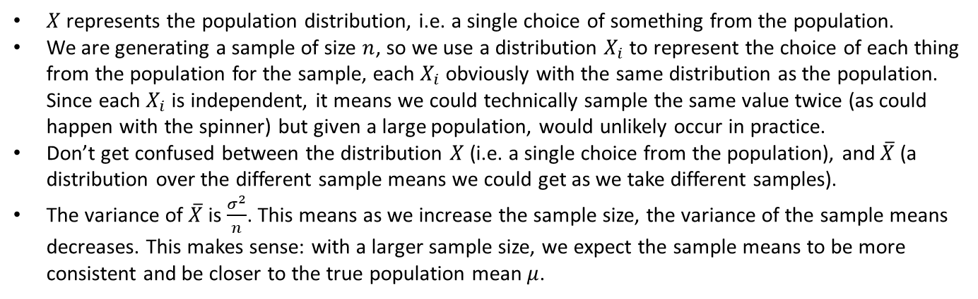

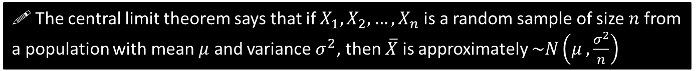
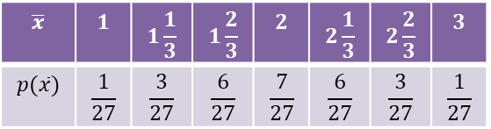
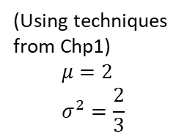
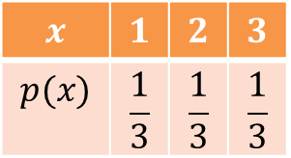
Central Limit Theorem
! The central limit theorem says that if $X_{1}, X_{2}, …, X_{n}$ is a random sample of size $n$ from a population with mean $μ$ and variance $σ^{2}$, then $\overline{X}$ is approximately $\sim N\left(μ ,\frac{σ^{2}}{n}\right)$
Important key understanding points:
$X$ represents the population distribution, i.e. a single choice of something from the population.
We are generating a sample of size $n$, so we use a distribution $X_{i}$ to represent the choice of each thing from the population for the sample, each $X_{i}$ obviously with the same distribution as the population. Since each $X_{i}$ is independent, it means we could technically sample the same value twice (as could happen with the spinner) but given a large population, would unlikely occur in practice.
Don’t get confused between the distribution $X$ (i.e. a single choice from the population), and $\overline{X}$ (a distribution over the different sample means we could get as we take different samples).
The variance of $\overline{X}$ is $\frac{σ^{2}}{n}$. This means as we increase the sample size, the variance of the sample means decreases. This makes sense: with a larger sample size, we expect the sample means to be more consistent and be closer to the true population mean $μ$.
Our $\overline{X}$ distribution for the mean of 3 spinners…
(Using techniques from Chp1)
$$μ=2 \\ σ^{2}=\frac{2}{3}$$
$$\overline{x}$$ | $$1$$ | $$1\frac{1}{3}$$ | $$1\frac{2}{3}$$ | $$2$$ | $$2\frac{1}{3}$$ | $$2\frac{2}{3}$$ | $$3$$
$$p(\overline{x})$$ | $$\frac{1}{27}$$ | $$\frac{3}{27}$$ | $$\frac{6}{27}$$ | $$\frac{7}{27}$$ | $$\frac{6}{27}$$ | $$\frac{3}{27}$$ | $$\frac{1}{27}$$
$$x$$ | $$1$$ | $$2$$ | $$3$$
$$p(x)$$ | $$\frac{1}{3}$$ | $$\frac{1}{3}$$ | $$\frac{1}{3}$$
1
2
3
Mean of the distribution above is still 2. Standard deviation of the distribution above is $\frac{2}{9}$ ; this is indeed $\frac{σ^{2}}{n}$!

Slide 6

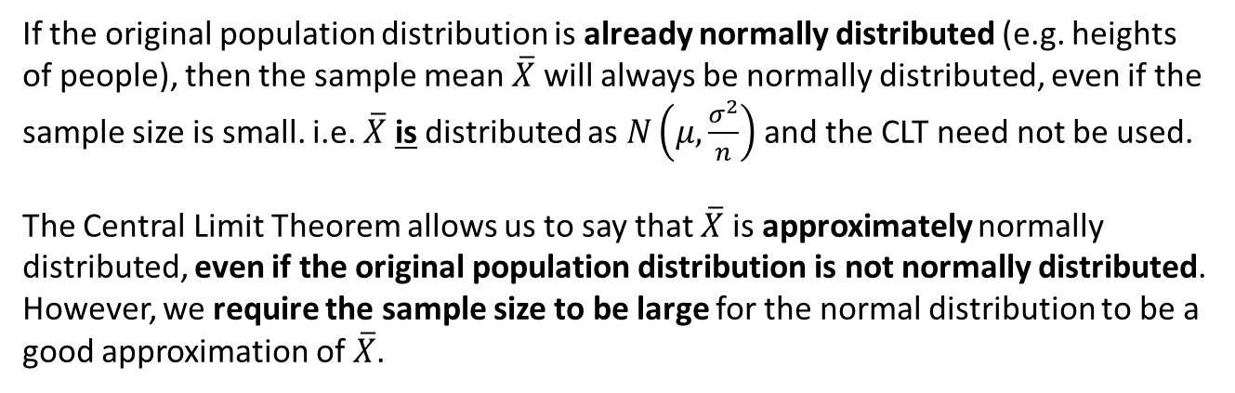
When does CLT apply and when doesn’t it?
If the original population distribution is already normally distributed (e.g. heights of people), then the sample mean $\overline{X}$ will always be normally distributed, even if the sample size is small. i.e. $\overline{X}$ is distributed as $N\left(μ,\frac{σ^{2}}{n}\right)$ and the CLT need not be used.
The Central Limit Theorem allows us to say that $\overline{X}$ is approximately normally distributed, even if the original population distribution is not normally distributed. However, we require the sample size to be large for the normal distribution to be a good approximation of $\overline{X}$.
For example if $n=1$, then $\overline{X}$ will have the same distribution as the population!

Slide 7
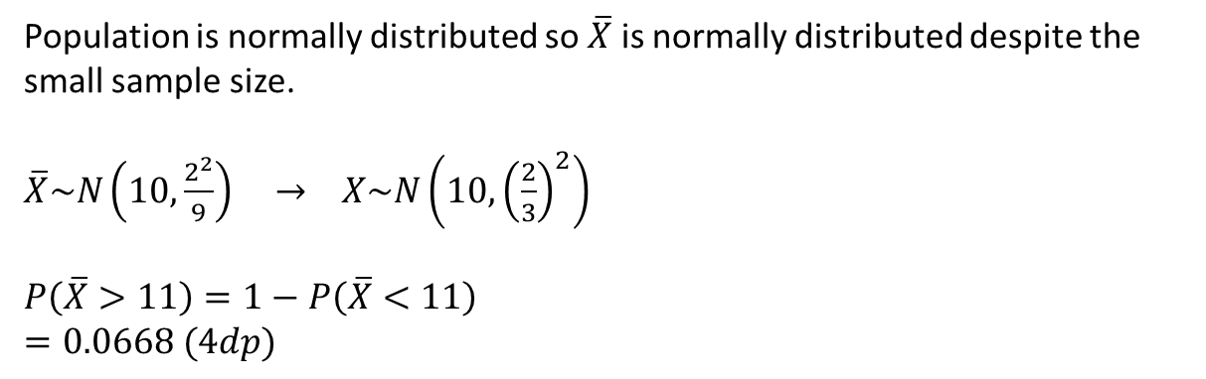
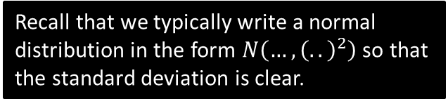
Example
[Textbook] A sample of size 9 is taken from a population with distribution $N\left({10,2}^{2}\right)$. Find the probability the sample mean $\overline{X}$ is more than 11.
Population is normally distributed so $\overline{X}$ is normally distributed despite the small sample size.
$\overline{X}\sim N\left(10,\frac{2^{2}}{9}\right) → X\sim N\left(10,{\left(\frac{2}{3}\right)}^{2}\right)$
$P\left(\overline{X}>11\right)=1−P\left(\overline{X}<11\right)$
$=0.0668 (4dp)$
?
Recall that we typically write a normal distribution in the form $N\left(…,{\left(..\right)}^{2}\right)$ so that the standard deviation is clear.
Use your calculator.

Slide 8

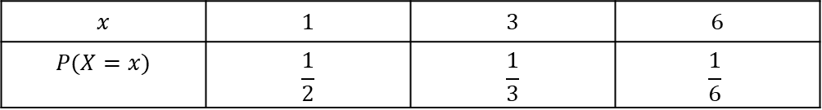
Test Your Understanding
[Textbook] A six-sided dice is relabelled so that there are three faces marked 1, two faces marked 3 and one face marked 6. The dice is rolled 40 times and the mean of the 40 scores is recorded.
Find an approximation distribution for the mean of the scores.
Use your approximation to estimate the probability that the mean is greater than 3.
Help: The probability distribution of the dice is the population distribution (as it’s what we use to create samples).
Help: Use your Chapter 1 knowledge to find $E(X)$ and $Var(X)$ of this distribution.
?
$$x$$ | $$1$$ | $$3$$ | $$6$$
$$P(X=x)$$ | $$\frac{1}{2}$$ | $$\frac{1}{3}$$ | $$\frac{1}{6}$$
Population distribution.
$$∴μ=E\left(X\right)=\left(1×\frac{1}{2}\right)+\left(3×\frac{1}{3}\right)+\left(6×\frac{1}{6}\right)=2.5 \\ σ^{2}=Var\left(X\right)=\left(1^{2}×\frac{1}{2}\right)+\left(3^{2}×\frac{1}{3}\right)+\left(6^{2}×\frac{1}{6}\right)−{2.5}^{2}=\frac{13}{4}$$
By the Central Limit Theorem, $\overline{X}≈N\left(2.5,{\sqrt{\frac{13}{160}}}^{2}\right)$
$P\left(\overline{X}>3\right)=0.0401 (4dp)$

Slide 9
Exercise 5A
Pearson Further Statistics 1
Pages 78-80
Complete before the lesson Q1-2
In Class:
Green Q3-4
Amber Q5-6
Red Q7-10

Slide 10


CLT with Poisson, Binomial and Geometric Distribs
[Textbook] A supermarket manager is trying to model the number of customers that visit her store each day. She observes that, on average, 20 new customers enter the store every minute.
Calculate the probability that fewer than 15 customers arrive in a given minute.
Find the probability that in one hour no more than 1150 customers arrive.
Use the Central Limit Theorem to estimate the probability that in one hour no more than 1150 customers arrive. Compare your answer to part b.
a
Let $X$ denote the number of customers that arrive in a minute. Then $X\sim Po(20)$.
$P\left(X<15\right)=0.1049 (4dp)$
Let $T$ denote the number of customers that arrive in an hour.
$$T\sim Po\left(60×20\right) → T\sim Po(1200)$$
$$P\left(T≤1150\right)=0.07589 (4dp)$$
We could consider each of the 60 minutes as a separate sample. Thus the observed average customers per minute is $\frac{1150}{60}=19.1666…$
Since $Var\left(X\right)=E\left(X\right)=λ$, by CLT, $\overline{X}≈N\left(20,{\sqrt{\frac{20}{60}}}^{2}\right)$
$P\left(\overline{X}≤1150\right)=0.0745 (4dp)$, which is close, so approximation using CLT is a good one.
?
(c) is an unusual way of solving the problem. Using the Stats Year 2 approach, we could use $T\sim Po(1200)$ and directly use a normal approximation $Y\sim N(1200,{\sqrt{1200}}^{2})$, finding $P(Y<1150.5)$
b
?
c
?

Slide 11

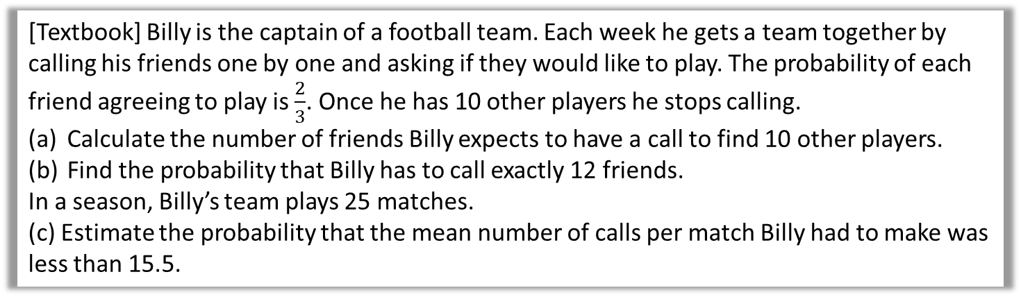
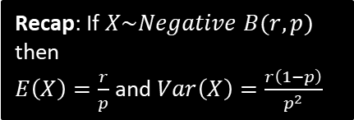
Test Your Understanding
[Textbook] Billy is the captain of a football team. Each week he gets a team together by calling his friends one by one and asking if they would like to play. The probability of each friend agreeing to play is $\frac{2}{3}$. Once he has 10 other players he stops calling.
Calculate the number of friends Billy expects to have a call to find 10 other players.
Find the probability that Billy has to call exactly 12 friends.
In a season, Billy’s team plays 25 matches.
(c) Estimate the probability that the mean number of calls per match Billy had to make was less than 15.5.
a
Let $X$ be the number of friends Billy calls. Then
$X\sim Negative\left(10,\frac{2}{3}\right)$ so $E\left(X\right)=\frac{30}{2}=5$
$P\left(X=12\right)=\left(\begin{matrix}11 \\ 9\end{matrix}\right)×{\left(\frac{2}{3}\right)}^{10}×{\left(\frac{1}{3}\right)}^{2}$
$=0.1060$
$E\left(X\right)=15$ and $Var\left(X\right)=\frac{10×\frac{1}{3}}{{\left(\frac{2}{3}\right)}^{2}}=7.5$
For a sample of size 25, the sample mean $\overline{X}$ is approximately $\sim N\left(15,\frac{7.5}{25}\right)$ or $N\left(15,0.3\right)$ by the CLT.
$$P\left(\overline{X}<15.5\right)≈0.8193$$
?
Recap: If $X\sim Negative B(r,p)$ then
$E\left(X\right)=\frac{r}{p}$ and $Var\left(X\right)=\frac{r\left(1−p\right)}{p^{2}}$
b
?
c
?

Slide 12
Exercise 5B
Pearson Further Statistics 1
Pages 81-82
Complete before the lesson Q1-2
In Class:
Green Q3-4
Red Q5-8

