Slide 1

Further Stats 1 Chapter 7 ::
Probability Generating Functions
jfrost@tiffin.kingston.sch.uk
www.drfrostmaths.com
@DrFrostMaths
Last modified: 23rd July 2018

Slide 2
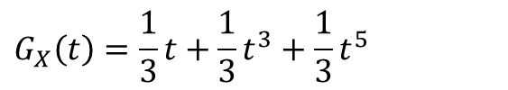

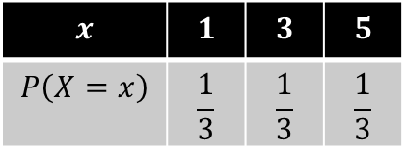
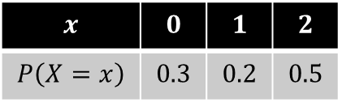

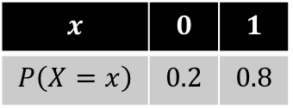

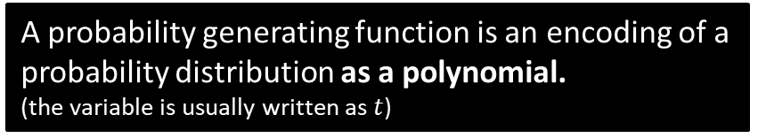
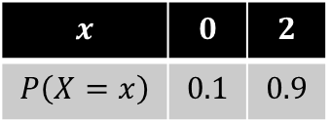
What is a probability generating function?
$$x$$ | $$0$$ | $$1$$ | $$2$$
$$P\left(X=x\right)$$ | $$0.3$$ | $$0.2$$ | $$0.5$$
$$G_{X}\left(t\right)=0.3t^{0}+0.2t^{1}+0.5t^{2}$$
A probability generating function is an encoding of a probability distribution as a polynomial.
(the variable is usually written as $t$)
Fro Note: Because polynomials only have non-negative integer powers, we can only obtain the probability generating function for discrete distributions with non-negative outcomes.
The outcomes are the powers and the probabilities are the coefficients of each term.
$$x$$ | $$0$$ | $$1$$
$$P\left(X=x\right)$$ | $$0.2$$ | $$0.8$$
?
$$G_{X}\left(t\right)=0.2+0.8t$$
$$x$$ | $$1$$ | $$3$$ | $$5$$
$$P\left(X=x\right)$$ | $$\frac{1}{3}$$ | $$\frac{1}{3}$$ | $$\frac{1}{3}$$
$$G_{X}\left(t\right)=\frac{1}{3}t+\frac{1}{3}t^{3}+\frac{1}{3}t^{5}$$
?
$$x$$ | $$0$$ | $$2$$
$$P\left(X=x\right)$$ | $$0.1$$ | $$0.9$$
?
$$G_{X}\left(t\right)=0.1+0.9t^{2}$$

Slide 3

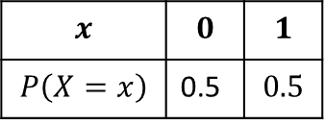
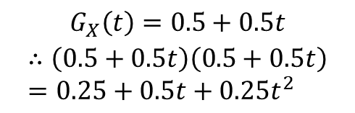

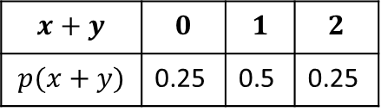
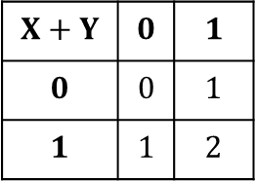


Why use probability generating functions?
It seems a bit bizarre to use write a probability distribution as a polynomial, when they seem to have no conceptual connection.
We will see that there are operations on probability distributions, e.g. finding the expected value or adding random variables, where we can combine/manipulate their polynomial forms in a certain way.
Polynomials are easy to manipulate: we can quickly multiply polynomials or differentiate them. Therefore, it is often easiest to work on their polynomial form instead, and where relevant, convert the resulting polynomial back into a standard probability distribution form. e.g.:
We will see that to add two random variables, $X+Y$, we just multiply their probability generating functions:
$$X+Y$$ | $$0$$ | $$1$$
$$0$$ | $$0$$ | $$1$$
$$1$$ | $$1$$ | $$2$$
$$x+y$$ | $$0$$ | $$1$$ | $$2$$
$$p(x+y)$$ | 0.25 | 0.5 | 0.25
$$x$$ | $$0$$ | $$1$$
$$P\left(X=x\right)$$ | 0.5 | $$0.5$$
Working out using GCSE method
$$X$$
$$+$$
$$Y$$
Using probability generating functions
Convert back to distribution
$$G_{X}\left(t\right)=0.5+0.5t$$
$$∴\left(0.5+0.5t\right)\left(0.5+0.5t\right) \\ =0.25+0.5t+0.25t^{2}$$
0
1
0
1

Slide 4

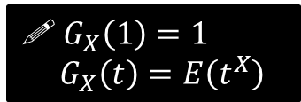

A few properties of P.G.F.s
$$x$$ | $$0$$ | $$1$$ | $$2$$
$$P\left(X=x\right)$$ | $$0.3$$ | $$0.2$$ | $$0.5$$
$$G_{X}\left(t\right)=0.3+0.2t+0.5t^{2}$$
What is $G_{X}(1)$, and why?
$$G_{X}\left(1\right)=0.3+0.2+0.5=1$$
$G_{X}(1)$ will always be 1 for all random variables $X$, because substituting in 1 gives us the sum of the coefficients of the polynomial; these are the probabilities, and we know these sum to 1.
Find $E\left(X\right), E(X^{2})$ and $E\left(t^{X}\right)$. What do you notice about $E\left(t^{X}\right)$?
$$E\left(X\right)=0.3\left(0\right)+0.2\left(1\right)+0.5(2) \\ E\left(X^{2}\right)=0.3\left(0^{2}\right)+0.2\left(1^{2}\right)+0.5\left(2^{2}\right) \\ E\left(t^{X}\right)=0.3\left(t^{0}\right)+0.2\left(t^{1}\right)+0.5\left(t^{2}\right)=G_{X}(t)$$
The last of these is the same as the probability generating function of $X$.
?
?
! $G_{X}\left(1\right)=1$
$G_{X}\left(t\right)=E\left(t^{X}\right)$
You’re implicitly using this one when you form a polynomial with the outcomes as the powers and the probabilities as the coefficients.

Slide 5
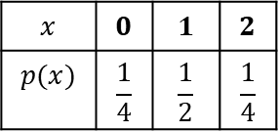


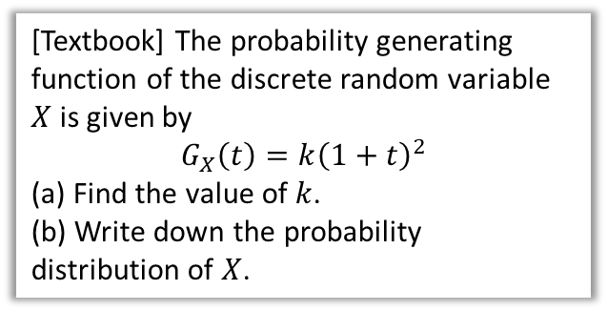
Examples
[Textbook] The probability generating function of the discrete random variable $X$ is given by
$$G_{X}\left(t\right)=k{\left(1+t\right)}^{2}$$
(a) Find the value of $k$.
(b) Write down the probability distribution of $X$.
Recall that $G_{X}\left(1\right)=1$
?
$$G_{X}\left(1\right)=k{\left(1+1\right)}^{2}=4k=1 \\ ∴k=\frac{1}{4}$$
$$G_{X}\left(t\right)=\frac{1}{4}{\left(1+t\right)}^{2} \\ =\frac{1}{4}\left(1+2t+t^{2}\right) \\ =\frac{1}{4}+\frac{1}{2}t+\frac{1}{4}t^{2}$$
$$x$$ | $$0$$ | $$1$$ | $$2$$
$$p(x)$$ | $$\frac{1}{4}$$ | $$\frac{1}{2}$$ | $$\frac{1}{4}$$

Slide 6
Exercise 7A
Pearson Further Statistics 1
Pages 130-131
Complete before the lesson Q1-2
In Class:
Green Q3-5
Amber Q6-8
Red Q9-11

Slide 7

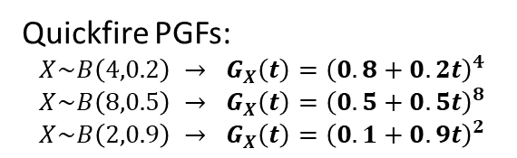
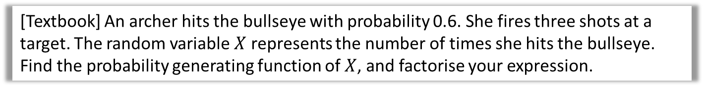

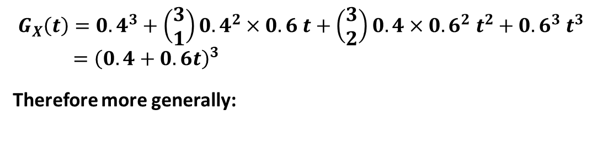
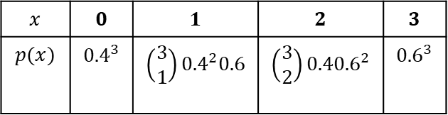
PGFs for common distributions
Binomial
[Textbook] An archer hits the bullseye with probability 0.6. She fires three shots at a target. The random variable $X$ represents the number of times she hits the bullseye. Find the probability generating function of $X$, and factorise your expression.
?
$$X\sim B\left(3, 0.6\right)$$
$$x$$ | $$0$$ | $$1$$ | $$2$$ | $$3$$
$$p(x)$$ | $${0.4}^{3}$$ | $$\left(\begin{matrix}3 \\ 1\end{matrix}\right){0.4}^{2}0.6$$ | $$\left(\begin{matrix}3 \\ 2\end{matrix}\right){0.40.6}^{2}$$ | $${0.6}^{3}$$
?
$$G_{X}\left(t\right)={0.4}^{3}+\left(\begin{matrix}3 \\ 1\end{matrix}\right){0.4}^{2}×0.6 t+\left(\begin{matrix}3 \\ 2\end{matrix}\right){0.4×0.6}^{2} t^{2}+{0.6}^{3} t^{3} \\ ={\left(0.4+0.6t\right)}^{3}$$
Therefore more generally:
?
? Factorised
Quickfire PGFs:
$$X\sim B\left(4,0.2\right) → G_{X}\left(t\right)={\left(0.8+0.2t\right)}^{4} \\ X\sim B\left(8,0.5\right) → G_{X}\left(t\right)={\left(0.5+0.5t\right)}^{8}$$
$$X\sim B\left(2,0.9\right) → G_{X}\left(t\right)={\left(0.1+0.9t\right)}^{2}$$
?
If $X\sim B(n,p)$ then $G_{X}\left(t\right)={\left(q+pt\right)}^{n}$
(where $q=1−p$ is probability of failure)
?
?
?

Slide 8

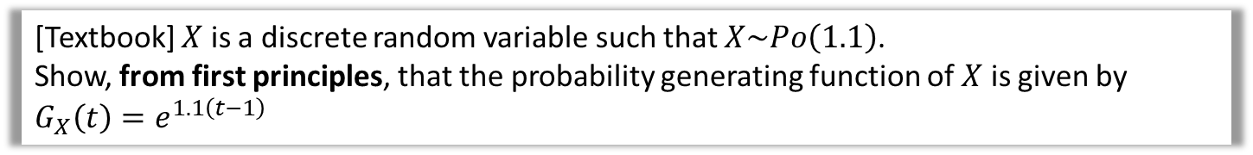
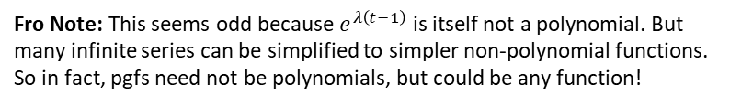


PGFs for common distributions
Poisson
Poisson distributions have infinitely many outcomes, thus the polynomial is infinitely long (known as an infinite series).
[Textbook] $X$ is a discrete random variable such that $X\sim Po\left(1.1\right)$.
Show, from first principles, that the probability generating function of $X$ is given by $G_{X}\left(t\right)=e^{1.1\left(t−1\right)}$
?
$p\left(x\right)=\frac{e^{−1.1}×{1.1}^{x}}{x!}$
$$∴G_{X}\left(t\right)=\left(\frac{e^{−1.1}×{1.1}^{0}}{0!}\right)+\left(\frac{e^{−1.1}×{1.1}^{1}}{1!}\right)t+\left(\frac{e^{−1.1}×{1.1}^{2}}{2!}\right)t^{2}+… \\ =e^{−1.1}\left(\frac{{1.1}^{0}t^{0}}{0!}+\frac{{1.1}^{1}t^{1}}{1!}+\frac{{1.1}^{2}t^{2}}{2!}+…\right) \\ =e^{−1.1}\left(\frac{{\left(1.1t\right)}^{0}}{0!}+\frac{{\left(1.1t\right)}^{1}}{1!}+\frac{{\left(1.1t\right)}^{2}}{2!}+…\right) \\ =e^{−1.1}e^{1.1t}$$
$=e^{1.1\left(t−1\right)}$
In Core Pure Year 2 you will learn that
$$e^{x}=\frac{x^{0}}{0!}+\frac{x^{1}}{1!}+\frac{x^{2}}{2!}+…$$
! If $X\sim Po\left(λ\right)$ then $G_{X}\left(t\right)=e^{λ\left(t−1\right)}$
Fro Note: This seems odd because $e^{λ\left(t−1\right)}$ is itself not a polynomial. But many infinite series can be simplified to simpler non-polynomial functions. So in fact, pgfs need not be polynomials, but could be any function!

Slide 9

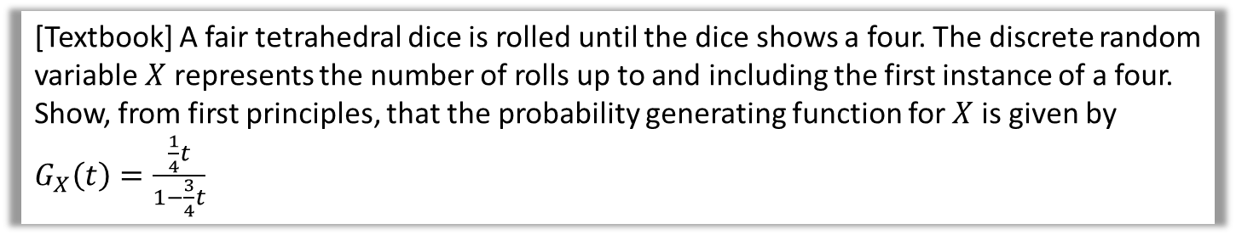

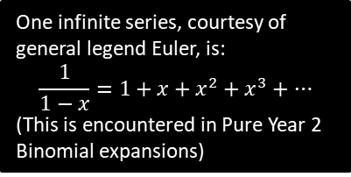
PGFs for common distributions
Geometric
[Textbook] A fair tetrahedral dice is rolled until the dice shows a four. The discrete random variable $X$ represents the number of rolls up to and including the first instance of a four.
Show, from first principles, that the probability generating function for $X$ is given by $G_{X}\left(t\right)=\frac{\frac{1}{4}t}{1−\frac{3}{4}t}$
?
$p\left(x\right)=Geo\left(\frac{1}{4}\right)$ as a quarter chance of getting a 4 on each throw
$G_{X}\left(t\right)=\frac{1}{4}t+\left(\frac{3}{4}\right)\left(\frac{1}{4}\right)t^{2}+{\left(\frac{3}{4}\right)}^{2}\left(\frac{1}{4}\right)t^{3}+…$
$=\frac{1}{4}t\left(1+\frac{3}{4}t+{\left(\frac{3}{4}t\right)}^{2}+{\left(\frac{3}{4}t\right)}^{3}+…\right)$
$=\frac{1}{4}t\left(\frac{1}{1−\frac{3}{4}t}\right)=\frac{\frac{1}{4}t}{1−\frac{3}{4}t}$
One infinite series, courtesy of general legend Euler, is:
$$\frac{1}{1−x}=1+x+x^{2}+x^{3}+…$$
(This is encountered in Pure Year 2 Binomial expansions)
! If $X\sim Geo\left(p\right)$ then $G_{X}\left(t\right)=\frac{pt}{1+qt}$

Slide 10

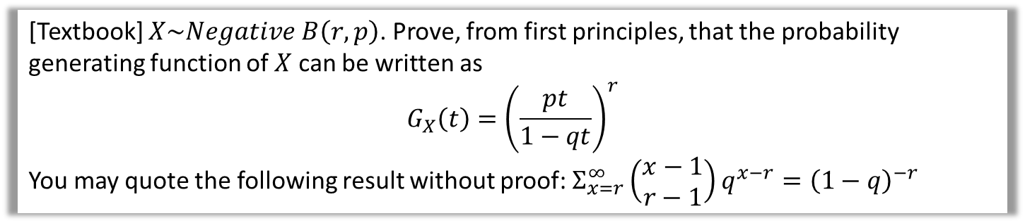


PGFs for common distributions
Negative Binomial
[Textbook] $X\sim Negative B\left(r,p\right)$. Prove, from first principles, that the probability generating function of $X$ can be written as
$$G_{X}\left(t\right)={\left(\frac{pt}{1−qt}\right)}^{r}$$
You may quote the following result without proof: $Σ_{x=r}^{∞}\left(\begin{matrix}x−1 \\ r−1\end{matrix}\right)q^{x−r}={\left(1−q\right)}^{−r}$
?
$$p\left(x\right)=\left(\begin{matrix}x−1 \\ r−1\end{matrix}\right)p^{r}q^{x−r}, x=r,r+1,r+2,… \\ G_{X}\left(t\right)=Σ_{x=r}^{∞}\left(\begin{matrix}x−1 \\ r−1\end{matrix}\right)p^{r}q^{x−r}t^{x} \\ =Σ_{x=r}^{∞}\left(\begin{matrix}x−1 \\ r−1\end{matrix}\right)p^{r}q^{x−r}t^{x−r}t^{r} \\ =p^{r}t^{r }Σ_{x=r}^{∞}\left(\begin{matrix}x−1 \\ r−1\end{matrix}\right)q^{x−r}t^{x−r} \\ =p^{r}t^{r }Σ_{x=r}^{∞}\left(\begin{matrix}x−1 \\ r−1\end{matrix}\right){\left(qt\right)}^{x−r} \\ =p^{r}t^{r}{\left(1−qt\right)}^{−r}={\left(\frac{pt}{1−qt}\right)}^{r} □$$
To use the provided result, we need the power to be $x−r$. So it makes sense to split the $t$ term in this way.
In general with summations, if a factor of the expression doesn’t depend on the variable being incremented, then it can be factorised out.
We can now finally use the provided result.
! If $X\sim Negative B\left(r,p\right)$ then $G_{X}\left(t\right)={\left(\frac{pt}{1−qt}\right)}^{r}$

Slide 11
Exercise 7B
Pearson Further Statistics 1
Pages 134-135
Complete before the lesson Q1-2
In Class:
Green Q3-5
Amber Q6-8
Red Q9-11

Slide 12

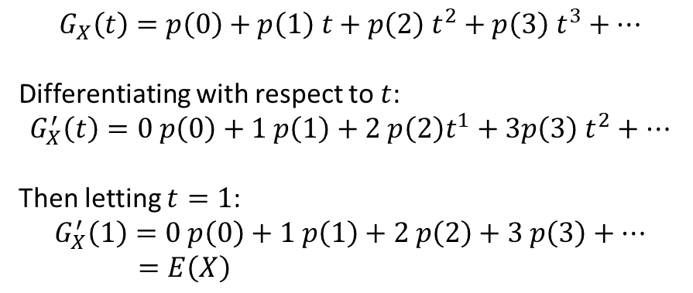
Calculating $E(X)$ and $Var\left(X\right)$
Another advantage of probability generating functions is that they often make $E(X)$ and $Var\left(X\right)$ easier to find.
$$G_{X}\left(t\right)=p\left(0\right)+p\left(1\right) t+p\left(2\right) t^{2}+p\left(3\right) t^{3}+…$$
Differentiating with respect to $t$:
$$G_{X}^{′}\left(t\right)=0 p\left(0\right)+1 p\left(1\right)+2 p\left(2\right)t^{1}+3p\left(3\right) t^{2}+…$$
Then letting $t=1$:
$$G_{X}^{′}\left(1\right)=0 p\left(0\right)+1 p\left(1\right)+2 p\left(2\right)+3 p\left(3\right)+… \\ =E\left(X\right)$$
?
?
?
! $E\left(X\right)=G_{X}^{′}\left(1\right)$

Slide 13
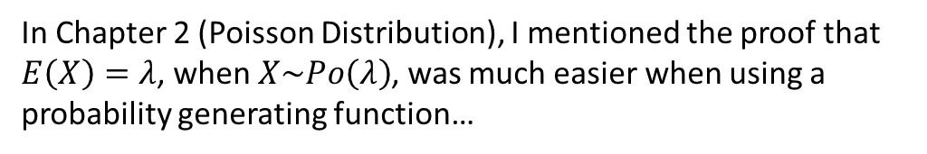

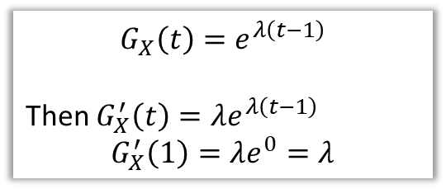
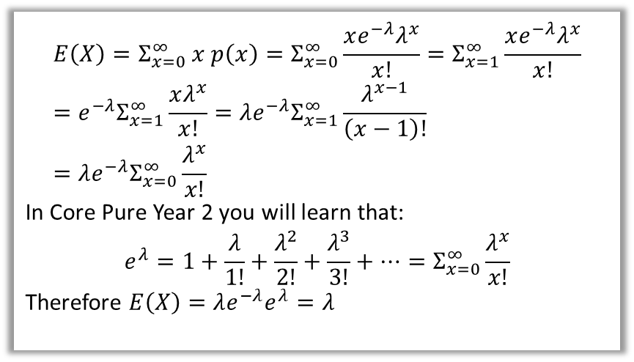
Calculating $E(X)$ and $Var\left(X\right)$
In Chapter 2 (Poisson Distribution), I mentioned the proof that $E\left(X\right)=λ$, when $X\sim Po\left(λ\right)$, was much easier when using a probability generating function…
Proof using original distribution:
(as seen in my Chapter 2 slides)
Proof using pgf:
$$G_{X}\left(t\right)=e^{λ\left(t−1\right)}$$
Then $G_{X}^{′}\left(t\right)=λe^{λ\left(t−1\right)}$
$$G_{X}^{′}\left(1\right)=λe^{0}=λ$$
$$E\left(X\right)=Σ_{x=0}^{∞} x p\left(x\right)=Σ_{x=0}^{∞}\frac{xe^{−λ}λ^{x}}{x!}=Σ_{x=1}^{∞}\frac{xe^{−λ}λ^{x}}{x!} \\ =e^{−λ}Σ_{x=1}^{∞}\frac{xλ^{x}}{x!}=λe^{−λ}Σ_{x=1}^{∞}\frac{λ^{x−1}}{\left(x−1\right)!} \\ =λe^{−λ}Σ_{x=0}^{∞}\frac{λ^{x}}{x!}$$
In Core Pure Year 2 you will learn that:
$$e^{λ}=1+\frac{λ}{1!}+\frac{λ^{2}}{2!}+\frac{λ^{3}}{3!}+…=Σ_{x=0}^{∞}\frac{λ^{x}}{x!}$$
Therefore $E\left(X\right)=λe^{−λ}e^{λ}=λ$
?
HOLY FREAKIN’ PAPA SMURF
We can similarly easily derive $E\left(X\right)=np$ for the Binomial distribution, and so on.

Slide 14
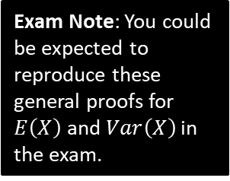


Calculating $E(X)$ and $Var\left(X\right)$
?
$$G_{X}\left(t\right)=Σt^{x}P\left(X=x\right) =E(t^{X}) \\ G_{X}^{′}\left(t\right)=Σxt^{x−1}P\left(X=x\right) =E\left(Xt^{X−1}\right) \\ G_{X}^{′′}\left(t\right)=Σx\left(x−1\right)t^{x−2}P\left(X=x\right) =E\left(X\left(X−1\right)t^{X−2}\right) \\ G^{′′}\left(1\right)=Σx\left(x−1\right)P\left(X=x\right) =E\left(X\left(X−1\right)\right)=E\left(X^{2}−X\right)=E\left(X^{2}\right)−E(X)$$
Thus:
$$Var\left(X\right)=E\left(X^{2}\right)−E{\left(X\right)}^{2} \\ =G^{′′}\left(1\right)+E\left(X\right)−E{\left(X\right)}^{2} \\ =G^{′′}\left(1\right)+G_{X}^{′}\left(1\right)−{\left(G_{X}^{′}\left(1\right)\right)}^{2}$$
?
?
?
?
?
Exam Note: You could be expected to reproduce these general proofs for $E\left(X\right)$ and $Var\left(X\right)$ in the exam.
! $Var\left(X\right)=G_{X}^{′′}\left(1\right)+G_{X}^{′}\left(1\right)−{\left(G_{X}^{′}\left(1\right)\right)}^{2}$

Slide 15
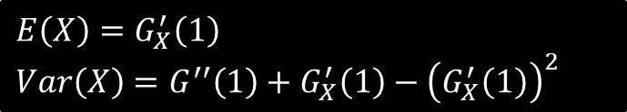
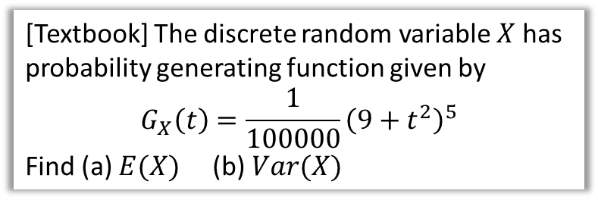

Examples
$$E\left(X\right)=G_{X}^{′}\left(1\right)$$
$$Var\left(X\right)=G^{′′}\left(1\right)+G_{X}^{′}\left(1\right)−{\left(G_{X}^{′}\left(1\right)\right)}^{2}$$
[Textbook] The discrete random variable $X$ has probability generating function given by
$$G_{X}\left(t\right)=\frac{1}{100000}{\left(9+t^{2}\right)}^{5}$$
Find (a) $E(X)$ (b) $Var(X)$
?
$G_{X}^{′}\left(t\right)=\frac{10t}{100000}{\left(9+t^{2}\right)}^{4}$ (using chain rule)
$G_{X}^{′}\left(1\right)=\frac{10\left(1\right)}{100000}{\left(9+1^{2}\right)}^{4}=1 ∴ E\left(X\right)=1$
$G_{X}^{′′}\left(t\right)=\frac{9\left(1+t^{2}\right){\left(9+t^{2}\right)}^{3}}{10000}$
$Var\left(X\right)=G^{′′}\left(1\right)+G_{X}^{′}\left(1\right)−{\left(G_{X}^{′}\left(1\right)\right)}^{2}$
$=\frac{9\left(1+1\right){\left(9+1\right)}^{3}}{10000}+1−1^{2}=\frac{9}{5}$

Slide 16
Exercise 7C
Pearson Further Statistics 1
Pages 137-138
Complete before the lesson Q1-3
In Class:
Green Q4
Amber Q5-9
Red Q10-15 & Challenge

Slide 17



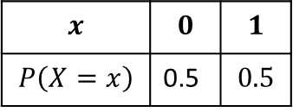

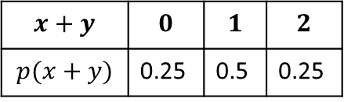
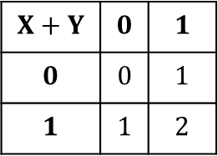
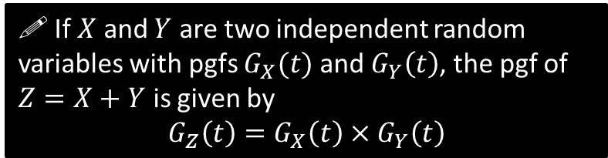
Sum of Independent Random Variables
At the start of this chapter we previewed a very remarkable (and very useful!) property of probability generating functions: that the product of these functions gives a new function which represents the sum of the two original distributions:
$$x$$ | $$0$$ | $$1$$
$$P\left(X=x\right)$$ | 0.5 | $$0.5$$
$$X+Y$$ | $$0$$ | $$1$$
$$0$$ | $$0$$ | $$1$$
$$1$$ | $$1$$ | $$2$$
$$x+y$$ | $$0$$ | $$1$$ | $$2$$
$$p(x+y)$$ | 0.25 | 0.5 | 0.25
Working out using GCSE method
?
?
$$X$$
$$+$$
$$Y$$
0
1
0
1
Convert back to distribution
Using probability generating functions
?
$$G_{X}\left(t\right)=G_{Y}\left(t\right)=0.5+0.5t$$
$∴$ Product of two pgfs:
$$\left(0.5+0.5t\right)\left(0.5+0.5t\right) \\ =0.25+0.5t+0.25t^{2}$$
Two fair spinners.
?
! If $X$ and $Y$ are two independent random variables with pgfs $G_{X}(t)$ and $G_{Y}\left(t\right)$, the pgf of $Z=X+Y$ is given by
$$G_{Z}\left(t\right)=G_{X}\left(t\right)×G_{Y}\left(t\right)$$
We will not cover the proof.

Slide 18
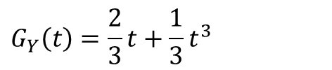
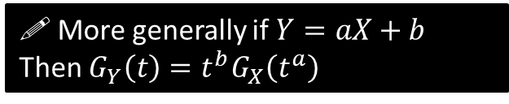
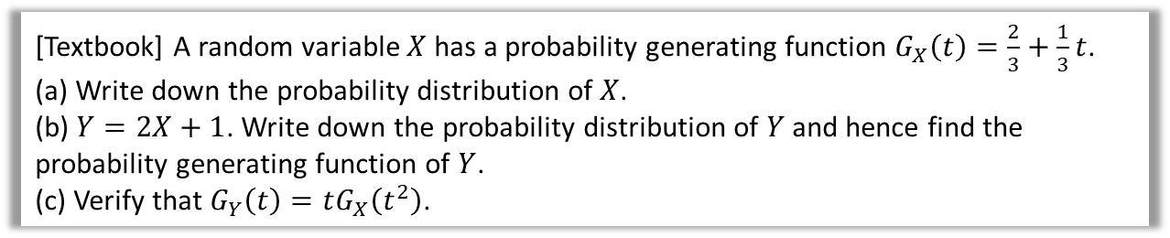
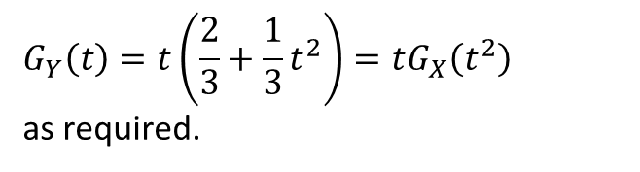
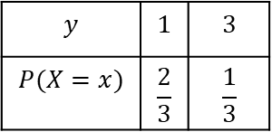
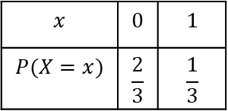
Examples
[Textbook] A random variable $X$ has a probability generating function $G_{X}\left(t\right)=\frac{2}{3}+\frac{1}{3}t$.
(a) Write down the probability distribution of $X$.
(b) $Y=2X+1$. Write down the probability distribution of $Y$ and hence find the probability generating function of $Y$.
(c) Verify that $G_{Y}\left(t\right)=tG_{X}\left(t^{2}\right)$.
a
?
c
?
$$x$$ | $$0$$ | $$1$$
$$P(X=x)$$ | $$\frac{2}{3}$$ | $$\frac{1}{3}$$
$$G_{Y}\left(t\right)=t\left(\frac{2}{3}+\frac{1}{3}t^{2}\right)=tG_{X}\left(t^{2}\right)$$
as required.
b
?
$$y$$ | $$1$$ | $$3$$
$$P(X=x)$$ | $$\frac{2}{3}$$ | $$\frac{1}{3}$$
$$G_{Y}\left(t\right)=\frac{2}{3}t+\frac{1}{3}t^{3}$$
! More generally if $Y=aX+b$
Then $G_{Y}\left(t\right)=t^{b}G_{X}\left(t^{a}\right)$

Slide 19
Exercise 7D
Pearson Further Statistics 1
Pages 141-142
Complete before the lesson Q1
In Class:
Green Q2
Amber Q3
Red Q4-5 & Challenge

