Slide 1
Year 1 Applied Mathematics
Forces and Motions
- Connected Particles
Chapter 10
(Part 3 of 4)

Slide 2
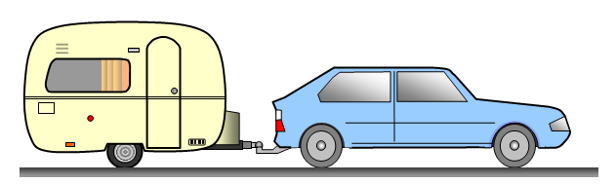
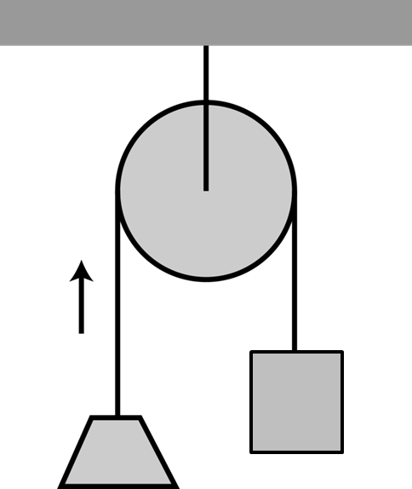
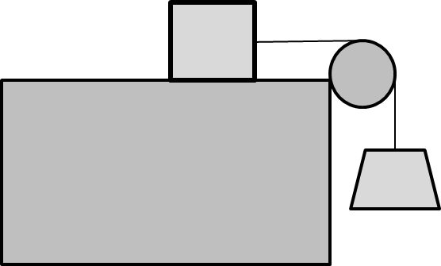
Connected Particles

Slide 3







Connected Particles
$$a$$
$$a$$
$$Tension$$
$$Force$$
m
m
$$Resistance$$
$$Force$$
$$Driving$$
$$Force$$
$$Tension$$
$$force$$
$$Resistance$$
$$Force$$
Name the forces of each coloured arrow.

Slide 4
Connected Particles
With connected objects
moving in the same direction,
calculations can be performed on:
one overall system
single particle
(caravan only)
single particle
(car only)

Slide 5










Connected Particles
$$a$$
m
$$Tension$$
m
$$Resistance$$
$$Forces$$
$$Driving$$
$$Force$$
$$Tension$$
$$Resistance$$
$$Forces$$
As one overall system it becomes:
$$a$$
$$Resistance$$
$$Forces$$
2m
$$Driving$$
$$Force$$
$$Resistance$$
$$Forces$$

Slide 6




Connected Particles
$$a$$
m
$$Tension$$
m
$$Resistance$$
$$Forces$$
$$Driving$$
$$Force$$
$$Tension$$
$$Resistance$$
$$Forces$$
Looking at the Car only:
$$a$$
$$Tension$$
m
$$Driving$$
$$Force$$
$$Resistance$$
$$Forces$$

Slide 7


Connected Particles
$$a$$
m
$$Tension$$
m
$$Resistance$$
$$Forces$$
$$Driving$$
$$Force$$
$$Tension$$
$$Resistance$$
$$Forces$$
Looking at the Caravan only:
$$a$$
m
$$Resistance$$
$$Forces$$
$$Tension$$

Slide 8
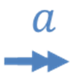
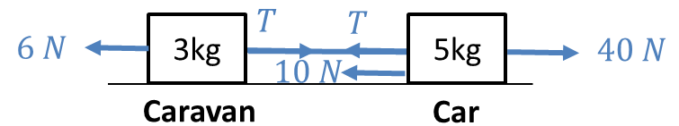










Connected Particles
Forces Diagram
F = ma
$$a$$
Car
$$T$$
$$10 N$$
5kg
$$40 N$$
40 – T – 10 = 5a
$$a$$
Caravan
$$6 N$$
3kg
$$T$$
T – 6 = 3a
$$a$$
Car and Caravan
$$16 N$$
8kg
$$40 N$$
24 = 8a

Slide 9






Connected Particles
$$a$$
The car is reversing!
$$a$$
$$Resistance$$
$$Forces$$
m
$$Tension$$
$$Tension$$
m
$$Driving$$
$$Force$$
$$Resistance$$
$$Forces$$
Draw the direction of each arrow for each force.

Slide 10
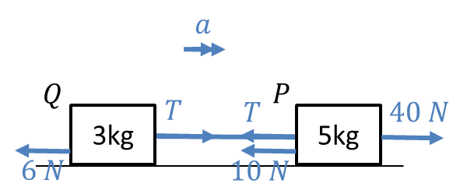
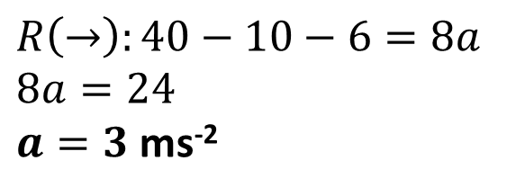
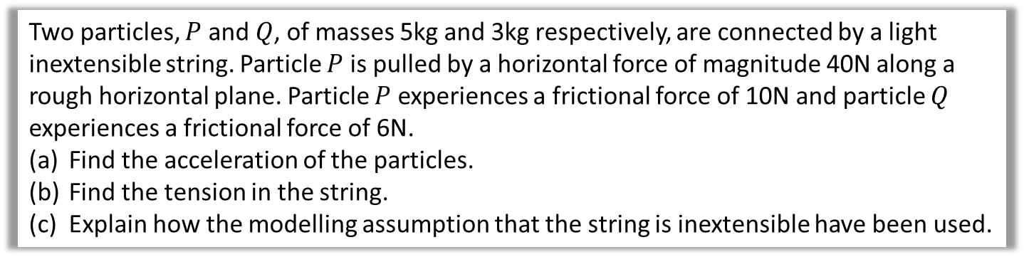
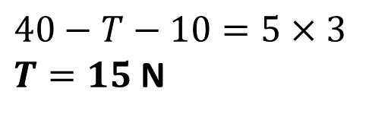
Connected Particles
Two particles, $P$ and $Q$, of masses 5kg and 3kg respectively, are connected by a light inextensible string. Particle $P$ is pulled by a horizontal force of magnitude 40N along a rough horizontal plane. Particle $P$ experiences a frictional force of 10N and particle $Q$ experiences a frictional force of 6N.
Find the acceleration of the particles.
Find the tension in the string.
Explain how the modelling assumption that the string is inextensible have been used.
a
$$R\left(→\right):40−10−6=8a \\ 8a=24$$
$a=3$ ms⁻²
b
$$40−T−10=5×3$$
$T=15$ N
c
Inextensible $⇒$ acceleration of objects the same

Slide 11
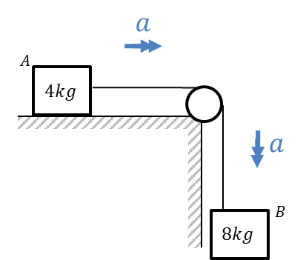
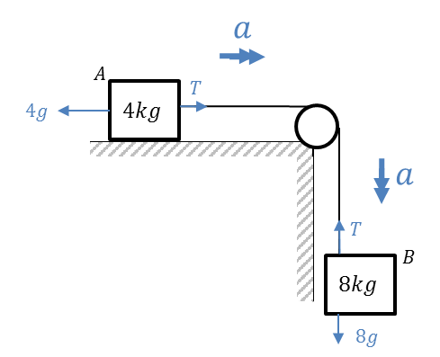
Connected Particles - Pulleys
Forces Diagrams
F = ma
8g – T = 8a
R
T – R = 4a

Slide 12
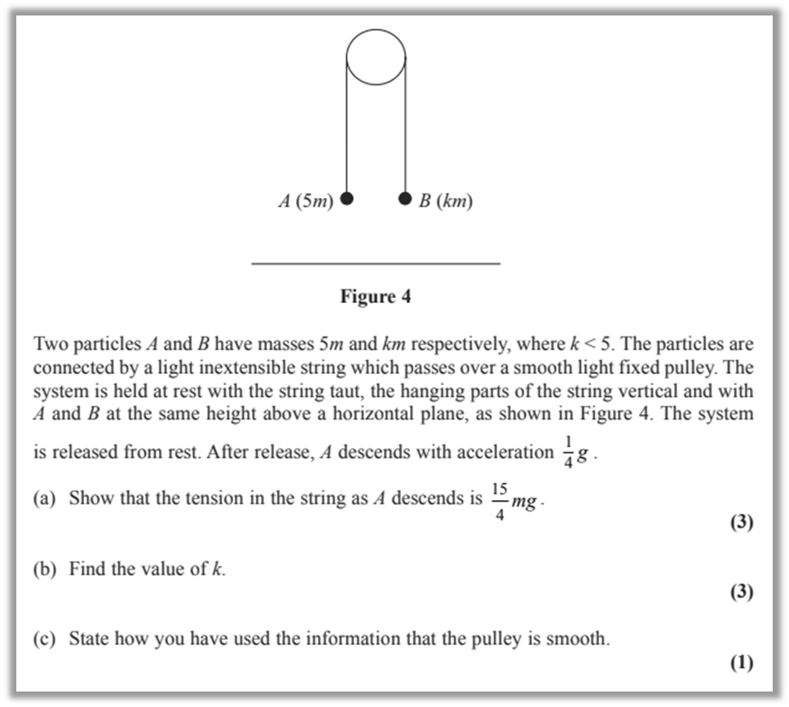







Connected Particles - Pulleys
Smooth and Light Pulley
Light inextensible string
$$a$$
$$T$$
$$T$$
Forces
Diagrams
$$a$$
5m
km
$$a$$
$$5mg$$
$$kmg$$
F = ma
5mg – T = 5ma
T - kmg = kma

Slide 13
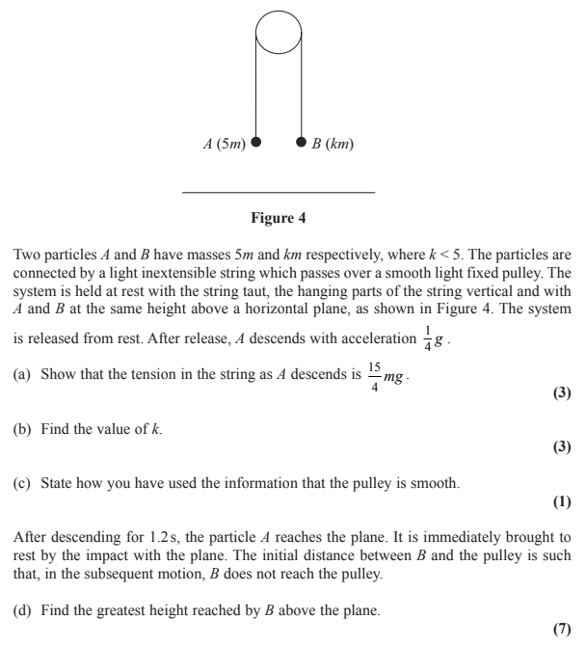
Connected Particles - Pulleys

Slide 14
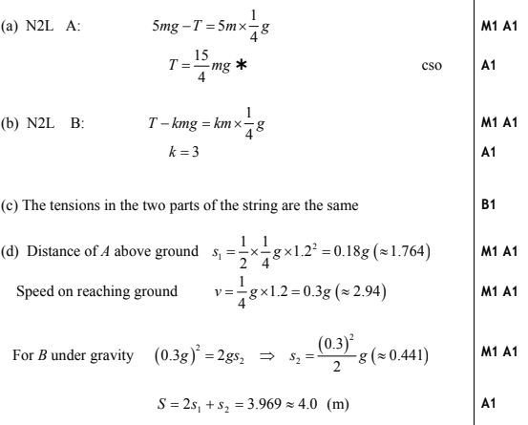
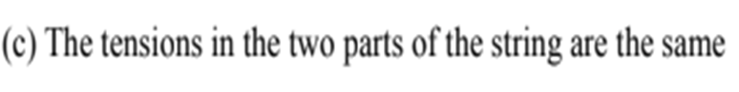
Connected Particles - Pulleys
k < 5

Slide 15
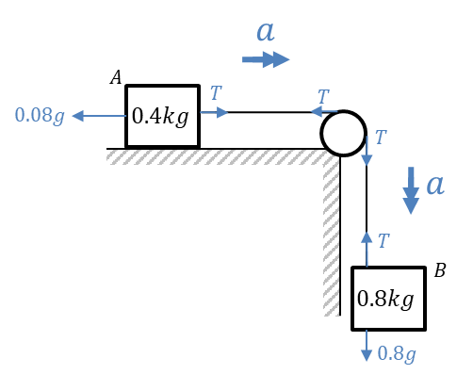
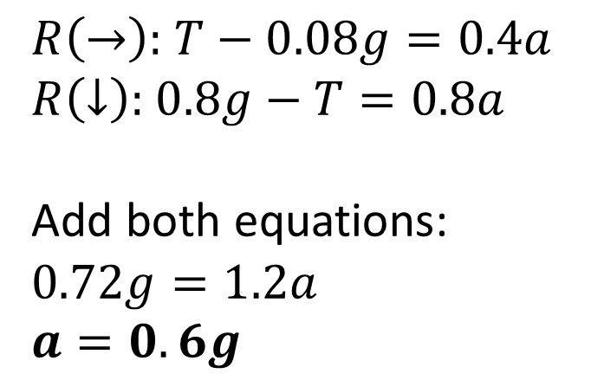
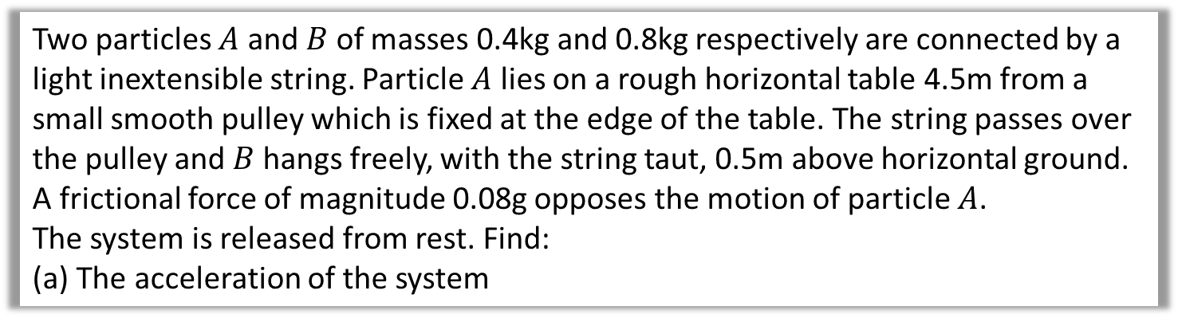
Connected Particles – Forces and SUVAT
Two particles $A$ and $B$ of masses 0.4kg and 0.8kg respectively are connected by a light inextensible string. Particle $A$ lies on a rough horizontal table 4.5m from a small smooth pulley which is fixed at the edge of the table. The string passes over the pulley and $B$ hangs freely, with the string taut, 0.5m above horizontal ground. A frictional force of magnitude 0.08g opposes the motion of particle $A$.
The system is released from rest. Find:
The acceleration of the system
$R\left(→\right):$ $T−0.08g=0.4a$
$R\left(↓\right):$ $0.8g−T=0.8a$
Add both equations:
$$0.72g=1.2a$$
$$a=0.6g$$
a
$A,B$ start moving.
$B$ hits ground.
$A$ comes to rest.
$$u=0$$
$$s=0.5$$
$$v→u$$
$$s=?$$
$$v=0$$
Time

Slide 16
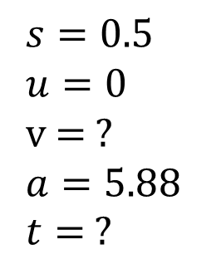
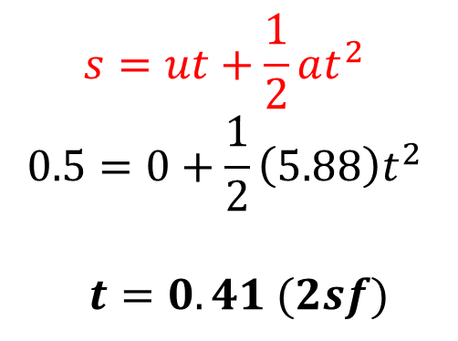
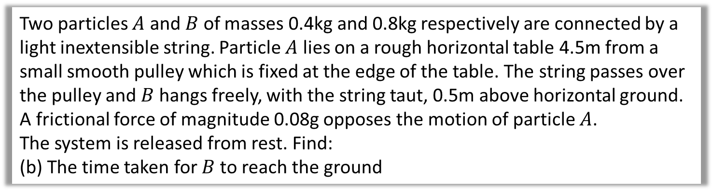
Connected Particles – Forces and SUVAT
Two particles $A$ and $B$ of masses 0.4kg and 0.8kg respectively are connected by a light inextensible string. Particle $A$ lies on a rough horizontal table 4.5m from a small smooth pulley which is fixed at the edge of the table. The string passes over the pulley and $B$ hangs freely, with the string taut, 0.5m above horizontal ground. A frictional force of magnitude 0.08g opposes the motion of particle $A$.
The system is released from rest. Find:
(b) The time taken for $B$ to reach the ground
$$s=0.5$$
$$u=0$$
v = ?
$$a=5.88$$
$$t= ?$$
b
$$s=ut+\frac{1}{2}at^{2}$$
$$0.5=0+\frac{1}{2}\left(5.88\right)t^{2}$$
$$t=0.41 (2sf)$$
$A,B$ start moving.
$B$ hits ground.
$A$ comes to rest.
$$u=0$$
$$s=0.5$$
$$v→u$$
$$s=?$$
$$v=0$$
Time

Slide 17
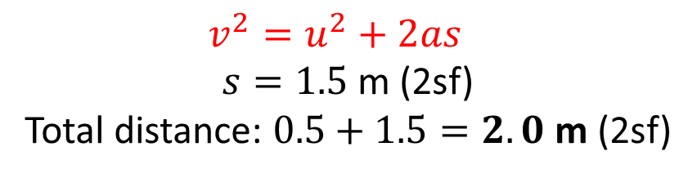

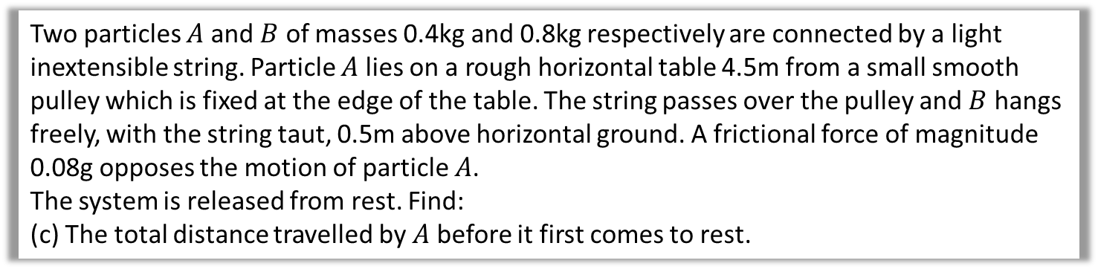
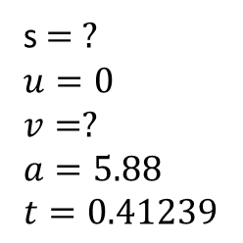

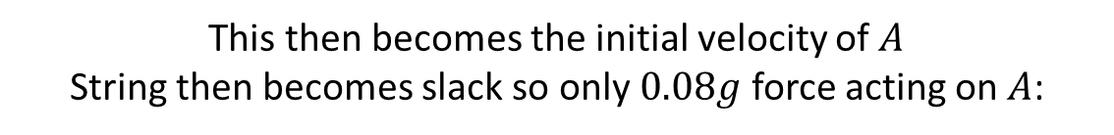
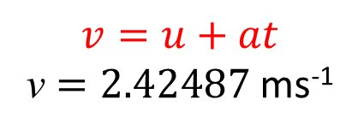

Connected Particles – Forces and SUVAT
Two particles $A$ and $B$ of masses 0.4kg and 0.8kg respectively are connected by a light inextensible string. Particle $A$ lies on a rough horizontal table 4.5m from a small smooth pulley which is fixed at the edge of the table. The string passes over the pulley and $B$ hangs freely, with the string taut, 0.5m above horizontal ground. A frictional force of magnitude 0.08g opposes the motion of particle $A$.
The system is released from rest. Find:
(c) The total distance travelled by $A$ before it first comes to rest.
c
First find speed of $B$ when it hits ground:
s $= ?$
$$u=0$$
$$v=?$$
$$a=5.88$$
$$t=0.41239$$
$$v=u+at$$
v $=2.42487$ ms⁻¹
This then becomes the initial velocity of $A$
String then becomes slack so only $0.08g$ force acting on $A$:
$$F=ma$$
$$0 − 0.08g=0.4a$$
$$a=−0.2g$$
$$s=?$$
$$u=2.42487$$
$$v=0$$
$$a=−0.2g$$
$$t= ?$$
$$v^{2}=u^{2}+2as$$
$s=1.5$ m (2sf)
Total distance: $0.5+1.5=2.0$ m (2sf)
$A,B$ start moving.
$B$ hits ground.
$A$ comes to rest.
$$u=0$$
$$s=0.5$$
$$v→u$$
$$s=?$$
$$v=0$$
Time

Slide 18
Exercise 10E
Pearson Stats/Mechanics Year 1
Pages 171-172
Complete before the lesson Q1-2
In Class:
Green Q3-4
Amber Q5
Red Q6-9

