Slide 1
Year 2 Pure Mathematics
Differentiation
- Sin and Cos
Chapter 9
(Part 1 of 10)

Slide 2
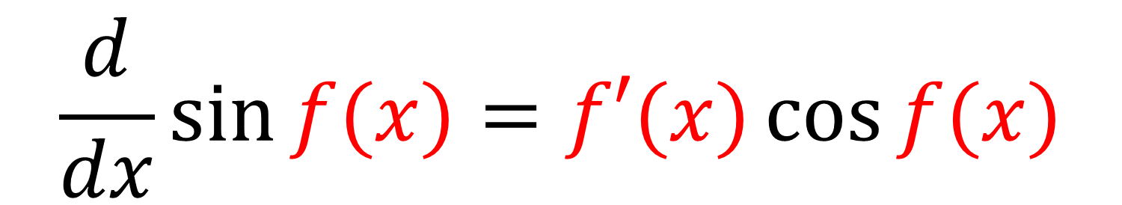

Differentiating $\sin{x}$
Differentiating sin $x$
$$\frac{d}{dx}\sin{f(x)}=f′(x)\cos{f(x)}$$

Slide 3
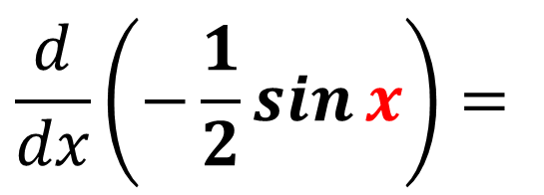
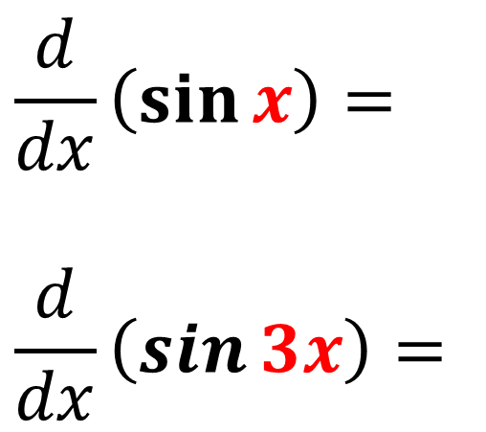
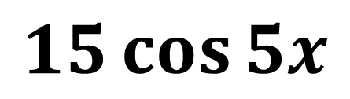
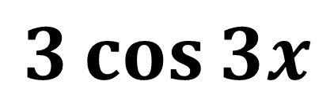
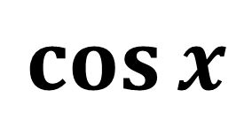
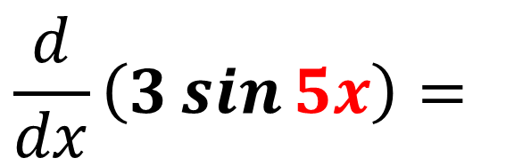
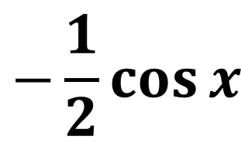
Differentiating: $\sin{f(x)}=f′(x)\cos{f(x)}$
$$\frac{d}{dx}\left(\sin{x}\right)=$$
$$\frac{d}{dx}\left(\sin{3x}\right)=$$
$$\cos{x}$$
$$3\cos{3x}$$
$$\frac{d}{dx}\left(3\sin{5x}\right)=$$
$$15\cos{5x}$$
$$\frac{d}{dx}\left(−\frac{1}{2}\sin{x}\right)=$$
$$−\frac{1}{2}\cos{x}$$

Slide 4
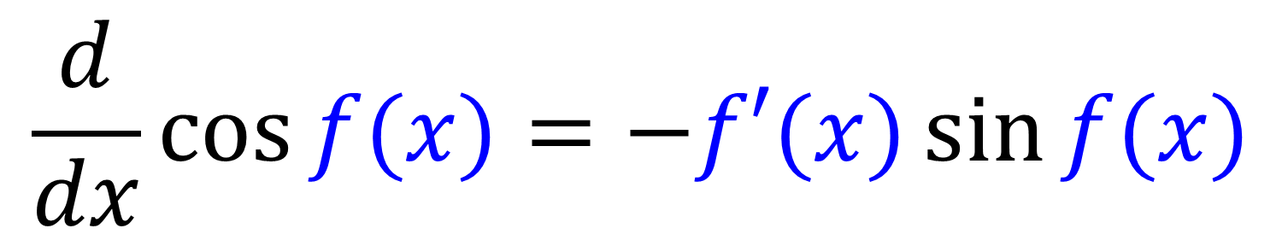

Differentiating $\cos{x}$
Differentiating cos $x$
$$\frac{d}{dx}\cos{f(x)}=−f′(x)\sin{f(x)}$$

Slide 5
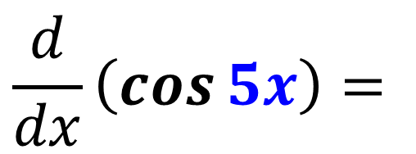
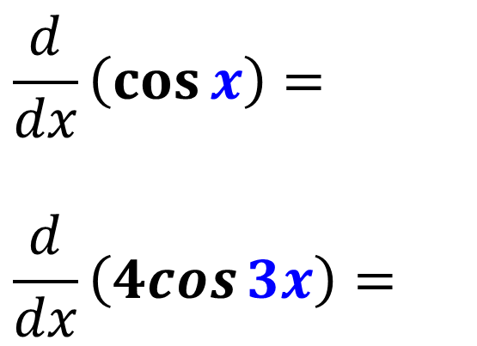
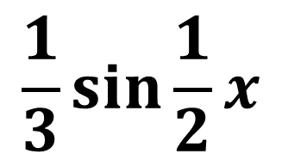
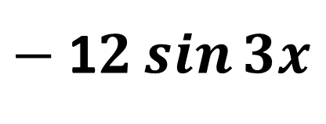
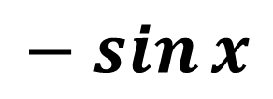
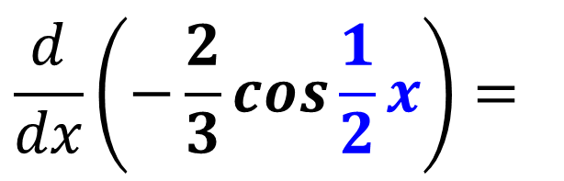
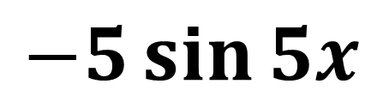
Differentiating: $\cos{f(x)}=−f′(x)\sin{f(x)}$
$$\frac{d}{dx}\left(\cos{x}\right)=$$
$$\frac{d}{dx}\left(4cos{3x}\right)=$$
$$− sin{x}$$
$−$1$2\sin{3x}$
$$\frac{d}{dx}\left(\cos{5x}\right)=$$
$$−5\sin{5x}$$
$$\frac{d}{dx}\left(−\frac{2}{3}\cos{\frac{1}{2}x}\right)=$$
$$\frac{1}{3}\sin{\frac{1}{2}x}$$

Slide 6
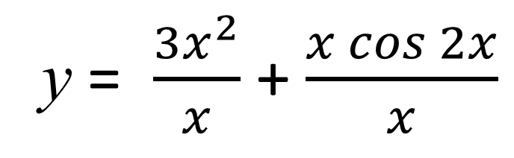
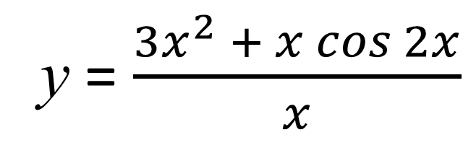

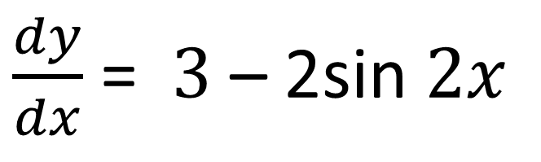
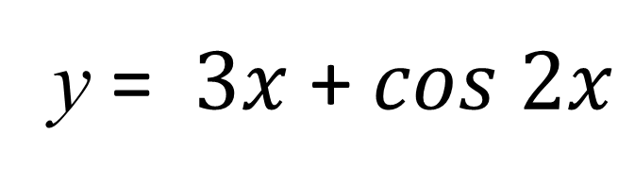
Differentiation – Exam Questions
y = $\frac{3x^{2} + x cos 2x}{x}$
Find $\frac{dy}{dx}$ for the equation
y = $\frac{3x^{2}}{x}$ + $\frac{x cos 2x}{x}$
y = $3x$ + $cos 2x$
$\frac{dy}{dx}$ = $3$ – 2sin$2x$

Slide 7
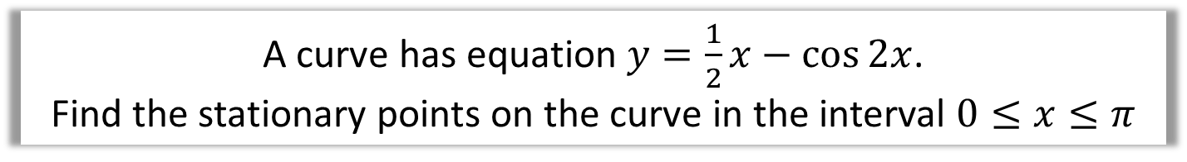
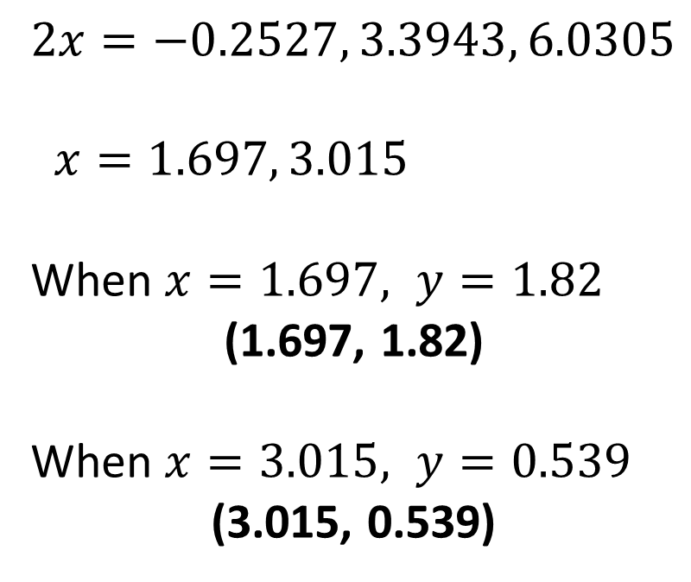
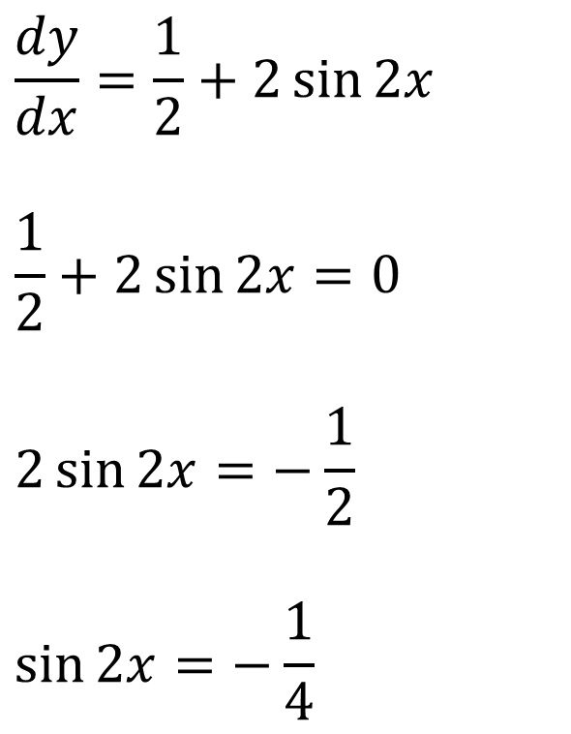
Differentiating $−$ Exam Questions
A curve has equation $y=\frac{1}{2}x−\cos{2x}$.
Find the stationary points on the curve in the interval $0≤x≤π$
$$\frac{dy}{dx}=\frac{1}{2}+2\sin{2x}$$
$$\frac{1}{2}+2\sin{2x}=0$$
$$2\sin{2x}=−\frac{1}{2}$$
$$\sin{2x}=−\frac{1}{4}$$
$$2x=−0.2527, 3.3943, 6.0305$$
$x=1.697, 3.015$
When $x=1.697, y=1.82$
(1.697, 1.82)
When $x=3.015, y=0.539$
(3.015, 0.539)

Slide 8
Exercise 9A
Pearson Pure Mathematics Year 2/AS
Page 234
Complete before the lesson Q4, 6 & 7
In Class:
Green Q8
Amber Q9
Red Q10 & Challenge

