Slide 1
Year 2 Applied Mathematics
Moments
- Centre of Mass
Chapter 4
(Part 4 of 5)

Slide 2
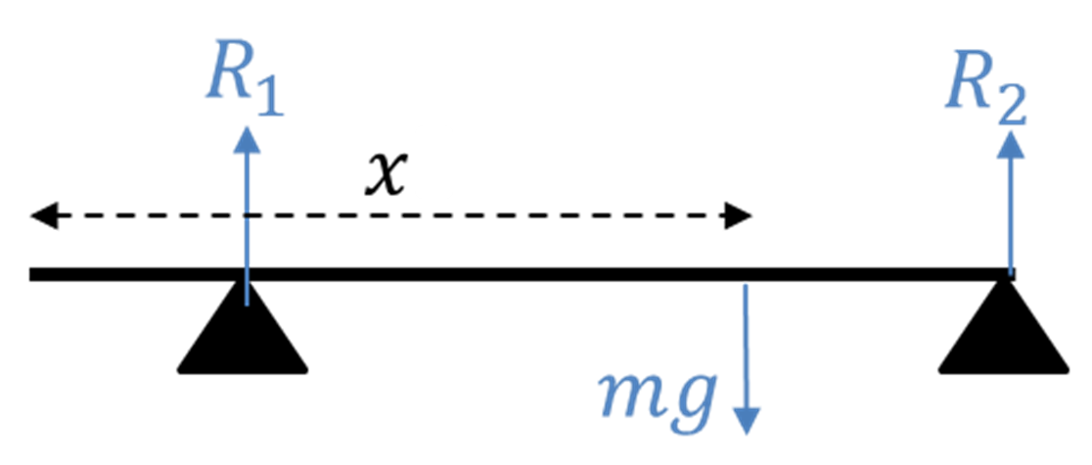
Centre of Mass
Non-uniform rods
You can’t model its weight as acting at the centre.

Slide 3
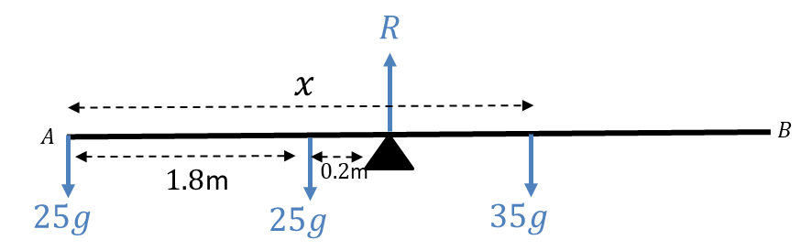
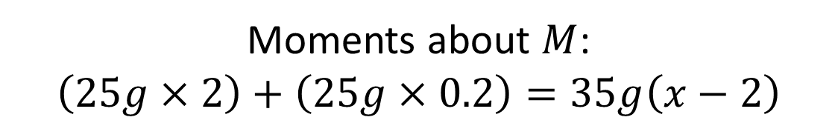
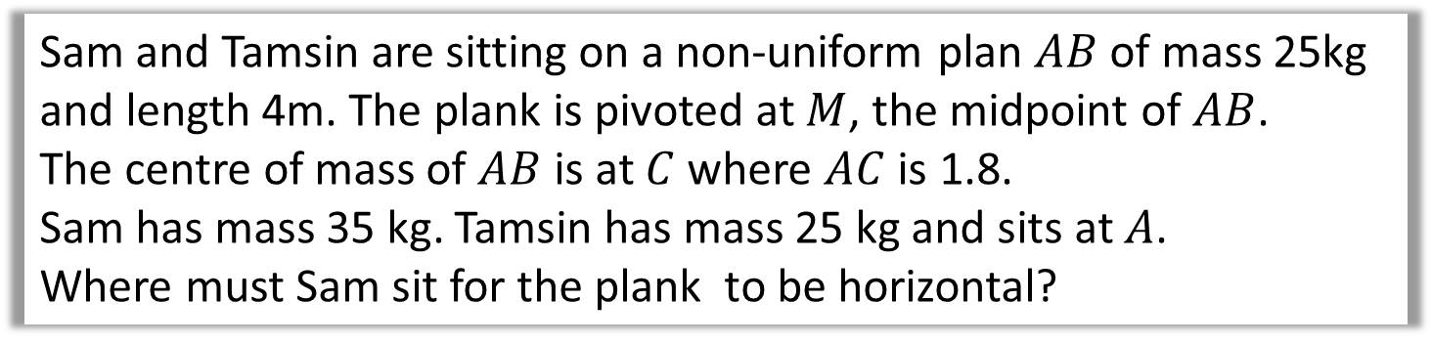

Centres of Mass - Example
Sam and Tamsin are sitting on a non-uniform plan $AB$ of mass 25kg and length 4m. The plank is pivoted at $M$, the midpoint of $AB$.
The centre of mass of $AB$ is at $C$ where $AC$ is 1.8.
Sam has mass 35 kg. Tamsin has mass 25 kg and sits at $A$.
Where must Sam sit for the plank to be horizontal?
Moments about $M$:
$$\left(25g×2\right)+\left(25g×0.2\right)=35g\left(x−2\right)$$
$$x=3.57$$

Slide 4
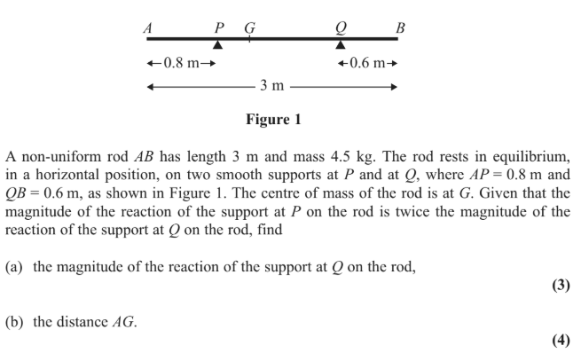
Centre of Mass – Exam Question

Slide 5
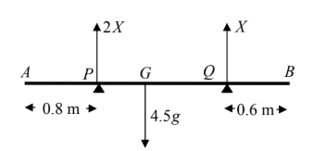

Test Your Understanding
a)

Slide 6
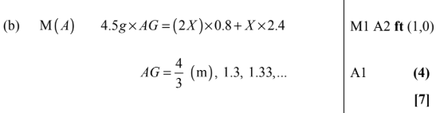
Test Your Understanding
b)

Slide 7
Test Your Understanding
Edexcel M1(Old) May 2012 Q2
? Diagram
?
?

Slide 8
Exercise 4D
Pearson Stats/Mechanics Year 2
Page 81-83
Complete before the lesson Q1-2
In Class:
Green Q3-4
Amber Q5-6
Red Q7-8 & Challenge

