Slide 1

CorePure1 Chapter 9 ::
Vectors
jfrost@tiffin.kingston.sch.uk
www.drfrostmaths.com
@DrFrostMaths
Last modified: 14th September 2018

Slide 2








www.drfrostmaths.com
Everything is completely free.
Why not register?
Register now to interactively practise questions on this topic, including past paper questions and extension questions (including MAT + UKMT).
Teachers: you can create student accounts (or students can register themselves), to set work, monitor progress and even create worksheets.
With questions by:
Dashboard with points, trophies, notifications and student progress.
Questions organised by topic, difficulty and past paper.
Teaching videos with topic tests to check understanding.

Slide 3
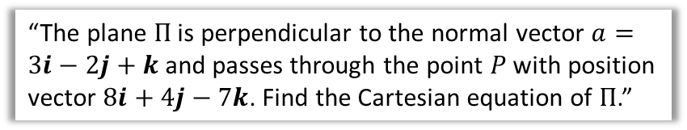
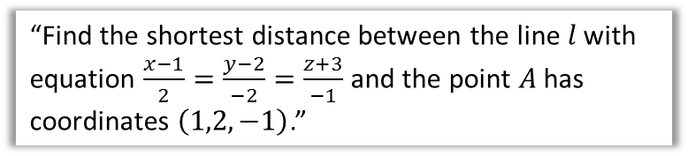

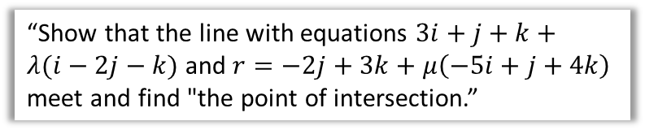
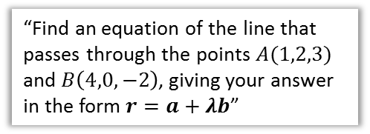
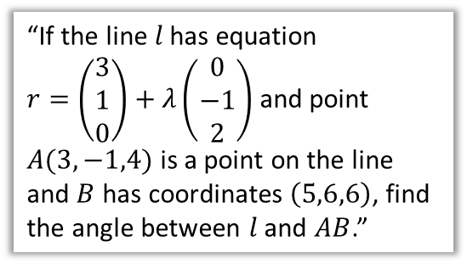
Chapter Overview
This will likely all be new content to you.
2:: Equations of planes
1:: Equations of straight lines in 3D
“The plane $Π$ is perpendicular to the normal vector $a=3i−2j+k$ and passes through the point $P$ with position vector $8i+4j−7k$. Find the Cartesian equation of $Π$.”
“Find an equation of the line that passes through the points $A(1,2,3)$ and $B\left(4,0,−2\right)$, giving your answer in the form $r=a+λb$”
4:: Scalar product form of equation of plane.
3:: Scalar product and angles between line + line or plane + line or plane + plane.
$$r⋅n=a⋅n$$
5:: Point of intersection of two planes.
“If the line $l$ has equation
$r=\left(\begin{matrix}3 \\ 1 \\ 0\end{matrix}\right)+λ\left(\begin{matrix}0 \\ −1 \\ 2\end{matrix}\right)$ and point $A(3,−1,4)$ is a point on the line and $B$ has coordinates $\left(5,6,6\right)$, find the angle between $l$ and $AB$.”
“Show that the line with equations $3i+j+k+λ(i−2j−k)$ and $r=−2j+3k+μ\left(−5i+j+4k\right)$ meet and find "the point of intersection.”
6:: Perpendicular distance between line + line or point + line or point + plane.
“Find the shortest distance between the line $l$ with equation $\frac{x−1}{2}=\frac{y−2}{−2}=\frac{z+3}{−1}$ and the point $A$ has coordinates $\left(1,2,−1\right)$.”
Teacher Note: This chapter is a combination of old C4 and FP3 content (although no cross product).

Slide 4







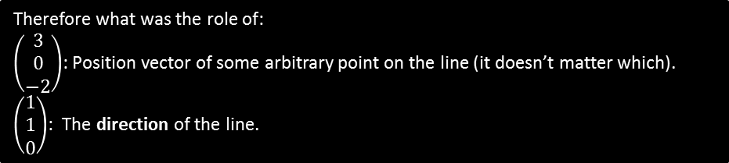


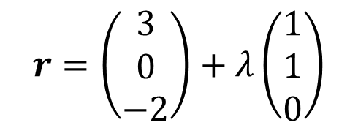


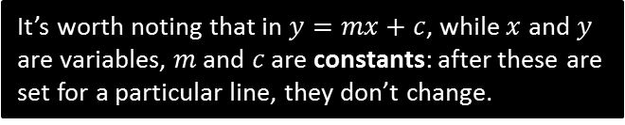

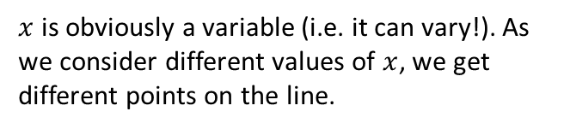


Vector equation of a straight line in 3D
Consider the equation of a straight line in 2D:
$$y=3x+2$$
$$y$$
$$x=2 →(2,8)$$
$$x=1 →(1,5)$$
$x$ is obviously a variable (i.e. it can vary!). As we consider different values of $x$, we get different points on the line.
$$x=0 →(0,2)$$
It’s worth noting that in $y=mx+c$, while $x$ and $y$ are variables, $m$ and $c$ are constants: after these are set for a particular line, they don’t change.
$$x$$
$$λ=2 →\left(5,2,−2\right)$$
Can we do something similar with vectors? Consider:
$$λ=1 →\left(4,1,−2\right)$$
$$r=\left(\begin{matrix}3 \\ 0 \\ −2\end{matrix}\right)+λ\left(\begin{matrix}1 \\ 1 \\ 0\end{matrix}\right)$$
$$λ=0 →\left(3,0,−2\right)$$
$$λ=−1 →\left(5,2,−2\right)$$
$$\left(\begin{matrix}1 \\ 1 \\ 0\end{matrix}\right)$$
$$\left(\begin{matrix}3 \\ 0 \\ −2\end{matrix}\right)$$
$$O$$
What happens as we vary $λ$?
Therefore what was the role of:
$\left(\begin{matrix}3 \\ 0 \\ −2\end{matrix}\right)$: Position vector of some arbitrary point on the line (it doesn’t matter which).
$\left(\begin{matrix}1 \\ 1 \\ 0\end{matrix}\right)$: The direction of the line.
?
?

Slide 5
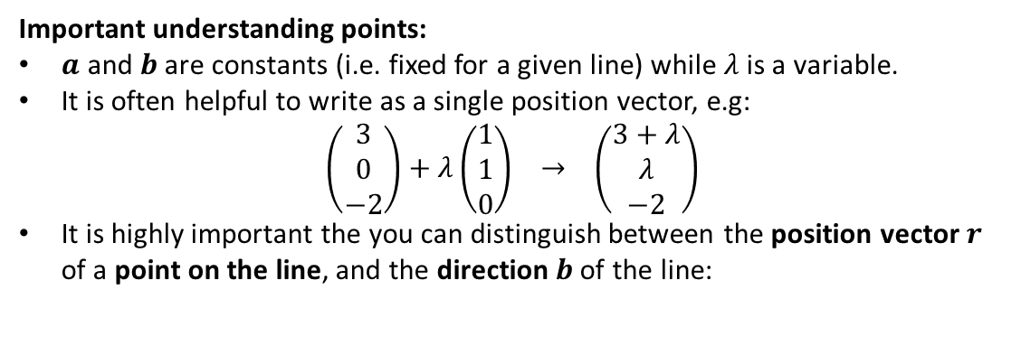
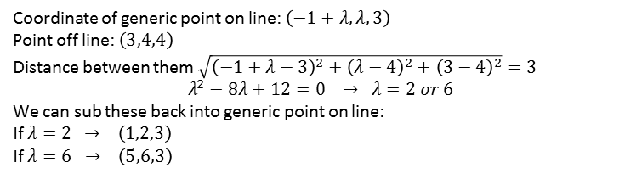
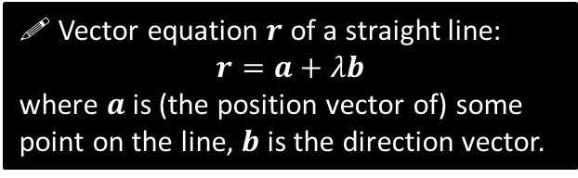

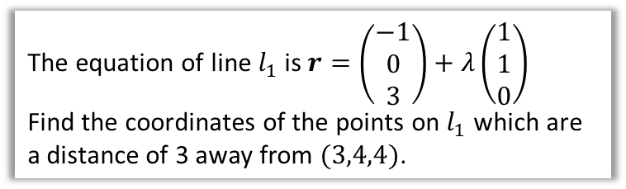
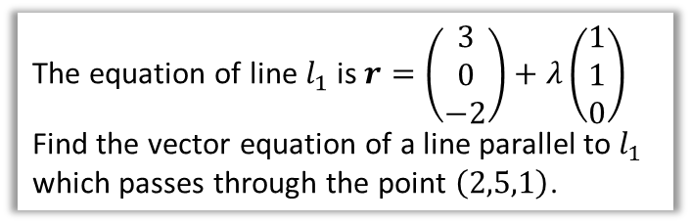
Vector equation of a straight line in 3D
! Vector equation $r$ of a straight line:
$$r=a+λb$$
where $a$ is (the position vector of) some point on the line, $b$ is the direction vector.
Important understanding points:
$a$ and $b$ are constants (i.e. fixed for a given line) while $λ$ is a variable.
It is often helpful to write as a single position vector, e.g:
$\left(\begin{matrix}3 \\ 0 \\ −2\end{matrix}\right)+λ\left(\begin{matrix}1 \\ 1 \\ 0\end{matrix}\right) → \left(\begin{matrix}3+λ \\ λ \\ −2\end{matrix}\right)$
It is highly important the you can distinguish between the position vector $r$ of a point on the line, and the direction $b$ of the line:
Example Problem
Example Problem
The equation of line $l_{1}$ is $r=\left(\begin{matrix}3 \\ 0 \\ −2\end{matrix}\right)+λ\left(\begin{matrix}1 \\ 1 \\ 0\end{matrix}\right)$
Find the vector equation of a line parallel to $l_{1}$ which passes through the point $\left(2,5,1\right)$.
The equation of line $l_{1}$ is $r=\left(\begin{matrix}−1 \\ 0 \\ 3\end{matrix}\right)+λ\left(\begin{matrix}1 \\ 1 \\ 0\end{matrix}\right)$
Find the coordinates of the points on $l_{1}$ which are a distance of 3 away from $(3,4,4)$.
Coordinate of generic point on line: $\left(−1+λ,λ,3\right)$
Point off line: $\left(3,4,4\right)$
Distance between them $\sqrt{{\left(−1+λ−3\right)}^{2}+{\left(λ−4\right)}^{2}+{\left(3−4\right)}^{2}}=3$
$$λ^{2}−8λ+12=0 → λ=2 or 6$$
We can sub these back into generic point on line:
If $λ=2$ $→ \left(1,2,3\right)$
If $λ=6 → \left(5,6,3\right)$
?
?
$$\left(\begin{matrix}2 \\ 5 \\ 1\end{matrix}\right)+λ\left(\begin{matrix}1 \\ 1 \\ 0\end{matrix}\right)$$
Same direction vector, but different ‘starting point’.

Slide 6



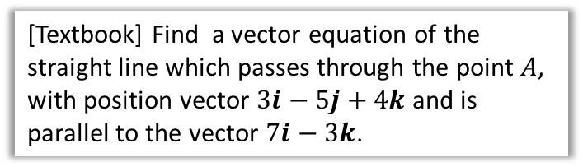

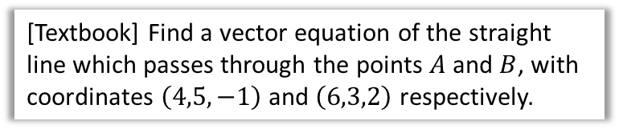
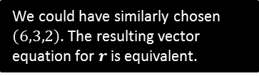
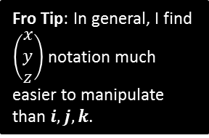

Examples
[Textbook] Find a vector equation of the straight line which passes through the point $A$, with position vector $3i−5j+4k$ and is parallel to the vector $7i−3k$.
[Textbook] Find a vector equation of the straight line which passes through the points $A$ and $B$, with coordinates $\left(4,5,−1\right)$ and $\left(6,3,2\right)$ respectively.
?
?
$$\left(\begin{matrix}3 \\ −5 \\ 4\end{matrix}\right)+λ\left(\begin{matrix}7 \\ 0 \\ −3\end{matrix}\right)$$
or as a single vector:
$$\left(\begin{matrix}3+7λ \\ −5 \\ 4−3λ\end{matrix}\right)$$
Fro Tip: In general, I find $\left(\begin{matrix}x \\ y \\ z\end{matrix}\right)$ notation much easier to manipulate than $i,j,k$.
$$B\left(6,3,2\right)$$
$$A\left(4,5,−1\right)$$
The direction of the line is $\vec{AB}=\left(\begin{matrix}2 \\ −2 \\ 3\end{matrix}\right)$
A point on the line:
$$\left(4,5,−1\right)$$
$$r=\left(\begin{matrix}4 \\ 5 \\ −1\end{matrix}\right)+λ\left(\begin{matrix}2 \\ −2 \\ 3\end{matrix}\right)$$
Note that $\vec{AB}=\vec{OB}−\vec{OA}$, i.e. $\left(\begin{matrix}6 \\ 3 \\ 2\end{matrix}\right)−\left(\begin{matrix}4 \\ 5 \\ −1\end{matrix}\right)$. But we can easily see by inspection that the change from 4 to 6 is -2, from 5 to 3 is -2, and so on.
We could have similarly chosen $\left(6,3,2\right)$. The resulting vector equation for $r$ is equivalent.

Slide 7

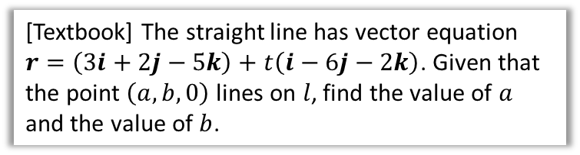


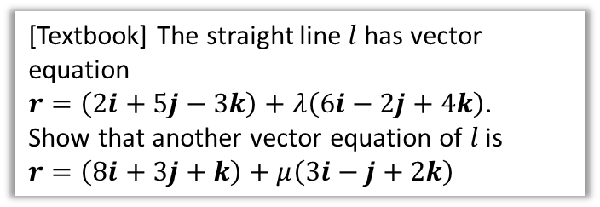
Examples
[Textbook] The straight line has vector equation $r=\left(3i+2j−5k\right)+t\left(i−6j−2k\right)$. Given that the point $\left(a,b,0\right)$ lines on $l$, find the value of $a$ and the value of $b$.
[Textbook] The straight line $l$ has vector equation
$r=\left(2i+5j−3k\right)+λ\left(6i−2j+4k\right)$.
Show that another vector equation of $l$ is
$r=\left(8i+3j+k\right)+μ\left(3i−j+2k\right)$
?
We can represent a point on the line as $\left(\begin{matrix}3+t \\ 2−6t \\ −5−2t\end{matrix}\right)$
$$∴\left(\begin{matrix}3+t \\ 2−6t \\ −5−2t\end{matrix}\right)=\left(\begin{matrix}a \\ b \\ 0\end{matrix}\right)$$
Solving simultaneously:
$$−5−2t=0 → t=−\frac{5}{2} \\ a=3+t → a=\frac{1}{2} \\ b=2−6t → b=17$$
?
Fro Exam Note: This kind of question never appeared on the old Edexcel C4 papers. But they did come up in other exam boards such as OCR.
The strategy is to show the two lines (a) have a point in common, and (b) are parallel.
$\left(\begin{matrix}6 \\ −2 \\ 4\end{matrix}\right)=2\left(\begin{matrix}3 \\ −1 \\ 2\end{matrix}\right)$
$∴$ lines are parallel
Letting $λ=0 → \left(2,5,−3\right)$
We can obtain the same point when $μ=−2$:
$$→ \left(2,5,−3\right)$$
We can arbitrarily let $λ$ be 0. We can then find a $μ$ that gives us the same point by observation.

Slide 8

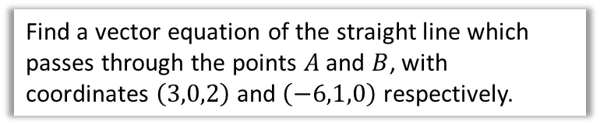
Test Your Understanding So Far
Find a vector equation of the straight line which passes through the points $A$ and $B$, with coordinates $\left(3,0,2\right)$ and $\left(−6,1,0\right)$ respectively.
?
$$\vec{AB}=\left(\begin{matrix}−9 \\ 1 \\ −2\end{matrix}\right)$$
$$∴r=\left(\begin{matrix}3 \\ 0 \\ 2\end{matrix}\right)+λ\left(\begin{matrix}−9 \\ 1 \\ −2\end{matrix}\right)$$

Slide 9
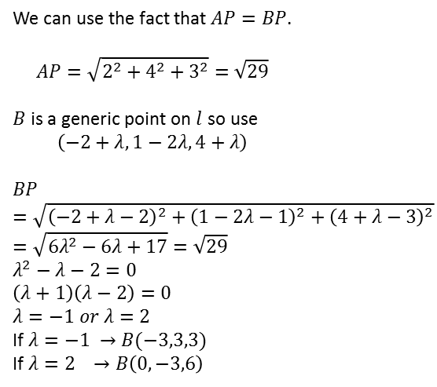


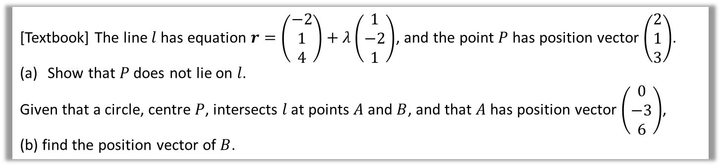




Examples
[Textbook] The line $l$ has equation $r=\left(\begin{matrix}−2 \\ 1 \\ 4\end{matrix}\right)+λ\left(\begin{matrix}1 \\ −2 \\ 1\end{matrix}\right)$, and the point $P$ has position vector $\left(\begin{matrix}2 \\ 1 \\ 3\end{matrix}\right)$.
Show that $P$ does not lie on $l$.
Given that a circle, centre $P$, intersects $l$ at points $A$ and $B$, and that $A$ has position vector $\left(\begin{matrix}0 \\ −3 \\ 6\end{matrix}\right)$,
(b) find the position vector of $B$.
a
?
b
$$l$$
$$r=\left(\begin{matrix}−2+λ \\ 1−2λ \\ 4+λ\end{matrix}\right)$$
$P(2,1,3)$ lies on line therefore
$$2=−2+λ ⇒ λ=4$$
But then $1−2λ=−7≠1$ and $4+λ=8≠3$, so $P$ does not lie on $l$.
?
$$B$$
We can use the fact that $AP=BP$.
$$AP=\sqrt{2^{2}+4^{2}+3^{2}}=\sqrt{29}$$
$B$ is a generic point on $l$ so use
$$\left(−2+λ, 1−2λ, 4+λ\right)$$
$$BP=\sqrt{{\left(−2+λ−2\right)}^{2}+{\left(1−2λ−1\right)}^{2}+{\left(4+λ−3\right)}^{2}} \\ =\sqrt{6λ^{2}−6λ+17}=\sqrt{29} \\ λ^{2}−λ−2=0 \\ \left(λ+1\right)\left(λ−2\right)=0 \\ λ=−1 or λ=2$$
If $λ=−1 →B(−3,3,3)$
If $λ=2 →B\left(0,−3,6\right)$
$$A\left(0,−3,6\right)$$
$$P\left(2,1,3\right)$$
Remember that $r$ is the coordinate of a generic point on the line. Point $B$ is unknown so use $r$.

Slide 10

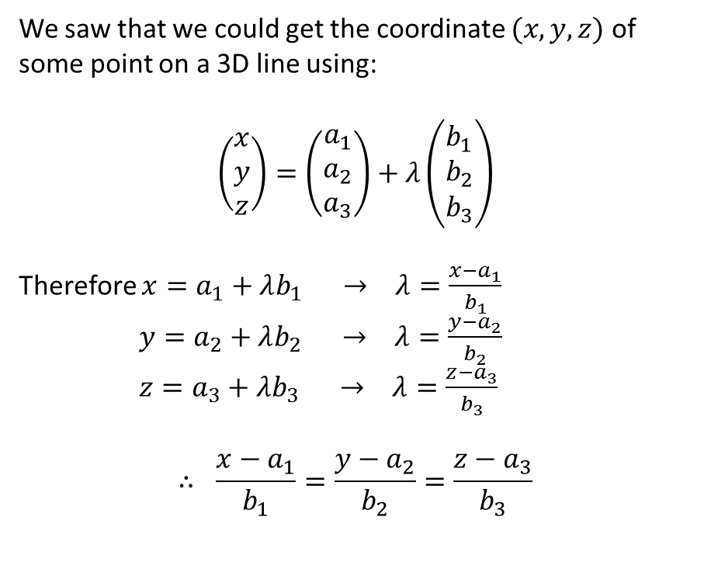
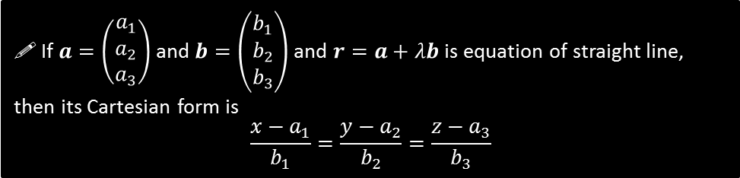
Cartesian form of equation of straight line
We saw that we could get the coordinate $(x,y,z)$ of some point on a 3D line using:
$$\left(\begin{matrix}x \\ y \\ z\end{matrix}\right)=\left(\begin{matrix}a_{1} \\ a_{2} \\ a_{3}\end{matrix}\right)+λ\left(\begin{matrix}b_{1} \\ b_{2} \\ b_{3}\end{matrix}\right)$$
Therefore $x=a_{1}+λb_{1} → λ=\frac{x−a_{1}}{b_{1}}$
$y=a_{2}+λb_{2} → λ=\frac{y−a_{2}}{b_{2}}$
$z=a_{3}+λb_{3} → λ=\frac{z−a_{3}}{b_{3}}$
$$∴ \frac{x−a_{1}}{b_{1}}=\frac{y−a_{2}}{b_{2}}=\frac{z−a_{3}}{b_{3}}$$
Recall that a Cartesian equation is one involving $x,y,z$ and no variable parameters (i.e. no $λ$).
! If $a=\left(\begin{matrix}a_{1} \\ a_{2} \\ a_{3}\end{matrix}\right)$ and $b=\left(\begin{matrix}b_{1} \\ b_{2} \\ b_{3}\end{matrix}\right)$ and $r=a+λb$ is equation of straight line, then its Cartesian form is
$$\frac{x−a_{1}}{b_{1}}=\frac{y−a_{2}}{b_{2}}=\frac{z−a_{3}}{b_{3}}$$

Slide 11
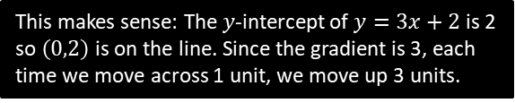

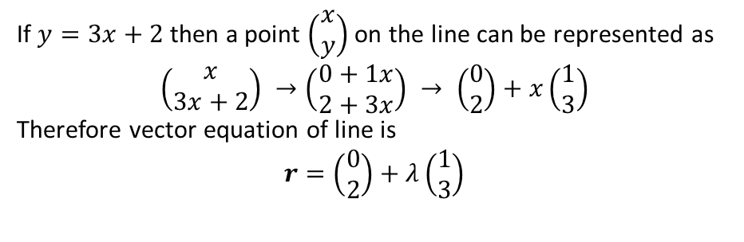

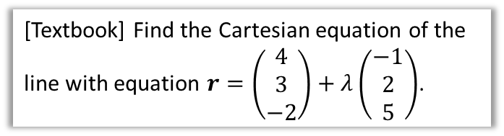
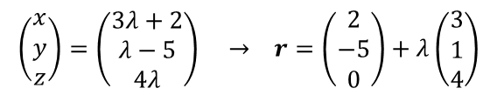

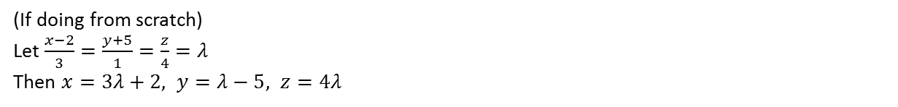
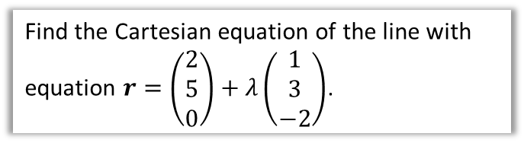
Examples
[Textbook] Find the Cartesian equation of the line with equation $r=\left(\begin{matrix}4 \\ 3 \\ −2\end{matrix}\right)+λ\left(\begin{matrix}−1 \\ 2 \\ 5\end{matrix}\right)$.
Find the Cartesian equation of the line with equation $r=\left(\begin{matrix}2 \\ 5 \\ 0\end{matrix}\right)+λ\left(\begin{matrix}1 \\ 3 \\ −2\end{matrix}\right)$.
?
?
$$\frac{x−4}{−1}=\frac{y−3}{2}=\frac{z+2}{5}$$
$$\frac{x−2}{1}=\frac{y−5}{3}=\frac{z}{−2}$$
The Cartesian equation of a line is $y=3x+2$. Find the vector form of the equation of the line.
?
If $y=3x+2$ then a point $\left(\begin{matrix}x \\ y\end{matrix}\right)$ on the line can be represented as
$$\left(\begin{matrix}x \\ 3x+2\end{matrix}\right) →\left(\begin{matrix}0+1x \\ 2+3x\end{matrix}\right) → \left(\begin{matrix}0 \\ 2\end{matrix}\right)+x\left(\begin{matrix}1 \\ 3\end{matrix}\right)$$
Therefore vector equation of line is
$$r=\left(\begin{matrix}0 \\ 2\end{matrix}\right)+λ\left(\begin{matrix}1 \\ 3\end{matrix}\right)$$
This is the opposite of combining $r=a+λb$ into a single vector: we’re splitting it up instead!
This makes sense: The $y$-intercept of $y=3x+2$ is 2 so $\left(0,2\right)$ is on the line. Since the gradient is 3, each time we move across 1 unit, we move up 3 units.
The Cartesian equation of a line is $\frac{x−2}{3}=\frac{y+5}{1}=\frac{z}{4}$. Find the vector form of the equation of the line.
?
(If doing from scratch)
Let $\frac{x−2}{3}=\frac{y+5}{1}=\frac{z}{4}=λ$
Then $x=3λ+2, y=λ−5, z=4λ$
$$\left(\begin{matrix}x \\ y \\ z\end{matrix}\right)=\left(\begin{matrix}3λ+2 \\ λ−5 \\ 4λ\end{matrix}\right) → r=\left(\begin{matrix}2 \\ −5 \\ 0\end{matrix}\right)+λ\left(\begin{matrix}3 \\ 1 \\ 4\end{matrix}\right)$$

Slide 12
Exercise 9A
Pearson Core Pure Year 1
Pages 173-175
Complete before the lesson Q1-4
In Class:
Green Q5-7
Amber Q8-11
Red Q12-17

Slide 13











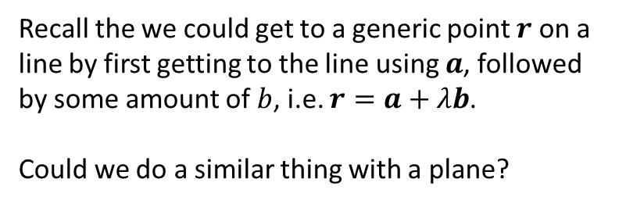
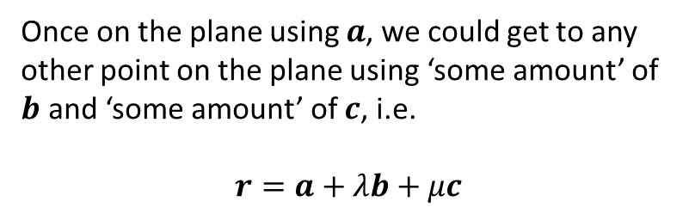
Equation of plane
$a$ is the position vector of a point on a plane and $b$ and $c$ are non-parallel vectors on the plane, how could we write the equation of the plane in vector form?
$$b$$
$$R$$
$$l$$
Recall the we could get to a generic point $r$ on a line by first getting to the line using $a$, followed by some amount of $b$, i.e. $r=a+λb$.
Could we do a similar thing with a plane?
$$a$$
$$r$$
$$O$$
?
Once on the plane using $a$, we could get to any other point on the plane using ‘some amount’ of $b$ and ‘some amount’ of $c$, i.e.
$$r=a+λb+μc$$
$$b$$
$$c$$
$$a$$
$$O$$

Slide 14
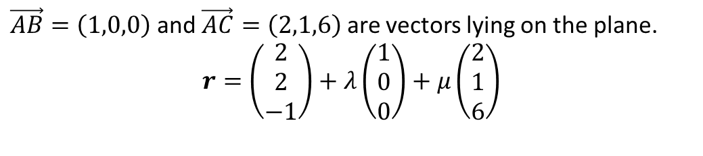

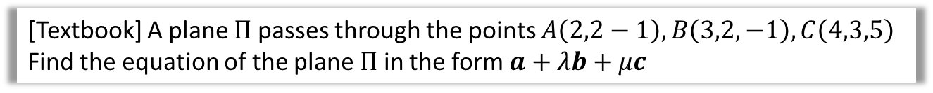
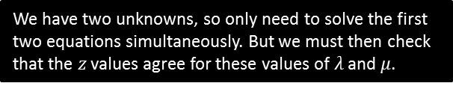
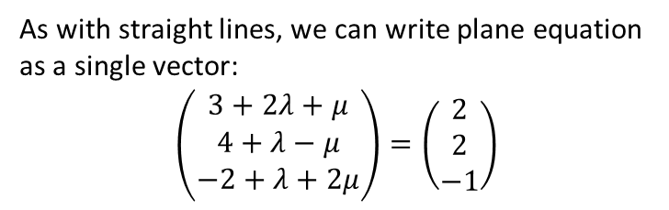
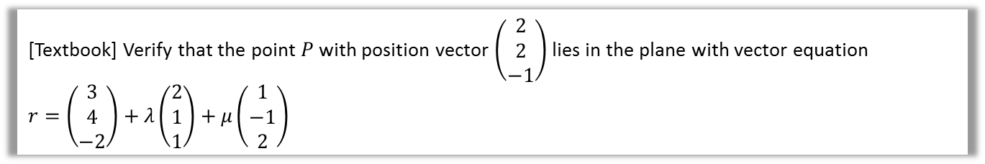
Examples
[Textbook] A plane $Π$ passes through the points $A\left(2,2−1\right), B\left(3,2,−1\right), C\left(4,3,5\right)$
Find the equation of the plane $Π$ in the form $a+λb+μc$
?
$\vec{AB}=\left(1,0,0\right)$ and $\vec{AC}=\left(2,1,6\right)$ are vectors lying on the plane.
$$r=\left(\begin{matrix}2 \\ 2 \\ −1\end{matrix}\right)+λ\left(\begin{matrix}1 \\ 0 \\ 0\end{matrix}\right)+μ\left(\begin{matrix}2 \\ 1 \\ 6\end{matrix}\right)$$
[Textbook] Verify that the point $P$ with position vector $\left(\begin{matrix}2 \\ 2 \\ −1\end{matrix}\right)$ lies in the plane with vector equation
$r=\left(\begin{matrix}3 \\ 4 \\ −2\end{matrix}\right)+λ\left(\begin{matrix}2 \\ 1 \\ 1\end{matrix}\right)+μ\left(\begin{matrix}1 \\ −1 \\ 2\end{matrix}\right)$
?
As with straight lines, we can write plane equation as a single vector:
$$\left(\begin{matrix}3+2λ+μ \\ 4+λ−μ \\ −2+λ+2μ\end{matrix}\right)=\left(\begin{matrix}2 \\ 2 \\ −1\end{matrix}\right)$$
We have two unknowns, so only need to solve the first two equations simultaneously. But we must then check that the $z$ values agree for these values of $λ$ and $μ$.
$$2λ+μ=−1 \\ λ−μ=−2 \\ →λ=−1, μ=1$$
Checking in last equation:
$$−2+\left(−1\right)+2\left(1\right)=−1$$
Therefore $P$ lies on plane.

Slide 15
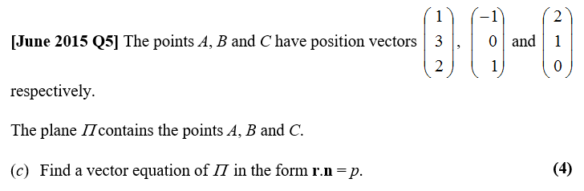

Test Your Understanding
?
Two vectors on the plane:
$$\vec{AB}=\left(\begin{matrix}−2 \\ −3 \\ −1\end{matrix}\right) \vec{AC}=\left(\begin{matrix}1 \\ −2 \\ −2\end{matrix}\right)$$
Possible equation:
$$r=\left(\begin{matrix}1 \\ 3 \\ 2\end{matrix}\right)+λ\left(\begin{matrix}−2 \\ −3 \\ −1\end{matrix}\right)+μ\left(\begin{matrix}1 \\ −2 \\ −2\end{matrix}\right)$$

Slide 16










Cartesian equation of a plane
For the Cartesian equation of a straight line, we made $λ$ the subject of each of the three equations so that we could equate:
$$\left(\begin{matrix}x \\ y \\ z\end{matrix}\right)=\left(\begin{matrix}a_{1} \\ a_{2} \\ a_{3}\end{matrix}\right)+λ\left(\begin{matrix}b_{1} \\ b_{2} \\ b_{3}\end{matrix}\right) \\ λ= \frac{x−a_{1}}{b_{1}}=\frac{y−a_{2}}{b_{2}}=\frac{z−a_{3}}{b_{3}}$$
We can’t use that same strategy as easily with a plane as there are two unknowns, $λ$ and $μ$.
$$y$$
$$\left(\begin{matrix}1 \\ 0.5\end{matrix}\right)$$
$$n=\left(\begin{matrix}−1 \\ 2\end{matrix}\right)$$
$$\left(0,3\right)$$
An alternative approach we could have used for the Cartesian equation of a straight line is to find a vector, perpendicular to the line (known as the normal vector $n$).
$$x$$
If $n=\left(\begin{matrix}n_{1} \\ n_{2}\end{matrix}\right)$, then the equation of the turns out to be $n_{1}x+n_{2}y=c$ where $c$ is a constant to be found. (We will prove this once we cover the scalar product of two vectors)
For example above: $n=\left(\begin{matrix}−1 \\ 2\end{matrix}\right)$ (by observation)
$$∴−1x+2y=c$$
As $(0,3)$ is on the line: $−1\left(0\right)+2\left(3\right)=c → c=6$
$$−x+2y=6$$
This is one reason in Pure Year 1 we might want the equation of a straight line equation in the form $ax+by=c$: the normal to the line will be $\left(\begin{matrix}a \\ b\end{matrix}\right)$.

Slide 17





Cartesian equation of a plane
$$n=\left(\begin{matrix}n_{1} \\ n_{2} \\ n_{3}\end{matrix}\right)$$
This extends to planes:
$$Π$$
! Equation of plane:
$$n_{1}x+n_{2}y+n_{3}z=c$$
[Textbook] The plane $Π$ is perpendicular to the normal $n=3i−2j+k$ and passes through the point $P$ with position vector $8i+4j−7k$. Find the Cartesian equation of $Π$.
?
$$3x−2y+z=c$$
It passes through $\left(8,4,−7\right)$ therefore:
$$3\left(8\right)−2\left(4\right)+\left(−7\right)=9=c$$
Therefore equation:
$$3x−2y+z=9$$

Slide 18
Exercise 9B
Pearson Core Pure Year 1
Pages 177-178
Complete before the lesson Q1-2
In Class:
Green Q3-5
Amber Q6-8
Red Q9-10 & challenge

Slide 19




Scalar Product
The scalar/dot product $a⋅b$ of two vectors is the sum of the products of the components.
$$a⋅b=\sum{a_{i}b_{i}}$$
$$\left(\begin{matrix}3 \\ 2 \\ 1\end{matrix}\right)⋅\left(\begin{matrix}4 \\ 0 \\ 1\end{matrix}\right)=13$$
$$\left(\begin{matrix}5 \\ −2 \\ 0\end{matrix}\right)⋅\left(\begin{matrix}3 \\ 3 \\ 1\end{matrix}\right)=9$$
?
?
$$\left(\begin{matrix}a \\ 5 \\ 1\end{matrix}\right)⋅\left(\begin{matrix}3 \\ b \\ 10\end{matrix}\right)=3a+5b+10$$
?

Slide 20






Angle between two vectors
Remarkably, if the two vectors are unit vectors, the dot product gives us the cosine of the angle between them.
$$a$$
! Angle between vectors:
$$\frac{a}{\left|a\right|}⋅\frac{b}{\left|b\right|}=\cos{θ}$$
but use:
$$\cos{θ}=\frac{a⋅b}{\left|a\right|\left|b\right|}$$
$$θ$$
$$b$$
Find the acute angle between the vectors $a=\left(\begin{matrix}5 \\ 3 \\ 1 \end{matrix}\right)$ and $b=\left(\begin{matrix}1 \\ 0 \\ 5\end{matrix}\right)$.
?
$$a⋅b=5+0+5=10 \\ \left|a\right|=\sqrt{35} \left|b\right|=\sqrt{26} \\ \cos{θ}=\frac{10}{\sqrt{35}\sqrt{26}}=0.331496… \\ θ=\cos^{−1}\left(…\right)=70.64°$$

Slide 21









Important point…
When finding an angle between two vectors using this method, ensure that the vectors point away from the point at which the angle is being measured.
The angle between two vectors may be acute or obtuse.
Find the angle between the vectors $\left(\begin{matrix}2 \\ 4 \\ −1\end{matrix}\right)$ and $\left(\begin{matrix}0 \\ 1 \\ 8\end{matrix}\right)$.
$$a$$
$$30°$$
?
$$b$$
$a=\left(\begin{matrix}2 \\ 4 \\ −1\end{matrix}\right)$ and $b=\left(\begin{matrix}0 \\ 1 \\ 8\end{matrix}\right)$
$$a⋅b=2\left(0\right)+4\left(1\right)+\left(−1\right)\left(8\right)=−4 \\ \left|a\right|=\sqrt{2^{2}+4^{2}+1^{2}}=\sqrt{21} \\ \left|b\right|=\sqrt{0^{2}+1^{2}+8^{2}}=\sqrt{65}$$
$$\cos{θ}=\frac{−4}{\sqrt{21} \sqrt{65}} \\ θ=96.2°$$
?
$$a$$
$$150°$$
$$b$$
$$30°$$

Slide 22











Further Examples
If $A\left(2,3,5\right), B(5,0,4)$ and $C\left(4,−3,2\right)$, determine the angle $ABC.$
Hence find the area of triangle $ABC$.
?
?
In general, area $=\frac{1}{2}ab\sin{C}$
So in this case:
$$Area=\frac{1}{2}\left|a\right|\left|b\right|\sin{θ}$$
$$=\frac{1}{2}×\sqrt{19}×\sqrt{14}×\sin{119.4°} \\ =7.10$$
Fro Tip: When finding an angle, always draw the diagram as pictured (with the points labelled) and explicitly write out what your $a$ and $b$ are before doing further calculation.
$$A$$
$$a$$
$$θ$$
$$B$$
Exam Note: Typically area questions come up within the last few parts of an exam question, where you have previously calculated an angle that can be used.
$$C$$
$$b$$
$$a=\vec{BA}=\left(\begin{matrix}−3 \\ 3 \\ 1\end{matrix}\right) b=\vec{BC}=\left(\begin{matrix}−1 \\ −3 \\ −2\end{matrix}\right) \\ a⋅b=3−9−2=−8 \\ \left|a\right|=\sqrt{9+9+1}=\sqrt{19} \\ \left|b\right|=\sqrt{1+9+4}=\sqrt{14}$$
$$θ=\cos^{−1}\left(\frac{−8}{\sqrt{19}\sqrt{14}}\right)=119.4°$$

Slide 23








Perpendicular vectors
[Textbook] Given that $a=−2i+5j−4k$ and $b=4i−8j+5k$, find a vector which is perpendicular to both $a$ and $b$.
$$a$$
?
Let this vector be $\left(\begin{matrix}x \\ y \\ z\end{matrix}\right)$
Then $\left(\begin{matrix}−2 \\ 5 \\ −4\end{matrix}\right)⋅\left(\begin{matrix}x \\ y \\ z\end{matrix}\right)=−2x+5y−4z=0$
And $\left(\begin{matrix}4 \\ −8 \\ 5\end{matrix}\right)⋅\left(\begin{matrix}x \\ y \\ z\end{matrix}\right)=4x−8y+5z=0$
Let $z=1$
$$−2x+5y=4 \\ 4x−8y=−5$$
$$→x=\frac{7}{4}, y=\frac{3}{2}, z=1$$
So possible vector is $\frac{7}{4}i+\frac{3}{2}j+k$
(or scaling, $7i+6j+4k$)
$$b$$
Using the equation from the previous slide…
$$\cos{90°}=0=\frac{a⋅b}{\left|a\right|\left|b\right|} \\ ∴a⋅b=0$$
?
Because the scaling of the vector doesn’t matter, we can set one of the values arbitrarily.
! If two vectors are perpendicular then:
$$a⋅b=0$$
Show that $a=\left(\begin{matrix}2 \\ 3 \\ 1 \end{matrix}\right)$ and $b=\left(\begin{matrix}1 \\ 0 \\ −2\end{matrix}\right)$ are perpendicular.
?
$a⋅b=\left(2×1\right)+\left(3×0\right)+\left(1×−2\right)=0$
$∴$perpendicular

Slide 24






Test Your Understanding
?
$$\vec{AB}=\left(\begin{matrix}3 \\ 3 \\ 5\end{matrix}\right)$$
?
$$\left(\begin{matrix}2 \\ 1 \\ −1\end{matrix}\right)⋅\left(\begin{matrix}3 \\ −1 \\ 5\end{matrix}\right)=\left(2×3\right)+\left(1×−1\right)+\left(−1×5\right) \\ =6−1−5=0$$
$$r=\left(\begin{matrix}2 \\ −1 \\ 5\end{matrix}\right)+t\left(\begin{matrix}3 \\ 3 \\ 5\end{matrix}\right)$$
Note: It’s the directions of the two lines which are perpendicular.
?
$$\vec{AD}=\left(\begin{matrix}−3 \\ 2 \\ −1\end{matrix}\right) \\ \left|\vec{AD}\right|=\sqrt{14} \\ \left|\vec{AB}\right|=\sqrt{43} \\ \vec{AD}⋅\vec{AB}=−8$$
$$θ=\cos^{−1}\left(−\frac{8}{\sqrt{14}\sqrt{43}}\right) \\ =109.03°$$
$$\vec{OC}=\vec{OB}+\vec{AD} \\ =\left(\begin{matrix}5 \\ 2 \\ 10\end{matrix}\right)+\left(\begin{matrix}−3 \\ 2 \\ −1\end{matrix}\right)=\left(\begin{matrix}2 \\ 4 \\ 9\end{matrix}\right)$$
Area $=2×\frac{1}{2}×\sqrt{14}×$
$$\sqrt{43}×\sin\left(109.03\right) \\ =23.2$$
?
?
(Hint: a parallelogram consists of two non-right angled triangles)
?

Slide 25
Exercise 9C
Pearson Core Pure Year 1
Pages 183-184
Complete before the lesson Q1-4 a-d only in each question
In Class:
Green Q5-9
Amber Q10-12
Red Q13-15 & challenge

Slide 26










Angles between straight lines
! To find angle between two lines:
Find the angle between their direction vectors.
$$d_{1}$$
?
$$θ$$
$$d_{2}$$
i.e. we only care about the directional part of the line, not how we got to the line.
$$a_{1}$$
$$a_{2}$$
$$O$$
?
$$\left(\begin{matrix}1 \\ −2 \\ 2\end{matrix}\right)$$
?
$$r=\left(\begin{matrix}2 \\ 6 \\ −1\end{matrix}\right)+t\left(\begin{matrix}1 \\ −2 \\ 2\end{matrix}\right)$$
$$d_{1}=\left(\begin{matrix}1 \\ −2 \\ 2\end{matrix}\right) d_{2}=\left(\begin{matrix}1 \\ 0 \\ 1\end{matrix}\right)$$
$$d_{1}⋅d_{2}=3$$
$$\left|d_{1}\right|=3$$
$$\left|d_{2}\right|=\sqrt{2}$$
$$θ=\cos^{−1}\left(\frac{3}{3\sqrt{2}}\right)=45°$$
?

Slide 27












Vector Equations of Planes
We use $Π$ to represent a plane (“capital pi”) in the same way we use $l$ to represent a straight line.
?
$$n$$
$n$ (the $n$ stands for “normal”) always indicates a vector perpendicular to the plane.
$$Π$$
Just as $a$ was used as the position vector of a fixed point on a line $l$, it is used in the same way for a plane.
$$r$$
We reuse the letter $r$ to mean “the position vector of some point on the plane”.
$$a$$
$$O$$
It’s important to realise here that $n$ and $a$ are fixed for a given plane (i.e. are constant vectors), whereas $r$ can vary as it represents all the possible points on the plane.
How could we use the dot product to find some relationship between $a, r, n$?
?
$r−a$ is perpendicular to $n$, thus $\left(r−a\right)⋅n=0$
$$r⋅n−a⋅n=0 \\ r⋅n=a⋅n$$
But since $a⋅n$ is a constant (as per discussion above), replace with constant scalar $p:$
! Equation of plane:
$$r⋅n=p$$
where $r$ is position vector of some point on the plane, $n$ is normal to plane, $p=a⋅n$ is a scalar constant.

Slide 28






Example
A point with position vector $2i+3j−5k$ lies on the plane and the vector $3i+j−k$ is perpendicular to the plane. Find the equation of the plane in:
Scalar product form.
Cartesian form.
Fromemorisation Tip: In $r⋅n=a⋅n$ , I remember that the normal vector $n$ is the one common to both sides.
?
! If $r⋅\left(\begin{matrix}n_{1} \\ n_{2} \\ n_{3}\end{matrix}\right)=p$ is the scalar product equation of a plane, then the Cartesian form is:
$$n_{1}x+n_{2}y+n_{3}z−p=0$$
$$a=\left(\begin{matrix}2 \\ 3 \\ −5\end{matrix}\right), n=\left(\begin{matrix}3 \\ 1 \\ −1\end{matrix}\right)$$
$$a⋅n=6+3+5=14 \\ ∴r⋅\left(\begin{matrix}3 \\ 1 \\ −1\end{matrix}\right)=14$$
Given that $r=\left(\begin{matrix}x \\ y \\ z\end{matrix}\right)$
$$\left(\begin{matrix}x \\ y \\ z\end{matrix}\right)⋅\left(\begin{matrix}3 \\ 1 \\ −1\end{matrix}\right)=14 \\ 3x+y−z=14 \\ 3x+y−z−14=0$$
?
How it appears in formula booklet. Note they use $d$ instead of $p$:

Slide 29








Angle between line and plane
Find the acute angle between the line $l$ with equation
$r=2i+j−5k+λ\left(3i+4j−12k\right)$ and the plane with equation $r⋅\left(2i−2j−k\right)=2$.
In the diagram, we want the angle $θ$. We can see that the angle between $n$ and $b$ is $90−θ$. So…
$$n=\left(\begin{matrix}2 \\ −2 \\ −1\end{matrix}\right) b=\left(\begin{matrix}3 \\ 4 \\ −12\end{matrix}\right) \\ n⋅b=10, \left|b\right|=13, \left|n\right|=3 \\ \cos^{−1}\left(\frac{10}{13×3}\right)=75.4° \\ θ=90−75.4=14.9°$$
$$l$$
?
$$n$$
$$b$$
$$θ$$
$$Π$$
! Angle $θ$ between line $r=a+λb$ and plane $r⋅n=k$:
$$\cos{α}=\frac{b⋅n}{\left|b\right|\left|n\right|} θ=90°−α$$

Slide 30



Test Your Understanding
?
Let $n$ be $\left(\begin{matrix}x \\ y \\ z\end{matrix}\right)$. Then $\left(\begin{matrix}0 \\ 2 \\ −1\end{matrix}\right)⋅\left(\begin{matrix}x \\ y \\ z\end{matrix}\right)=0$ and $\left(\begin{matrix}3 \\ 2 \\ 2\end{matrix}\right)⋅\left(\begin{matrix}x \\ y \\ z\end{matrix}\right)$ giving $2y−z=0$ and $3x+2y+2z=0$. As per earlier in the chapter, let $z=1$ arbitrarily then find $x$ and $y$, leading (after scaling) to $2i−j−2k$.
You don’t know this method.
?

Slide 31









Angle between two planes
Find the acute angle between the planes:
$$Π_{1}: r⋅\left(4i+4j−7k\right)=13 \\ Π_{2}: r⋅\left(7i−4j+4k\right)=6$$
$$Π_{1}$$
$$n_{1}$$
With a suitable diagram, we can see that if $α$ is the (obtuse) angle between $n_{1}$ and $n_{2}$, $θ=180°−α$
$$n_{1}=\left(\begin{matrix}4 \\ 4 \\ −7\end{matrix}\right), n_{2}=\left(\begin{matrix}7 \\ −4 \\ 4\end{matrix}\right) \\ α=\cos^{−1}\left(\frac{−16}{9×9}\right)=101.4° \\ θ=180−101.4=78.6°$$
?
$$n_{2}$$
$$θ$$
$$Π_{2}$$
CATCHPHRASE INTERMISSION
“Say what you see!”
Snakes on a Plane
?

Slide 32


Test Your Understanding
Find the acute angle between the planes:
$$Π_{1}: r⋅\left(3i−j+k\right)=4 \\ Π_{2}: r⋅\left(2i+3j\right)=7$$
?
$$a=\left(\begin{matrix}3 \\ −1 \\ 1\end{matrix}\right), b=\left(\begin{matrix}2 \\ 3 \\ 0\end{matrix}\right) \\ a⋅b=6−3=3 \\ \left|a\right|=\sqrt{9+1+1}=\sqrt{11} \\ \left|b\right|=\sqrt{4+9}=\sqrt{13} \\ φ=\cos^{−1}\left(\frac{3}{\sqrt{11}\sqrt{13}}\right)=75.47° \\ θ=360°−90°−90°−75.47°=104.5°$$

Slide 33
Exercise 9D
Pearson Core Pure Year 1
Pages 187-189
Complete before the lesson Q1-3
In Class:
Green Q4-8
Amber Q9-11
Red Q12-14

Slide 34





Points of intersection
[Textbook] The lines $l_{1}$ and $l_{2}$ have vector equations $r=3i+j+k+λ(i−2j−k)$ and $r=−2j+3k+μ\left(−5i+j+4k\right)$ respectively. Show that the two lines intersect, and find the position vector of the point of intersection.
$$l_{2}$$
$$l_{1}$$
We can represent any point on $l_{1}$ as the position vector $\left(\begin{matrix}3+λ \\ 1−2λ \\ 1−λ\end{matrix}\right)$ and any point line $l_{2}$ as $\left(\begin{matrix}−5μ \\ −2+μ \\ 3+4μ\end{matrix}\right)$ . If the lines intersect, there must be a choice of $λ$ and $μ$ that makes those two points equal, i.e. $\left(\begin{matrix}3+λ \\ 1−2λ \\ 1−λ\end{matrix}\right)=\left(\begin{matrix}−5μ \\ −2+μ \\ 3+4μ\end{matrix}\right)$
?
$\left(\begin{matrix}3+λ \\ 1−2λ \\ 1−λ\end{matrix}\right)=\left(\begin{matrix}−5μ \\ −2+μ \\ 3+4μ\end{matrix}\right)$
Solve two of these equations simultaneously:
$$3+λ=−5μ \\ 1−2λ=−2+μ \\ →λ=2, μ=−1$$
The lines may or may not intersect, so we need to check the $z$-values:
$$1−2=3+\left(−4\right) \\ −1=−1$$
Therefore lines intersect.
Use either $λ=2$ or $μ=−1$ to get point of intersection:
$$\left(\begin{matrix}3+2 \\ 1−2(2) \\ 1−2\end{matrix}\right)=\left(\begin{matrix}5 \\ −3 \\ −1\end{matrix}\right)$$
Terminology: Two straight lines are skew lines if they do not intersect.

Slide 35



Test Your Understanding So Far
?

Slide 36




Intersection of line and plane
Find the point of intersection of the line $l$ and the plane $Π$ where:
$$l: r=−i+j−5k+λ\left(i+j+2k\right) \\ Π:r⋅\left(i+2j+3k\right)=4$$
Big Hint: Again solve simultaneously, this time noting common $r$.
The point $r$must satisfy both equations, so sub in $r$ representing point on line into plane equation:
$$\left(\begin{matrix}−1+λ \\ 1+λ \\ −5+2λ\end{matrix}\right)⋅\left(\begin{matrix}1 \\ 2 \\ 3\end{matrix}\right)=4 → −1+λ+2\left(1+λ\right)+3\left(−5+2λ\right)=4$$
$→ λ=2 → (1,3,−1)$
?
Put $λ$ back into equation of line to fix point.
$$Π$$

Slide 37


Intersection of lines in Cartesian form
[Textbook] The lines $l_{1}$ and $l_{2}$ have equations $\frac{x−2}{4}=\frac{y+3}{2}=z−1$ and $\frac{x+1}{5}=\frac{y}{4}=\frac{z−4}{−2}$ respectively. Prove that $l_{1}$ and $l_{2}$ are skew.
Convert to vector form first then proceed as before.
?
If $\frac{x−2}{4}=\frac{y+3}{2}=z−1=λ$
then $x=4λ+2$, $y=2λ−3$, $z=λ+1$ $→\left(\begin{matrix}4λ+2 \\ 2λ−3 \\ λ+1\end{matrix}\right)$
If $\frac{x+1}{5}=\frac{y}{4}=\frac{z−4}{−2}=μ$
Then $x=5μ−1, y=4μ, z=−2μ+4$ $→ \left(\begin{matrix}5μ−1 \\ 4μ \\ −2μ+4\end{matrix}\right)$
$$\left(\begin{matrix}4λ+2 \\ 2λ−3 \\ λ+1\end{matrix}\right)=\left(\begin{matrix}5μ−1 \\ 4μ \\ −2μ+4\end{matrix}\right)$$
$$4λ+2=5μ−1 \\ 2λ−3=4μ \\ ⇒λ=−\frac{9}{2}, μ=−3$$
Substituting into last equation:
$$−\frac{9}{2}+1=−2\left(−3\right)+4$$
$−3.5≠10$ so lines do not intersect.

Slide 38
Exercise 9E
Pearson Core Pure Year 1
Pages 191-192
Complete before the lesson Q1-3
In Class:
Green Q4-6
Amber Q7-9
Red Q10-12

Slide 39










Shortest distance between parallel lines
Show that the shortest distance between the parallel lines with equations:
$r=i+2j−k+λ\left(5i+4j+3k\right)$ and $r=2i+k+μ\left(5i+4j+3k\right)$,
where $λ$ and $μ$ are scalars, is $\frac{21\sqrt{2}}{10}$
The key with such “shortest distance” problems is that the line connecting $l_{1}$ and $l_{2}$ whose distance is shortest, is perpendicular to the two lines.
In this example, if $A$ is a general point on $l_{1}$ and $B$ is a general point on $l_{2}$, then $\vec{AB}$ is perpendicular to $\left(\begin{matrix}5 \\ 4 \\ 3\end{matrix}\right)$
$$l_{1}$$
$$A$$
$$\left(\begin{matrix}5 \\ 4 \\ 3\end{matrix}\right)$$
?
$$\vec{AB}=\left[\left(\begin{matrix}2 \\ 0 \\ 1\end{matrix}\right)+μ\left(\begin{matrix}5 \\ 4 \\ 3\end{matrix}\right)\right]−\left[\left(\begin{matrix}1 \\ 2 \\ −1\end{matrix}\right)+λ\left(\begin{matrix}5 \\ 4 \\ 3\end{matrix}\right)\right]$$
$=\left(\begin{matrix}1 \\ −2 \\ 2\end{matrix}\right)+t\left(\begin{matrix}5 \\ 4 \\ 3\end{matrix}\right)$ where $t=μ−λ$
$$\left(\begin{matrix}1+5t \\ −2+4t \\ 2+3t\end{matrix}\right)⋅\left(\begin{matrix}5 \\ 4 \\ 3\end{matrix}\right)=0 \\ 5\left(1+5t\right)+4\left(−2+4t\right)+3\left(2+3t\right)=0 \\ t=−\frac{3}{50}=−0.06$$
$$\vec{AB}=\left(\begin{matrix}1+5\left(−0.06\right) \\ −2+4\left(−0.06\right) \\ 2+3\left(−0.06\right)\end{matrix}\right)=\left(\begin{matrix}0.7 \\ −2.24 \\ 1.82\end{matrix}\right) \\ \left|\vec{AB}\right|=\sqrt{{0.7}^{2}+{2.24}^{2}+{1.82}^{2}}=\frac{21\sqrt{2}}{10}$$
$$B$$
$$l_{2}$$
$$\left(\begin{matrix}5 \\ 4 \\ 3\end{matrix}\right)$$
Note that it’s not possible to find the coordinates of $A$ and $B$ (these can both slide together along their respective lines)

Slide 40








Shortest distance between any two lines
The lines $l_{1}$ and $l_{2}$ have equations $r=\left(\begin{matrix}1 \\ 0 \\ 0\end{matrix}\right)+λ\left(\begin{matrix}0 \\ 1 \\ 1\end{matrix}\right)$ and $r=\left(\begin{matrix}−1 \\ 3 \\ −1\end{matrix}\right)+μ\left(\begin{matrix}2 \\ −1 \\ −1\end{matrix}\right)$ respectively, where $λ$ and $μ$ are scalars.
Find the shortest distance between these two lines.
$$l_{1}$$
$$A$$
Again, use same strategy, but this time $\vec{AB}$ is perpendicular to both $l_{1}$ and $l_{2}$.
$$l_{2}$$
$$B$$
$A$ has position vector $\left(\begin{matrix}1 \\ λ \\ λ\end{matrix}\right)$, and $B$ $\left(\begin{matrix}−1+2μ \\ 3−μ \\ −1−μ\end{matrix}\right)$
$$\vec{AB}=\left(\begin{matrix}−1+2μ \\ 3−μ \\ −1−μ\end{matrix}\right)−\left(\begin{matrix}1 \\ λ \\ λ\end{matrix}\right)=\left(\begin{matrix}−2+2μ \\ 3−μ−λ \\ −1−μ−λ\end{matrix}\right)$$
$\vec{AB}$ is perpendicular to both$\left(\begin{matrix}0 \\ 1 \\ 1\end{matrix}\right)$ and $\left(\begin{matrix}2 \\ −1 \\ −1\end{matrix}\right)$.
$$\left(\begin{matrix}−2+2μ \\ 3−μ−λ \\ −1−μ−λ\end{matrix}\right)⋅\left(\begin{matrix}0 \\ 1 \\ 1\end{matrix}\right)=3−μ−λ−1−μ−λ=0 \\ λ+μ=1$$
Similarly, using $\left(\begin{matrix}2 \\ −1 \\ −1\end{matrix}\right)$, we obtain $λ+3μ=3$
Solving simultaneously, $λ=0, μ=1$
$$∴\vec{AB}=\left(\begin{matrix}−2+2μ \\ 3−μ−λ \\ −1−μ−λ\end{matrix}\right)=\left(\begin{matrix}0 \\ 2 \\ −2\end{matrix}\right) \\ \left|\vec{AB}\right|=\sqrt{0^{2}+2^{2}+2^{2}}=2\sqrt{2}$$
?

Slide 41








Shortest distance between point and line
The line $l$ has equation $\frac{x−1}{2}=\frac{y−1}{−2}=\frac{z+3}{−1}$, and the point $A$ has coordinates $\left(1,2,−1\right)$.
Find the shortest distance between $A$ and $l$.
Find the Cartesian equation of the line that is perpendicular to $l$ and passes through $A$.
? a
a
$$\frac{x−1}{2}=\frac{y−1}{−2}=\frac{z+3}{−1}=λ \\ ∴x=2λ+1, y=−2λ+1, z=−λ−3 \\ r=\left(\begin{matrix}1 \\ 1 \\ −3\end{matrix}\right)+λ\left(\begin{matrix}2 \\ −2 \\ −1\end{matrix}\right)$$
Again same strategy! If $B$ is a point on the line, $\vec{AB}$ is perpendicular to the direction of the line.
Let $B$ be generic point on line $l$.
With a suitable diagram, we can see that $\vec{AB}$ is perpendicular to the direction of the line.
$$\vec{AB}=\left(\begin{matrix}2λ \\ −1−2λ \\ −2−λ\end{matrix}\right) \\ \left(\begin{matrix}2λ \\ −1−2λ \\ −2−λ\end{matrix}\right)⋅\left(\begin{matrix}2 \\ −2 \\ −1\end{matrix}\right)=0 \\ … → λ=−\frac{4}{9} \\ \vec{AB}=\left(\begin{matrix}−\frac{8}{9} \\ −\frac{1}{9} \\ −\frac{14}{9}\end{matrix}\right) ∴\left|\vec{AB}\right|=\frac{\sqrt{29}}{3}$$
? b
Direction of line is $\left(\begin{matrix}−\frac{8}{9} \\ −\frac{1}{9} \\ −\frac{14}{9}\end{matrix}\right)$ or more simplify $\left(\begin{matrix}8 \\ 1 \\ 14\end{matrix}\right)$
$$r=\left(\begin{matrix}1 \\ 2 \\ −1\end{matrix}\right)+λ\left(\begin{matrix}8 \\ 1 \\ 14\end{matrix}\right)$$
$∴$ Cartesian equation:
$$\frac{x−1}{8}=\frac{y−2}{1}=\frac{z+1}{14}$$
b
$$B\left(1+2λ, 1−2λ, −3−λ\right)$$
$$\left(\begin{matrix}2 \\ −2 \\ −1\end{matrix}\right)$$
$$A\left(1,2,−1\right)$$

Slide 42
Exercise 9F
Pearson Core Pure Year 1
Pages 191-192
(Note: I have split this exercise in two. We will do the distance between planes and points in a separate lesson)
Q1-5, 7, 9, 11
Complete before the lesson Q1-2
In Class:
Green Q
Amber Q
Red Q

Slide 43











Shortest Distance from Plane to Origin
A plane $Π$ has equation $r⋅n=k$.
Suppose $R$ is a generic point on the plane $Π$ and $F$ is the foot of the perpendicular from the origin $O$ to the plane.
Suppose also that $n$ is of unit length, i.e. $n=\hat{n}$.
What is the distance $d=OF$?
$$Π$$
$$F$$
?
If $θ$ is the angle between the between the vectors $n$ and $r$:
$$\cos{θ}=\frac{r⋅\hat{n}}{\left|r\right|\left|\hat{n}\right|}=\frac{r⋅\hat{n}}{\left|r\right|}$$
But by basic trigonometry we can also see that:
$$\cos{θ}=\frac{OF}{OR}=\frac{d}{\left|r\right|}$$
Thus:
$$\frac{d}{\left|r\right|}=\frac{r⋅\hat{n}}{\left|r\right|} ∴d=r⋅\hat{n}=k$$
$$\hat{n}$$
$$R$$
$$d$$
$$θ$$
$$r$$
$$O$$
! If equation of plane is $r⋅\hat{n}=d$, then $d$ is the shortest distance between the origin and a point on the plane.

Slide 44



Shortest distance between point and plane
! The perpendicular distance from the point with position vector $x$ to the plane with equation $r⋅n=d$ is
$$\frac{x⋅n−d}{\left|n\right|}$$
You are given this formula in the formula booklet. For the sake of time we will not prove it, but you can find it in my old FP3 Vectors slides.
Find the perpendicular distance from the point with coordinates $\left(3,2,−1\right)$ to the plane with equation $2x−3y+z=5$.
?
$$n=\left(\begin{matrix}2 \\ −3 \\ 1\end{matrix}\right), d=5, x=\left(\begin{matrix}3 \\ 2 \\ −1\end{matrix}\right)$$
Distance $=\frac{\left(2×3−3×2+1×\left(−1\right)\right)−5}{\sqrt{2^{2}+{\left(−3\right)}^{2}+1^{2}}}=−\frac{6}{\sqrt{14}}$
So distance is $\frac{6}{\sqrt{14}}$
Distance is a positive value.

Slide 45


Test Your Understanding
?

Slide 46








Reflections of points in planes
The plane $Π$ has equation $r⋅\left(i+2j+2k\right)=5$. The point $P$ has coordinates $\left(1,3,−2\right)$.
Find the shortest distance between $P$ and $Π$.
The point $Q$ is the reflection of the point $P$ in $Π$.
(b) Find the coordinates of point $Q$.
$$n=\left(\begin{matrix}1 \\ 2 \\ 2\end{matrix}\right), d=5, x=\left(\begin{matrix}1 \\ 3 \\ −2\end{matrix}\right)$$
Distance = $\frac{1×1+2×+2×\left(−2\right)−5}{\sqrt{1^{2}+2^{2}+2^{2}}}=−\frac{2}{\sqrt{9}} → \frac{2}{3}$
?
a
From the diagram, we can see that the line $PQ$ is in the direction of the normal to the plane.
Therefore:
$$l: r=\left(\begin{matrix}1 \\ 3 \\ −2\end{matrix}\right)+λ\left(\begin{matrix}1 \\ 2 \\ 2\end{matrix}\right)=\left(\begin{matrix}1+λ \\ 3+2λ \\ −2+2λ\end{matrix}\right)$$
$M$ is on the plane so satisfies the equation:
$$\left(\begin{matrix}1+λ \\ 3+2λ \\ −2+2λ\end{matrix}\right)⋅\left(\begin{matrix}1 \\ 2 \\ 2\end{matrix}\right)=5 \\ 1+λ+6+4λ−4+4λ=5 → λ=\frac{2}{9}$$
We want to move two lots of this from $P$ $∴$
$Q$ has coordinates$\left(\begin{matrix}1 \\ 3 \\ −2\end{matrix}\right)+\frac{4}{9}\left(\begin{matrix}1 \\ 2 \\ 2\end{matrix}\right) →\left(\frac{13}{9},\frac{35}{9},−\frac{10}{9}\right)$
$$Π$$
$$Q$$
b
?
$$M$$
$$l$$
$$P$$

Slide 47








Reflections of lines in planes
The line $l_{1}$ has equation $\frac{x−2}{2}=\frac{y−4}{−2}=\frac{z+6}{1}$. The plane $Π$ has equation $2x−3y+z=8$.
The line $l_{2}$ is the reflection of line $l_{1}$ in the plane $Π$. Find a vector equation of the line $l_{2}$.
Vector equation of $l_{1}$: $r=\left(\begin{matrix}2 \\ 4 \\ −6\end{matrix}\right)+λ\left(\begin{matrix}2 \\ −2 \\ 1\end{matrix}\right)=\left(\begin{matrix}2+2λ \\ 4−2λ \\ −6+λ\end{matrix}\right)$
When it intersects the plane:
$$2\left(2+2λ\right)−3\left(4−2λ\right)+\left(−6+λ\right)=8 \\ λ=2$$
Therefore point of intersection:
$$\left(\begin{matrix}2+2(2) \\ 4−2(2) \\ −6+2\end{matrix}\right)=\left(\begin{matrix}6 \\ 0 \\ −4 \end{matrix}\right) → A\left(6,0,−4\right)$$
$P\left(2,4,−6\right)$ is a point on line $l_{1}$ (by arbitrarily letting $λ=0$), so reflect in the plane using same method as previous question:
$$l_{PQ}: \left(\begin{matrix}2 \\ 4 \\ −6\end{matrix}\right)+λ\left(\begin{matrix}2 \\ −3 \\ 1\end{matrix}\right)=\left(\begin{matrix}2+2λ \\ 4−3λ \\ −6+λ\end{matrix}\right)$$
… and so on…
$$Q\left(\frac{58}{7},−\frac{38}{7},−\frac{20}{7}\right)$$
Since $Q$ and $A$ are on $l_{2}$, direction of $l_{2}$ is $\vec{AQ}=\left(\begin{matrix}\frac{16}{7} \\ −\frac{38}{7} \\ \frac{8}{7}\end{matrix}\right)$
Vector equation of $l_{2}$: $\left(\begin{matrix}6 \\ 0 \\ −4\end{matrix}\right)+t\left(\begin{matrix}8 \\ −19 \\ 4\end{matrix}\right)$
?
The key here is that we need to reflect two points on the line through the plane, then find the equation of the line through these new points.
Fro Note: We could technically pick any two points on the line, say when $λ=0$ and when $λ=1$, and reflect each in the plane as before. But we save some work if we find where the line intersects the plane, as we don’t need to subsequently reflect it.
$$l_{1}$$
$$Q$$
$$A$$
$$l_{2}$$
$$P\left(2,4,−6\right)$$

Slide 48
Exercise 9F (again)
Pearson Core Pure Year 1
Pages 191-192
Q6, 8, 10, 12
Complete before the lesson Q1-2
In Class:
Green Q
Amber Q
Red Q

