Slide 1
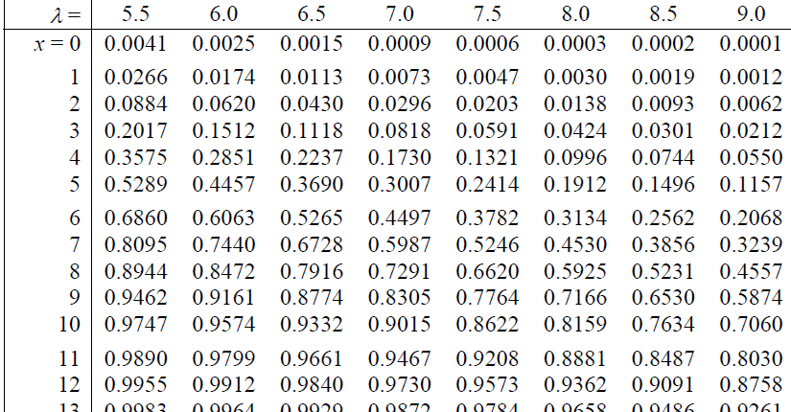
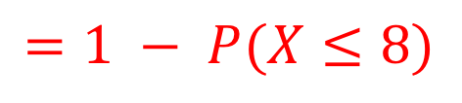
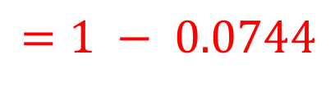

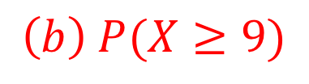
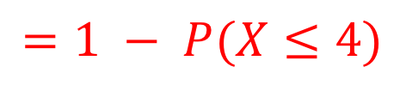

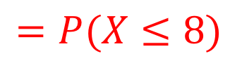
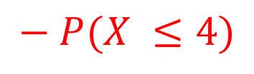

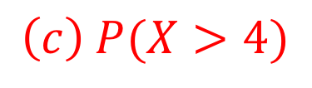
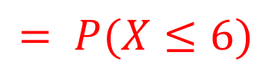
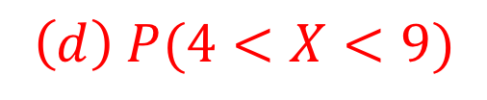

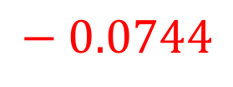
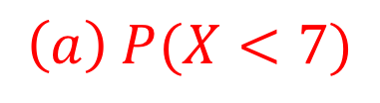
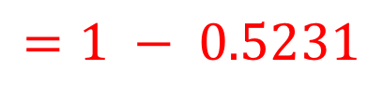

USING TABLES
If X ~ Po(8.5) find:
(a) P(X < 7) (b) P(X ≥ 9) (c) P(X > 4) (d) P(4 < X < 9)
$$\left(a\right) P(X<7)$$
$$= P(X≤6)$$
$$=0.2562$$
$$\left(b\right) P(X≥9)$$
$$=1 − P(X≤8)$$
$$=1 − 0.5231$$
$$=0.4769$$
$$\left(c\right) P(X>4)$$
$$\left(d\right) P(4<X<9)$$
$$=1 − P(X≤4)$$
$$=P(X≤8)$$
$$− P(X ≤4)$$
$$=1 − 0.0744$$
$$=0.5231$$
$$− 0.0744$$
$$=0.9256$$
$$=0.4487$$
Notes:
You can use tables for Poisson probabilities provided λ is between 0.5 and 10 in steps of 0.5. As with binomial, tables give CUMULATIVE probabilities, so when you look up the probability for x = 8 from these tables you are actually finding the P(X≤8).

Slide 2
Exercise 2B
Pearson Further Statistics 1
Page 22
Complete before the lesson Q1-2
In Class:
Green Q3-4
Amber Q5-6

