Slide 1
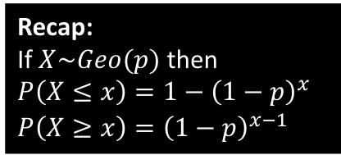
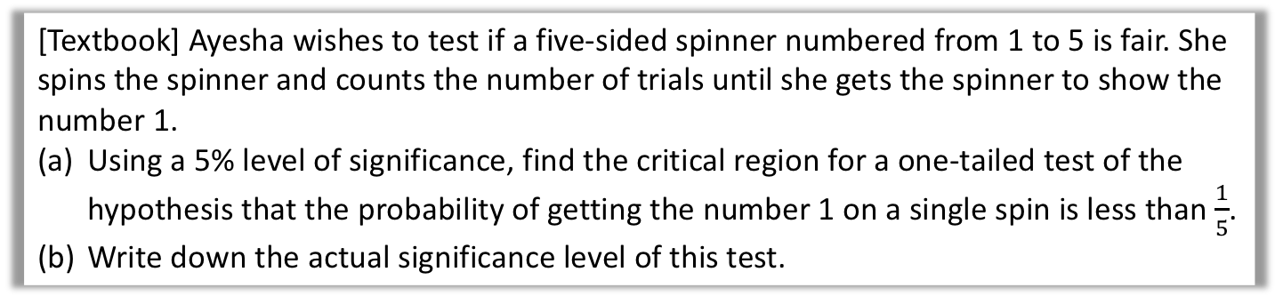

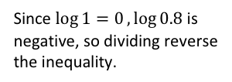

Critical Regions for Geometric Tests
[Textbook] Ayesha wishes to test if a five-sided spinner numbered from 1 to 5 is fair. She spins the spinner and counts the number of trials until she gets the spinner to show the number 1.
Using a 5% level of significance, find the critical region for a one-tailed test of the hypothesis that the probability of getting the number 1 on a single spin is less than $\frac{1}{5}$.
Write down the actual significance level of this test.
We don’t have any tables to work with here, and using trial and error would take far too long. We can work out the critical value algebraically!
Suppose that the critical value is $k$.
$$P\left(X≥k\right)<0.05 \\ {\left(1−\frac{1}{5}\right)}^{k−1}<0.05 \\ {0.8}^{k−1}<0.05 \\ \left(k−1\right)\log{0.8}<\log{0.05} \\ k−1>\frac{\log{0.05}}{\log{0.8}} \\ k>14.43 → k=15$$
Critical region is $X≥15$
Actual significance level $=P\left(X≥15\right)={0.8}^{14}=0.04398 (5dp)$
Recap:
If $X\sim Geo(p)$ then
$P\left(X≤x\right)=1−{\left(1−p\right)}^{x}$
$P\left(X≥x\right)={\left(1−p\right)}^{x−1}$
a
Because $H_{1}:p<0.2$, we therefore find $P(X≥k)$.
?
Since $\log{1=0},\log{0.8}$ is negative, so dividing reverse the inequality.
b
?

Slide 2


Test Your Understanding
[Textbook] In a particular city, a Lobster Card is used as a method of payment on trains. The company that administers the card claims that only 1 in 1000 cards will be rejected by the card reader at the train station. A station manager feels that the company is understating the proportion of cards rejected by the card reader, and decides to carry out a test. When he comes on shift at 5:00 am he counts the number of passengers who pass through until he notes a passenger who has a Lobster Card rejected.
Using a 5% level of significance, find the critical region for a one-tailed test of the hypothesis that the proportion of Lobsters Cards rejected by the card reader is greater than 1 in 1000.
Write down the actual significance level of the test in part a.
a
Let $k$ be the critical value.
$$P\left(X≤k\right)<0.05 \\ 1−{\left(1−0.0001\right)}^{k}<0.05 \\ … \\ k<51.267 → k=51$$
So critical region is $X≤51$.
Actual significance level $=P\left(X≤51\right)$
$=1−{0.999}^{51}=0.0497 (4dp)$
?
Recap:
If $X\sim Geo(p)$ then
$P\left(X≤x\right)=1−{\left(1−p\right)}^{x}$
$P\left(X≥x\right)={\left(1−p\right)}^{x−1}$
b
?

Slide 3
Exercise 4D
Pearson Further Statistics 1
Pages 71-72
Complete before the lesson Q1-3
In Class:
Amber Q4-6
Red Challenge

