Slide 1



Linear Transformations
You can use matrix products to represent combinations of transformations
The points A(1,0), B(0,1) and C(2,0) are the vertices of a triangle T. The triangle T is rotated 90° anticlockwise around (0,0) and then the image T’ is reflected in the line y = x to obtain the triangle T’’.
On separate diagrams, draw T, T’ and T’’
i) Find the matrix P such that P(T) = T’
ii) Find the matrix Q such that Q(T’) = T’’
These are asking you what matrix takes you from T to T’ and from T’ to T’’ respectively…
Consider coordinate changes…
C
T
T’
B
A
A
C
A
C
B
B
T’’
Rotated 90° anticlockwise about (0,0)
Reflected in y = x
First transformation, the 90° anticlockwise rotation
$$Original pair: \left[\begin{matrix}1 & 0 \\ 0 & 1\end{matrix}\right]$$
(0,1)
(0,1)
Replace the coordinates!
(-1,0)
(1,0)
$$P=\left[\begin{matrix}0 & −1 \\ 1 & 0\end{matrix}\right]$$
$$New pair:\left[\begin{matrix}0 & −1 \\ 1 & 0\end{matrix}\right]$$
7D

Slide 2


Linear Transformations
You can use matrix products to represent combinations of transformations
The points A(1,0), B(0,1) and C(2,0) are the vertices of a triangle T. The triangle T is rotated 90° anticlockwise around (0,0) and then the image T’ is reflected in the line y = x to obtain the triangle T’’.
On separate diagrams, draw T, T’ and T’’
i) Find the matrix P such that P(T) = T’
ii) Find the matrix Q such that Q(T’) = T’’
These are asking you what matrix takes you from T to T’ and from T’ to T’’ respectively…
Consider coordinate changes…
C
T
T’
B
A
A
C
A
C
B
B
T’’
Rotated 90° anticlockwise about (0,0)
Reflected in y = x
Second transformation, the reflection in y = x (remember use the standard starting coordinates)
$$Original pair: \left[\begin{matrix}1 & 0 \\ 0 & 1\end{matrix}\right]$$
(0,1)
(0,1)
Replace the coordinates!
(1,0)
(1,0)
$$P=\left[\begin{matrix}0 & −1 \\ 1 & 0\end{matrix}\right]$$
$$Q=\left[\begin{matrix}0 & 1 \\ 1 & 0\end{matrix}\right]$$
$$New pair:\left[\begin{matrix}0 & 1 \\ 1 & 0\end{matrix}\right]$$
7D

Slide 3











Linear Transformations
You can use matrix products to represent combinations of transformations
The points A(1,0), B(0,1) and C(2,0) are the vertices of a triangle T. The triangle T is rotated 90° anticlockwise around (0,0) and then the image T’ is reflected in the line y = x to obtain the triangle T’’.
On separate diagrams, draw T, T’ and T’’
i) Find the matrix P such that P(T) = T’
ii) Find the matrix Q such that Q(T’) = T’’
These are asking you what matrix takes you from T to T’ and from T’ to T’’ respectively…
Consider coordinate changes…
c) By finding a matrix product, find the single matrix that will perform a 90° anticlockwise rotation followed by a reflection in y = x
It is important to note that P acts first, and then Q acts on P
→ This is written as below…
$$QP$$
$$Q=\left[\begin{matrix}0 & 1 \\ 1 & 0\end{matrix}\right]$$
$$P=\left[\begin{matrix}0 & −1 \\ 1 & 0\end{matrix}\right]$$
(2 x 2)
x
(2 x 2)
=
(2 x 2)
$$\left[\begin{matrix}0 & 1 \\ 1 & 0\end{matrix}\right]\left[\begin{matrix}0 & −1 \\ 1 & 0\end{matrix}\right]=\left[\begin{matrix} & \\ & \end{matrix}\right]$$
$$\left(0×0\right)+(1×1)$$
$$\left(0×−1\right)+(1×0)$$
$$\left(1×0\right)+(0×1)$$
$$\left(1×−1\right)+(0×0)$$
$$QP=\left[\begin{matrix}1 & 0 \\ 0 & −1\end{matrix}\right]$$
$$P=\left[\begin{matrix}0 & −1 \\ 1 & 0\end{matrix}\right]$$
$$Q=\left[\begin{matrix}0 & 1 \\ 1 & 0\end{matrix}\right]$$
(0,1)
Consider how the original coordinates have moved…
→ This is a reflection in the x-axis!
(1,0)
(0,-1)
(1,0)
7D

Slide 4

Linear Transformations
You can use matrix products to represent combinations of transformations
The points A(1,0), B(0,1) and C(2,0) are the vertices of a triangle T. The triangle T is rotated 90° anticlockwise around (0,0) and then the image T’ is reflected in the line y = x to obtain the triangle T’’.
On separate diagrams, draw T, T’ and T’’
i) Find the matrix P such that P(T) = T’
ii) Find the matrix Q such that Q(T’) = T’’
These are asking you what matrix takes you from T to T’ and from T’ to T’’ respectively…
Consider coordinate changes…
c) By finding a matrix product, find the single matrix that will perform a 90° anticlockwise rotation followed by a reflection in y = x
$$QP=\left[\begin{matrix}1 & 0 \\ 0 & −1\end{matrix}\right]$$
← Reflection in the x-axis!
Think about our original diagrams…
C
T
T’
B
A
A
C
A
C
B
B
T’’
Rotated 90° anticlockwise about (0,0)
Reflected in y = x
$$P=\left[\begin{matrix}0 & −1 \\ 1 & 0\end{matrix}\right]$$
$$Q=\left[\begin{matrix}0 & 1 \\ 1 & 0\end{matrix}\right]$$
You can see that the overall effect is as above, a reflection in the x-axis!
7D

Slide 5












Linear Transformations
You can use matrix products to represent combinations of transformations
The following matrices represent three different transformations:
Find the matrix representing the transformation represented by R, followed by Q, followed by P and give a geometrical interpretation of this transformation.
Ensure you get the order correct!
R acts first, is acted on by Q which is then acted on by P
PQR
Let us calculate PQ first, then multiply the answer by R
Remember another option would be to calculate QR and multiply P by the answer
$$P=\left[\begin{matrix}1 & 1 \\ 2 & 3\end{matrix}\right]$$
$$Q=\left[\begin{matrix}1 & 2 \\ 0 & 1\end{matrix}\right]$$
(2 x 2)
x
(2 x 2)
=
(2 x 2)
$$PQ$$
$$P=\left[\begin{matrix}1 & 1 \\ 2 & 3\end{matrix}\right]$$
$$Q=\left[\begin{matrix}1 & 2 \\ 0 & 1\end{matrix}\right]$$
$$R=\left[\begin{matrix}3 & 7 \\ −1 & −2\end{matrix}\right]$$
$$\left[\begin{matrix}1 & 1 \\ 2 & 3\end{matrix}\right]\left[\begin{matrix}1 & 2 \\ 0 & 1\end{matrix}\right]=\left[\begin{matrix} & \\ & \end{matrix}\right]$$
$$\left(1×1\right)+(1×0)$$
$$\left(1×2\right)+(1×1)$$
$$\left(2×1\right)+(3×0)$$
$$\left(2×2\right)+(3×1)$$
$$PQ=\left[\begin{matrix}1 & 3 \\ 2 & 7\end{matrix}\right]$$
Now we need to multiply this matrix by R
7D

Slide 6









Linear Transformations
You can use matrix products to represent combinations of transformations
The following matrices represent three different transformations:
Find the matrix representing the transformation represented by R, followed by Q, followed by P and give a geometrical interpretation of this transformation.
Ensure you get the order correct!
R acts first, is acted on by Q which is then acted on by P
PQR
Let us calculate PQ first, then multiply the answer by R
Remember another option would be to calculate QR and multiply P by the answer
$$PQ=\left[\begin{matrix}1 & 3 \\ 2 & 7\end{matrix}\right]$$
$$R=\left[\begin{matrix}3 & 7 \\ −1 & −2\end{matrix}\right]$$
(2 x 2)
x
(2 x 2)
=
(2 x 2)
$$PQR$$
$$P=\left[\begin{matrix}1 & 1 \\ 2 & 3\end{matrix}\right]$$
$$Q=\left[\begin{matrix}1 & 2 \\ 0 & 1\end{matrix}\right]$$
$$R=\left[\begin{matrix}3 & 7 \\ −1 & −2\end{matrix}\right]$$
$$\left[\begin{matrix}1 & 3 \\ 2 & 7\end{matrix}\right]\left[\begin{matrix}3 & 7 \\ −1 & −2\end{matrix}\right]=\left[\begin{matrix} & \\ & \end{matrix}\right]$$
$$\left(1×3\right)+(3×−1)$$
$$\left(1×7\right)+(3×−2)$$
$$\left(2×3\right)+(7×−1)$$
$$\left(2×7\right)+(7×−2)$$
$$PQR=\left[\begin{matrix}0 & 1 \\ −1 & 0\end{matrix}\right]$$
This is a 90° rotation clockwise around (0,0)
(0,1)
(1,0)
(0,-1)
(1,0)
7D

Slide 7

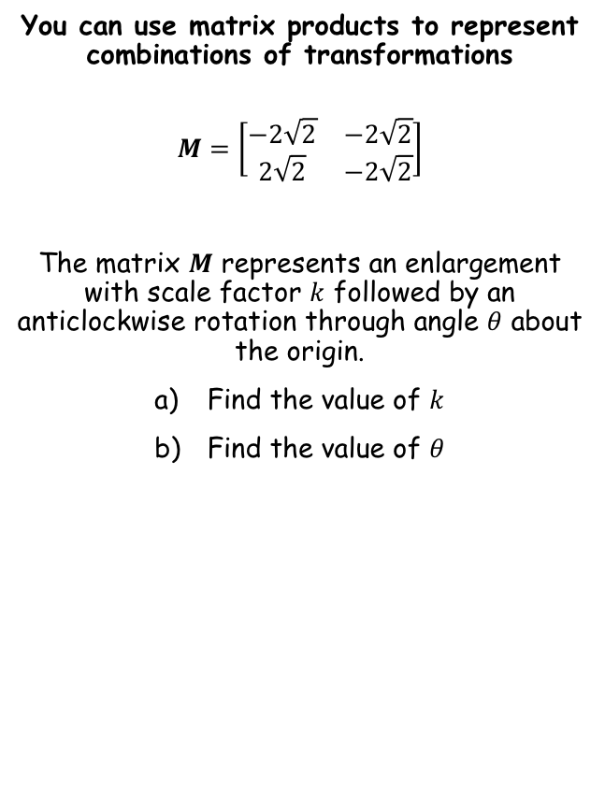



Linear Transformations
You can use matrix products to represent combinations of transformations
$$M=\left[\begin{matrix}−2\sqrt{2} & −2\sqrt{2} \\ 2\sqrt{2} & −2\sqrt{2}\end{matrix}\right]$$
The matrix $M$ represents an enlargement with scale factor $k$ followed by an anticlockwise rotation through angle $θ$ about the origin.
Find the value of $k$
Find the value of $θ$
We can find the area scale factor by calculating $\det{M}$. This can then be used to find the scale factor of enlargement.
$$\det{M}=16$$
$$\sqrt{16}=4$$
→ So the scale factor of enlargement is 4
$$=4$$
7D

Slide 8












Linear Transformations
You can use matrix products to represent combinations of transformations
$$M=\left[\begin{matrix}−2\sqrt{2} & −2\sqrt{2} \\ 2\sqrt{2} & −2\sqrt{2}\end{matrix}\right]$$
The matrix $M$ represents an enlargement with scale factor $k$ followed by an anticlockwise rotation through angle $θ$ about the origin.
Find the value of $k$
Find the value of $θ$
$$\left[\begin{matrix}Rotation \\ Matrix\end{matrix}\right]×\left[\begin{matrix}Enlargement \\ Matrix\end{matrix}\right]=\left[\begin{matrix}Overall \\ Matrix\end{matrix}\right]$$
Replace each
$$\left[\begin{matrix}cosθ & −sinθ \\ sinθ & cosθ\end{matrix}\right]$$
$$×\left[\begin{matrix}4 & 0 \\ 0 & 4\end{matrix}\right]$$
$$=\left[\begin{matrix}−2\sqrt{2} & −2\sqrt{2} \\ 2\sqrt{2} & −2\sqrt{2}\end{matrix}\right]$$
Work out left side
$$\left[\begin{matrix}4cosθ & −4sinθ \\ 4sinθ & 4cosθ\end{matrix}\right]=\left[\begin{matrix}−2\sqrt{2} & −2\sqrt{2} \\ 2\sqrt{2} & −2\sqrt{2}\end{matrix}\right]$$
$$=4$$
Compare sides and form equations. Remember there can sometimes be multiple answers!
$$4cosθ=−2\sqrt{2}$$
$$4sinθ=2\sqrt{2}$$
$$cosθ=−\frac{\sqrt{2}}{2}$$
$$sinθ=\frac{\sqrt{2}}{2}$$
$$θ={135}^{°}$$
$θ=135^{°}$ or $225^{°}$
$θ=45^{°}$ or $135^{°}$
7D

Slide 9
Linear Transformations
You can use matrix products to represent combinations of transformations
$$M=\left[\begin{matrix}−2\sqrt{2} & −2\sqrt{2} \\ 2\sqrt{2} & −2\sqrt{2}\end{matrix}\right]$$
The matrix $M$ represents an enlargement with scale factor $k$ followed by an anticlockwise rotation through angle $θ$ about the origin.
Find the value of $k$
Find the value of $θ$
We can find the area scale factor by calculating $\det{M}$. This can then be used to find the scale factor of enlargement.
$$\det{M}=16$$
$$\sqrt{16}=4$$
→ So the scale factor of enlargement is 4
$$=4$$
Hang on a moment…
We could also have had the answer -4 above…
What would have happened if we used that? It is ok to do so??
7D

Slide 10
Exercise 7D
Pearson Pure Mathematics Year 1/AS
Pages 3-5
Complete before the lesson Q1-4
In Class:
Green Q5-7
Amber Q8-11
Red Q12-14 & challenge

