Slide 1
Polar Coordinates
Twitter: @Owen134866
www.mathsfreeresourcelibrary.com

Slide 2
Teachings for
Exercise 5B

Slide 3
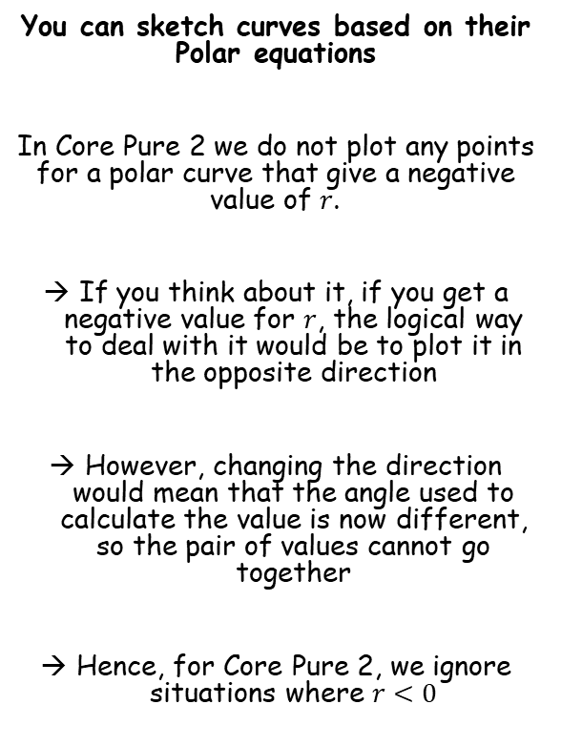
Polar Coordinates
You can sketch curves based on their Polar equations
In Core Pure 2 we do not plot any points for a polar curve that give a negative value of $r$.
If you think about it, if you get a negative value for $r$, the logical way to deal with it would be to plot it in the opposite direction
However, changing the direction would mean that the angle used to calculate the value is now different, so the pair of values cannot go together
Hence, for Core Pure 2, we ignore situations where $r<0$
5B

Slide 4
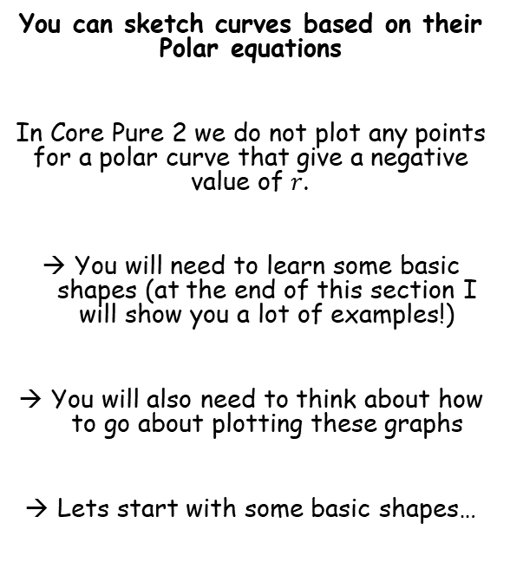
Polar Coordinates
You can sketch curves based on their Polar equations
In Core Pure 2 we do not plot any points for a polar curve that give a negative value of $r$.
You will need to learn some basic shapes (at the end of this section I will show you a lot of examples!)
You will also need to think about how to go about plotting these graphs
Lets start with some basic shapes…
5B

Slide 5

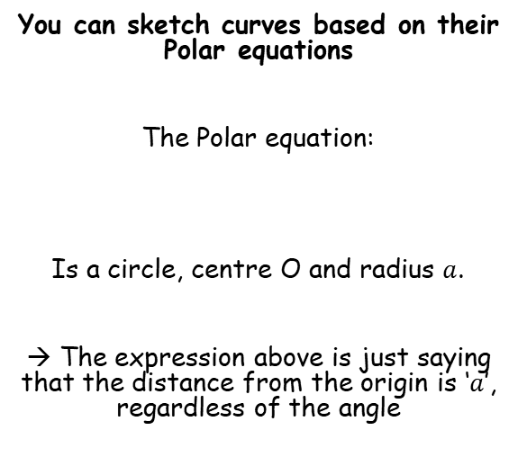
Polar Coordinates
You can sketch curves based on their Polar equations
The Polar equation:
Is a circle, centre O and radius $a$.
→ The expression above is just saying that the distance from the origin is ‘$a$’, regardless of the angle
a
$$r=a$$
a
a
a
5B

Slide 6

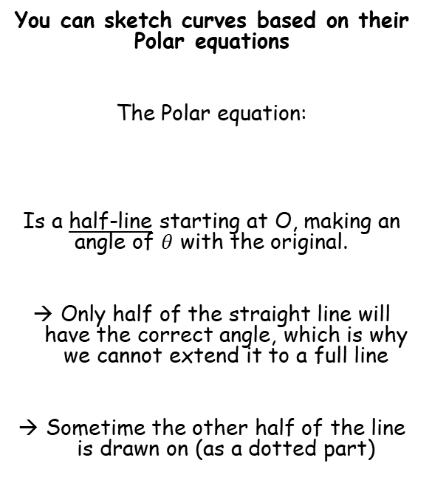
Polar Coordinates
You can sketch curves based on their Polar equations
The Polar equation:
Is a half-line starting at O, making an angle of $θ$ with the original.
Only half of the straight line will have the correct angle, which is why we cannot extend it to a full line
Sometime the other half of the line is drawn on (as a dotted part)
a
$$θ=a$$
5B

Slide 7
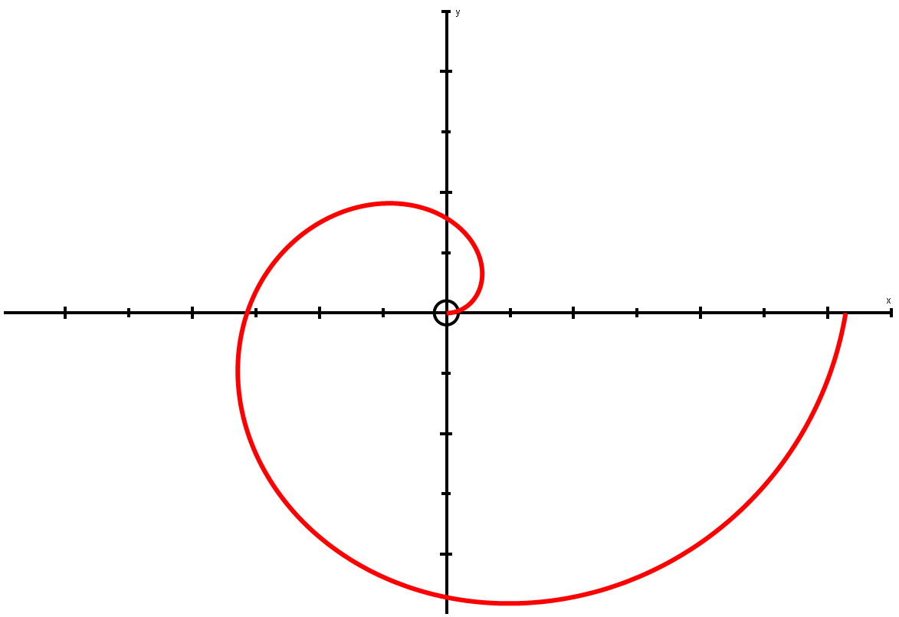

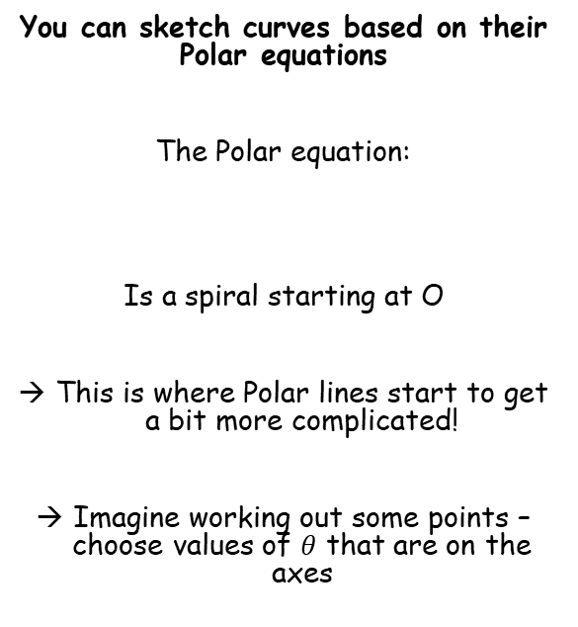

Polar Coordinates
It sometimes helps to label the axes with the angles they represent…
π 2
You can sketch curves based on their Polar equations
The Polar equation:
Is a spiral starting at O
This is where Polar lines start to get a bit more complicated!
Imagine working out some points – choose values of $θ$ that are on the axes
$$r=aθ$$
^{aπ}/₂
aπ
2aπ
π
0
0, 2π
Bigger angle = bigger distance!
^{3aπ}/₂
3π 2
θ
0
^{π}/₂
π
^{3π}/₂
2π
$$r=aθ$$
r
0
^{aπ}/₂
aπ
^{3aπ}/₂
2aπ
Think about the equation – as the angle we turn through increases, so should the distance from the origin, O!
5B

Slide 8
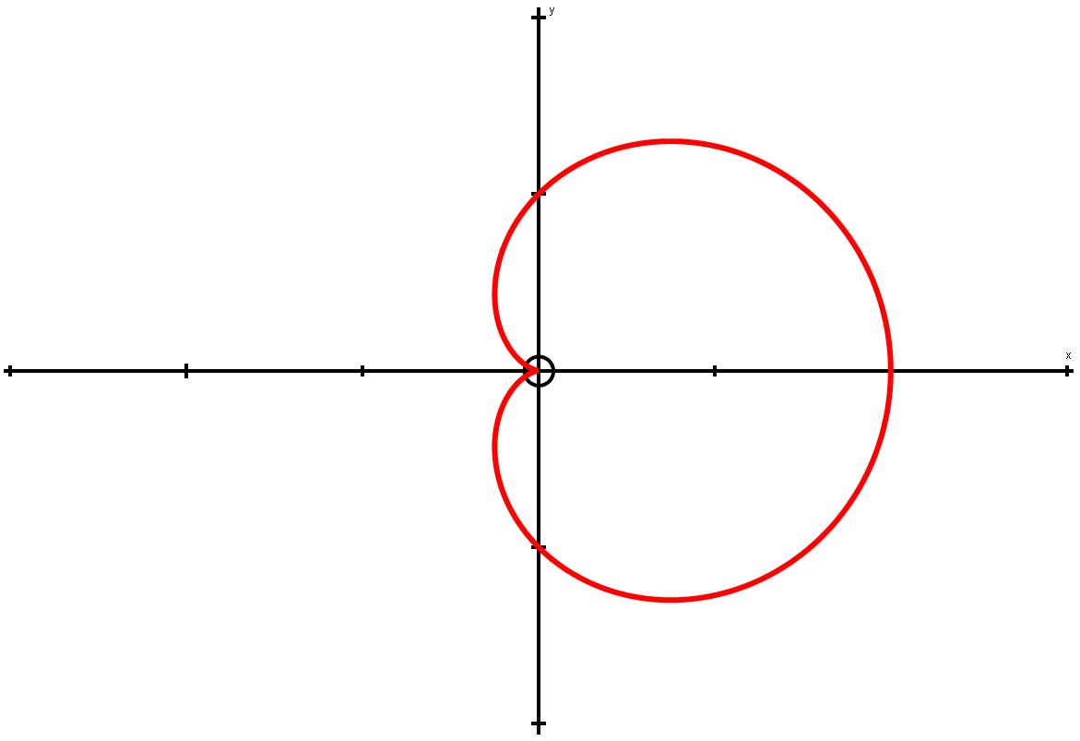

Polar Coordinates
π 2
You can sketch curves based on their Polar equations
Sketch the following curve:
Like last time, you can draw up a table of values
Think about what the value of cosθ will be for each of these…
This shape is called a Cardioid!
a
$$r=a(1+cosθ)$$
π
0
2a
0, 2π
a
θ
0
^{π}/₂
π
^{3π}/₂
2π
r
2a
a
0
a
2a
3π 2
1
Cosθ
0
θ = ^{3π}/₂, Cosθ = 0
θ = 0, Cosθ = 1
θ = 2π, Cosθ = 1
θ = ^{π}/₂, Cosθ = 0
θ = π, Cosθ = -1
-1
^{π}/₂
π
^{3π}/₂
2π
5B

Slide 9





Polar Coordinates
You can sketch curves based on their Polar equations
Sketch the following curve:
Sometimes, you can change the equation to a simple Cartesian one, in order to sketch it
Remember that this will not always make the equation easier to ‘understand’
$$r=asecθ$$
$$r=\frac{a}{cosθ}$$
Secθ = ¹/_{cosθ}
Multiply by cosθ
$$rcosθ=a$$
$$r=asecθ$$
rcosθ = x
$$x=a$$
a
5B

Slide 10

Polar Coordinates
You can sketch curves based on their Polar equations
Sketch the following curve:
In terms of working out points to plot, the angle (θ) only needs to go up to 2π as this is a complete turn
We could of course go further but we do not need to for now
As the angle in our equation is above is 3θ, we can go up to 6π
Let’s work out some values, up to 6π (use the same increments as before, ie) going up by ^{π}/₂ each time)
3θ
0
π 2
π
3π 2
2π
5π 2
3π
7π 2
4π
9π 2
5π
11π 2
6π
θ
0
π 6
π 3
π 2
2π 3
5π 6
π
7π 6
4π 3
3π 2
5π 3
11π 6
2π
r
0
1
0
-1
0
1
0
-1
0
1
0
-1
0
$$r=sin3θ$$
Remember that if we are going to plot points, we need values of θ (rather than 3θ)
Then substitute these into the equation to the left to find the distances for the given angles
We get this ‘up and down’ repeating pattern due to the shape of the sine graph…
1
Sinθ
0
-1
^{π}/₂
π
^{3π}/₂
2π
5B

Slide 11

Polar Coordinates
You can sketch curves based on their Polar equations
Sketch the following curve:
Now we can plot these. Remember we do not plot negative values…
You can think of the plotting as being in several ‘sections’
3θ
0
π 2
π
3π 2
2π
5π 2
3π
7π 2
4π
9π 2
5π
11π 2
6π
θ
0
π 6
π 3
π 2
2π 3
5π 6
π
7π 6
4π 3
3π 2
5π 3
11π 6
2π
r
0
1
0
-1
0
1
0
-1
0
1
0
-1
0
$$r=sin3θ$$
Hopefully you can see the ranges we need to plot are only the positive ones!
From ^{π}/₃ radians, we keep increasing the angle. The distance reaches -1 and then is back to 0 at ^{2π}/₃ radians
→ All the distances in this range are negative, so we do not plot them
We start at 0. By ^{π}/₆ radians, we are a distance 1 unit away from the origin.
As we keep increasing the angle, we then get closer, back to 0 radians at ^{π}/₃
From ^{2π}/₃ radians, we keep increasing the angle. The distance reaches 1 and then is back to 0 at π radians
→ These are positive so will be plotted!
5B

Slide 12
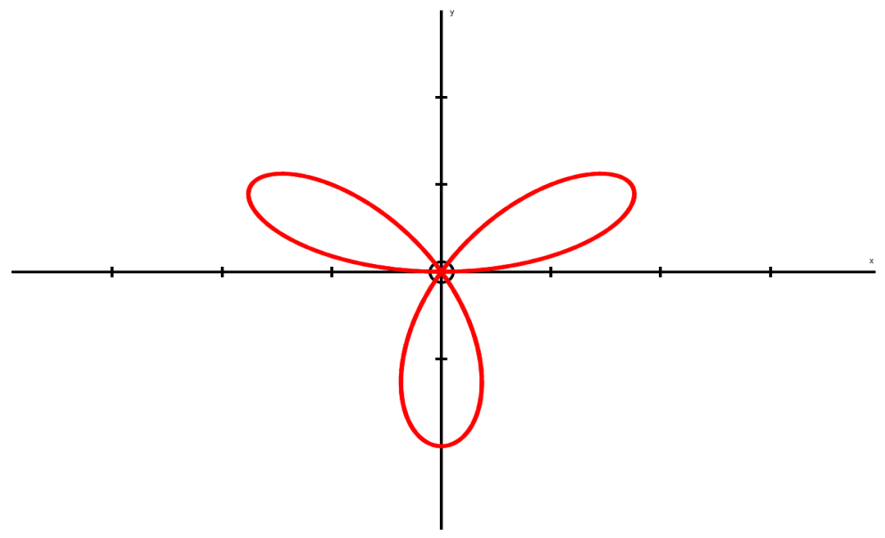

Polar Coordinates
You can sketch curves based on their Polar equations
Sketch the following curve:
Now we can plot these. Remember we do not plot negative values…
You can think of the plotting as being in several ‘sections’
3θ
0
π 2
π
3π 2
2π
5π 2
3π
7π 2
4π
9π 2
5π
11π 2
6π
θ
0
π 6
π 3
π 2
2π 3
5π 6
π
7π 6
4π 3
3π 2
5π 3
11π 6
2π
r
0
1
0
-1
0
1
0
-1
0
1
0
-1
0
$$r=sin3θ$$
π 2
As the angle increases, the distance does, up until ^{π}/₆ radians, when it starts to decrease again
(1,^{5π}/₆)
(1,^{π}/₆)
→ A Polar equation of the form $r=asin3θ$ will be the shape shown!
π
0
0, 2π
This pattern is repeated 3 times as we move though a complete turn!
(1,^{3π}/₂)
3π 2
5B

Slide 13

Polar Coordinates
You can sketch curves based on their Polar equations
Sketch the following curve:
Let’s do the same as for the last equation
As θ can go up to 2π, 2θ can go up to 4π, so we need to start by drawing up a table up to this value
2θ
0
π 2
π
3π 2
2π
5π 2
3π
7π 2
4π
θ
0
π 4
π 2
3π 4
π
5π 4
3π 2
7π 4
2π
r
a
0
-
0
a
0
-
0
a
$$r^{2}=a^{2}cos2θ$$
Real values cannot be calculated here as we would have to square root a negative
→ They therefore will not be plotted…
5B

Slide 14
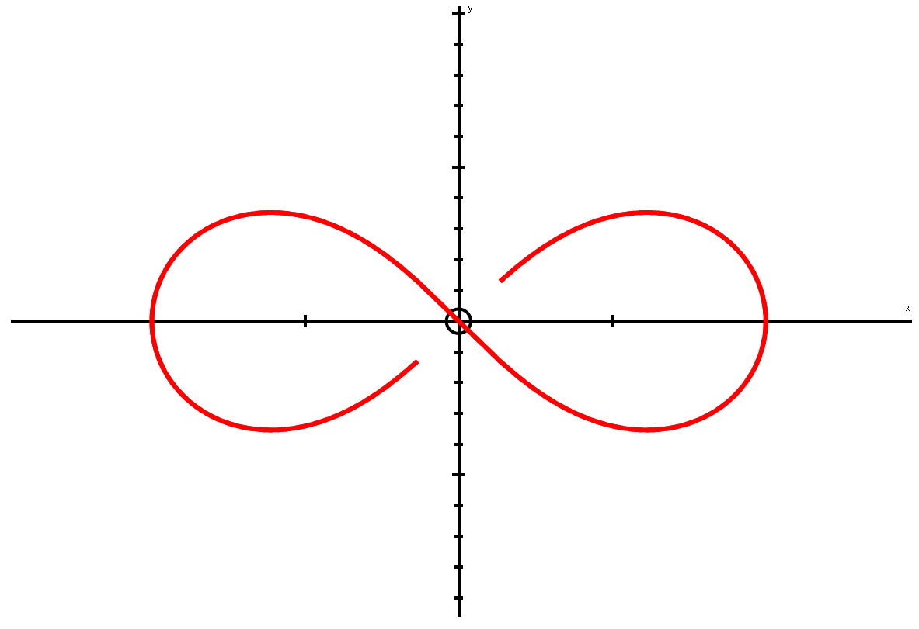
Polar Coordinates
You can sketch curves based on their Polar equations
Sketch the following curve:
Let’s do the same as for the last equation
As θ can go up to 2π, 2θ can go up to 4π, so we need to start by drawing up a table up to this value
2θ
0
π 2
π
3π 2
2π
5π 2
3π
7π 2
4π
θ
0
π 4
π 2
3π 4
π
5π 4
3π 2
7π 4
2π
r
a
0
-
0
a
0
-
0
a
$$r^{2}=a^{2}cos2θ$$
Curve starts at ‘a’
→ As we increase the angle, the distance moves to 0 by ^{π}/₄ radians
π 2
The curve then moves out again after ^{7π}/₄ radians until it is at a distance ‘a’ once more, after a complete turn (2π)
From ^{3π}/₄ radians, the curve increases out a distance of ‘a’, after π radians, then comes back
a
a
π
0, 2π
0
3π 2
5B

Slide 15
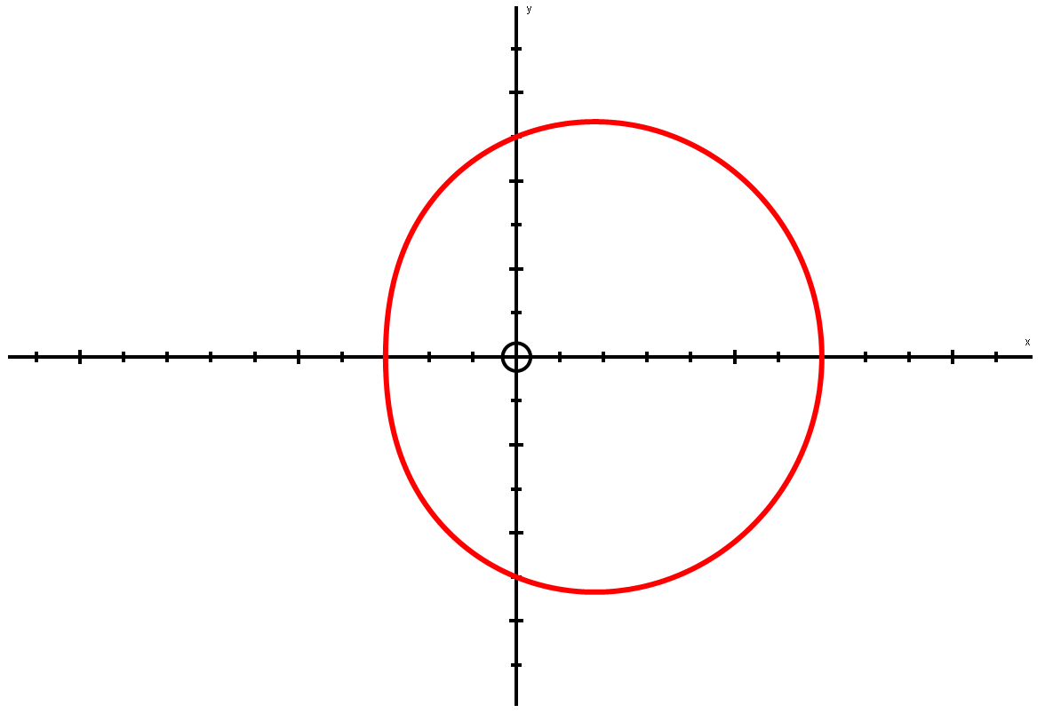

Polar Coordinates
You can sketch curves based on their Polar equations
Sketch the following curve:
→ Work out values up to 2π
π 2
$$r=a(5+2cosθ)$$
5a
θ
0
^{π}/₂
π
^{3π}/₂
2π
π
3a
7a
0, 2π
r
7a
5a
3a
5a
7a
r decreasing
r increasing
5a
As we increase the angle from 0 to π, the distance of the line from the origin becomes smaller
After π, we keep increasing the angle, but now the distance increases again at the same rate it was decreasing before…
3π 2
It is important to note that this it NOT a circle, it is more of an ‘egg’ shape!
5B

Slide 16
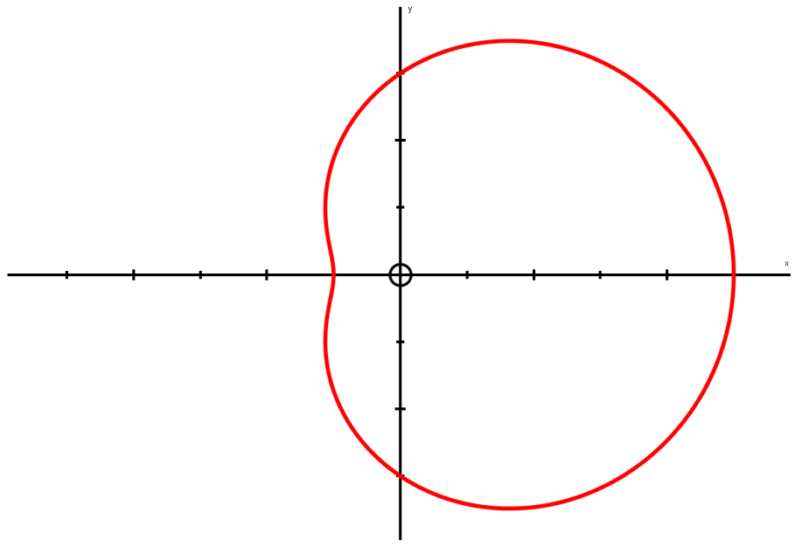

Polar Coordinates
You can sketch curves based on their Polar equations
Sketch the following curve:
Work out values up to 2π
This follows a similar pattern to the previous graph, but the actual shape is slightly different…
π 2
3a
$$r=a(3+2cosθ)$$
a
5a
π
θ
0
^{π}/₂
π
^{3π}/₂
2π
0, 2π
r
5a
3a
a
3a
5a
3a
3π 2
This shape has a ‘dimple’ in it
→ We will see the condition for this on the next slide…
5B

Slide 17




Polar Coordinates
You can sketch curves based on their Polar equations
Look at the patterns for graphs of the form:
$$r=a(p+qcosθ)$$
p < q
q ≤ p < 2q
As we would get some negative values for the distance, r (caused by cos being negative), so the graph is not defined for all values of θ
We will not plot this graph as some values cannot be calculated
If p is greater than q, but less than 2q, we get an egg-shape, but with a ‘dimple’ in it
(we will prove this in section 7E)
p = q
p ≥ 2q
When p = q, we will get a value of 0 for the distance at one point (when θ = π, as cos will be -1. Therefore we do p – q which cancel out as they’re equal)
→ This gives us the ‘cardioid’ shape
If p is equal to or greater than 2q, we get the ‘egg’ shape, but as a smooth curve, without a dimple
→ The greater p is, the ‘wider’ the egg gets stretched!
Note that ‘r = a(p + qsinθ)’ has the same pattern, but rotated 90 degrees anticlockwise!
5B

Slide 18
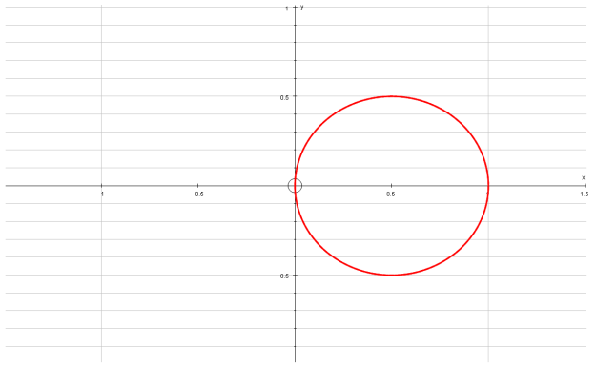
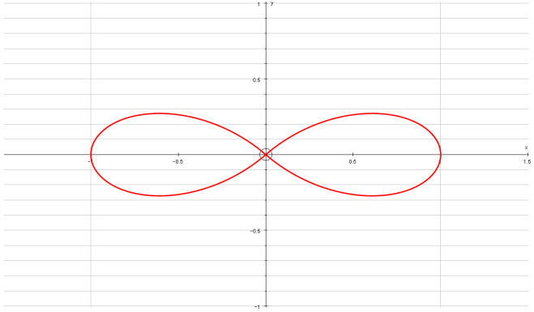
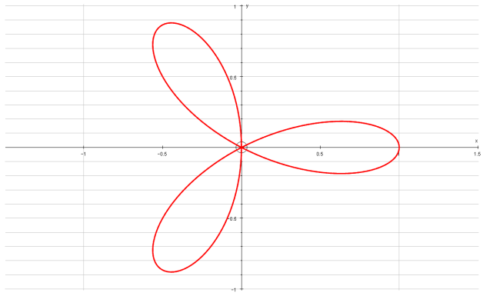
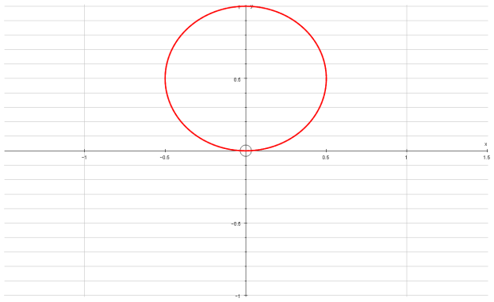
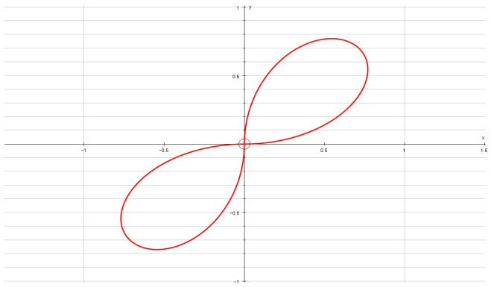
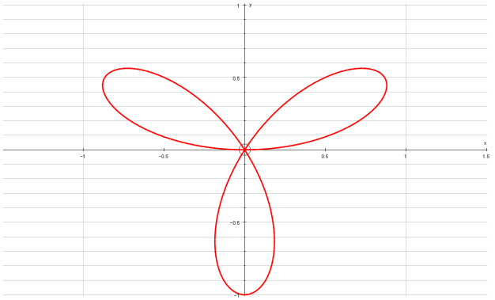






Polar Coordinates
You can sketch curves based on their Polar equations
You don’t need to memorise these shapes (as you can work them out if needed), but they are useful to be aware of (in addition to those you have seen so far…)
$$r=cosθ$$
$$r=cos2θ$$
$$r=cos3θ$$
$$r=sinθ$$
$$r=sin2θ$$
$$r=sin3θ$$
5B

Slide 19
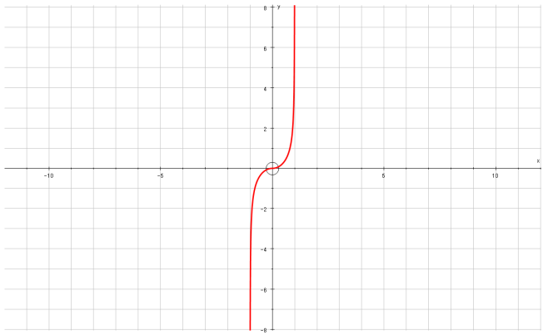
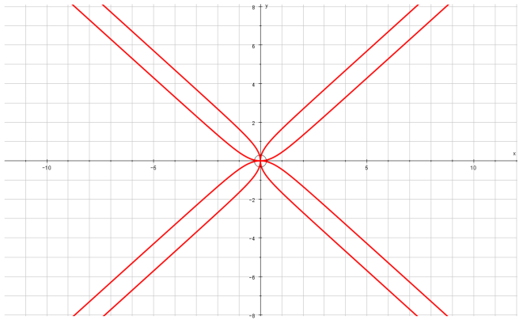
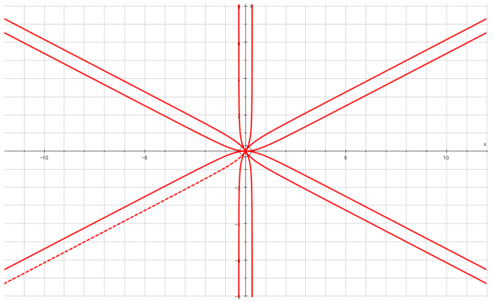
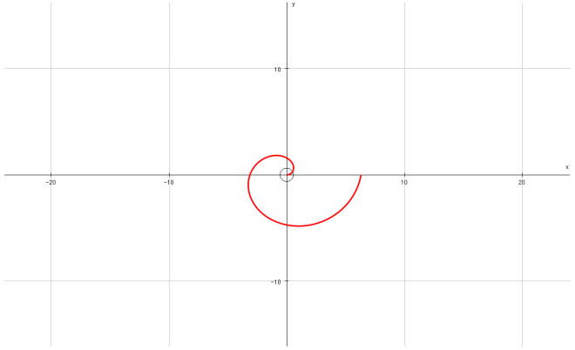
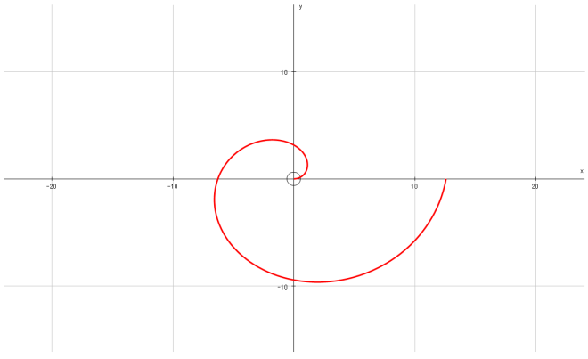
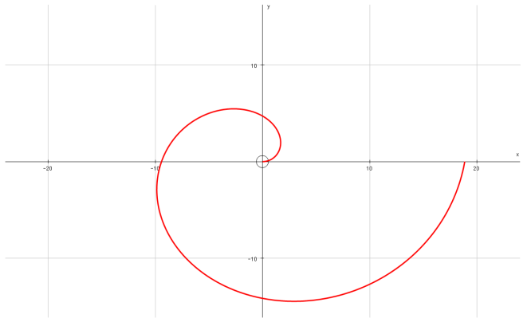






Polar Coordinates
You can sketch curves based on their Polar equations
You don’t need to memorise these shapes (as you can work them out if needed), but they are useful to be aware of (in addition to those you have seen so far…)
$$r=tanθ$$
$$r=tan2θ$$
$$r=tan3θ$$
$$r=θ$$
$$r=2θ$$
$$r=3θ$$
5B

Slide 20
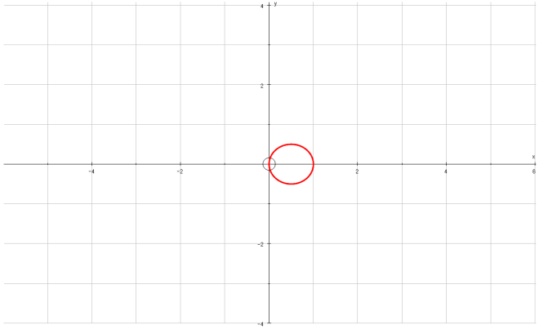
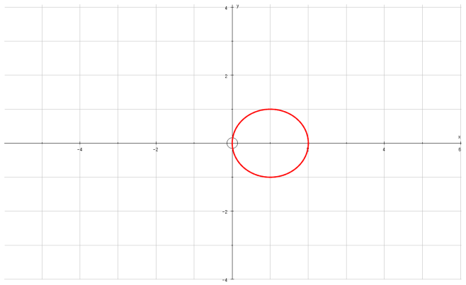

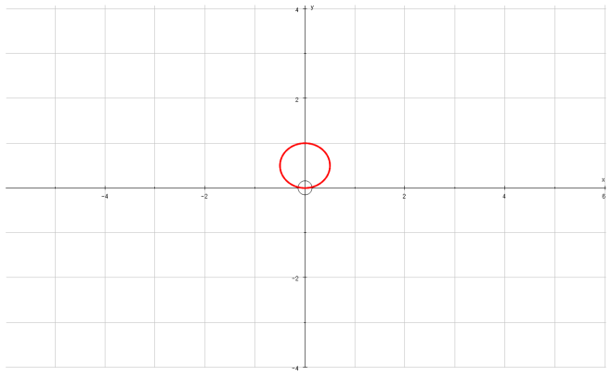
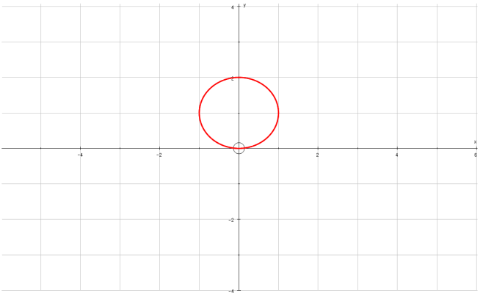







Polar Coordinates
You can sketch curves based on their Polar equations
You don’t need to memorise these shapes, but they are useful to be aware of (in addition to those you have seen so far…)
$$r=cosθ$$
$$r=2cosθ$$
$$r=4cosθ$$
$$r=sinθ$$
$$r=2sinθ$$
$$r=4sinθ$$
5B

Slide 21






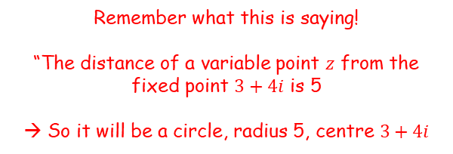
Polar Coordinates
$$Im$$
$$\left|z−3−4i\right|=5$$
You can sketch curves based on their Polar equations
a) Show on an argand diagram the locus of points given by the values of $z$ satisfying:
$$\left|z−3−4i\right|=5$$
$$3+4i$$
$$Re$$
Rewrite
$$\left|z−(3+4i)\right|=5$$
Remember what this is saying!
“The distance of a variable point $z$ from the fixed point $3+4i$ is 5
→ So it will be a circle, radius 5, centre $3+4i$
5B

Slide 22



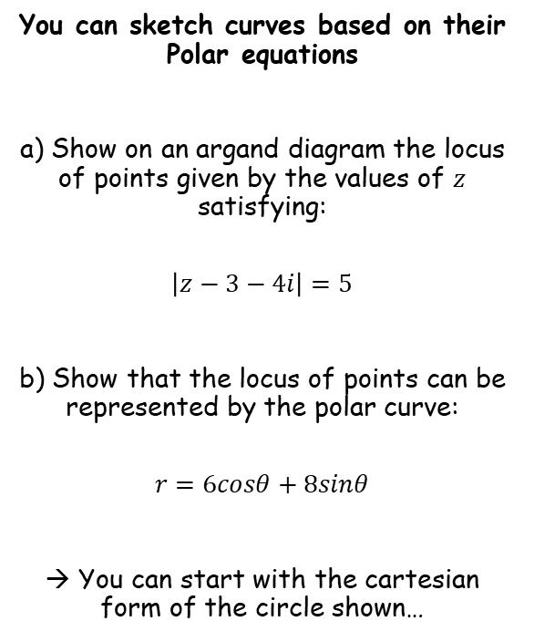




Polar Coordinates
$$Im$$
$$\left|z−3−4i\right|=5$$
You can sketch curves based on their Polar equations
a) Show on an argand diagram the locus of points given by the values of $z$ satisfying:
$$\left|z−3−4i\right|=5$$
b) Show that the locus of points can be represented by the polar curve:
$$r=6cosθ+8sinθ$$
→ You can start with the cartesian form of the circle shown…
$$3+4i$$
$$Re$$
$${\left(x−3\right)}^{2}+{\left(y−4\right)}^{2}=25$$
For polar, $x=rcosθ$ and $y=rsinθ$
$${\left(rcosθ−3\right)}^{2}+{\left(rsinθ−4\right)}^{2}=25$$
Expand brackets
$$r^{2}cos^{2}θ−6rcosθ+9+r^{2}\sin^{2}θ−8rsinθ+16=25$$
Group like terms
$$r^{2}\left(cos^{2}θ+\sin^{2}θ\right)−6rcosθ−8rsinθ+25=25$$
Subtract 25, and $\sin^{2}θ+\cos^{2}θ=1$
$$r^{2}−6rcosθ−8rsinθ=0$$
Divide by $r$
$$r−6cosθ−8sinθ=0$$
Rearrange
$$r=6cosθ+8sinθ$$
5B

Slide 23
Exercise 5B
Pearson Core Pure Year 2
Page 108-109
Complete before the lesson Q1
In Class:
Green Q2
Amber Q3
Red Q4

