Slide 1
Year 2 Pure Mathematics
Functions and Graphs
- Mapping and Functions
Chapter 2
(Part 2 of 6)

Slide 2
Functions - Mapping
A mapping is something which
maps one set of numbers to another.
x
y
3
6
0.5
1
f (x) = 2x

Slide 3
Functions - Mapping
Function: One to one
x
y
-3
-6
2.5
5
f (x) = 2x

Slide 4
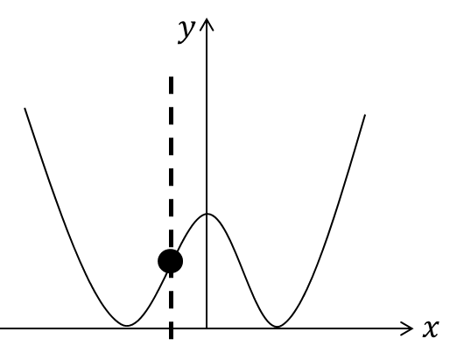
Functions - Mapping
Function: One to one

Slide 5
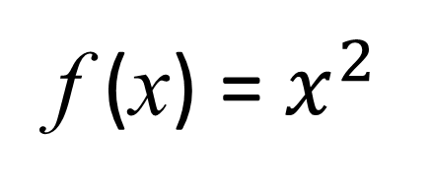
Functions - Mapping
Function: Many to one
x
y
3
9
-3
f (x) = $x^{2}$

Slide 6
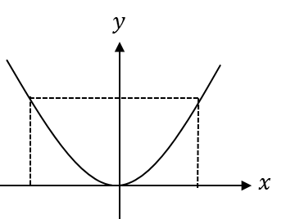
Functions - Mapping
Function: Many to one

Slide 7
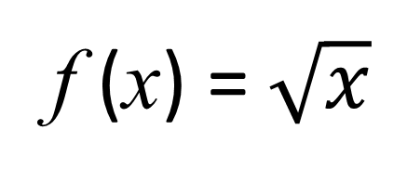
Functions - Mapping
Not a Function: One to many
x
y
9
3
-3
f (x) = $\sqrt{x}$

Slide 8
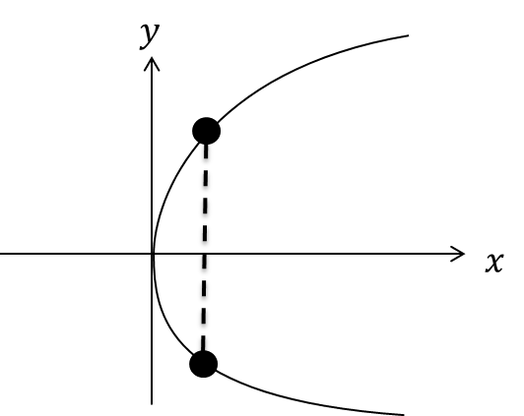
Functions - One-to-one vs Many-to-one
Not a Function: One to many

Slide 9
Functions – Domain and Range
Domain is the possible values of x of a function.
Range is the possible values
of y of a function.

Slide 10
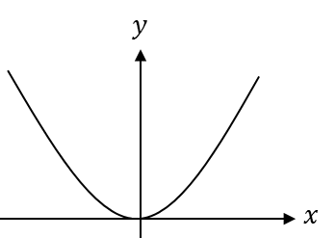
Functions – Domain and Range
Range
Domain

Slide 11
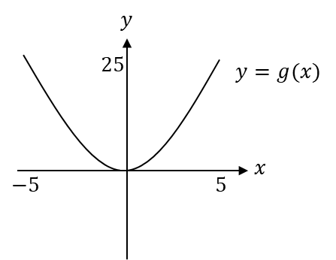
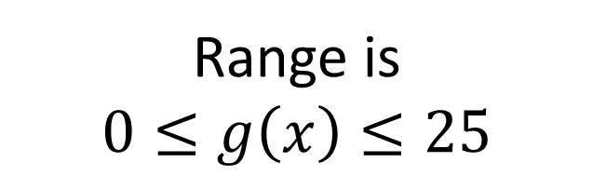
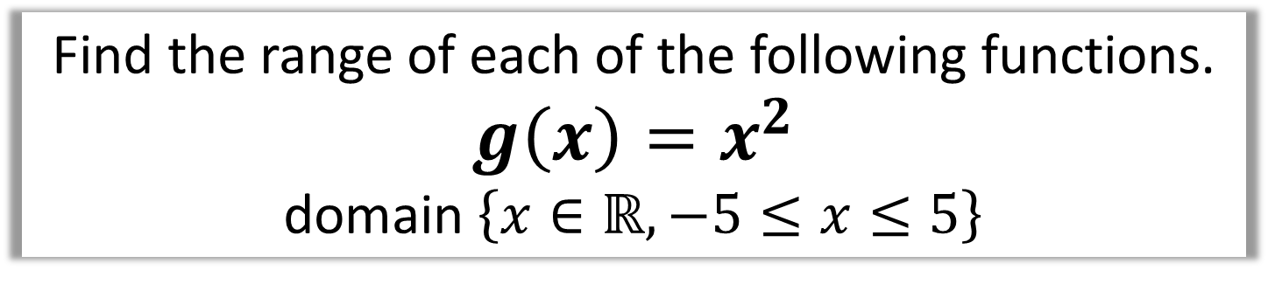
Functions – Domain and Range
Find the range of each of the following functions.
$g\left(x\right)=x^{2}$
domain $\left\{x∈ℝ, −5≤x≤5\right\}$
Range is
$$0≤g\left(x\right)≤25$$

Slide 12
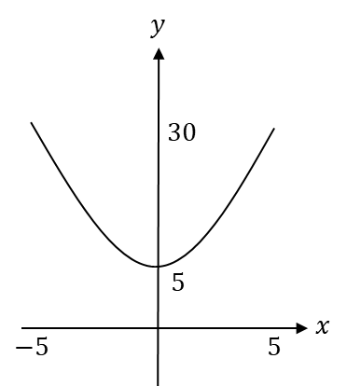
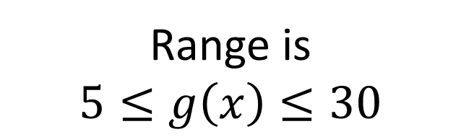
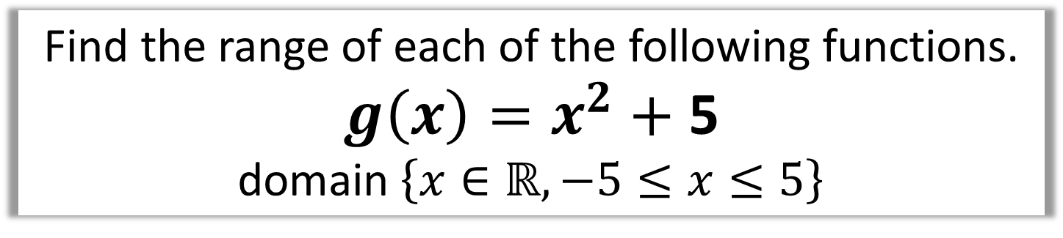
Functions – Domain and Range
Find the range of each of the following functions.
$g\left(x\right)=x^{2}+$ 5
domain $\left\{x∈ℝ, −5≤x≤5\right\}$
Range is
$$5≤g\left(x\right)≤30$$

Slide 13
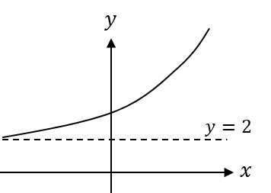
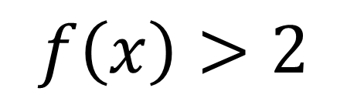
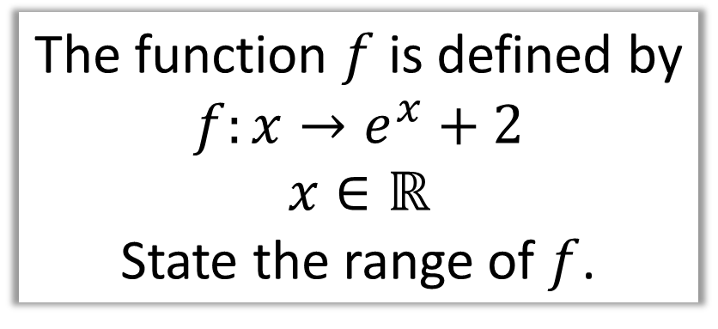
Functions – Domain and Range
The function $f$ is defined by
$$f:x→e^{x}+2$$
$$x∈ℝ$$
State the range of $f$.
$$f\left(x\right)>2$$

Slide 14
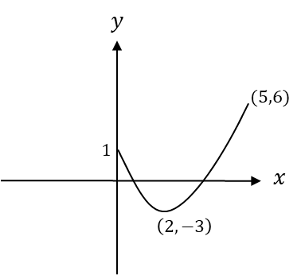
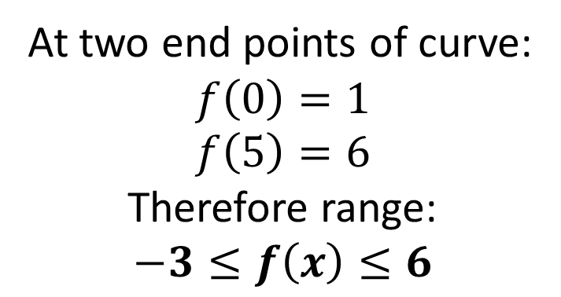
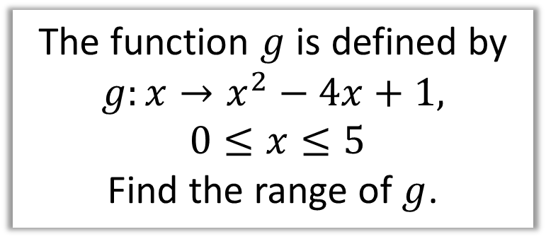
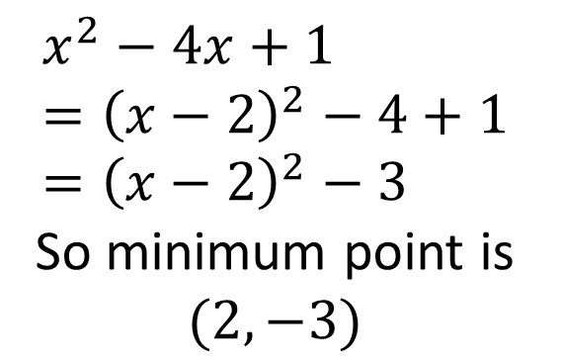
Functions – Domain and Range
The function $g$ is defined by
$$g:x→x^{2}−4x+1,$$
$$0≤x≤5$$
Find the range of $g$.
$$x^{2}−4x+1 \\ ={\left(x−2\right)}^{2}−4+1 \\ ={\left(x−2\right)}^{2}−3$$
So minimum point is $(2,−3)$
At two end points of curve:
$$f\left(0\right)=1 \\ f\left(5\right)=6$$
Therefore range:
$$−3≤f\left(x\right)≤6$$

Slide 15
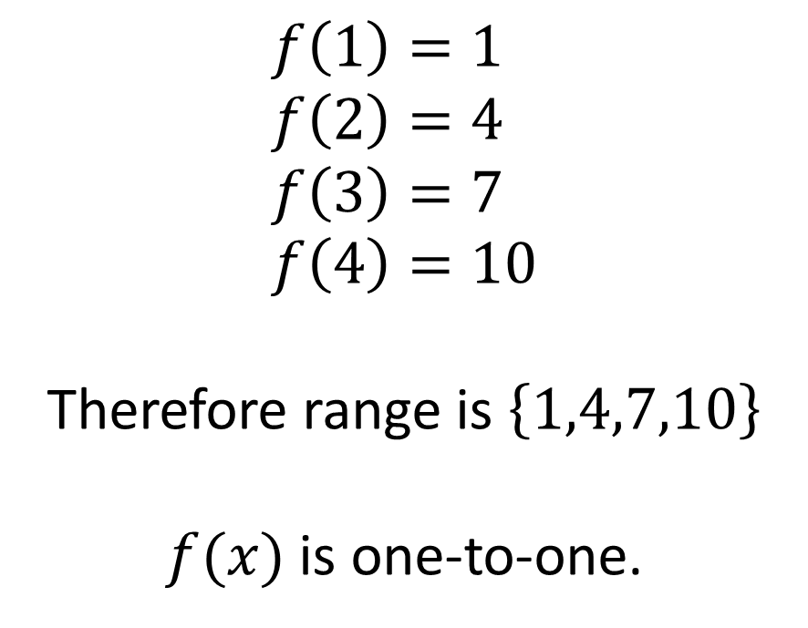
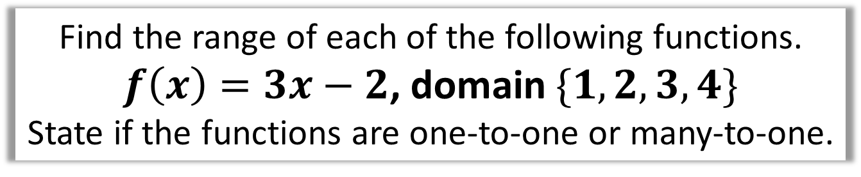
Functions – Domain and Range
Find the range of each of the following functions.
$f\left(x\right)=3x−2$, domain $\{1,2,3,4\}$
State if the functions are one-to-one or many-to-one.
$$f\left(1\right)=1 \\ f\left(2\right)=4 \\ f\left(3\right)=7 \\ f\left(4\right)=10$$
Therefore range is $\left\{1,4,7,10\right\}$
$f(x)$ is one-to-one.

Slide 16
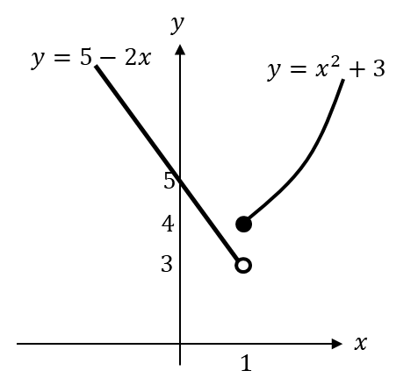
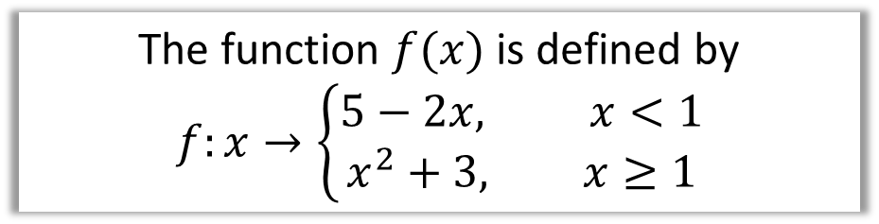
Functions - Piecewise
A ‘piecewise function’ is one which is defined in parts:
The function $f(x)$ is defined by
$$f:x→\left\{\begin{aligned}5−2x, x<1 \\ x^{2}+3, x≥1\end{aligned}\right.$$

Slide 17




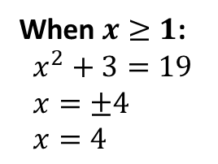



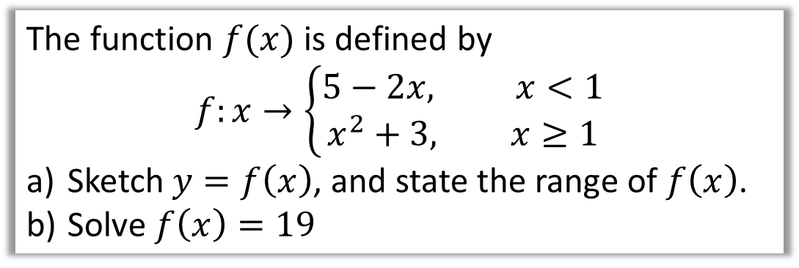









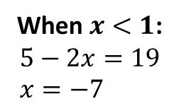

Piecewise Functions
The function $f(x)$ is defined by
$$f:x→\left\{\begin{aligned}5−2x, x<1 \\ x^{2}+3, x≥1\end{aligned}\right.$$
Sketch $y=f\left(x\right)$, and state the range of $f\left(x\right)$.
Solve $f\left(x\right)=19$
b
Using the graph, the range is $f\left(x\right)>3$
a
$$y$$
$$y$$
$$y=x^{2}+3$$
$$y=5−2x$$
$$y=x^{2}+3$$
$$19$$
$$5$$
$$5$$
$$4$$
$$4$$
$$3$$
$$3$$
$$1$$
$$x$$
When $x≥1$:
$$x^{2}+3=19 \\ x=±4 \\ x=4$$
$$x$$
When $x<1$:
$$5−2x=19 \\ x=−7$$
$$1$$

Slide 18
Exercise 2B
Pearson Pure Mathematics Year 2/AS
Pages 30-32
Complete before the lesson Q1-3
In Class:
Green Q4-6
Amber Q7-8
Red Q9-12

